Slide 1
Transanal Endoscopic Microsurgery ( TEMS )
M Miah, S Ikram, SM Ahmad

Slide 2
Background
Procedure first described by Prof. G Buess 1983
Employed for low rectal tumours, near the anorectal junction
Recognized treatment modality for large and sessile benign rectal polyps, small carcinoid tumours, early rectal cancers, palliating advanced rectal cancers

Slide 3
Background
TEMS has been proposed for use in local excision of rectal lesions that cannot be easily and directly visualized transanally, and as an alternative to open or laparoscopic rectal excision. Results indicate that

Slide 4
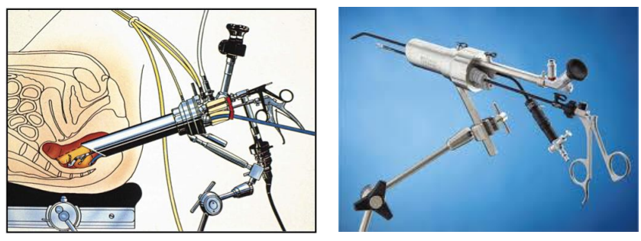
Brackground
Notes:
TEMS also requires a surgeon who possesses advanced laparoscopic skills since it is essentially a form of laparoscopic surgery performed in a much more confined space

Slide 5
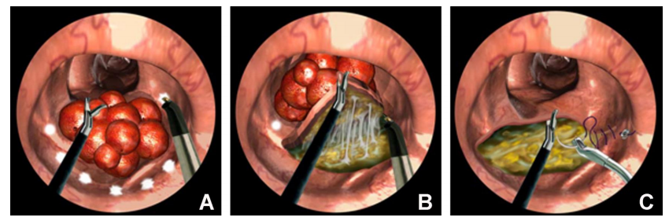
Background
Van Vledder et al, Seminars in Colon and Rectal Surgery 26(2015)9–14

Slide 6
Background
The greatest controversy currently lies with the application of local excision with TEMS/TEO in early rectal cancer treatment.
This disease is regarded as likely to be cured with radical surgery; however, in a proportion of patients this is also likely to represent overtreatment

Slide 7
Guidelines
The following indications have been recommended by various surgical societies, including the American Society of Colon and Rectal Surgeons (ASCRS):
Lesions smaller than 3 cm
Mobile lesions
Polypoid lesions
Anatomically accessible lesions localized to the bowel wall (T1N0)
Lesions confined to the extraperitoneal region of the rectum
Lesions occupying less than 40% of the circumference of the bowel lumen
Notes:
Absence of clear guidelines in NICE, however, these were the general recommendations.
a study by Khoury et al reported the use of TEM to treat benign rectal lesions in the range of 5-8 cm
the use of TEM for giant circumferential rectal adenomas has been reported

Slide 8
Guidelines/NHS England
Patients with suspected or proven rectal cancers suitable for trans anal procedures will be discussed at the MDT.
The Association of Coloproctologists of Great Britain and Ireland have suggested that only T1 tumours less than 3 cm be treated by endo anal excision.

Slide 9
Guidelines/NHS England
Criteria for referral shall be
The rectal cancer (or suspicious neoplasm) is less than 3cm in size.
The lesion is T1/T2 N0 M0 on MRI and preferably on endo-rectal ultrasound.
The patient has been seen by a colorectal surgeon and has been fully discussed at the referring MDT.
The patient’s views on local excision have been sought after discussion of risks/benefits of more radical procedures.
The patient is fit for the procedure.
Notes:
1st point - There may be reasons when, exceptionally, a malignant lesion of greater than 3 cm is treated by these techniques This decision must be made by the MDT and the outcome audited for each case.

Slide 10
Guidelines/NHS England
Key Short term outcomes:
R0 (complete resection) of T1/2 rectal tumours
Very low 30 and 90 day mortality
Very low intra peritoneal perforation rate
A robust surveillance program set up for follow up for resected tumours
Key Long term outcomes:
Acceptable recurrence rates
Recurrences detected at an early stage without compromising overall cure rates

Slide 11
Guidelines/NHS England
Recurrences detected at an early stage without compromising overall cure rates

Slide 12
Operative Video

Slide 13
SGH Performance
All patients who underwent TEMs at SGH between 2010 and 2017 were identified.
Retrospective data collected from clinic letters, discharge summaries, histology, radiology and endoscopy reports.

Slide 14
SGH Performance
Aim was to audit our service outcomes and compare results with published studies/meta-analysis
Results compiled against those found in literature for benign and malignant lesions.

Slide 15
Results
Total of 77 patients underwent the procedure
Average patient age was 70.9 years
Max – 92
Min – 43
Average Follow-up - 2.5 Years

Slide 16
Results
All patients were offered the procedure after MDT discussion. (for malignant)
90% of patients had follow-up endoscopy.
Notes:
Rest refused, moved to differnet site or were not fit

Slide 17
Discussion/Comparison
Mario Morino , Marco E. Allaix. Gastroenterology Report
Morino et al. Surg Endosc (2013) 27:181–188
Moore et al, DCR 2008
Clancy et al, DCR 2015
Notes:
Despite high rates of residual polyps, recurrence rates are low. Tumour size is a risk factor for local recurrence.

Slide 18
Conclusion
TEMs service offered in compliance to NHS England and outcomes comparable to published results if not better.

Slide 19
Thank you

