Slide 1
Is it Kawasaki or something new?!!
Mohammed Ismael Abd El-Monem
Specialist of pediatrics and neonatology
Benha children hospital

Slide 2
Case presentation
O.Y., male, 4 years, 5th in order, non consangious marriage, average social class, living in Benha.
Presented to ER with low grade fever , abd. Pain, peeling of skin.
Condition started 7 days before admission with low grade fever not associated with URT manif., moderate colicky abd. Pain (hypogastric area), vomiting but no diarrhea.
SMA and received abs.

Slide 3
Case presentation
On the 2nd day developed strawberry tongue, fissured lip and bilateral non purulent conjunctivitis.
After 5 days, peeling of skin of groin area.

Slide 4
Case presentation
Condition isn’t assoc. with pallor or jaundice.
No abd. Distention.
No bleeding tendency as epistaxis or GIT bleeding.
No cough nor dyspnea.
No convulsions nor other neurological manif.
No dysuria nor frequency.
No rash.

Slide 5
Past history
+ve history of contact with confirmed case of COVID-19 within 2 weeks before appearance of symptoms.

Slide 6
Past history
Ante natal history:
G5 P5 A0.
No PROM.
No fever, rash, jaundice or blood transfusion.
Natal history:
FT- NVD- immediate first cry.

Slide 7
Past history
Post natal history:
No NICU admission, no history of jaundice, no convulsions, no fever, no bleeding.
Developmental history:
Normal motor and mental development.

Slide 8
Past history
Dietetic history:
Exclusive breast feeding till age of 6 m.
Weaned at age of 6 m. on yogurt, cereals and fruits.
Vaccine:
Up to date
Family history:
Negative cons.
-ve family history for renal, skeletal, neuro ms dis.

Slide 9
Examination
  generally well and active.
  No abnormal facies.
  Vital signs (HR 120- TEMP 39- BL.PR 100/65- RR 40)
  Growth parameters:
  Weight 16kg( 40th centile)
  Length 102cm( 40th centile)
  H.C 52cm (50th centile)

Slide 10
Examination
Head: Back:
No Pallor. No anomalies
No cyanosis or jaundice.
No ch.ch. Facies.
Bilateral non purulent conjunctivitis.
Fissured lip.
Strawberry tongue.
Bilateral LN (one on each side – not tender – not matted – freely mobile)

Slide 11
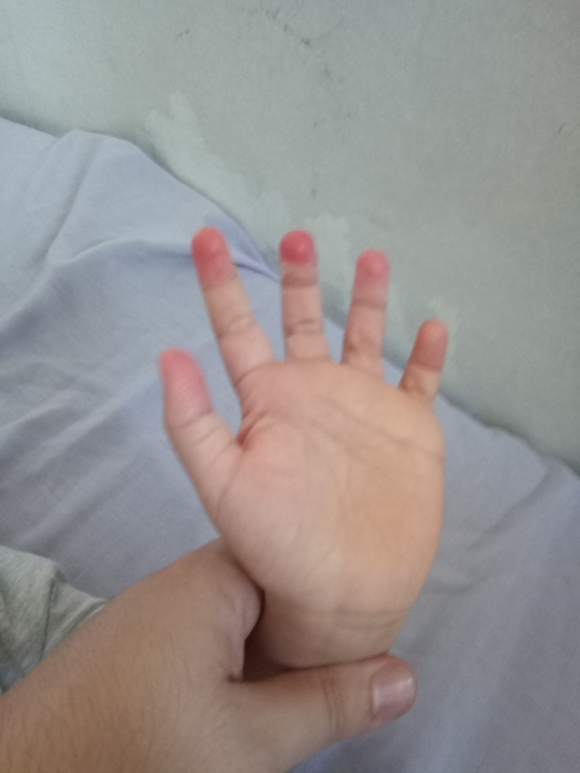
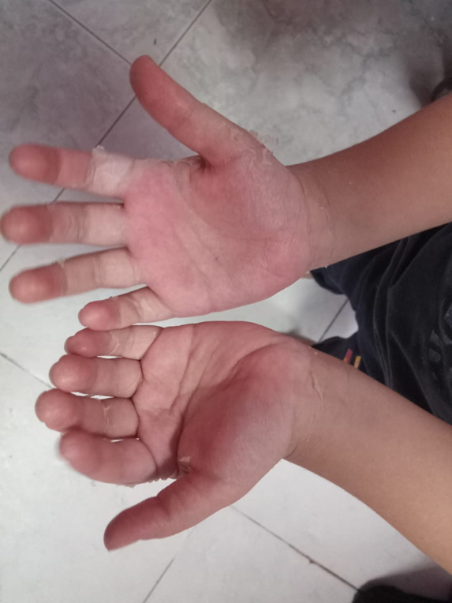
Examination
Limb:
Erythema of fingers and toes.
Desquamation/ no lower limb edema.
No inflammation at
BCG vaccination site.

Slide 12
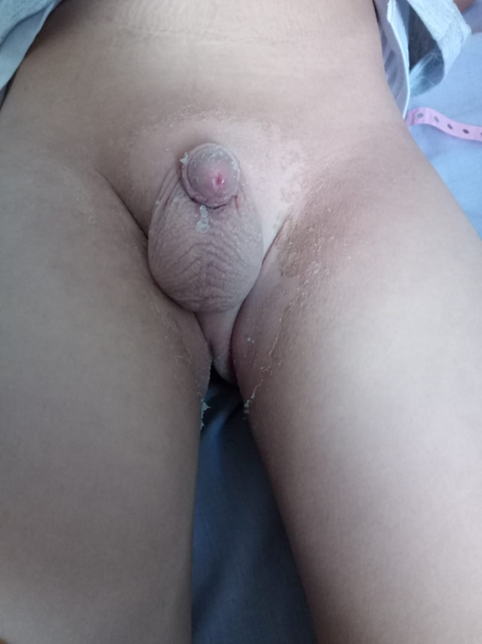
Examination
Abd. Exam.:
Lax, no tenderness, no dilated veins.
No HSM.
Genitals:
Desquamation in groin area.

Slide 13
Examination
Cardiac exam.:
HR 120.
Apex at 4th intercostal space.
Normal heart sound.
No audible murmur.
Chest exam.:
No R.D
Breath sound harsh vesicular, no adv. Sounds (wheezes or creps)

Slide 14
Examination
CNS exam.:
Fully consc.
Normal motor power.
Normal reflexes and tone.

Slide 15
Investigations
CBC:
TLC: 11.6 (N)
Hb: 11.7 – HCT: 33.5
PLT: 351.

Slide 16
Investigations
CRP: 104
ESR: 100
LDH: 338
Serum ferritin: 300
ALT: 260 / AST: 277
Albumin: 3.6
Urea: 9.2 / Creat: 0.2
Na: 136
K: 3.7
Ca: 9.4

Slide 17
Investigations
Urine analysis:
Pus cells > 100
RBCs: 8-10
Urine culture: no growth
Covid nasopharyngeal swab PCR: -ve
Anti-HCoV antibodies: +ve

Slide 18
Investigations
Troponin I: 0.09
CPK: 70
Pro BNP: 100
IL-6: <1.5

Slide 19
Investigations
Abd US:
Normal.
Neck US:
Multiple reactive neck LNs, the largest on rt side (1.9× 0.9)

Slide 20
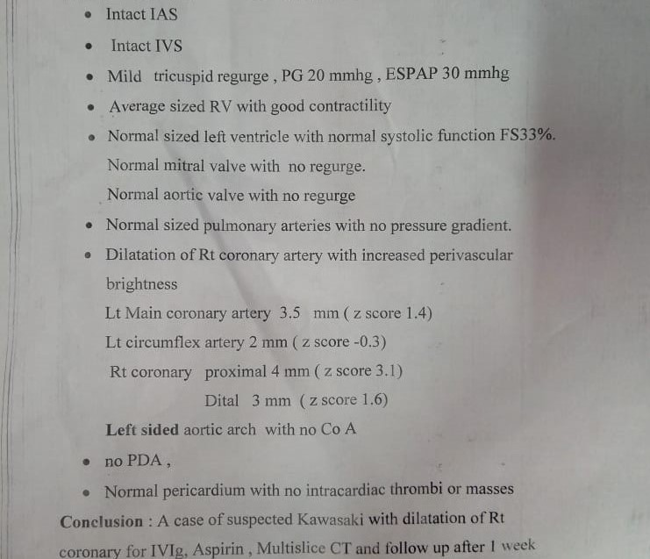
Investigations
Echo:

Slide 21
Treatment
Treatment:
IVIG 2gm\kg.
Aspirin 20mg/kg/ 6 hours for 2 weeks.

Slide 22
Kawasaki disease
Fever lasting at least 5 days* without any other explanation combined with at least 4 of the 5 following criteria:
1- Bilateral bulbar conjunctival injection
2- Injected or fissured lips, injected pharynx, or strawberry tongue
3- Erythema of palms or soles/ periungual desquamation
4- Polymorphous rash
5- Cervical lymphadenopathy (at least 1 lymph node >1.5 cm in diameter)

Slide 23
KD in post COVID-19
A 30 times increase in incidence of KD in Italy was reported since the onset of (COVID-19) pandemic (Verdoni et al., 2020).
There has been a noticeable increase in incidence of ‘Kawasaki-like illness’ in association with this pandemic.
Confirmation of infection with COVID-19 in these reports has been through serology and/or RT-PCR (Feldstein et al., 2020).

Slide 24
KD in post COVID-19
Approximately 9% of patients with KD have recent history of respiratory infections (usually rhinovirus, adenovirus and influenza).
Interval between onset of respiratory syndrome and development of KD is approximately 2 weeks.
This subgroup of patients often has incomplete KD and is associated with high frequency of coronary aneurysms.

Slide 25
MIS-C
Exposure of children to SARS-CoV-2 has been reported to result in development of Multisystem Inflammatory Syndrome (MIS-C) in some of them.
Several terminologies have been used to describe this condition:
Kawasaki-like syndrome (KLS).
atypical Kawasaki disease.
incomplete Kawasaki disease.
SARS-CoV-2-induced Kawasaki-like Hyper-inflammatory Syndrome (SCiKH Syndrome).
Kawa-COVID-19.

Slide 26
MIS-C
Approximately 70% of children with MIS-C have a positive antibody response against SARS-CoV-2.
Interval between SARS-CoV-2 exposure and development of MIS-C varies from 2 to 4 weeks. During this time, virus may be cleared by neutralizing antibodies and immune cells.
Therefore, MIS-C is predominantly a post-infectious inflammatory syndrome.

Slide 27
MIS-A
There have been several reports of Multisystem Inflammatory Syndrome in Adults (MIS-A), a condition that appears to be similar to MIS-C.
There is predominant involvement of cardiovascular and gastrointestinal systems.
Laboratory features include elevated inflammatory parameters (e.g., CRP and ferritin), raised d-dimer levels and lymphocytopenia

Slide 28

Adopted from Kabeerdoss et al., (2020)
Differential diagnosis
 | MIS-C | KD | Severe COVID-19 in children
Age of presentation | 8–10 years | Below 5 years | Adolescents
Gender difference | Male > female | Male > female | Male = female
Fever | Present | Present | Present
Cutaneous signs | Similar to KD but full range of spectrum seen in < 50% | Typical signs seen in majority of patients | Usually absent; rarely, chilblain like lesions on toes
Lymphadenopathy | Not common | More common | Not known

Slide 29
Differential diagnosis
 | MIS-C | KD | Severe COVID-19 in children
Cardiovascular Complications | Cardiac dysfunction, myocarditis and pericarditis | coronary artery dilatation and aneurysms are seen | Myocardial dysfunction
Predominant manifestations | GIT manif. are present in > 80% patients. | GI symptoms are usually not prominent | Cough, respiratory distress but GI symptoms are less common
Inflammatory markers | Markedly increased levels compared to classical KD. | Neutrophilic leukocytosis is usual. | Lymphopenia and neutropenia may be seen.
Organ dysfunction | Multiorgan dysfunction seen | Multi-organ dysfunction is not common | ARDS and shock are common
Anti-HCoV antibodies | 70–90% | Paucity of data | Nearly 90%

Slide 30
Egyptian Pediatric Clinical Practice Guidelines Committee
Egyptian Protocol for Management of COVID-19 in Pediatrics and MIS-C
Age≤ 21 years
Fever≥ 38.0°C for ≥24 hrs
Multi-system involvement
+ve evidence of COVID-19
No other microbial cause of inflammation
≥1 abnormal inflammatory markers
MIS-C Suspected
Additional workup: CXR, Echo, ECG, Doppler, Abdomen US

Slide 31
Thank you

