Slide 1

SMILE
Bahrain Experience
Dr. Moemen Al Reefy F.R.C.S
Cheif Executive

Slide 2

Introduction
Smile is a small incision lenticular extraction design to treat :
Myopia
Hyperopia
Astigmatism
Presbyopia.

Slide 3
Bahrain experience
Myopia - 2.75 to - 14.50
Astigmatism - 0.50 to - 3.00

Slide 4
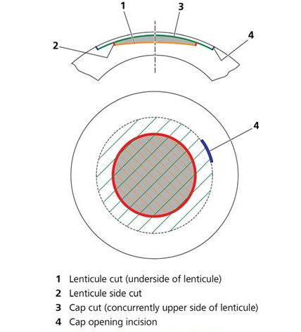
SMILE
PROCEDURE

Slide 5
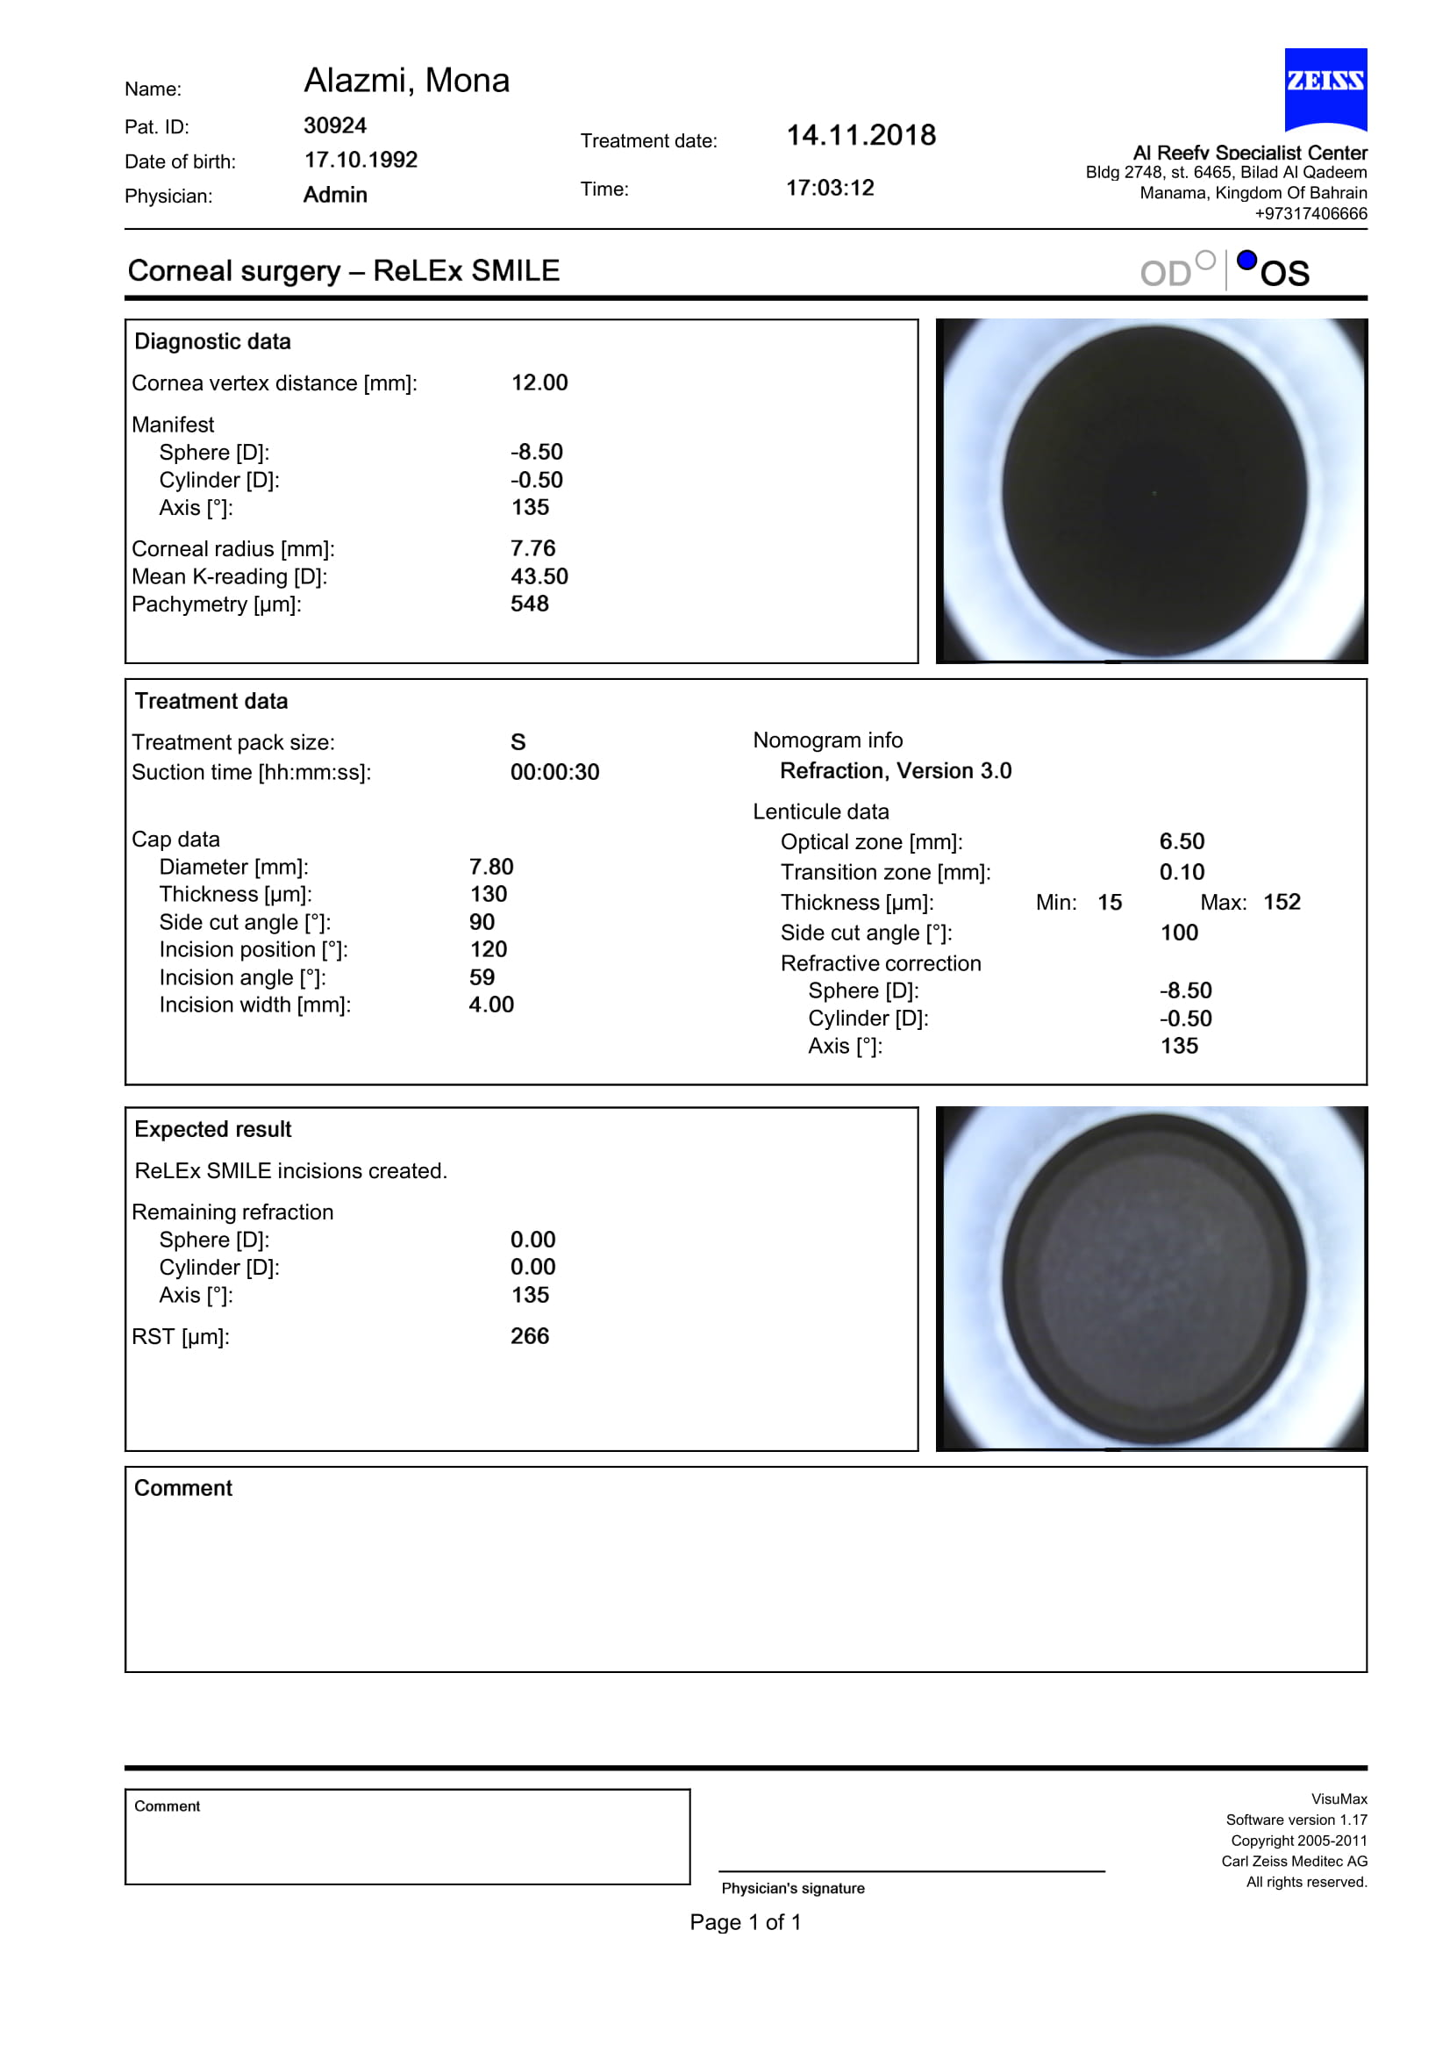
Smile SURGERY video Click HerE

Slide 6
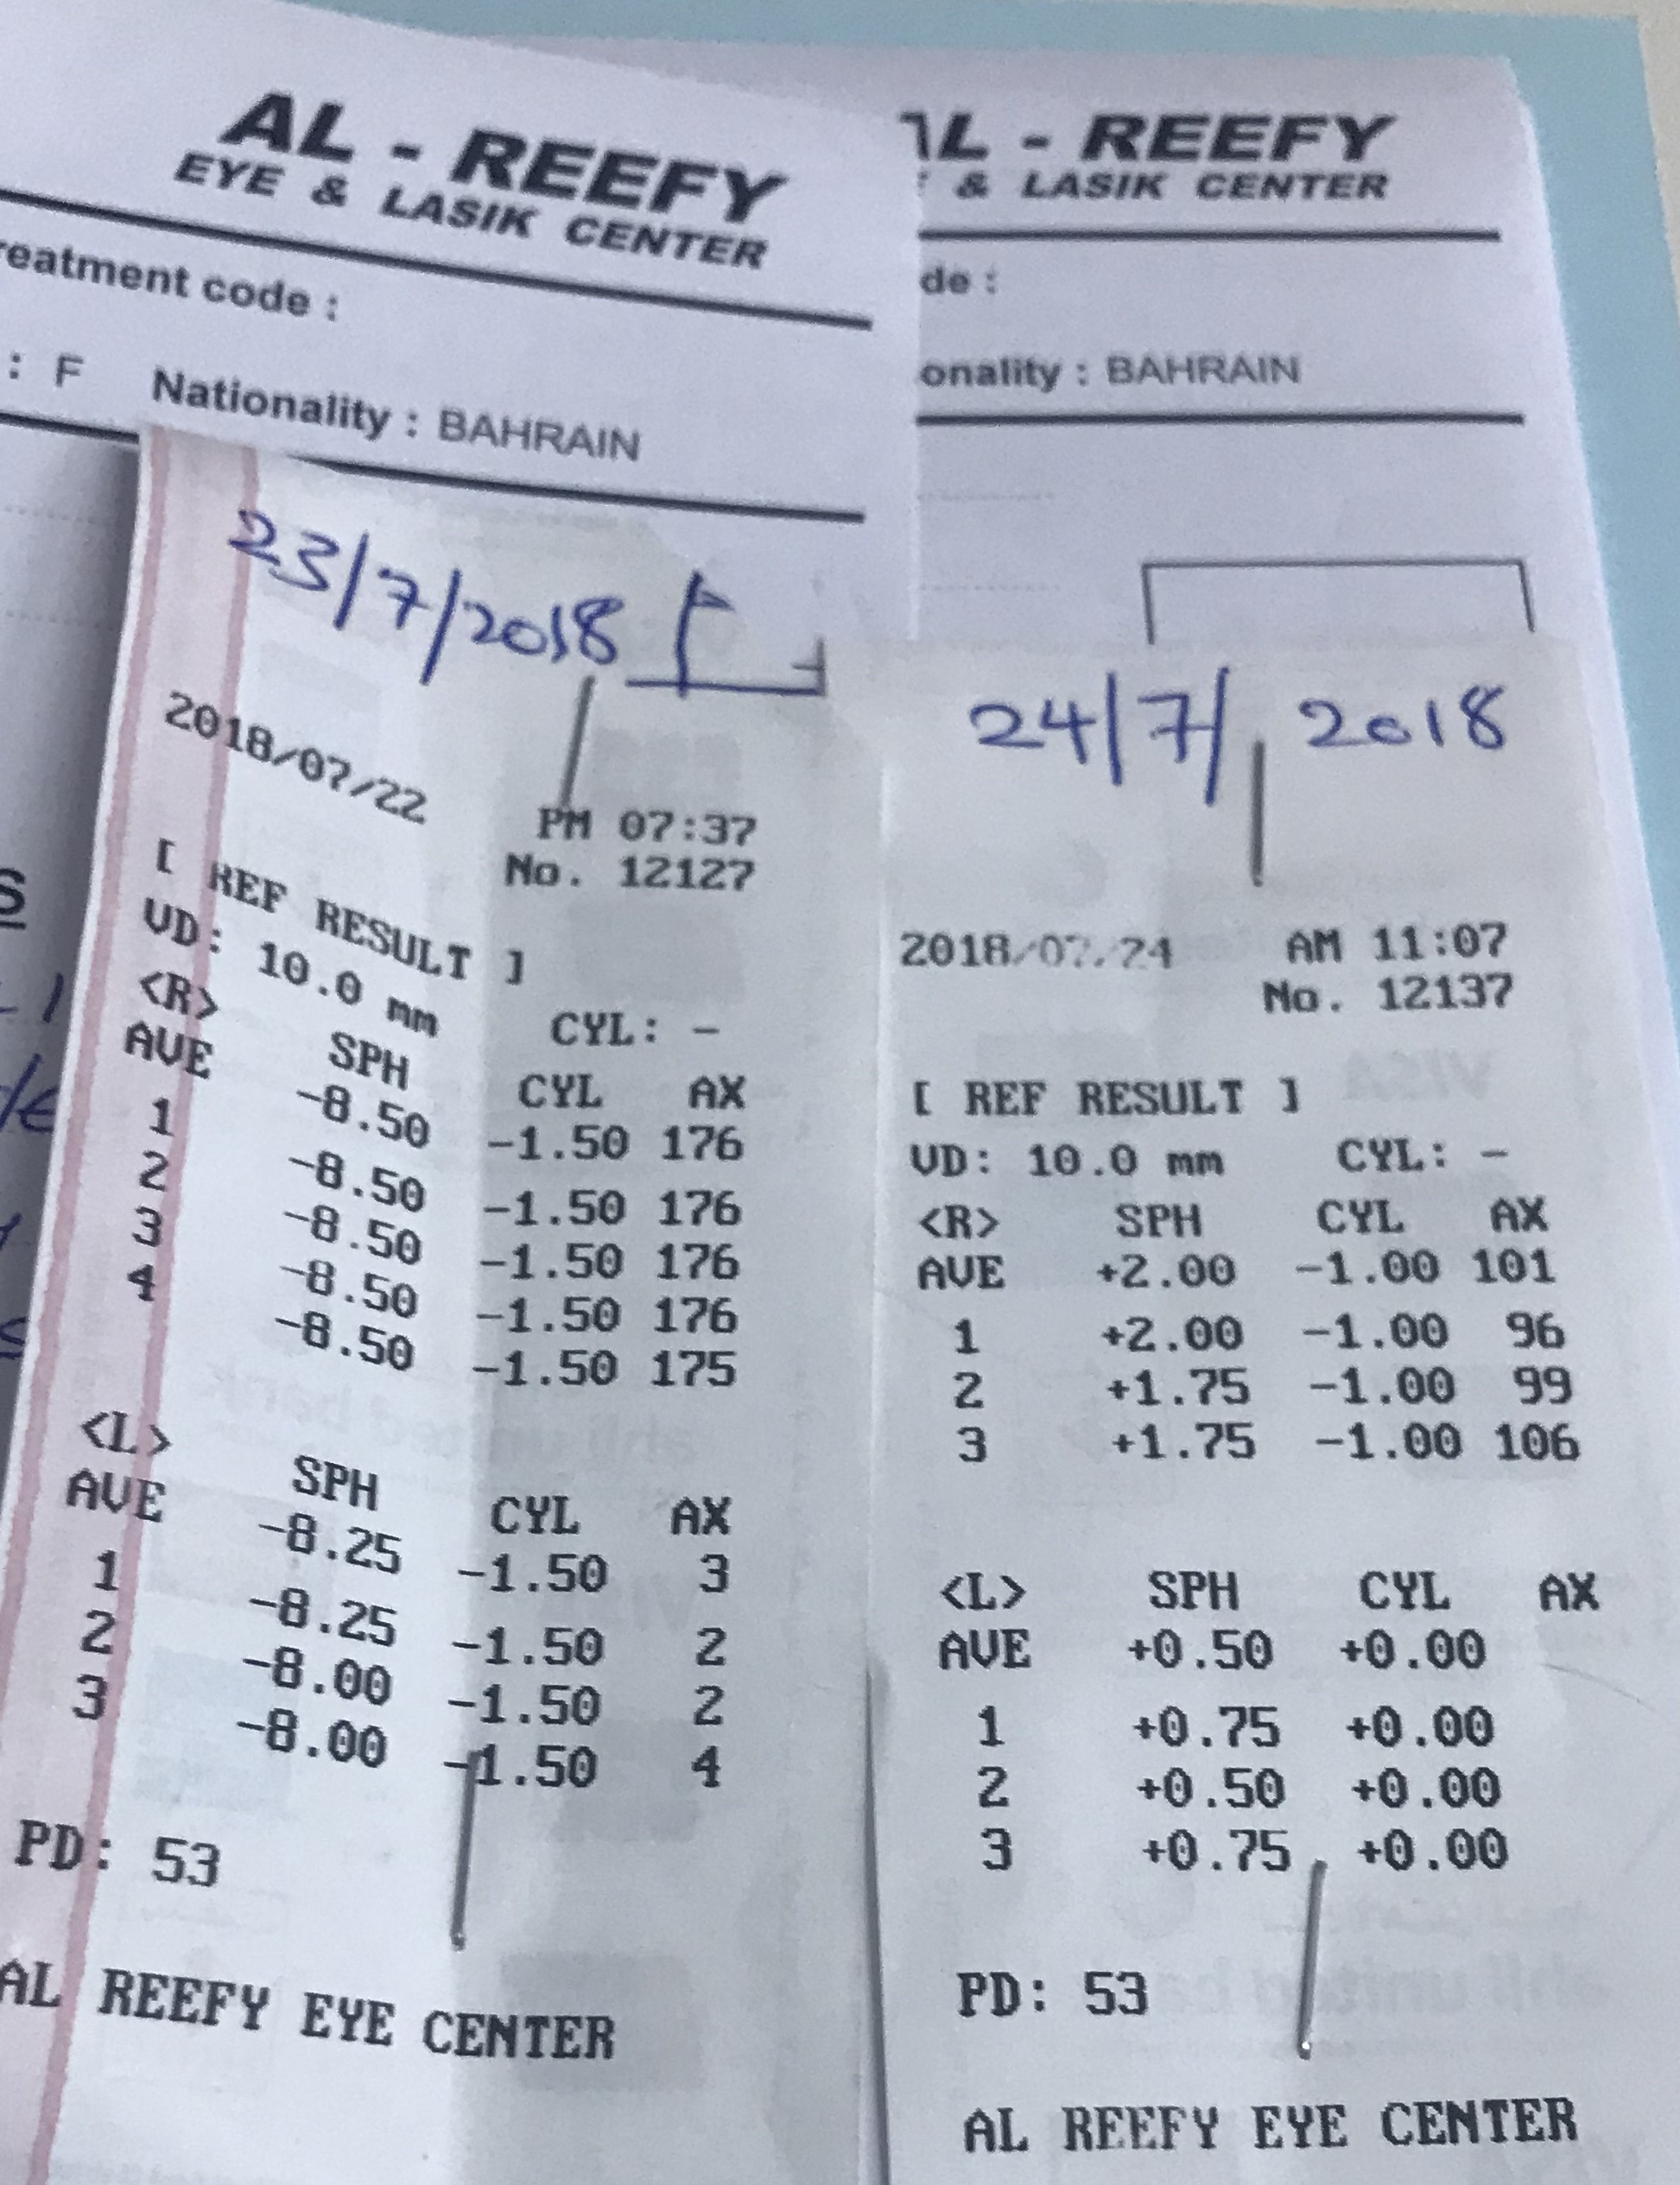
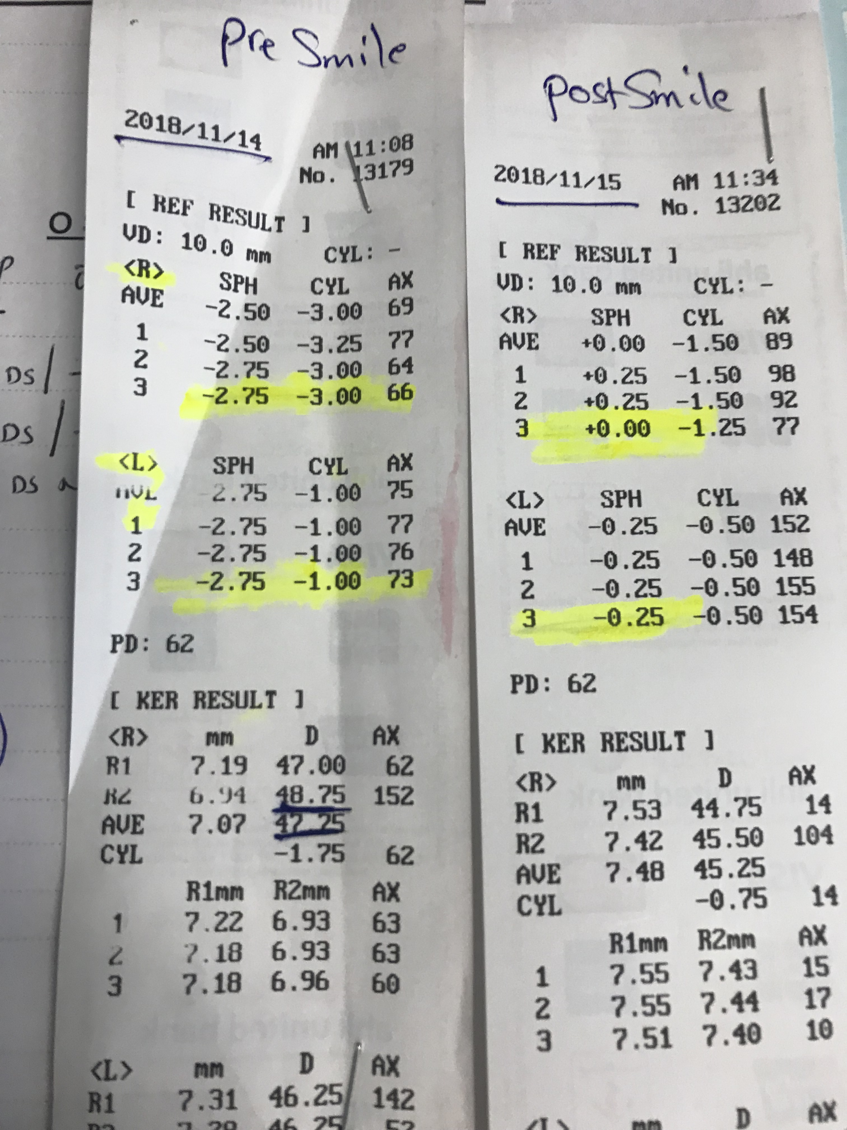
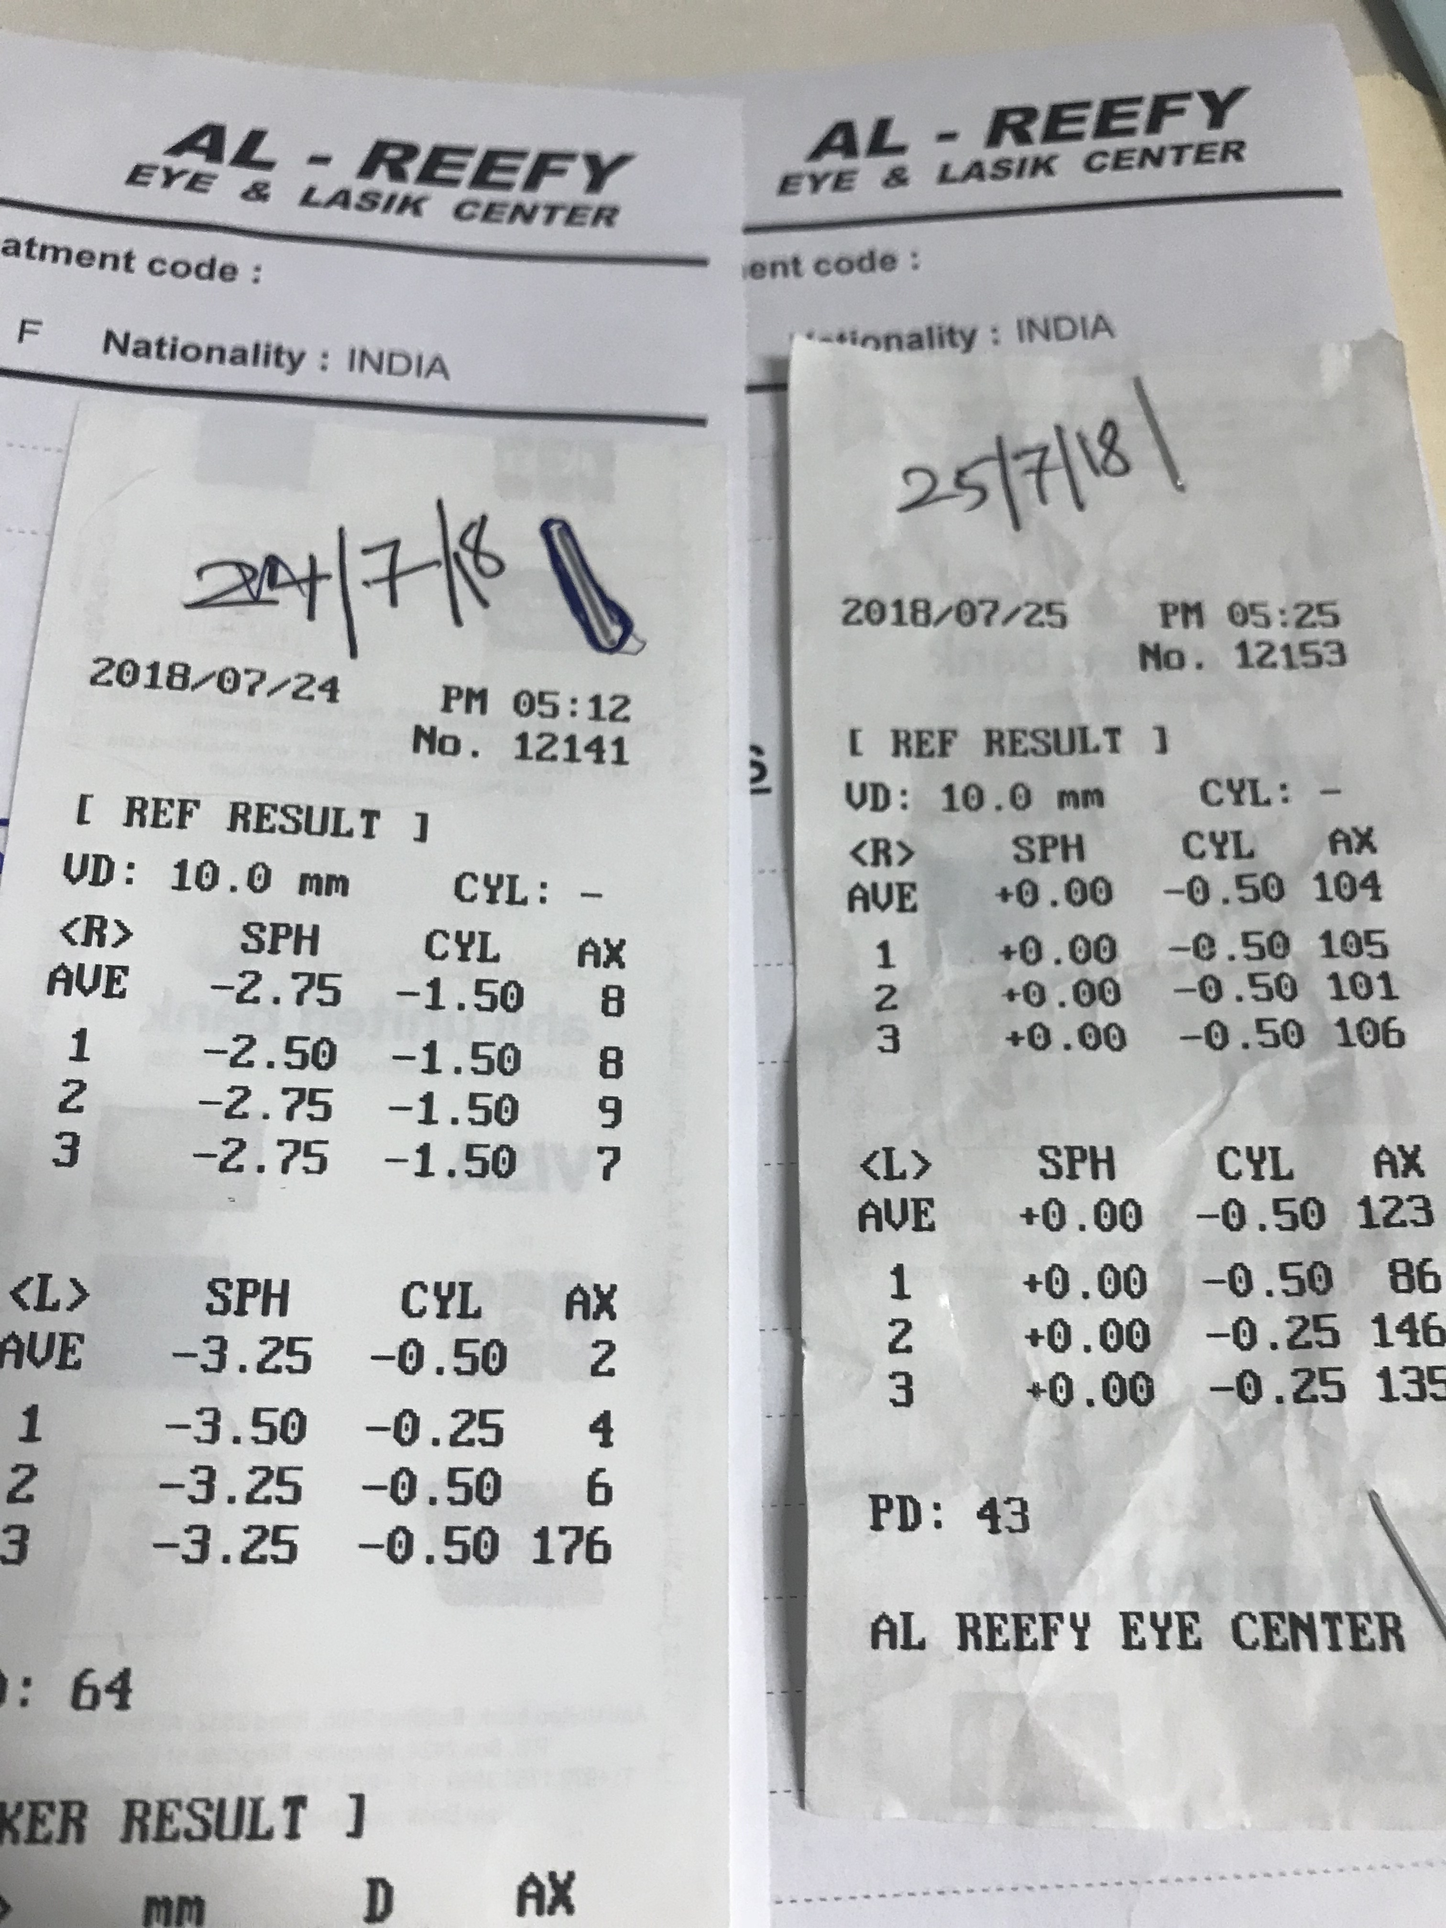
Smile pre and post auto refraction

Slide 7
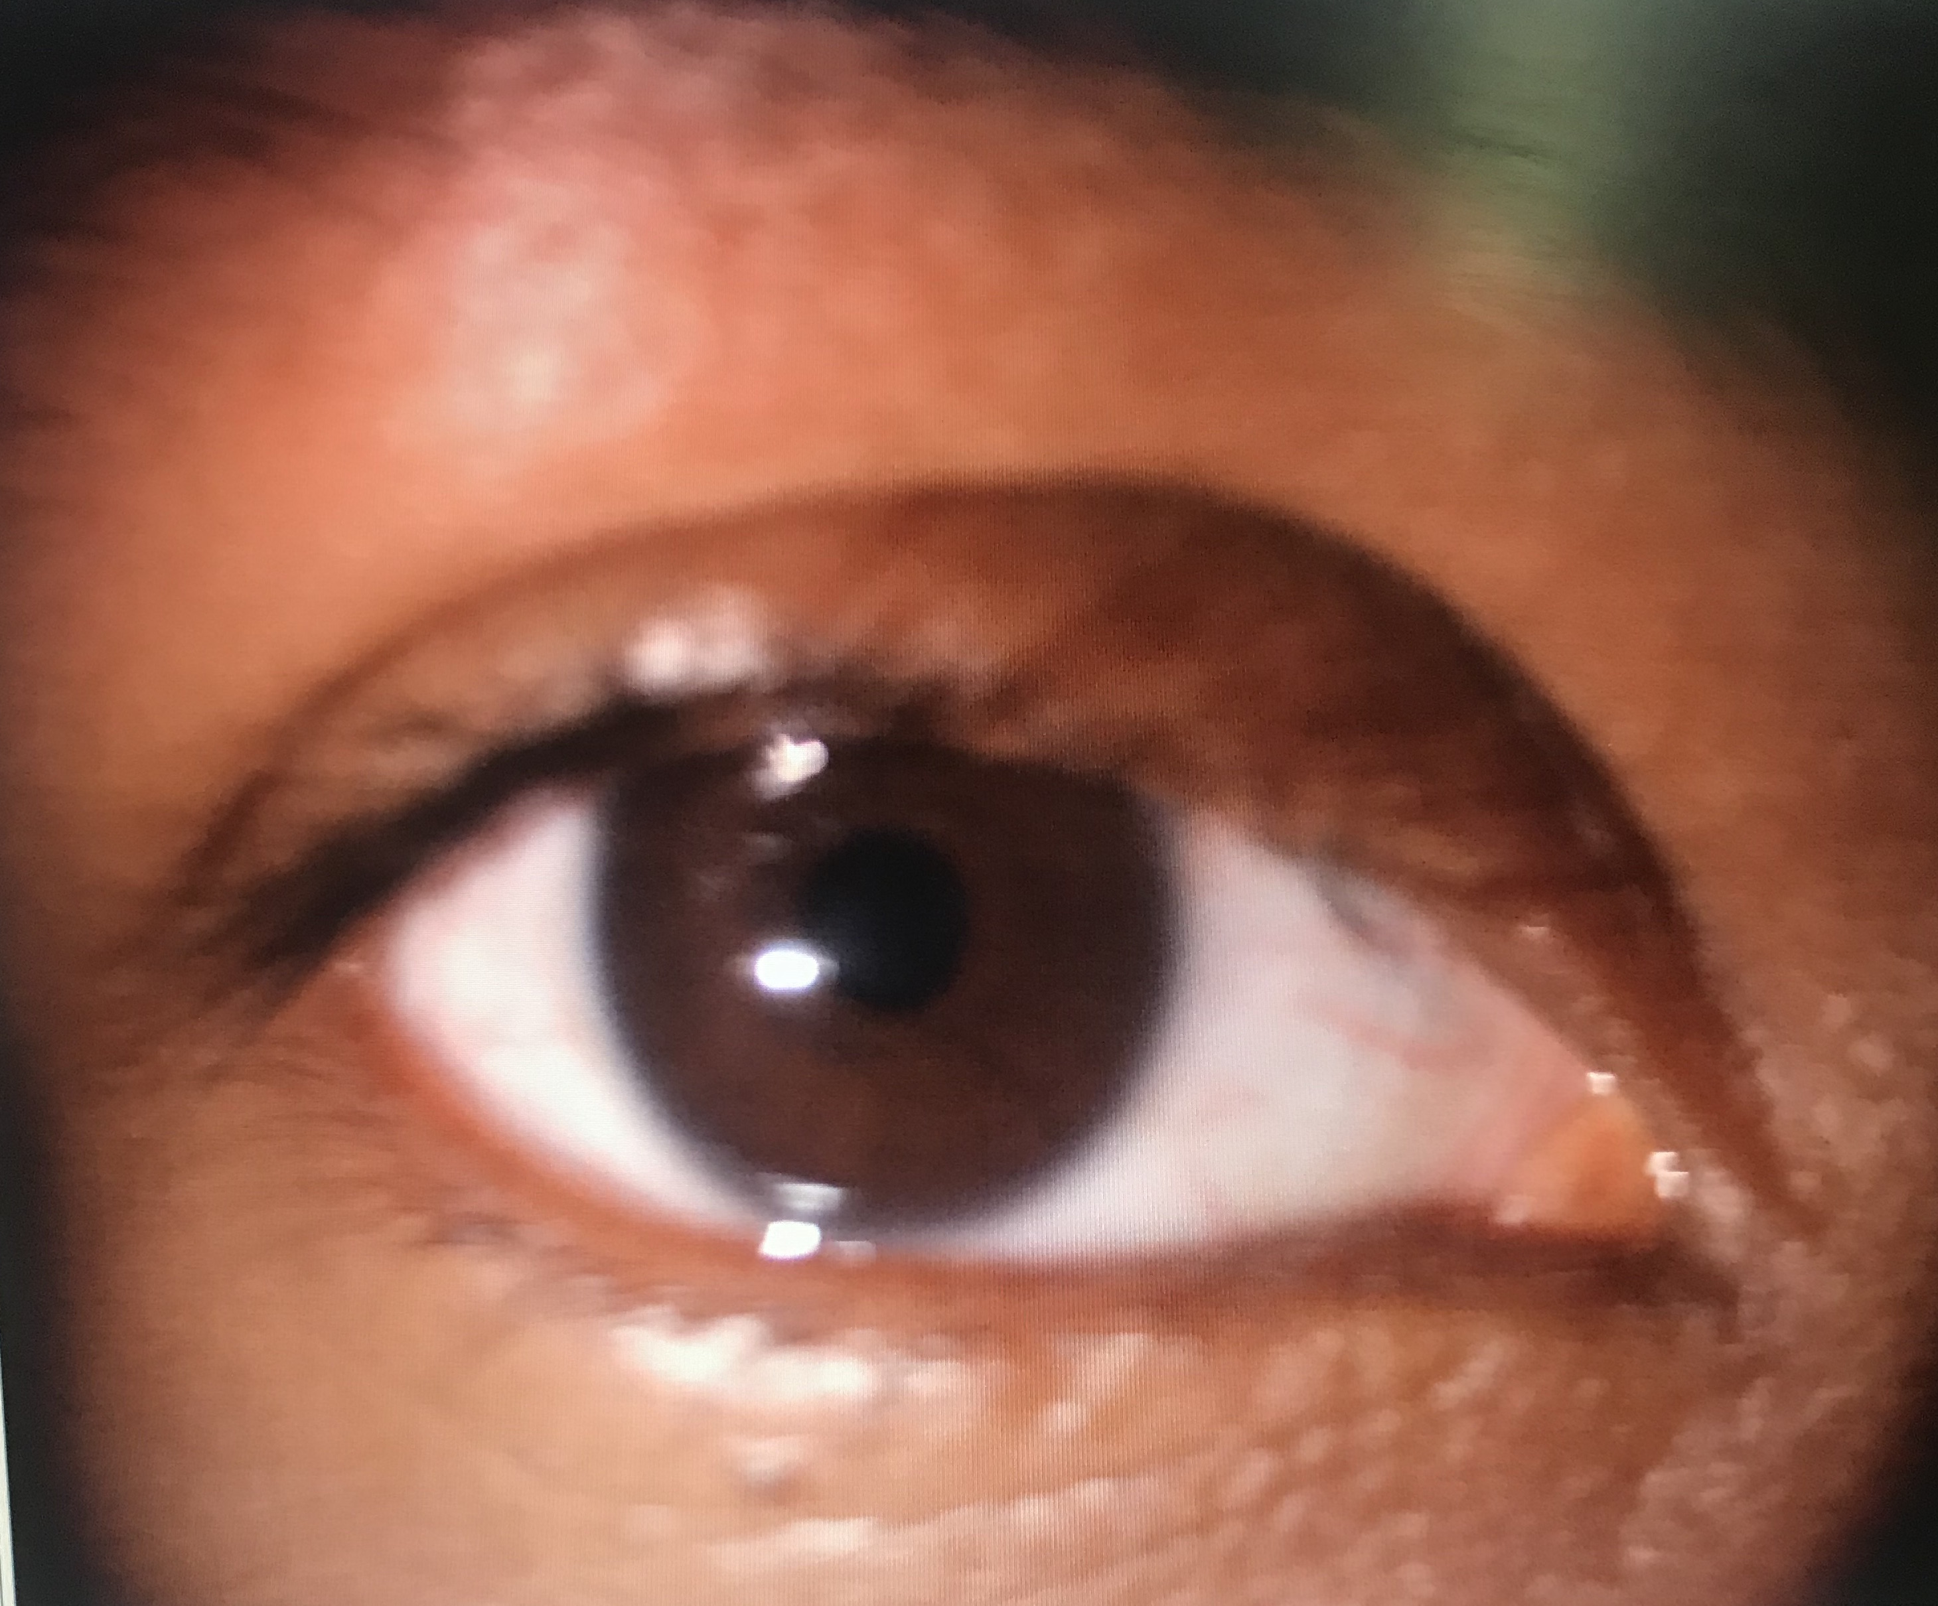
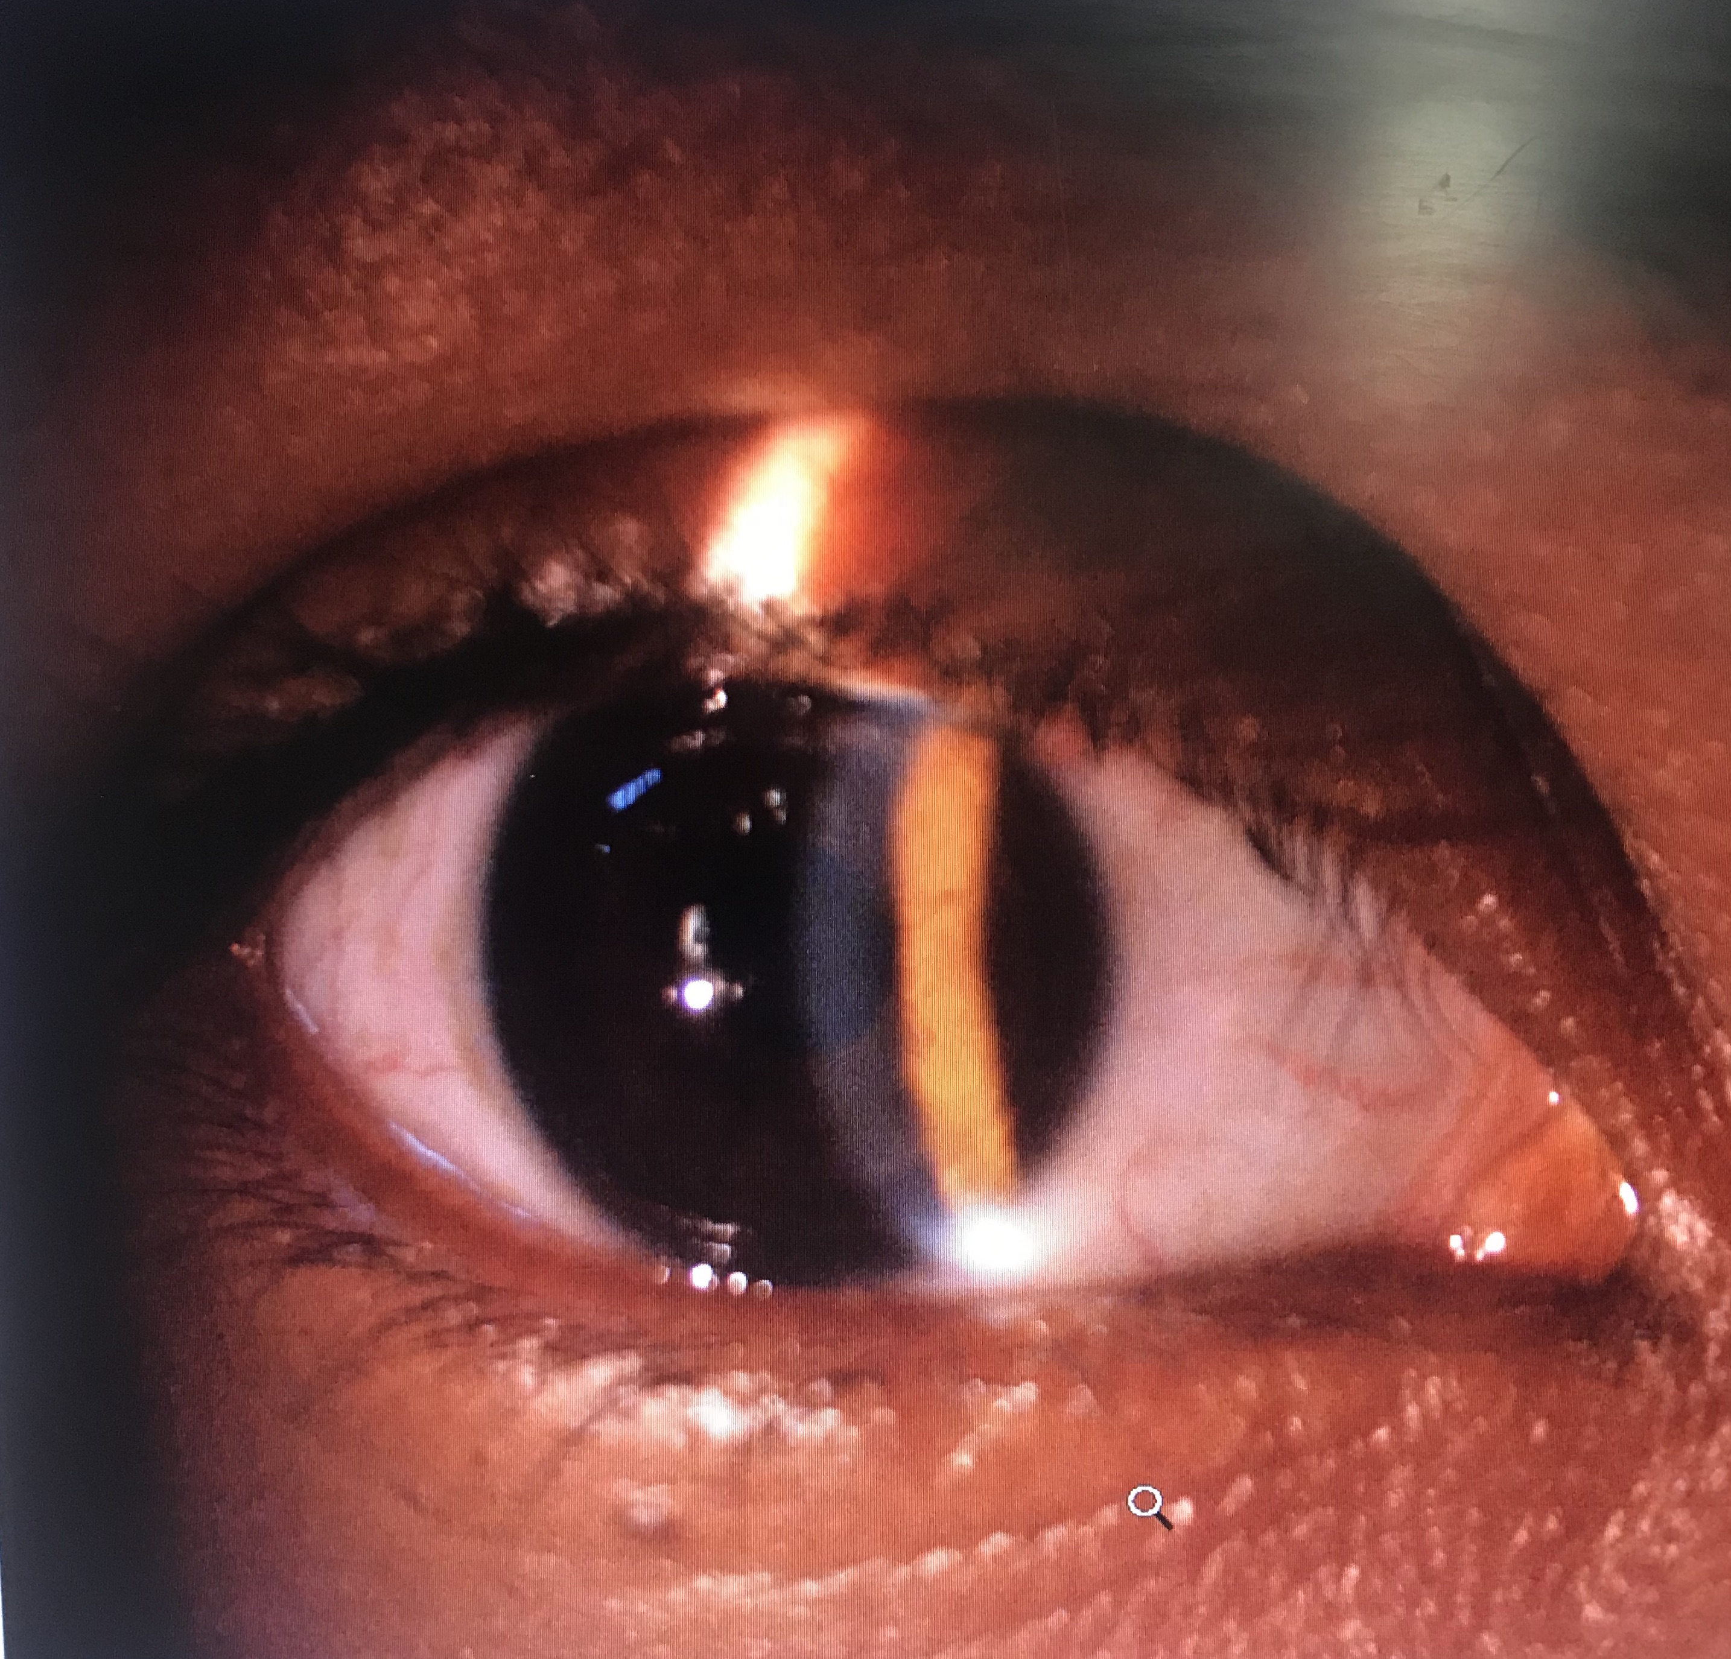
Smile pre and post op slit lamp

Slide 8
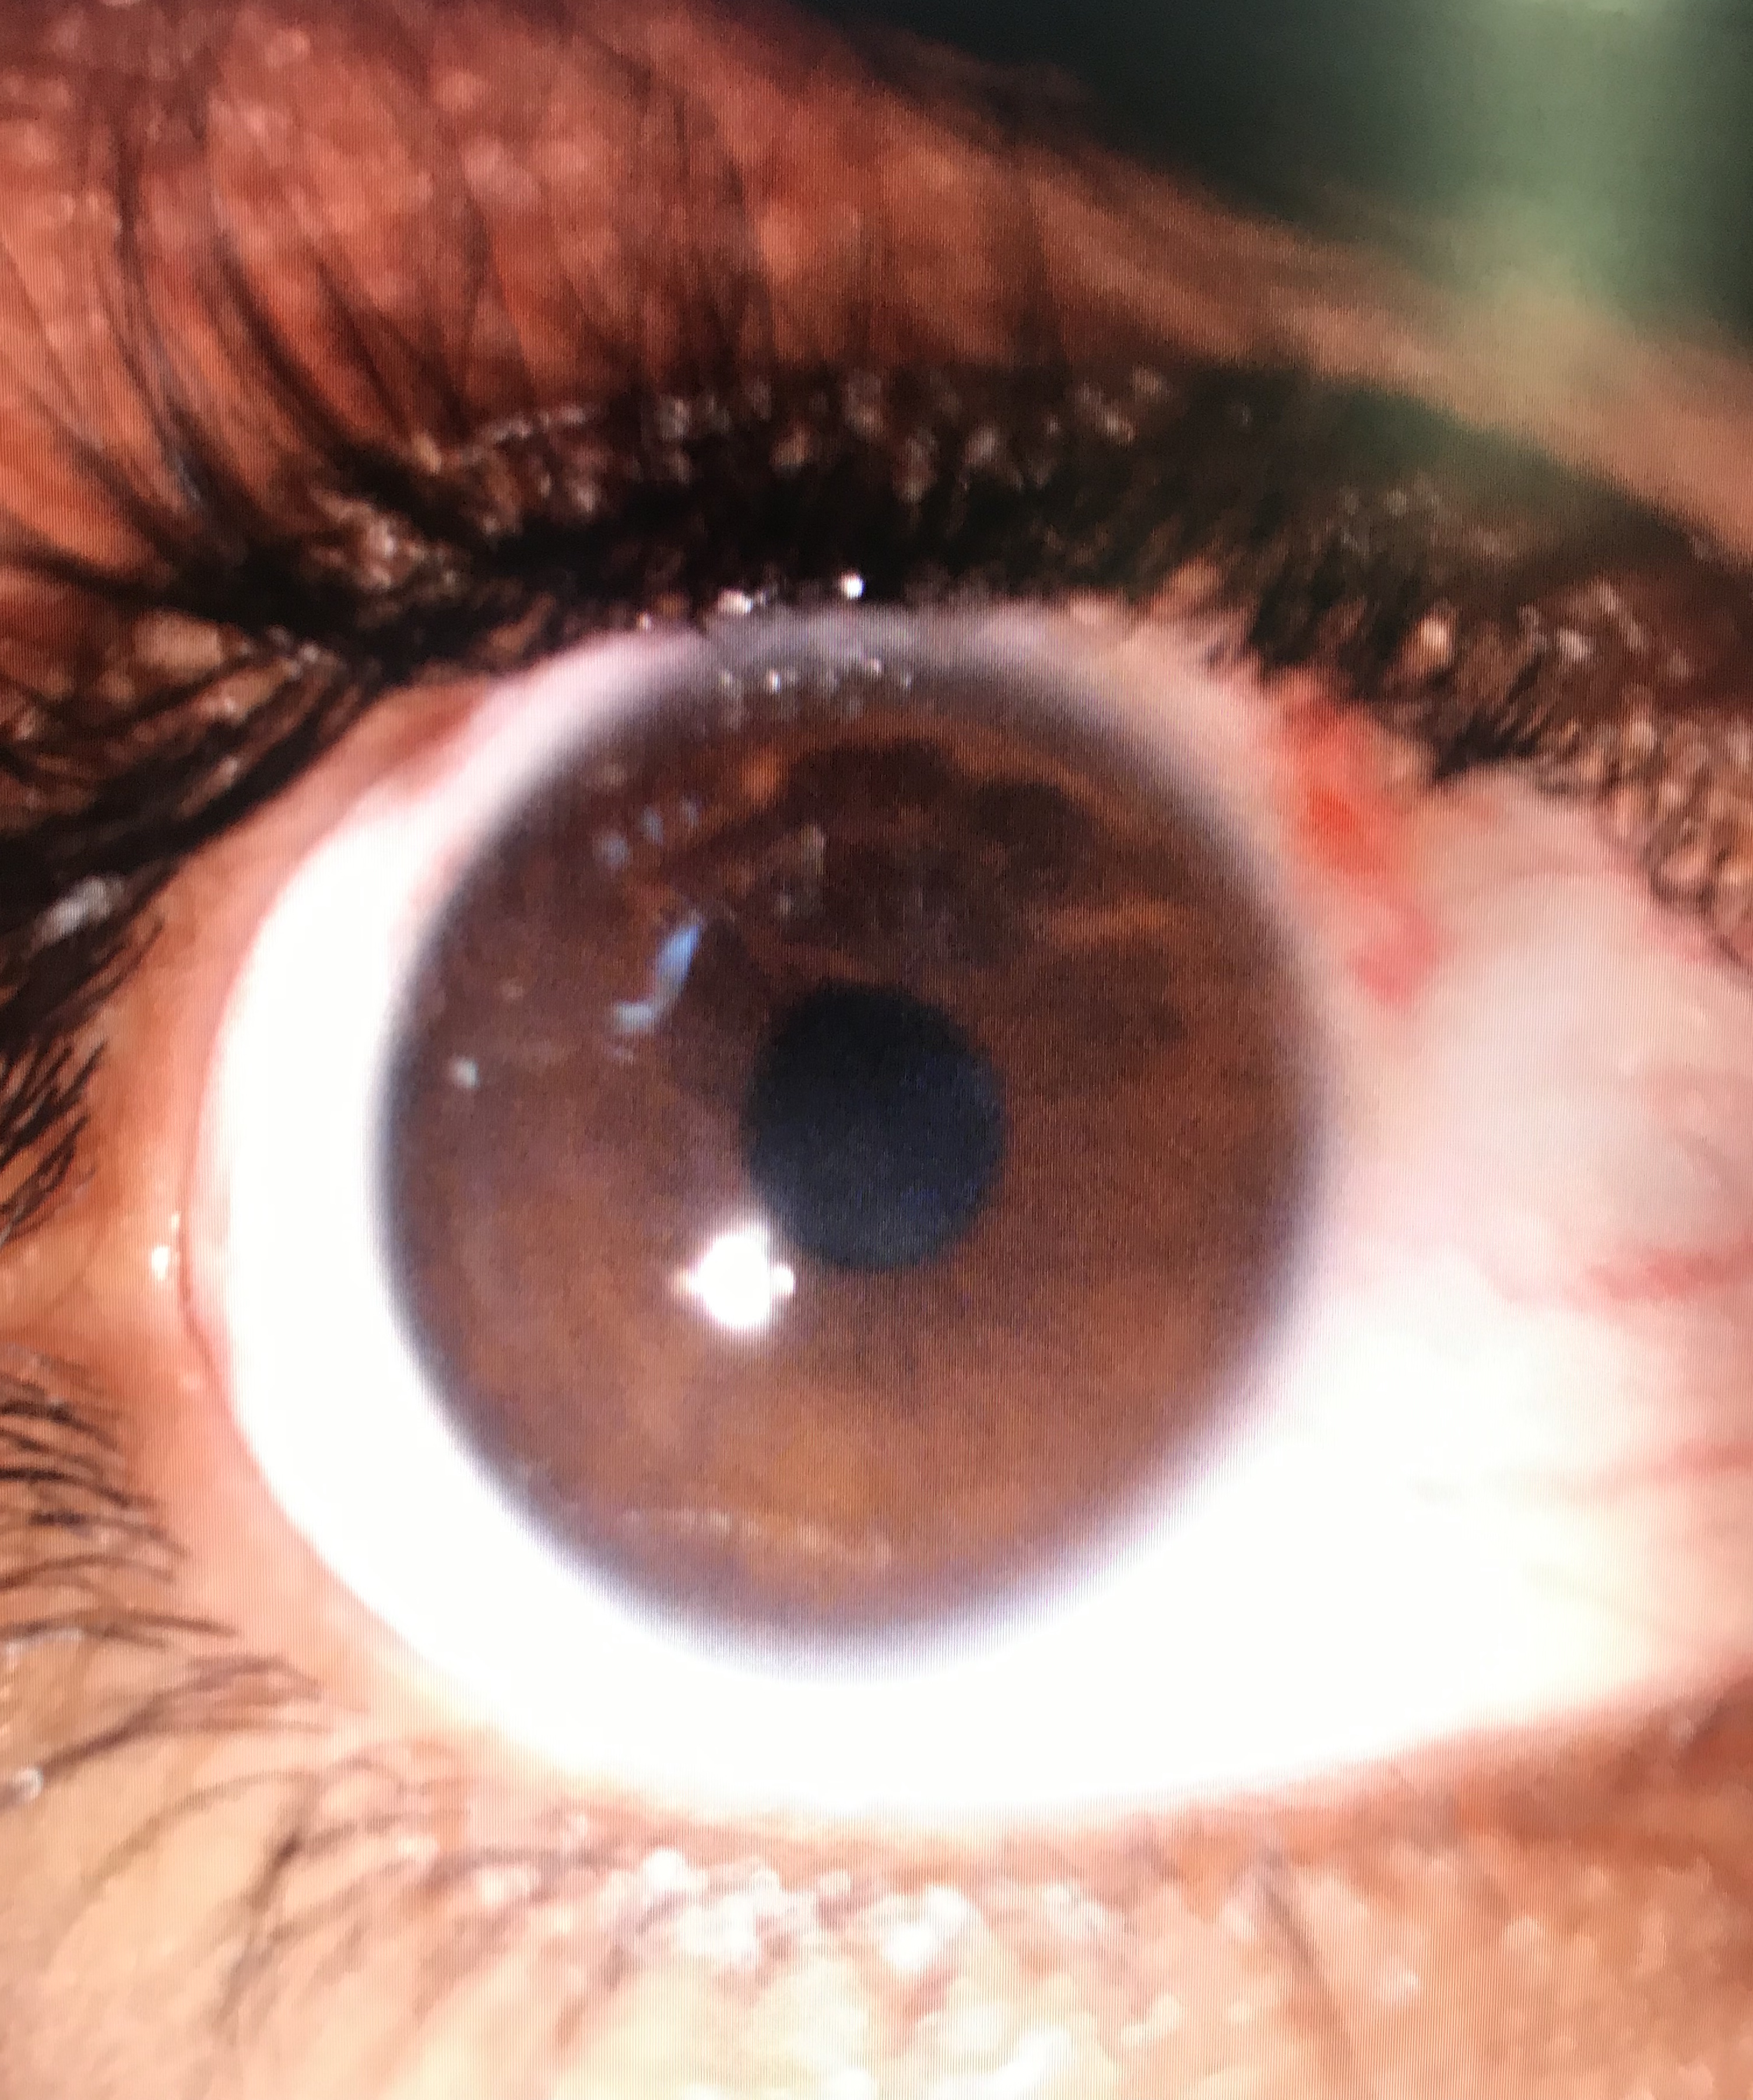
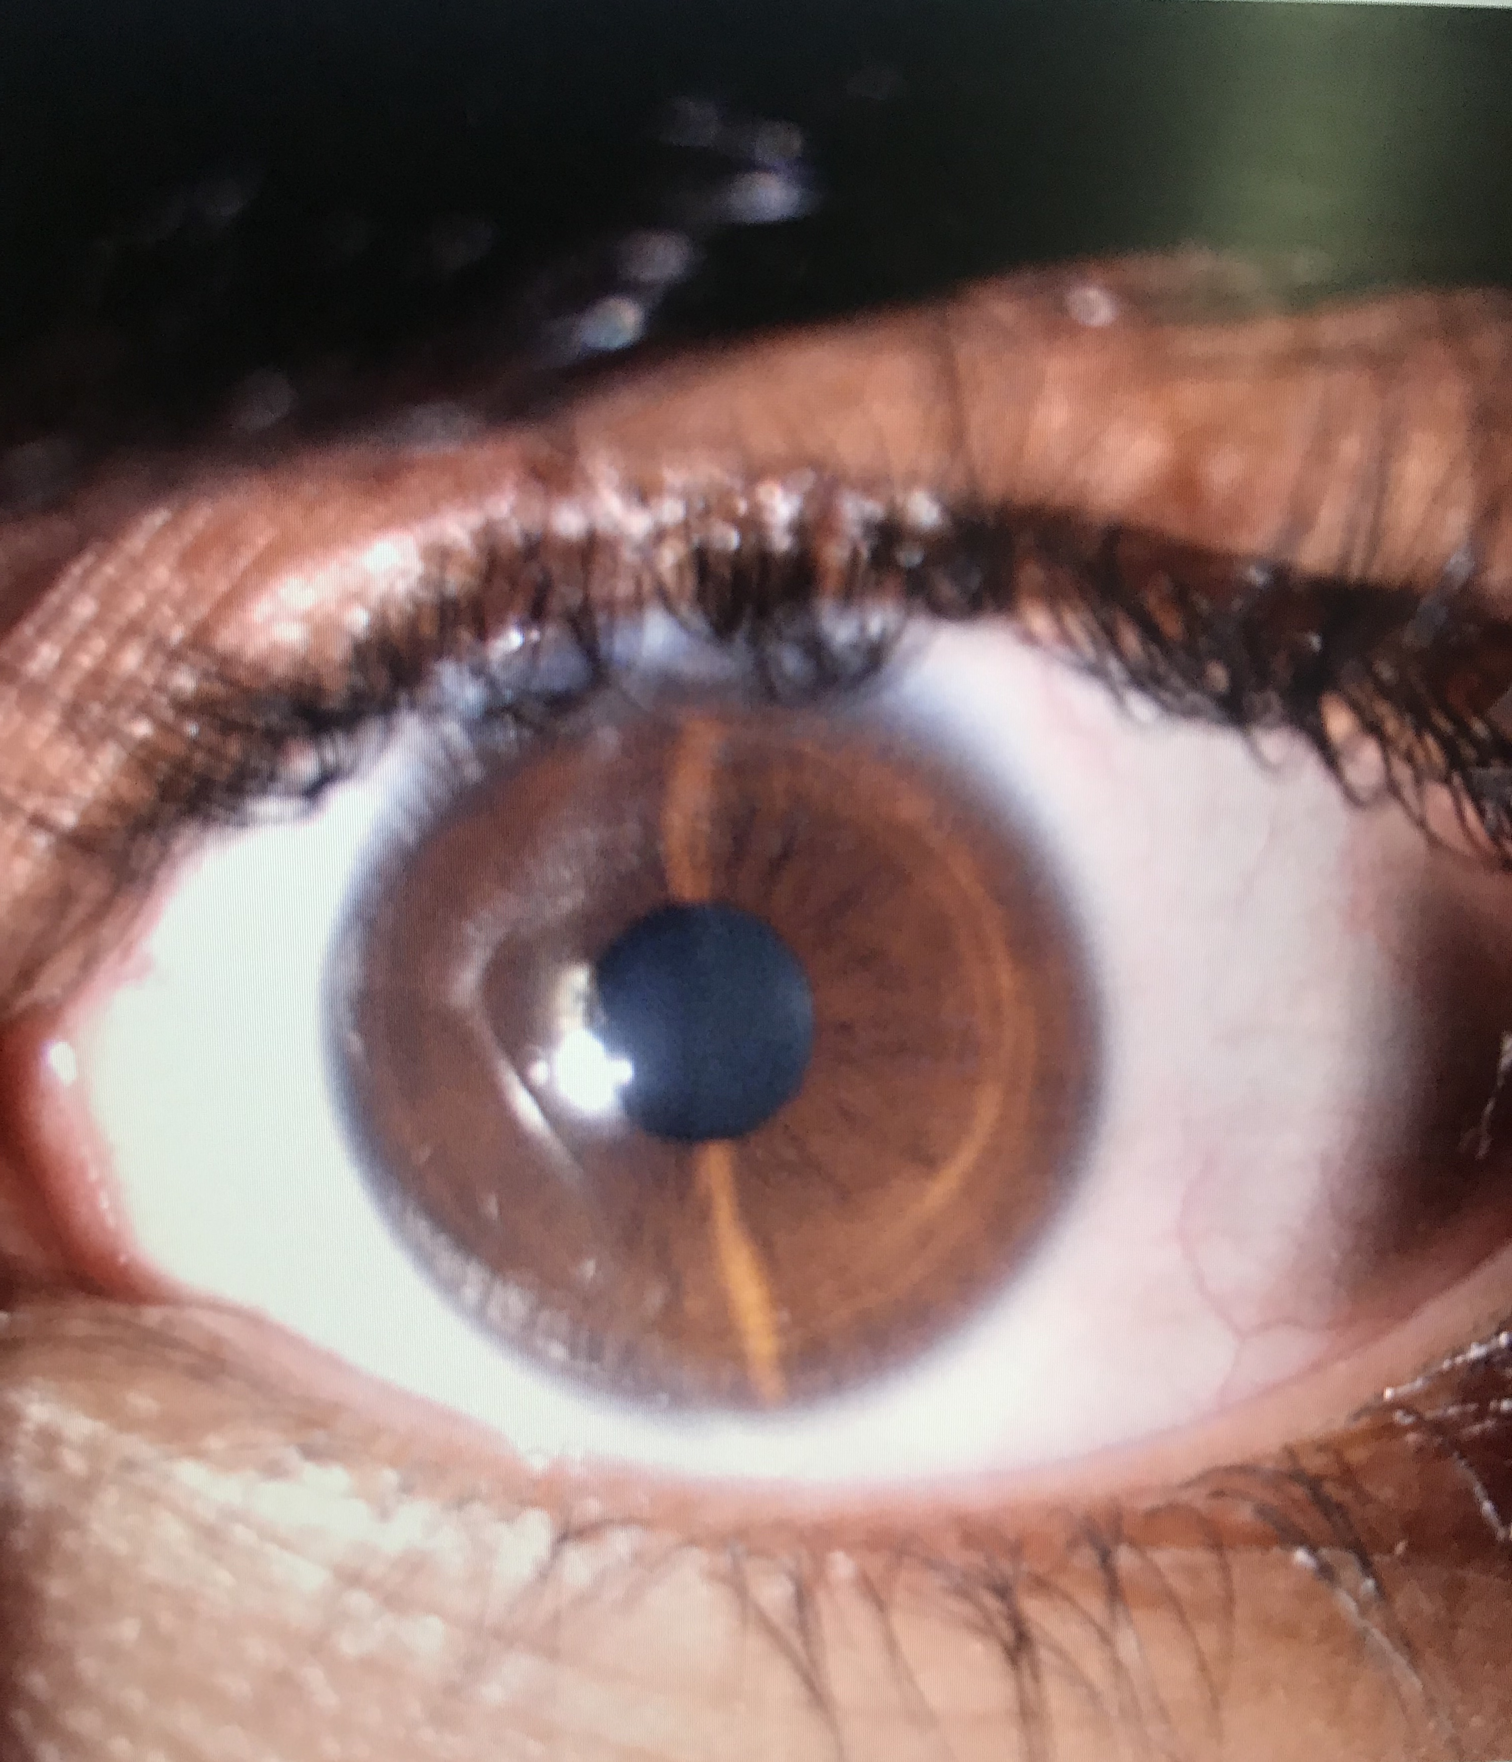
Smile post op slit lamp pics

Slide 9
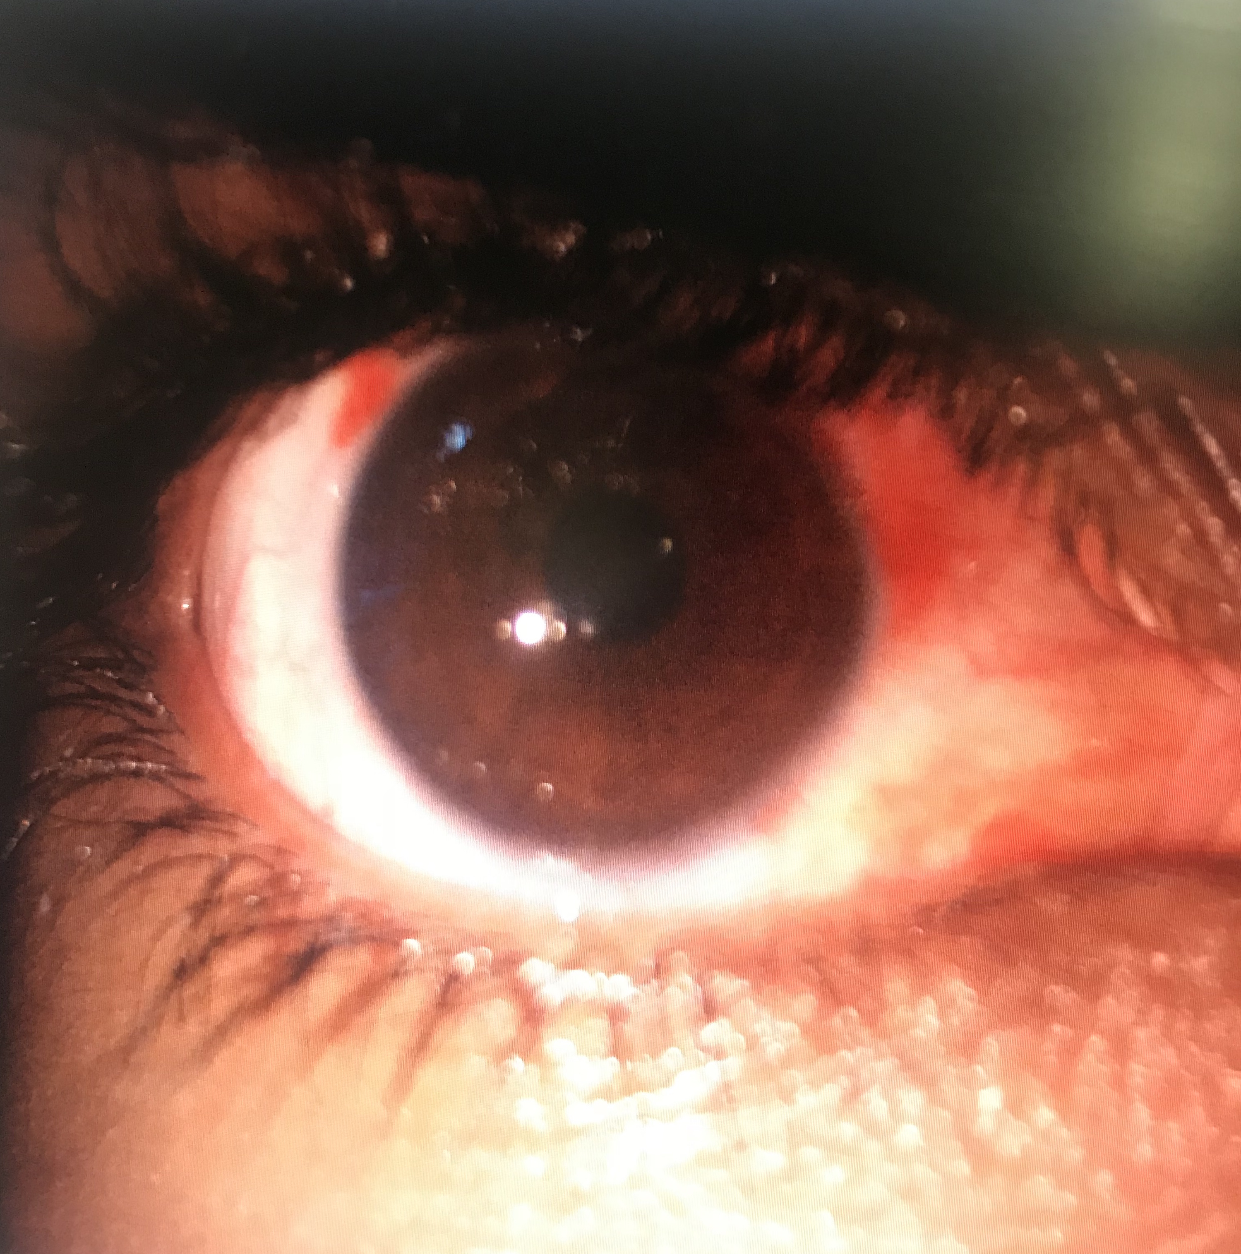
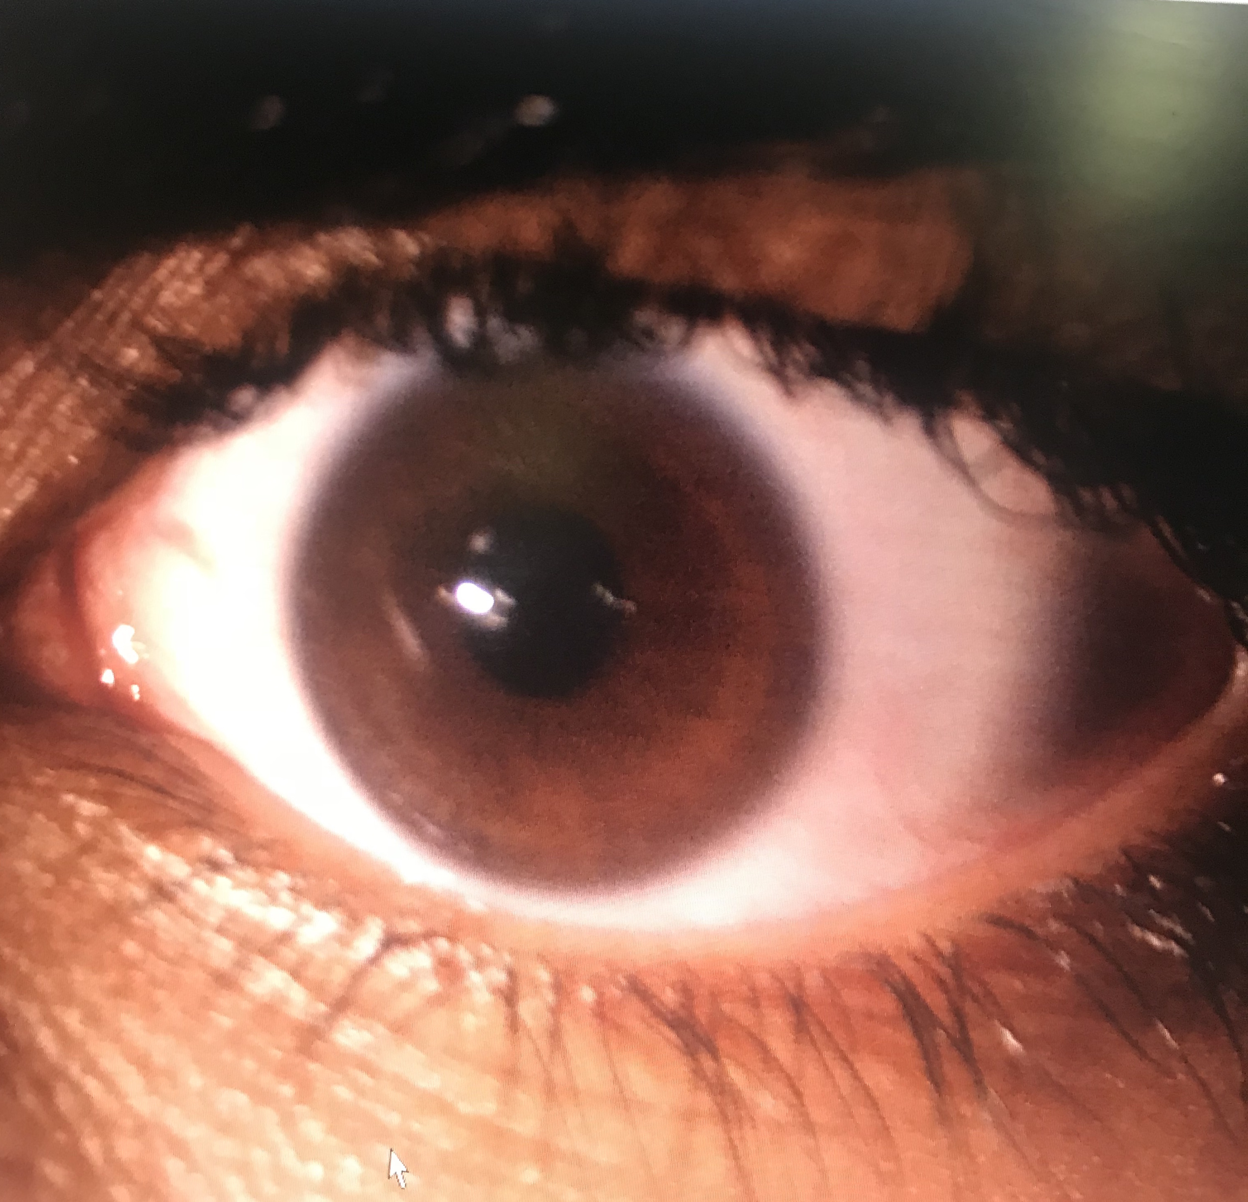
Smile post op slit lamp pics

Slide 10
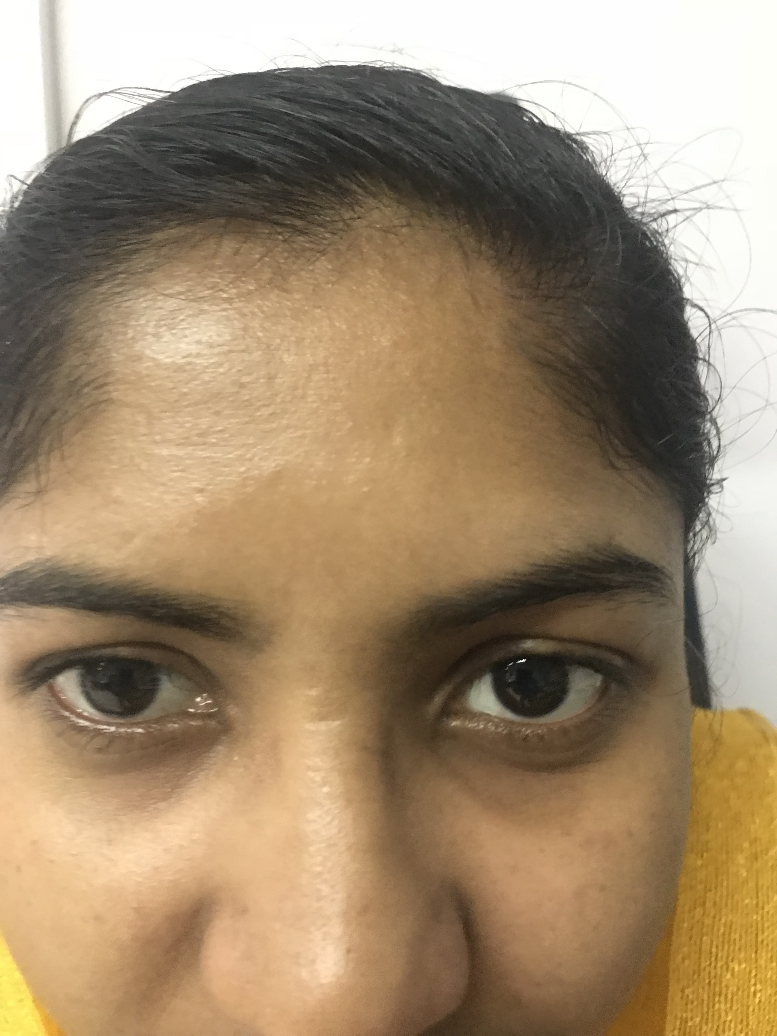
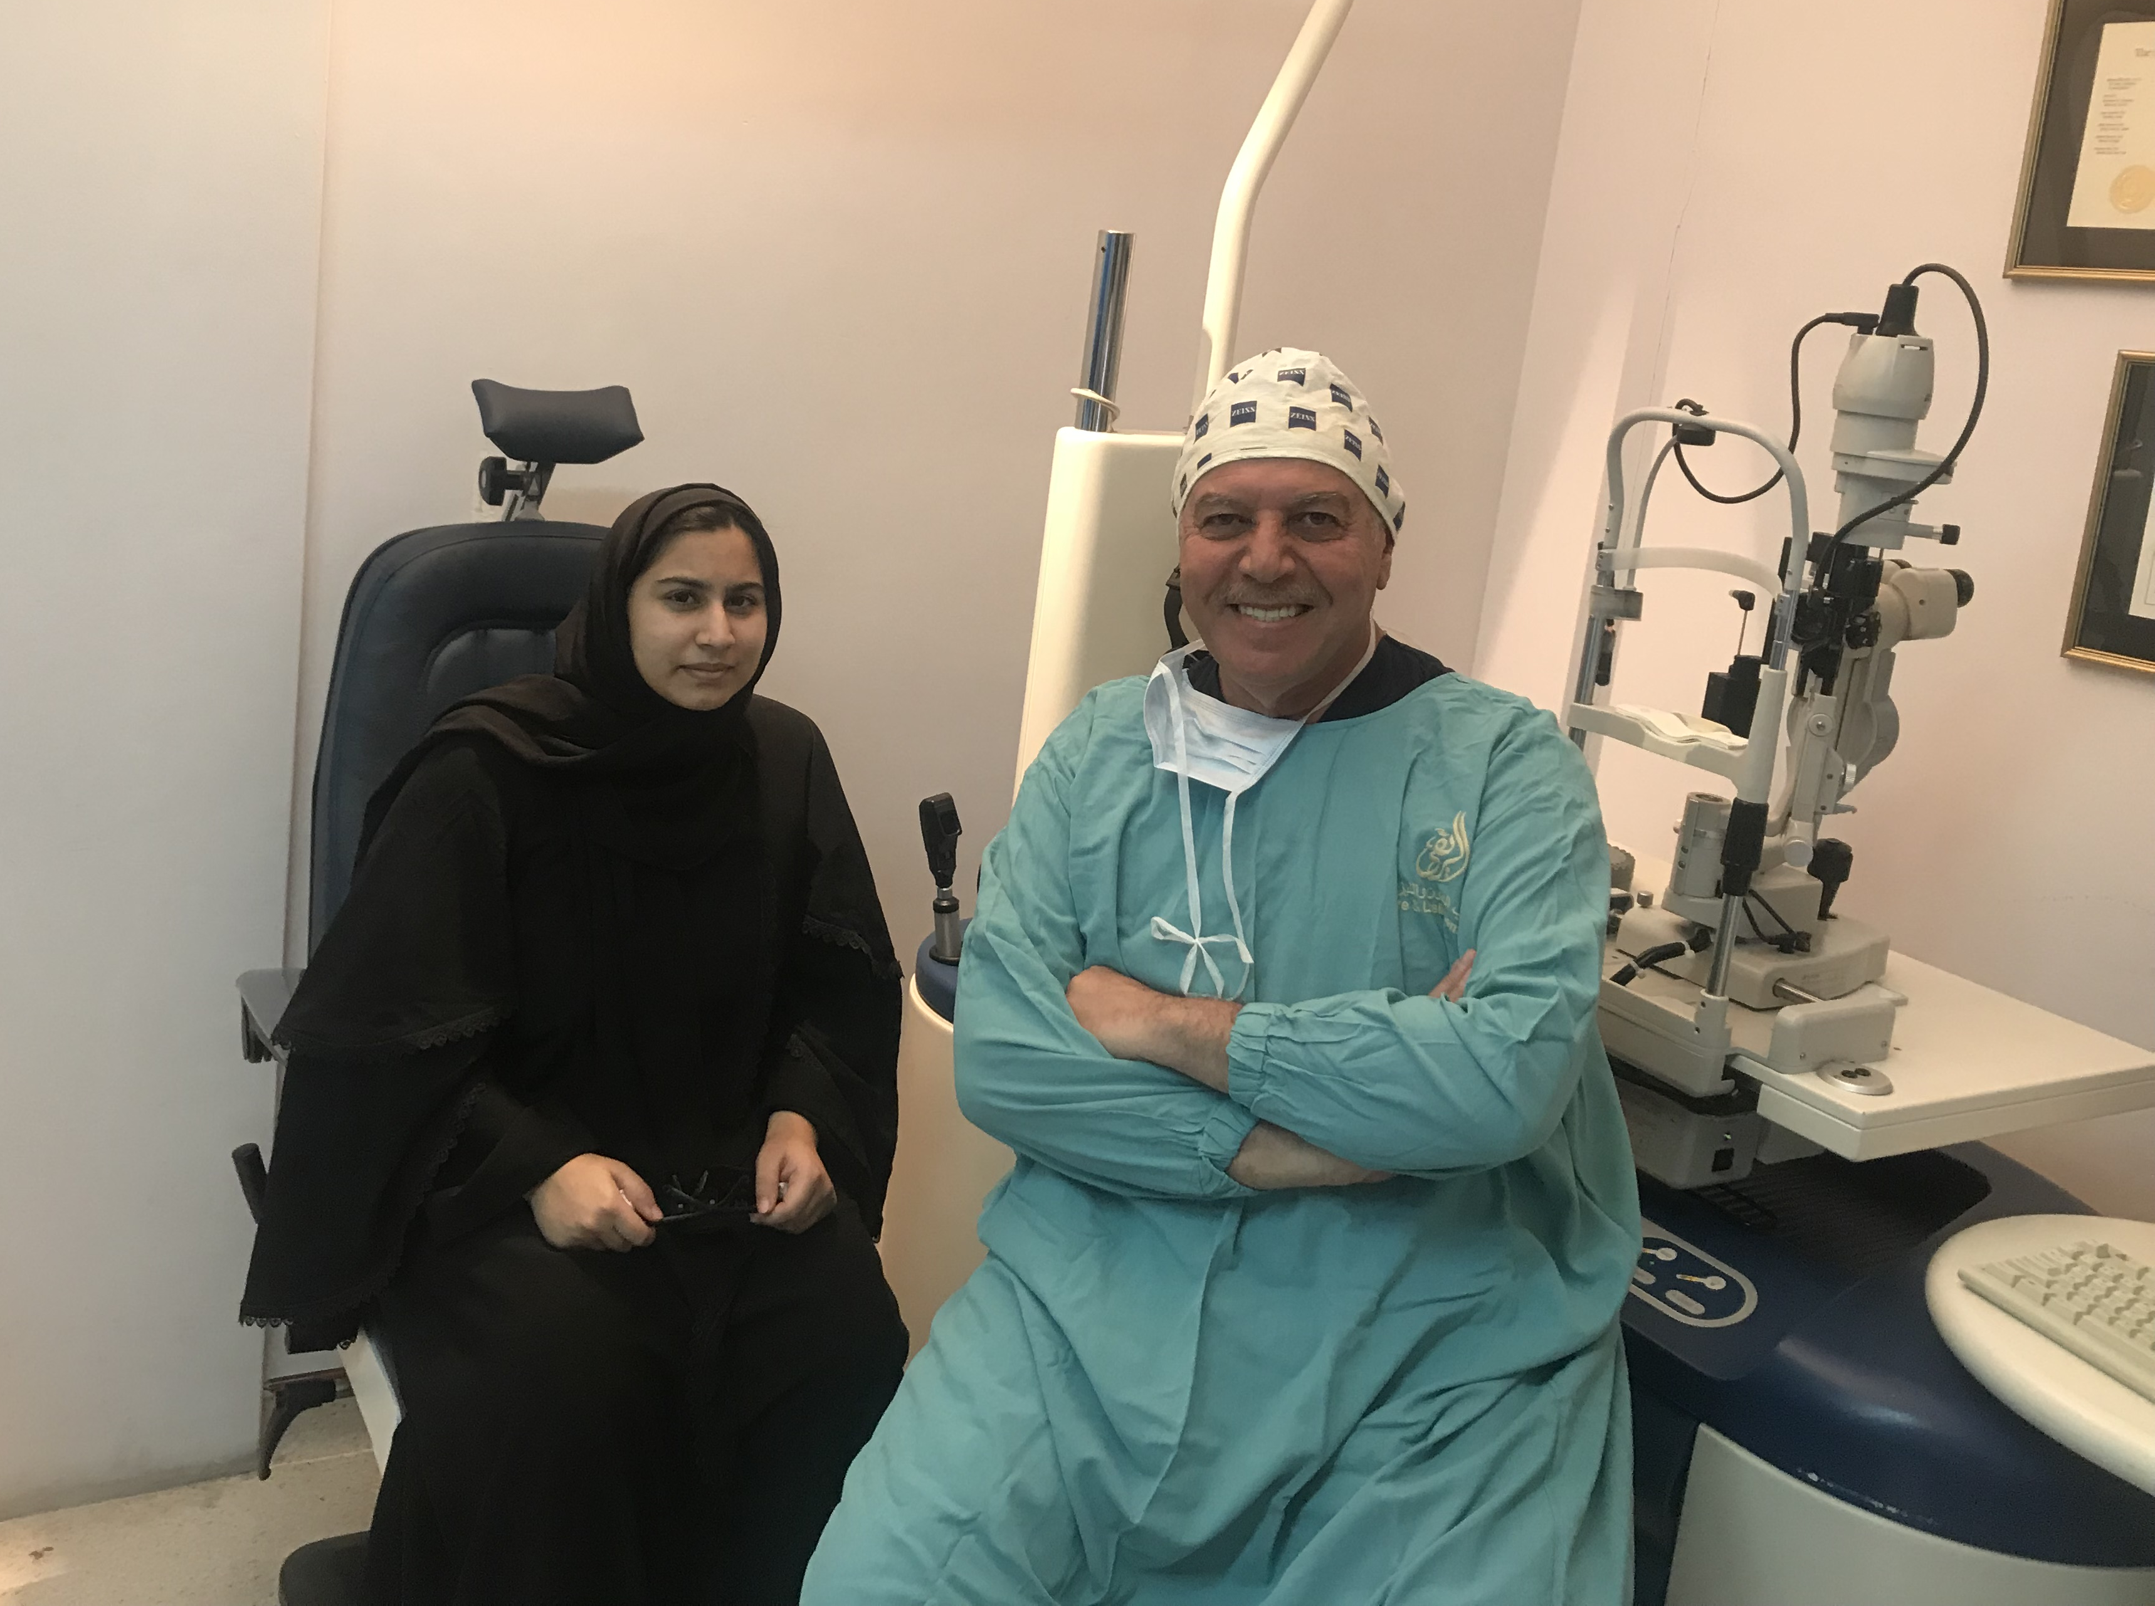
smile
First day post op

Slide 11
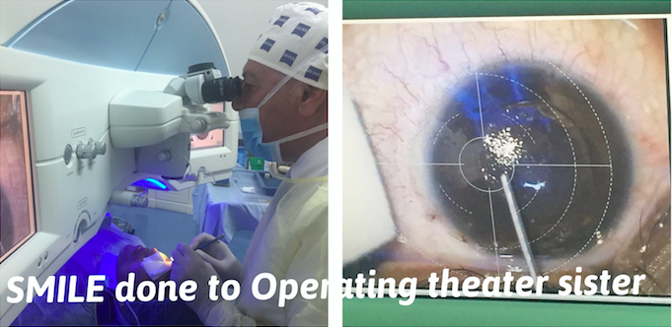
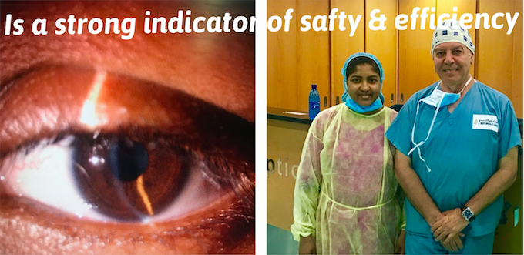
SMILE ON THEATRE SISTER

Slide 12
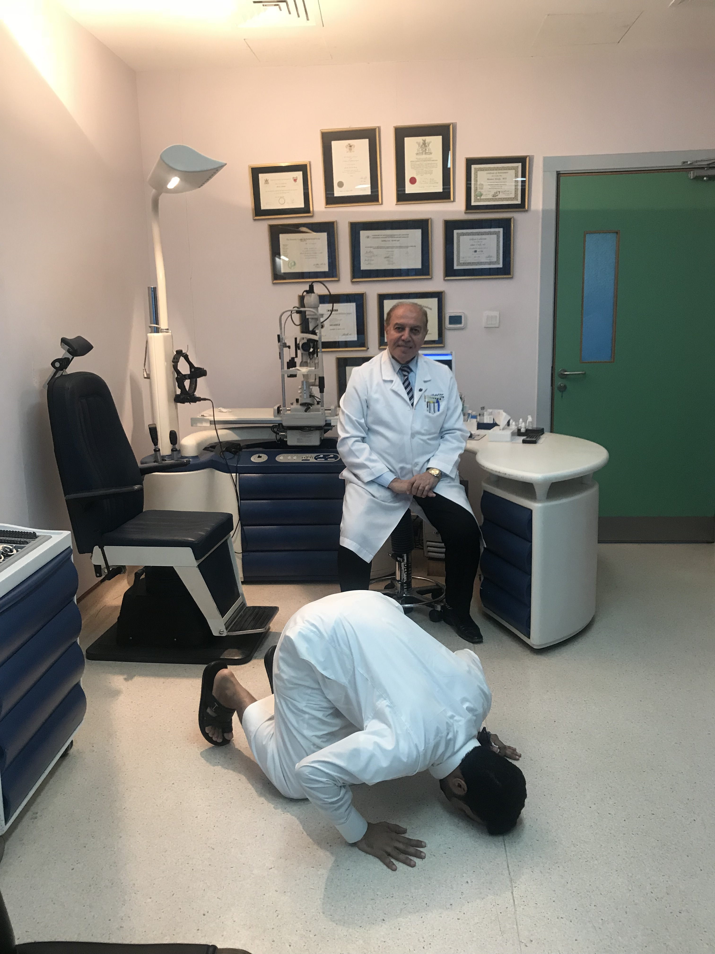
Smile patient appreciation

Slide 13
Smile efficiency
95.5 % within ± 1.00 D
78 % within ± 0.50 D
100 % V.A 20/40 or better
76.5 % V.A 20/20
We done 76 cases from July-2018 to til July-2018 and Our Report Similiar to Reinstein et al: SMILE history, fundamentals of a new refractive surgery technique & clinical outcomes.Eye &Vision 2014 1:3.web 10 Mar.2015.

Slide 14
Smile
Complications
Epithelial abrasions 10 %
Small tears in incisions 5 %
Loss of suction during procedure 10 %
Dryness during first two months 50 %

Slide 15
SMILE
CONCLUSION
SMILE is an effective & Safe Procedure.
Ability to correct high Myopia values.
Corneal biomechanics almost preserved.
Reduced risk of Dry-Eye.
Rapid Recovery of Corneal Sensitivity.

Slide 16
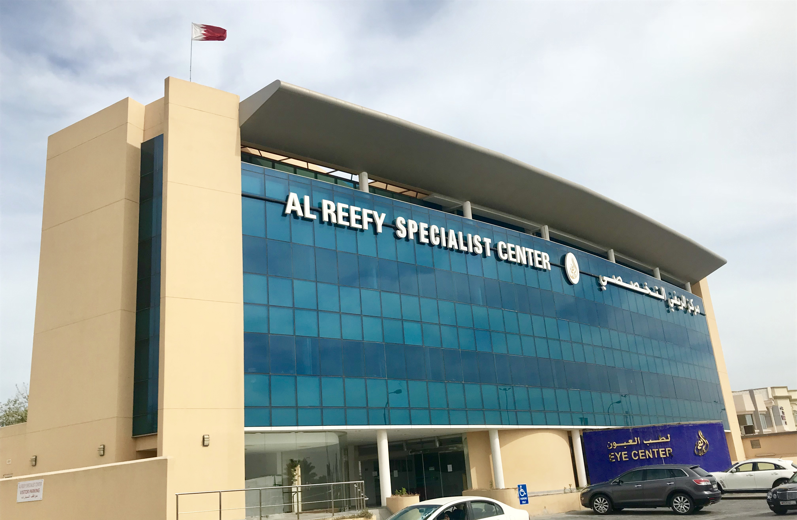
Thank you

