Slide 1
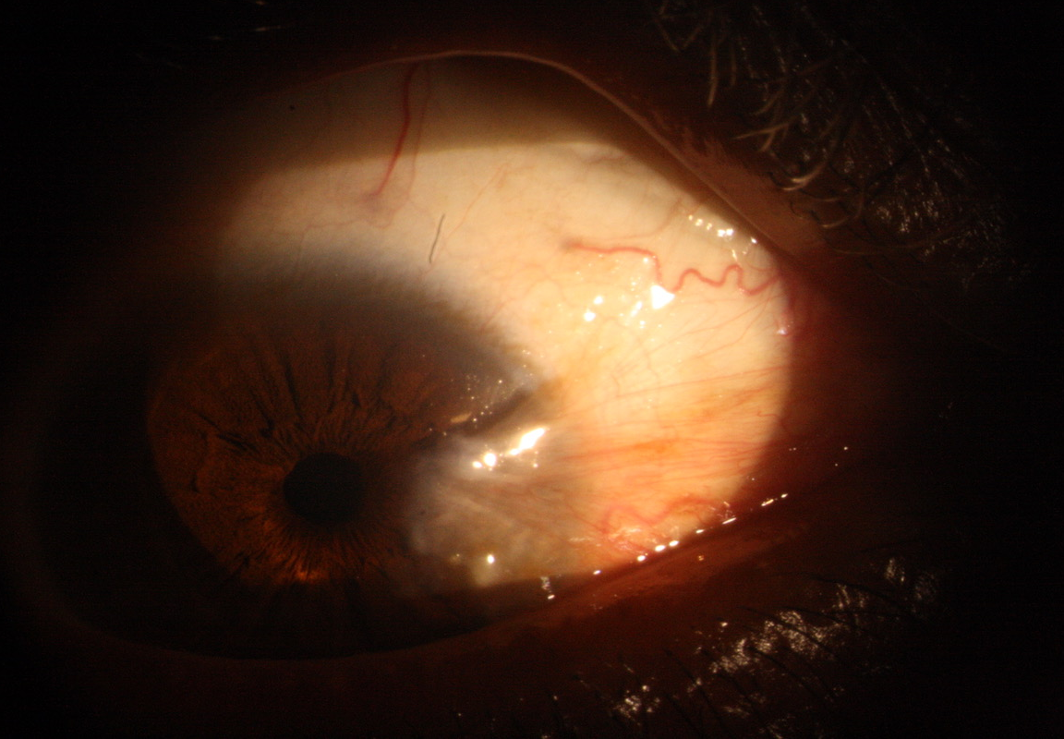
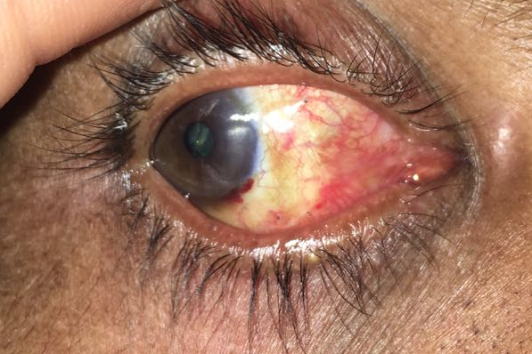
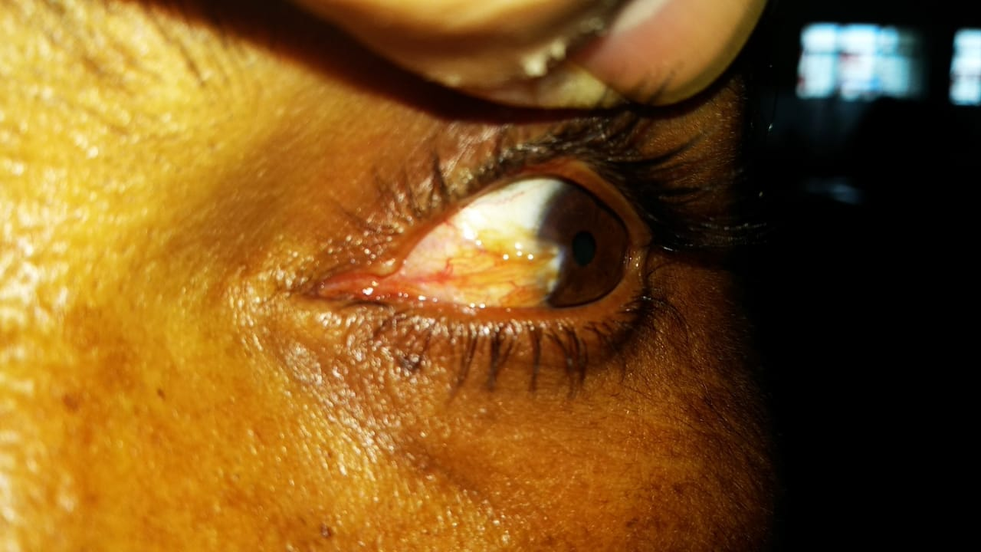
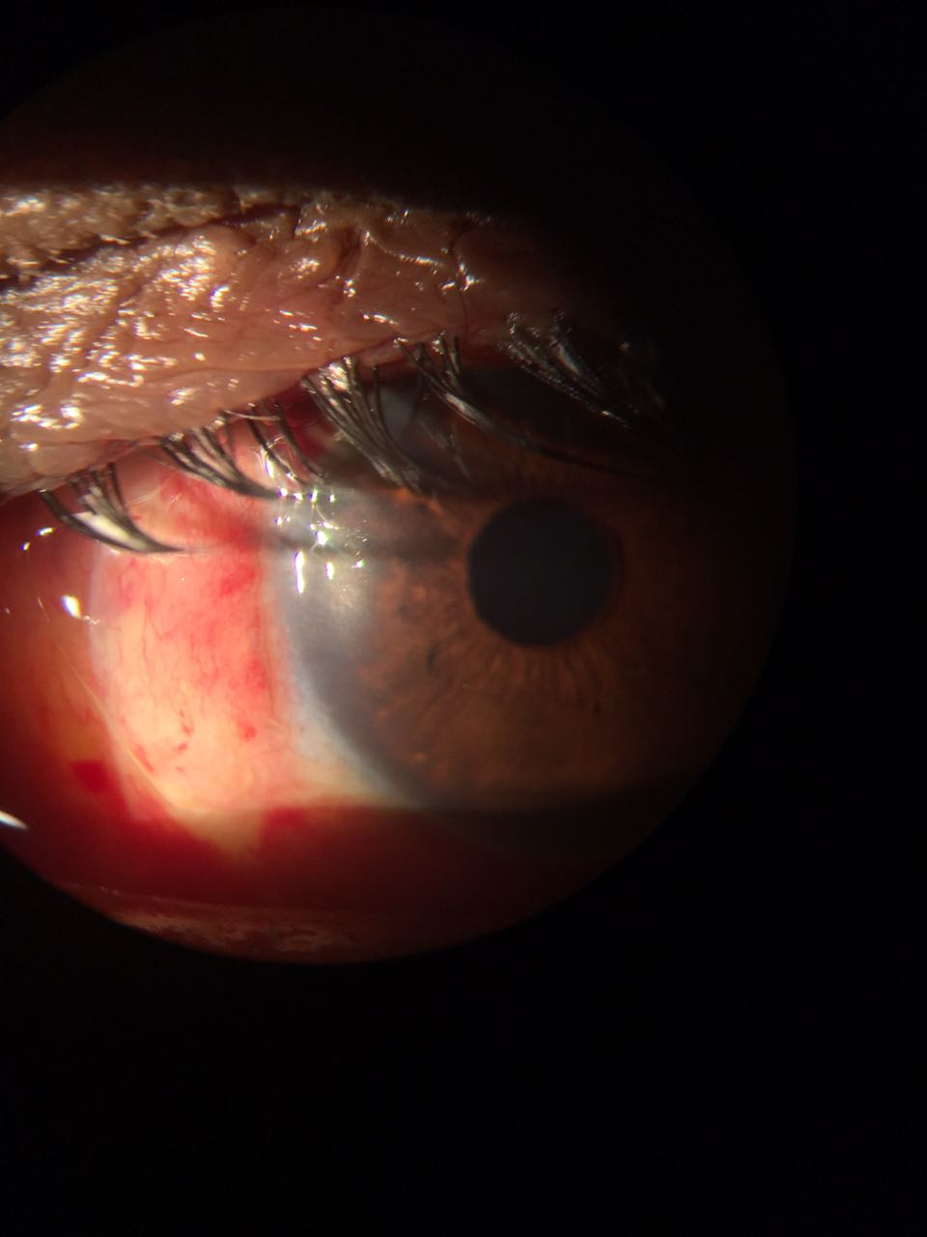
A COMPARATIVE STUDY OF POSTOPERATIVE OUTCOME AFTER PTERYGIUM EXCISION USING AUTOLOGOUS BLOOD AND SUTURES
Dr. Parag Ramnani, Dr. Harpal Singh (HOD & Professor), Dr. Rajesh S. Pattebahadur, Dr. Pragya Jain, Dr. Sagarika Laad, Dr. Pranav Saluja, Dr. Shashank Gupta
Peoples College of Medical sciences & Research Centre, Bhopal, Madhya Pradesh
Introduction
Results
Pterygium is a degenerative and hyperplastic condition of subconjunctival tissue. It proliferates as vascularised granulation tissue invading cornea, thus destroying the superficial layers of stroma and Bowman’s membrane most often present on the nasal side.1 It may vary from small, atrophic inactive asymptomatic lesions or with minimal symptoms such as redness and foreign body sensation initially to large, aggressive, rapidly growing fibrovascular lesions resulting in impairment of vision. Vision impairment can be due to covering of pupillary area of the cornea or by altering the curvature of the cornea due to fibrosis resulting in “with the rule astigmatism.” Pterygium occur more frequently between 30 degrees latitude north and south of the equator called as “pterygium belt” where there is warm, dry, dusty climate with more exposure to ultraviolet radiation.3,4 It is more common in young adult males than females, agricultural workers or those who are doing outdoor work in dusty and warm climate.5
Out of 50 patients, 28 were in group A and 22 were in group B. Maximum numbers of patients were involved in outdoor activities. In comparison to autologous blood technique, postoperative discomfort was more in suture group after pterygium excision. In group A, the graft displacement was found in 2 (7.1%) patients, whereas in group B, there was no graft displacement seen. While in group B2 (9.1%) patients had granuloma formation. The recurrence of pterygium was high (22.7%) in group B as compared to group A (3.6%). There was a significant correlation between rate of recurrence and type of surgery (P value <0.05).
Conclusion
In our study, conjunctival graft with autologous blood was found to have better results in terms of postoperative discomfort and recurrence when compared with suturing group, though the graft displacement remains a problematic situation with autologous blood group. But, overall incidences of suture-related discomfort and complications were less. Therefore, considering cost effectiveness, less postoperative discomfort and no risk of viral disease transmission, pterygium excision with autologous blood maybe a preferable surgical method for treatment of pterygium. Thus, from this study, we arrived at the conclusion that conjunctival autografting by patient’s own blood is more effective as compared to suture group B
Purpose
Fig. 1 and 2 Preoperative and postoperative picture of right eye
To compare the two modalities of treatment in pterygium excision with postoperative outcomes.
Material and methods
A comparative study was conducted from July 2016 to August 2017 in the Department of Ophthalmology. Total 50 patients with primary nasal pterygium of grade 2 or more were enrolled from eye outpatient department. The patients were randomly divided into two groups for pterygium excision with conjunctival autografting using either autologous blood (group A) or sutures (group B). Two groups were compared for postoperative discomfort, recurrence and graft displacement. In group A, autologous serum bed was formed over the sclera by oozing vessels of the excised pterygium and active bleeding at the graft site was avoided by applying pressure with cotton buds. Then, the graft was placed over the serum bed and spread with the help of plain forceps. Gentle pressure was applied for 3-5 minutes and then wait for 7-10 minutes for proper placement of the graft. In group B, graft was placed and secured with 10-0 absorbable Vicryl suture. Followup was done on 1st, 7th, 15th, 30th and 90th postoperative day.
References
[1] Duke-Elder S, Leigh AG. Disease of the outer eye. In: Duke-Elder S, ed. System of ophthalmology. London: Henry Kimpton Publ 1985:573-585.
[3] Cameron ME. Pterygium throughout the World. Springfield IL: Charles C Thomas 1965.
[4] Saw SM, Tan D. Pterygium: prevalence, demography and risk factors. Ophthalmic Epidemiol 1999;6(3):219-228.
[5] Mackenzie FD, Hirst LW, Battistutta D, et al. Risk analysis in the development of pterygia. Ophthalmology 1992;99(7):1056-1061.
Fig. 3 and 4 Preoperative and postoperative picture of left eye

