Slide 1
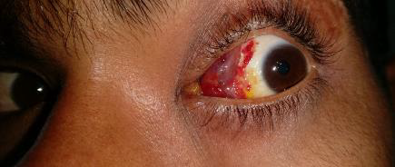
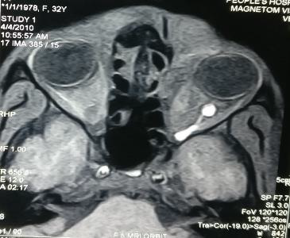
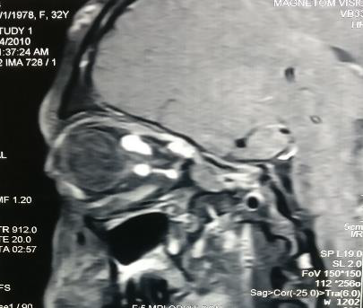
ORBITAL VENOUS VARIX- AN UNCOMMON VASCULAR MALFORMATION
Dr. Parag Ramnani, Dr . Harpal Singh (Professor&HOD), Dr. Rajesh S. Pattebahadur, Dr. Pragya Jain, Dr. Sagarika Laad Dr. Pranav Saluja, Dr.Shashank Gupta
Peoples College of Medical sciences & Research Centre, Bhopal, Madhya Pradesh
Introduction
Treatment
Orbital varices are rare, abnormally thin walled and distensible veins with low flow velocities. These orbital varicosities are of unknown aetiology. Equally affecting the young and the elderly.¹ Orbital varicosities are mostly asymptomatic, but may present with intermittent periorbital pain, unilateral Proptosis or acute visual loss. As it communicates with the extra-orbital circulation, engorgement may occur through a Valsalva manoeuvre or similar action (e.g., bending, coughing and straining)² resulting in intermittent periorbital pain, varying degrees of proptosis, thrombosis and haemorrhage.³ Vascular complications such as variceal thrombosis or haemorrhage usually result in acute unilateral anopia due to optic nerve compression.
As most of the patient with orbital varices are asymptomatic or have very few symptoms thus requires no treatment. Occasionally, periorbital pain, eye bulging, compression of the optic nerve, vision loss or disfigurement develops and require prompt treatment.⁴ There are no well established guidelines for treatment. Treatment usually depends on the individual patients. In our case conservative management was opted by prescribing spectacles correction for best corrected visual acuity and patient was kept on close follow-up to look for any progression.
Fig 1 Clinical Picture Showing Conjunctival
Mass with Subconjunctival Haemorrhage
Conclusion
Purpose
There has a limited differential diagnosis of orbital varix without thrombosis(Orbital venous malformation, Orbital Lymphangioma, Orbital haemangioma, Intracranial arteriovenous malformations, Caroticocavernous fistula, Dural arteriovenous fistula). Orbital varices are easily identifiable on either CT or duplex ultrasound imaging. But, it is less reliable in demonstrating flow across fistulae. Thrombosed orbital varices may or may not show patchy enhancement, thus clinicians should be cautious for evidence of thrombus extension to the cavernous sinus. MRI are usually helpful and enhance intensely after the administration of contrast material.⁵ Thus it should be considered in such cases for appropriate diagnosis.
To report a case of uncommon vascular malformation
Excised cyst.
Case report
A 23-year-old male presented to eye OPD with complain of mass in left eye since the last 3 years. He developed mild pain and redness in the same eye since the last 10 days. There was no history of trauma, foreign body or any other relevant history. No history of any systemic illness. Vision was 6/6 in right eye and 6/36 in left eye recorded on Snellen’s chart. Ocular movements were normal. On slit lamp examination of left eye, irregular growth on nasal side extending from upper fornix to lower fornix upto medial one third under the conjunctiva with overlying dilated vessels and subconjunctival haemorrhage was seen. Rest anterior segment was normal. Right eye was normal. Fundus examination showed normal disc with dilated and torturous blood vessels in left eye more than right eye. On Valsalva manoeuvre, eye proptosed 2-3 mm. We then went for MRI orbit with contrast which revealed multiple abnormal segmentally dilated club like vascular channels at the orbital apex at both intra and extraconal retrobulbar space and median canthus of the left orbit. These vascular channels appeared hypointense on T1-weighted and hyperintense on T2-weighted sequence. Hence suggesting vascular malformation (orbital varix).
Figure 2 and 3 MRI Contrast Showing Enhancement
of the Vascular Lesion
References
1. Arat YO, Mawad ME, Boniuk M. Orbital venous malformations: current multidisciplinary treatment approach. Arch Ophthalmol 2004;122(8):1151-1158.
2. Shields JA, Dolinskas C, Augsburger JJ, et al. Demonstration of orbital varix with computed tomography and valsalva maneuver. Am J Ophthalmol 1984;97(1):108-110.
3. Bullock JD, Goldberg SH, Connelly PJ. Orbital varix thrombosis. ohthalmology 1990;97(2):251-256.
4. Xu D, Liu D, Zhang Z, et al. Gamma knife radiosurgery for primary orbital varices: a preliminary report. Br J Ophthalmol 2011;95(9):1264-1267.
5. Islam N, Mireskandari K, Rose GE. Orbital varices and orbital wall defects. Br J Ophthalmol 2004;88(6):833- 834.

