Slide 1
Challenges Facing Continuous Ambulatory Peritoneal Dialysis
Nursing Experience from
Muhimbili National Hospital
Oswald Wandwe

Slide 2
Introduction
Peritoneal dialysis is a technique that employs the patient’s peritoneal membrane as a dialyser
Excess body water is removed by an osmotic gradient created by the high dextrose concentration in the dialysate
Wastes are removed by diffusion from peritoneal capillaries into the dialysate.
                (Daugirdas et al. 2006).

Slide 3
Peritoneal dialysis vs Hemodialysis
PD has several advantages over Hemodialysis including:-
  Better quality of life due to its ability to provide better patient mobility and independence
  Simplicity of use
  Clinical advantages of maintaining residual renal function

Slide 4
Case study
A 58 years old male patient with CKD ESRD, anuric and on thrice weekly maintenance hemodialysis schedules for 2 years
He had -MULTIPLE ACESS FAILURE.
Was referred to MNH ON 20th March 2018 for further management

Slide 5
Patient Evaluation and Treatment
Patient was anuric with: -
    Raised serum creatinine 3600umol/l Generalized body swelling,
    Difficult Breathing
Urgent peritoneal dialysis was needed! BUT
  There was no CAPD catheter at the hospital! !
  Experienced surgeon had retired

Slide 6
Patient consented and CAPD catheter inserted successfully day 8th post admission
PD exchanges initiated 2 l of 2.3 % glucose every 8 hourly
14 days post PD insertion patient was stable, discharged home with 1.5% PD fluid
wife and daughter were trained on how to perform PD exchanges aseptically at home

Slide 7
Back to the patient….
3 weeks post discharge:-
Patient re- admitted with
    Cloudy yellowish- effluent
    abdominal discomfort
    Pain on instilling PD fluid
Laboratory evaluation done – CRP 154mg/l ,blood no growth/pd fluid cultured but results were not available
Iv antibiotics initiated –intra peritoneally

Slide 8
PD exchanges were done by 1.5 % and then by 2.3% dextrose PD solutions
There was good flow in and out suggesting that there was no blockage of the catheter
The effluent started clearing up however patients condition was deteriorating
Patient passed away 4 days after his second admission

Slide 9
Complications of Peritoneal Dialysis
Infection remains the most significant cause for morbidity in patients receiving chronic peritoneal dialysis
        peritonitis and exit site infection
Risk of inadequate dialysis occurs due to loss of permeability of the peritoneal membrane
                ISPD report of 2012 Vol. 32,

Slide 10
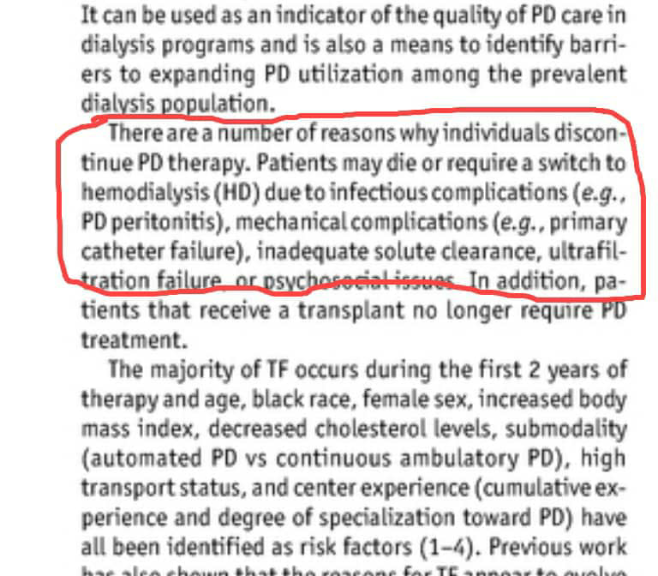

Slide 11
LESSONS FROM THIS CASE STUDY
Proper PD program is needed at MNH
Home visits by PD nurses
Could Automated ambulatory PD machine have helped this patient ??
Could emergency kidney transplantation be a better option???

Slide 12

Thank you !

