Slide 1

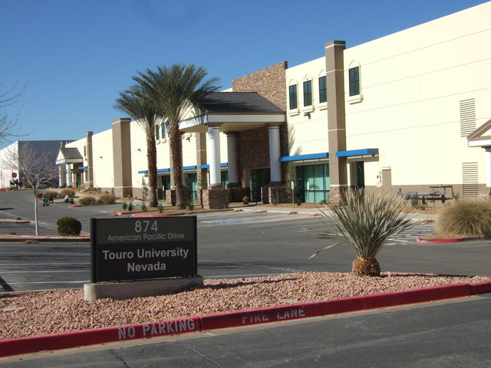

Constructivism Theory in a DNP Program
Judith Carrion EdD, MSN/Ed, MSHS, RN-BC, CNOR and Mary Bemker PhD, PsyS, MSN, LAC, LPCC, RN , Nadia Luna DNP, MBA, RN
TOURO UNIVERSITY NEVADA
BACKGROUND
SUPPORT
METHODS/APPLICATION
CONCLUSION
Using a constructivist approach with an online DNP program is a best practice that allows for a relationship between theory and graduate nursing education. This framework provides students an opportunity to explore relevant problems and exemplary applications The learner is self-directed and involved which allows for knowledge to be internalized. Education is also a collaborative process in which the educator and student have shared responsibilities in this active learning approach and supports an assimilation of information and reframing.
FLIPPED CLASSROOM: An example of inverting the instruction is by recording live lessons (lectures) using screen- capturing software and post lessons online on YouTube for student access. These online video lessons are generally less than minutes and are an overview of the lesson content and end with a summary. The educator can insert their own voice, use video clips, photographs, and images. The students can view the videos at their convenience via their electronic device, and are able to interact within the class and collaborate with each other as they address questions and work through problems.
DNP PROJECT AND THINGS TO CONSIDER;
Choosing a Problem
A. Have a passion for the topic
B. Do student have means to Implement during Identified timeframe?
C. Document that it is a problem.
D. Narrow topic to manageable size
E. Focus on DNP vs MSN or PhD - aka no research!!!
SUPPORT PROBLEM WITH CURRENT LITERATURE;
A. Does literature support that this is a problem?
B. What research has been conducted related to this problem?
C. Is the problem and potential intervention reflective of current constructs in health care?
D. How will the intervention reflect the literature and research available in a new manner?
THEORETICAL FRAMEWORK:
A. Choose a framework that addresses key elements of the problem and possible solution
B. Select a framework that demonstrates the philosophy of the DNP student
METHODOLOGY;
A. Based on theoretical constructs and framework
B. Demonstrates an understanding and application of the research and other literature supports
C. Reflects the problem, environment, participants and situational needs
D. Can be obtained within the timeframe allotted
E. Is an actualized intervention based on knowledge, constructs and evidence for positive change
EVALUATION;
A. Have an evaluation plan that reflects both the identified problem and the intervention actualized
B. Collect appropriate data to answer the questions that the student has regarding the project outcomes
C. Manage timelines and milestones so the student does not get "lost in the project"
D. Implement the data analysis plan
CASE STUDY; variety across cases ensures richness and depth in order to understand the shared phenomenon of interest. Particularly useful when looking at a process and “how” questions.
Students are presented with the following information.
A 63 year old female presents with her granddaughter for consolation at a clinic where you work. The grandmother grew up in Troublesome Creek, Kentucky and moved to Owensboro, KY approximately 40 years ago. She is concerned because her granddaughter has started to date a young man who has a strong family connection family connection to Hazard, KY (He is a McCoy.), and she is concerned the relationship might become serious. From the discussion you will determine answers to the questions.
Hint: some helpful references.
http://www.indiana.edu/~oso/lessons/Blues/TheBlues.htm
http://abcnews.go.com/Health/blue-skinned-people-kentucky-reveal-todays-genetic-lesson/story?id=15759819
CHAT ROOMS; a well implemented electronic chat room can support constructivism. Web chats promote real-time collaboration and discussion between students and instructors that lead to deeper processing of class material.
It is of great importance that the methods used in a DNP program support the personal reflections of the student and helps them internalize the knowledge in an independent way. Constructivism can be seen as an effective tool to achieve this goal. The modules and courses within the curriculum form the framework for teaching and learning , but the focus must primarily lie on the actual content of these modules and courses which is how it is communicated and received.
BIBLIOGRAPHY
Brandon, A. & All, A. (2010). Constructivism theory analysis and application to curricula. Nursing Education Perspective, 31 ( 2), 89-92
Hunter, J. L. (2008). Applying constructivism to nursing education toward cultural competence course that bears repeating. Journal of Transcultural Nursing. 19(4), 354-362
Hunter, J. & Krantz, S. (2010). Constructivism in Cultural Competence Education. Journal of Nursing Education, 49(4), 207-214
Kala, S. & Isaramalai, S.A., & Pohthong, A. (2010). Electronic learning and constructivism: A model for nursing education. Nurse Education Today, 30(1), 61-66.
Blackburn, S. (2016). Oxford Dictionary of Philosophy. (3rd ed). Oxford, UK: Oxford University Press.
Brooks, M. (1999). In search of understanding: The case for Constructivist classrooms. Danvers, MA: Association for
Supervision and Curriculum Development.
Concept to Classroom. (2004). Workshop: Constructivism as a paradigm for teaching and learning.
Retrieved from: http://www.thirteen.org/edonline/concept2class/constructivism/index_sub6.html.
Oregon Technology and Education Council. (n.d.) Learning theories and transfer of learning. Retrieved from:
http://otec.uoregon.edu/learning_theory.htm
University of Sydney. (2016). Constructivism: Learning and teaching. Retrieved from:
http://sydney.edu.au/education_social_work/learning_teaching/ict/theory/constructivism.shtml
LITERATURE SUPPORT
What is constructivism?
People develop their own understanding of the world by experiencing and reflection of those experiences.
Involves a hypotheses of an idea or construct that is comprised of a comprehensive thought related to an independent exploration and supposition. (Blackburn, p. 102)
Each individual generates the rules and mental perceptions by which experiences are presented. These constructs are then adjusted to make way for an understanding of new experiences. In turn, learning then is a search for the meaning within an experience. This requires a concept of the whole as well as each individual part (Brooks, 1999). Results when individuals build their own understanding about the world and dynamics within it, based on their experiences and knowledge developed. (Concept to Classroom, 2004) Constructivist learning is founded on an individual's active participation in problem solving and critical thinking linked to an educational experience derived form their own determination of relevance. Ideas are tested and outcomes are determined based on prior knowledge and experiences as it is applied to a new endeavor. (Oregon Technology and Education Council, n.d.) Learning theory founded in psychology and applied to education that offers a rationale for how individuals develop knowledge and learn. People created their own knowledge and meaning from the experiences they are afforded. (University of Sydney, 2016)
DNP students explore a problem they identify from their own professional experiences. Building upon that knowledge, they then review literature, speak to experts in the field and observe the dynamic as appropriate. From their construct of this issue, they then develop a means of positively impacting the situation, apply this remedy and evaluate its effectiveness. Throughout this process, previous knowledge and ideas are built upon so that they can then evolve their understanding and "reality" through this new application and experience. Education needs to continuously change and evolve to ensure student performance is successfully achieved.

