Slide 1
Polycystic Kidney Disease
2020 Perspective
Theodore I. Steinman, M.D,
Professor of Medicine, HMS
Senior Physician, BIDMC
Boston, MA
March 26, 2020

Slide 2
Disclosures
Grant from Kadmon Corp. LLC
Grant from Reata
Grant from Retrophin
Consultant: Genzyme Sanofi

Slide 3
ADPKD
4th leading cause of ESKD, accounts for 6% of all ESKD cases (10% for <60 yr old)
ADPKD develops when the genes encoding polycystin 1 and polycystin 2 are disrupted, leading to cyst development and eventual destruction of renal parenchyma.

Slide 4
Prevalence of Mutations in ADPKD
Estimates: 9.3 cases/10,000 sequenced (~600,000 in US and 12.4 million worldwide)
  50 % reach ESRD by age 55 (PKD1 trunc. mut.)
  significant allelic effect in PKD1 with milder disease associated with non-truncating mutations
80 % risk for hypertension
60% risk for painful kidney complications
20% risk for symptomatic PLD (female)

Slide 5
Molecular Based Screening
1. Next Generation Sequencing (NGS) and exome sequencing (high throughput)- targeted NGS identifies PKD 1 & PKD 2 pathogenic variants
2. To date, >930 PKD1 and 170 PKD2 pathogenic mutations reported (extensive allelic heterogeneity, especially for PKD1)

Slide 6
Autosomal Dominant Polycystic Kidney Disease
Mutation in ~70-78% located on short arm of chromosome 16p 13.3 – p13.1 – (PKD1 locus)
~15-20% of mutation located on chromosome 4q21-q23 milder phenotype with PKD2 locus. Later age of diagnosis and hypertension, smaller kidney volume, fewer kidney cysts, later age of ESRD onset. Liver, pancreatic and vascular abnormalities same with both genotypes

Slide 7
PKD 2 - Population Based
US – 36%
Canada – 26%
Mutations
GANAB – 0.3%
DNAJB – 0.1%
ALG9 – loss of function variant
Unknown – 7%

Slide 8
Family History of Severity of Renal Disease Predicts Mutated Gene in ADPKD
      Median Age of ESRD
      PKD1 ~ 53 years
      PKD2 ~ 73 years
  Presence of at least one affected family member who developed
  ESRD at age < 55 years was highly predictive of PKD1 mutation
  (PPV 100%, sensitivity 72%)
If family member developed ESRD at age > 70 years, then highly predictive of PKD 2 mutations (PPV 100%, Sensitivity 74%)
Barua et al JASN 20: 1833, 2009

Slide 9
Family History May Be Absent
Denovo mutations (7-19%) effect cilia proteins
* plays impt role in kidney cyst formation
Mosaicism – hallmark is presence of >one genetically distinct cell lines in an individual.
Mild disease from PKD2
Non-truncating PKD1 mutation
Unavailability of parenteral medical record

Slide 10
ADPLD
Loss of function mutations in ADPLD genes are more common than expected
(20.2 cases /10,000 sequenced).
Extensive heterogeneity w no one single gene accounting for large proportion of severe PLD cases.
Need to identify genetic modifiers:
- improve risk prediction
- ?Rx

Slide 11
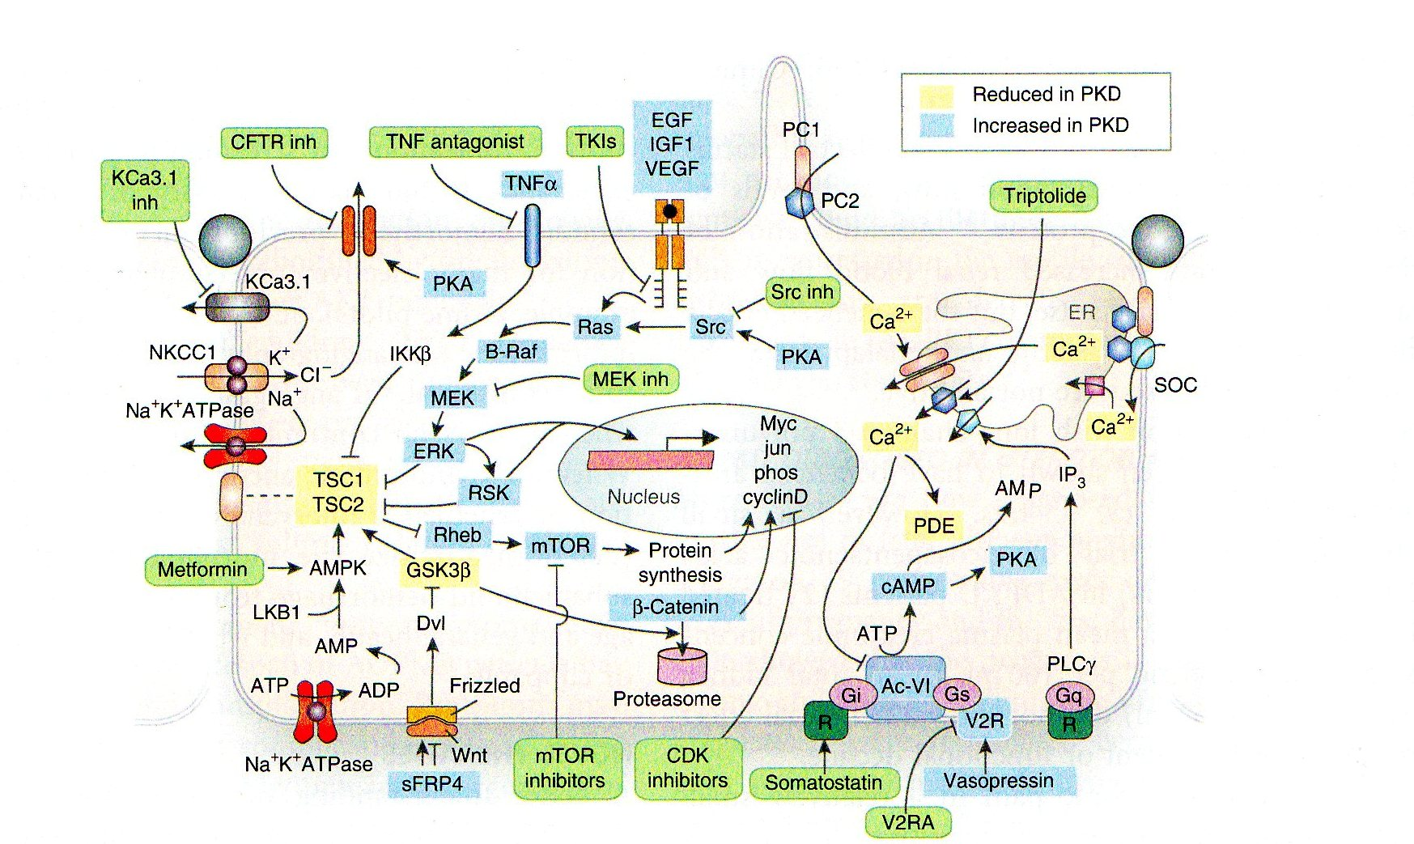
Diagram depicting putative pathways up- or downregulated in polycystic kidney disease and rationale for treatment with a V2 receptor antagonists, somatostatin, triptolide; tyrosine kinase, src, MEK, TNFa, mTOR, or CKD inhibitors; metformin, and CFTR or KCA3.1 inhibitors (green boxes)
Torres, Harris, KI 76:149-168, 2009

Slide 12
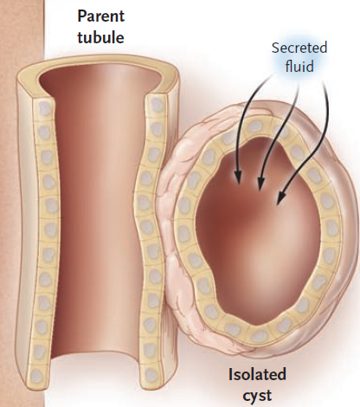
Cystogenesis
Proliferation of renal tubular epithelial cells
Cyst cavity filled with fluid
from glomerular filtrate
Cyst separates from parent
nephrons
Progressive cyst enlargement
by cellular proliferation and
fluid secretion into cyst lumen
coupled with active Cl⁻ transport
N Engl J Med 2008; 359: 1477-85
J Am Soc Nephrol 2008; 19: 1-2
Notes:
Let’s review some of the basic mechanisms of cyst formation and then we’ll talk about more recent advances that provided the rationale for testing tolvaptan in PKD
Focal proliferation of renal tubular epithelial cells forms a small out-pouching in the wall of the tubule. Cysts progressively expand
by aberrant cell differentiation and sustained proliferation. Fluid from glomerular filtrate fills cysts cavity. After cyst separates from parent tubule, fluid is transported across the epithelium into the cyst lumen coupled with active chloride transport

Slide 13
Mediator of Electrolyte-Fluid Secretion is Cl⁻ Channel
Cyst growth involves secretion of electrolytes and fluid by epithelial cells
that line cysts
Cystic Fibrosis Transmembrane Regulator (CFTR) is a mediator of electrolyte-fluid secretion via chloride channel

Slide 14
Hypothesis About Role of Angiogenesis in ADPKD
Necessary for cyst cells to grow
Responsible for increased vascular permeability facilitating fluid secretion into cysts
Neovascularization may result in formation of aneurysms
  ? Brain – PC 1 & 2 expressed in smooth muscle cells of cerebral arteries
  ? Renal bleeding

Slide 15
Angiogenesis
VEGF – a potent regulator of angiogenesis.
-- demonstrated in ADPKD cyst fluid
-- correlates with TKV/TCV and LVMI
-- negatively correlated with Ccr
Hypothesis: angiogenesis plays a role in early progression of renal and CV disease in ADPKD. Hypertensive children have significantly higher LVMI than normotensive PKD patients.
LVH less with good BP control, short duration of HTN and use of ACE-I/ARB. Early BP Rx may decease CV deaths
Gitomer, et al. and Perrone, et al. (HALT PKD Study) 2017
_{r}

Slide 16
Imaging
Current US can detect cysts ~1cm or > in diameter.
High resolution modern US scanners can detect cysts down to 2-3 mm.
MRI sensitive to 0.9 mm or >.
US kidney length >16.5 cm and htTKV >650 ml had best cut point for predicting the development of CKD Stage III
      KI 88:146-151, 2015

Slide 17
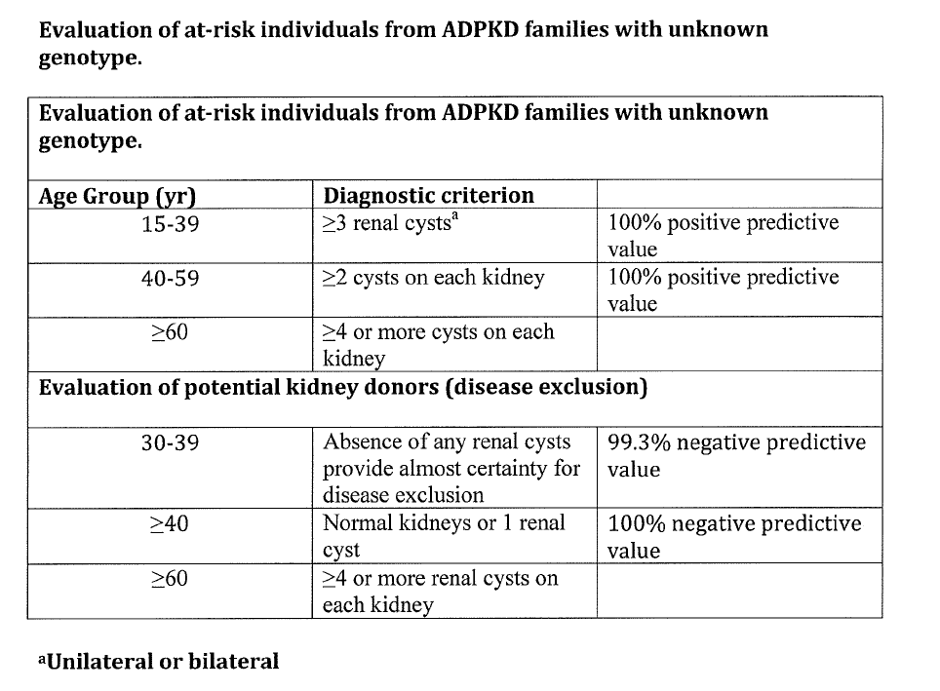
Criteria for US Diagnosis

Slide 18
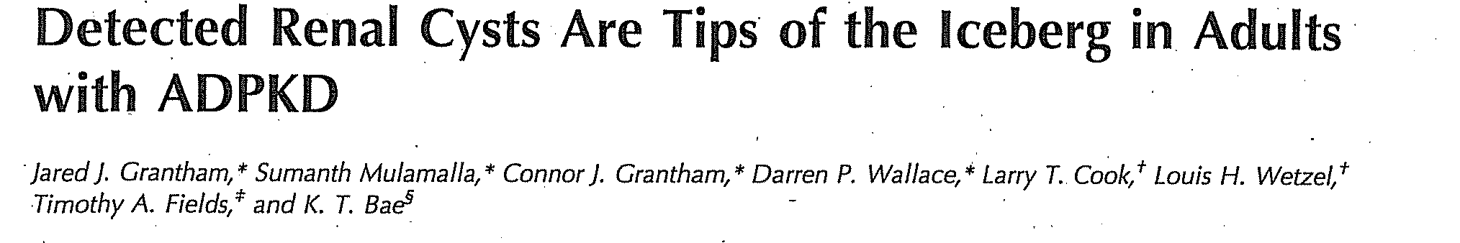
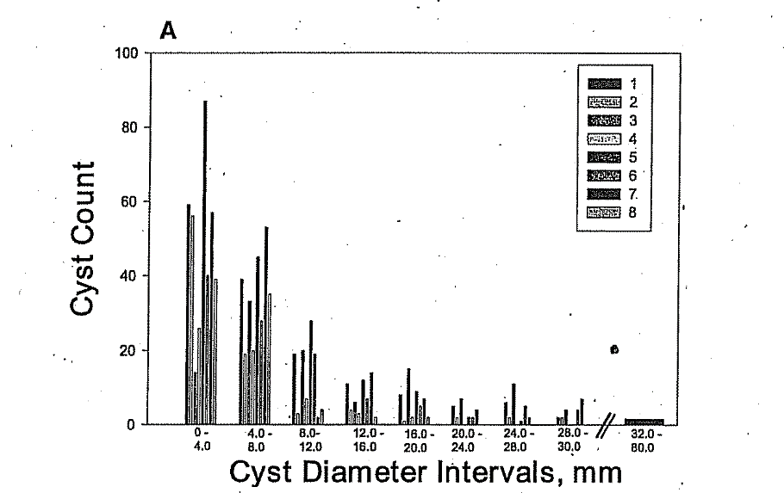
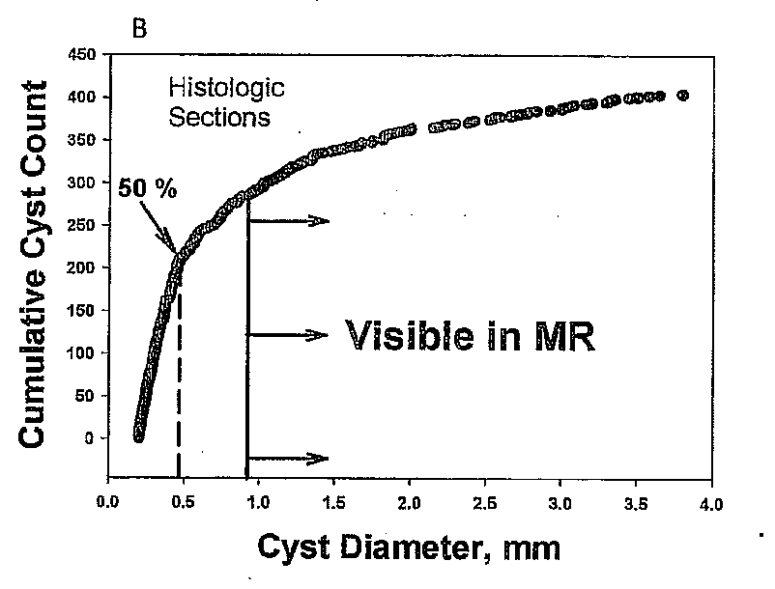

Slide 19
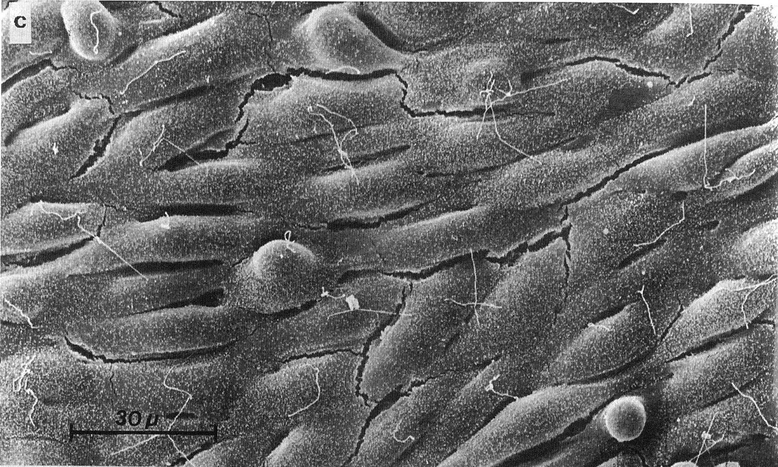
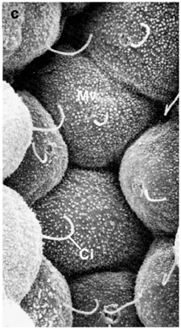
Primary Cilia on Kidney Cells
Wheatley, 1995; Pan, 2005

Slide 20
Evidence that PKD is a Disorder of Cilia
The proteins that are mutated in ADPKD and ARPKD are located in kidney cilia
  Polycystin-1
  Polycystin-2
  Fibrocystin
Mice lacking kidney cilia develop PKD
Polycystin-1 and polycystin- 2 are required for ciliary signaling . Loss of PC2 from smooth muscle cells – hypotension.

Slide 21
Cilia
Functional cilia may contribute to acute flow-induced NO production & NOS isoform abundance.
In PKD decreased availability of vasodilator NO (endothelial dysfunction) -?altered cilia.
Loss of PC1 from smooth muscle cells diminishes myogenic response in mesenteric circulation – alters systemic BP

Slide 22
Colony Stimulating Factor 1
1. A receptor kinase inhibitor – reduces disease severity by targeting tissue resident macrophages.
* juvenile macrophages present during
periods of accelerated cyst formation.
2. cAMP (a messenger molecule) expressed
higher than normal levels in PKD
* PDE-4 (enzyme) breaks down cAMP and lowers intracellular cAMP – the signaling event inhibits cyst formation.

Slide 23
Vasopressin-Mediated AQP-2
Trafficking requires normal cilium
Collecting ducts become dedifferentiated without normal cilium → enhanced salt & water absorption.
* contribute to hypertension in PKD patients.

Slide 24

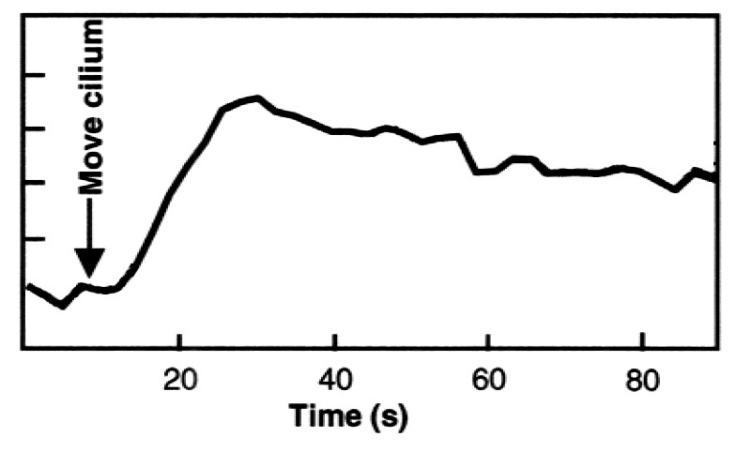
Cilia Bending Produces a Rise in Cell Calcium
Calcium
concentration
adapted from Praetorius, 2001

Slide 25
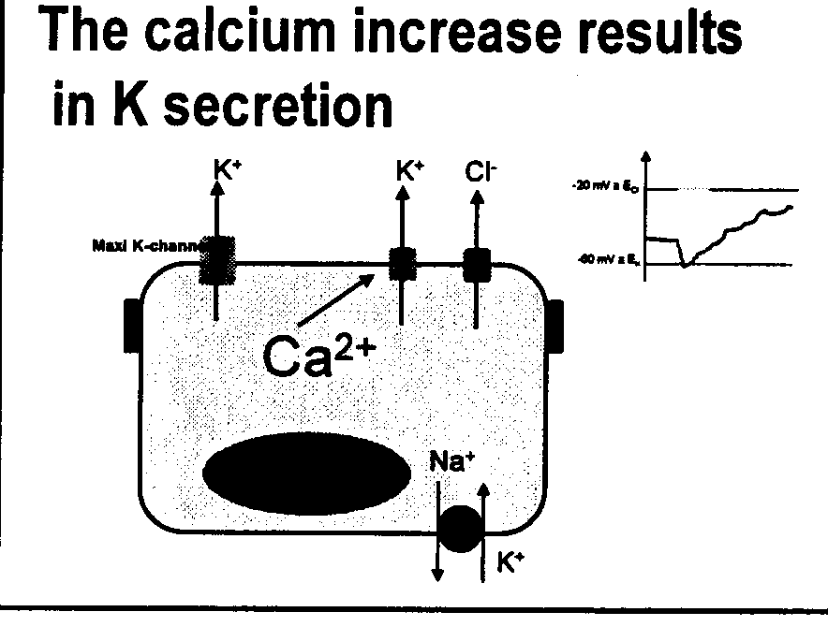
The calcium increases results in K secretion

Slide 26
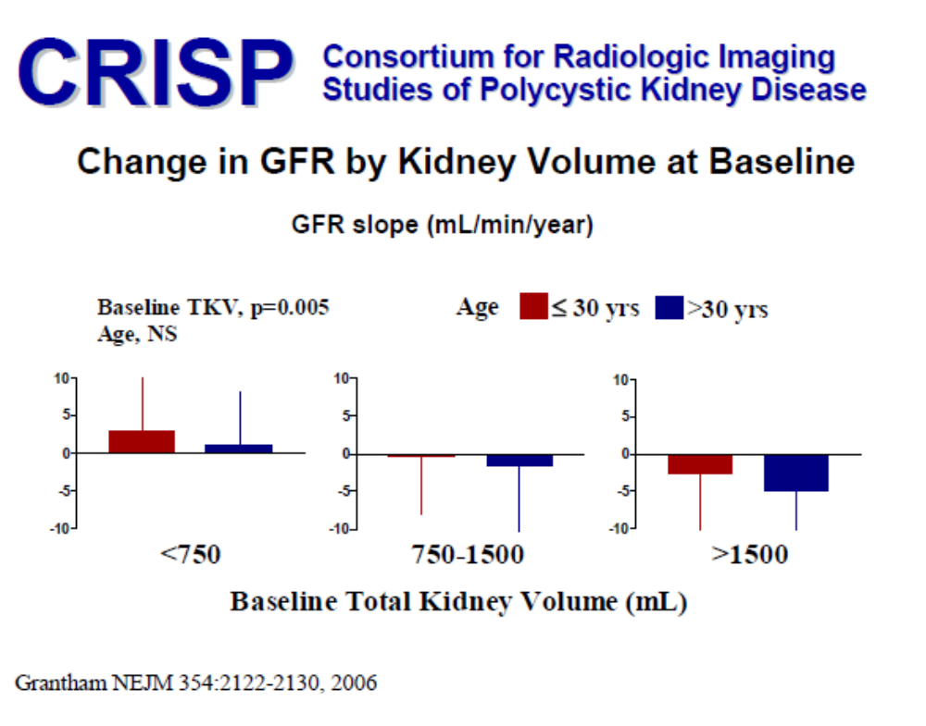

Slide 27
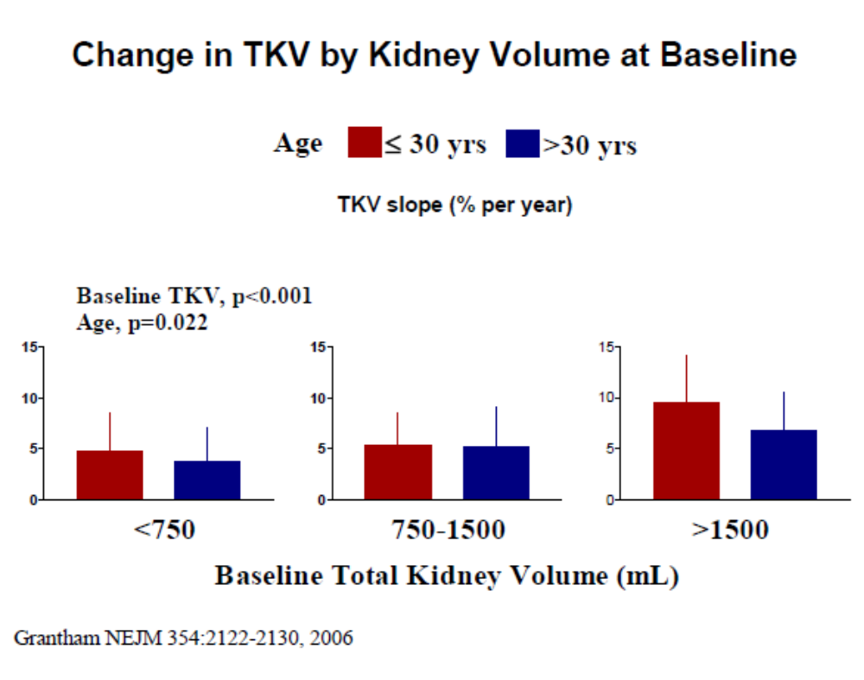

Slide 28
Volume as an Endpoint in ADPKD
Cysts are the disease, volume equals severity
Cyst growth is distinctive and measurable
Cyst volume strongly linked to functional decline
Height-adjusted (htTKV) at baseline of 600 cm³/m or > predicts the risk of developing Stage III CKD and beyond within 8 yrs of F/U. Most sensitive marker for progression.

Slide 29
Cysts are the Disease
Interference with primary cilia formation or its resident PC1/PC2 complex leads to the formation of cysts.
High cystic burden destroys normal parenchyma and ultimately results in ESRD for majority of patients
Goal is to target cyst growth before it disconnects from parent nephron. Prevent initial proliferative phase stemming from cilial defects

Slide 30
Monitoring Disease Progression
GFR is not informative: htTKV, combined with age & kidney function, will identify individuals at high risk for progression to later stages CKD/ESRD.
htTKV (TKV divided by height in meters)– T2 weighted MRI (ellipsoid equation) accurate assessment of cyst burden and associates with pain, HTN, gross hematuria, proteinuria.
Rate of TKV increase is exponential and highly variable – each patient defines his/her own course of progression.
-- average rate of TKV increase in adults is 5 -6%/year

Slide 31
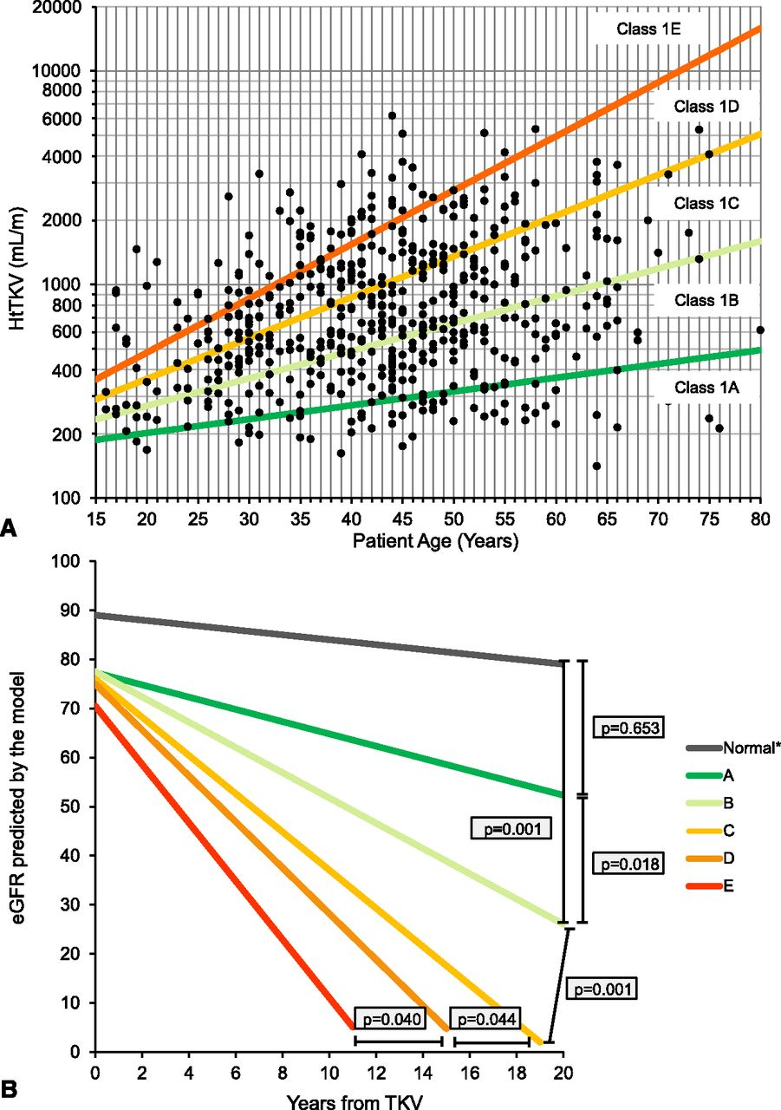

Classification by HtTKV0 and age at HtTKV0 predicts the change in eGFR over time in class 1 patients.
Irazabal M V et al. JASN 2015;26:160-172
©2015 by American Society of Nephrology
Notes:
Classification by HtTKV0 and age at HtTKV0 predicts the change in eGFR over time in class 1 patients. (A) Subclassification of patients with class 1 ADPKD at baseline based on HtTKV limits for their age. Limits are defined based on estimated kidney growth rates of 1.5%, 3.0%, 4.5%, and 6.0%. (B) Slopes for men based on the model presented in Table 5. As a reference, the average eGFR at baseline (75 ml/min per 1.73 m²) and the average age at baseline (44 years) for all class 1 patients were used for the model. Estimated slopes (ml/min per 1.73 m² per year) by subclass (A–E) are −0.23,−1.33, −2.63, −3.48, and −4.78, respectively, for men and 0.03, −1.13, −2.43, −3.29 and −4.58, respectively, for women (not plotted). Values for normal slope (*) were obtained from a population of healthy kidney donors.¹⁶

Slide 32
Relationship between hypertension and PKD
Across all age ranges hypertension is noted when TKV is ~ 1000 mL.
htTKV = volume relative to height
(~6 mL/cm height)

Slide 33
Hypertension in PKD
LV mass reduced more when BP <120/80 as compared to < 140/90
Healthy life style helps: Na+ restriction to <2g/day, active exercise
- ADPKD pts are Na+ overloaded and have
Na+-sensitive HTN
- In CRISP Study association between
higher Na+ intake and increased TKV
* Upregulation of RAAS in ADPKD

Slide 34
Vitamin D Deficiency & Renal Volume in ADPKD
Vitamin D insufficiency (<30 ng/ml) associated with larger kidney volumes in ADPKD population with normal renal function as compared to normal values.
Adjusted for gender, height, hypertension and season.
?? Unknown if correction will significantly impact kidney function
Gitomer for the HALT PKD Study Investigators , ASN Abstracts 2010

Slide 35
Progressive Loss of Kidney Function
Rate of decline of GFR (data from MDRD study, starting at GFR <55 ml/min)
  Males 5 - 6 ml/min/year
  Females 4 - 5 ml/min/year
Pattern of GFR loss has recently been established by CRISP study
  GFR stable for many years, despite progressive increase in total kidney volume
  GFR decrease not detected until total kidney volume exceeds 1500 ml

Slide 36
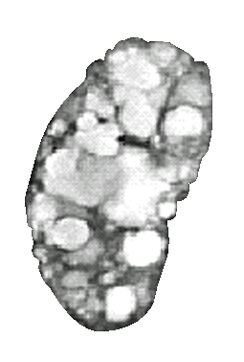
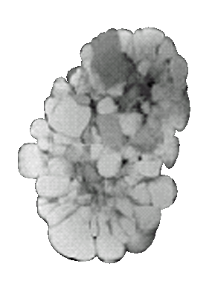
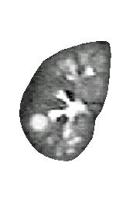
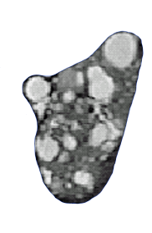
Loss of Kidney Function in ADPKD
100
80
60
Renal function (%)
40
20
0
0
10
20
30
40
50
60
Age (years)
Torres Mayo <aupCP1047707-9
Notes:
Rasters CP1047707 8a.jpg, 8b.jpg, 8c.jpg, 8d.jpg

Slide 37
Predictors of Disease Progression (MR)
Hemodynamic
RBF
RVR
GFR
Anatomic
Ht Total kidney volume
Total cyst volume
% cyst volume
CRISP and HALT PKD Studies, KI 2003; 64:2214-2221

Slide 38
PROPKD Score: Predict Renal Survival in ADPKD
Characteristics
Male
HTN<35 yo
1st urologic event<35 yo
  Hematuria, Pain, Cyst Infection
Mutation
  Truncating PKD 1
  Non-Truncating PKD 1
  PKD 2
Points
1
2
2
4
2
0
Risk Category Points (ESRD)
yr
Low: 0-3 (71)
Intermed: 4-6 (57)
High: 7-9 (49)
JASN 27: 942-951, 2016

Slide 39
ADPKD Progression: FHx & Mutation
Group FHx Mutation %⬆ TKV/yr
1A + PKD 1 or 2 5.82
1B _+ NMD 4.65
2A - PKD 1or 2 6.0
2B - NMD 3.3
Braun and HALT PKD Steering Cmte
1B

Slide 40
RBF & GFR
Reduction in RBF precedes decline in GFR and predicts progression.
RBF adds to the predictive value of TKV on rate of GFR decline since it reflects ischemic damage.
Torres for the JHALT PKD Study Investigators, ASN Abstract 2011

Slide 41
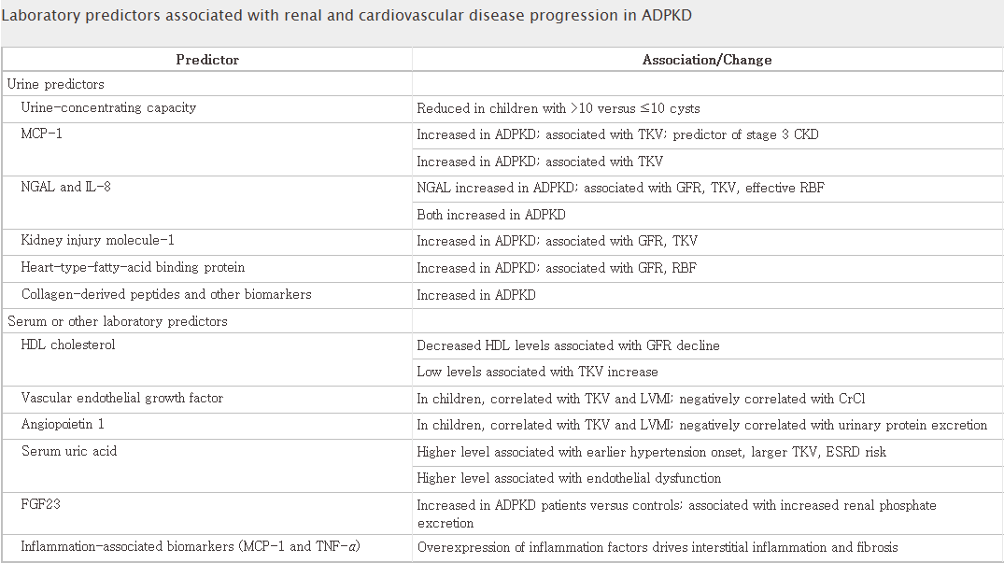
JASN November 2014 vol. 25 no. 11 2399-2418

Slide 42
Positive Correlation with Cyst Growth and PKD Progression
Increased U_{NaV}
Lower serum HDL-cholesterol
Higher 24-h urine osmolality
Younger age at baseline
T. Steinman Curr Opin Nephrol Hypertens 21:189-194, 2012

Slide 43
HALT PKD Study
Dietary Salt & Progression
Urinary Na+ excretion (UNaE) assoc with TKV increase and GFR decline.
For each 100mEq UNaE increase:
Study A: TKV ⬆ +2.4%/yr
GFR ⬇ -0.37 ml/min/yr
Study B: HR 1.56 decrease eGFR
increase in ESRD & death
Torres & HALT PKD Study Steering Cmte.

Slide 44
Proteinuria in ADPKD
>300 mg/24 hrs occurs in ~ 25% of patients.
Associated with:
- large kidney volume
- faster decline of renal function
- earlier onset of ESRD
If nephrotic range proteinuria noted, look for another cause.

Slide 45
Principal Extrarenal Manifestations
Hepatic and pancreatic cysts
Asymptomatic in many patients, but can expand and cause pain and infection; rarely massive PLD
Cardiac valvular abnormalities
Mitral, tricuspid and aortic valve prolapse and regurgitation
Intracranial aneurysms (see below)
Seminal vesicle cysts
Found in ~39-60% of men; undefined risk of infertility

Slide 46
Nephrolithiasis in ADPKD
Occurs in ~20-36% of patients
Uric acid (UA) (~50%); Ca Ox (~47%)
Predisposing factors include hypocitraturia, hyperoxaluria, hypercalciuria, hypomagnesuria, possible distal acidification defects
S_{UA} and renal urate handling normal
Expanding cysts compress the collecting system producing urinary stasis, which predisposes to stone formation and infection
Steinman & Garg, Nova Science Publ. 2015

Slide 47
Patient Characteristics in Stone Formers
Older
Higher incidence of hypertension
Hepatic cysts
Impairment in submaximal Uosm
History/Presence of UTIs
Low urine volume
LOW URINE pH (major factor)

Slide 48
ADDITIONAL FACTORS in Stone Formation
Activation of RAAS occurs early in ADPKD
Type A acid secreting intercalated cells (OMCD) express Type Ι angiotensin receptors (AT₁R)
AΙΙ stimulates vacuolar H⁺-ATPase activity in intercalated cells

Slide 49
Hypothesis
In ADPKD upregulation of AΙΙ renal expression results in stimulation of H⁺ into CD lumen
Failure to adequately buffer increased H⁺ results in urine acidification (UA stone risk)
?Will Rx with ACEI &/or ARBs increase urinary pH (if <5.5) by downregulating H⁺-ATPase, with subsequent reduction in uric acid stone formation.
Pech et al JASN 19:84-91, 2008

Slide 50
Treatment of Nephrolithiasis in ADPKD
With high incidence of hypocitraturia, K
citrate might be useful to prevent uric acid
stones and reduce calcium oxalate super
saturation.
Alkalinization of urine

Slide 51
Hematuria in ADPKD
Cyst hemorrhage occurs in ~60% of individuals
  gross or microscopic hematuria if cyst connects to collecting system
  intracyst or subcapsular hemorrhage without hematuria
  Correlation with increased TKV
Excessive angiogenesis results in fragile blood vessels stretched across walls of enlarging cysts; susceptible to minor trauma with resultant hemorrhage
Early onset of recurrent gross hematuria correlates with kidney size and more rapid progression to kidney failure

Slide 52
Treatment of Hematuria in ADPKD
Appropriate diagnosis and treatment of specific entity, such as infection or stone
Correction of coagulopathy, if present
Conservative management with hydration, bed rest, and appropriate use of analgesics
Rarely, massive bleeding may require transfusion, kidney embolization (TAE) or nephrectomy

Slide 53
Management of Intractable Gross Hematuria
23% of patients with gross hematuria experience >6 occurrences
Risk Factors: hypertension and increased renal size
Medication approach before invasive Rx
Epsilon amino caproic acid (EACA)
Aprotinin
DDVAP – 0.3 mcg/kg x 3 daily doses.
Shan and Steinman, 2011

Slide 54
Kidney Infection in ADPKD
30 to 50% of patients with ADPKD will have a urinary tract infection, either pyelonephritis or cyst infection, during their lifetime
Urinary tract infections are more common in women with ADPKD
Fever and flank pain are the presenting symptoms
Urine culture may be negative in cyst infection, as cysts frequently don’t communicate with the collecting system

Slide 55
Evaluation of Infection
FDG PET-CT (positron emission tomography) scan is most useful in detecting and locating infected cysts (detects degree of inflammation).
Sensitivity and specificity of PET-CT imaging in diagnosis of cyst infection was 86.7% and 100%, respectively.
Jouret, et al. ASN Abstracts 2010

Slide 56
Treatment of Kidney Cyst Infection in ADPKD
Lipophilic antibiotics such as ciprofloxacin, norfloxacin, trimethoprim, chloramphenicol
Percutaneous or operative drainage is rarely needed; only for refractory infection
Resistant organisms
Localization of infected cyst is difficult
  Labeled WBC or gallium scan
  MRI with contrast
  PET scan

Slide 57
Sleep –Disordered Breathing in Symptomatic ADPKD
Highly prevalent
Independently associated with higher htTLKV
CJASN 10: 949,2015

Slide 58
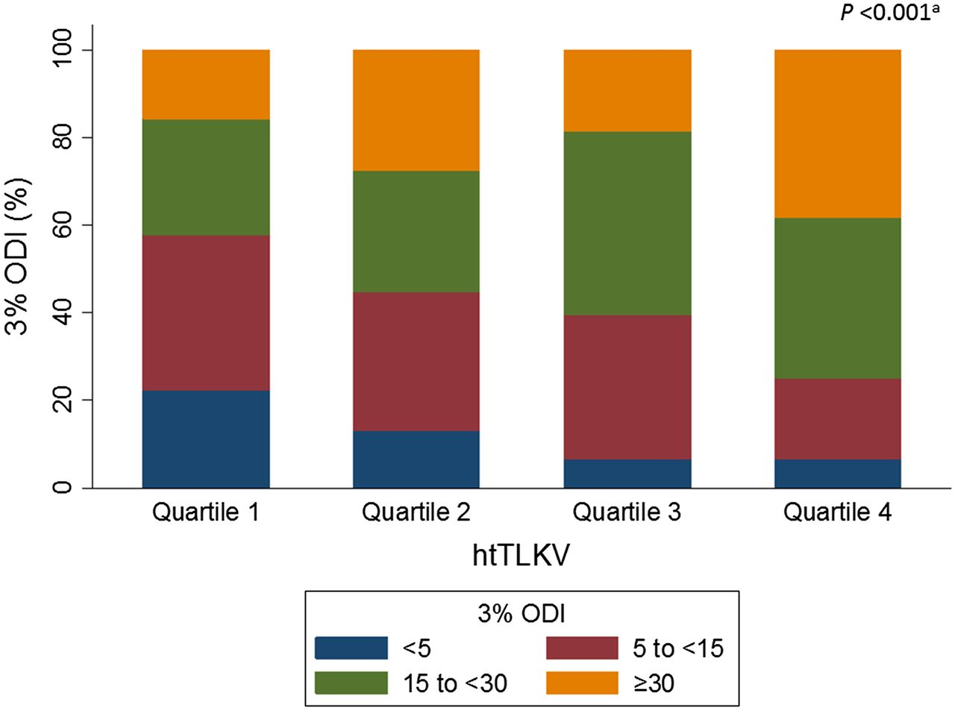

Sleep-Disordered Breathing in PKD
Keiichi Sumida et al. CJASN 2015;10:949-956
©2015 by American Society of Nephrology

Slide 59
Pain in ADPKD
Occurs in about 60% of the PKD population
While pain more noted in those with htTKV >1000 ml, there is a weak correlation between kidney size and pain (especially if eGFR > 60)
With eGFR 20-44, pts reported that pain impacted their daily lives (lower SF-36 scores)

Slide 60
Liver Cysts: Sx & Infection
With marked hepatomegaly:
-- heaviness, dull ache
-- mechanical low back pain
-- early satiety
If fever persists 1-2 wks after antibiotics in infected cysts, drainage frequently needed
Hepatic cyst infection more serious than renal cyst infection. Do not delay drainage.

Slide 61
Carbohydrate Antigen (CA) 19-9: Marker for Hepatic Cyst Infection
CA 19-9 secreted by biliary epithelium lining hepatic cysts and overproduction in hepatic cyst infection
Immunostaining for CA 19-9 showed strong positivity in biliary tree epithelia and in liver cysts.
Rise (active infection) / fall (improvement)
Kanaan et al AJKD March, 2010

Slide 62
Octreotide LAR Rx for PLD
Over 2 years OctLAR (somatostatin analogue): significant reduced rate of TLV (-4-6% with Rx v. +1.6% in placebo) and ?TKV increase - decrease in cAMP in the biliary epithelial cells
OctLAR improved health perception and had an acceptable side effect profile in patients with PLD : females < 48 yrs did better than males
Side effects: diarrhea, nausea, hyerglycemia, cholelithiasis
Liver cyst volume increases when drug D.C.
Hogan, et al. ASN Abstracts 2010
ALADIN Study

Slide 63
Lanreotide in ADPKD
Among patients with later stage ADPKD (GFR 30-60 ml/min/1.73 m2), Rx with this somatostatin analogue x 2.5 yrs f/u did not slow the rate of decline in kidney function, but reduced TKV and TLV.
VanDents RMM, et al Gastroenterol 2019

Slide 64
Screening for cerebral aneurysm
Polycystin expression in VSMC and endothelium vascular malformation.
Aneurysm development not related to hypertension in ADPKD, but uncontrolled BP can accelerate the process
Qian, et al. JASN 2280, 2003

Slide 65
Aneurysm (ICA) Formation in ADPKD
Incidence
General Population
2-3 %
16.0 % *
* 2 first degree relatives with ICA, smoking history, hypertension
ADPKD
~ 8-9 % ¤
20-29% ≠
¤ only 3% risk of ICA rupture
≠ With family history of ICA/SAH
84% of aneurysms in anterior circulation
16% of aneurysms in posterior circulation (greater risk of rupture)
Torres 2009

Slide 66
Risk of ICA Rupture in ADPKD
%Yr
1.1
2.2
2.8
Aneurysm Size
2-6 mm *
7-9 mm
10-26 mm
*20% rupture w ICA <5mm
30% rupture 5-9 mm
0.05% per year < 10 mm. No personal or family history of SAH
0.5% per year < 10 mm. With personal or family history of SAH
No Hx SAH
0
Hx SAH
1.5% per year
Betz KI 63: 2003
Gibbs KI 64: 2004

Slide 67
Risk Factors for ICA Rupture
Most aneurysms have a very low risk of rupture and occurs without a family history. Risk: rapid growth of small ICA rupture &/or
2 PKD relatives with SAH (RR = 2.15)
F > M and ICA > 8 mm
Pack years of smoking
Hypertension > 10 years
In PKD average age of rupture is ~40 years, about 10 years earlier than general population. 40-60% mortality rate w rupture
Torres 2009

Slide 68
ICA Hemorrhage In ESRD
Risk increased with adjusted hazard ratio of 1.63 v. non-ADPKD pts.
Risk not manifest until ~ 3 years after starting dialysis

Slide 69
Recommendations for ICA Screening
Family history of ICA, documented aneurysmal rupture (SAH)
Personal history of SAH
Prior to major elective surgery ?(transplant)
High risk occupation –loss of consciousness a threat to others (i.e., airline pilots, bus drivers, crane operators)
Need for reassurance ? Screening at age 30 would result in a gain of QALY only if 5 yr rupture rate >8.5% (far > than actual rate)

Slide 70
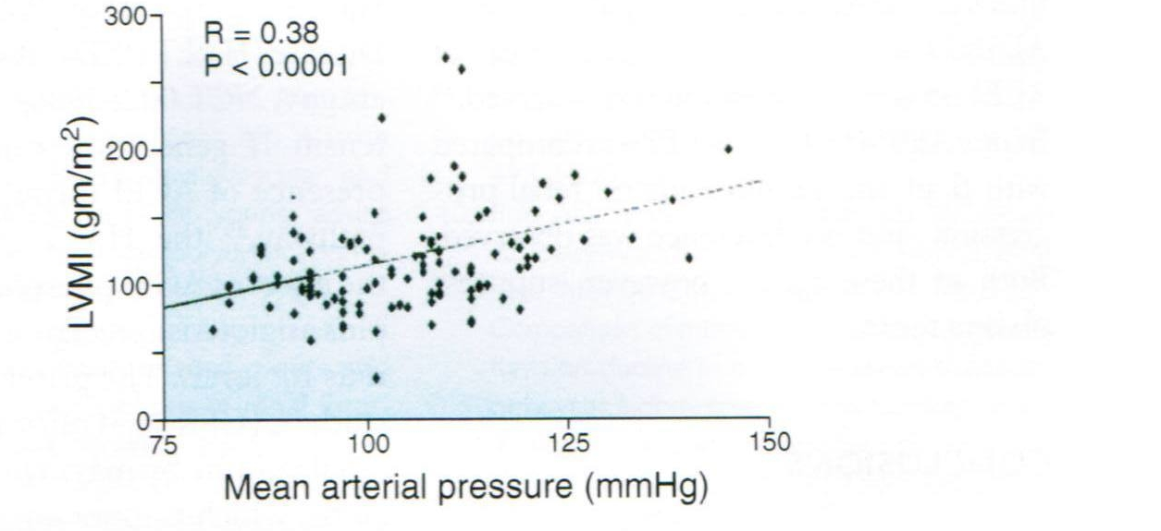
Correlation between BP and LVMI in PKD
Schrier JASN 20:1888-1893, 2009

Slide 71
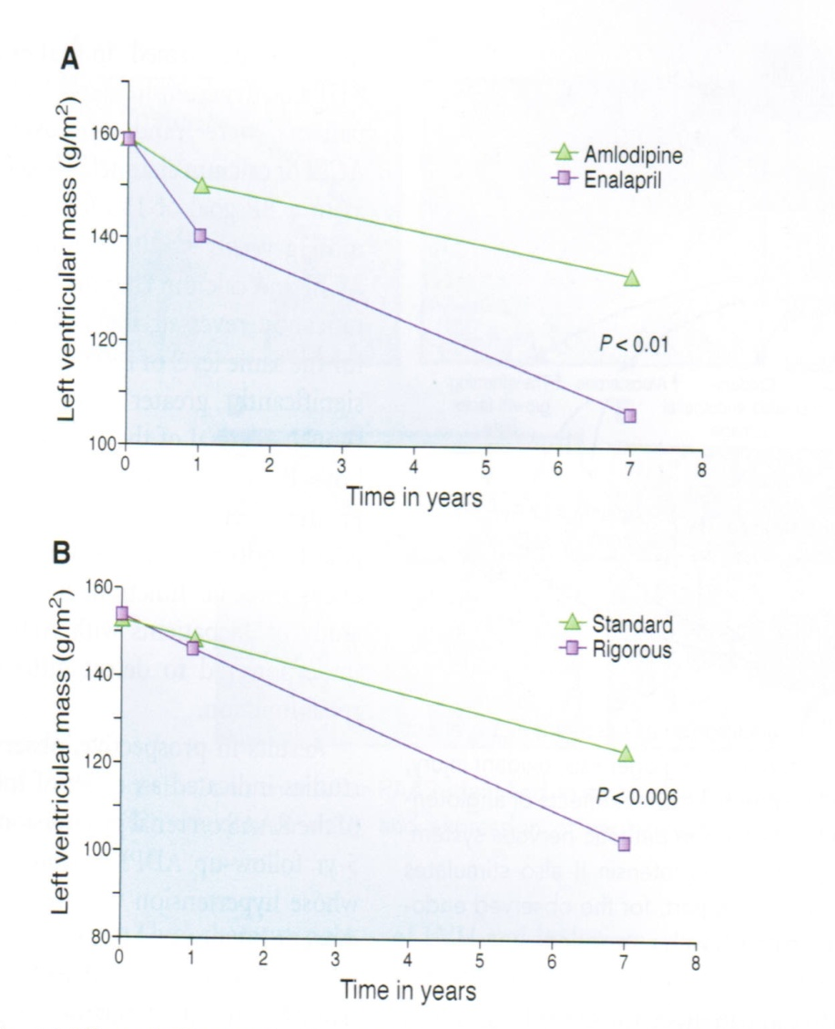
(A) Effect of BP control with amlodipine versus enalapril on LVMI in patients with ADPKD over 7 yr.
Effect of rigorous versus standard BP control on LVMI in patients with ADPKD over 7 yr
Schrier JASN 20:1888-1893, 2009

Slide 72
HALT-PKD
(Halt Progression of Autosomal Dominant Polycystic Kidney Disease)
Objective: Two concurrent, randomized, double-blinded controlled trials to assess the effects of multi-level blockade of the renin-angiotensin-aldosterone system (RAAS) and aggressive blood pressure control on progression of early (NKF Stage 1-2) and late (NKF Stage 3) ADPKD over a 5-year period
Hypotheses:
1) Blockade of RAAS will significantly reduce renal progression as compared to other antihypertensive therapy
2) Lower blood pressure will significantly reduce renal progression as compared to standard BP targets

Slide 73
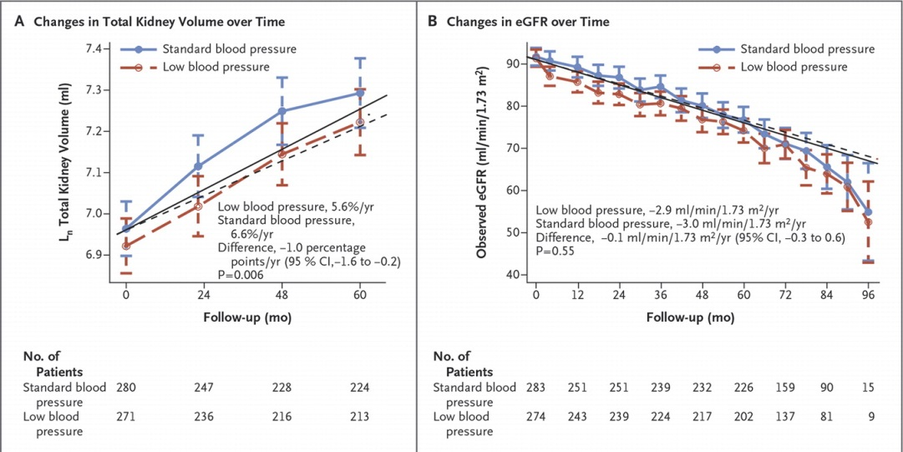

Schrier RW et al. N Engl J Med 2014;371:2255-2266.
Changes in Total Kidney Volume and Estimated Glomerular Filtration Rate (eGFR) during Follow-up and Subgroup Analyses, According to Blood-Pressure Group.
Notes:
Figure 2. Changes in Total Kidney Volume and Estimated Glomerular Filtration Rate (eGFR) during Follow-up and Subgroup Analyses, According to Blood-Pressure Group. The logarithm-transformed total kidney volume (Panel A) and eGFR (Panel B) over time according to blood-pressure group and prespecified subgroup analyses (Panel C) are presented. In Panels A and B, symbols represent means, and I bars 95% confidence intervals (CI); the solid lines (standard blood pressure) and dashed lines (low blood pressure) represent model-based trajectories. In Panel C, the absolute treatment effect is the between-group difference in the annual slope. P values associated with overall subgroups correspond to interactions of subgroup by month by study group; all other P values correspond to interactions of month by study group within a particular subgroup. The slope estimates for the total kidney volume were based on linear mixed-effects models with natural log transformations on the outcome and were converted to the annual percentage change. Follow-up time ranged from 5 to 8 years.

Slide 74
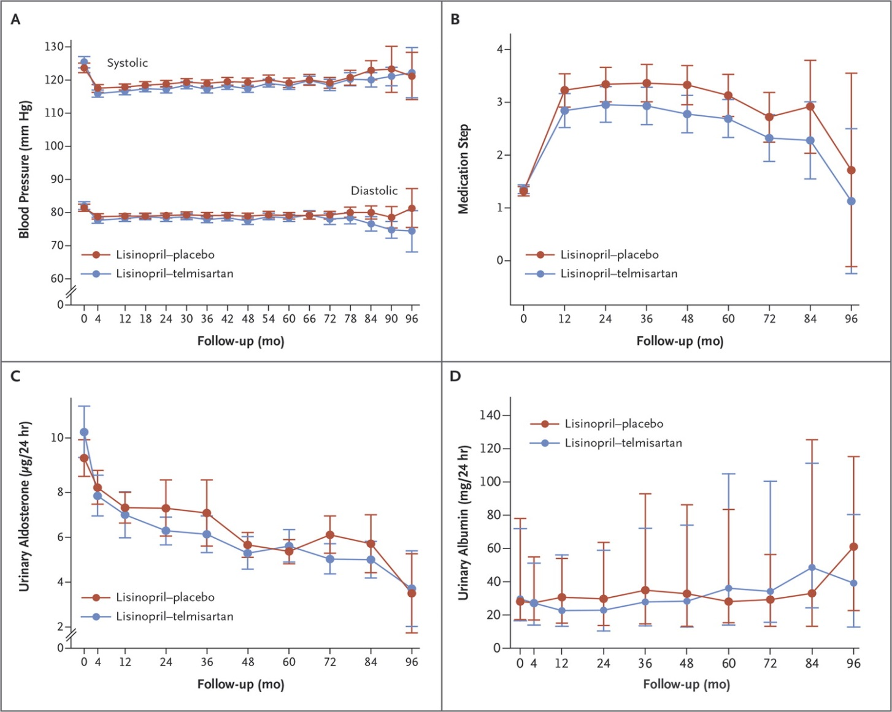
Torres VE et al. N Engl J Med 2014;371:2267-2276.
Blood-Pressure Levels, Medication Steps, and Urinary Aldosterone and Albumin Excretion.
Notes:
Figure 2. Blood-Pressure Levels, Medication Steps, and Urinary Aldosterone and Albumin Excretion. The graphs show the mean systolic and diastolic blood pressures (Panel A), steps in the medication-dose adjustments (Panel B, and Table S1 in the Supplementary Appendix), urinary aldosterone excretion (Panel C), and median urinary albumin excretion (Panel D) in participants treated with lisinopril–telmisartan and those who received lisinopril–placebo. I bars indicate 95% confidence intervals (Panels A, B, and C) or interquartile ranges (Panel D).

Slide 75
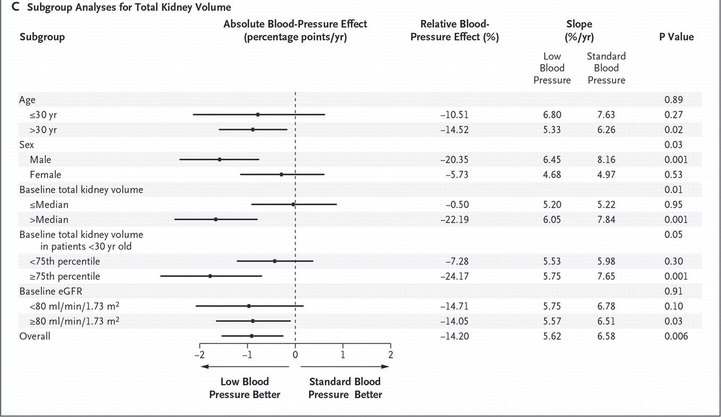
Schrier RW et al. N Engl J Med 2014;371:2255-2266.
Changes in Total Kidney Volume and Estimated Glomerular Filtration Rate (eGFR) during Follow-up and Subgroup Analyses, According to Blood-Pressure Group.
Notes:
Figure 2. Changes in Total Kidney Volume and Estimated Glomerular Filtration Rate (eGFR) during Follow-up and Subgroup Analyses, According to Blood-Pressure Group. The logarithm-transformed total kidney volume (Panel A) and eGFR (Panel B) over time according to blood-pressure group and prespecified subgroup analyses (Panel C) are presented. In Panels A and B, symbols represent means, and I bars 95% confidence intervals (CI); the solid lines (standard blood pressure) and dashed lines (low blood pressure) represent model-based trajectories. In Panel C, the absolute treatment effect is the between-group difference in the annual slope. P values associated with overall subgroups correspond to interactions of subgroup by month by study group; all other P values correspond to interactions of month by study group within a particular subgroup. The slope estimates for the total kidney volume were based on linear mixed-effects models with natural log transformations on the outcome and were converted to the annual percentage change. Follow-up time ranged from 5 to 8 years.

Slide 76
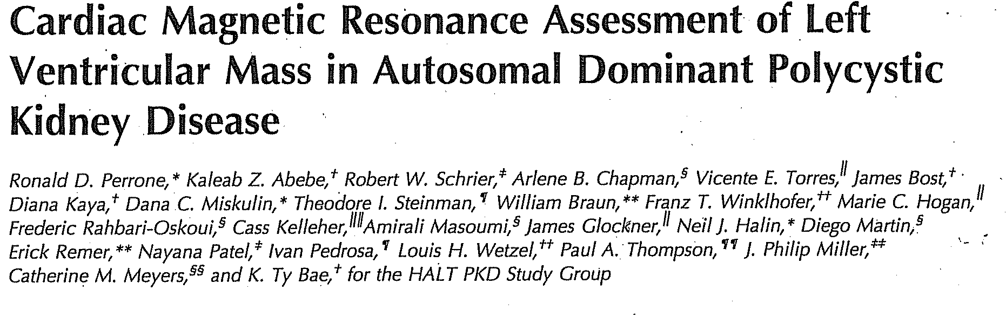
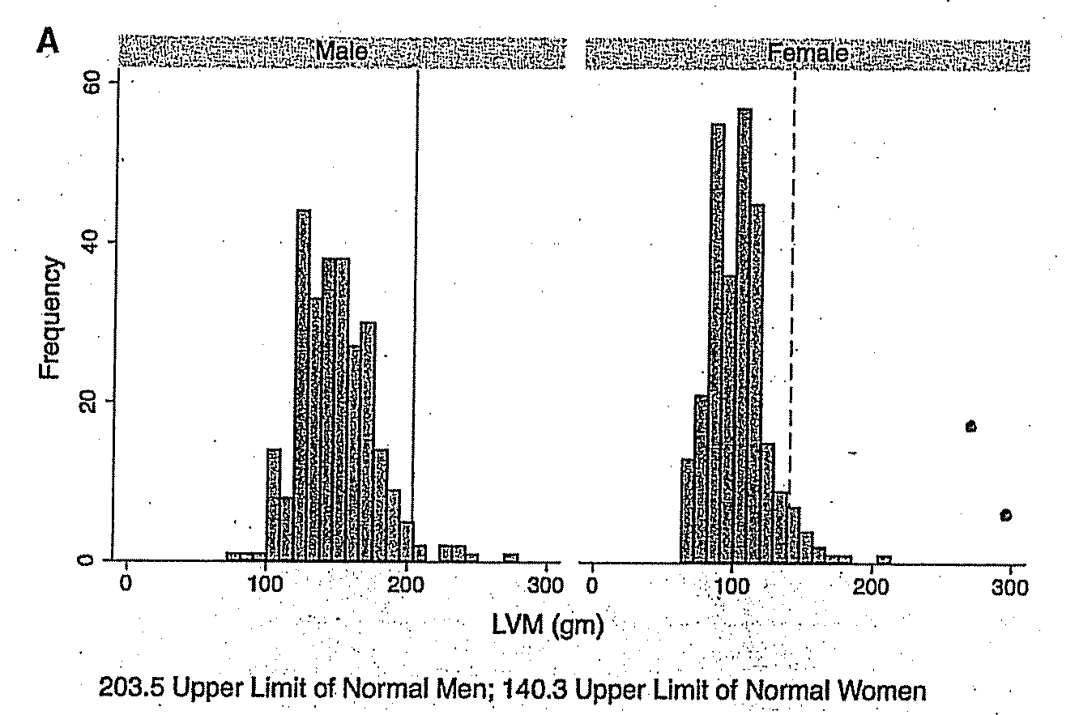
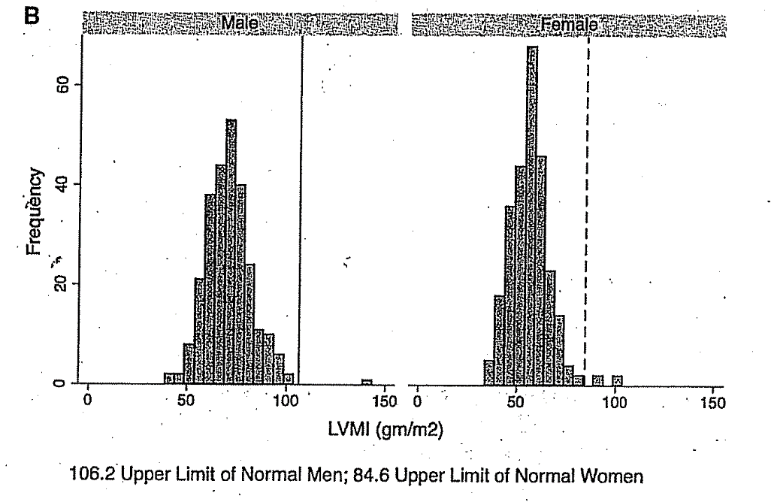
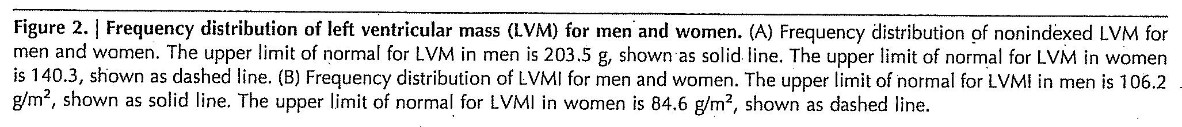

Slide 77
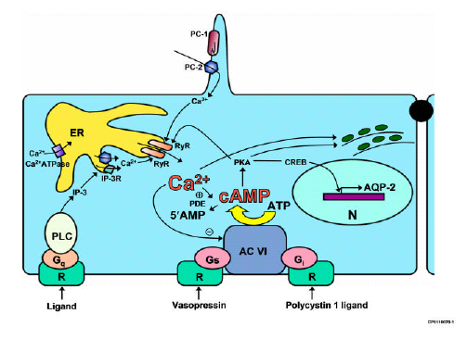
Tolvaptan

Slide 78
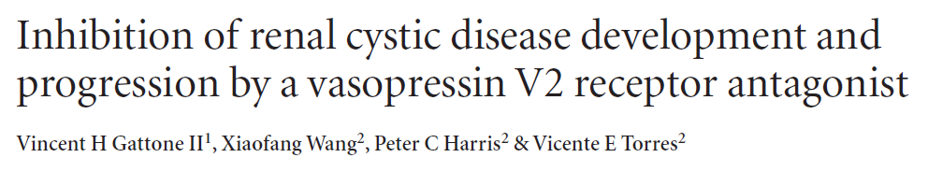
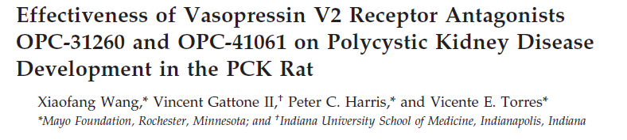
V2 receptors antagonists inhibit cystogenesis in animal models of autosomal recessive PKD and nephronophthisis
Nature Medicine 2003; 9 (10): 1323-1326
J Am Soc Nephrol 2005; 16: 846-851
Notes:
Animal models of ARPKD (PCK rat) and nephronophthisis (pcy mouse)

Slide 79
Vasopressin and ADPKD
Direct correlation between higher vasopressin level and decline in kidney function
V2RA (Tolvaptan) appears to be renoprotective at the expense of physiologic side effects – for PKD1, but not PKD2 mutation
Intervene early (higher benefit) – slows cyst growth (decreased fluid secretion), but eGFR stable over 3 yrs
On withdrawal, TKV growth resumes at expected rates.
Torres, et al TEMPO Trial NEJM 2012; 367:1930-1942

Slide 80
Results of TEMPO Trial
Tolvaptan Placebo
I yr: eGFR -2.34 -3.61 ml/min
1.27 ml/min/1.73 m² not clinically significant:
>55 years of age
Non-white
Stage 2 CKD

Slide 81
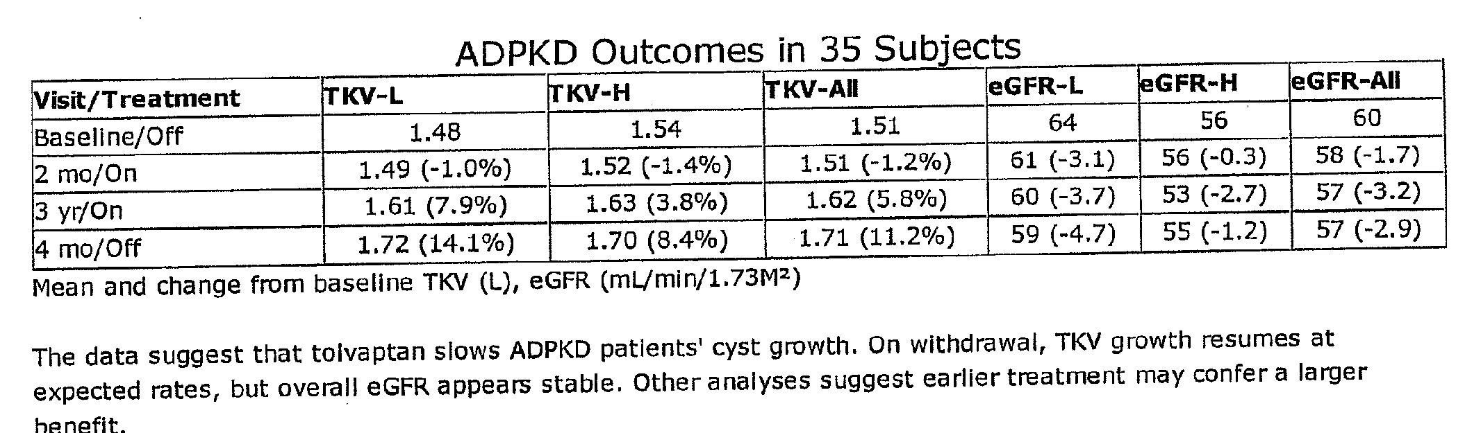
TKV & GFR – 3Yrs of Tolvaptan

Slide 82
TEMPO & REPRISE Trials
For younger cohort, potentially extend time to ESRD: 6.2 to 9 years. Renal function stable w 2 yrs. Rx
SAE higher in Tolvaptan group:
* 12.5% vs 8.8% overall
* Liver-related events – 10.9% vs 5.3 %
* DC rates – 9.5% vs 2.2%
Health Related QoL – long tem use ; adaptation to aquaresis
Significant Limitation: continuous eGFR outcome (less precise vs hard outcome such as 50% decline in eGFR or ESRD) .
Reprise Trial. NEJM 2017;377:1930-1942

Slide 83
Tolvaptan (TLV)
increasing dose of TLV appears to suppress decline in kidney function over 3 yrs, irrespective of effect on TKV.
TLV appears safe in pts >50 yo with Stage 3b-4
CKD, but caution w GFR <30 cc/min
Rx Emergent Adverse Effects (TEAE)
- ~90% had TEAE, but only 17% SAE (5-6% discontinued med)
- Liver toxicity: 1st 18 mos. greatest susceptibility. Longer exposure, less DC due to AE

Slide 84
Side Effects of Tolvaptan
TEMPO REPRISE
Thirst 23% 32%
Polyuria 20% 32%
Nocturia (>3) 15% 22%
Hypertension 17%
Renal pain 20%
Nasophayngitis 15%

Slide 85
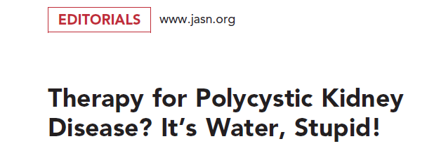
J Am Soc Nephrol 2008; 19: 1-2
Notes:
So all of these basic science data provided the rationale for a therapeutic approach for PKD using V2 antagonists

Slide 86
Water in Treatment in PKD
Tubule cell proliferation – Transepithelial fluid secretion
cAMP stimulates growth
Enlarging Renal cysts
V2 receptor
AVP (ADH)
Renal dysfunction
Blocking action of AVP dramatically ameliorates the disease process
Torres, Bankir, Grantham CJASN: 4: 1140-1150, 2009

Slide 87
Brattleboro Rat & PKD Rat
Brattleboro rat deficient in vasopressin (model for central DI)
Crossing the 2 strains – no cysts develop in offspring
Add Arginine Vasopressin (AVP) results in cysts developing in offspring

Slide 88
Additional Treatment
RCT with HMG-CoA Reductase Inhibition (Pravastatin) in children with ADPKD slowed TKV and reduced loss of kidney function.
Small 2 yr adult study (49 pts) showed no significant differences in rate of eGFR decline or level of proteinuria between active Rx v. placebo.

Slide 89
Management Issues
Avoid drugs that stimulate release of Vasopressin or potentiate its action
- SSRI
- TCA
* Caffeine (a methylxanthine) increases intracelluar cAMP (in cultured ADPKD renal epithelial cells), BUT NO association between caffeine intake and TKV within the range of “routine” caffeine intake.

Slide 90
Tyrosine Kinase Inhibitors
Tesevatinib (a multi-targted TKI)
- Annual ⬆ TKV in a Phase 2 study (3 yrs)
* Rx cohort: 2-3% increase in TKV
* Control: 7-10% increase in TKV
- Better preservation of eGFR.
Now in Phase 3 study.
Kadmon Corp. Investigators

Slide 91
Safety in Larger Kidneys (SILK)
Tesvatinib (50 mg/day) – Phase 2 Study.
GFR decline after 2 yrs.
RX Control
6.6% 13.8%

Slide 92
Metformin
An activator of AMP-activated protein kinase (AMPK), thereby inhibiting both CFTR and the mTOR pathways.
Significant arrest of cystic growth both in-vitro and ex vivo models of renal cystogenesis.
V. Takiar, et al. Proc Natl Acad Sci 108: 2462-2467, 2011

Slide 93
Sirolimus
Sirolimus had no effect on changes in kidney and cyst volume or eGFR. A negative study except for showing side effects of sirolimus (apthous stomatitis).
Repeat study showed Sirolimus was unsafe and ineffective in ADPKD. MTOR inhibitor therapy may be contraindicated in this context.
Serra et al, NEJM June 26, 2010
Ruggenenti et al. CJASN 11: 785-794, 2016

Slide 94
Pathogenic Process in PKD
1. Increased circulating ROS markers
2. Inflammatory markers elevated – contributes to vascular remodeling.
Hence, a new approach to Rx - Bardoxolone

Slide 95
Bardoxolone Methyl
Activator of erythroid-derived 2-related nuclear factor (Nrf2) – this transcription factor induces molecular pathways.
Promotes restoration of mitochondrial function (decreased in PKD) and thus reduction of oxidative stress. Inhibition of pro-inflammatory signaling
PHOENIX study – eGFR increase of 9.3 ml/min over 12 weeks with Rx.
Now 3yr FALCON Study in GFR 30-90 cc/min

Slide 96
Bardoxolone in PKD
Activation of Keap 1/Nrf2 pathway increases GFR by increasing glomerular effective filtration area without affecting afferent/efferent arteriole ratio.
Keap 1/Nrf2 pathway regulates cyto-protective/anti-inflammatory/antioxidant genes – also impacts GFR

Slide 97
Soluble Urokinase Plasminogen Activator Receptor (suPAR)
In ADPKD levels assoc w progressive decline in renal function and incident ESRD.
? May aid early identification of pts at high risk of disease progression.
JASN 2019, 301: 1305-1313

Slide 98
PKD1 in Urinary Exosomes
PC1 & PC2 are secreted on urinary exosome-like vesicles (ELVs)
– reduced by 54% and 53% in PKD1
Transmembrane protein 2 (TMEM2)
-- homology to fibrocystin and >2x
PC1 or 2 / TMEM2 ratio inversely correlated with htTKV
-- utility in dx and monitor course of PKD
JASN 26: 1661-1670, 2015

Slide 99
Predictors of ADPKD Progression (1)
1. PKD1 Mutation – truncating mutations
■ frameshift, nonsense splice mutations and large rearrangements
2. Male & early onset hypertension
3. Early and frequent gross hematuria
4. <24 mEq/L HCO3- had lower eGFR, higher BMI and SBP. Adjusted model: each 1 mEq/L increase in HCO3 assoc w 0.1 ml/min/1.73m2 increase in annual slope of eGFR. HCO3, but not urine NH4+, predicts renal outcomes in PKD.

Slide 100
Progression (2)
5. Women with 3 or > pregnancies (especially hypertensive women at baseline)
6. Increase in TKV (greater # of cysts)
7. Decrease in GFR and RBF
8. Proteinuria (macroalbuminuria)
9. Elevated copeptin levels
10. Mutations toward 5´ end of PKD1 assoc. with a vascular phenotype & ruptured ICA

Slide 101
Progression (3)
Race:
AA have earlier onset of ESRD than Caucasians (43.2 v. 55.4 years)
2. Those with Sickle Cell trait reached ESRD earlier than those with ADPKD alone (38 v. 48 years)

Slide 102
Progression (4)
Family History of Hypertension
HTN in the non-ADPKD parent (v. normotension) assoc with ESRD at a younger age in both males/females offspring
2. HTN in PKD parent assoc with higher frequency of HTN in affected children
* younger age at dx of HTN, independent of TKV and renal function

Slide 103
Progression (5)
Multiple UTIs - more rapid decline in renal function and antibiotic prophylaxis reduces incidence of infection and limits loss of renal function.
Dietary PO4 restriction attenuates PKD progression and renal gene expression for early markers of fibrosis in pcy/pcy mice.

Slide 104
Progression (6)
Cyst Rupture
Marker of more severe disease
2. Results in decrease in renal volume:
indicates higher baseline TKV- prognosis
more episodes of flank pain, macro- hematuria, infection and hypertension

Slide 105
Progression (7)
Overweight and obesity are predictors of progression in early ADPKD.
* increased annual % change in TKV >7%
compared to <5% with normal BMI
Obesity strongly and independently associated with greater GFR decline
JASN 2018; 29:571-578

Slide 106
Progression (8)
Aberrant expression of serum miRs occur in ADPKD pts w fast disease progression.
? Potential biomarker
Disruption of key pathways that influence scarring in pts w faster progression:
upregulated miRs 1246, 6785-5p, 323a-3p
downregulated miRs 93, 451a, 106-5p

Slide 107
Acknowledgement
All the PKD co-investigators:
Jared Grantham, Chair (deceased)
Vicente Torres, Peter Harris, Marie Hogan
Arlene Chapman, Frederick Rahbari-Oskoui
Robert Schrier, Berenice Gitomer, Godela Brosnahan,
Ronald Perrone, Dana Miskulin, Terri Watnick.
William Braun, Peter Czarnecki, KZ Abebe
Alan Yu, Franz Winklhofer, K.T Bae
Renal Fellows at BIDMC

