Slide 1

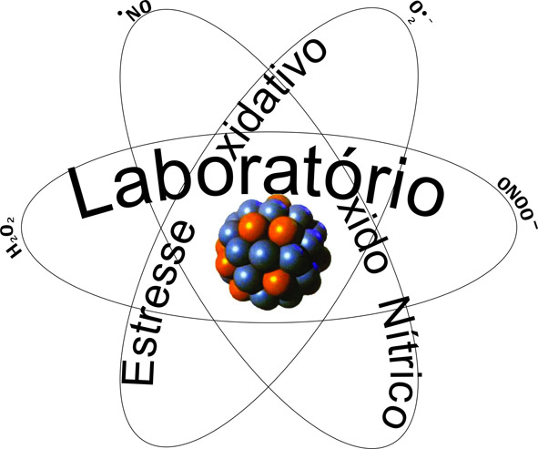
Advances in the pathophysiology and on alternative approaches to the treatment of renal diseases
Laboratory of Nitric Oxide and Oxidative Stress
Departament of Medicine
UNIFESP
ELISA MIEKO SUEMITSU HIGA, MD, PhD, Full Professor
ADELSON MARÇAL RODRIGUES, MSc, PhD
GIOVANA RITA PUNARO, MSc, PhD
DEYSE YORGOS LIMA, MSc
MARGARET GORI MOURO, MSc
Nephrology Division/ Medicine Department/ UNIVERSIDADE FEDERAL DE SÃO PAULO

Slide 2

- It will be approached aspects related to pathophysiology and treatment of diabetes mellitus (DM), with emphasis on its complications, such as diabetic nephropathy.
- DM is now considered the main cause of end-stage renal disease, leading the patient to the need for renal replacement therapy. Associated with the millions of affected individuals, it causes great losses to the public coffers.
- In our Laboratory, we developed a line of research directed to the study of the pathophysiology of DM, and in this conference, we will present some of our results on the participation of oxidative stress (OE) and associated inflammatory factors. We will also discuss aspects related to the use of antioxidants such as flavonoids, which, due to their action against EO, may be extremely useful as adjuvants in the treatment and control of the complications of this disease.

