Slide 1

WGO Global Guidelines for Management of Esophageal Varices
A Resource Sensitive Solution
Professor Aamir Ghafoor Khan

Slide 2
Introduction
Esophageal varices are porto-systemic collaterals that link the portal venous and the systemic venous circulation.
Variceal bleeding accounts for 10–30% of all cases of upper gastrointestinal bleeding.

Slide 3
Epidemiology of esophageal varices
Esophageal varices develop in patients with cirrhosis at an annual rate of 5–8%.
Approximately 4–30% of patients with small varices will develop large varices each year and will therefore be at risk of bleeding.

Slide 4
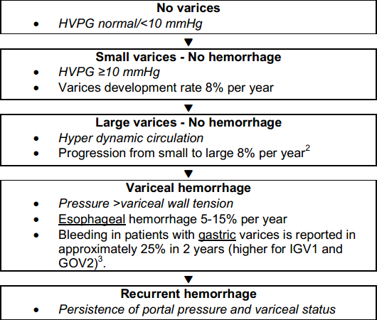
Natural history

Slide 5
Risk factors for esophageal varices and hemorrhage
Development of varices
  High portal vein pressure: HVPG >10 mmHg in patients who have no varices at initial endoscopic screening.

Slide 6
Risk factors for esophageal varices and hemorrhage
Progression from small to large varices
  Decompensated cirrhosis (Child-Pugh B/C)
  Alcoholic cirrhosis
  Presence of red wale marks at baseline endoscopy.
Notes:
Red spots?
‹#›

Slide 7
Risk factors for esophageal varices and hemorrhage
Initial variceal bleeding episode
  Large varices (>5 mm) with red color signs
  High CTP or MELD score
  Continuing alcohol consumption
  High HVPG >16 mm Hg
  Coagulopathy

Slide 8
Diagnosis
Esophagogastroduodenoscopy is the gold standard for the diagnosis of esophageal varices.
If the gold standard is not available, other possible diagnostic steps would be Doppler ultrasonography of the blood circulation (not endoscopic ultrasonography).

Slide 9
Diagnosis
Further alternatives include barium swallow of the esophagus and stomach, and portal vein angiography and manometry.
Notes:
Manometry (of what)?
‹#›

Slide 10
Guideline for diagnosing esophageal varices
A screening esophagogastroduodeno-scopy (EGD) for the diagnosis of esophageal and gastric varices is recommended when a diagnosis of cirrhosis has been made.

Slide 11

Guideline for diagnosing esophageal varices
Surveillance endoscopies are recommended on the basis of the level of cirrhosis and the presence and size of the varices

Slide 12
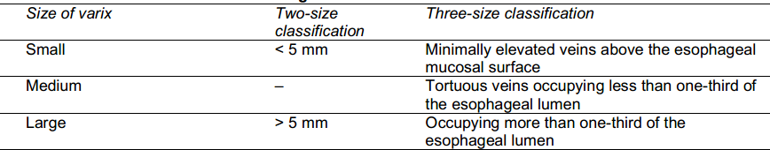
Guideline for diagnosing esophageal varices
Progression of gastrointestinal varices can be determined on the basis of their size at the time of EGD
Notes:
Changed wording
‹#›

Slide 13
Guideline for diagnosing esophageal varices
Variceal hemorrhage is diagnosed on the basis of one of the following findings on endoscopy:
  Active bleeding from a varix
  “White nipple” overlying a varix
  Clots overlying a varix
  Varices with no other potential source of bleeding

Slide 14
Differential diagnosis of esophageal varices/hemorrhage
The differential diagnosis for variceal hemorrhage includes all etiologies of (upper) gastrointestinal bleeding.
Peptic ulcers are also more frequent in cirrhotics.

Slide 15
Other considerations
Screening EGD in cirrhotic patients
  The presence of high-grade varices or red wale marks may be an indication for prophylactic banding.
  Many who undergo screening EGD do not have varices or do not require prophylactic therapy
  Expensive; requires sedation
  Can be avoided in cirrhotic patients with nonselective β-blocker treatment for arterial hypertension or other reasons .
Notes:
Red spots
‹#›

Slide 16
Other considerations
Non-invasive markers
  platelet count, FibroTest, spleen size, portal vein diameter, transient elastography
  Predictive accuracy still unsatisfactory.
β-Blocker therapy
  Cost-effective form of prophylactic therapy
  Does not prevent development or growth from small to large varices
  Has significant side effects
Notes:
FibroTest = FibroScan ?
‹#›

Slide 17
Management of varices and hemorrhage
Pharmacological therapy
  Splanchnic vasoconstrictors
    Vasopressin (analogues)
    Somatostatin (analogues)
    Non-cardioselective β-blockers

Slide 18
Management of varices and hemorrhage
Venodilators
  Nitrates
    Nitrates alone are not recommended.
    Isosorbide 5-mononitrate reduces portal pressure, but its use in cirrhotic patients is limited by its systemic vasodilatory effects.

Slide 19
Management of varices and hemorrhage
Vasoconstrictors and vasodilators
  Combination therapy leads to a synergistic effect in reducing portal pressure.
  However, these beneficial effects may be outweighed by detrimental effects on kidney function and long-term mortality.
  Routine use of combination therapy is therefore not recommended.

Slide 20
Management of varices and hemorrhage
Endoscopic therapy
  Endoscopic variceal ligation (EVL) or sclerotherapy
  Endoscopic sclerotherapy and variceal band ligation are effective in stopping bleeding in up to 90% of patients.

Slide 21
Management of varices and hemorrhage
Shunting therapy
  Surgical or radiological (Transjugular Intrahepatic Portosystemic Shunt, TIPS)
  TIPS is a good alternative when endoscopic treatment and pharmacotherapy fail.

Slide 22
Management of varices and hemorrhage
Combined endoscopic and pharmacologic treatment is shown to achieve better control of acute bleeding than endoscopic treatment alone.

Slide 23
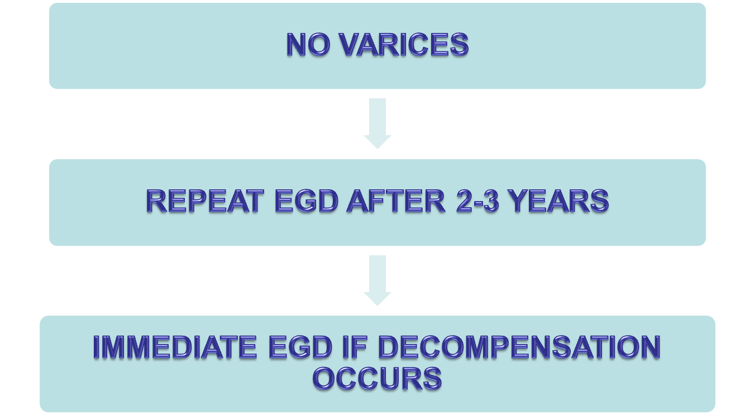
Patients with cirrhosis but no varices

Slide 24
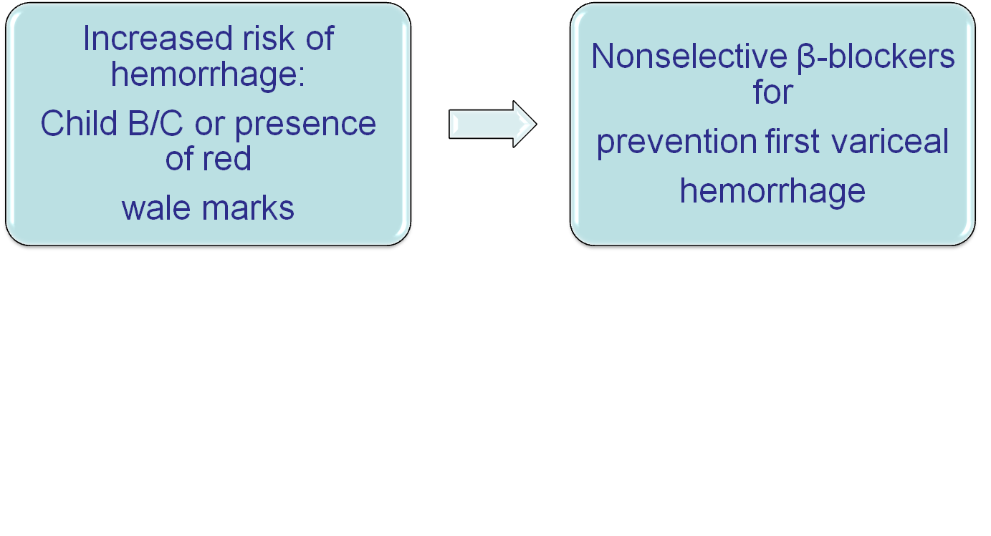
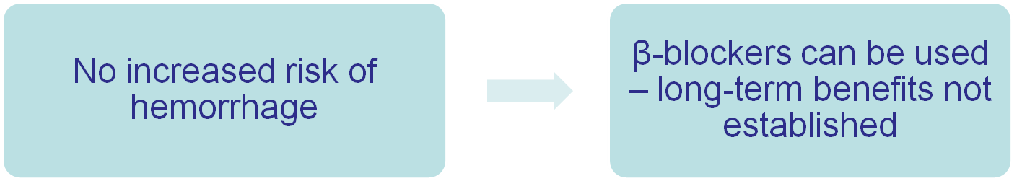
Patients with cirrhosis and small varices, but no hemorrhage

Slide 25
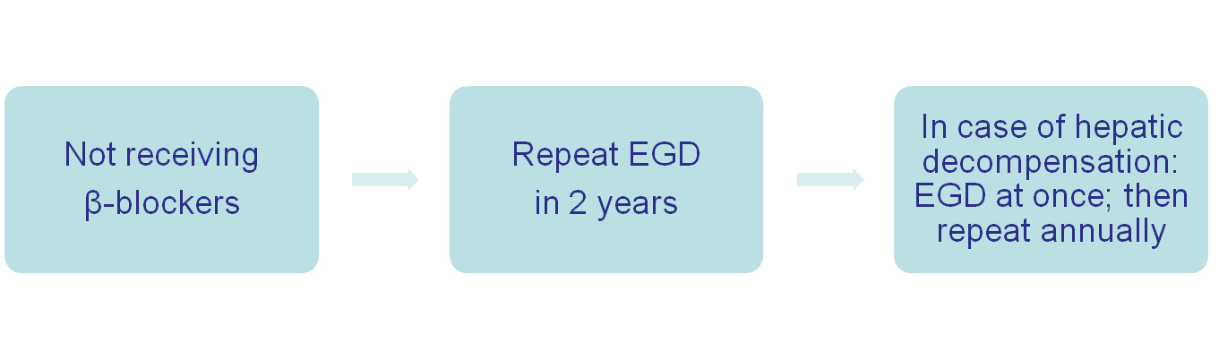
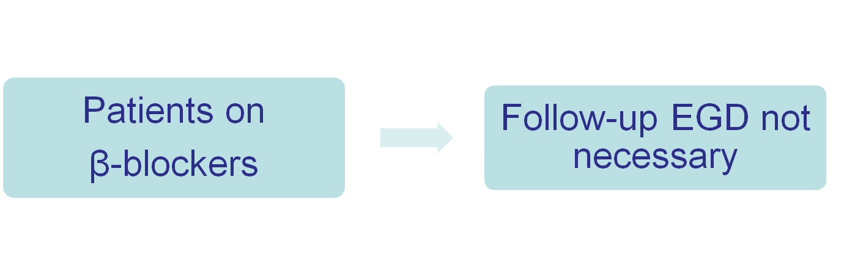
Patients with cirrhosis and small varices, but no hemorrhage

Slide 26
Patients with cirrhosis and small varices, but no hemorrhage
Non-cardioselective β-blockers starting at a low dosage, if necessary increasing the dose until a reduction in the resting heart rate of 25%, but not lower than 55 beats/min, is reached.
In comparison with β-blockers, endoscopic variceal ligation was found to reduce bleeding episodes and severe adverse events significantly, but it had no effect on the mortality rate.

Slide 27
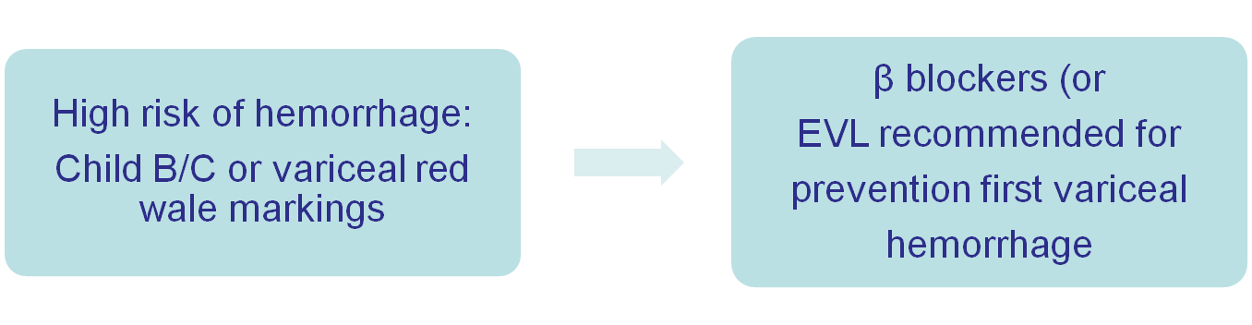
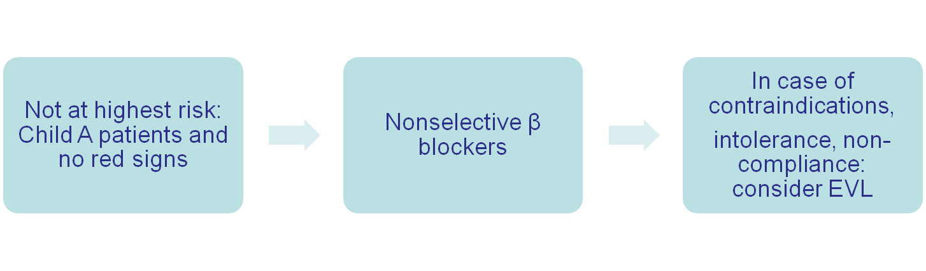
Patients with medium or large varices, but no hemorrhage

Slide 28
Patients with cirrhosis and acute variceal hemorrhage
EMERGENCY SCHEME
Resuscitation measures
  IV volume support
  Blood transfusion
Antibiotic prophylaxis (up to 7 days)
  Oral norfloxacin (400 mg BID)
  Or IV ciprofloxacin
  Or IV ceftriaxone (1g/day) in advanced cirrhosis
Pharmacological therapy–continue 2-5 days
  Terlipressin (2 mg every 4 hrs)
  Or somatostatin (or octreotide, vapreotide)

Slide 29
Patients with cirrhosis and acute variceal hemorrhage
Within 12 hours:
Confirm diagnosis with EGD
Treat VH with EVL or sclerotherapy
In uncontrollable bleeding or recurrence:
TIPS
In uncontrollable bleeding while waiting for TIPS or endoscopic therapy:
Balloon tamponade as temporizing
measure for 24 hours maximum
Notes:
Temporary (instead of temporizing)?
‹#›

Slide 30
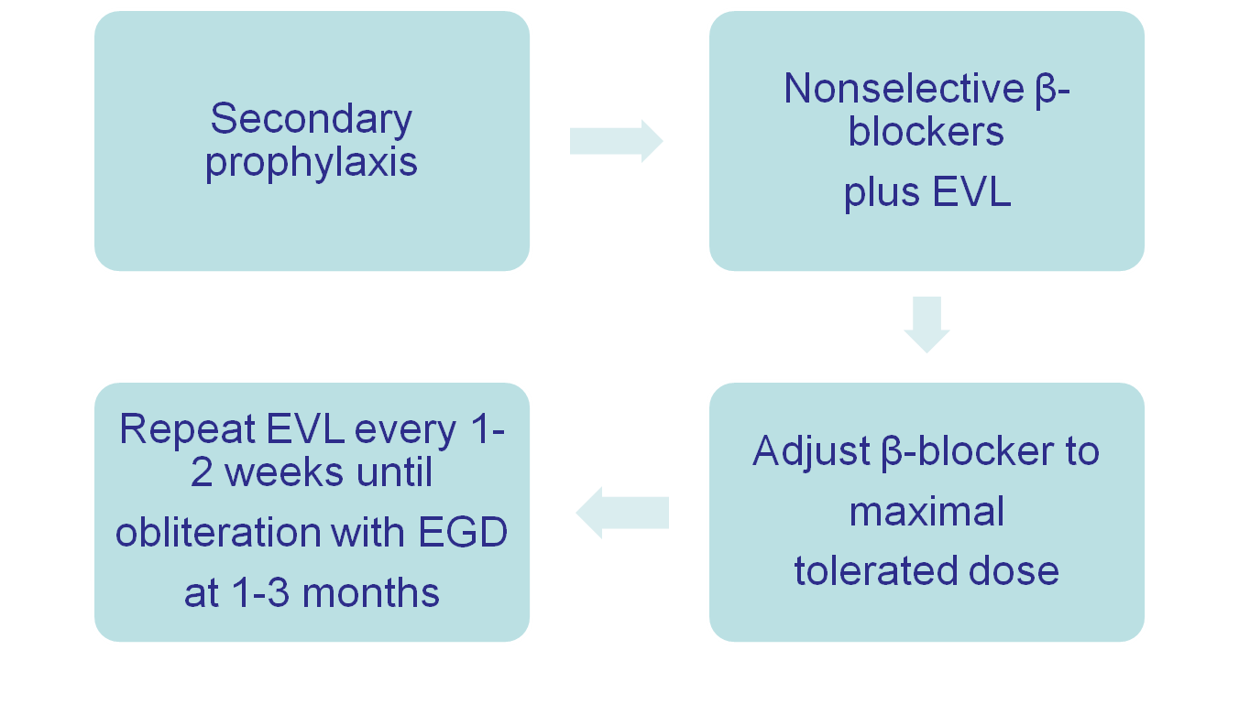
Patients who have recovered from acute variceal hemorrhage

Slide 31
Patients who have recovered from acute variceal hemorrhage
Long-term endoscopic control with banding or sclerotherapy of recurrent varices every 3–6 months.
If endoscopic band ligation is not available or contraindicated, non-cardioselective β-blockers (propranolol, nadolol, or carvedilol) can be prescribed.

Slide 32
Patients who have recovered from acute variceal hemorrhage
In younger patients with less advanced cirrhosis (Child–Pugh A), the addition of isosorbide 5-mononitrate may be considered if sclerotherapy or pharmacotherapy fail.
TIPS should be considered, especially in candidates for liver transplantation.

Slide 33
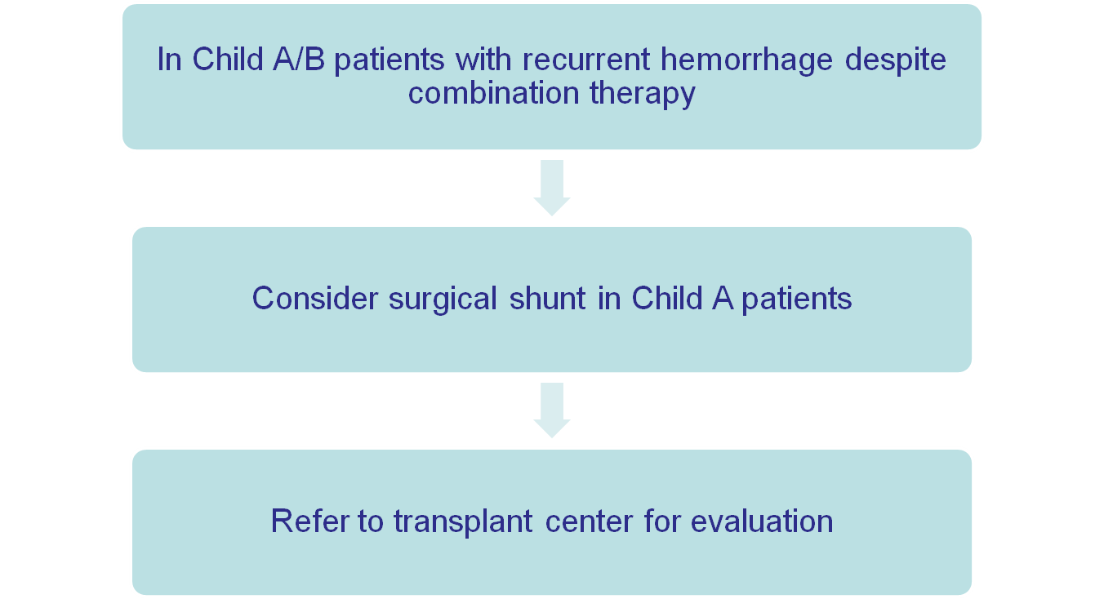
Patients who have recovered from acute variceal hemorrhage.

Slide 34
Cascade for the treatment of acute esophageal variceal hemorrhage
A cascade is a hierarchical set of diagnostic or therapeutic techniques for the same disease, ranked by the resources available.
The optimal therapy in an individual setting very much depends on the relative ease of local availability of these methods and techniques.

Slide 35
Cascade for the treatment of acute esophageal variceal hemorrhage
If endoscopy is not readily available, one has to resort to pharmacotherapy in any case of suspected variceal bleeding — e.g. in patients with hematemesis and signs of cirrhosis.

Slide 36
Cascade for the treatment of acute esophageal variceal hemorrhage.
Similarly, pharmacological therapy might be administered in circumstances such as primary prophylaxis in a cirrhotic patient with signs of portal hypertension.

Slide 37
Cascade for the treatment of acute esophageal variceal hemorrhage.
If pharmacotherapy is also not available and variceal bleeding is suspected, one must resort to general resuscitation measures and transport the patient as soon a possible to an institution where the necessary diagnostic/therapeutic means are available; balloon tamponade could be extremely helpful in such a situation.

Slide 38
Cascade for the treatment of acute esophageal variceal hemorrhage.
Resource level
Band ligation + vasoactive IV drug therapy: octreotide or terlipressin
GOLD STANDARD
NORMAL
Band ligation
MEDIUM
Sclerotherapy
LOW
Balloon therapy

Slide 39


