Slide 2
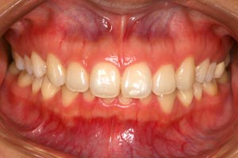
Deep Bite

Slide 3
Tooth Movements Associated with Deep Overbite Correction
maxillary anterior intrusion
maxillary posterior extrusion
mandibular anterior intrusion
mandibular posterior extrusion .

Slide 4
normal maxillofacial growth

Slide 5
normal maxillofacial growth

Slide 6
normal maxillofacial growth

Slide 7
normal maxillofacial growth

Slide 8
normal maxillofacial growth

Slide 9
normal maxillofacial growth

Slide 10
normal maxillofacial growth

Slide 11
normal maxillofacial growth

Slide 12
normal maxillofacial growth

Slide 13
normal maxillofacial growth

Slide 14
normal maxillofacial growth

Slide 15
normal maxillofacial growth

Slide 16
normal maxillofacial growth

Slide 17
normal maxillofacial growth

Slide 18
normal maxillofacial growth

Slide 19
normal maxillofacial growth

Slide 20
normal maxillofacial growth

Slide 21
normal maxillofacial growth

Slide 22
normal maxillofacial growth

Slide 23
normal maxillofacial growth

Slide 24
normal maxillofacial growth

Slide 25
normal maxillofacial growth

Slide 27
Inter Maxillary
Growth Space

Slide 28
Simultaneous Eruption of
Teeth And Gap Closure

Slide 37
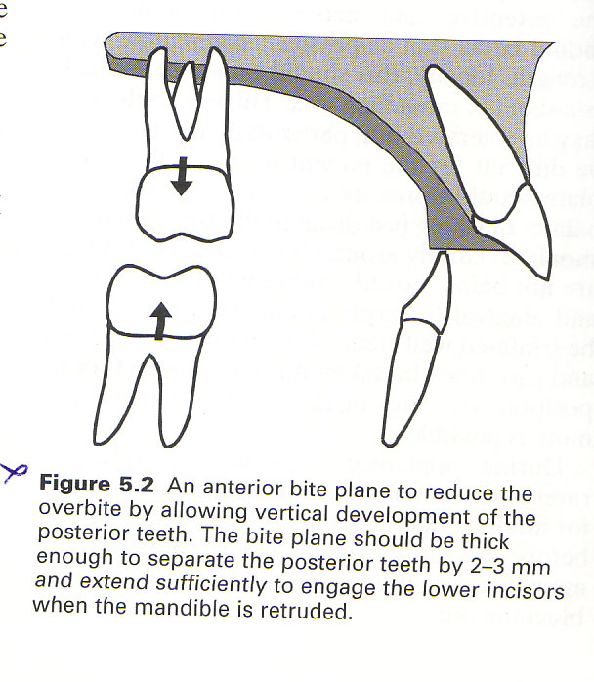
Anterior bite plate

Slide 56
Clinical Considerations:
Vertical clearance of Post. Teeth
Inclination of ant. bite plate
Facial height
Unfavorable occlusal changes
Age of patient
Lip relation

Slide 57
Clinical Considerations:
Vertical clearance of Post. Teeth
Inclination of ant. bite plate
Facial height
Unfavorable occlusal changes
Age of patient
Lip relation

Slide 58
Clinical Considerations:
Vertical clearance of Post. Teeth
Inclination of ant. bite plate
Facial height
Unfavorable occlusal changes
Age of patient
Lip relation

Slide 59
Clinical Considerations:
Vertical clearance of Post. Teeth
Inclination of ant. bite plate
Facial height
Unfavorable occlusal changes
Age of patient
Lip relation

Slide 60
Clinical Considerations:
Vertical clearance of Post. Teeth
Inclination of ant. bite plate
Facial height
Unfavorable occlusal changes
Age of patient
Lip relation

Slide 61
Clinical Considerations:
Vertical clearance of Post. Teeth
Inclination of ant. bite plate
Facial height
Unfavorable occlusal changes
Age of patient
Lip relation

Slide 62
Clinical Considerations:
Vertical clearance of Post. Teeth
Inclination of ant. bite plate
Facial height
Unfavorable occlusal changes
Age of patient
Lip relation

Slide 63
Thickness of bite plate and vertical
opening of posterior teeth
3mm

Slide 87
Simultaneous correction of Class II and
deep bite by anterior inclined plane

Slide 88
Simultaneous correction of Class II and
deep bite by anterior inclined plane

Slide 89
Simultaneous correction of Class II and
deep bite by anterior inclined plane

Slide 90
Simultaneous correction of Class II and
deep bite by anterior inclined plane

Slide 91
Simultaneous correction of Class II and
deep bite by anterior inclined plane

Slide 92
Simultaneous correction of Class II and
deep bite by anterior inclined plane

Slide 93
Simultaneous correction of Class II and
deep bite by anterior inclined plane

Slide 94
Simultaneous correction of Class II and
deep bite by anterior inclined plane

Slide 95
Simultaneous correction of Class II and
deep bite by anterior inclined plane

Slide 96
Simultaneous correction of Class II and
deep bite by anterior inclined plane

Slide 97
Simultaneous correction of Class II and
deep bite by anterior inclined plane

Slide 98
Simultaneous correction of Class II and
deep bite by anterior inclined plane

Slide 99
Simultaneous correction of Class II and
deep bite by anterior inclined plane

Slide 100
Simultaneous correction of Class II and
deep bite by anterior inclined plane

Slide 101
Simultaneous correction of Class II and
deep bite by anterior inclined plane

Slide 102
Simultaneous correction of Class II and
deep bite by anterior inclined plane

Slide 103
Simultaneous correction of Class II and
deep bite by anterior inclined plane

Slide 104
Simultaneous correction of Class II and
deep bite by anterior inclined plane

Slide 105
Simultaneous correction of Class II and
deep bite by anterior inclined plane

Slide 106
Simultaneous correction of Class II and
deep bite by anterior inclined plane

Slide 113
50 mm

Slide 117
53 mm

Slide 122
Normal incisor-lip relationship

Slide 123
Over eruption of upper incisors

Slide 124
Over eruption of lower incisors

Slide 125
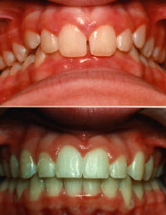
Before & after treatment

