Slide 1
ASD Device Closure Of A 86 Year Old Patient: A Very Rare Survival Suitable For Device Closure
Dr Rameshwar Bishnoi
Cardiologist
Fortis DTM Hospital
Bikaner,INDIA

Slide 2
INTRODUCTION
A 86 year old male patient with chief complaints of shortness of breath, easy fatigability are found to be having large ostium secondum ASD.
Defect size ,rims and total septal length thouroughly examined on TTE and patient found suitable for ASD device closure.

Slide 3
The natural course of isolated ASDs (which are primarily secundum ASDs) varies from spontaneous closure to enlarging defects and increasing symptoms with age.
Most secundum ASDs less than 8 mm in diameter close spontaneously by two to five years of age.
Secundum ASDs ≥8 mm in diameter and other types of ASDs are unlikely to close spontaneously. Spontaneous closure of a secundum ASD is unusual in older children and adults and defect size tends to increase with age.
Primum ASDs, sinus venosus defects, and coronary sinus defects do not close spontaneously.

Slide 4
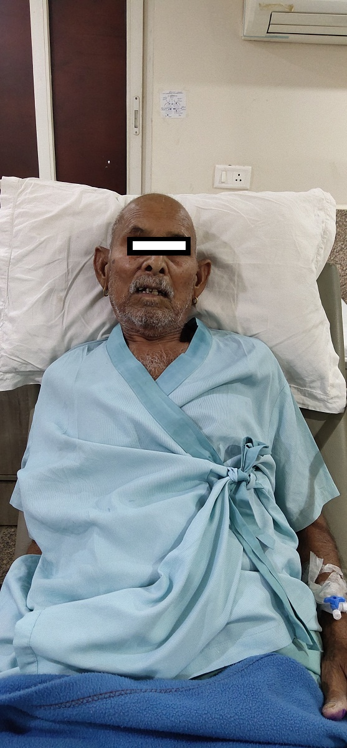

Slide 5
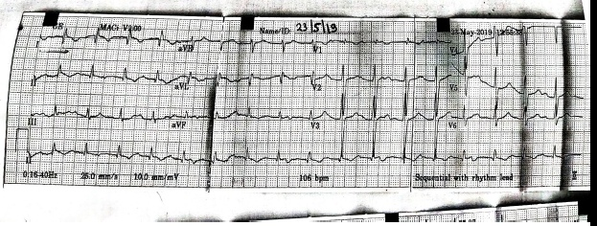

Slide 6
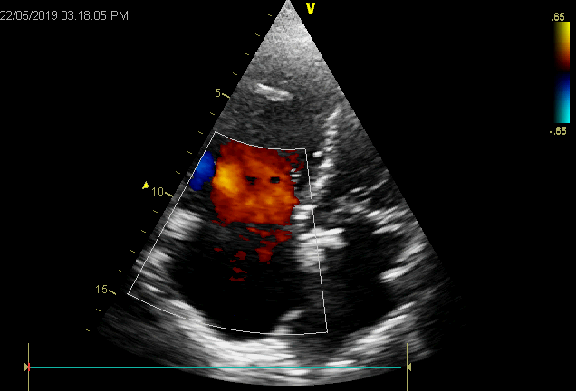
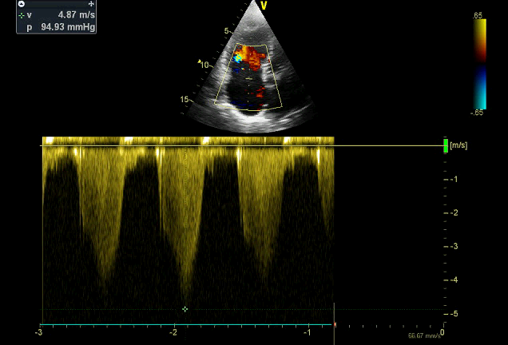
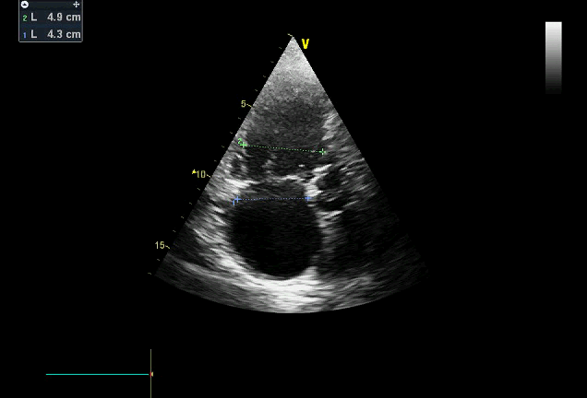
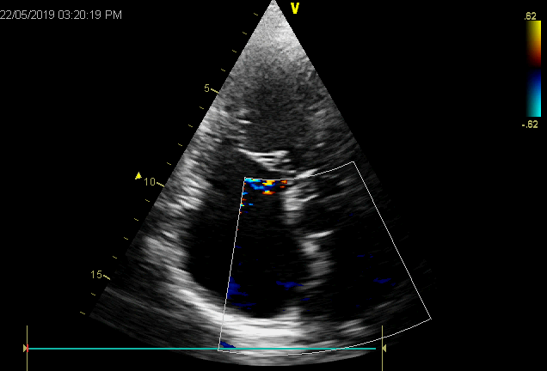

Slide 7
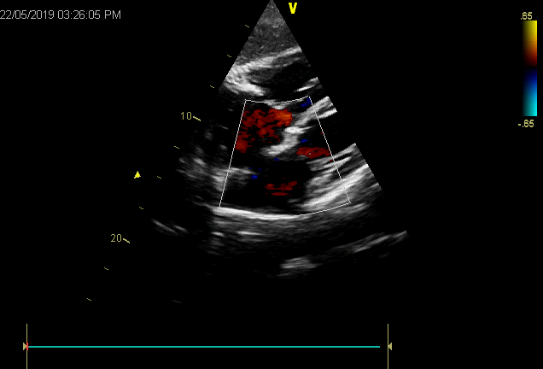
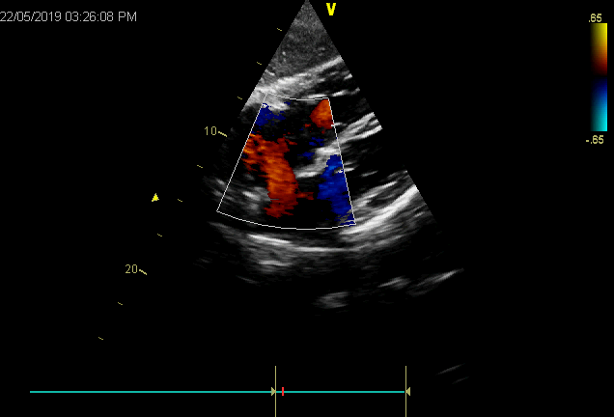
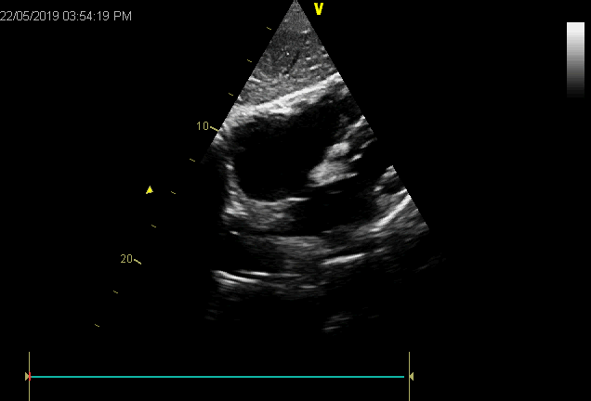
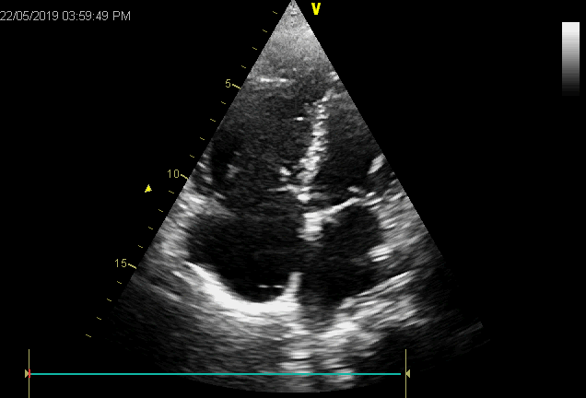

Slide 8
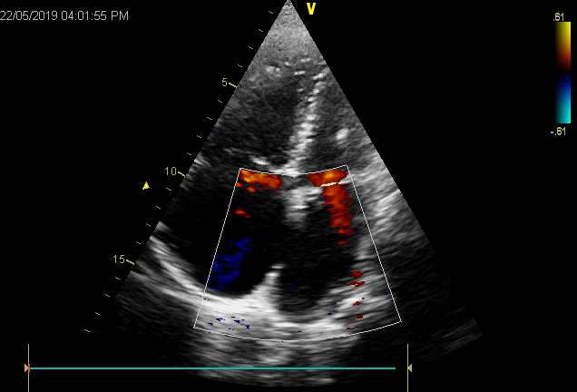
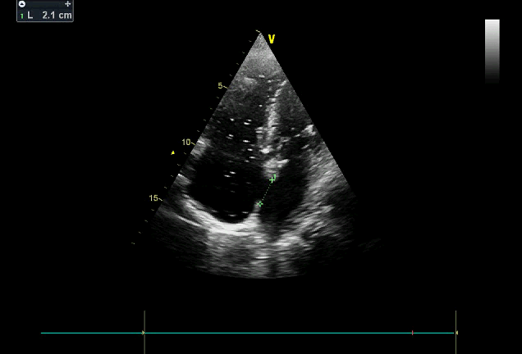
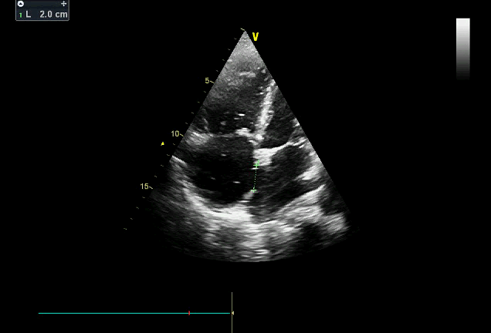
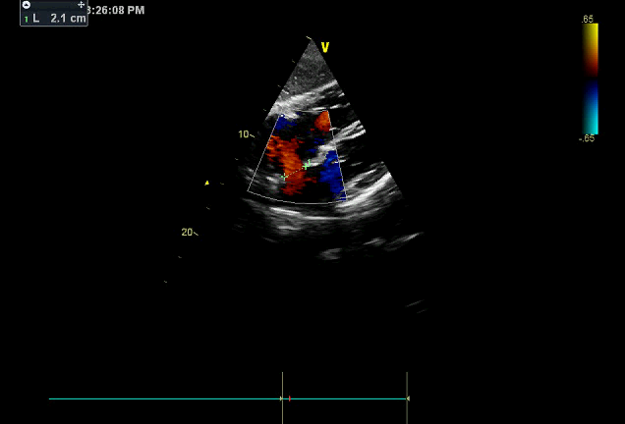

Slide 9
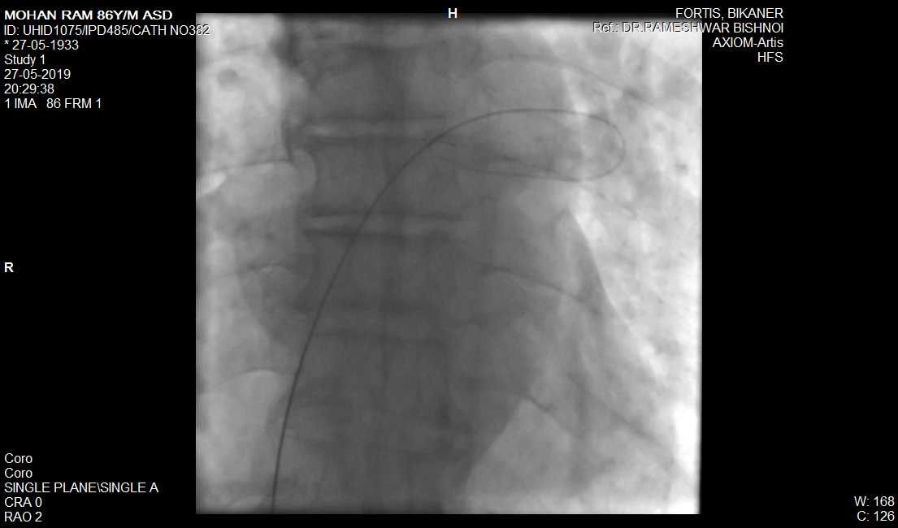

Slide 10
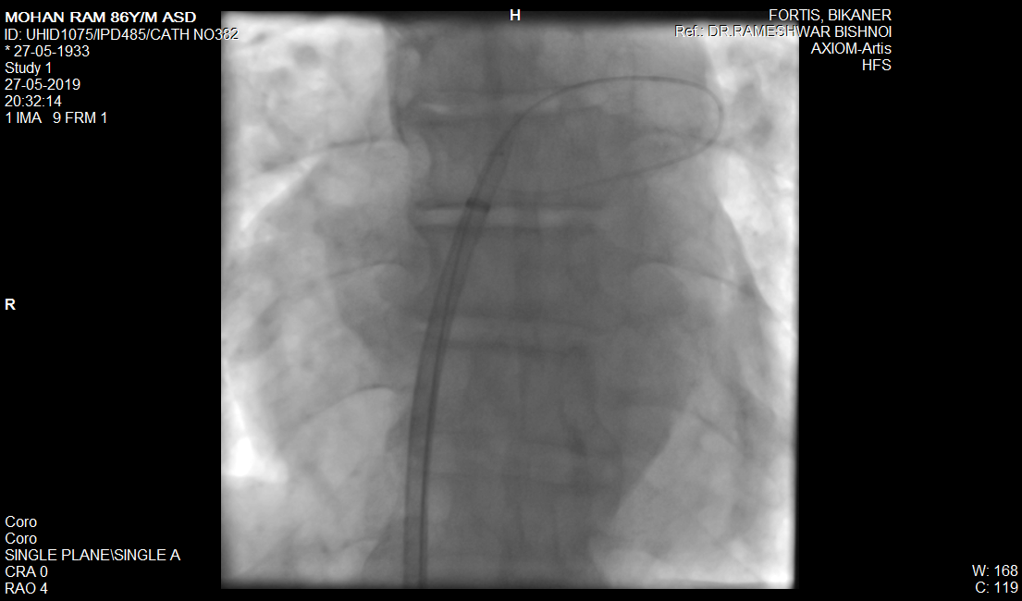

Slide 11
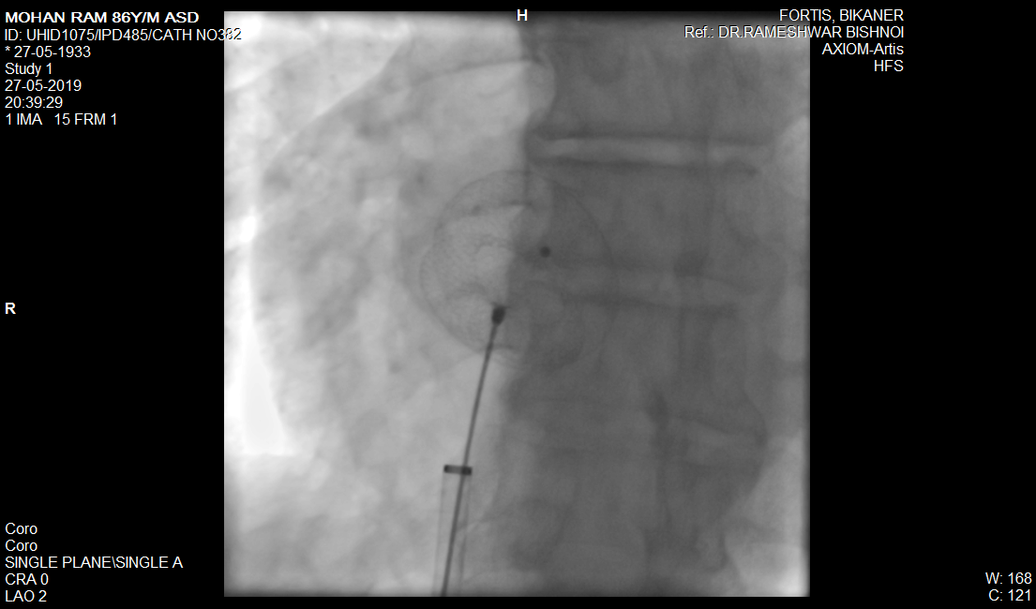

Slide 12
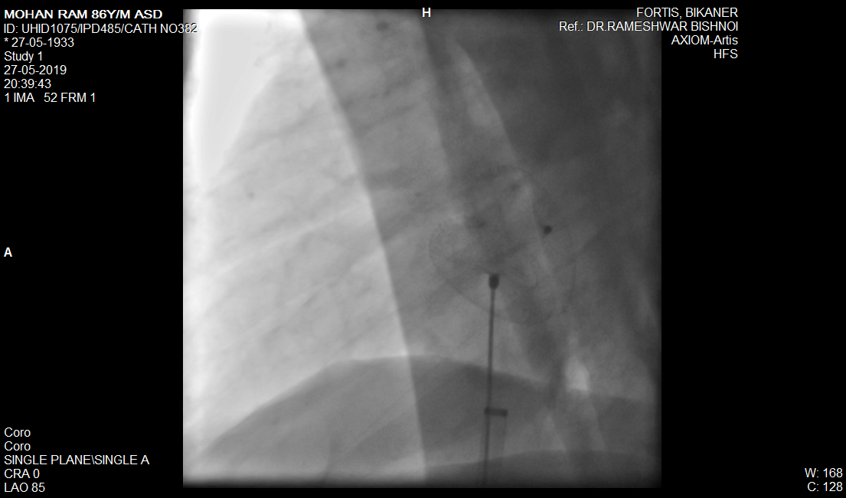

Slide 13
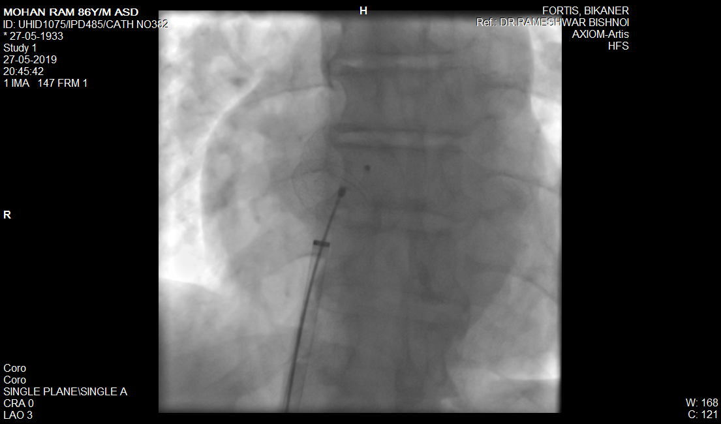

Slide 14
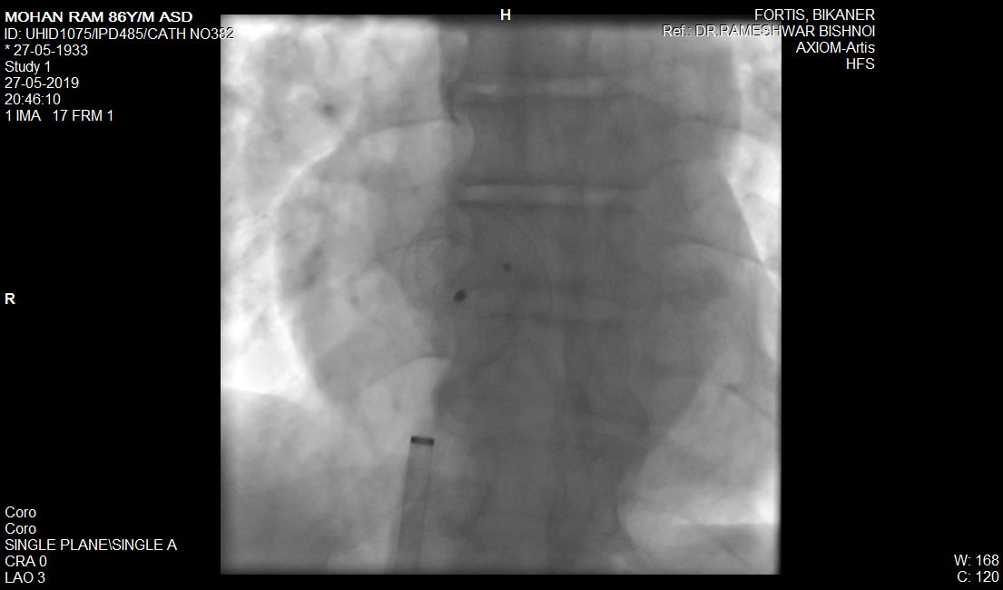

Slide 15
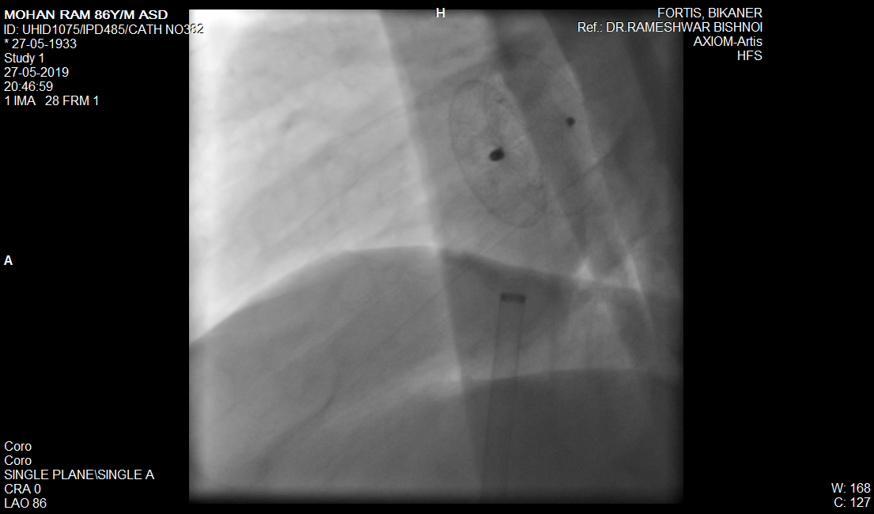

Slide 16
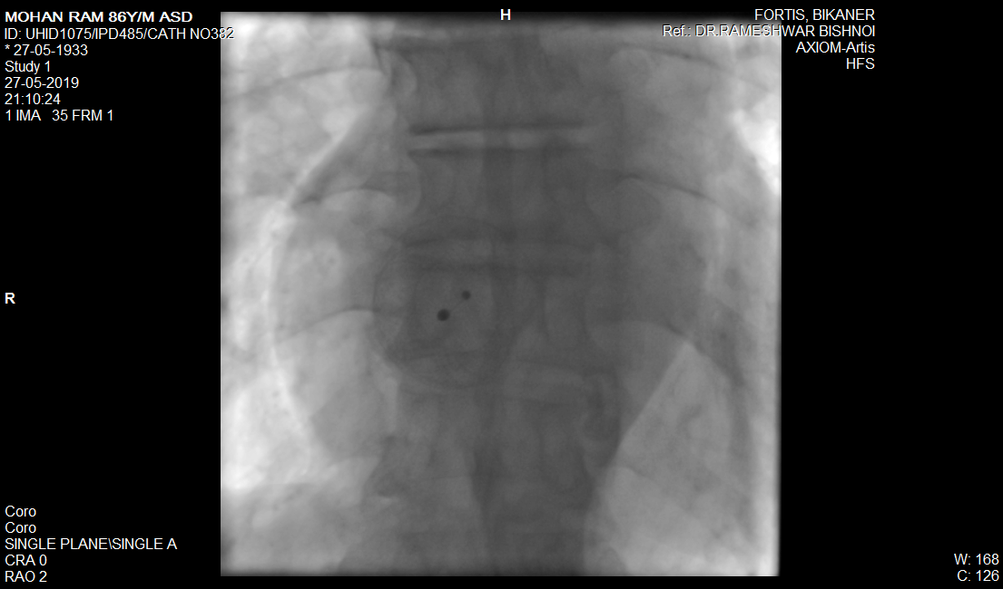

Slide 17
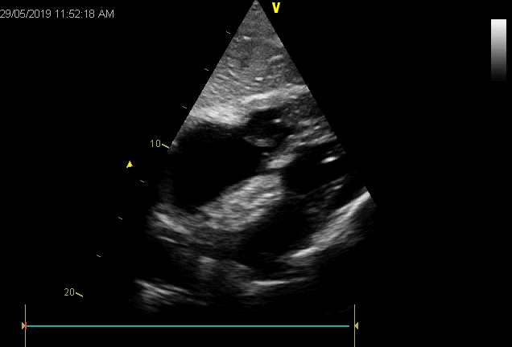
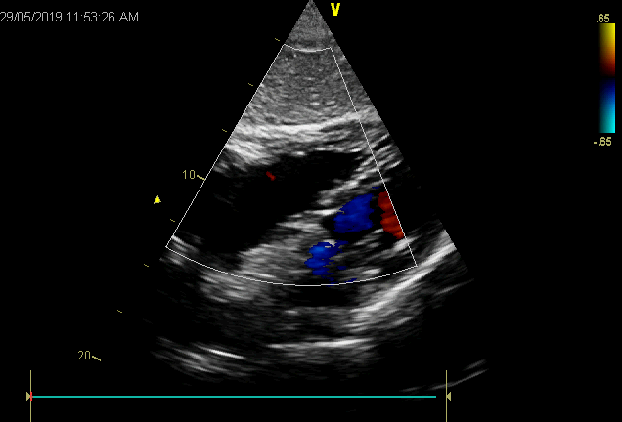
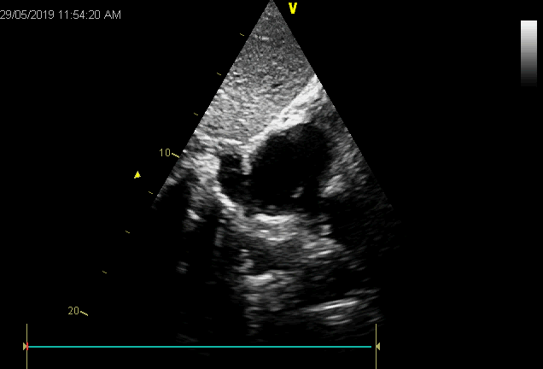
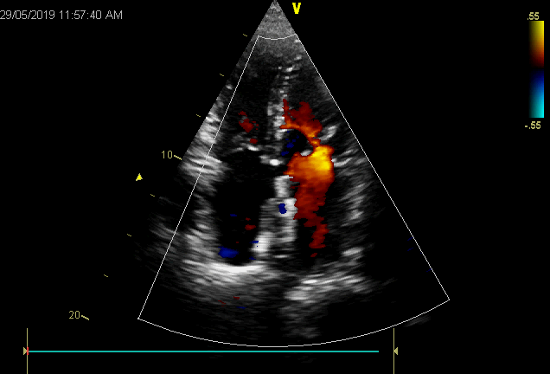

Slide 18
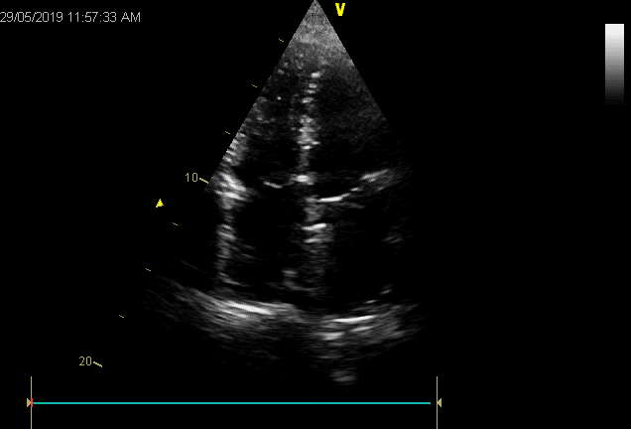
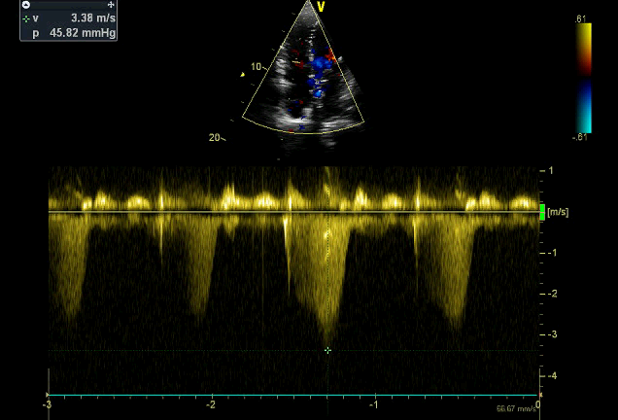
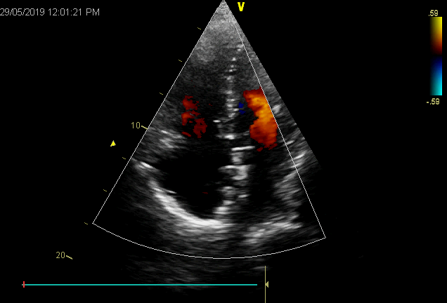
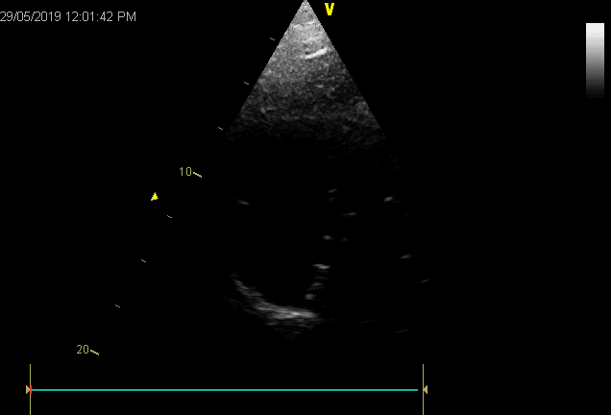

Slide 19
DISCUSSION
Transcatheter closure of ASDs is a safe and effective treatment.
Over the past few years, an increasing number of elderly patients (age >60 years) have been underwent for transcatheter closure to prevent ongoing congestive heart failure from volume overload.
In our opinion, even elderly patients with clinical impairment and right-heart enlargement could be benefitted from ASD closure.

Slide 20
Closure of ASDs in elderly patients resulted in significant clinical and hemodynamic improvement after percutaneous treatment, which requires long-term follow-up.
Right-heart remodelling can occur in patients >60 years of age.

Slide 21
Take Home Message
Symptoms and RA&RV dilation are more pronounced in the elderly (>50 years), but reversibility is the same as in the young (<50 years) patients.
The elderly benefit substantially from ASD closure.
Based on these data, ASD closure is recommendable even after the fifth decade. (European Journal of Cardio-Thoracic Surgery, Volume 43, Issue 4, April 2013, Pages 752–757)
Under TTE guidance even in adults percutaneous ASD closure can be done safely.

Slide 22
THANKS

