Slide 1
Iatrogenic extensive dissection of RCA: a nightmare in cath lab

Slide 2
Clinical details
44yr old female
Known DM,DLP &HTN
Admitted with ACS-NSTEMI
Radial CAG showed SVD- tight lesion distal RCA and PDA
Severe radial spasm with guiding catheter
Inadvertent deep intubation of guiding catheter causing extensive dissection
Rescue PCI

Slide 3
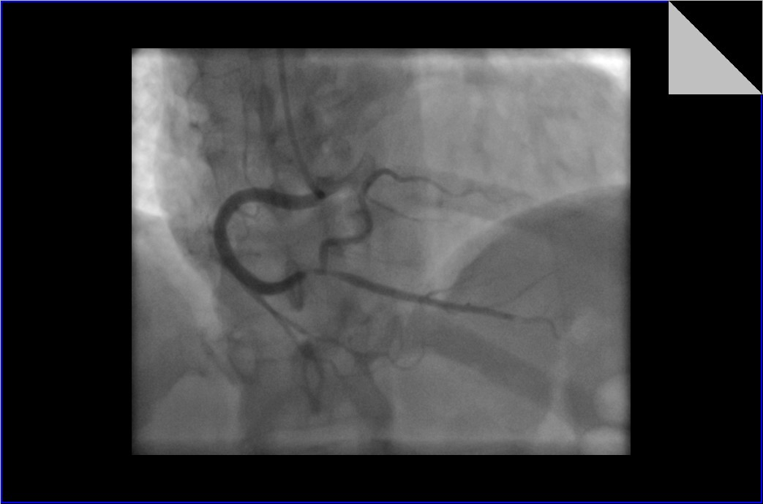

Slide 4
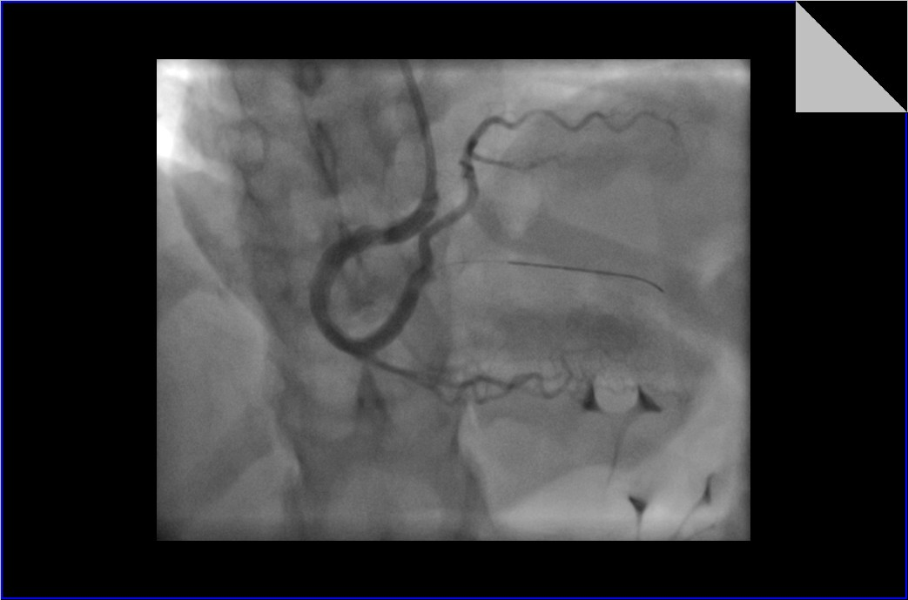

Slide 5
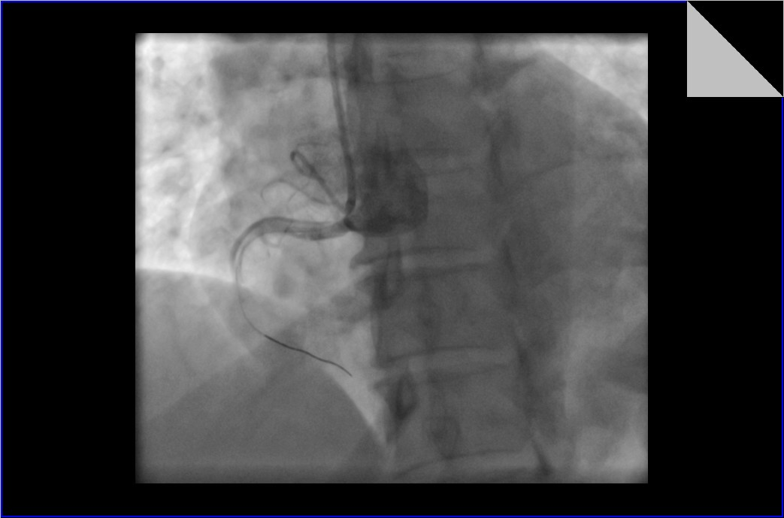

Slide 6
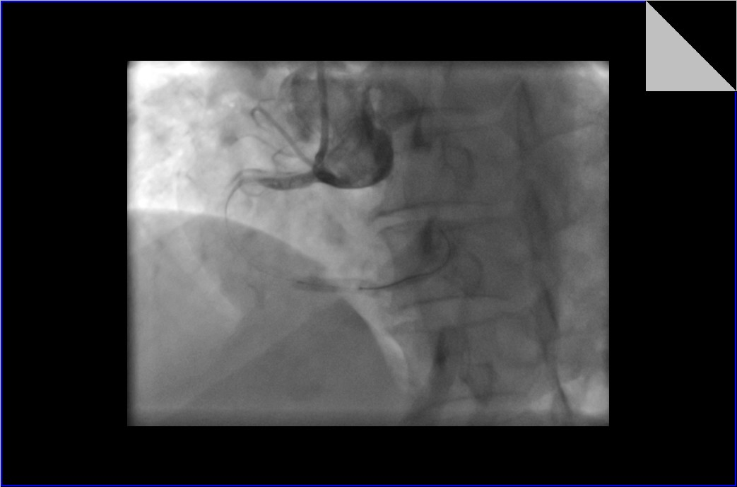

Slide 7
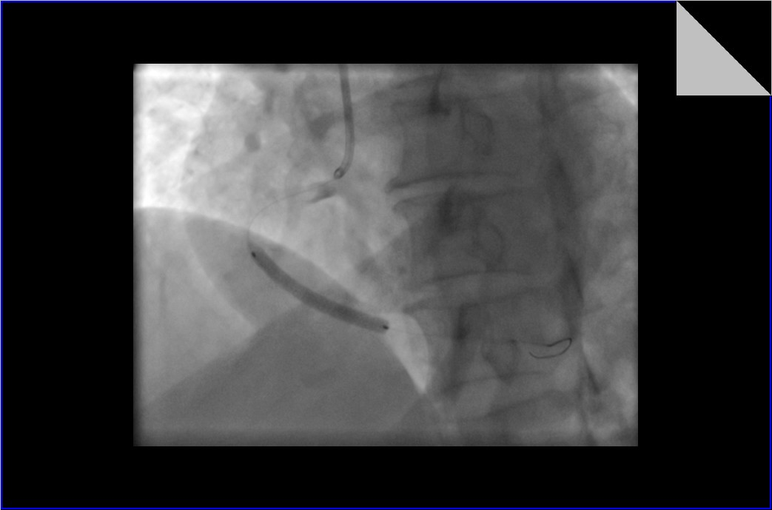

Slide 8
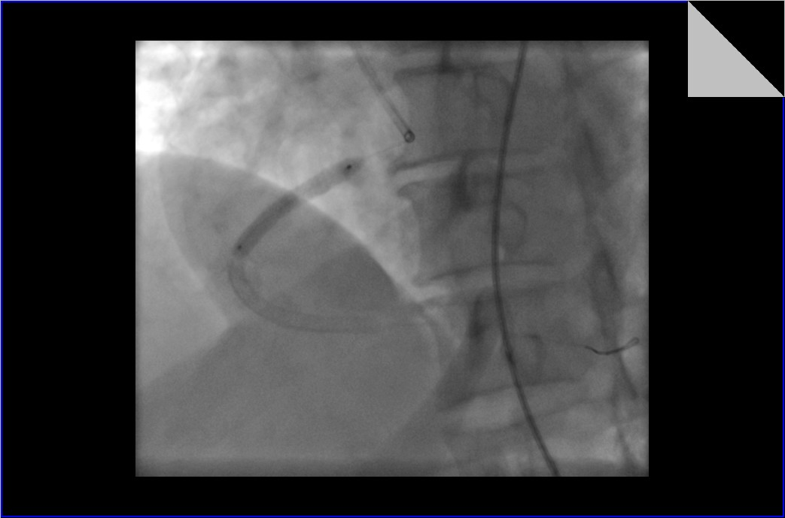

Slide 9
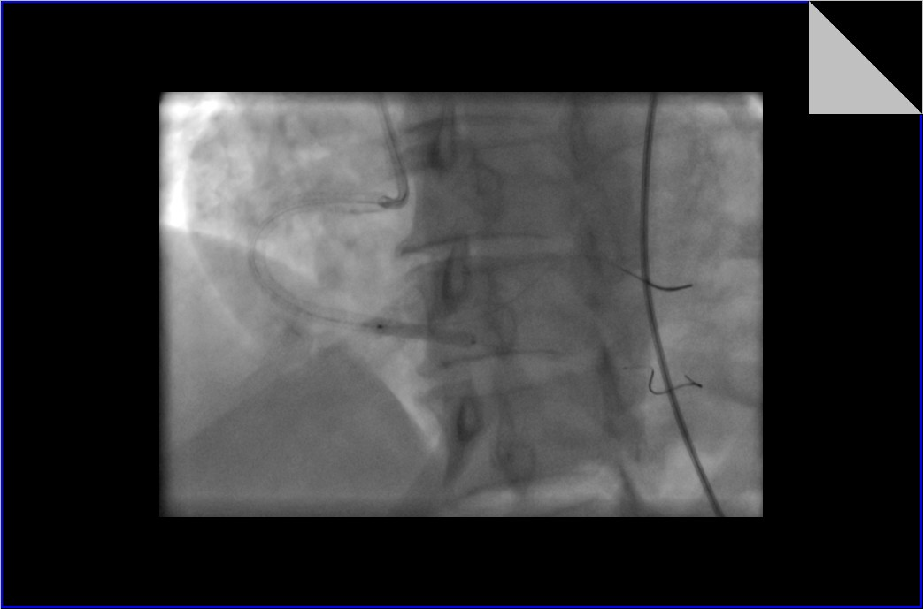

Slide 10
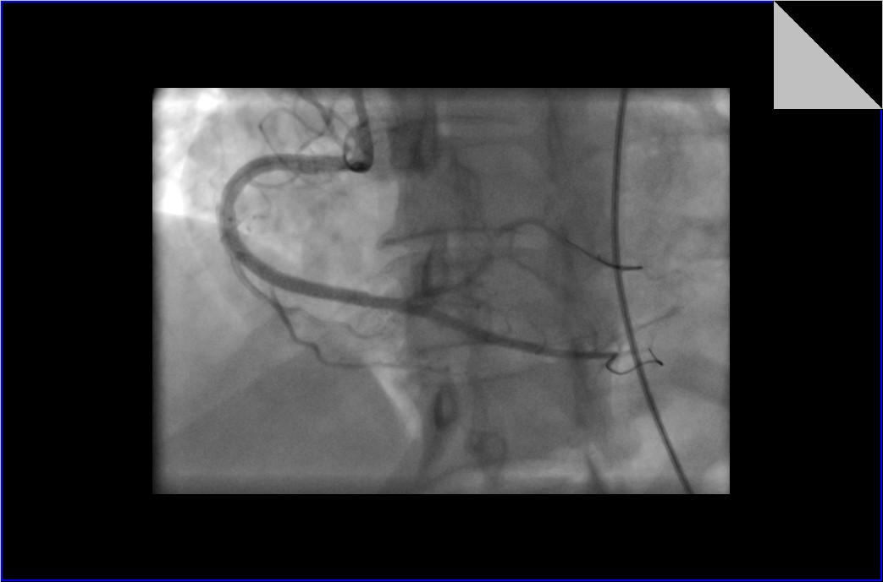

Slide 11
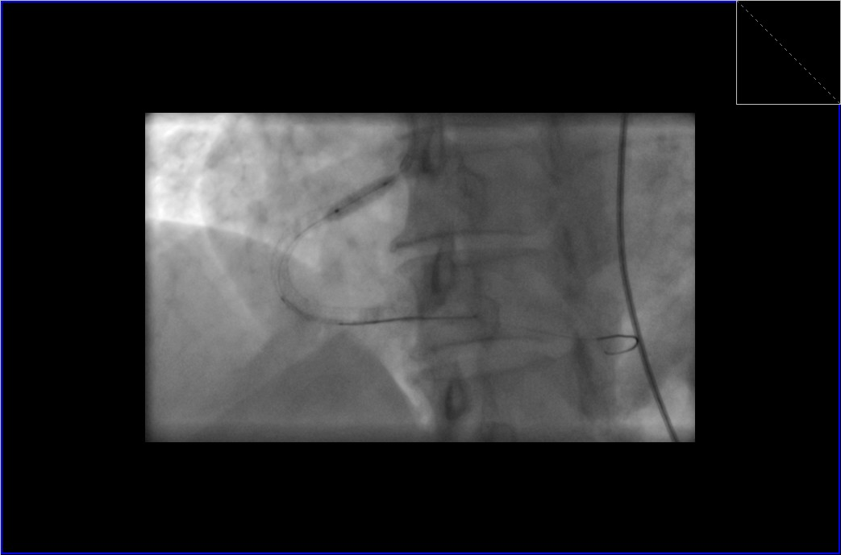

Slide 12
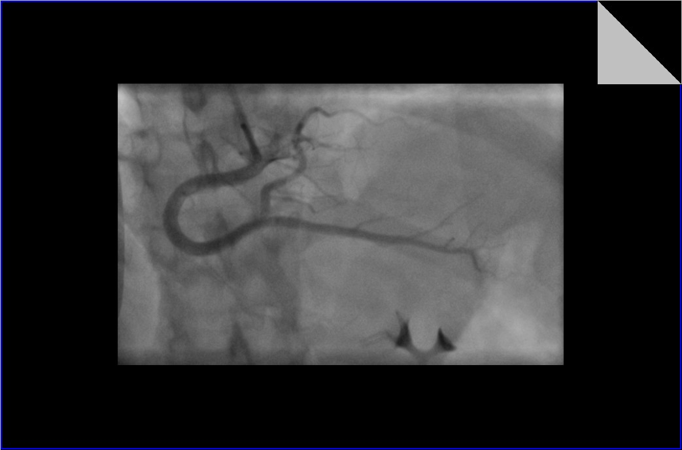

Slide 13
Conclusion
Radial spasm is a common complication of radial procedure which can be tackled by adequate conscious sedation of patient and spasmolytic cocktail
Iatrogenic dissection is an infrequent complication of PCI. In this case it is due to inadvertent deep engagement of guiding catheter. The uncontrolled hypertension could have also contributed to the dissection.
Complication was managed by timely intervention

