Slide 1



The USAID/Kenya and East Africa Afya Jijini Program
Notes:
1) Project Objectives: list the objectives of your project/program directly related to the GFSS. No more than 3 lines.
2) Project Location(s): list county locations where your project/program is present in Kenya.
3) Expectations for CLA: list your expectations for what USAID should do with CLA? What are your expectations for your CLA? No more than 3 lines.

Slide 2

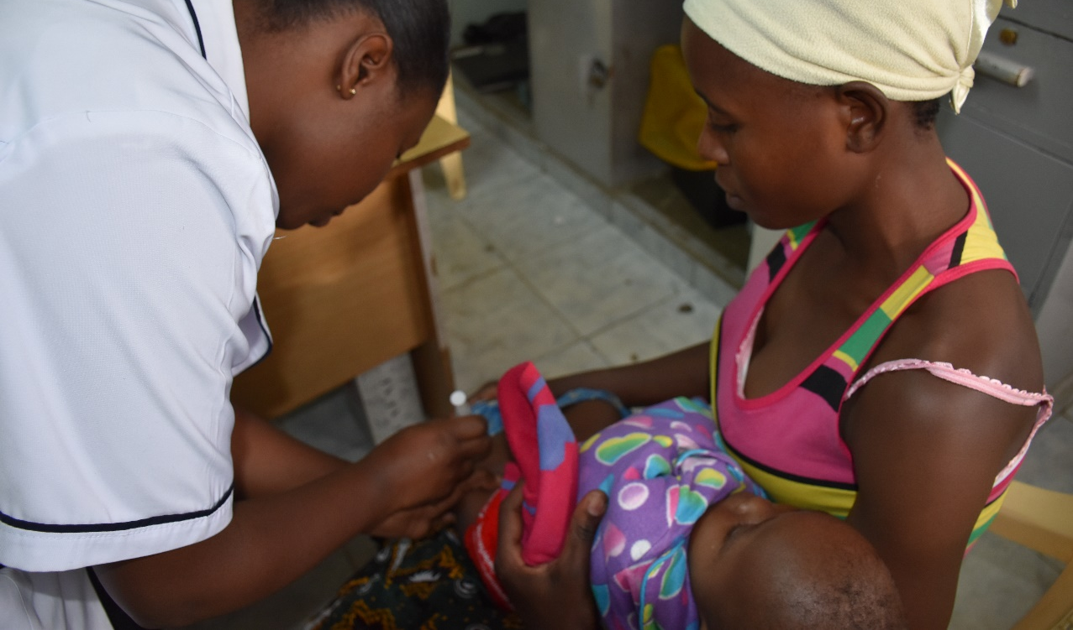
Improving Perinatal Outcomes at Peri-partum Period through Public Private Partnership;
A Case Study of St. Mary’s Mission Hospital, Nairobi
By JANE KOECH
-
Notes:
1) Project Objectives: list the objectives of your project/program directly related to the GFSS. No more than 3 lines.
2) Project Location(s): list county locations where your project/program is present in Kenya.
3) Expectations for CLA: list your expectations for what USAID should do with CLA? What are your expectations for your CLA? No more than 3 lines.

Slide 3
Introduction and program description
The USAID/Kenya and East Africa and PEPFAR-funded Afya Jijini program aims to improve county-level institutional capacity and health service delivery.
The program’s purpose is to improve and increase access and utilization of quality health services in Nairobi City County through strengthened service delivery and institutional capacity of its county health systems. .
IMA World Health is the Implementing partner
Main Consortium
MEDS: Supply chain and laboratory strengthening (SP3)
CHAK: HIV/TB integration & UHAI integration into CHAK-supported facilities (SP1, SP2)
NOPE: Community engagement, youth, gender (particularly at-risk youth, including AGYW) (SP1, SP2)
University of Nairobi: Dropped because key populations removed from the program
Population served---Informal settlements of Nairobi County
Sub-purpose 1: Increased access to and utilization of quality HIV services
Sub-purpose 2: Increased access and utilization of focused MNCH, FP, WASH, and Nutrition
Sub-purpose 3: Strengthened and functional county health system
Partnership with government and strategic planning
HRH
Health products and technologies
Strategic M&E systems
QI systems
Elimination of MTCT
HIV Care and Support Services
HTS
HIV prevention, HTC, VMMC
TB/HIV Co-infection
  MNCH
  Child Health
  FP
  WASH
  Nutrition

Slide 4

Introduction: An Overview of Perinatal Health
Globally
About 46% of all under-five deaths, occur during neonatal period.
First day - 40% of neonatal deaths
By 1st week - about 75% of all neonatal deaths.
Main causes - asphyxia, prematurity, and neonatal sepsis (WHO, 2016).
In Kenya:
Perinatal mortality rate - 28/1000 live births
Neonatal mortality rate - 22/1000 live births (KDHS, 2014).
Proposed Solutions:
1. Simple, low-cost interventions can reduce perinatal and late neonatal deaths, through combined effort of Public Private Partnership (PPP)
2. Public and private sectors in new ways through sharing of risks and responsibilities.

Slide 5
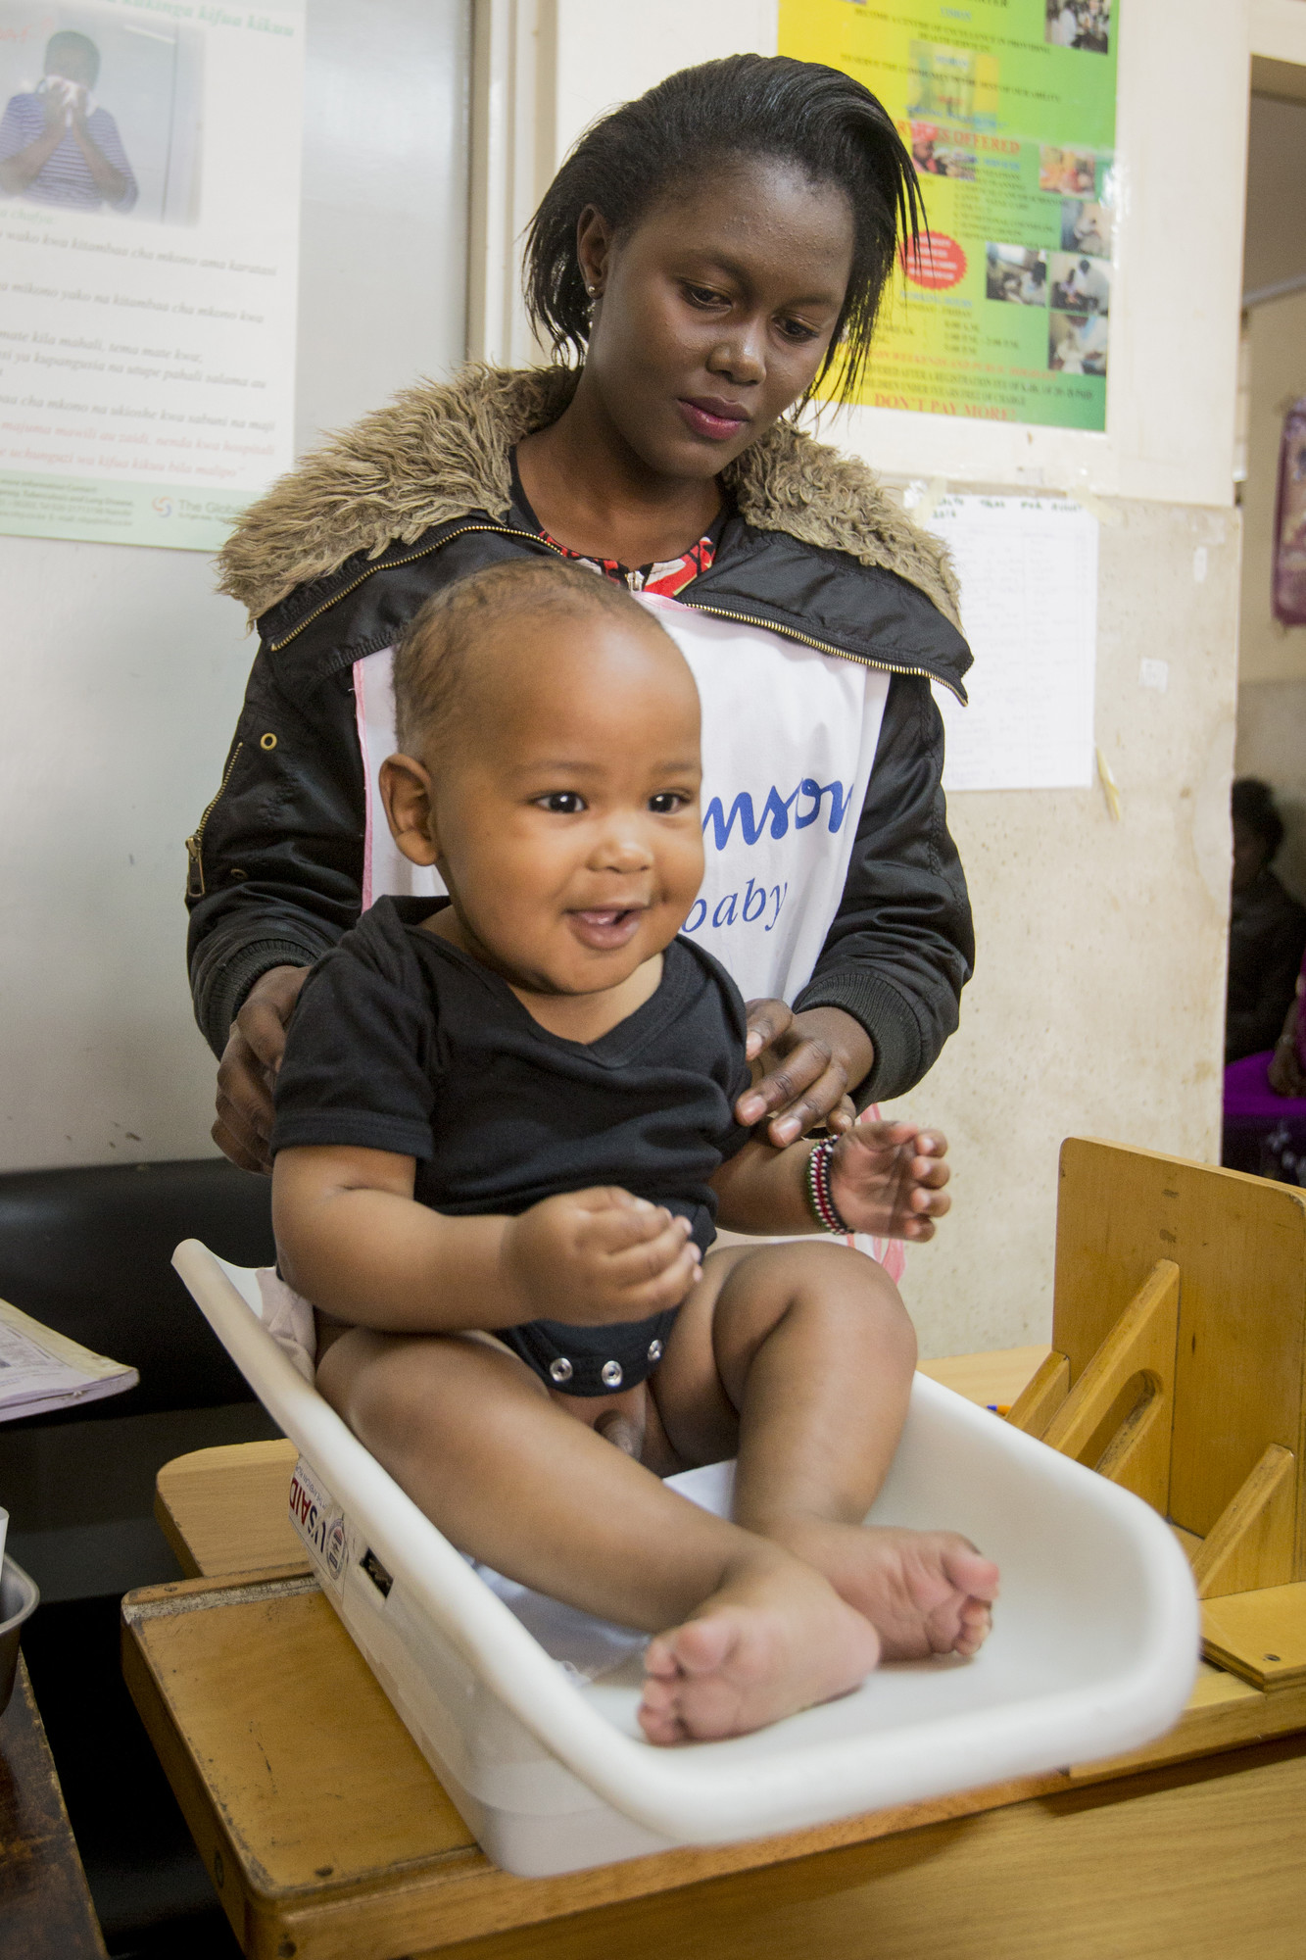
Introduction Continued…
Private health sector supervision by the county health team poses a challenge especially in Nairobi County which has a very high number of private/FBO facilities with high staff turn over compared to the Public Health Facilities.
Emergency Obstetric and Newborn care (EmONC), a pillar for maternal health, is critical for frontline Health workers (nurses, Clinical officers and medical officers) in Kenya to enable them to acquire the necessary competencies for the delivery of emergency care that addresses the major causes of maternal and neonatal morbidity and mortality.
The Public Health Sector – more updated with current health information and intervention, has mentors and supervisors for various program areas such as maternal and newborn health.
Combining public sector efforts through skill transfer to the private health sector may prove to be a solution in reducing poor perinatal outcomes.
In 2017, St. Mary’s experienced an increase in poor perinatal outcomes which peaked in Oct-Dec 2017 mainly contributed by the managerial instability coupled with health workers industrial action in the public sector. This required urgent interventions to address the challenges.

Slide 6
Methodology
Formative stage
Stakeholder engagement
Setting structures in Place
MPDSR committee formation
Actual Implementation
Review of all maternal and perinatal deaths through monthly meetings (25 babies born with mild to severe asphyxia (APGAR score<7) 4 NDs reviewed and 19 FSBs reviewed.
EmONC assessment
QIT and departmental WITs formed
Development of CME and mentorship
Monthly WIT meetings to review progress
Bi-weekly mentorships in maternity by the Sub County Mentors
Quarterly data review meetings
Provision and orientation on key SOPs/Job Aids, equipment
Quarterly Sub County Supportive Supervision

Slide 7
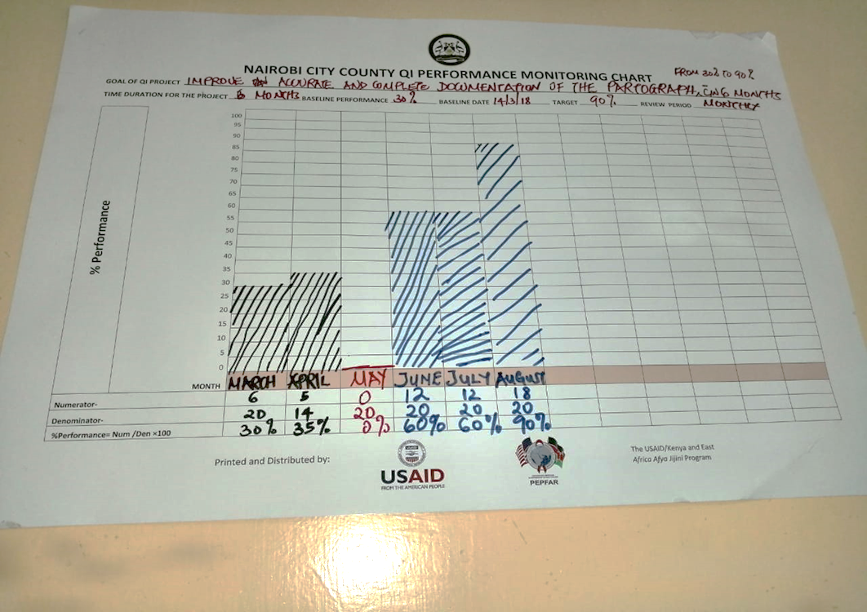
Results
Partograph monitoring and documentation had improved from 0% to 90% over the period.

Slide 8
Results
Moderate to severe birth asphyxia (low APGAR score <7) decreased from 2.28% of deliveries to 0.51%
Start of intervention

Slide 9
Results
Neonatal deaths (ND) in labor ward decreased from 2.51% to 0.41%.
Public Sector HCWs strike

Slide 10
Results
Fresh still births (FSBs) decreased from 1.37% to 0.41%.
Start of interventions
Public Sector HCWs strike

Slide 11
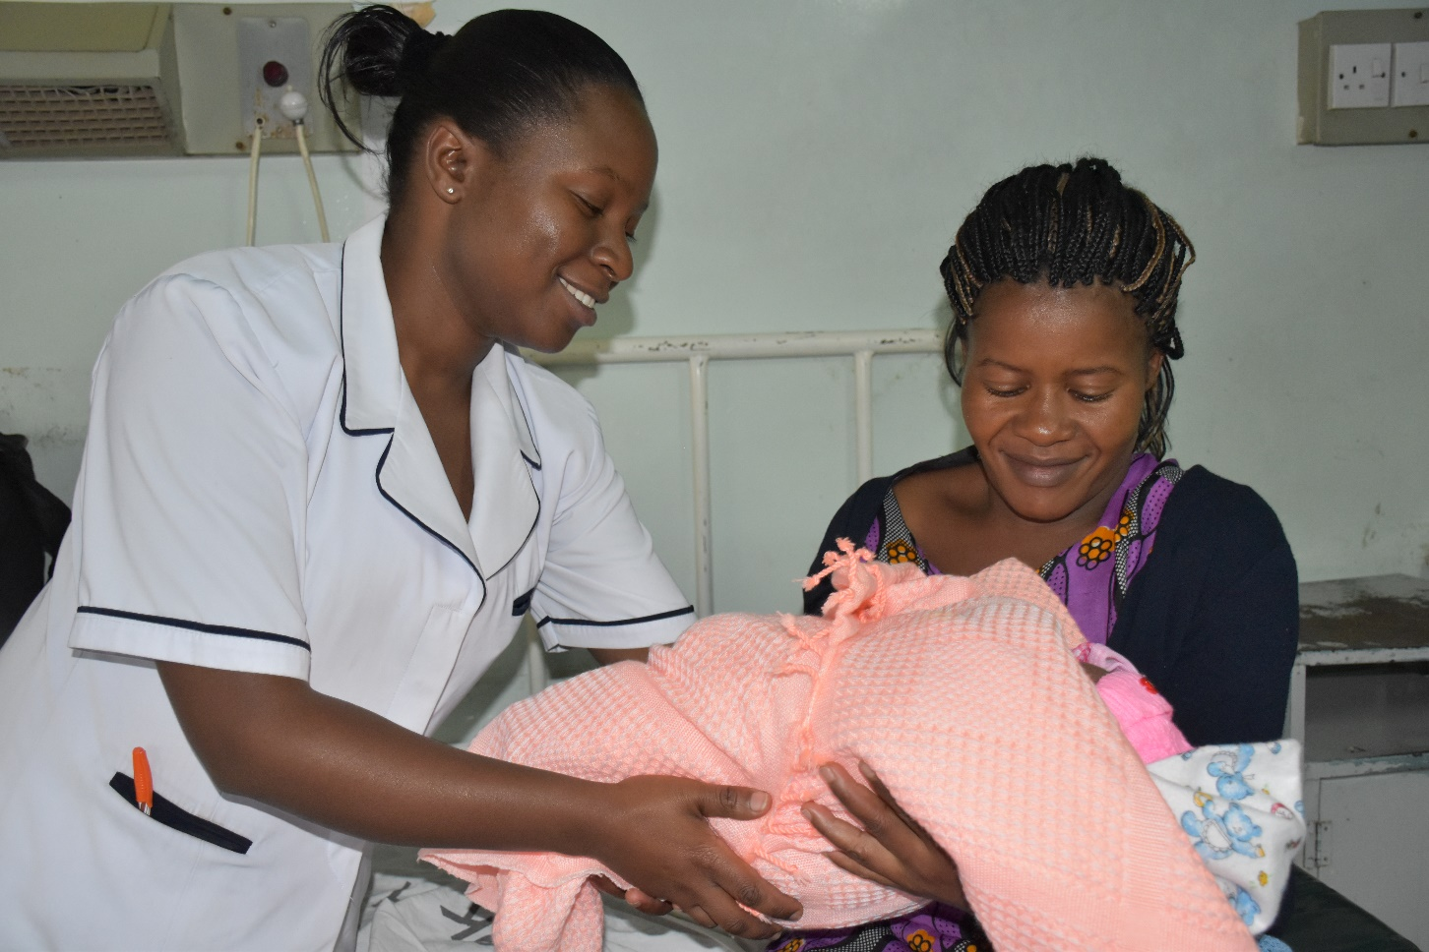

Lessons Learnt
Role of Public Health Sector
Integration and Collaboration
Human Factors
Human factors can contribute to over 50% in poor perinatal outcomes during labour and delivery.
Public health sector plays a crucial role in reducing human errors in the private sector.
Achieving good perinatal outcomes requires an integrated intervention model, coupled with PPP

Slide 12
Recommendations and Way Forward
PPP Collaboration
Mentorship
Integrated interventions
Better outcomes for newborns can be achieved through joint efforts between the public health and private health sectors through addressing specific health system problems affecting a facility’s quality of care by mentorship and training
Mentorship by skilled providers tapped from the Ministry of Health can yield results if implemented in a structured model
Integrated interventions (MPDSR, QI, Supervision and continued mentorship) are required to sustain good perinatal outcomes

Slide 13

References
Bang et al., 2005. Reduced Incidence of Neonatal Morbidities: Effect of Home-Based Neonatal Care in Rural Gadchiroli, India.
http://khf.co.ke/committees/public-private-partnership; Accessed 20th July 2018.
Kenya Demographic Health Survey, 2014.
DHIS-2; Accessed 18th February 2019
WHO, 2016. http://www.who.int/gho/child_health/mortality/neonatal_text/en/; Accessed 20th July 2018

Slide 14

Acknowledgement
Ministry of Health
The USAID/Kenya and East Africa Afya Jijini Program
Nairobi City County Government,
St. Mary’s Mission Hospital

Slide 15
THANK YOU

Slide 16

Questions? Discussion Time

