Slide 1
Antimicrobial Prophylaxis for Children with Vesicoureteral Reflux
This article was published on May 4, 2014,
at NEJM.org.

Slide 2
ABSTRACT
Background
Children with febrile urinary tract infection commonly have vesicoureteral reflux.
Because trial results have been limited and inconsistent, the use of antimicrobial prophylaxis to prevent recurrences in children with reflux remains controversial.

Slide 3
Methods
In this 2-year, multisite, randomized, placebo-controlled trial involving 607 children with vesicoureteral reflux that was diagnosed after a first or second febrile or symptomatic urinary tract infection, we evaluated the efficacy of trimethoprim–sulfamethoxazole prophylaxis in preventing recurrences (primary outcome).
Secondary outcomes were renal scarring, treatment failure (a composite of recurrences and scarring), and antimicrobial resistance.

Slide 4
Results
Recurrent urinary tract infection developed in 39 of 302 children who received prophylaxis
as compared with 72 of 305 children who received placebo
(relative risk,0.55; 95% confidence interval [CI], 0.38 to 0.78).
Prophylaxis reduced the risk of recurrences by 50% (hazard ratio, 0.50; 95% CI, 0.34 to 0.74)
and was particularly effective in children whose index infection was febrile (hazard ratio, 0.41; 95% CI, 0.26 to 0.64)
and in those with baseline bladder and bowel dysfunction (hazard ratio, 0.21; 95% CI, 0.08 to 0.58).
The occurrence of renal scarring did not differ significantly between the prophylaxis and placebo groups (11.9% and 10.2%, respectively).
Among 87 children with a first recurrence caused by Escherichia coli, the proportion of isolates that were resistant to trimethoprim–sulfamethoxazole was 63% in the prophylaxis group and 19% in the placebo group.

Slide 5
Conclusions
Among children with vesicoureteral reflux after urinary tract infection, antimicrobial prophylaxis was associated with a substantially reduced risk of recurrence but not of renal scarring.

Slide 6
Vesicoureteral reflux is present in one third of children presenting with febrile urinary tract infection and has been associated with a heightened risk of renal scarring
Early randomized, controlled trials that compared antireflux surgery with antimicrobial prophylaxis showed no significant differences in the rates of recurrent urinary tract infection (recurrences) and renal scarring.
however, the lack of a placebo or observation group precluded a determination that either surgery or prophylaxis was effective.

Slide 7
Methods
Study Design and Oversight
The study was a randomized, double-blind, placebo- controlled trial of prophylaxis with trimethoprim– sulfamethoxazole (Sulfatrim Pediatric suspension from Actavis and Sulfamethoxazole and Trimethoprim Oral Suspension from Hi-Tech Pharmacal) in children with vesicoureteral reflux that was diagnosed after a first or second febrile or symptomatic urinary tract infection (index infection).

Slide 8
The project steering committee designed the trial, which was sponsored by the National Institute of Diabetes and Digestive and Kidney Diseases (NIDDK) and was conducted under an Investigational New Drug application (number 75,739) to the Food and Drug Administration.
The study rationale and design have been published previously, and the protocol is available with the full text of this article at NEJM.org.
The writing group wrote the manuscript and vouches for the completeness and accuracy of the data and analyses and the fidelity of the study to the protocol.

Slide 9
We enrolled children at 19 clinical sites across the United States who were 2 to 71 months of age and had grade I to IV vesicoureteral reflux.
We excluded children whose index infection occurred more than 112 days before randomization and children with coexisting urologic anomalies, contraindications for the use of trimethoprim-sulfamethoxazole, or certain medical conditions

Slide 10
We followed the children for 2 years to ascertain the primary outcome of febrile or symptomatic recurrence and secondary outcomes of renal scarring, failure of prophylaxis, and antimicrobial resistance.
We also assessed bladder and bowel dysfunction according to a standardized measure.
An NIDDK data and safety monitoring board and an institutional review board at each site approved the protocol.
Parents or legal guardians of the children provided written informed consent before enrollment.

Slide 11
Randomization
Randomization was performed in permuted blocks, stratified according to site.
Data management and statistical analyses were performed by a data-coordinating center at the University of North Carolina at Chapel Hill.

Slide 12
We randomly assigned children to receive daily trimethoprim– sulfamethoxazole suspension (3 mg of trimethoprim plus 15 mg of sulfamethoxazole per kilogram of body weight) or placebo (prepared by UPM Pharmaceuticals) that was nearly identical in color, smell, taste, and consistency.
Four persons at the data-coordinating center managed the linkage of study-group assignments with study medications; the data management software confirmed the eligibility of each child and generated assignments to coded bottles of study medication.

Slide 13
Study Procedures
Urine specimens from children who were not toilet trained were obtained by means of catheterization or suprapubic aspiration; bag-collected specimens were not permitted.
Clean, voided specimens were collected from toilet-trained children.
Index and outcome infections met stringent diagnostic criteria that included evidence of pyuria on urinalysis, culture-proven infection, and fever (≥38°C) or urinary tract symptoms within 24 hours before or after urine collection.

Slide 14
Renal scanning with technetium-99m–labeled dimercaptosuccinic acid was performed at baseline and after 1 and 2 years.
Two pediatric nuclear-medicine physicians assessed the extent of renal cortical defects semiquantitatively by dividing the cortex into 12 segments and determined severity on the basis of the number of segments affected.
Treatment failure was defined as two febrile recurrences, one febrile and three symptomatic recurrences, or four symptomatic recurrences over the course of the study or as new or worsening scarring at 1 year

Slide 15
At baseline, after the occurrence of treatment failure, and at 24 months, we obtained rectal swabs, which were tested in a central laboratory for resistance of Escherichia coli isolates to trimethoprim– sulfamethoxazole
We also assessed, at local laboratories, resistance among pathogens identified in children with recurrences

Slide 16
Statistical Analysis
We estimated that a sample of 300 children in each study group would provide at least 80% power to detect a reduction in the proportion of children with febrile or symptomatic recurrences during a 2-year follow-up period from 20% in the placebo group to 10% in the trimethoprim–sulfamethoxazole group, at a two-sided alpha level of 0.05.

Slide 17
Our a priori plan called for an intention to-treat analysis of recurrences, stratified according to site, with the use of a Cochran–Mantel– Haenszel test with missing outcomes imputed as events, as well as time-to-event analyses with the use of a stratified log-rank test.
We used Kaplan–Meier estimates to describe the proportions of children who had febrile or symptomatic recurrences or who met the criteria for treatment failure.
We used Cox models both in analyses of treatment effects according to age, sex, severity of reflux, and other factors and in analyses that were controlled for multiple factors.
We used Fisher’s exact test to compare adverse events in the two study groups.

Slide 18
Reported P values have not been adjusted for multiple comparisons; a P value of less than 0.046 was considered to indicate statistical significance for the primary outcome.
Sensitivity analyses of febrile or symptomatic recurrences were performed, first, by including children for whom outcome data were missing and classifying them as not having had an event and, second, by omitting such children from the analyses.

Slide 19
Results
10,871 Children were assessed for eligibility
9445 Were not eligible
6374 Did not meet UTI criteria
807 Did not undergo VCUG
1646 Did not have VUR
61 Had VUR of grade V
557 Met other exclusion criteria

Slide 20
1426 Were eligible (13.1%)
819 Did not participate
607 Underwent randomization (42.6%)
492 Had screening data available
115 Did not have screening data available for those not enrolled

Slide 21
302 Were assigned to receive TMP-SMX
247 Were assessed at 1-yr visit
261 Were assessed at 2-yr visit
202 Continued intervention :
24 Had inconclusive intervention status
305 Were assigned to receive placebo
262 Were assessed at 1-yr visit
259 Were assessed at 2-yr visit
189 Continued intervention
25 Had inconclusive intervention status

Slide 22
76 Discontinued intervention
14 Were withdrawn by parent
12 Met criteria for treatment failure
20 Had study medication stopped by parent
7 Had adverse drug reaction
6 Had discontinuation related to UTI
4 Had parent who preferred prophylaxis to be prescribed
13 Had other reasons
16 Were withdrawn from study by parent
302 Were included in the analysis
91 Discontinued intervention
16 Were withdrawn by parent
27 Met criteria for treatment failure
18 Had study medication stopped by parent
6 Had adverse drug reaction
7 Had discontinuation related to UTI
8 Had parent who preferred prophylaxis to be prescribed
9 Had other reasons
19 Were withdrawn from study by parent
305 Were included in the analysis

Slide 23
Follow-up was completed in June 2013.
Briefly, 554 children (91.3%) were enrolled after their first urinary tract infection; the index infection was febrile in 521 children (85.8%).
The median age was 12 months, and 558 (91.9%) of the children were girls.
A total of 484 of 602 children (80.4%) had grade II or III vesicoureteral reflux; 287 of 600 children (47.8%) had bilateral reflux.
Of 126 toilet-trained children, 71 (56.3%) had symptoms of bladder and bowel dysfunction.
No significant differences in sex, race, or ethnic group were apparent between enrolled children and those who were screened but not enrolled.
The study groups did not differ significantly with respect to any baseline characteristic

Slide 24
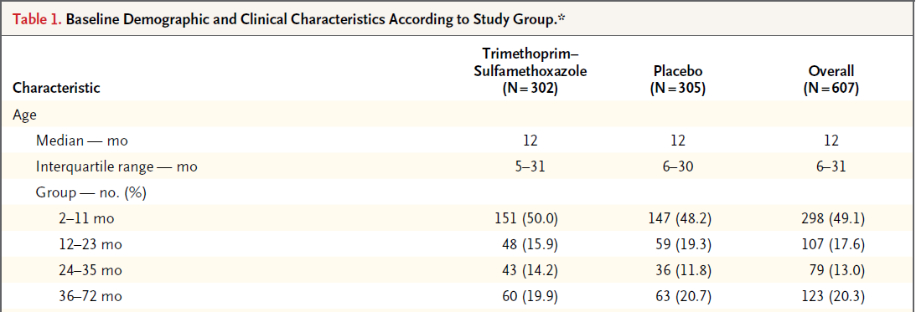

Slide 25
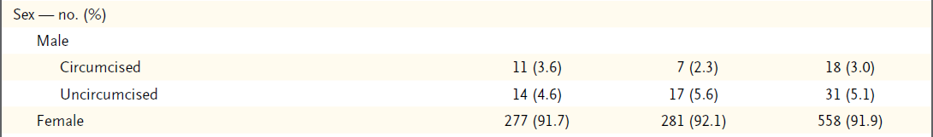
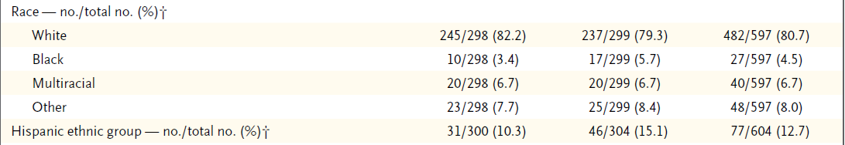

Slide 26
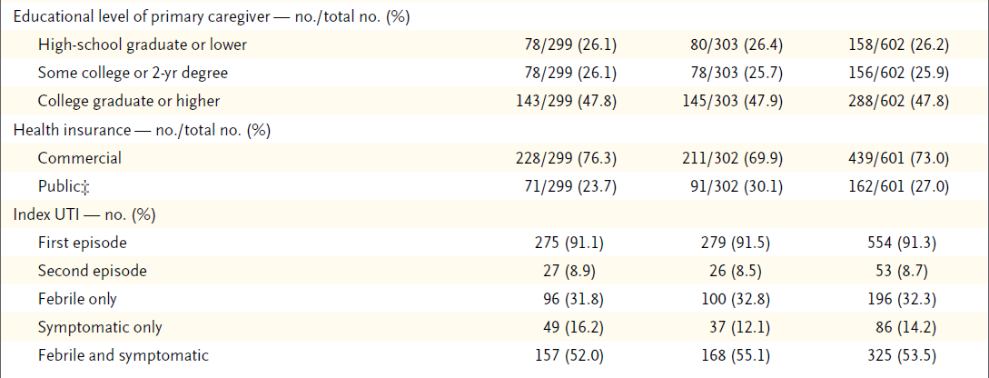

Slide 27
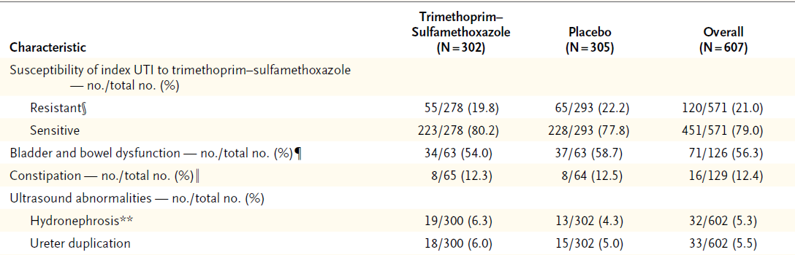

Slide 28
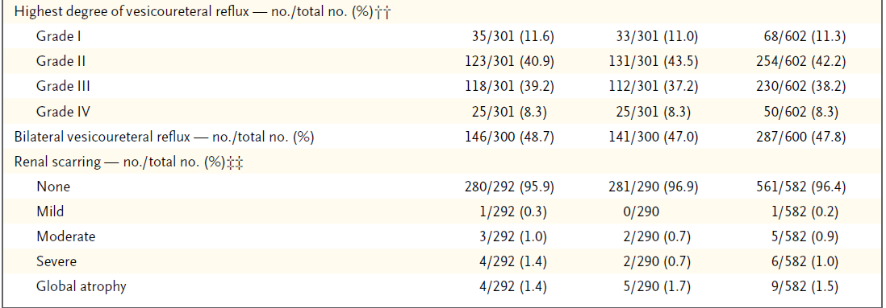

Slide 29
Adherence
Parents of 467 of the children (76.9%) reported having administered the study medication at least 75% of the time
Parents of 517 children (85.2%) reported having administered it at least 50% of the time.
Parents of 91 children in the prophylaxis group and of 76 children in the placebo group discontinued the study medication.
No significant difference in reported adherence to the study-medication regimen was noted between the study groups.

Slide 30
Recurrences of Febrile or Symptomatic Urinary Tract Infection
During the trial, 111 children had 171 recurrences of urinary tract infection
Of 111 first recurrences, 80 (72.1%) were febrile; 2 first recurrences took place after 24 months but before the study exit visit.
The risk of febrile or symptomatic recurrences was reduced by half among children who received prophylaxis as compared with those who received placebo
and the difference between the two groups widened progressively over time (hazard ratio, 0.50; 95% confidence interval [CI], 0.34 to 0.74)

Slide 31
The interval between enrollment and a 10% incidence of recurrence was 336 days in the prophylaxis group and 106 days in the placebo group.
Eight children (95% CI, 5 to 16) would have had to be treated for 2 years to prevent one case of febrile or symptomatic urinary tract infection.

Slide 32
In our primary intention-to-treat analysis with the assumption that children with missing primary-outcome data had had an event, a significantly smaller proportion of children who received prophylaxis, as compared with those who received placebo, had a febrile or symptomatic recurrence (25.5% vs. 37.4%; relative risk, 0.68; 95% CI, 0.53 to 0.87)
Similar results were obtained from sensitivity analyses that included children with missing outcome data but assumed they had not had an event (12.8% vs. 25.4%; relative risk, 0.55; 95% CI, 0.38 to 0.78)

Slide 33
and that omitted children for whom primary outcome data were missing (14.8% vs. 27.4%; relative risk, 0.54; 95% CI, 0.38 to 0.77).
The proportion of children meeting the criteria for treatment failure in the placebo group was nearly twice the proportion in the prophylaxis group (9.6% vs. 5.0%, P = 0.035).
In separate Cox models, the study-group effect remained unchanged after we controlled for age, whether the index urinary tract infection was the child’s first or second episode, the degree of baseline reflux, and the presence or absence of baseline renal scarring

Slide 34
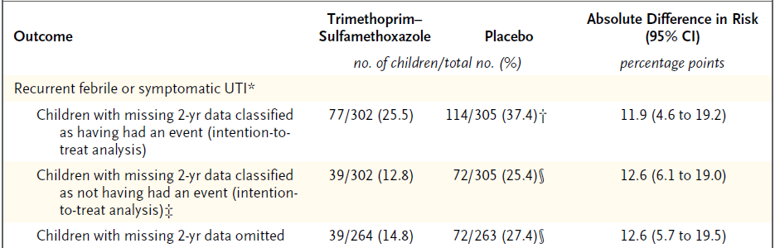

Slide 35
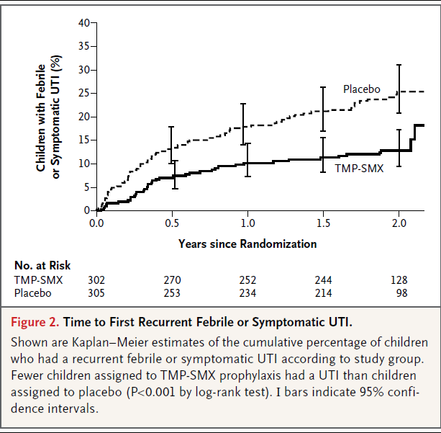

Slide 36
Renal Scarring
As reported previously, a total of 98 of 582 baseline scans were obtained less than 31 days after the index infection (16.8%), and 484 were obtained between 31 and 112 days after the index infection (83.2%).
A total of 21 scans (3.6%) were interpreted as indicating renal scarring, and 71 (12.2%) were interpreted as indicating acute pyelonephritis.

Slide 37
Outcome scans (at the 2-year visit or 3 to 4 months after the child had met treatment failure criteria) showed no significant between group differences in the incidence of renal scarring (11.9% in the prophylaxis group and 10.2% in the placebo group, P = 0.55), severe renal scars (4.0% and 2.6%, respectively; P = 0.37), or new renal scars since baseline (8.2% and 8.4%, respectively; P = 0.94)

Slide 38
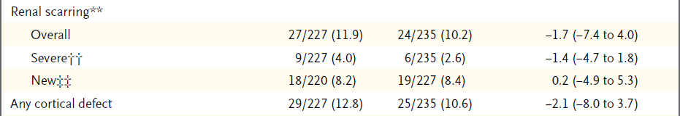

Slide 39
Antimicrobial Resistance
Stool colonization with resistant E. coli was more common in the prophylaxis group than in the placebo group, but the difference was not significant
Among 87 children with a first febrile or symptomatic recurrence with E. coli, the proportion of isolates that were resistant to trimethoprim–sulfamethoxazole was 63% with prophylaxis and 19% with placebo (P<0.001).

Slide 40
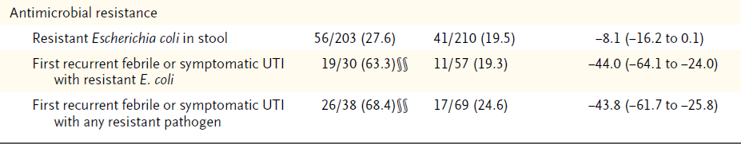

Slide 41
Effect Modifiers
Children with grade III or IV reflux at baseline were more likely to have febrile or symptomatic recurrences than were children with grade I or II reflux (64 of 280 children [22.9%] vs. 46 of 322
[14.3%], P = 0.003).
Hazard ratios for recurrences consistently favored the prophylaxis group, irrespective of sex, age at study entry, degree of reflux, whether children had one or two urinary tract infections before enrollment, whether the index infection was caused by a resistant pathogen, and whether reflux present at baseline had resolved, improved, not changed, or worsened at 2 years

Slide 42
There were significant interactions between study group and the type of index infection (P = 0.04) and between study group and the presence or absence of bladder and bowel dysfunction at baseline (P = 0.02).
The estimated hazard ratio for a febrile or symptomatic recurrence in the prophylaxis group relative to the placebo group was 0.41 (95% CI, 0.26 to 0.64) among children with a febrile index infection and 1.28 (95% CI, 0.47 to 3.46) among children with a nonfebrile index infection.

Slide 43
Corresponding hazard ratios for children with and those without bladder and bowel dysfunction at baseline were 0.21 (95% CI, 0.08 to 0.58) and 1.40 (95% CI, 0.43 to 4.58).
The study population included too few boys to evaluate the effect of circumcision, but all four boys with a first recurrence were uncircumcised at baseline.

Slide 44
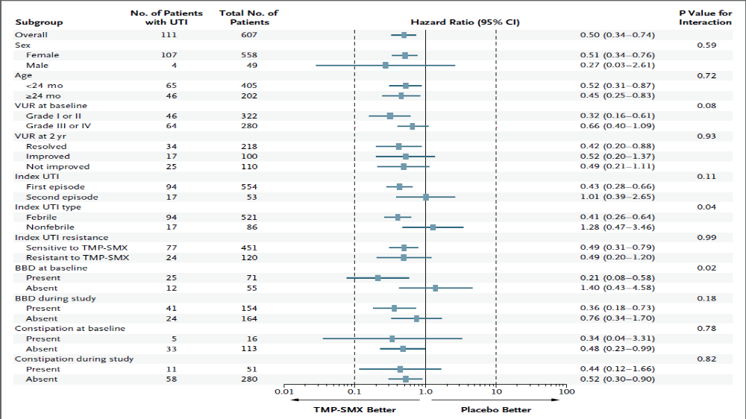

Slide 45
Reflux Status at 2 Years
Voiding cystourethrography was performed at 2 years in 428 children.
Reflux was considered to be resolved in 218 children (50.9%), improved in 100 (23.4%), unchanged in 79 (18.5%), and worse in 31 (7.2%).

Slide 46
Adverse Events
We found no significant between-group differences in the proportions of children with fever (14.2% in the prophylaxis group and 18.0% in the placebo group, P = 0.23)
otitis media (4.3% and 7.9%, respectively; P = 0.09)
diarrhea (3.6% and 6.2%, P = 0.19)
pharyngitis (6.3% and 4.6%, P = 0.38)
rash (7.6% and 7.5%, P = 1.0)
Viral infection (4.6% and 5.2%, P = 0.85)
Hospitalizations or emergency room visits (41.1% and 48.5%, respectively; P = 0.06)

Slide 47
Discussion
Antimicrobial prophylaxis in children with vesicoureteral reflux diagnosed after a first or second urinary tract infection was associated with a halving of the risk of febrile or symptomatic recurrences.
Differences between the prophylaxis and placebo groups were apparent early on and increased over a 2-year period.
Children with bladder and bowel dysfunction at baseline and children whose index infection was febrile derived particular benefit from prophylaxis, with reductions in recurrences of approximately 80% and 60%, respectively.

Slide 48
Rates of renal scarring at the outcome visit were low and were not reduced by prophylaxis, perhaps because most children were enrolled after their first infection and because parents, who were instructed to be vigilant, sought early medical attention.
Not unexpectedly, recurrences that did occur in children who received prophylaxis were more likely to have been caused by a resistant pathogen.

Slide 49
We designed our trial to avoid certain limitations of previous studies. We enrolled, from a variety of clinical settings, a large, representative sample of children with vesicoureteral reflux (grade I to IV) that was diagnosed after a urinary tract infection.
We applied stringent diagnostic criteria and used standardized scales to identify predisposing factors.
Our radiologists applied standardized criteria to enhance the reliability of their interpretations of urinary tract images.

Slide 50
Our trial has certain limitations: our results may not be applicable to children with different demographic or clinical characteristics or children in locales where the choice of trimethoprim– sulfamethoxazole may be limited by susceptibility patterns or clinical acceptability,
and some of our subgroup analyses had limited statistical power.

Slide 51
There are both similarities and differences between our findings and those of two other trials.
Craig et al. enrolled 576 Australian children under the age of 18 years with stringently defined urinary tract infection in a placebocontrolled trial of trimethoprim–sulfamethoxazole prophylaxis.
Sixty-four percent of the children were girls.

Slide 52
Twelve months of prophylaxis was associated with a reduction in the absolute risk of symptomatic recurrences of 6 percentage points (number needed to treat, 14).
However, pyuria was not found at the index infection in 32% of the children, only 42% of the children had reflux, 41% had normal voiding studies, 17% did not undergo voiding cystourethrography, and renal scanning with technetium- 99m–labeled dimercaptosuccinic acid was performed after 1 year in only 27% of the children.

Slide 53
In our trial, all children were younger than 6 years of age,
92% were girls,
all were considered to have grade I to IV reflux,
the diagnosis of infection required the presence of pyuria,
renal scanning was performed after 2 years in 76% of the children
the effect of prophylaxis was sustained over a 2-year period (number needed to treat, 8).

Slide 54
Brandstr.m et al. randomly assigned 203 Swedish children 12 to 23 months of age with grade III or IV reflux to receive antimicrobial prophylaxis (with trimethoprim, nitrofurantoin, or cefadroxil), endoscopic treatment, or surveillance only.
A total of 37% of the participants were boys, most of whom were uncircumcised.
Clinicians and parents were aware of the studygroup assignments, and bag-collected urine specimens were permitted.

Slide 55
Significant differences in outcome were noted only in girls.
Girls in the surveillance-only group had the highest incidence of febrile recurrence and the shortest time to a first recurrence;
girls who received antimicrobial prophylaxis had the lowest incidence of renal scarring at 2 years of follow-up.

Slide 56
Do our results support recent recommendations regarding urinary tract imaging in children with a first febrile urinary tract infection
Many factors may influence that decision in individual children, including the presence or absence of a family history of vesicoureteral reflux,
age, sex, and race, which affect the probability that vesicoureteral reflux is present;
the severity of the clinical course of the infection;
the status of bladder and bowel function;
the cost of voiding cystourethrography and associated discomfort;

Slide 57
the importance that parents place on preventing recurrences (which sometimes result in alarming symptoms, hospitalization, and parental work loss and which may influence the decision to proceed to surgery in children found to have reflux);
perceived parental ability to adhere to a prophylaxis regimen;
parental concern about potential long-term effects of prophylaxis, such as the development of antimicrobial resistance and alterations of the microbiome;
and most important, the effectiveness of prophylaxis in preventing recurrences.

Slide 58
As long as evidence supporting the benefit of prophylaxis was dubious, the recommendation of a watchful-waiting approach, without performance of a voiding cystourethrographic study, seemed reasonable, because the imaging findings would not affect the nature of treatment.
However, our finding that antimicrobial prophylaxis was associated with a reduced risk of recurrence may warrant reconsideration of that recommendation.

Slide 59
Decision analysis and costeffectiveness analysis may help to clarify the clinical and financial trade-offs, which may help clinicians and families reach more informed decisions about the advisability of imaging in young children such as those in our study.

