Slide 1
VISUAL PATHWAY AND ITS DEFECTS
Dr. Mustafa Shuaib

Slide 2
Components
Retina
Optic nerve
Optic tracts
Lateral geniculate bodies
Optic radiations
Visual cortex

Slide 3
retina
Neural pathway for vision is a three order neuronal pathway
First order sensory nerve cell – bipolar cell of the inner nuclear layer (periperal optic nerve)
Second order sensory nerve cell - Ganglion cells
Nerve fibre layer
Optic nerve

Slide 4
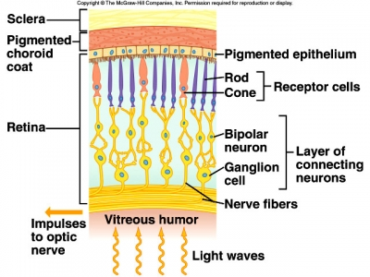

Slide 5
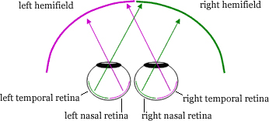

Slide 6
Each retina divided into nasal and temporal halves
Light rays travel only in straight lines, through the pupil, and so objects of temporal vision are perveived by the nasal half of the retina and those in the nasal vision are perceived by the temporal half of the retina

Slide 7
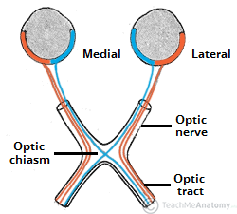

Slide 8
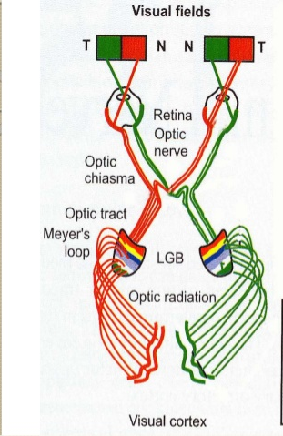
Note that immediately after crossing, the nasal fibres loop forward for a short distance into the optic nerve of the opposite eye- von Willebrand knee

Slide 9
Optic tract
Fibres from the nasal half of the retina cross over to the opposite side at the optic chiasma
Through the opposite optic tract
Terminate in the opposite lateral geniculate body

Slide 10
Fibres of the temporal half of the retina remain uncrossed in the optic chiasma
Continue on the same side of the optic tract
Terminate in the ipsilateral geniculate body
Each optic tract contains the temporal fibres of the same side and the nasal fibres of the opposite side

Slide 11
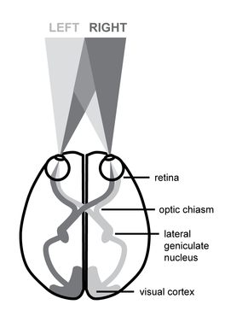
Binocular visual field

Slide 12
Lateral geniculate body, optic radiations and visual cortex
Third order sensory neurons are located in the LGB
The axons form the optic radiations
project to the visual cortex

Slide 13
Lesions of the Visual pathway
Loss of vision in one-half of the visual field (right or left) is called hemianopia
If the same halves of visual fields are affected in both eyes- homonymous hemianopia
If different halves of visual fields are affected – heteronymous hemianopia

Slide 14
Optic nerve lesions
Chiasmal lesions
Retrochiasmal lesions – those of the LGN, Optic Radiations and Occipital Lobe

Slide 15
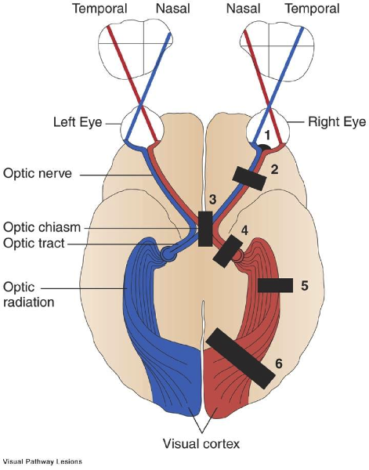

Slide 16
Optic nerve lesions
Etiology:
Optic nerve atrophy
Traumatic avulsion of optic nerve
Ischemic optic neuropathy
Acute optic neuritis

Slide 17
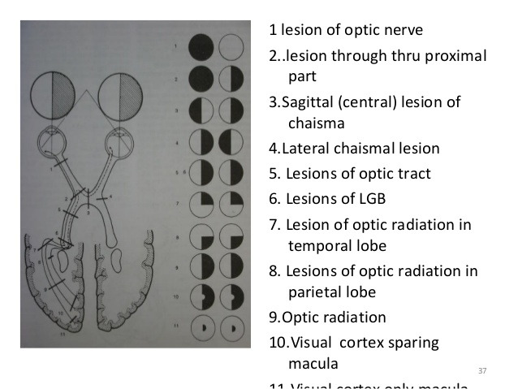

Slide 18
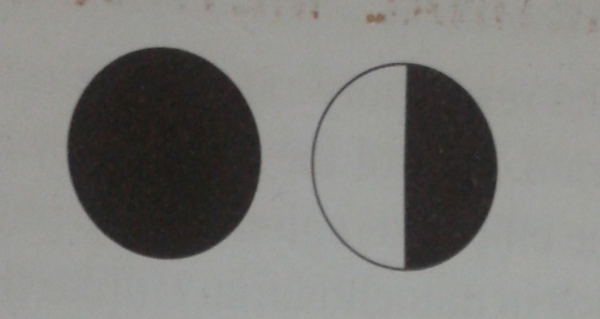
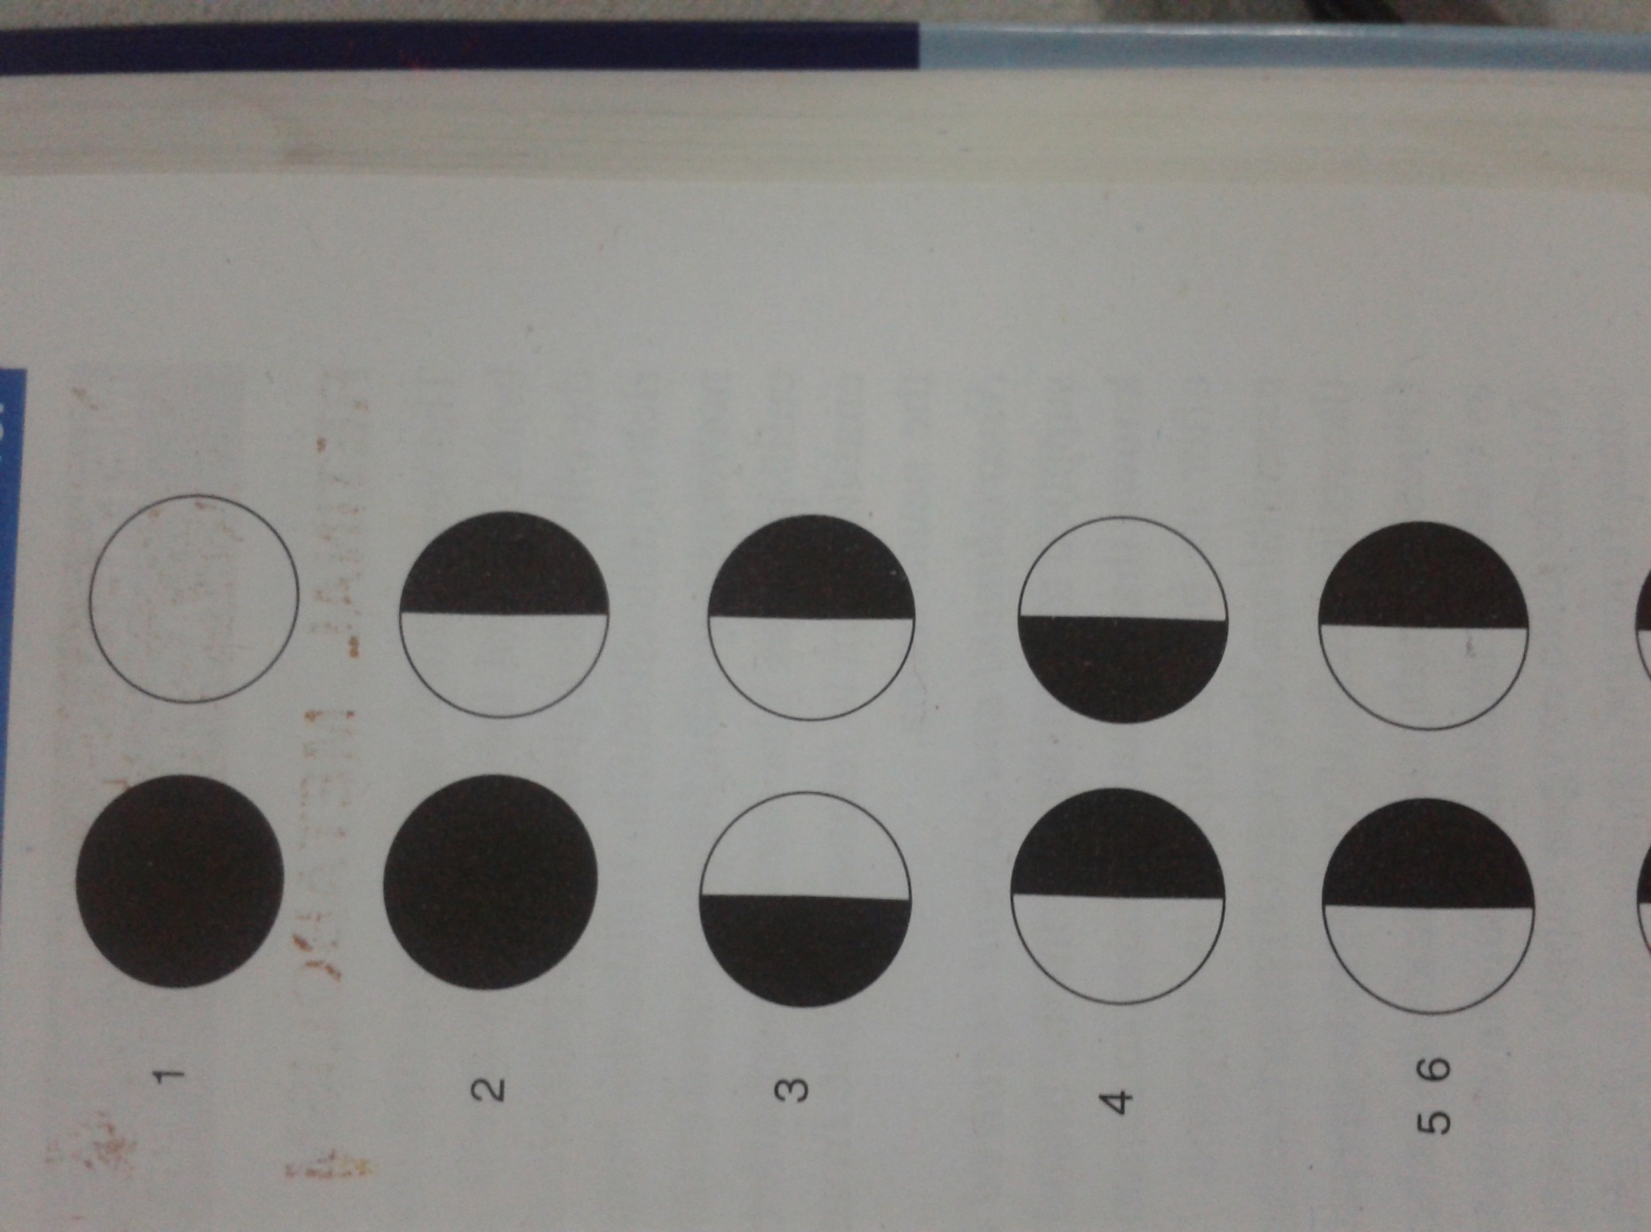
PROXIMAL | DISTAL
IPSILATERAL BLINDNESS CONTRALATERAL HEMIANOPIA | IPSILATERAL BLINDNESS
LOSS OF DIRECT REFLEX ON THE IPSILATERAL SIDE AND CONSENSUAL REFLEX ON THE CONTRALATERAL SIDE | LOSS OF DIRECT REFLEX ON THE IPSILATERAL SIDE AND CONSENSUAL REFLEX ON THE CONTRALATERAL SIDE
ACCOMODATION REFLEX PRESENT | ACCOMODATION REFLEX PRESENT

Slide 19
CHIASMAL LESIONS
Etiology:
Intrinsic causes: which produce thickening of the chiasma itself include gliomas, multiple sclerosis
Extrinsic causes: compressive lesions like pituitary adenoma, meningioma, craniopharyngiomas
Others: metabolic, toxic, traumatic and inflammatory conditions

Slide 20
CHIASMAL LESIONS
CHIASMAL SYNDROME: the set of signs and symptoms associated with the lesions of optic chiasma.
Classified into three:
ANTERIOR
MIDDLE
POSTERIOR

Slide 21
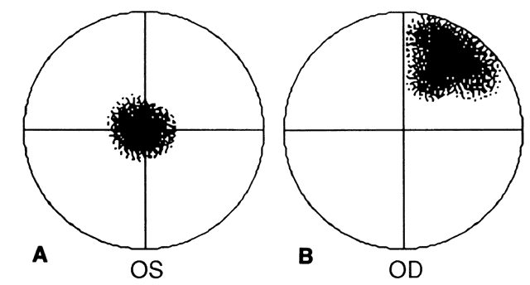
Anterior chiasmal syndome
Affects the ipsilateral optic nerve fibres and the contralateral inferonasal fibres located in the von Willebrand knee
Typically produces the junctional scotoma – a combination of central scotoma of one eye and a temporal heminanopia of the other

Slide 22
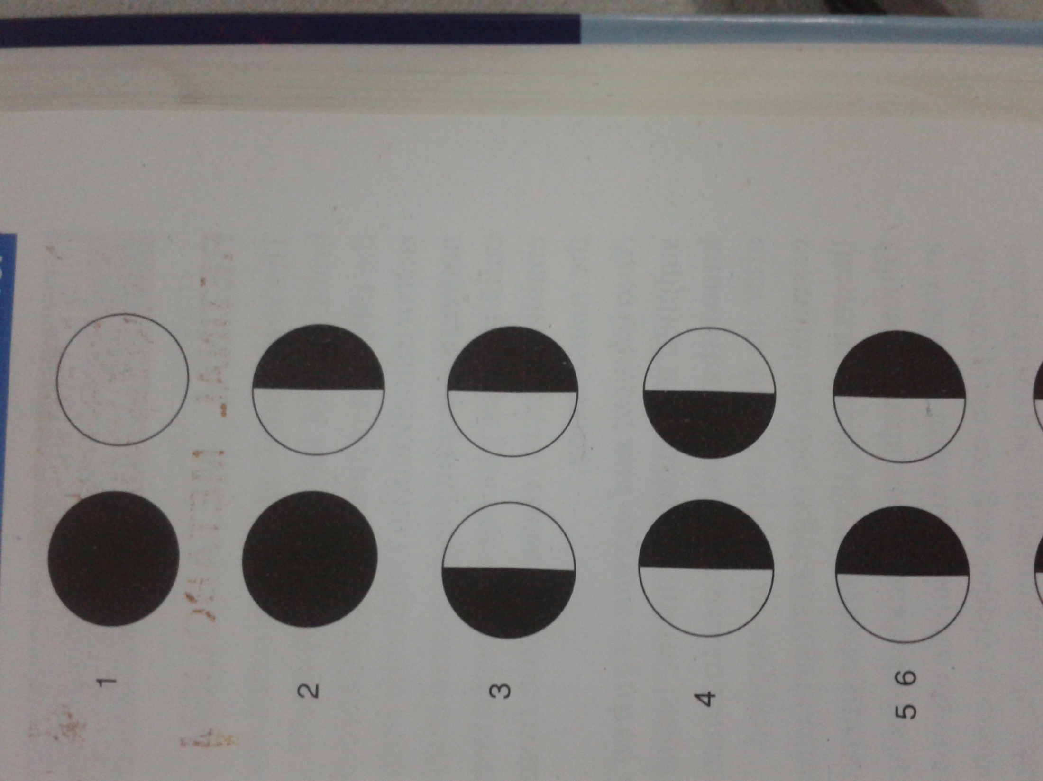
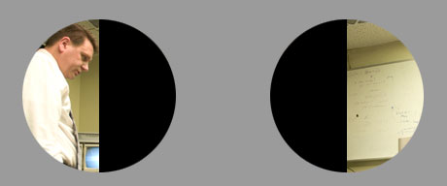
Middle/Central chiasmal syndrome
Lesions affecting the decussating nasal fibres in the body of the chiasma
Classically produces bitemporal hemianopia and bitemporal hemianopic paralysis of pupillary reflexes
Rarely, binasal hemianopia (when it affects the uncrossed temporal fibres)

Slide 23
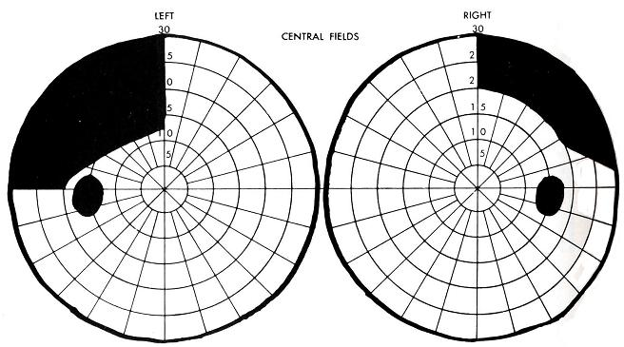
Posterior chiasmal syndrome
Macular fibres cross posteriorly in the chiasma
Typically produces the paracentral bitemporal field defects
Visual acuity and color vision may not be damaged as the temporal macular fibres are not damaged

Slide 24

Lateral chiasmal lesions
Distension of third ventricle causing pressure on each side of chiasma
Atheroma of the carotids or posterior communicating arteries
Binasal hemianopia
Binasal hemianopic paralysis of the pupillary refexes

Slide 25
RETROCHIASMAL LESIONS
Include lesions of optic tract, LGB, optic radiations and occipital lobe
Contralateral homonymous hemianopia of different forms such as incomplete (congruous or incongruous) or complete, depending upon the site of lesion is the classical field defect

Slide 26
Optic tract
Etiology:
  Intrinsic causes: Demyelinating diseases and infarction.
  Extrinsic causes: Compressive lesions. Eg. Pituitary adenomas, craniopharyngiomas
  Others: syphilitic meningitis, tubercular meningitis

Slide 27
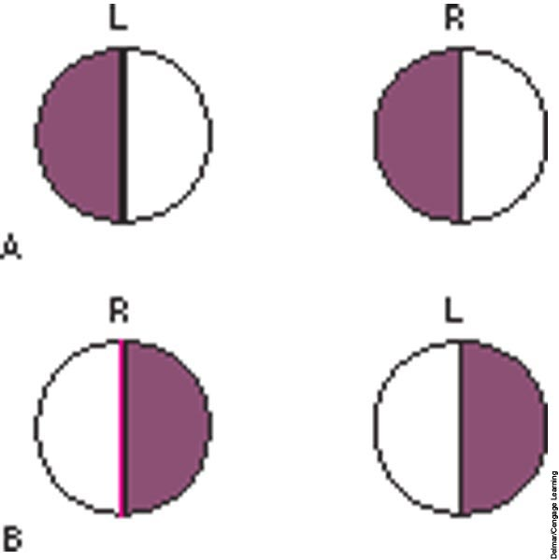
Each optic tract contains ipsilateral temporal fibres and contralateral nasal fibres
Incongruous homonymous hemianopia : assymmetrical field defect of involving either right halves of visual field of both eyes (in left optic tract lesions and vice versa)

Slide 28
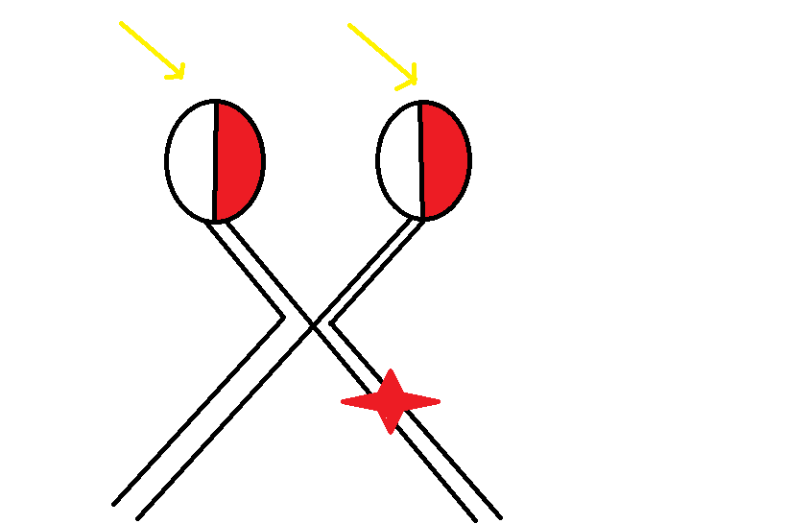
Contralateral hemianopic pupillary responses – the Wernicke’s reaction
Optic disc changes: descending type
of partial optic atrophy characterized
by temporal pallor on the side of lesion
Visual acuity is usually intact in the
Intrinsic lesions

Slide 29

Lesions of lateral geniculate nucleus
Homonymous hemianopia produced is usually incongruous
Pupillary reflexes are normal (as fibres for pupillary reflexes from the optic tract are diverted to pretectal nucleus and do not reach the LGN
Optic disc pallor may occur due to partial descending atrophy

Slide 30
Lesions of optic radiations
Etiology:
Vascular occlusion
Primary & secondary tumors
Trauma

Slide 31
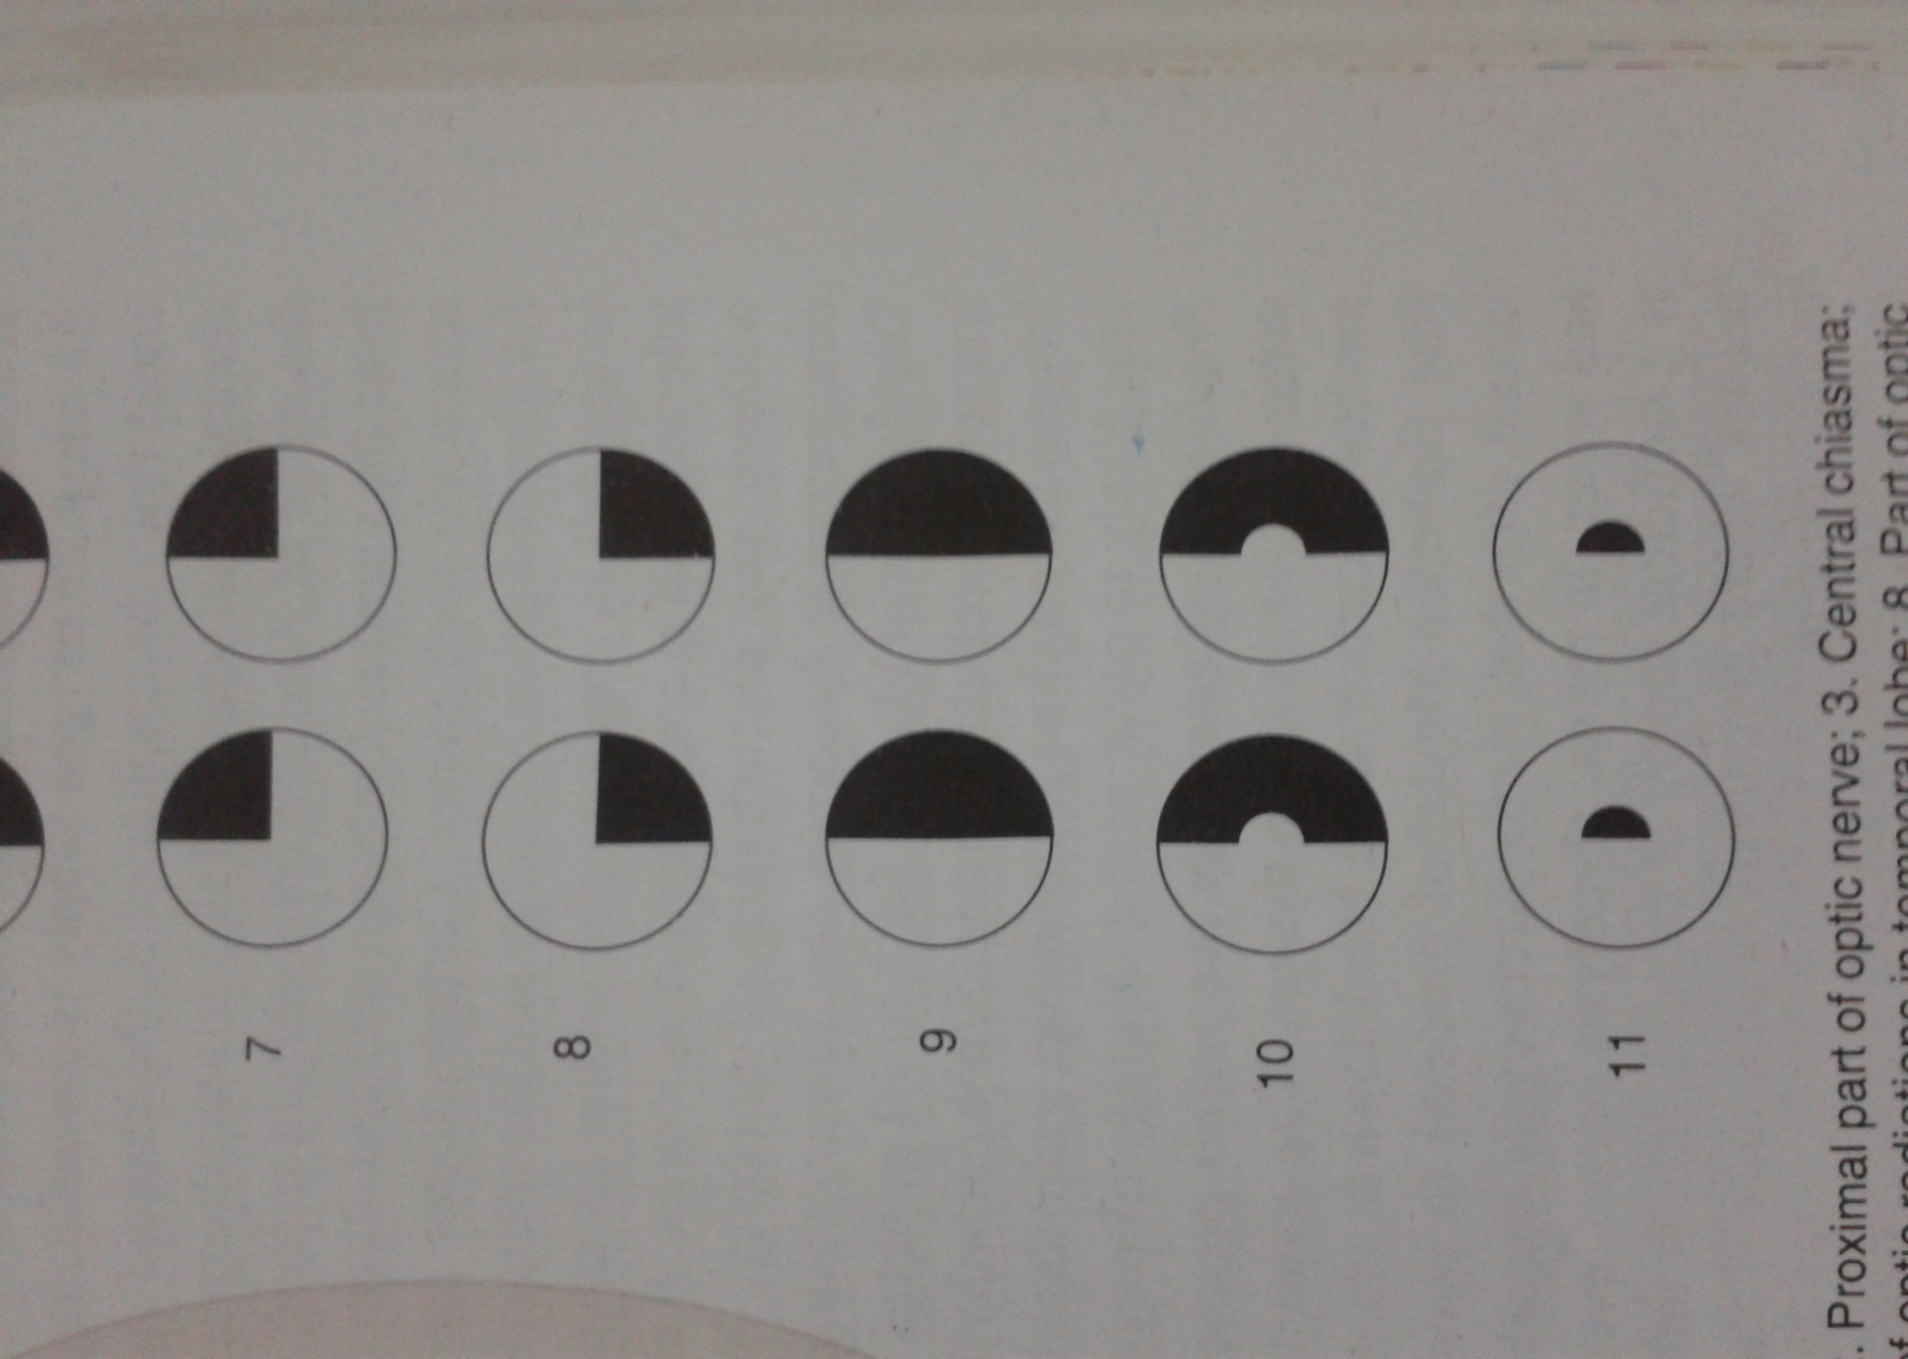
TOTAL OPTIC RADIATION INVOLVEMENT
COMPLETE HOMONYMOUS HEMIANOPIA( sometimes sparing macula)
LESIONS OF TEMPORAL LOBE (involving inferior fibres of optic radiations)
SUPERIOR QUADRANTIC HEMIANOPIA( pie in the sky)

Slide 32

LESIONS OF PARIETAL LOBE (involving superior fibres of optic radiations)
INFERIOR QUADRANTIC HEMIANOPIA( PIE ON THE FLOOR)
Pupillary reactions are normal as fibres of light reflex leave the optic tracts to synapse in the superior colliculi.
Lesions of optic radiations do not produce optic atrophy as the 2nd order neurons (optic nerve fibres) synapse in LGB.

Slide 33
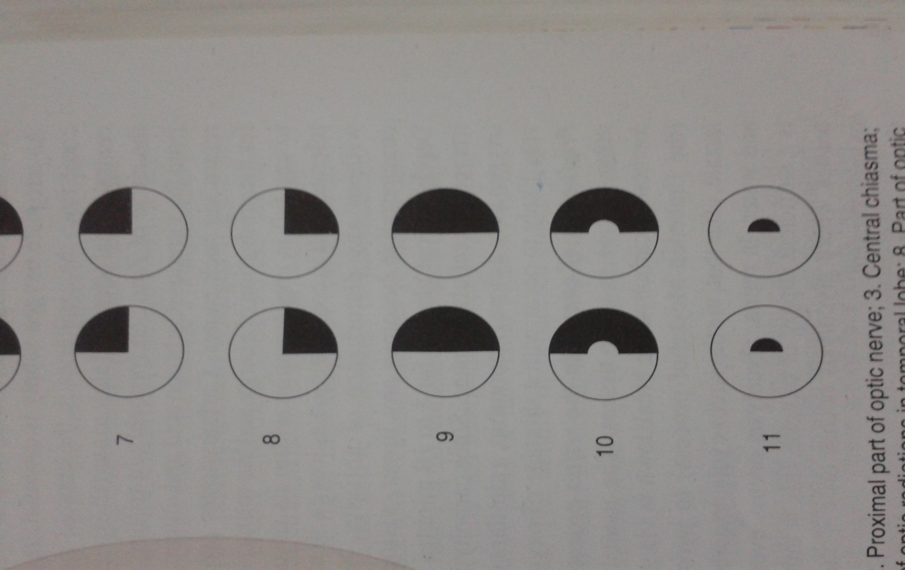
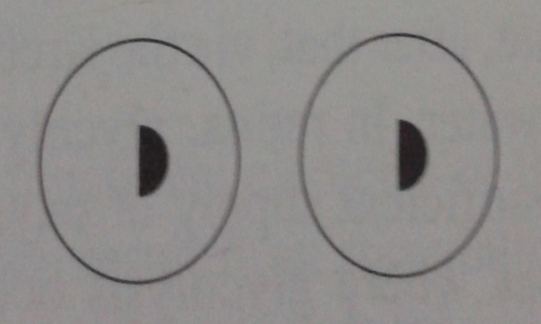
Lesions of visual cortex
Congruous homonymous hemianopia(sparing macula)
Occlusion of posterior cerebral artery supplying anterior part of occipital cortex
Congruous homonymous macular defect
Head injury/gun shot injury leading to lesions of tip of occipital cortex

Slide 34
Pupillary reflexes are normal
Not associated with optic atrophy

