Slide 1
Identification of Ankyrin Repeats Domain and RNASE Domain Mutations of RNASE-L in HCC and its correlation with HCV viral load
ANUM LIAQUAT ALI
M.Phil.
Molecular Pathology,CHPE
Lecturer ,Pathology,DIMC
Institute of Biomedical Sciences
DOW University of Health Sciences

Slide 2

OUTLINE
Introduction
Objectives
Research methodology
Results and Discussion
Conclusion

Slide 3
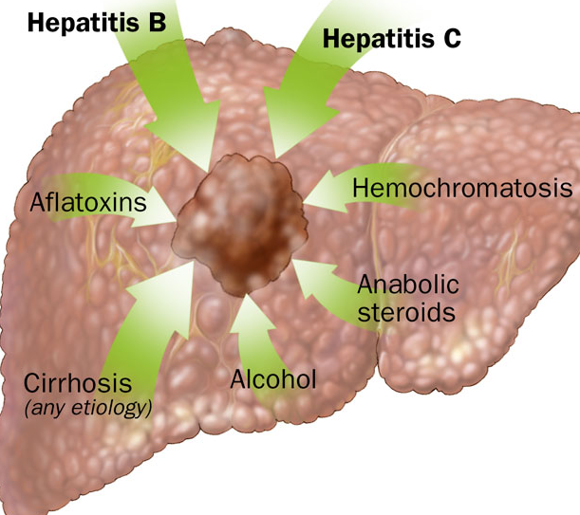
Hepatocellular Carcinoma
Introduction
Hepatocellular carcinoma (HCC) is a primary malignancy of the liver.
Its occurs predominantly in patients with underlying chronic liver disease and cirrhosis.
The incidence of HCC is highest in Asia and Africa.

Slide 4


HEPATOCELLULAR CARCINOMA
Globally Half million new cases every year.
World wide mortality rate is 662,000.
The occurrence of HCC in Pakistan is 5.7% for men , 3.7% for women.
Notes:
.

Slide 5
Risk Factors of HCC
Alcoholism
Hepatitis B
Hepatitis C
Type 2 Diabetes
Mutation of genes like RNASE L
Cirrhosis of liver

Slide 6
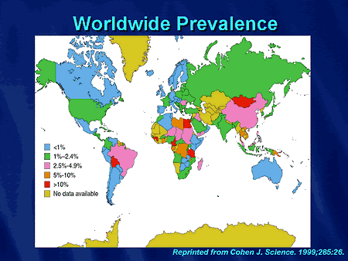
Prevalence Of Hepatitis C Virus
Worldwide, 1% of population infected with HCV (WHO 2017)
HCV is found in 80% of the HCC cases
Pakistan has high burden of Hepatitis C
Prevalence of HCV is about 6% in general population of Pakistan

Slide 7





Cellular Immune Mechanism in HCV Infection:
Activation of
Natural killer (NK) cells
Cytotoxic T lymphocytes
Different cytokines

Slide 8
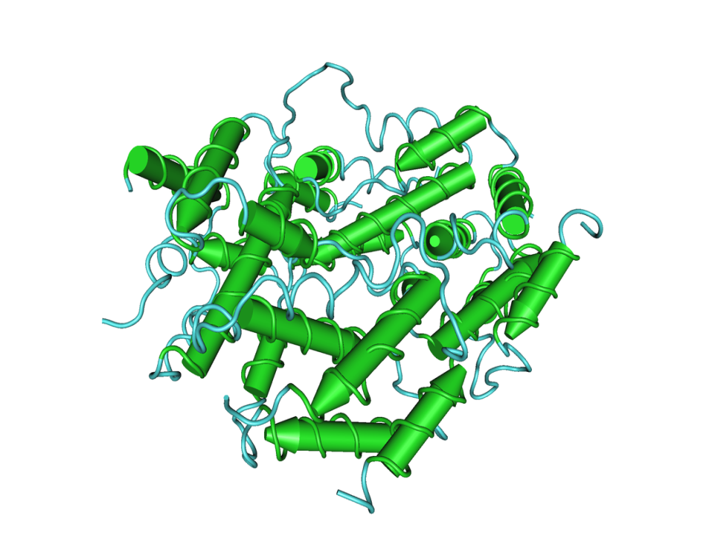
Interferon
Central role in initiating immune responses, especially antiviral and antitumor effects.
IFN triggers immune defense mechanism to eradicate pathogens.
IFN induced 2-5A, OAS-RNASE L pathway and eradicate viral infection.

Slide 9
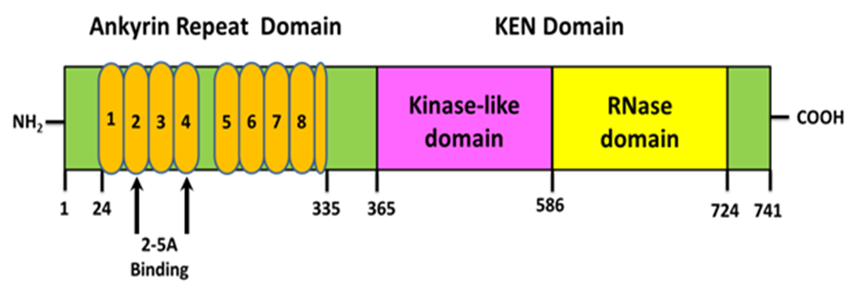
RNASE L GENE
RNASE L GENE
Ankyrin Repeat Domain
RNASE Domain
2-5 A binding
Binding of 2-5A in the Ankyrin-region of RNase L
Converts the enzyme from inactive to active dimers
Its activation, destroys all RNA within the cell (both cellular and viral)

Slide 10
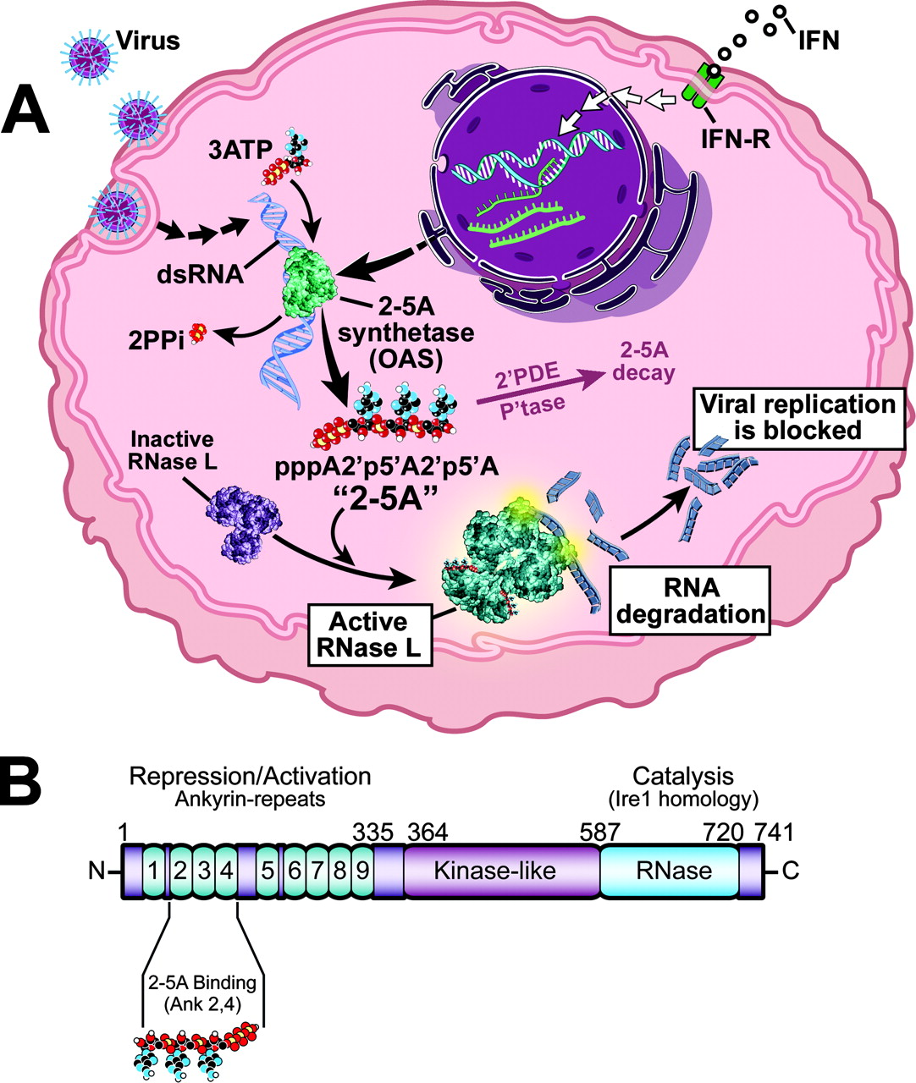

Slide 11

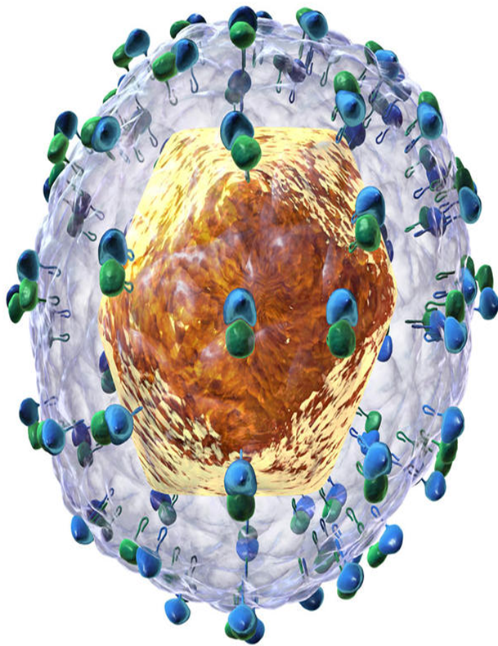
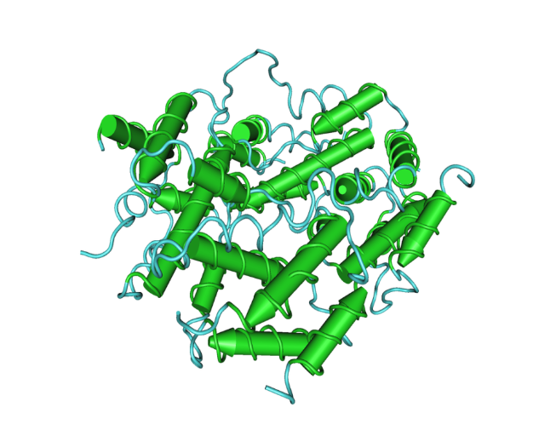
Rationale
RNASE L has known antiviral, antiapoptotic and anti-proliferative activity
Different groups have investigated mutation/s of RNASE L gene in different cancers including breast, prostate, cervical, head and neck

Slide 12

OBJECTIVES
To determine mutational analyses of RNASE L 2,5A binding ANK and RNASE L RNASE domains
To determine HCV viral load in HCC

Slide 13
RESEARCH METHODOLOGY
RESEARCH METHODOLOGY
Research setting:
Molecular Pathology, DDRRL and National Institute of Liver & Gastro Intestinal Diseases (NILGID), Dow University of Health Sciences
Research design:
Cross sectional
Inclusion Criteria
Diagnosed patients with HCC with HCV
Only HCV diagnosed patients
Exclusion Criteria
Co infection HBV with HCV
Triple Infection HBV, HDV and HCV

Slide 14
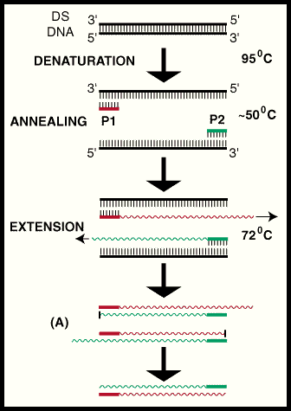
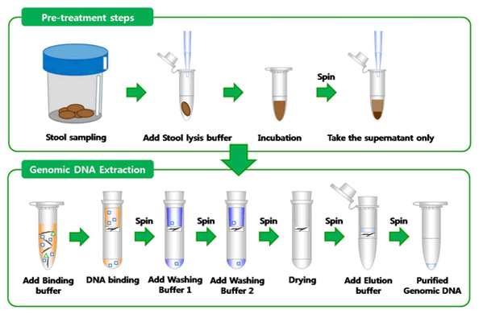
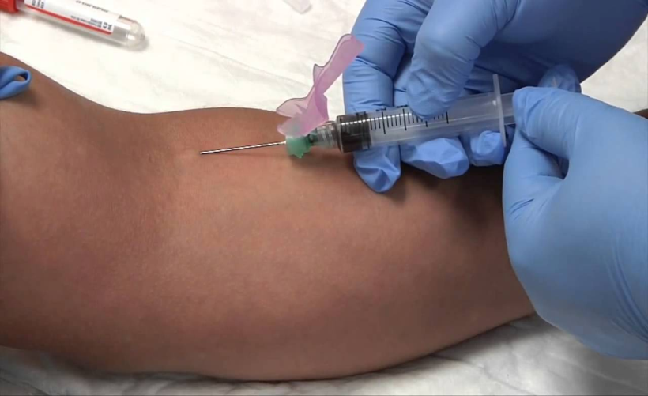
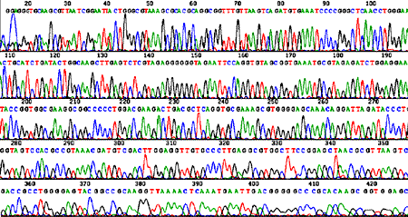
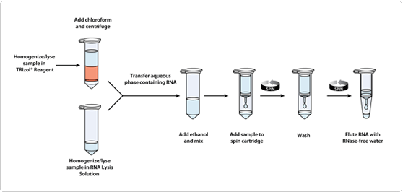
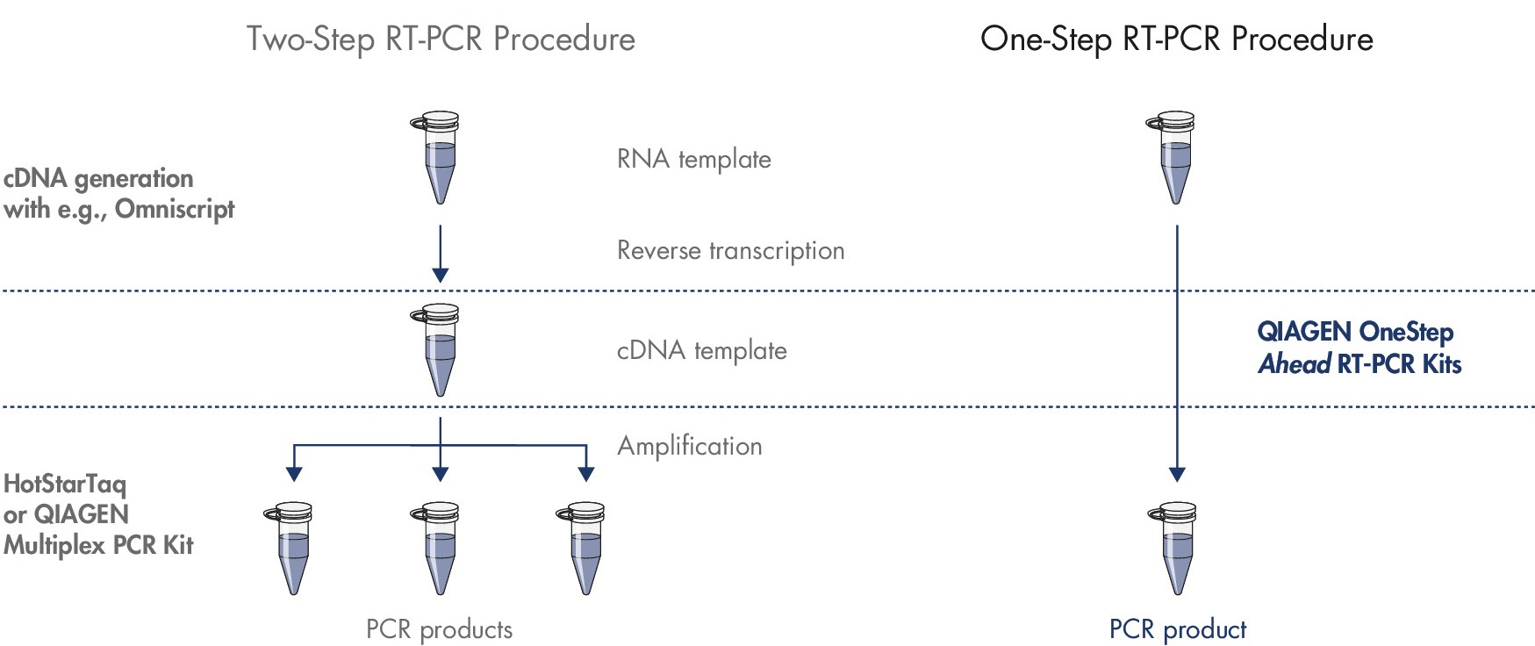

Methodology
Collection of Blood Sample
DNA extraction
Statistically analyses
RNA Extraction
Amplification of ANK domain through PCR
Amplification of RNASE domain through PCR
HCV viral load by qRT PCR
Sequencing
Detection of mutation
Sequencing
Detection of mutation
DNA Sequencing and mutation analyses of ANK and RNASE domain
Amplification of ANK domain andRNASE domain through PCR
Sample was collected from patients
DNA extraction was performed
ARD-F 5 CGAAGATGTTGACCTGGTCC-3’ 302 bp
ARD-R 5’- CATACACAGCGGCTTCCATG -3’
RN1-F 5`-GATTTATTTTGTGTTGCTACCAC-3` 208bp
RN1-R 5`-GTAGGAATGAAAACAATACTTAC-3`
RN1-R 5`-GTAGGAATGAAAACAATACTTAC-3
RN2-F5`- GGCCATATGCTGTGAAGCGG-3 404bp
RNA extraction was done
RNA extraction from plasma followed by qRT PCR for HCV Viral load quantifcation

Slide 15
DEMOGRAPHIC PROFILE OF PATIENTS
The distribution of total 80 patient’s age is shown in table
RESULTS
Age 10-25 years n=5 (6.2%) |  | Age 26-41 years n=23 (28.7 %) |  | Age42-57years n=23(28.7 %) |  | Age 58-73 years n=29 (36.4%) |  | Total n=80
Male | Female | Male | Female | Male | Female | Male | Female | Male | Female
02 | 03 | 13 | 10 | 12 | 11 | 19 | 10 | 46 | 34

Slide 16
GENDER WISE DISTRIBUTION
Gender wise distribution of samples (n=80).

Slide 17
hcv
hcc
95%
5%

Slide 18
HCC WITH HCV

Slide 19
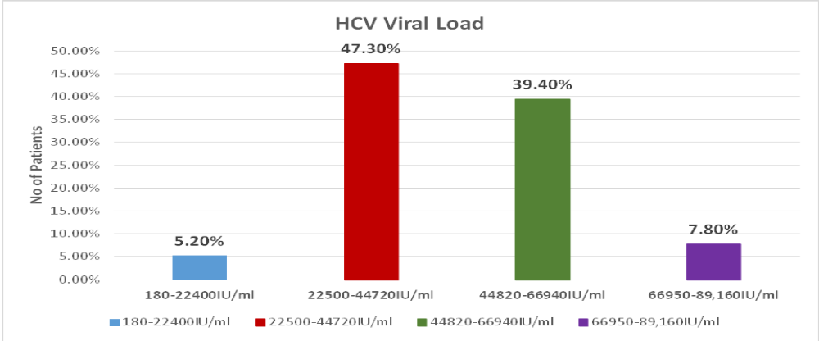
HCV VIRAL LOAD QUANTIFICATION
No of Patients%

Slide 20
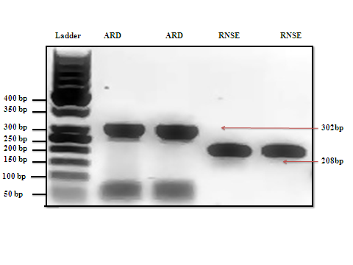
Gel Photograph of rnase l gene amplification
1
2
3
4
5
2% Agarose gel-electrphoresis image showing a 204 & 302bp amplified product.
Lane 1 = 50 bp DNA reference ladder , lane 2,3 ARD Domain,4,5= RNASE Domain of RNASE L amplified gene.

Slide 21
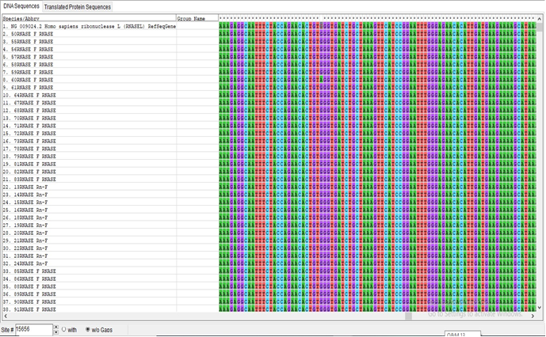
Mutation Analyses of ARD and RNASE domain of RNASE L gene
Only Single mutation(g.15656G>A) in RNASE domain of RNASE L in HCC patient
No SNV mutation in ARD domain

Slide 22
discussion
It was observed that the rate of men suffering from HCC is higher than women, which is in agreement with the previous studies conducted by CHEN CJ et al. and Jemal A et al.
HCV was also present in most of the HCC patients which supports the results of AI Gomaa et al.
Carpten et al. has proposed RNASE L as a candidate gene for HCC pathogenesis. However, only single mutation (g.15656G>A) was observed in RNASE domain of RNASE L in HCC patients which is not reported in any previous study
Abbas et al has reported that HCV geno­type 3 is present in 96% of the patients.

Slide 23
Conclusion
Prevalence of Hepatocellular Carcinoma is increasing, due late diagnosis at advanced stages, less awareness and the disease burden of Hepatocellular Carcinoma associated with HCV viral load.
We have observed single SNV (g.15656G>A) in RNASE domain of RNASEL gene in one sample only.
None of the samples showed SNV in ARD domain.
Majority of the patients were males and belonged to age group 58-73 years age.
All of the HCV infected individuals have HCV genotype 3 .

Slide 24
ACKNOWLEDGEMENT
Vice chancellor and Pro-vice chancellors of Dow university of Health Sciences
Director IBMS
Director DDRRL
Research Department
Administrative Staff of IBMS
Members of Molecular Pathology Lab

Slide 25


