Slide 1
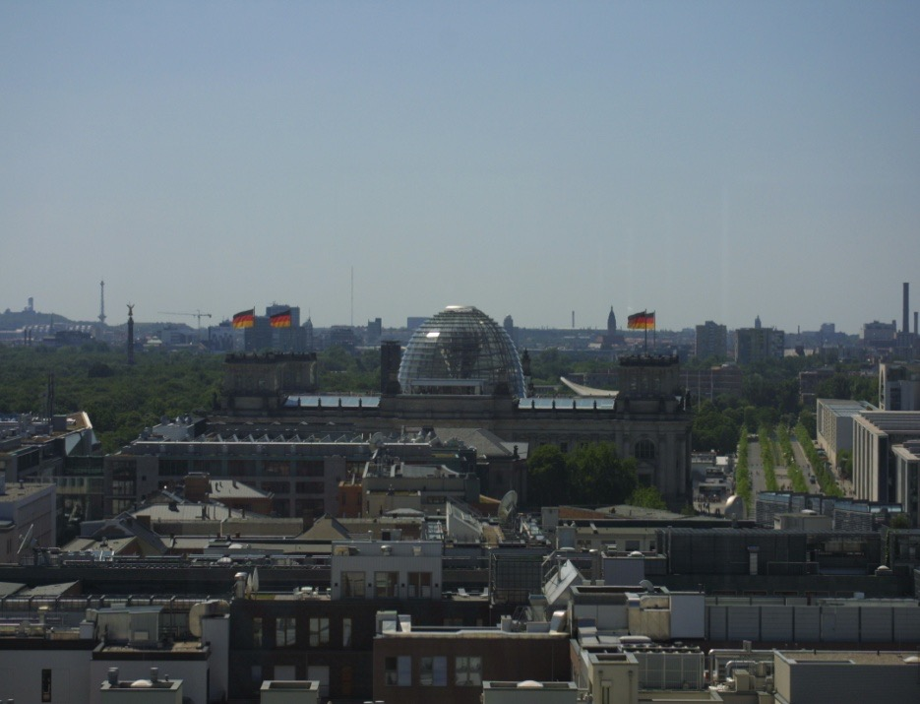
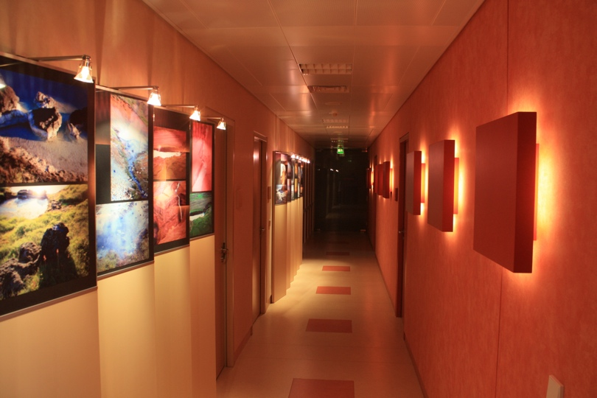
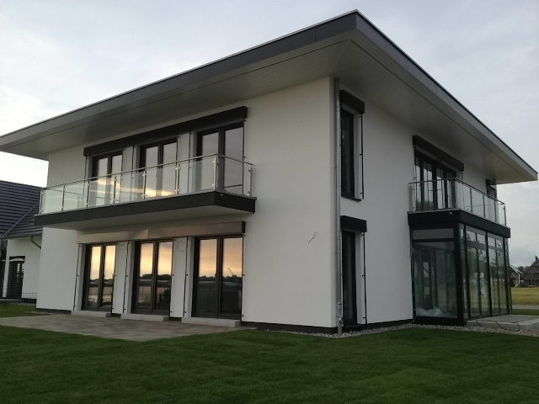
2th. Annual Congress of ESVM
Roma 8.-10.05.2016
    Sealing veins with „VenaSeal Closure“ system
50 Month - Study: results for 1251 treated veins

Slide 2
Disclosure
Speaker name: Dr. Ulf Thorsten Zierau
I have the following potential conflicts of interest to report:
                Consulting
                Employment in industry
                Stockholder of a healthcare company
                Owner of a healthcare company
                Other(s)
X I do not have any potential conflict of interest.

Slide 3
Saphenion since 1997
Since the opening of our vascular praxis in Berlin, February 1^{st.} 1997 and the opening of a second venous center in Rostock August 1^{st.} 2012 we have done the following:
Conventional surgery of stripping and phlebectomy in 1.000 cases (until 2012)
Laser ablation (2002 - 2008) of nearly 2.800 veins
Radio frequency of 2.500 truncal veins
VenaSeal Closure treatment since August, 1^{st.} 2012:
Implantation into 1.251 veins in 700 patients

Slide 4
VenaSeal® Closure - our experience
Treatment with Cyanoacrylat
Since 1949 the chemical compound is known, first being used in operative medicine in the early 60s.
Tissue adhesive or replacement of wound sutures
Nearly all operative disciplines were using cyanoacrylate i.e dermatology, ophthalmology, orthopedics, surgery orthodontics, interventional radiologists.
The risk of allergic reaction is not real - we didn`t find any report or scientific study in medline or pubmed
FDA - approval states: VenaSeal® is bio-compatible, bio-resorptive, not carcinogenic and not allergenic!

Slide 5
VenaSeal® Closure - our experience
Until August, 16^{st.} we sealed greater saphenous vein in 876 cases, smaller saphenous vein in 365 cases and saphena - accessoria - veins in 10 cases
Treatment of one truncal vein in 202 cases, 449 patients received treatment for two truncal veins simultaneously, in 45 cases we treated three truncal veins; 4 patients had four truncal veins treated in a single session (summary: 700 patients)
In 6 cases we treated a truncal veins with ulcera crures - healed 2 weeks after.
Nearly all procedures carried out under sedation (dormicum), 27 patients without any anesthesia, one patient performed pain acupuncture on herself on point G4
In over 95% our patients chose to use music therapy with head phones, no general anesthesia in any case, in nearly 98% of all cases the patients left without compression stockings
Recommendation for ectatic veins (over 1.2 cm in diameter) and aneurysms

Slide 6
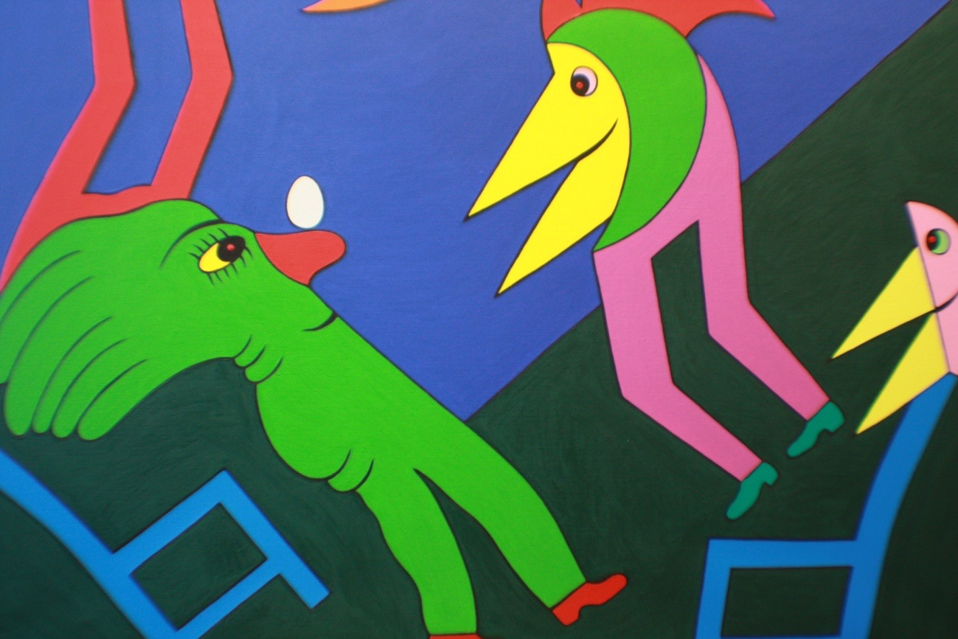
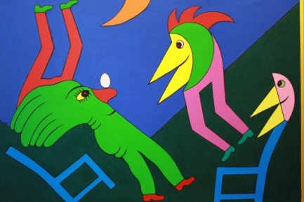


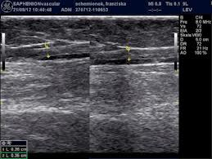
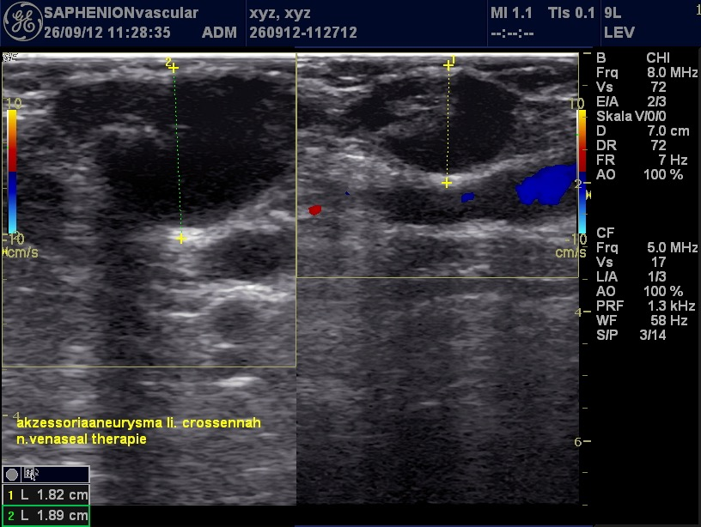
VenaSeal® Closure - sealing veins

Slide 7
VenaSeal® Closure - our results
for the treatment of one truncal vein we need 1.2 ml to 1.8 ml of glue.
time of treatment for one GSV: 12-18 min., for two veins 20-30 min.
side effects in 10 - 13% of all cases:
unspecific inflammatory reaction of tissue in 13.0% (no phlebitis!)
ecchymosis in 6%, especially in extra-anatomic subcutaneous truncal veins
lymph fistula at the puncture site in three cases
  There was not to be found: hypesthesia, paresthesia, permanent skin reaction, no phlebitis or thrombosis.

Slide 8
VenaSeal® Closure - our results
Duplex control follow up over almost 50 month: the first day 1.251 veins were re-examined – 1.241 veins were sealed initially: = 99.2% closure rate
after 14 - 30 days we found 24 partial and 4 completely recanalized veins:
= 97.8% closure rate
three to four months post operationem we had 25 partial and 6 complete recanalisations: = 97,5% closure rate
after six to eight months we observed 25 partial and 9 complete recanalisations: = 97.3% closure rate
further recanalisations were not observed until month 37 in this retrospective study
closure rate over 50 months: 97.3%

Slide 9
VenaSeal® Closure - our discussion
quality standards for endovenous therapy have been developed
colleagues have secure quality criteria for trans-catheter treatment methods. VenaSeal® closure is the newest development.
in contrast to most other methods VenaSeal® is performed without using thermal or mechanical energy.
the side effects of laser or radiowave are not an issue, pain score compared to radiowave is significantly lower (1.6 – 3.4)
we neither need general anesthesia or tumescence, nor do we need compression stockings
we can treat two or more truncal veins simultaneously in one single session
The closure rate of VenaSeal® compared to radiowave is the same or better!

Slide 10
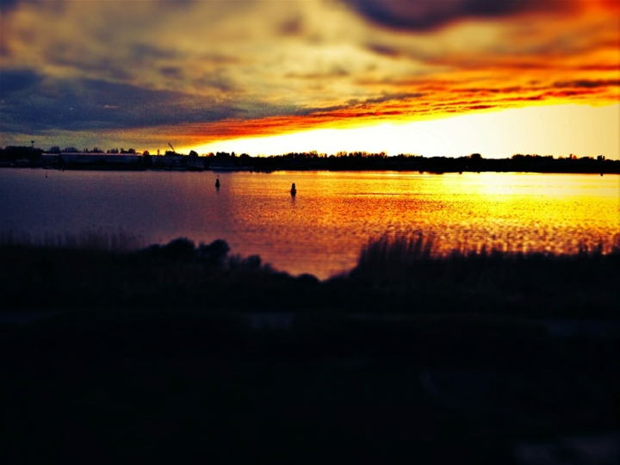
After 14 years of working with endovenous techniques we say:
Think endovenously!
Our experience with endovenous therapy and especially with
VenaSeal® Closure made it our basic therapy of truncal varicous veins.

Slide 11
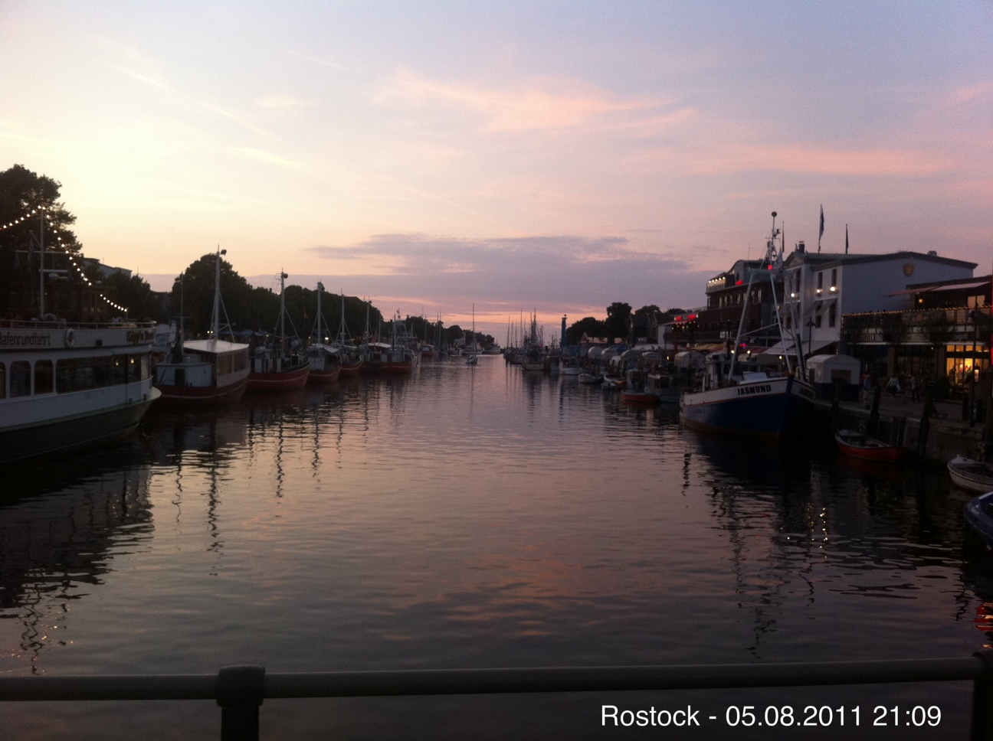
Thank you for your attention.

