Slide 1
Nepal Korea Friendship Hospital
Madhyapur Thimi, Bhaktapur
Phone 6633442
Email: knfh66@gmail.com
Web: www.knfh.org.np
Face book: Hospital knfh
Annual Progress Report
April 2017—Mar2018

Slide 2
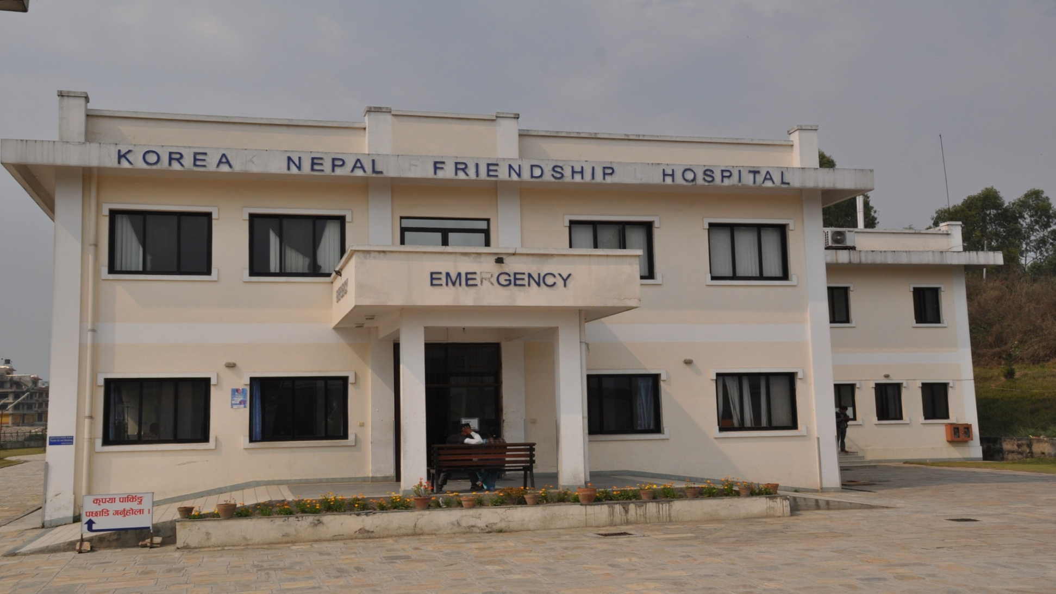
NEPAL KOREA FRIENDSHIP HOSPITAL

Slide 3
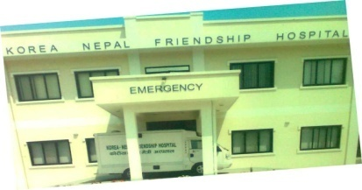





N
Siddhikali Temple
N.T.A.
Thimi
N.T.C.
Char dobato
Gathhaghar
Thimi chook
Bhaktapur
Way to Dadhikot
Way to Balkot

Slide 4
Nepal Korea Friendship Hospital
Madhyapur Thimi Bhaktapur
(Brief Information
Background of the Hospital:-
Nepal Korea Friendship Hospital was established in 1999 in the name of Kyung Hee Nepal Health Centre with the purpose of providing various health Services especially to the people of Bhaktapur and adjoining districts.
To provide the preventive, Curative, promotive and rehabilitative health service is its motto. Passing the various phases from 1999, it has got the opportunity to be a 50 bedded general hospital by the decision made by the bill of right committee under the cabinet of Nepalese Government at the date 2009/09/14.
To reach in this phase for this hospital KOICA has played a vital role by supporting the financial and technical support. This hospital stands as a well equipped hospital in Bhaktapur District.
To develop the status of this hospital KOICA, Madhyapur Thimi Municipality are doing common efforts and executive committee are committed to make it a hospital as per the people’s hospital runned by community.

Slide 5
Importance of the Hospital in Nepal:-
This hospital is stand as per the symbol of the friendship between Korea and Nepal. So that it has got the opportunity to be inaugurated by the First President of Nepal, even though it is not a big hospital in Nepalese Context. This Hospital is the first baby of KOICA in Nepal and also this is only one Hospital under the ministry of Local Development in Nepal. This is a community hospital and runned by community for the community .So, all these are the challenges and opportunities for this hospital
Governing Rule of the Hospital:-
There is one personnel administration rule 2067 B.S. and Financial administration rule 2067 B.S. prepared and approved by the government to develop and run the hospital. All the administrative and financial activities will be guided by this rule.
Governing Body:-
The governing body of this hospital has been formed by the government of Nepal.It has eleven numbers of members and called executive committee. It consist Mayor of Madhyapur Thimi Municipality as a president and representative from Local development Ministry, Representative from district Public health office and so on.

Slide 6
Recruitment System:-
There is one recruitment committee under the personnel administration rules 2067 B.S. This committee is independent to recruit the vacant post .The post will be created by the executive committee as per the needs of the hospital. But sometimes for the certain period some of the post could be fulfilled by hiring in contract.

Slide 7
Nineteen years Journey of
Nepal Korea Friendship Hospital
(1999-2017)
Years | Activities
1999 | Established Kyung hee Nepal Health Centre(Launched 2 General Health Camp) Started OPD with Lab, Pharmacy and X-Ray
2000 | Added Ultrasound service
2001 | Added various programmes with Nepalese Non Govt.Organization
2002 | Ambulance service started
2003 | Added Endoscopy service
2004 | Added Emergency services 24 hrs in co-operation of Madhyapur Thimi Municipality and named Korea Thimi Friendship Hospital.
2005 | Various Health Camp and regular health services was launched
2006 | Developed the proposal for Korea Nepal Friendship Hospital and Forwarded through M.T.M to Korean Embassy and the team from Korea started to visit to hospital ,concerning to hospital building.

Slide 8
2007 | Various Korean and Nepalese Team visited concerning to hospital building
2008 | Construction work of hospital building completed and handover to M.T.M by KOICA /Nepal
2009 | Preparation of rules and regulations for the hospital and efforts to get approval from Government of Nepal .Hospital Inaugurated by President.
2010 | Approval for hospital as per the hospital development committee by the Government .hospital started various major operations .
2011 | Preparation for Epilepsy care program in hospital Human Resource development training in Korea for this purpose also established basic foundation for Epilepsy care and installed EEG machine.
2012 | Started Epilepsy care program with EEG Service. And well equipped Physiotherapy and Gynae/obs. ward .
2013 | Preparation for, C- arm machine installation and doing orthro. surgery and Dental implant in hospital installed C-arm machine and Dental implant set.Digital X-ray machine Support by Nepal Gov.

Slide 9
2014 | Hospital Based Health promotion programme established support by KOICA
2015 | Under the OT Development programme add the New anesthesia machine, Ventilator OT light and added the CTG Machine ,Baby Warmer in Gynae obs ward Support by Nepal Gov. infra Structure Development programme . Conducted NCD Programme in 5 out reach clinic supported by KOICA. Started Surgical ICU .
2016 | Development of Cardio Unit Support by Nepal Gov. Hospital Structure Development programmed .
2017 | Hospital launched health insurance program of Nepal Gov. social health security services. Till date, KNFH is highest to provide service under this program in Bhaktapur District)

Slide 10
NEPAL-KOREA FRIENDSHIP HOSPITAL
pknAw ;]jfx?
24 hours services
Emergency
Pharmacy
X-ray
Laboratory
Medical Service
Surgical Service
SICU
Gynae./ obs. Service
Orthro. Service
Emergency OT Service
Ambulance
Sunday To Friday
OPD( General)
Dental Service
Immunization
Nutrition
DOTS
Pregnancy and Women Health Check up
F.P.
Consultant OPD (Orthro, Chest, cardiac , Surgery Diabetic Skin, ENT, Eye, abdomen and liver, Internal Medicine Epi.Etc)
NCD Clinic
Echo, TMT
Endoscopy, Colonoscopy
USG
EEG
Physiotherapy
ECG

Slide 11
Nepal Korea Friendship Hospital
Madhyapur Thimi
Investigation Status 2017/2018

Slide 12
Nepal Korea Friendship Hospital
Madhyapur Thimi
Investigation Status 2017/2018

Slide 13
Nepal Korea Friendship Hospital
Madhyapur Thimi
Investigation Status 2017/2018

Slide 14
Nepal Korea Friendship Hospital
Madhyapur Thimi
Investigation Status 2017/2018

Slide 15
Nepal Korea Friendship Hospital
Madhyapur Thimi
Investigation Status 2017/2018

Slide 16
Nepal Korea Friendship Hospital
Madhyapur Thimi
OPD Status 2017/2018

Slide 17
Nepal Korea Friendship Hospital
Madhyapur Thimi
OPD Status 2017/2018

Slide 18
Nepal Korea Friendship Hospital
Madhyapur Thimi
OPD Status 2017/2018

Slide 19
Nepal Korea Friendship Hospital
Madhyapur Thimi
OPD Status 2017/2018

Slide 20
Nepal Korea Friendship Hospital
Madhyapur Thimi
OPD Status 2017/2018

Slide 21
Nepal Korea Friendship Hospital
Madhyapur Thimi
OPD Status 2017/2018

Slide 22
Nepal Korea Friendship Hospital
Madhyapur Thimi
OPD Status 2017/2018

Slide 23
Nepal Korea Friendship Hospital
Madhyapur Thimi
OPD Status 2017/2018

Slide 24
Nepal Korea Friendship Hospital
Madhyapur Thimi
OPD Status 2017/2018

Slide 25
Nepal Korea Friendship Hospital
Madhyapur Thimi
OPD Status 2017/2018

Slide 26
Nepal Korea Friendship Hospital
Madhyapur Thimi
OPD Status 2017/2018

Slide 27
Nepal Korea Friendship Hospital
Madhyapur Thimi
OPD Status 2017/2018

Slide 28
Nepal Korea Friendship Hospital
Madhyapur Thimi
OPD Status 2017/2018

Slide 29
Nepal Korea Friendship Hospital
Madhyapur Thimi
DOTS & Immunization Status 2017/2018

Slide 30
Nepal Korea Friendship Hospital
Madhyapur Thimi
OPD Status 2017/2018

Slide 31
Nepal Korea Friendship Hospital
Madhyapur Thimi
OPD Status 2017/2018

Slide 32
Nepal Korea Friendship Hospital
Madhyapur Thimi
OPD Status 2017/2018

Slide 33
Nepal Korea Friendship Hospital
Madhyapur Thimi
OPD Status 2017/2018

Slide 34
Nepal Korea Friendship Hospital
Madhyapur Thimi
Surgery Status 2017/2018

Slide 35
Nepal Korea Friendship Hospital
Madhyapur Thimi
Status 2017/2018

Slide 36
Nepal Korea Friendship Hospital
Madhyapur Thimi
Male Female Status 2017/2018

Slide 37
Nepal Korea Friendship Hospital
Madhyapur Thimi
Status 2017/2018

Slide 38
Nepal Korea Friendship Hospital
Madhyapur Thimi
Status 2017/2018

Slide 39
Nepal Korea Friendship Hospital
Madhyapur Thimi
Health Insurance Patient Visit 2017/2018

Slide 40
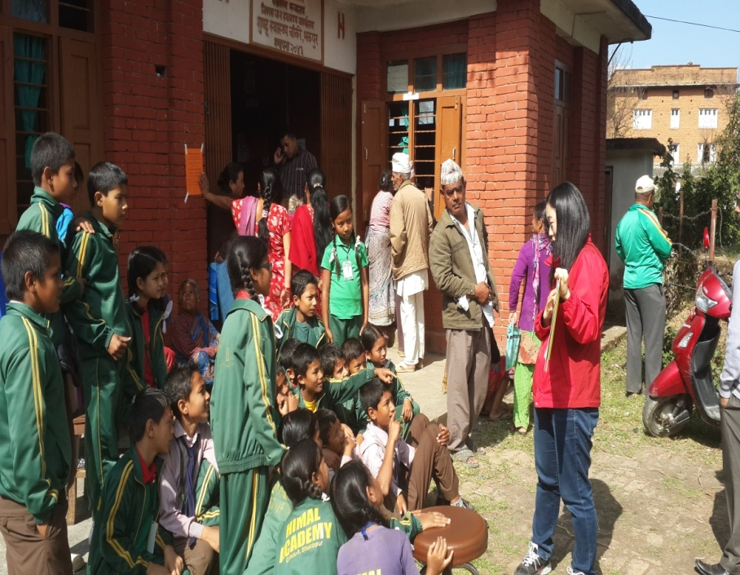
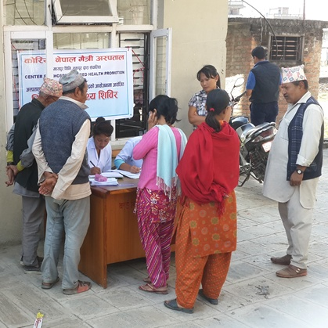
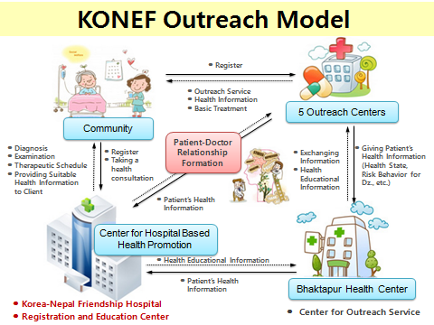
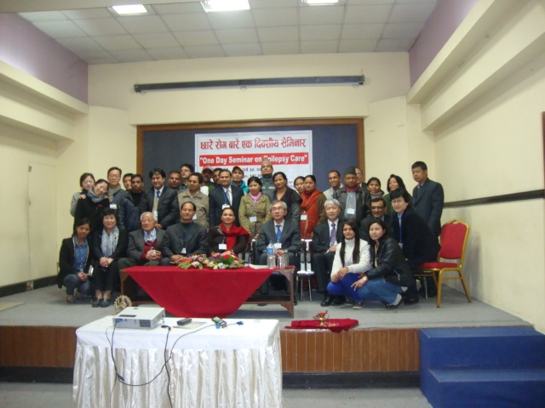
t:aL/ cfkm} af]N5g\,,,

Slide 41
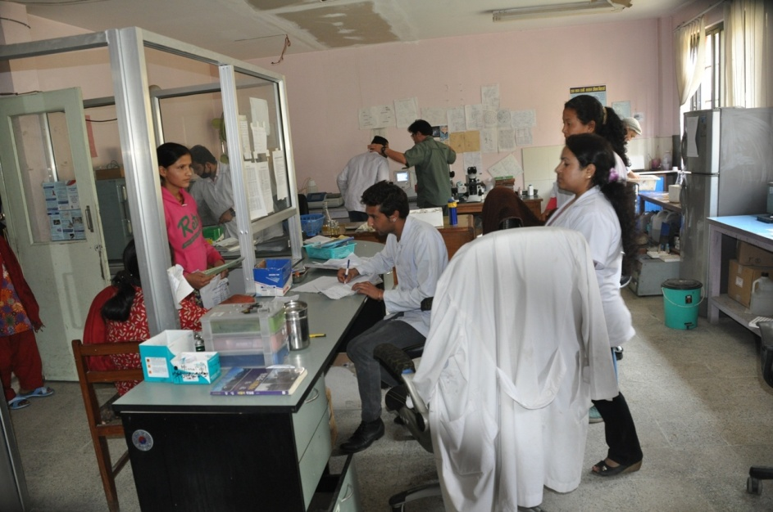
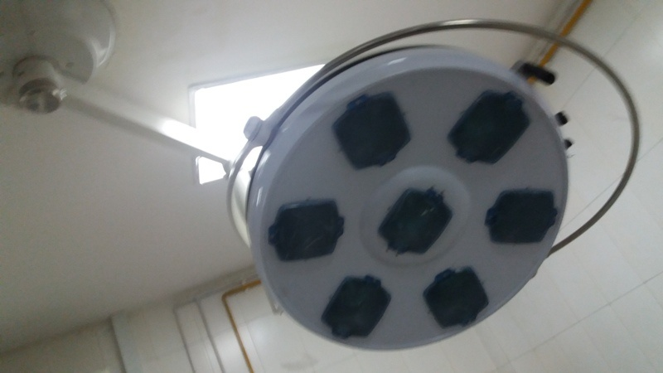
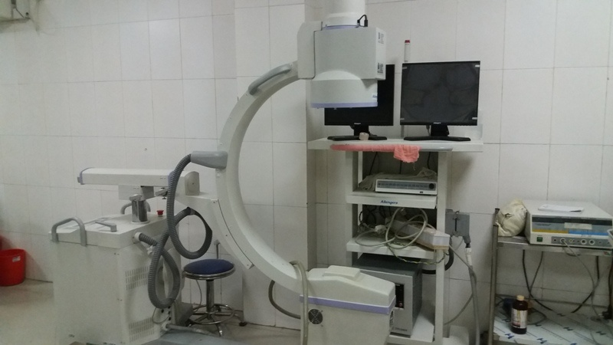
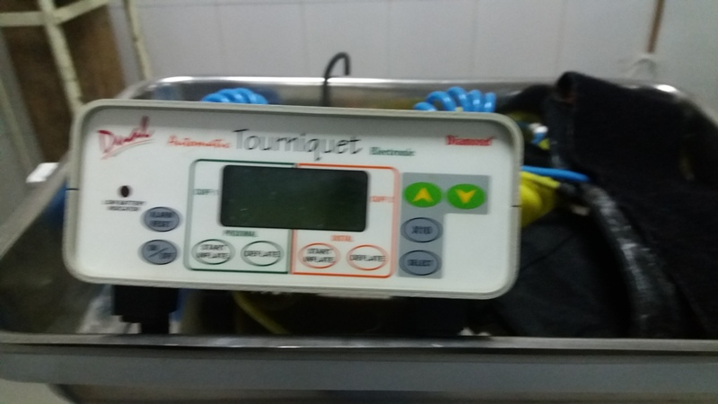
t:aL/ cfkm} af]N5g\,,,,

Slide 42
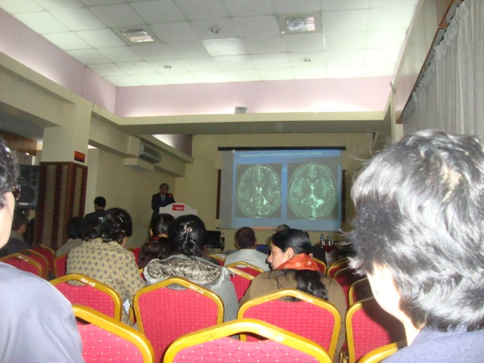
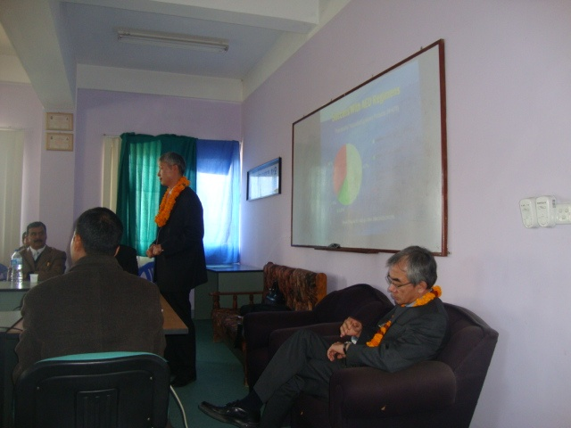
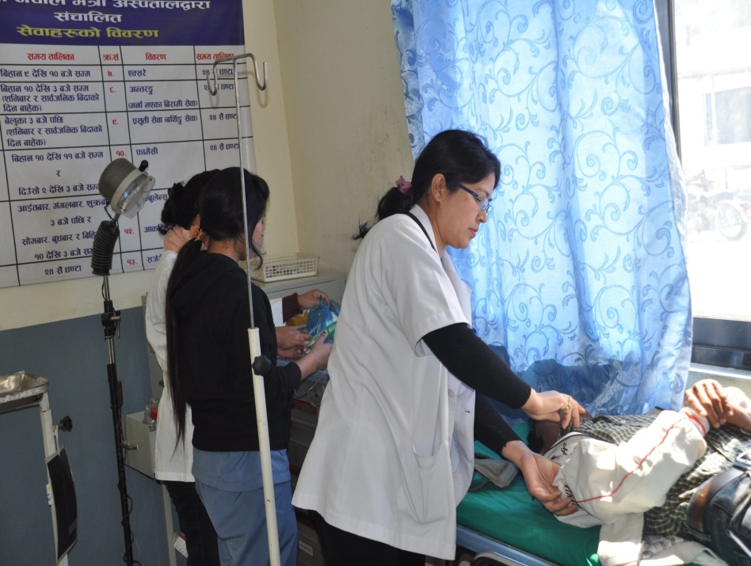
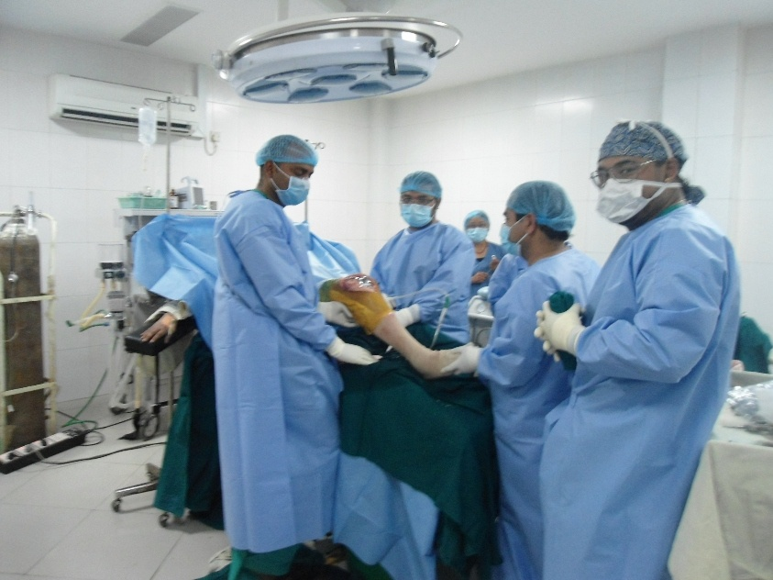
t:aL/ cfkm} af]N5g\,,,,

Slide 43
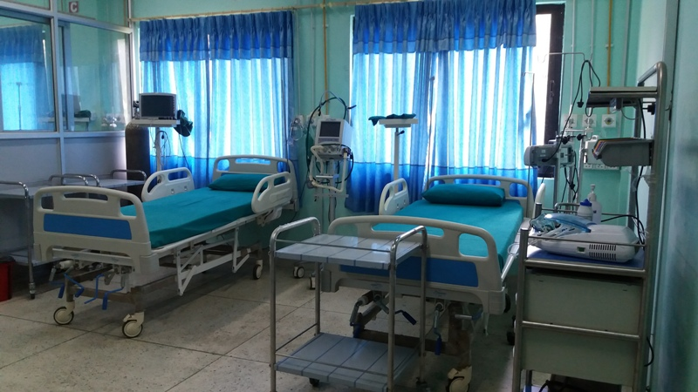
t:aL/ cfkm} af]N5g\,,,,

Slide 44
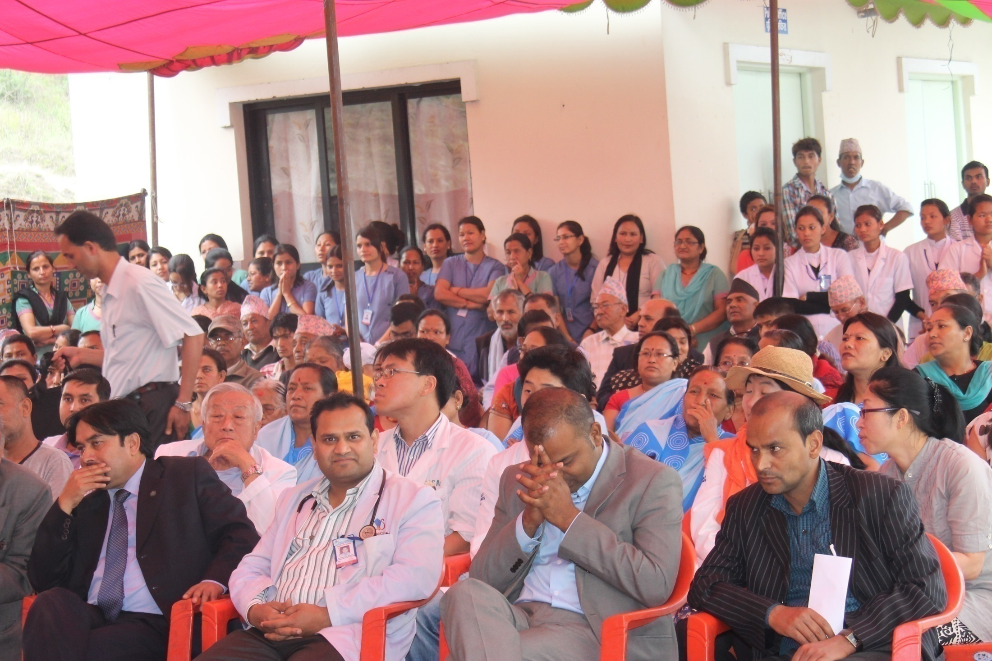

Slide 45
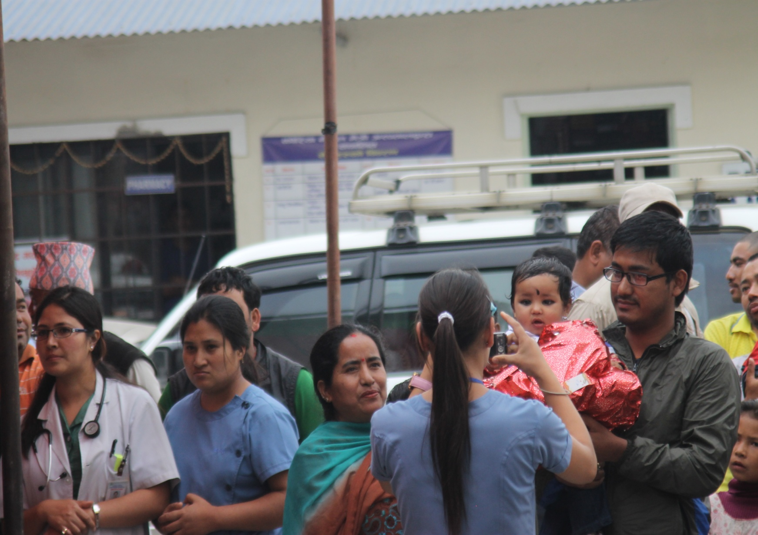

Slide 46
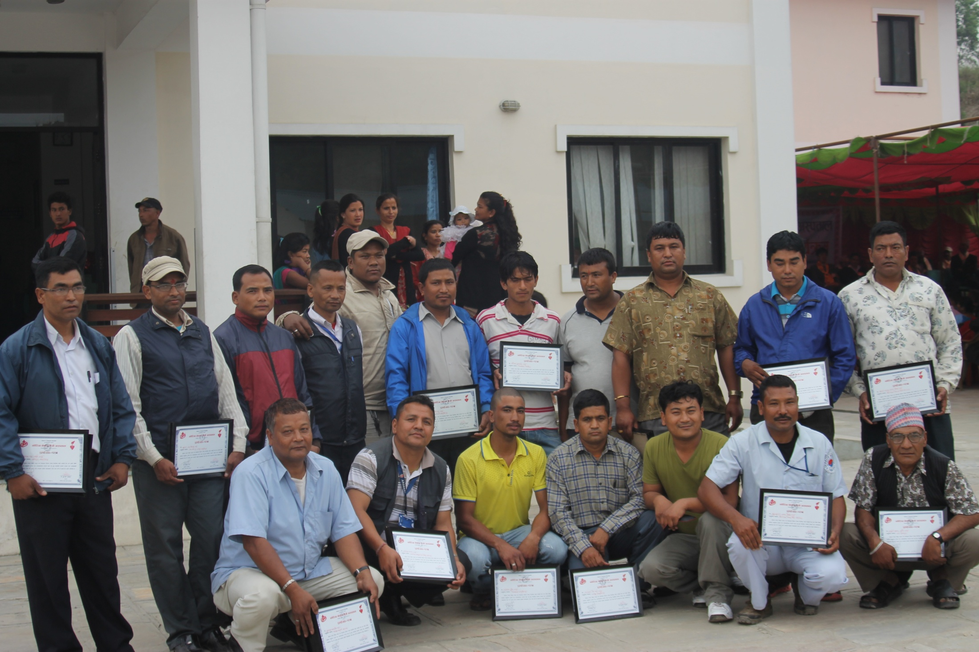

Slide 47
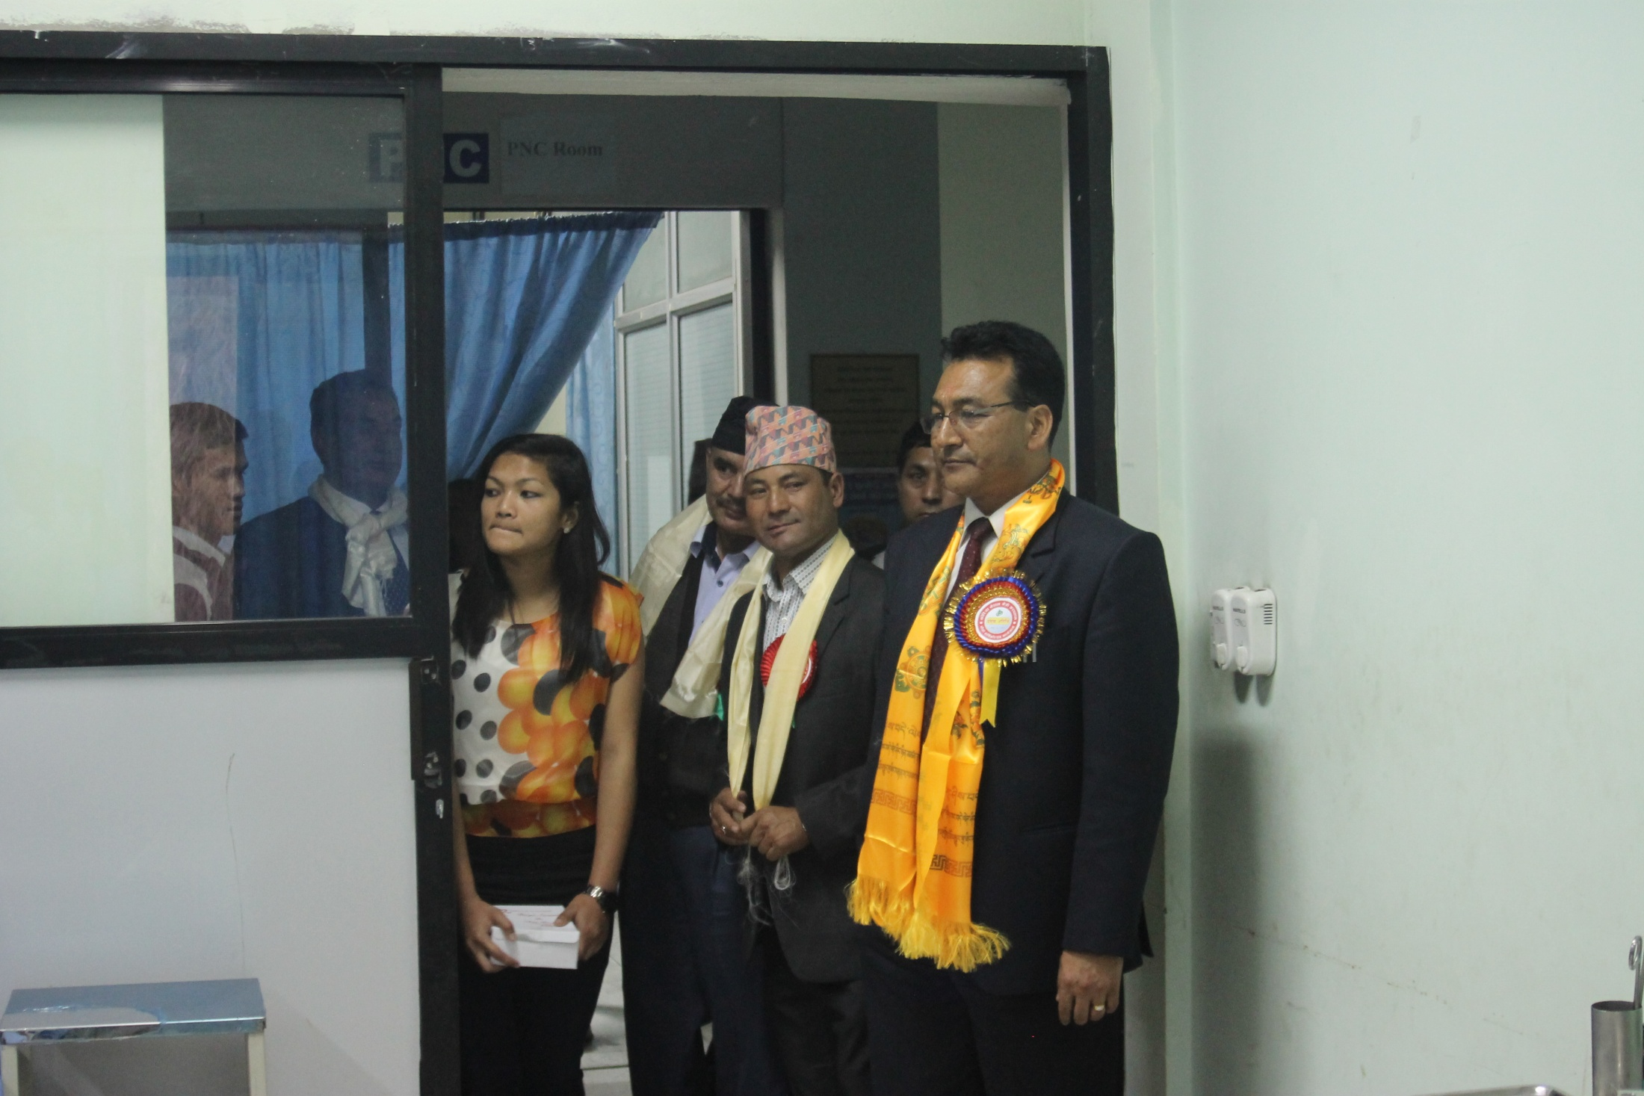

Slide 48
