Slide 1


Transanal Endoscopic Microsurgery
(TEMS ):
Rectal Surgery Without a Single Skin Incision
M Miah, S Ikram, SM Ahmad

Slide 2


Background
Procedure first described by Prof. G Buess 1983
Employed for low rectal tumours, near the anorectal junction
Recognized treatment modality for large and sessile benign rectal polyps, small carcinoid tumours, early rectal cancers, palliating advanced rectal cancers

Slide 3
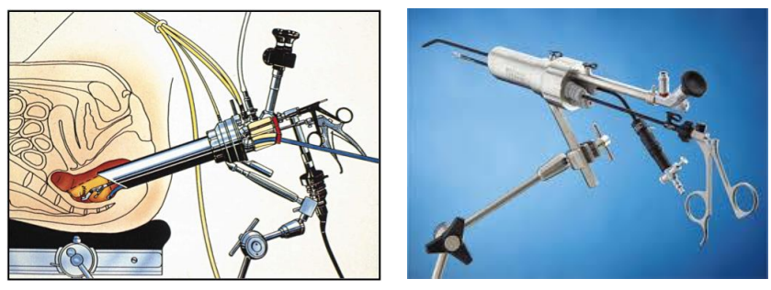
Operative Technique
Notes:
TEMS also requires a surgeon who possesses advanced laparoscopic skills since it is essentially a form of laparoscopic surgery performed in a much more confined space

Slide 4
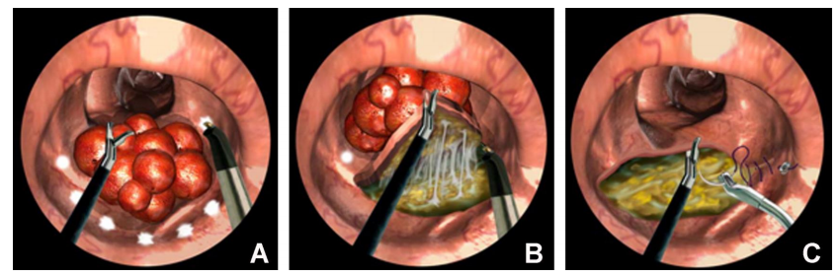
Operative Technique
Van Vledder et al, Seminars in Colon and Rectal Surgery 26(2015)9–14

Slide 5
Guidelines
The following indications have been recommended by various surgical societies, including the American Society of Colon and Rectal Surgeons (ASCRS):
Lesions <3 cm
Mobile lesions
Polypoid lesions
Anatomically accessible lesions localized to the bowel wall (T1N0)
Lesions occupying less than 40% of the circumference of the bowel lumen
Notes:
Absence of clear guidelines in NICE, however, these were the general recommendations.
a study by Khoury et al reported the use of TEM to treat benign rectal lesions in the range of 5-8 cm
the use of TEM for giant circumferential rectal adenomas has been reported

Slide 6
Guidelines/NHS England
All patients with suspected or proven rectal cancers suitable for trans anal procedures will be discussed at the MDT.
The Association of Coloproctologists of Great Britain and Ireland have suggested that only T1 tumours less than 3 cm be treated by endo anal excision.

Slide 7
NHS England TEMS Outcome
Key Short term outcomes:
R0 (complete resection) of T1/2 rectal tumours
Very low 30 and 90 day mortality
Very low intra peritoneal perforation rate
A robust surveillance program set up for follow up for resected tumours
Key Long term outcomes:
Acceptable recurrence rates
Recurrences detected at an early stage without compromising overall cure rates

Slide 8
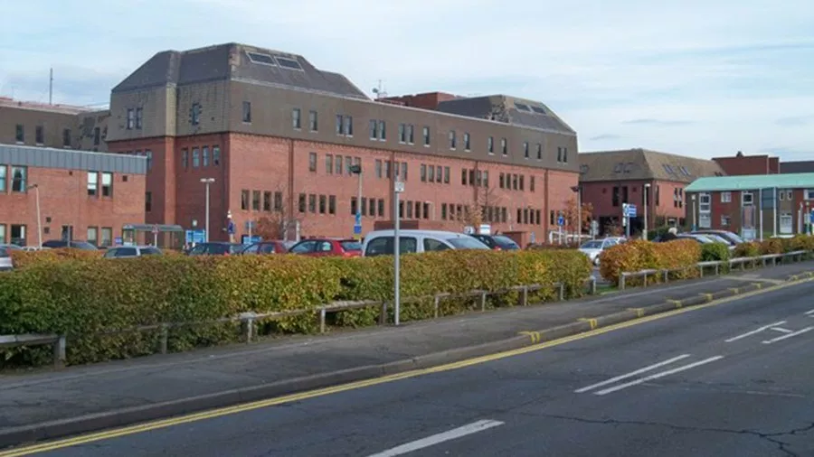
TEMS in Scunthorpe General Hospital

Slide 9
SGH Performance
All patients who underwent TEMs at SGH between 2010 and 2017 were identified.
Retrospective data collected from clinic letters, discharge summaries, histology, radiology and endoscopy reports via WEB-V, our Hospital Soft wear of patient Records.

Slide 10
SGH Performance
Total of 77 patients underwent TEMs at SGH between 2010 and 2017
Average patient age was 70.9 years
Max – 92
Min – 43
Average Follow-up - 2.5 Years

Slide 11
SGH Performance
All patients were offered the procedure after MDT discussion (for malignant).
90% of patients had follow-up endoscopy.
Notes:
Rest refused, moved to differnet site or were not fit

Slide 12
Comparison
Mario Morino , Marco E. Allaix. Gastroenterology Report
Morino et al. Surg Endosc (2013) 27:181–188
Moore et al, DCR 2008
Clancy et al, DCR 2015
Notes:
Despite high rates of residual polyps, recurrence rates are low. Tumour size is a risk factor for local recurrence.

Slide 13

Case Presentation
85 years old gentleman referred to clinic with incontinence, weight loss and anaemia
Colonoscopy: a fungating polypoid circumferential neoplasm in rectum 10 cm from anal verge. Rectal biopsy: Adenocarcinoma.
MRI: 4 cm low rectal lesion T2N0.
Discussed in MDT
Received Neoadjuvant Radiotherapy
Underwent TEMS
Was discharged on the next day after surgery without any complications

Slide 14
Operative Video

Slide 15
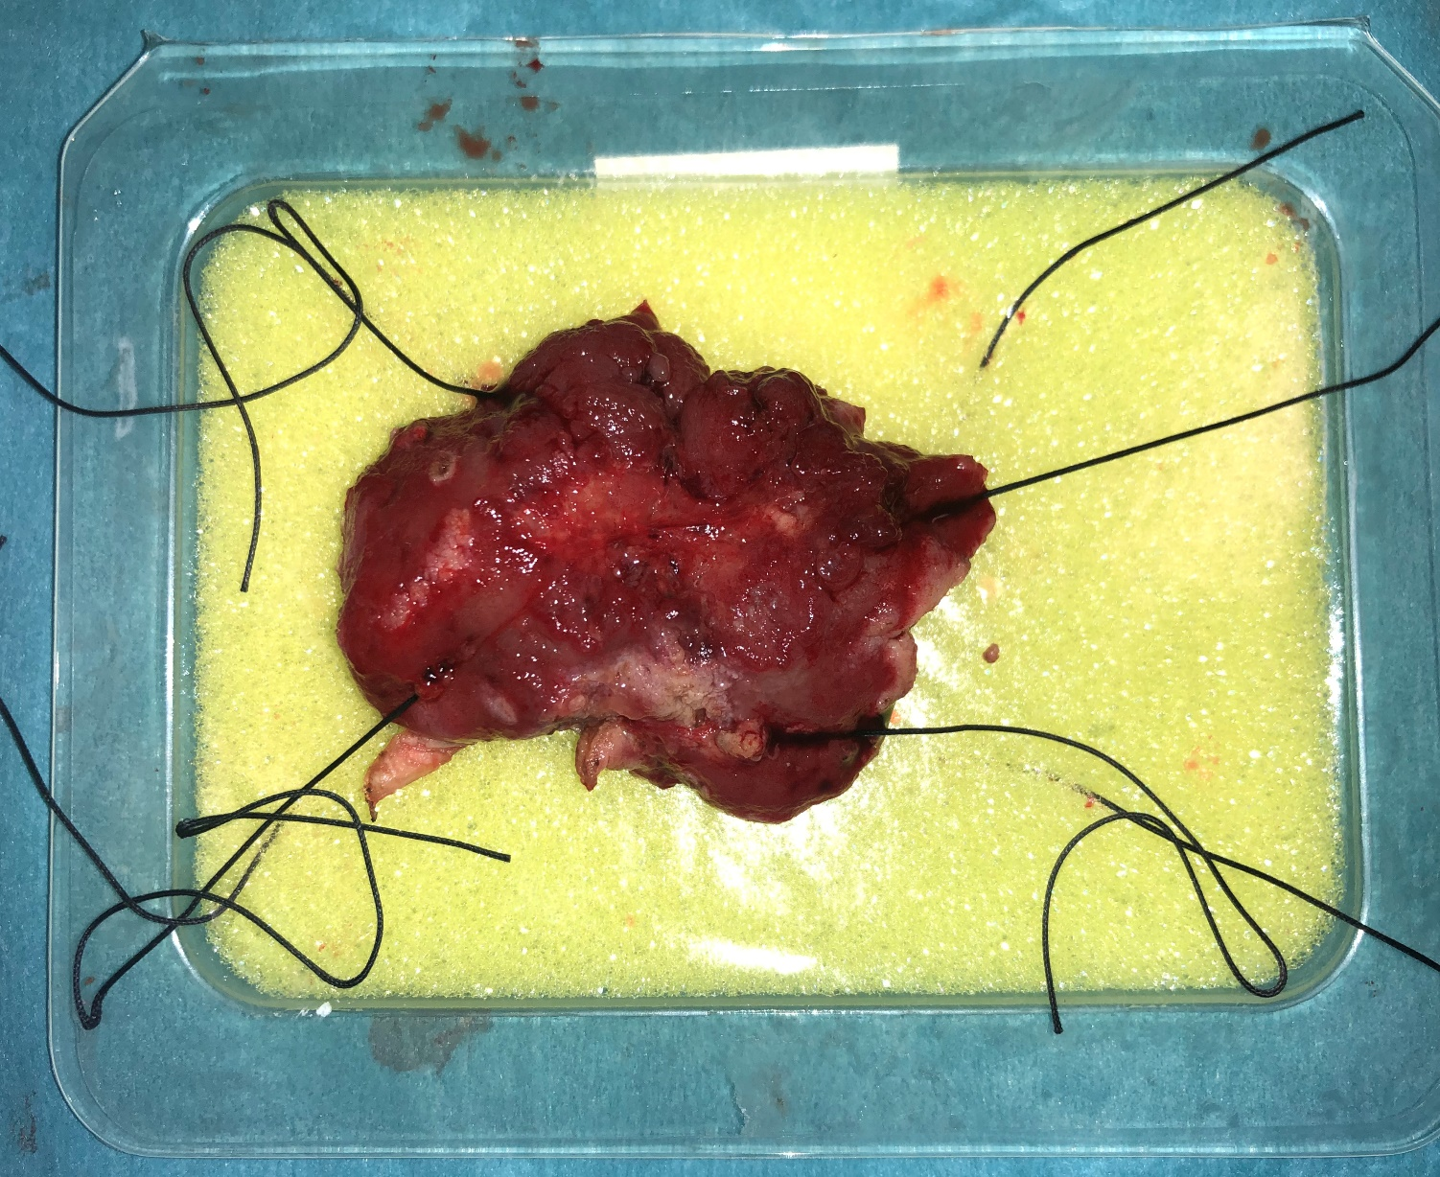
Reseceted Specimen

Slide 16
Conclusion
TEMS is a 30-year-old innovation, which has come into new flavour in the minimally invasive surgical era.
TEMS is a safe operation. It is cost effective with enhanced recovery associated with low mortality and morbidity rate.
However, all cases should be approached in a multidisciplinary fashion with careful pathologic, radiologic, and oncologic consideration.

Slide 17

Thank you

