Slide 1


Slide 2
Secondary Umbilical Endometriosis: A Case report and its management in Lautoka Hospital, Fiji
Dr Robert A. Bancod, Associate Professor UPSM,University of FIJI
ALLPPT.com _ Free PowerPoint Templates, Diagrams and Charts

Slide 3

OBJECTIVE

Slide 4
Objective:
To investigate the clinical manifestation of Secondary Umbilical Endometriosis
and
Systematically review the literature regarding this finding, as we performed
this retrospective clinical study.

Slide 5
INTRODUCTION
secondary endometriosis definition as the presence of endometrial glands
and stroma abnormally located outside the uterine cavity
extra-pelvic endometriosis accounts up to 15% of all cases of endometriosis
umbilical endometriosis has been reported to be around 0.4–4% of all
patients with endometriosis
pathogenesis of secondary UE seems to be relatively, the transplantation
theory
Common locations of Secondary endometriosis are the pelvic organs, mostly the ovaries, the fallopian tubes, the utero-sacral ligaments, the recto-vaginal septum and the pelvic peritoneum.

Slide 6


Slide 7
Patient and Method
Patient who had received surgical treatment with a diagnosis of Secondary Umbilical
Endometriosis was studied and recorded the:
age
gender
symptoms and signs
abdominal imaging study
surgical procedure
location of Secondary Umbilical Endometriosis

Slide 8
Result
One patient was studied:
Age: 34 years old
Sex: Female.
Sign And Symptom:
shown slowly increased in size nodule.
had started to bleed concomitantly with the menstrual
periods. .
Diagnostics:
Ultrasound confirmed the presence of a hypo-echoic mass of
7 mm in the umbilicus, with blood vessels at doppler examination
Operative procedure:
Wide wedge excision of the endometrial nodule
not sparing the umbilicus
Location:
Umbilicus
Notes:
A 34-year old woman, gravida 2, was seen to outpatient clinics with a 3 years history of umbilical nodule. The nodule had slowly increased in size and had started to bleed concomitantly with the menstrual periods. Her medical history was unremarkable and she denied symptoms of pelvic endometriosis such as dysmenorrhea, abdominal pain or dyspaurenia. She was not taking any oral contraceptives and had regular menstrual cycles. Physical examination revealed a brown, moderately tender nodule of about 2 centimeter in diameter located deep in the umbilical fold. On the basis of history and clinical findings, secondary umbilical endometriosis was suspected and the patient was asked to return for further examination during her menstrual period, which occurred after a week. At this second look, the umbilical nodule appeared tenderer, showing with signs of recent bleeding. An ultrasound confirmed the presence of a hypo-echoic mass of 7 mm in the umbilicus, with blood vessels at Doppler examination.
The patient was referred to a gynecologist for further clinical evaluation. No clinical or ultrasonographic signs of endometriosis could be detected. Thus, surgical removal of the umbilical nodule was proposed and the patient was informed about the risk of local recurrence. The patient underwent excision of the nodule, not saving the navel, under general anesthesia. The lesion was entirely excised deep to the fascia, together with a rim of macroscopic normal skin of 2.5 cm all around. There was no evidence of connection with the peritoneal cavity and the skin was reconstructed with continuous suture using absorbable stitches. On gross examination a nodular, tan lesion of 2 cm × 0.8 cm covered by normal skin was appreciable. On microscopic examination, histologic sections revealed a glandular proliferation of mono-layered endometrial epithelium surrounded by a cytostroma with extravasated erythrocytes. Postoperative recovery was uneventful.

Slide 9
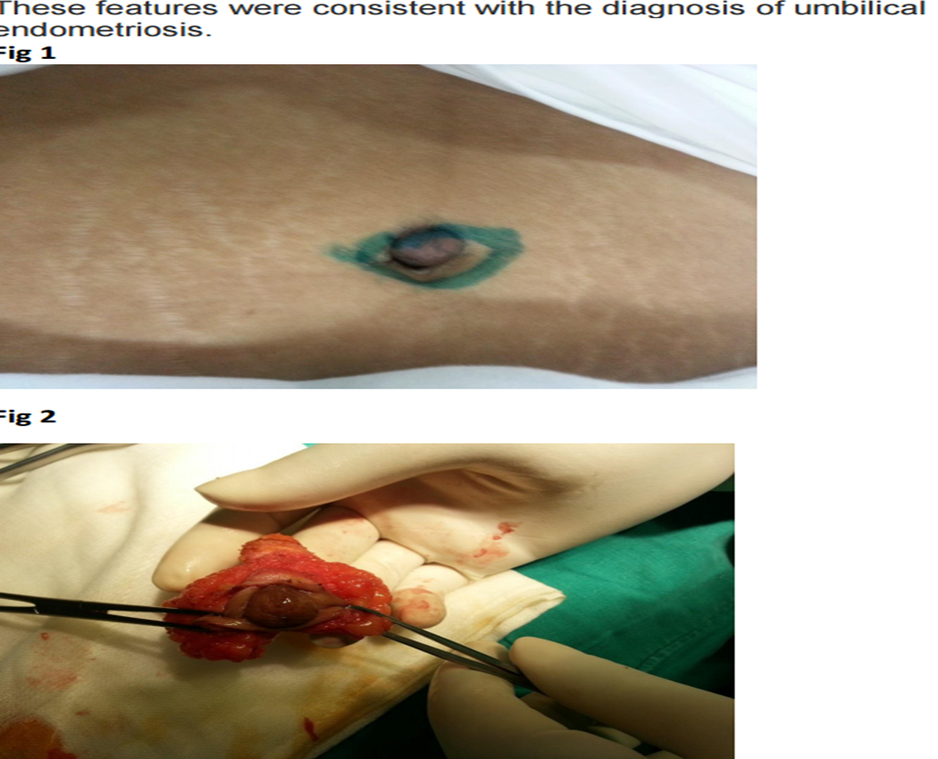

Slide 10
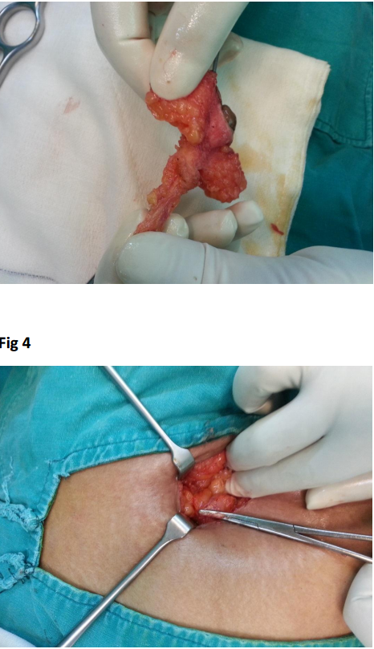

Slide 11


Slide 12
CONCLUSION
Secondary UE is a rare entity which deserves attention in
the differential diagnosis of umbilical disorders. The decision on treatment should be tailored on each single patient, taking
into consideration the size of the lesion, the duration of
symptoms and the presence of possible associated pelvic endometriosis. Wide wedge excision of the endometrial nodule
not sparing the umbilicus under general anesthesia may offer
definitive management in selected cases, such as young
patients with moderate secondary umbilical UE nodules.

Slide 13


