Slide 1
THE TREATMENT OF LOWER JAW TOTAL OR PARTIAL DEFECTS USING VASCULARIZED FIBULAR GRAFT
Khachatryan L.G., MD, Khachatryan G.E., MD, Hakobyan G.V. MD, PHD
Medical center Modern Implant Medicine, Yerevan, Armenia
Yerevan State Medical University after M. Heratsi, Department of oral surgery and maxillo-facial surgery

Slide 2
The treatment of jaw bone defects is one of the most actual problems in reconstructive maxillofacial surgery. The management involves surgical reconstruction, prosthetic reconstruction or a combination of both.
The free vascularized fibula flap is considered as the treatment of choice in mandibular reconstruction for extensive bone defects resulting from trauma, infection or tumor resections.

Slide 3
The present study aimed at investigating the 3-year clinical treatments outcomes a 21patients (12 males and 9 females, the age was 28–63 ),who underwent surgical reconstruction of the lower jaw with the microvascular fibular graft and further dental implantation. After 6 months reconstruction of lower jaw defects 134 implants were inserted within fibula flaps. The patient was rehabilitated with a full arch, screw-retained prosthetic restoration after implants osseointegration.

Slide 4
At 3 years follow up, excellent integration of grafted tissue, steady levels of bone around the implants and healthy peri-implant tissues were reported. The reconstruction of mandibular defects following ablation for tumors with fibula-free flaps has been demonstrated to be a reliable technique with good long-term results. Implants placed in the reconstructed areas were demonstrated to integrate normally, implant survival rate of 96,2%, with a mean observation period of 36 months.

Slide 5
Case #1
Patient V.H., 29 y/o
Complains:
  The lose of lower teeth
  Pain and swelling around lower jaw

Slide 6
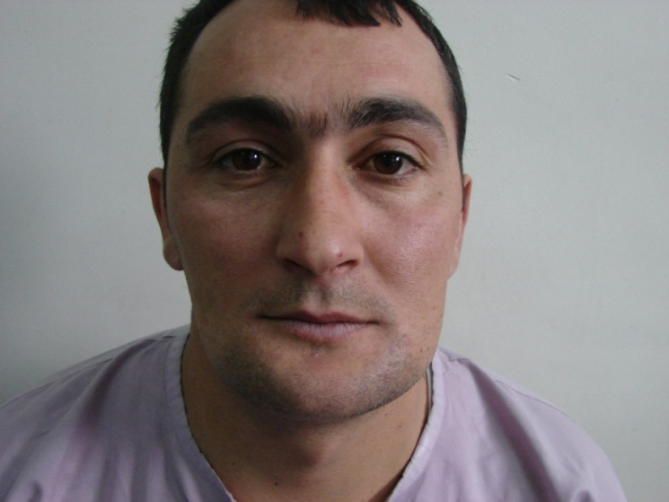
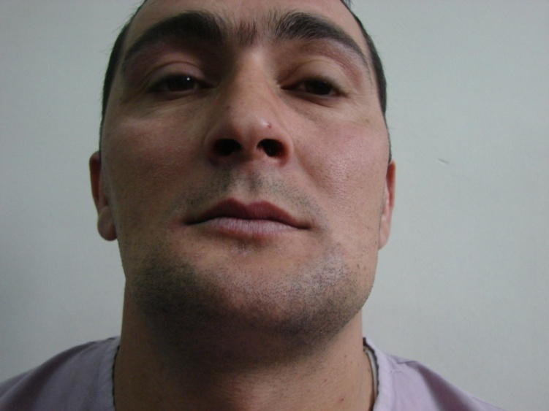
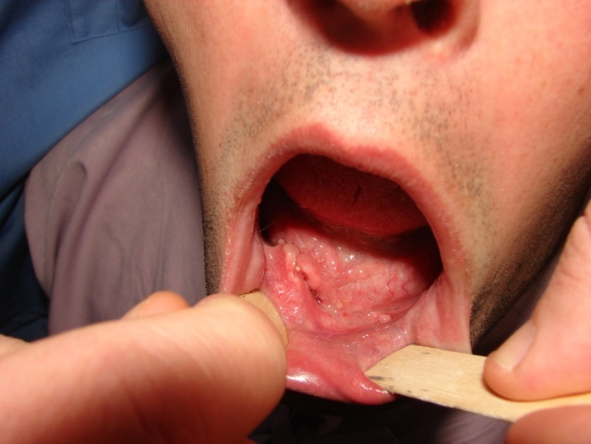
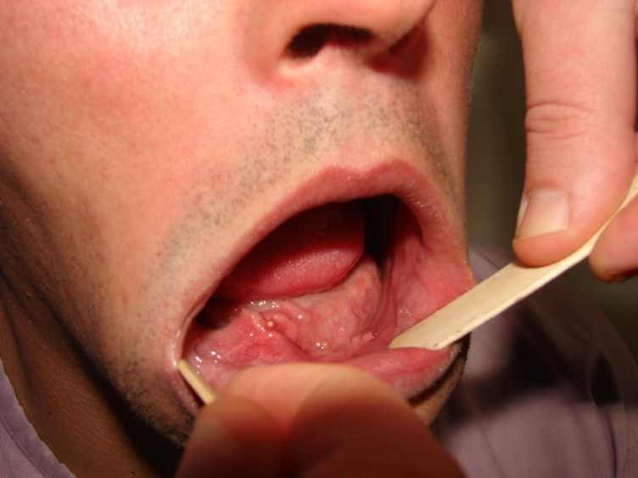
Clinical appearance before the surgery

Slide 7
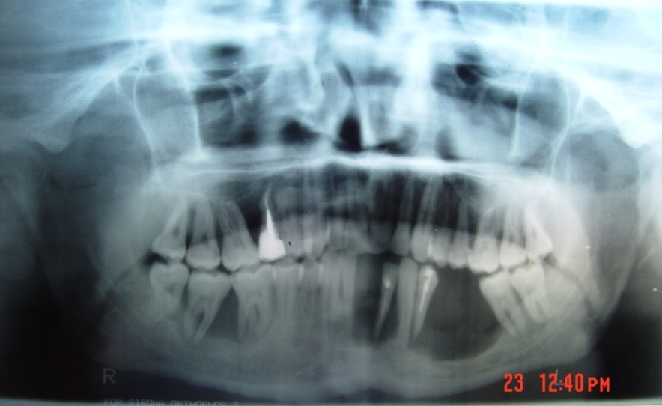
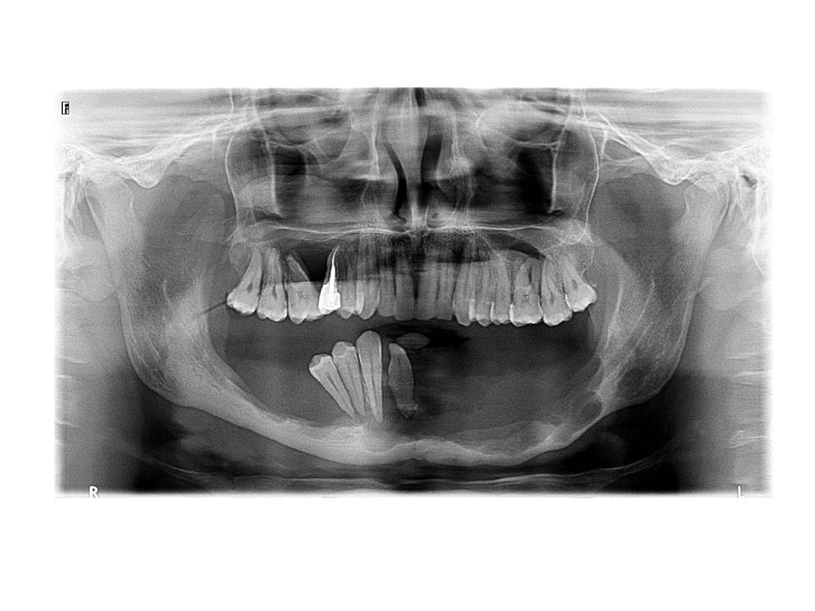
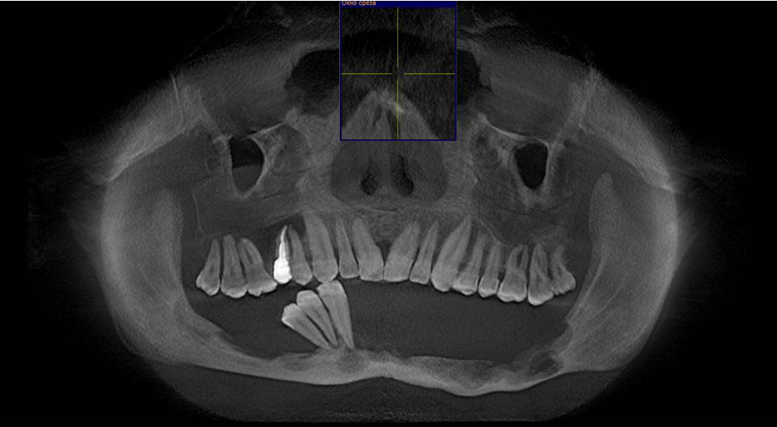
Evaluation of the patient before the surgery
X-ray of the patient in 2008
X-ray of the patient in 2011
3D CT scan
Sirona GALILEOS
in 2012

Slide 8
Evaluation of the patient before the surgery
Biopsy on December, 2011
The results of biopsy showed eosinophylic granuloma of the lower jaw

Slide 9
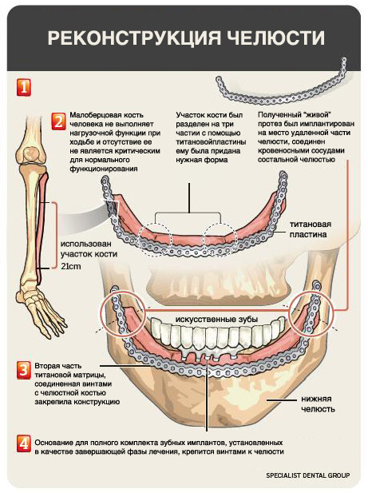
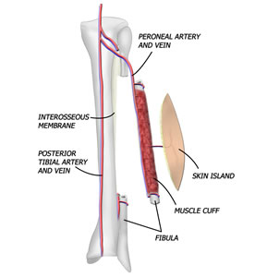
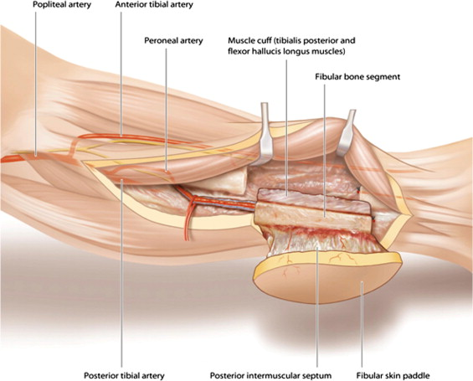
Treatment plan
Resection of the lower jaw
Vascularized fibular graft to replace the bone defect of the lower jaw
Shaping of the graft and its fixation with the plate and screws

Slide 10
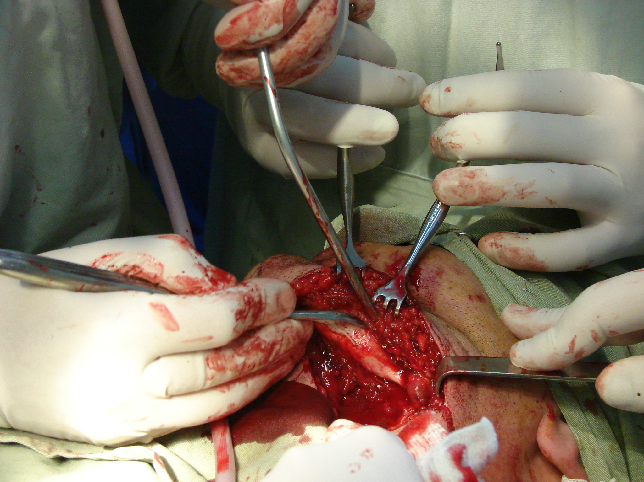
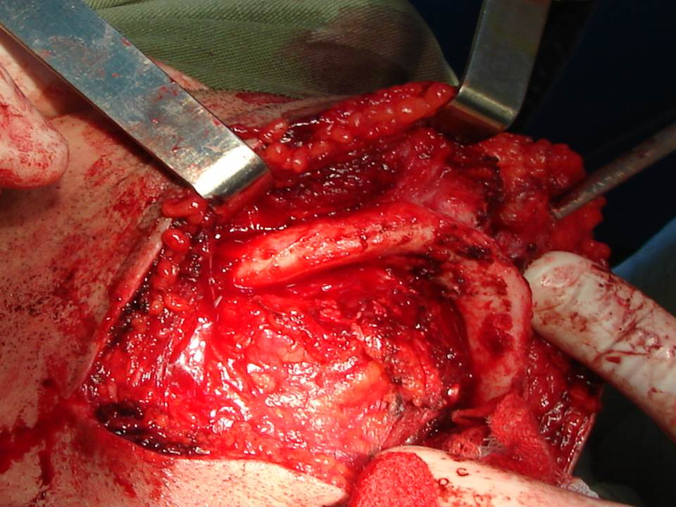
Treatment
Surgery on January, 2012 :
Stage I - resection of the lower jaw

Slide 11
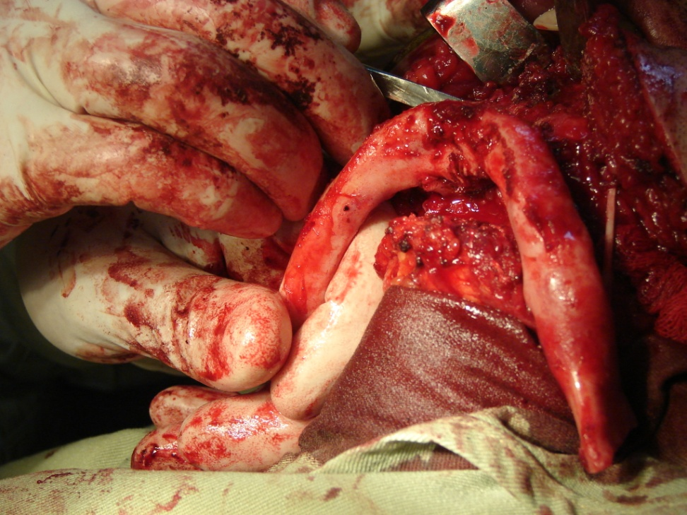
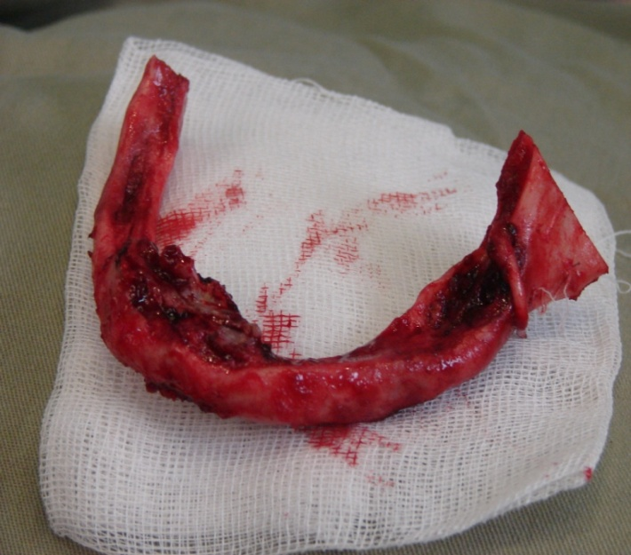
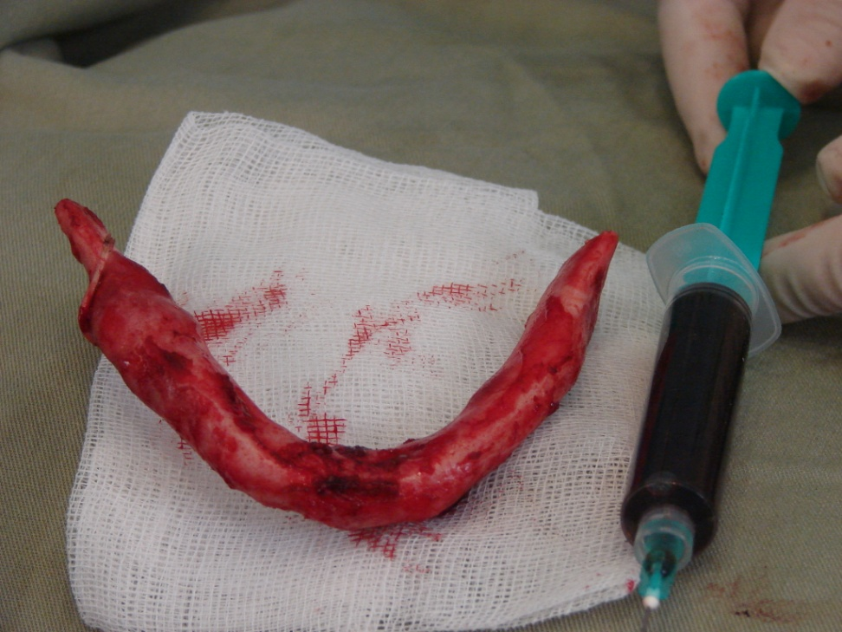
Treatment
Surgery on January, 2012 :
Stage I - resection of the lower jaw

Slide 12
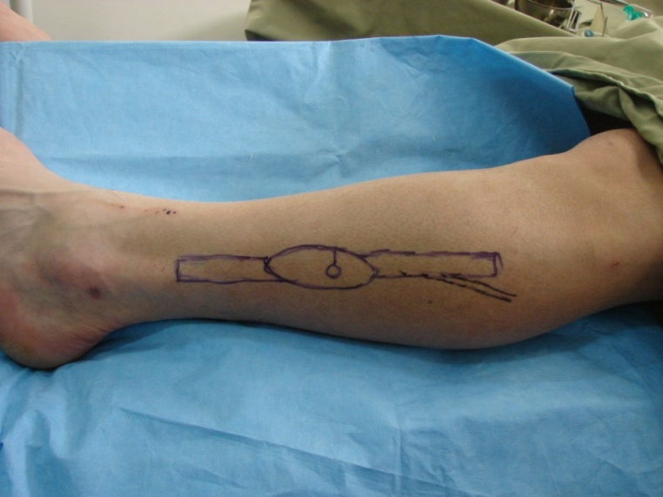
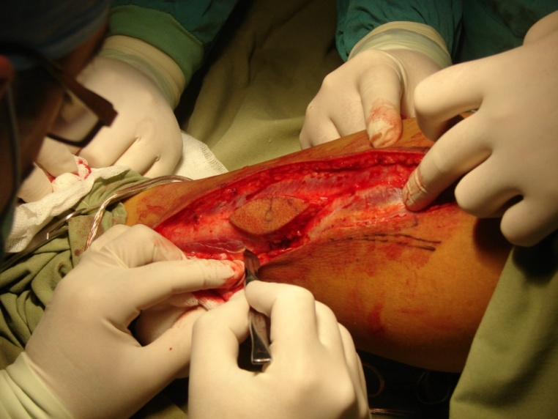
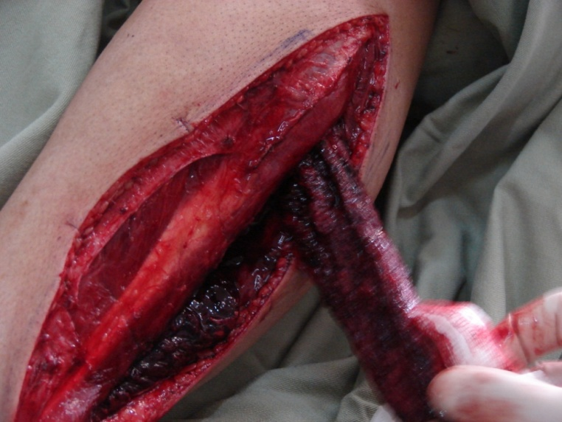
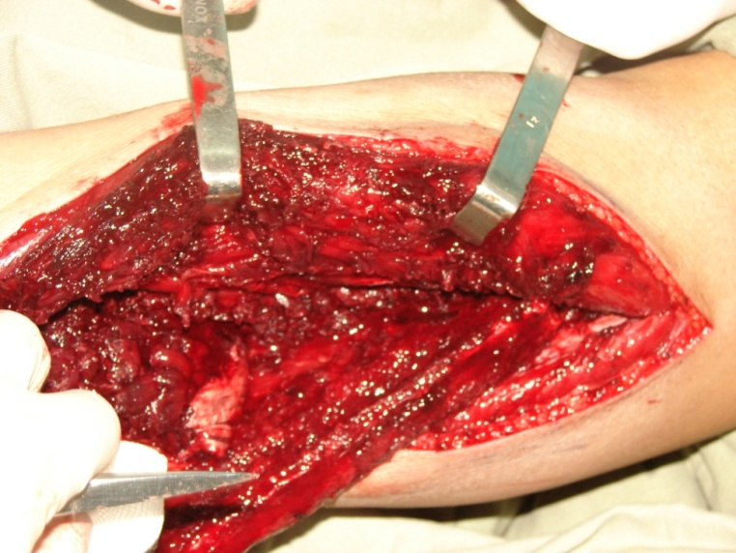
Treatment
Surgery on January, 2012 :
Stage II - harvesting of the fibular graft

Slide 13
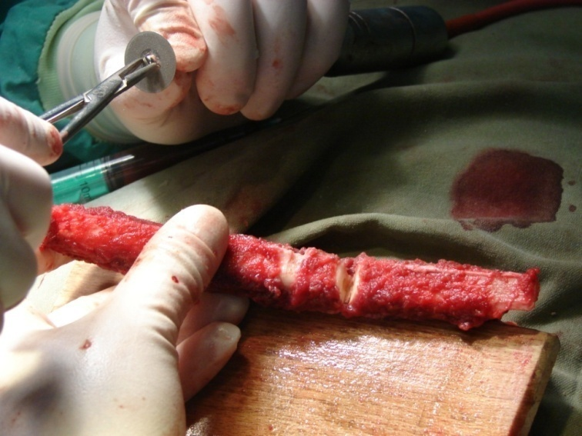
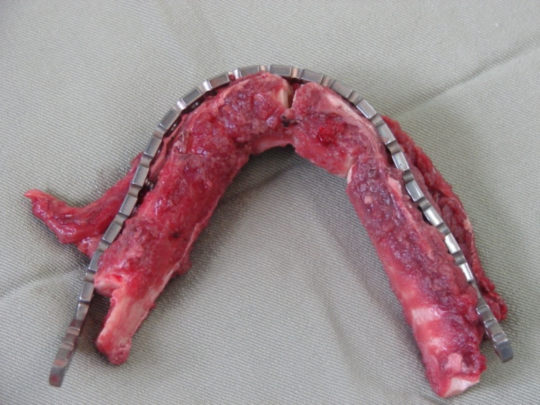
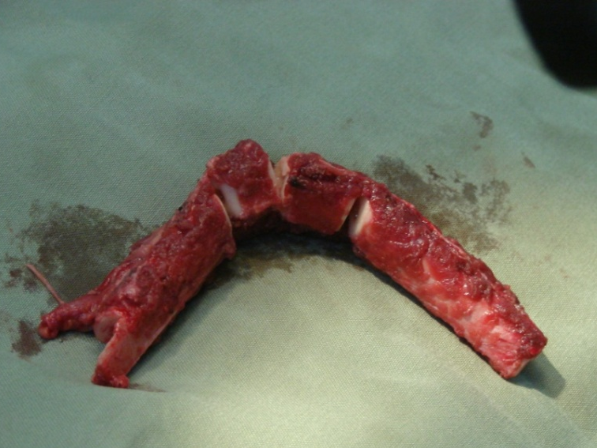
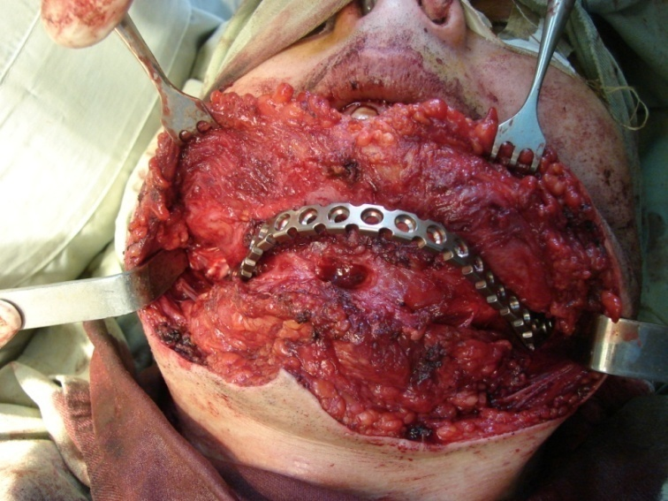
Treatment
Surgery on January, 2012 :
Stage III - shaping of the fibular graft and its fixation with the plate

Slide 14
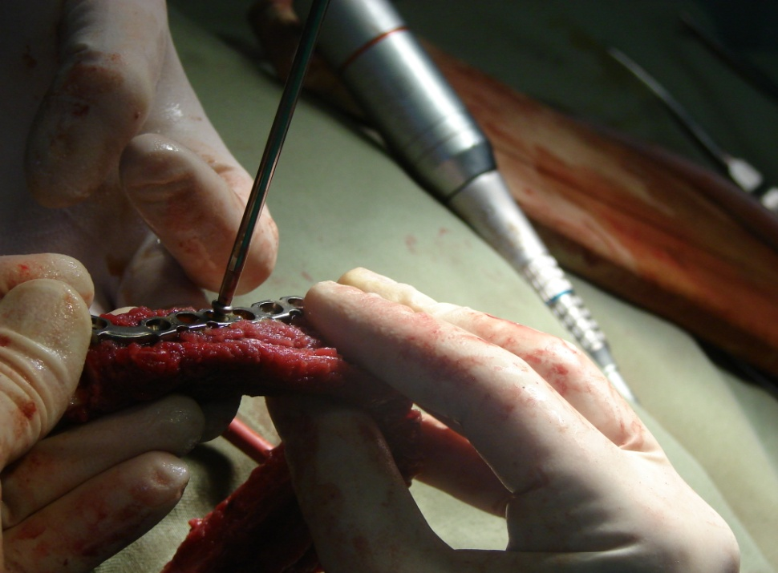
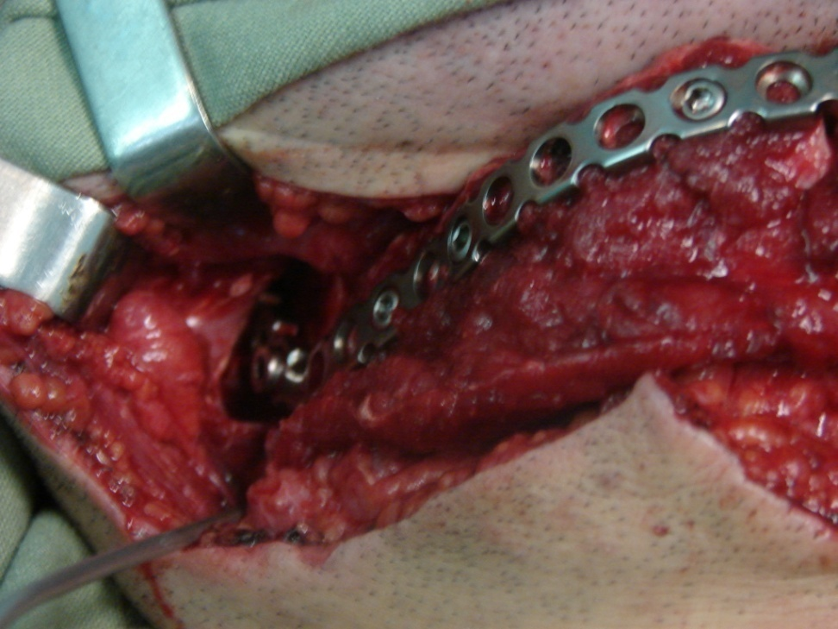
Treatment
Surgery on January, 2012 :
Stage III - fixation of the graft on lower jaw

Slide 15
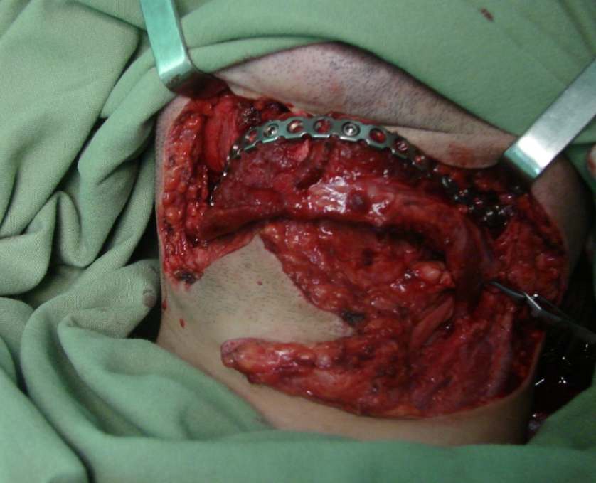
Treatment
Surgery on January, 2012 : the final view of the graft after imposition of the vascular anastomoses

Slide 16
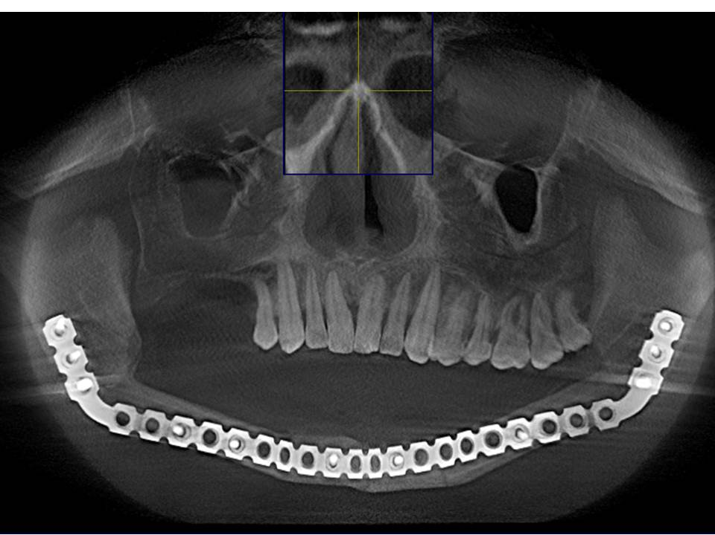
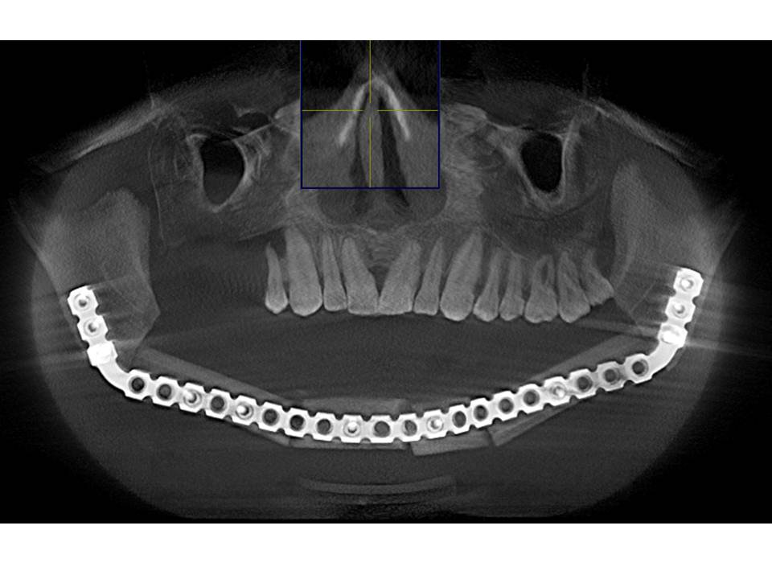
The follow-up x-rays:
After 1 month
After 5 months

Slide 17
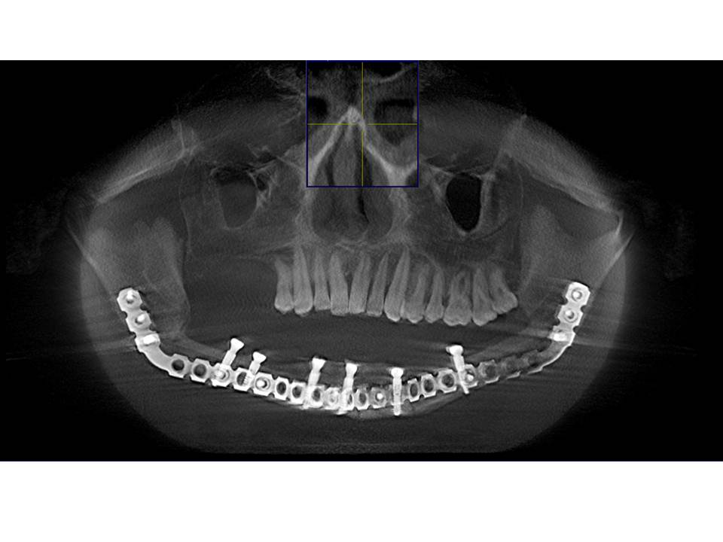
Insertion of Ankylos C/X dental implants 6 months after the surgery

Slide 18
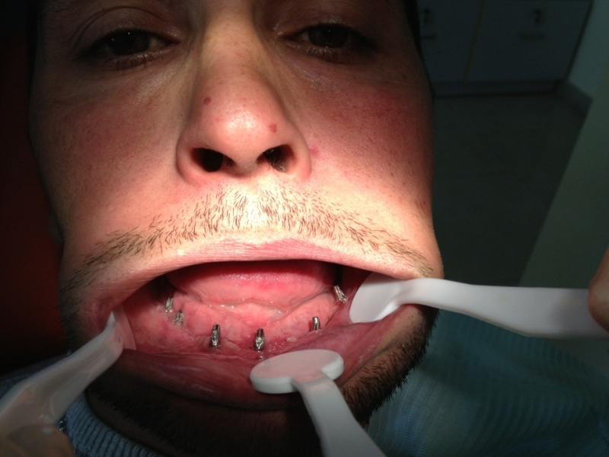
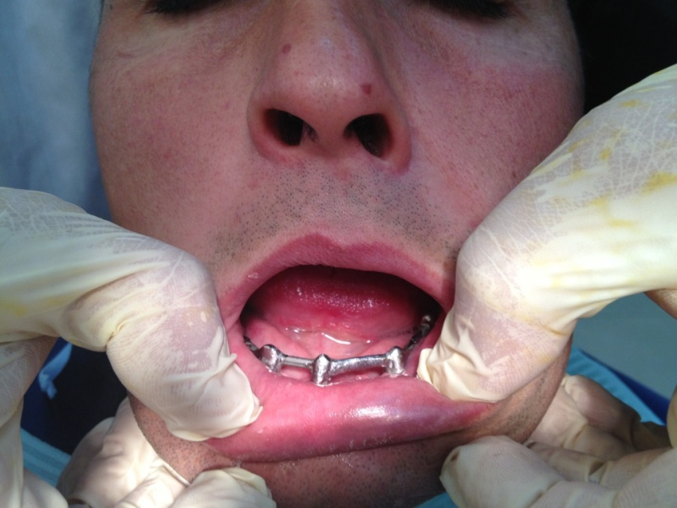
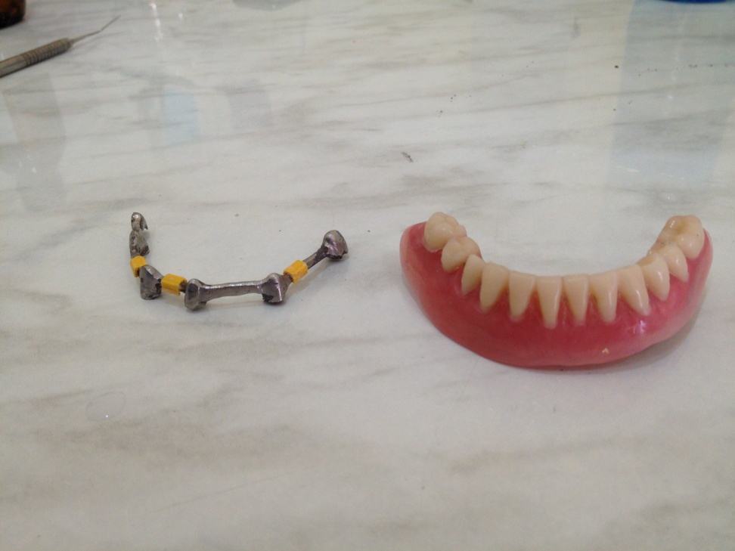
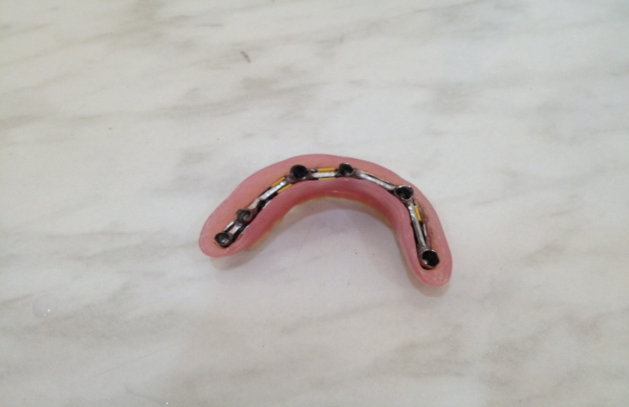
Stages of orthopedic reconstruction of dentition

Slide 19
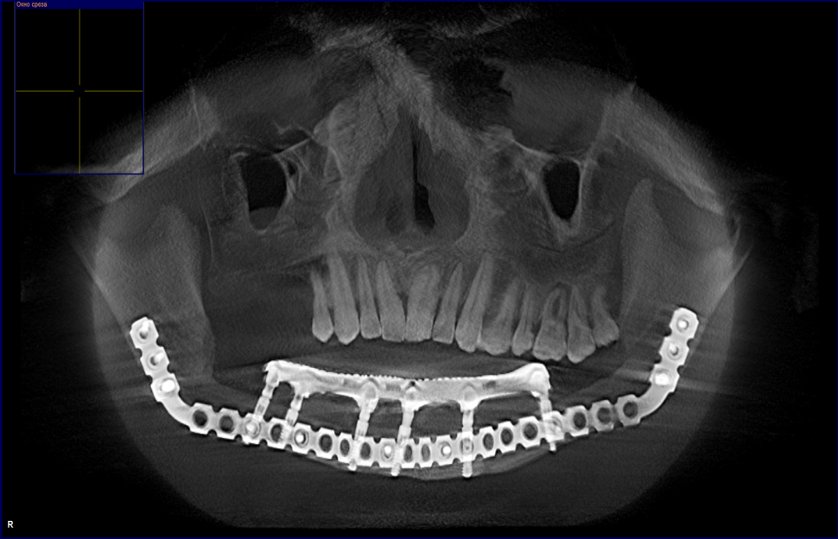
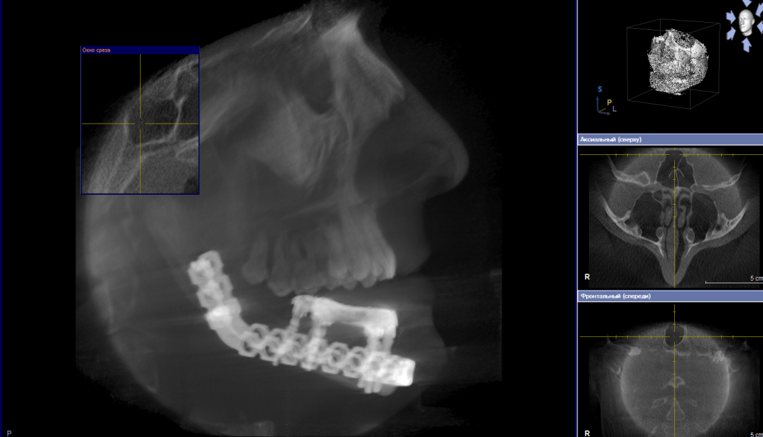
CT scan 8 months after the surgery

Slide 20
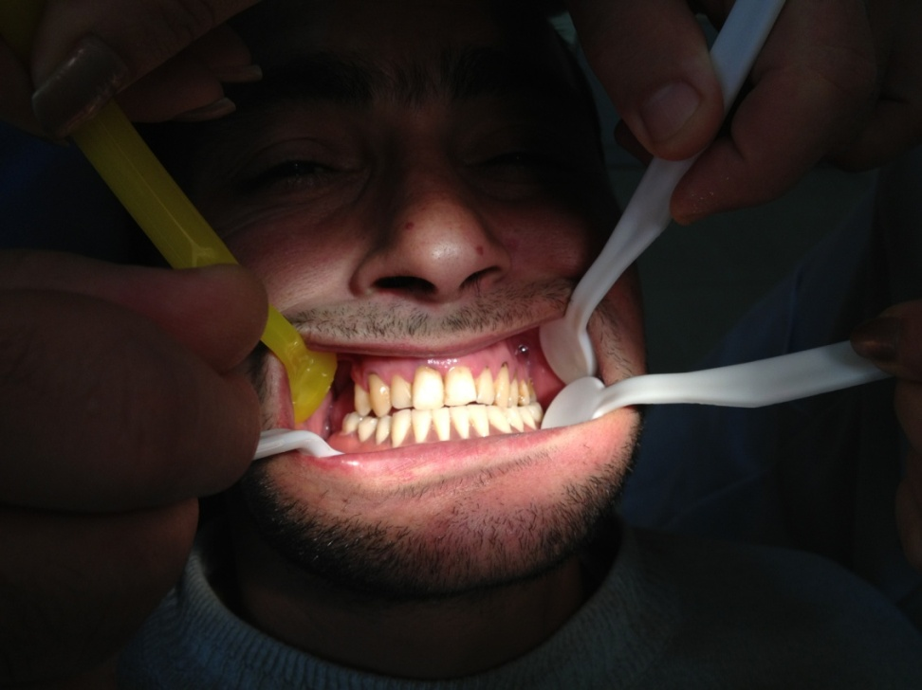
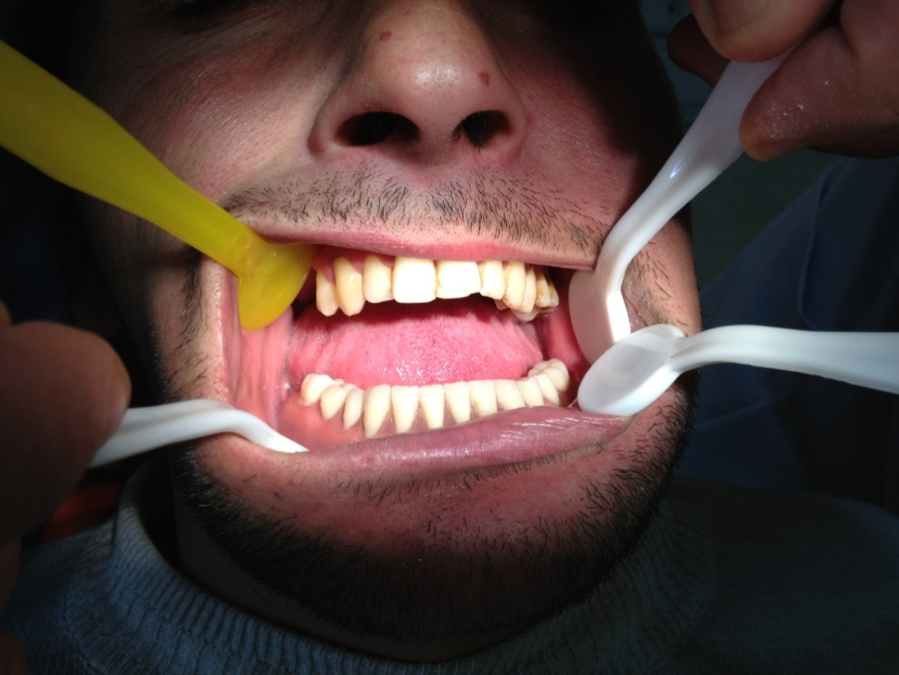
Final result

Slide 21
Case #2
Patient E.A., 30 y/o
History of illness:
  was operated for osteogenic sarcoma of the lower jaw
  the bone defect was replaced twice with free bone grafts from iliac crest
  failure of the fixation and substitution of the bone defect

Slide 22
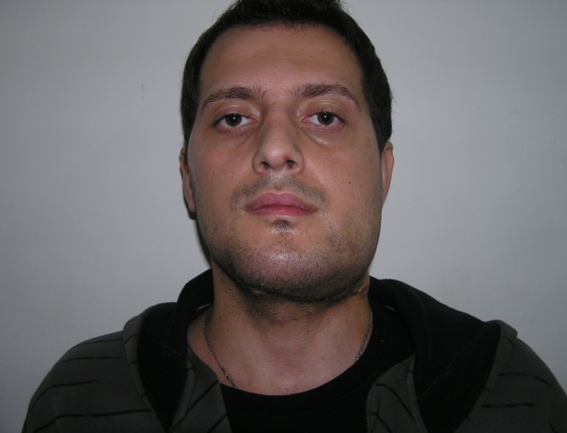
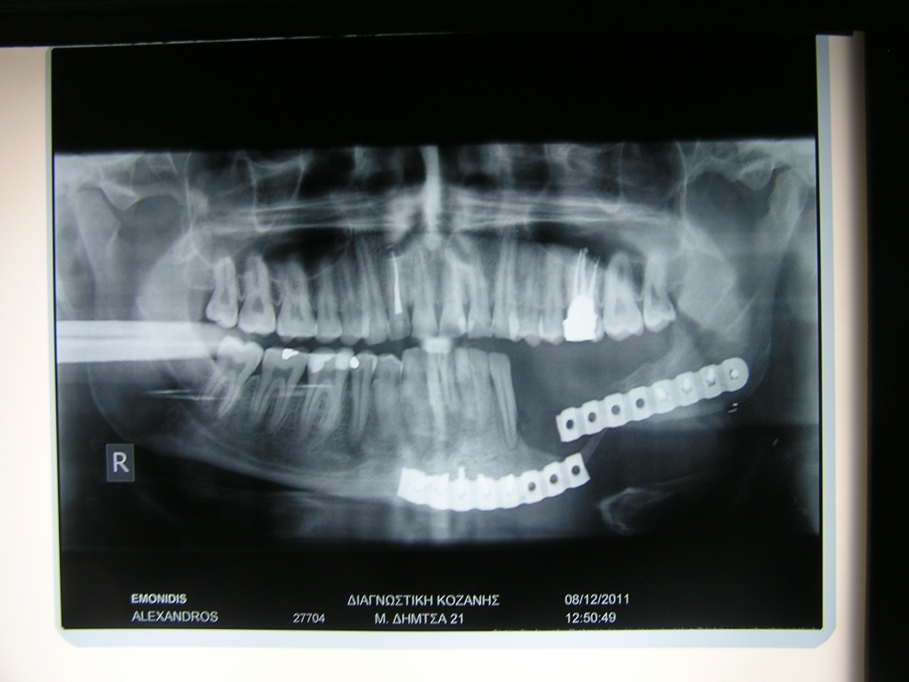
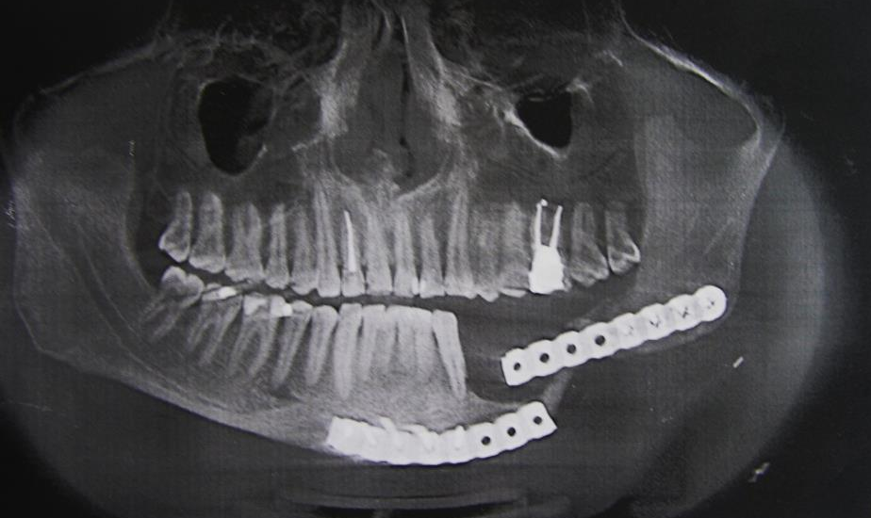
Clinical appearance and x-rays of the patient

Slide 23
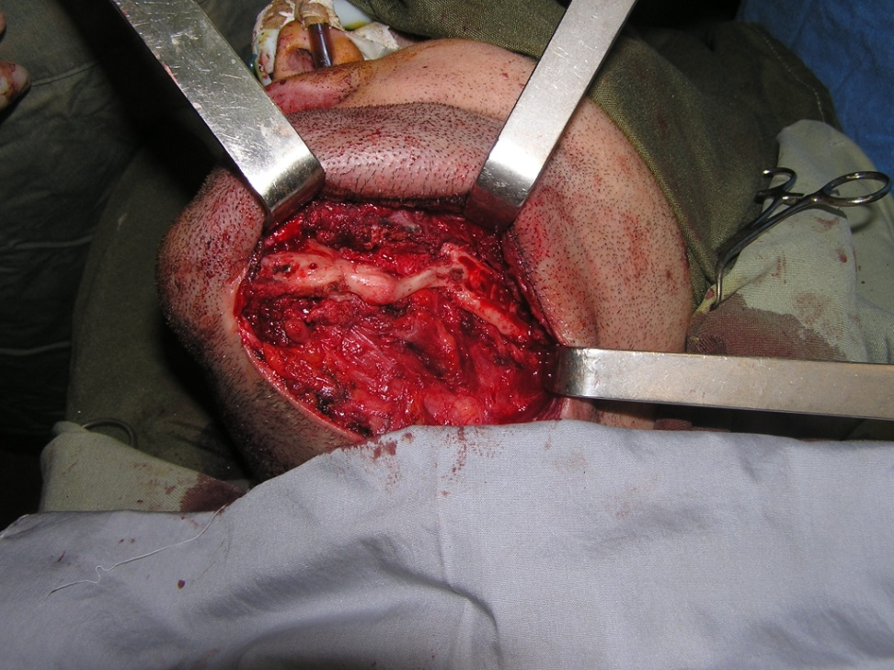
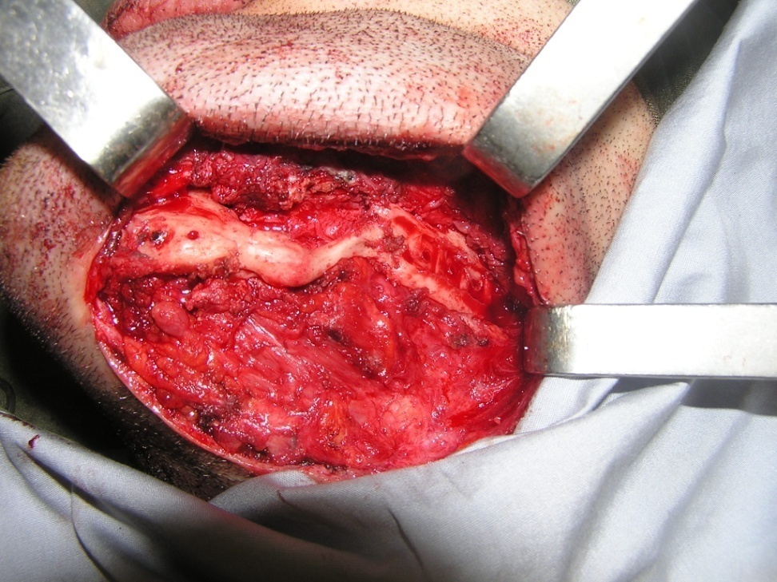
Intraoperative view
After preparing the recipient site

Slide 24
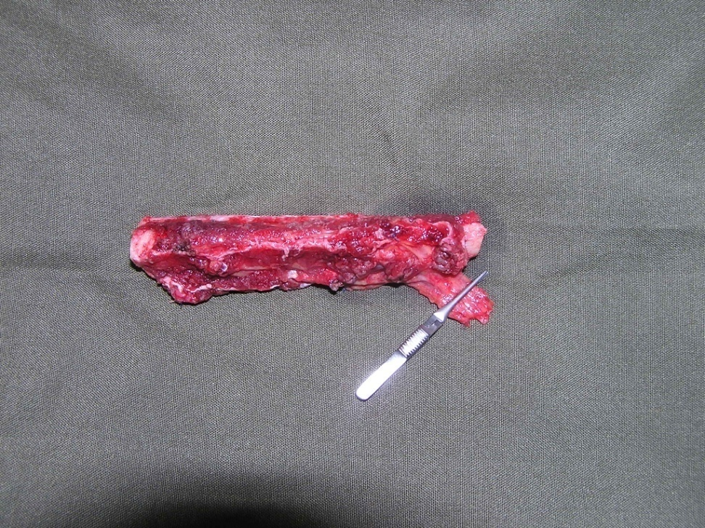
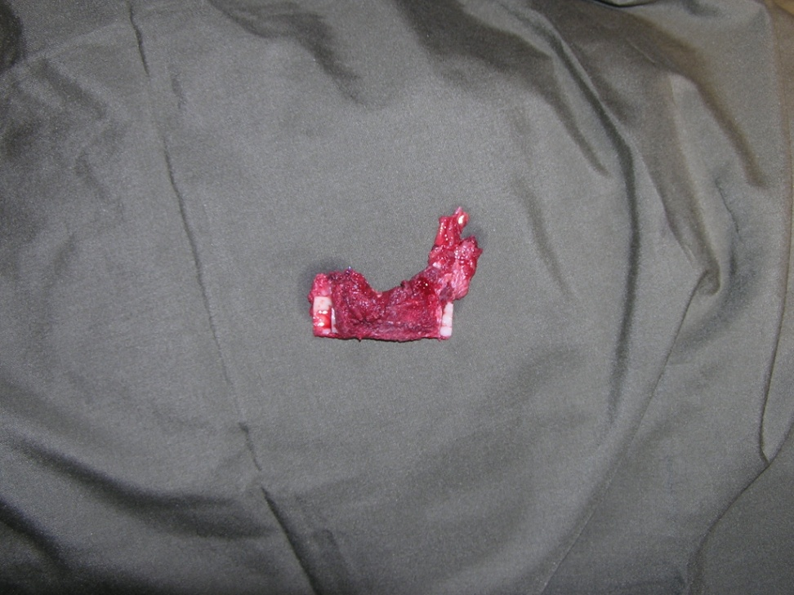
Intraoperative view
Harvested vascularized fibular graft

Slide 25
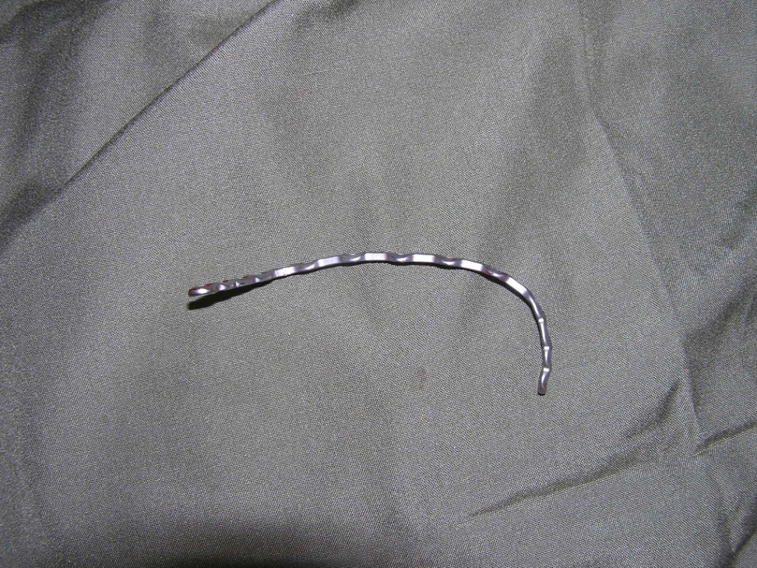
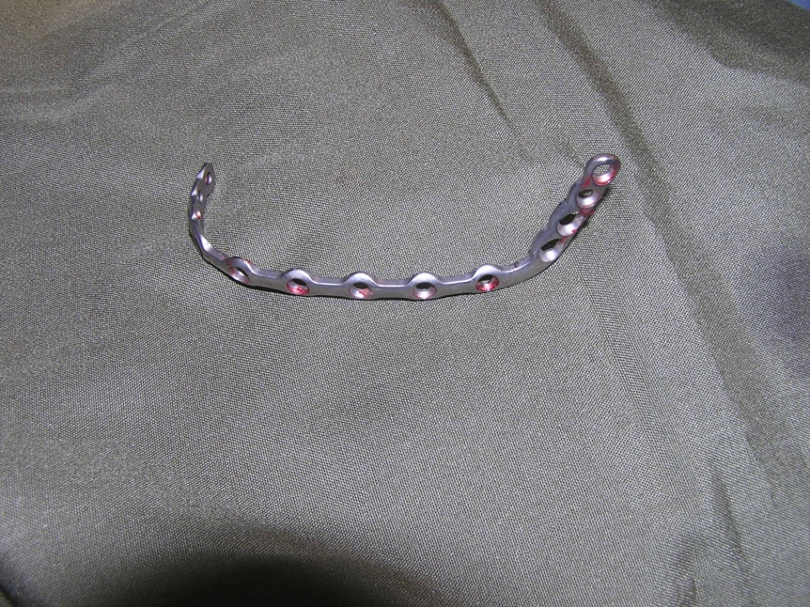
Titanium plate for fixation

Slide 26
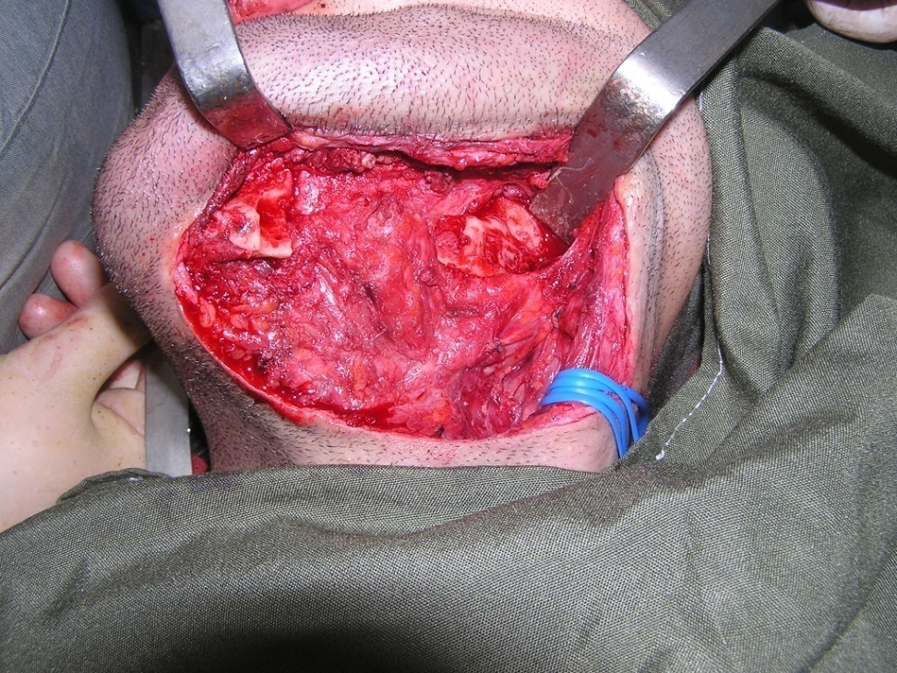
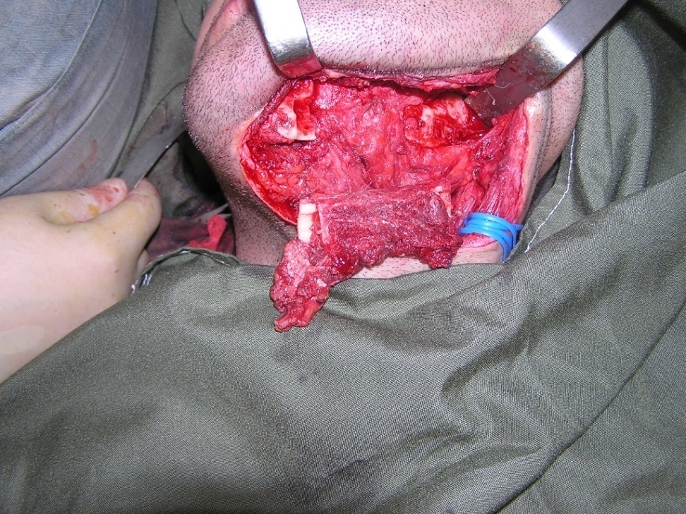
Intraoperative view
Shaping and adjustment of the graft to the recipient site

Slide 27
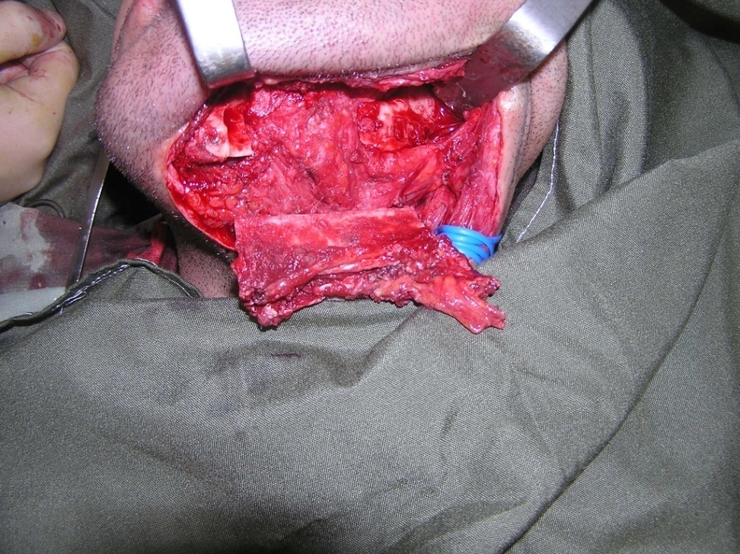
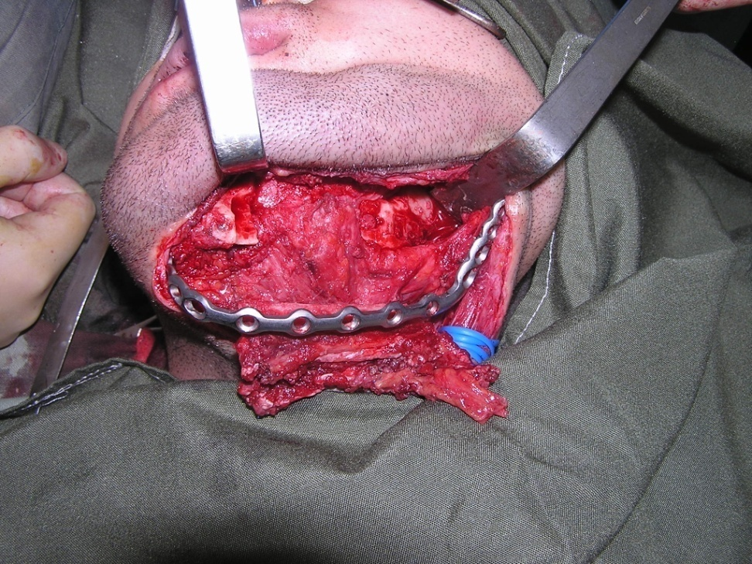
Intraoperative view
Shaping and adjustment of the graft to the recipient site

Slide 28


Intraoperative view
Fixation of the graft

Slide 29


Intraoperative view
Fixation of the graft and imposition of the vascular anastomosis with a/v facialis

Slide 30




Stages of orthopedic restoration of dentition

Slide 31




Final result

