Slide 1
Motivation and Resilience
ID: jobactive – information – 1271 – Version 1.0

Slide 2
VERSION CONTROL
DATE DEVELOPER DETAILS VERSION
May 2016 Learning & Development New 1

Slide 3

Agenda
The benefits of Working.
Dealing with Feedback.
Personal Support Networks.
Wellbeing and Self-Care.
Examining barriers to success.

Slide 4
At the end of this session you will….....
Identify the benefits of working.
Understand how to deal with feedback.
Identify and build your personal support network.
Formulate a self care plan.
Recognise barriers to success.

Slide 5


What makes you laugh?

Slide 6
“I haven’t failed. I’ve identified 10,000 ways this doesn’t work.” Thomas Edison
“When nothing in life seems to go right, go left.” Unknown Author
“Be kind, for everyone you meet is fighting a hard battle.” Plato

Slide 7

The benefits of working
Financial
Social
Personal
Choice

Slide 8

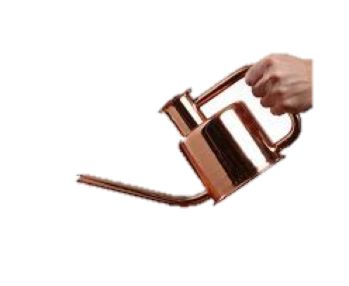

Dealing with feedback

Slide 9
Dealing with feedback
Don’t react at first
Understand concerns
Evaluate the feedback and give a proper reply
Recognise that negative feedback is a positive thing
Learn from the feedback

Slide 10
Dealing with feedback
How can I improve?
What have I learnt about myself?
What have I learnt about others?
What have I learnt about the situation?

Slide 11

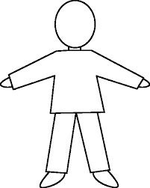

Personal Support Networks
Action Plan

Slide 12

Wellbeing & Self Care
Self Care Plan

Slide 13
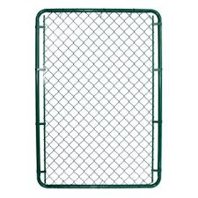
Barriers to success
Fear that you will outgrow your friends and family.
Fear that you won’t have time to enjoy life.
Fear it won’t be enough.
Fear that you will miss something better.

Slide 14
Summary
Identify the benefits of working.
Understand how to deal with feedback.
Identify and build your personal support network.
Formulate a self care plan.
Recognise barriers to success.

