Slide 1

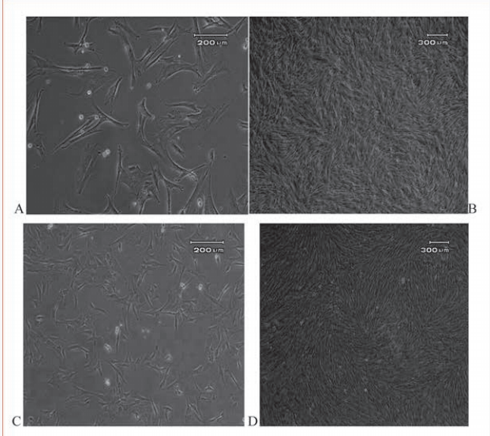
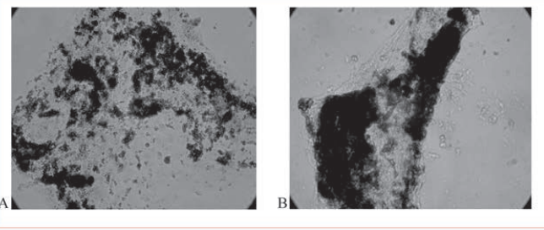
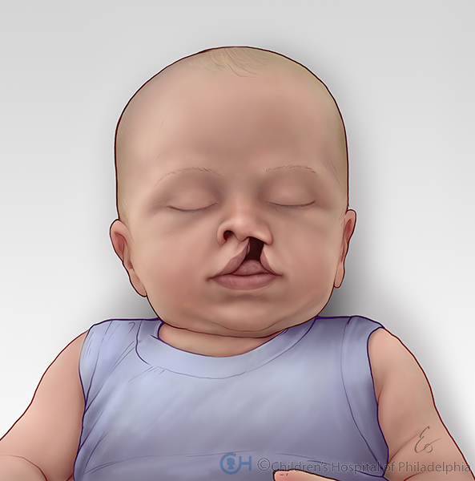
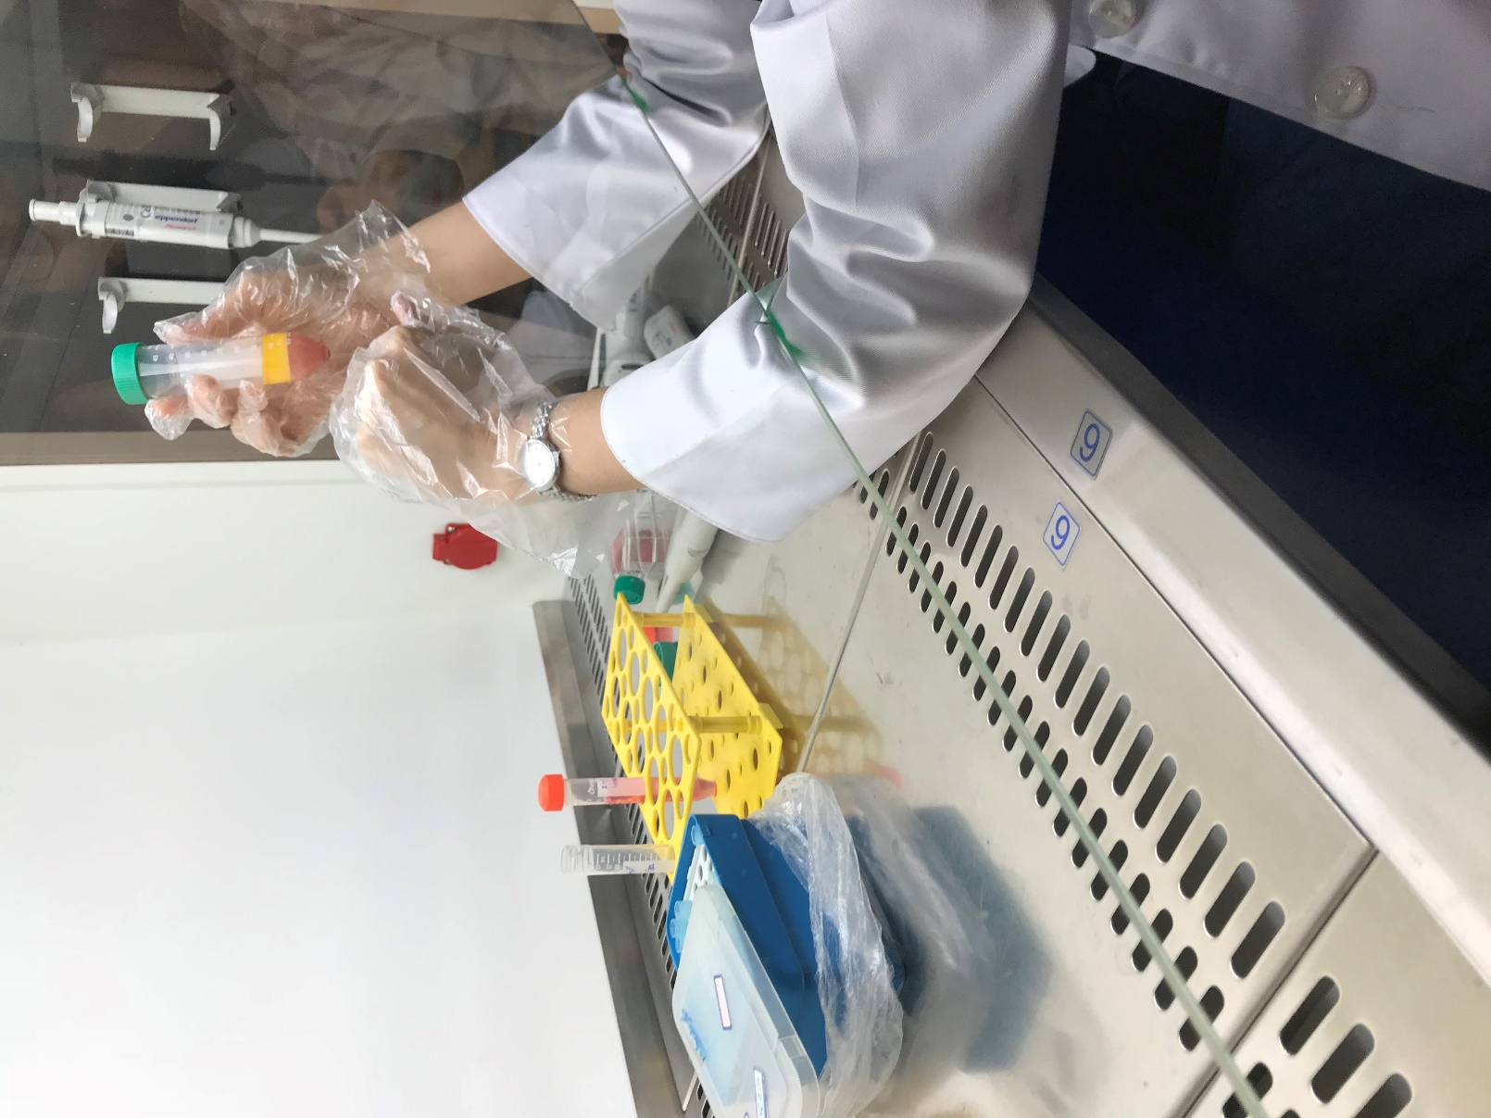
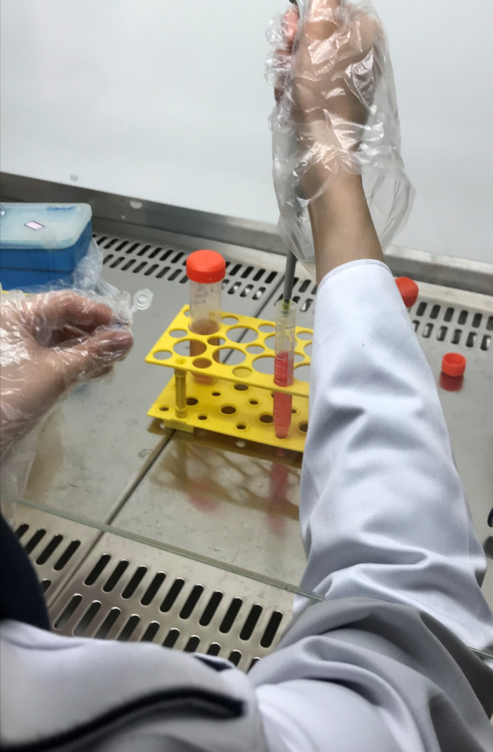
The effect of stem cells on treatment of cleft lip defect in children
Mobina Vatankhah| Iran | Farzanegan high school
Abstract
Results
Results
Hare lip or Cleft lip or Palate is one of the most prevalent congenital defect in human being which has the rate of 1per 700 or 1000 births in white race people. In recent years physicians and surgeons attempted to treat the malformation by surgery immediately afterbirth, but in some cases this defect can’t be treated by surgery easily. Our objective to use stem cells to eliminate such malformation is to save children to be put under surgery operation, the need to do general anesthesia to extract bone has consequences such as long-lasting pains and natural disorders. The innovation of extraction of stem cells provides more commensurate alternative in comparison with offensive technique of treatment of cleft lip and palate.
Orofacial split is the most prevalent congenital defect which can be treated by using stem cells driven of Cord tissue and without applying complicated surgery operations. According to the latest sratistics, about 20% of the children with this defect, will be treated by the method.
We hope to make a better and happier life for children.
Background
The history of surgery of cleft lip and palates reaches as far backwards as the pre-Christian era to 390 B.C. when for the first time a cleft lip was closed successfully in China. Although Egyptian and Greek medicines developed to a remarkable degree, no descriptions of cleft operations have survived. In the middle ages operations on cleft lip have been several times described. A successful operation on a cleft palate did however not occur until 1816. This can be explained by the fact that cleft palates were thought to be secondary to syphilis, but also because without anaesthetic this operation was extremely painful and difficult. Graefe in 1816 and Roux in 1819 published the first satisfactory results. After the introduction of chloroform cleft surgery made remarkable progress. The development of cleft surgery has been chronologically described and finally the present state of affairs is discussed. All surgical procedures carry some uncertainty and risk. When surgery is performed by a qualified plastic surgeon with experience in cleft lip and cleft palate plastic surgery, the results can be quite positive. Nevertheless, as with any operation, there are risks associated with surgery and specific complications associated with this procedure.
In cleft lip surgery, the most common problem is asymmetry, when one side of the mouth and nose does not match the other side. The goal of cleft lip surgery is to close the separation in the child's upper lip, creating a normal look with normal function. We can add to that goal the creation of a balanced and symmetric nostril. Incisions and scars are necessary to accomplish these goals. We attempt to keep scars to a minimum and to place them in locations where they will be least apparent.
Pictures
Methods
Umbilical cord tissue (CT) can provide a virtually unlimited source of multipotent mesenchymal stem cells (MSC) that can potentially be used in a variety of regenerative medicine and tissue engineering applications. Cord tissue segments can be frozen and preserved in liquid nitrogen dewars for prolonged periods of time, having been frozen in time at the peak of biological activity. CT stem cells are capable of giving rise to various mesenchymal and non-mesenchymal cell lineages including bone, cartilage, fat and neurons. Thus, CT stem cells are candidates to develop stem cell-based therapies for a wide variety of diseases including cardiovascular, ophthalmic, orthopedic and neurological applications. CT is currently being used in several regenerative medicine clinical studies, examples of which include treatment of graftversus- host disease and non-healing bone fractures. CT represents an additional source of stem cells that have both immediate and future applications for the individual donor. CT is derived from the human umbilical cord that develops during gestation to support the development of the fetus. The average length of the cord itself is between 30-50cm depending on a variety of factors including maternal age, heath and ethnicity. Stem cells have been identified in various anatomical locations throughout the cord tissue including the amniotic compartment, the Wharton’s jelly and the perivascular space surrounding the blood vessels.
References
Daniela Franco Bueno, New Source of Muscle-Derived Stem Cells with Potential for Alveolar Bone Reconstruction in Cleft Lip and/or Palate Patients, University of São Paulo, 2008, 54-58.
Sanam Sadegi, Ahmad Khosh Zaban, Seperation , cultivation and identification of Mezanchimic stem cells driven of fat tissue of human being, Tehran medical faculty magazine, 2014, 27-32.
Zeynab Abdollahi, Toba Mirzapoor, The investigation of stemming cells of Mezanchimic jelly Warton of umbilical cord during distinction to same cells. New cell and Mol biotechnology magazine, 2010, 54-58.
Alviano F, Fossati V, Marchionni C, Arpinati M,Bonsi L, Franchina M, et al. Term amniotic membrane is a high throughput source for multipotentmesenchymal.
Portmann-Lanz CB, Schoeberlein A, Huber A. Placental mesenchymal stem cells as potential autologous graft for pre- and perinatal neurodegeneration. Am J Obstet Gynecol. 2006;664-673.
Karahuseyinoglu S, Cinar O, Kilic E, Kara F, Akay GG, Demiralp DO, et al. Biology of stem cells in human umbilical cord stroma: in situ and in vitro sur-veys. Stem Cells. 2007;319-31.

