Slide 1
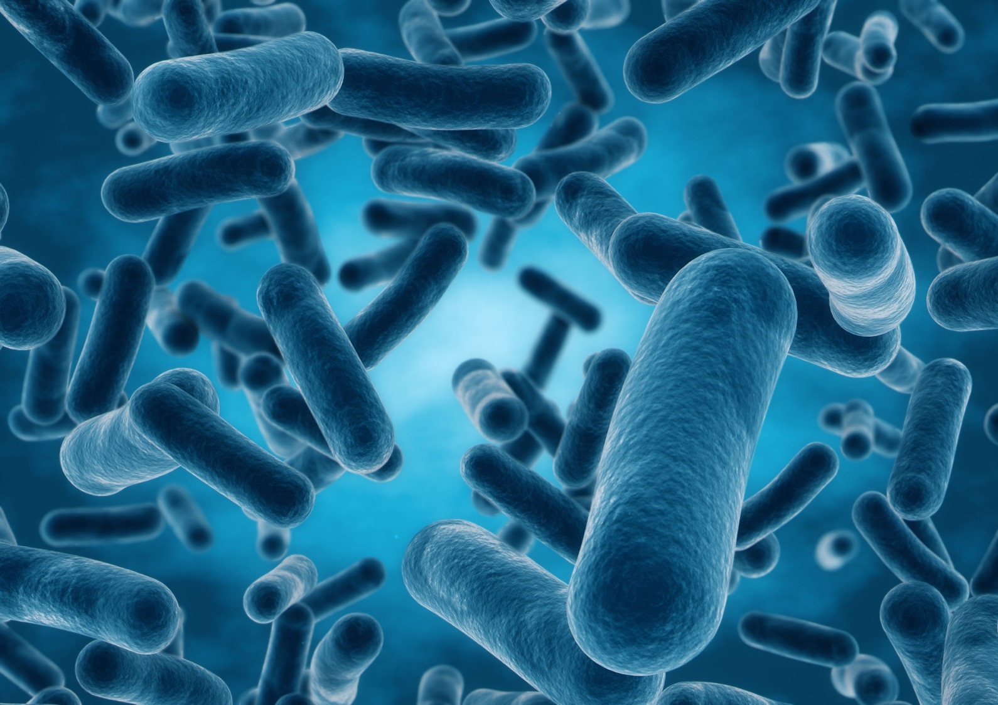

The spectacular role of the human microbiome in preventing metabolic endotoxemia, the number one cause of mortality worldwide.
Dr. Tom Bayne, D.C.
President

Slide 2


Slide 3
WHAT IS METABOLIC ENDOTOXEMIA?
Metabolic endotoxemia is essentially an innate immune response that becomes a sub-clinical, persistent, low-grade inflammation because of increased, circulating endotoxins. – Primarily LPS.
Metabolic endotoxemia is a condition that is estimated to affect approximately 33% of the western population.
The condition is characterized by increased serum endotoxin (typically lipopolysaccharide) concentration during the first five hours of the post-prandial period following consumption of a meal.
Meals that are high in fat and dense in calories seem to impact the condition more so than low fat and low calorie meals.
This increase in serum endotoxin concentration is followed by elevated inflammation that is marked by measurable increases in interleukin-6, interleukin-1-alpha, interferon-gamma, triglycerides and post-prandial insulin.
Chronic metabolic endotoxemia and the associated inflammation has been shown to have significant correlation to increases in the risk of developing a variety of chronic diseases:
  cardiovascular disease, diabetes, obesity, hypogonadism, autoimmunity and even mood disorders such as anxiety and depression.
Notes:
Nagpal R, Kumar M, Yadav AK, et al. Gut microbiota in health and disease: an overview focused on metabolic inflammation. Benef Microbes. 2016;7(2):181-94.
https://www.ncbi.nlm.nih.gov/pubmed/26645350
Boutagy NE, McMillan RP, Frisard MI, Hulver MW. Metabolic endotoxemia with obesity: Is it real and is it relevant? Biochimie. 2016;121:11-20. https://www.ncbi.nlm.nih.gov/pubmed/26133659
Sanz Y, Olivares M, Moya-Perez A, Agostoni C. Understanding the role of gut microbiome in metabolic disease risk. Pediatric Research. 2015;77:236-244.
De Punder K, Pruimboom L. Stress induces endotoxemia and low-grade inflammation by increasing barrier permeability. Front Immunol. 2015;15(6):223.

Slide 4
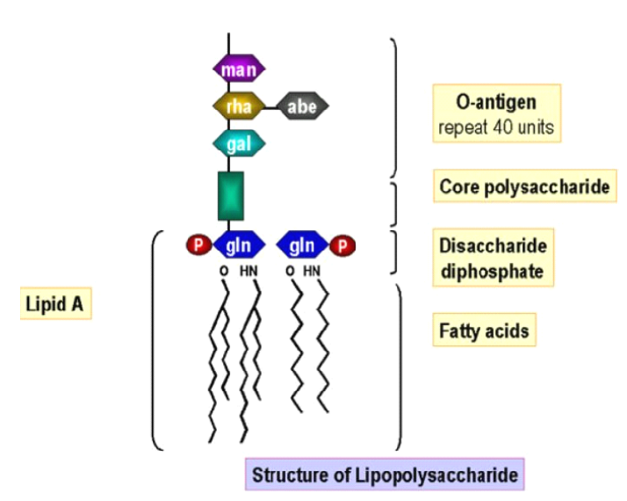
What is an endotoxin?
AKA lipopolysaccharide (LPS)
● Inflammatory immunogens
● Component of gram-negative bacterial outer cell wall
○ Adhesion for colonization of host
○ Diversity of antigenic strains
● Circulates at low-grade levels in healthy individuals
● Toxicity mainly mediated by the lipid-A component
http://caltagmedsystems.blogspot.com/2013/05/uscn-specialist-elisa-kit-manufacturer.html
Erridge, et al. Am J Clin Nutr. 2007;86:1286-1292

Slide 5
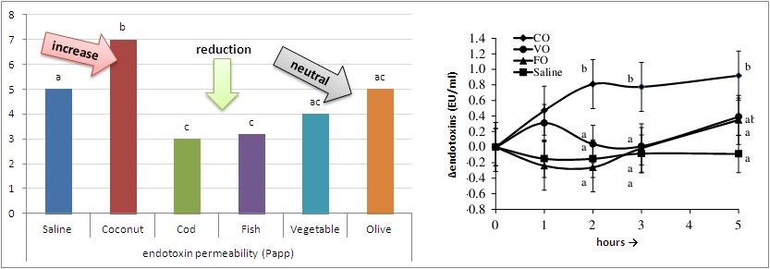
TYPES OF DIETARY FATS AND ENDOTOXEMIA
Endotoxin permeability and changes in serum endotoxin levels in the hours subsequent to the ingestion of a test meal containing either 50ml coconut (CO), vegetable (VO) and fish oil (FO) in otherwise healthy pigs (Mani. 2013).
Nutrition & Metabolism201310:6 https://doi.org/10.1186/1743-7075-10-6

Slide 6
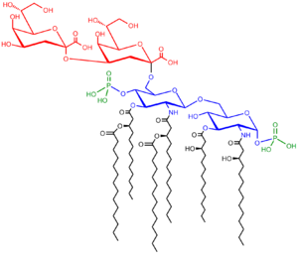
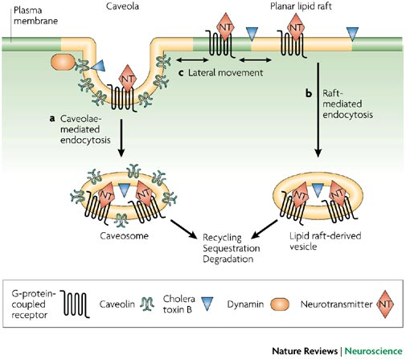
Why does the type of fat matter?
Saturated fat (SFA) and n-3 PUFAs have opposite effects on LPS receptor, TLR4, and lipid rafts
○ Lipid-A component of LPS is composed of SFA
○ Endotoxin toxicity is reduced when SFA in lipid-A is substituted for n-3 PUFAs
Lee, et al. J Biol Chem. 2004;279:16971-16979
How does endotoxin enter the blood?
Paracellular pathways
○ Via tight junctions
Transcellular pathways
○ Via lipid rafts (endocytosis)
  Rigid portion of membrane
  Composed of cholesterol, SFA
  Important in cell signaling
Triantafilou, et al. J Cell Sci. 2002;115:2603-2611;

Slide 7
IMMUNE ACTIVATION IN METABOLIC ENDOTOXEMIA
TLR4 is an important signaling protein in innate immunity and is found on the surfaces of innate immune defense cells like Macrophages and dendritic cells.
Circulating LPS gets bound by a phospholipid transfer protein called LBP, which carriers LPS to the CD14-TLR complex for examination.
Once LPS-LBP has bound to the CD14-TLR complex, it initiates an immune cascade that leads to the activation of NFKβ
The activation of NFKβ leads to the increased expression of pro-inflammatory mediators TNFα, IL-1beta, IL-6 and MCP-1.
Innate immune cells that become activated by LPS and subsequently cause the chronic release of pro-inflammatory cytokines, exist in all parts of the body, including the blood-brain barrier.
Notes:
Sanz Y, Olivares M, Moya-Perez A, Agostoni C. Understanding the role of gut microbiome in metabolic disease risk. Pediatric Research. 2015;77:236-244.
Glaros TG, Chang S, Gilliam EA, Maitra U, Deng H, Li L. Causes and consequences of low grade endotoxemia and inflammatory diseases. Front Biosci (Schol Ed). 2013; 5:754-65
P Ancuta, A Kamat, KJ Kunstman, EY Kim, P Autissier, A Wurcel, T Zaman, D Stone, M Mefford, S Morgello, EJ Singer, SM Wolinsky, D Gabuzda. Microbial translocation is associated with increased monocyte activation and dementia in AIDS patients. PLoS One 3, e2516 (2008)
http://dx.doi.org/10.1371/journal.pone.0002516
U Maitra, L Gan, S Chang, L Li. Low-dose endotoxin induces inflammation by selectively removing nuclear receptors and activating CCAAT/enhancer-binding protein delta. J Immunol 186, 4467-73 (2011)
http://dx.doi.org/10.4049/jimmunol.1003300

Slide 8
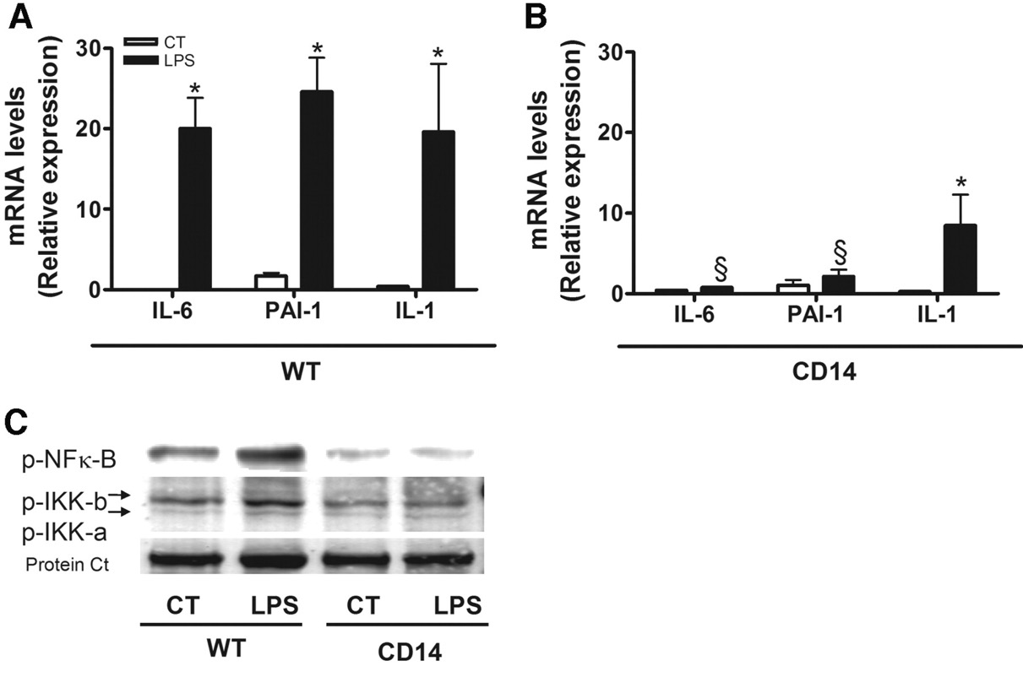

CD14 mutant mice are protected against LPS-induced inflammation. mRNA concentrations of IL-6, PAI-1, and IL-1 in adipose tissue 3 h after a saline (control [CT]; n = 6) or an LPS (n = 6) infusion in WT (A) and CD14 mutant (B) mice. *P < 0.05 vs.
Patrice D. Cani et al. Diabetes 2007;56:1761-1772
©2007 by American Diabetes Association
Notes:
CD14 mutant mice are protected against LPS-induced inflammation. mRNA concentrations of IL-6, PAI-1, and IL-1 in adipose tissue 3 h after a saline (control [CT]; n = 6) or an LPS (n = 6) infusion in WT (A) and CD14 mutant (B) mice. *P < 0.05 vs. CT; §P < 0.05 vs. WT. C: Representative Western blot analysis of p-NFk-B and p-IKK-b and p-IKK-a in the liver of mice from the same experiment. Protein Ct corresponds to a loading control of major protein, which cross-reacts nonspecifically with the anti–p-IKK-a antibody.

Slide 9
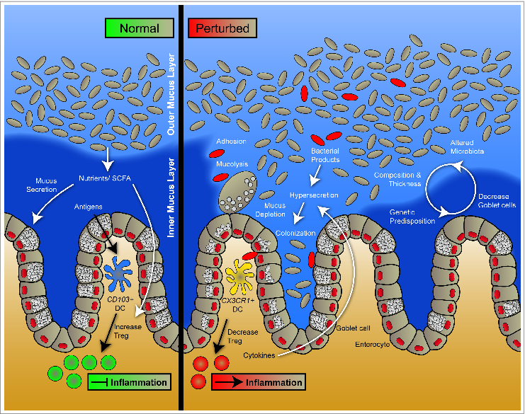
MICROBIAL-IMMUNE-METABOLIC AXIS OF COMMUNICATION
Positive Microbiome Metabolites
i.e. butyrate, acetate, indole, taurine, intectin
EIC Derived Anti-microbials:
α-defensins, lysozyme C, phospholipases and C-type lectin
Negative Microbiome Metabolites:
i.e.
Siacylic acid,
Succinate,
mucinase
Tissue Barriers. 2015; 3(1-2): e982426. Published online 2015 Jan 15. doi: 10.4161/21688370.2014.982426
Notes:
The mucus layer under normal and perturbed conditions. The gut mucosa is covered by a thick layer of mucus that acts as a protective barrier against harmful substances. The barrier consists of 2 layers, an inner mucus layer and an outer mucus layer. Commensal and environmental microbes colonize and remain in the outer mucus layer by binding to mucus via lectin-like molecules, while the inner mucus layer is relatively sterile. Mucus is composed of high molecular weight glycoproteins called mucins. Mucins are produced and packaged into secretory granules within the goblet cell cytoplasm and secreted at the apical membrane. Under normal conditions, goblet cells continuously produce mucus to maintain a functional mucus layer; however, genetic and environmental factors can modulate goblet cell function and mucus production. Short chain fatty acids (SCFAs) produced by commensal microorganisms not only provide nutrients for colonocytes but also increase mucus production and secretion. Furthermore, SCFAs also modulate immune homeostasis and tolerance in the intestines. Under perturbed conditions during infection, pathogens can induce mucin hypersecretion, inhibit mucus production, degrade mucus or induce changes in mucin glycosylation that can lead to disruption of the mucus barrier. Altered barrier function can subsequently cause commensal and pathogenic microbes as well as microbial products to translocate to the epithelial surface. This in turn can trigger immune cell response and cytokine production leading to inflammation.

Slide 10
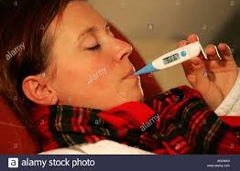
CLINICAL MANIFESTATIONS OF LPS INDUCED CHRONIC IMMUNE ACTIVATION

Slide 11
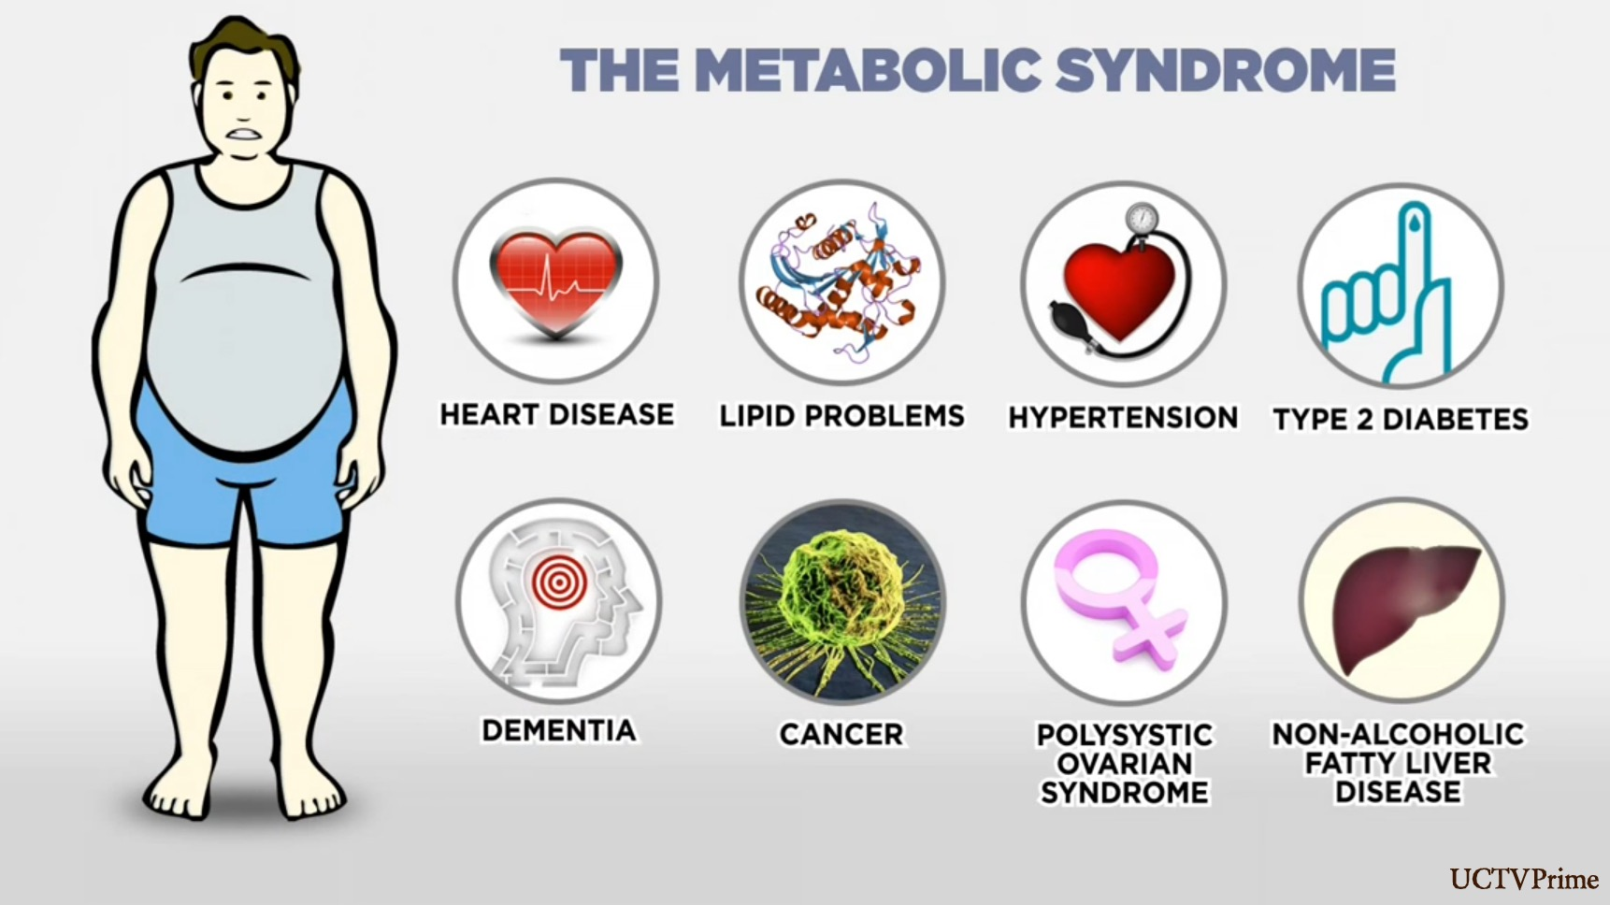
http://www.fortmyerschirostudio.com/2016/02/18/a-vicious-cycle-the-trappings-of-metabolic-syndrome/

Slide 12
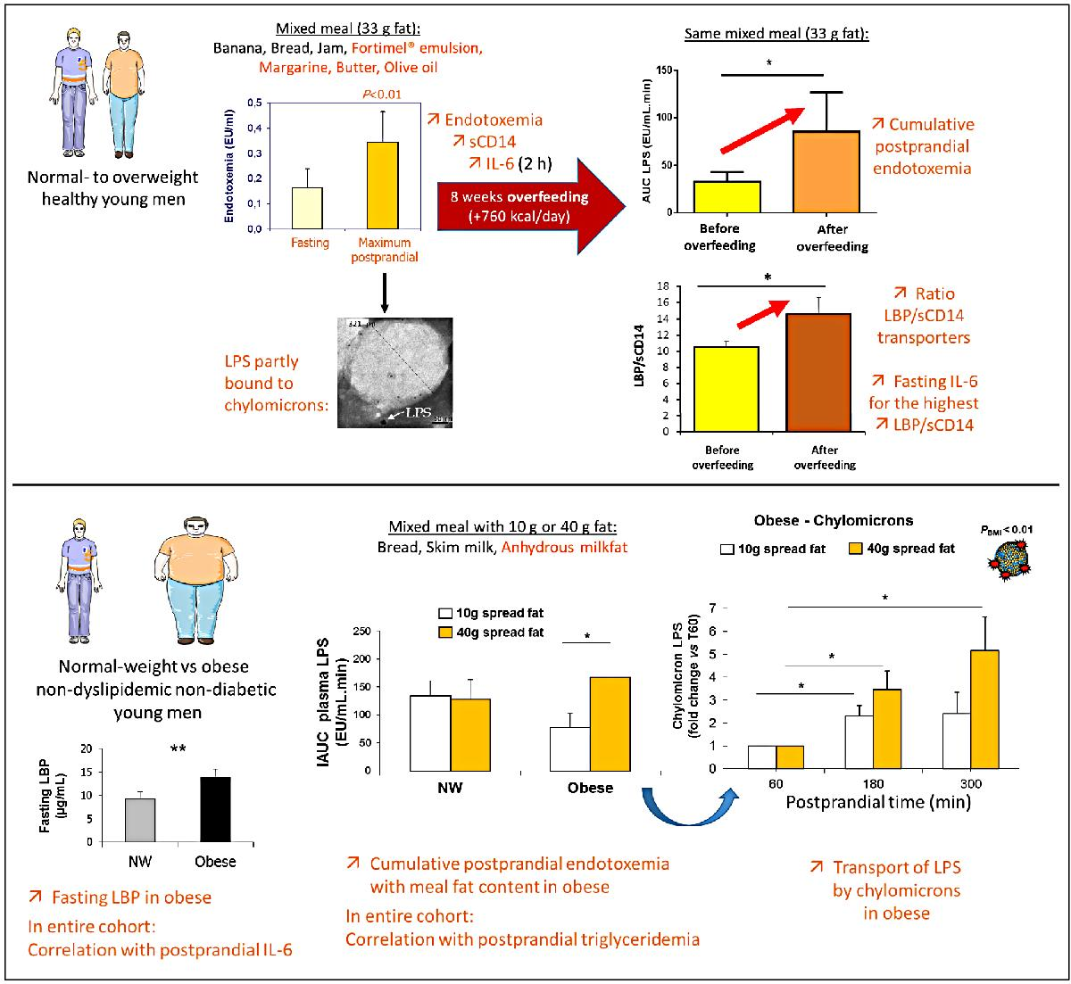
Summary of recent studies about postprandial endotoxemia in lean, overweight or obese men (Laugerette et al., 2011, 2014; Vors et al., 2015).
Upper panel: lean to overweight subjects were submitted to the same postprandial test before and after 8 weeks of overfeeding.
Lower panel: lean and obese subjects were submitted to two different postprandial tests varying by the amount of fat in the meal.

Slide 13
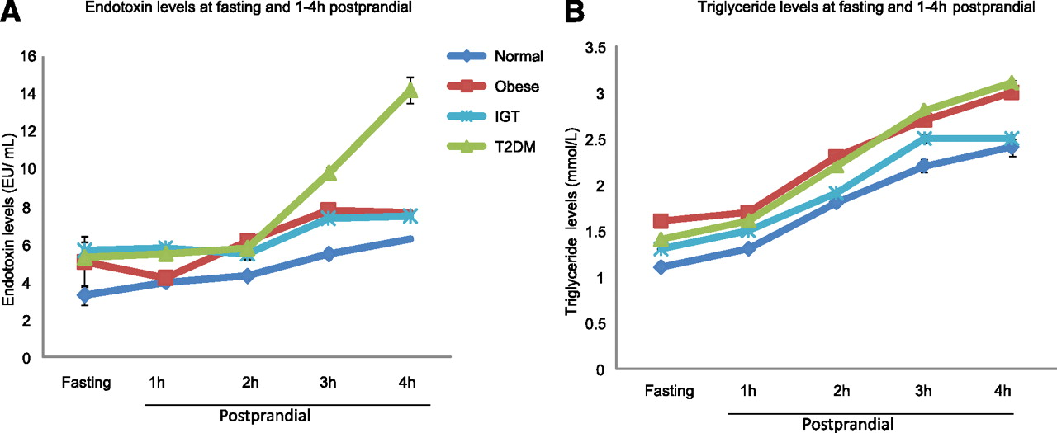
Changes in circulating endotoxin levels (A) and triglyceride levels (B) in NOC, IGT, obese, and type 2 diabetic (T2DM) subjects.
changes in circulating endotoxin levels (A) and triglyceride levels (B) in NOC, IGT (impaired glucose tolerance), obese, and type 2 diabetic (T2DM) subjects. Endotoxin and triglyceride levels were measured at baseline and then, after a high-SFA meal, at each hour postprandially over a 4-h duration. Each point on the graph represents the mean value for each cohort (± SEM).
Alison L. Harte et al. Dia Care 2012;35:375-382
©2012 by American Diabetes Association

Slide 14
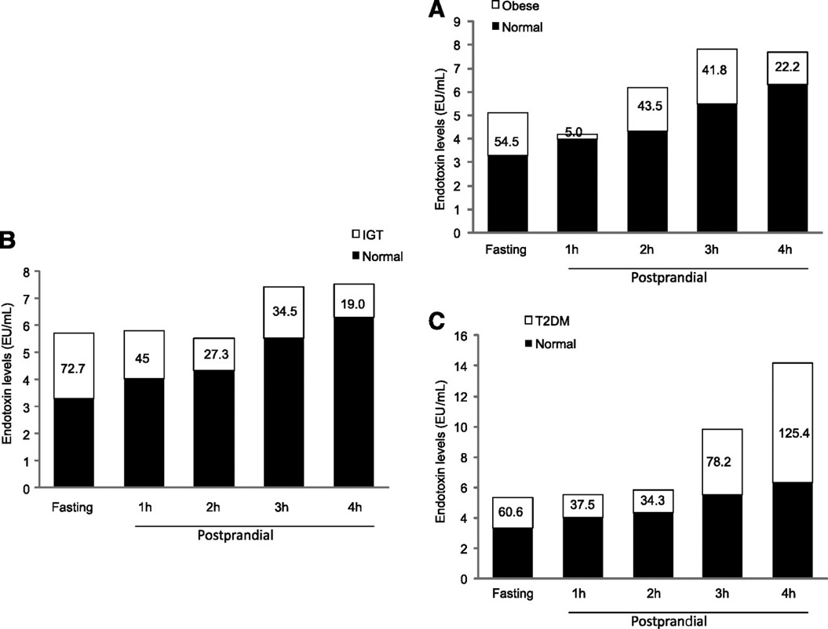
Increase in endotoxin levels between the NOC subjects and the obese (A), IGT (B), and type 2 diabetic (T2DM) (C) subjects from baseline to 4 h after a high-fat meal.
Alison L. Harte et al. Dia Care 2012;35:375-382
©2012 by American Diabetes Association
Notes:
Increase in endotoxin levels between the NOC subjects and the obese (A), IGT (B), and type 2 diabetic (T2DM) (C) subjects from baseline to 4 h after a high-fat meal. Endotoxin is measured in EU/mL, and the percentage increase compared with NOC is also shown.

Slide 15
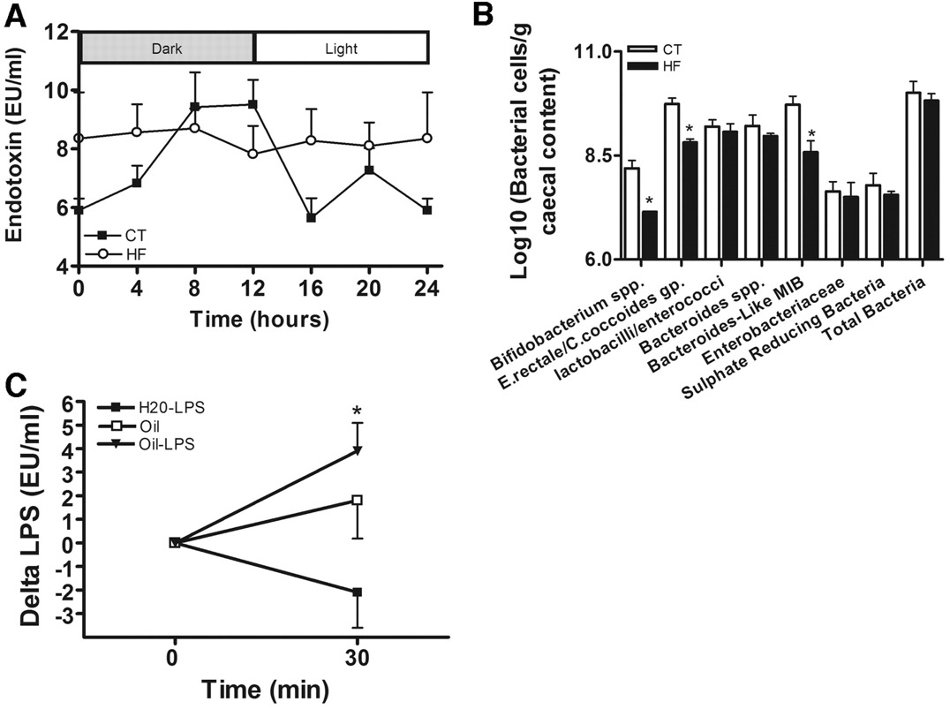
High-fat feeding increased endotoxemia and changed intestinal microbiota.
Patrice D. Cani et al. Diabetes 2007;56:1761-1772
©2007 by American Diabetes Association
Notes:
High-fat feeding increased endotoxemia and changed intestinal microbiota. A: Plasma LPS concentration (EU/ml) was assessed every 4 h throughout the day in normal diet (CT; n = 9) (▪) and 4-week high-fat–fed (HF; n = 9) (○) mice. B: Groups of bacteria in the caecal content of mice fed the normal diet (CT; n = 8) or the high-fat diet (HF; n = 8) for 4 weeks. Bacterial numbers are expressed as log10 (bacterial cells per gram caecal content wet weight). *P < 0.05 vs. CT. C: Delta plasma LPS concentration in (EU/ml) in mice before and 30 min after an oral administration of LPS diluted in corn oil (n = 6) (oil-LPS) or in water (n = 6) (H2O-LPS) or an administration of oil alone (n = 6) (oil). *P < 0.05 vs. H2O-LPS. Data are means ± SE.

Slide 16


Slide 17
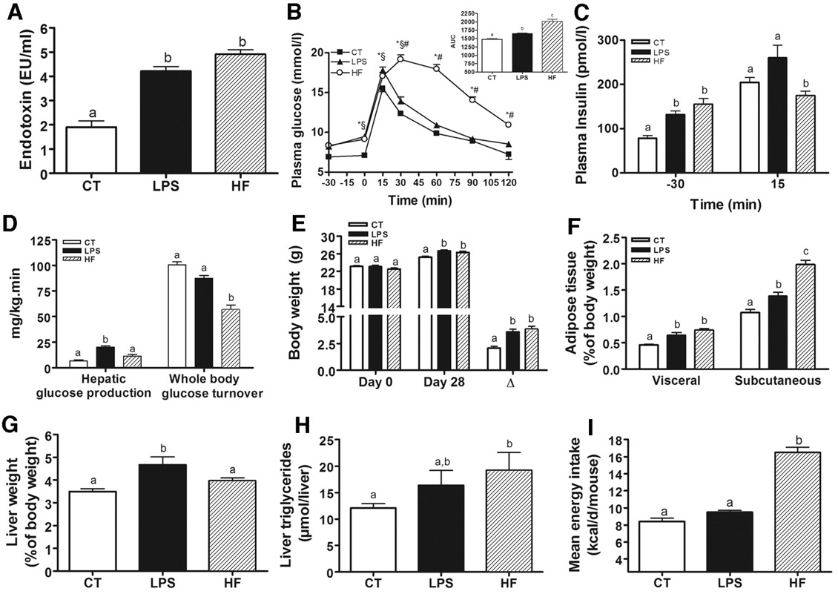
Chronic experimental metabolic endotoxemia induces obesity and diabetes.
Patrice D. Cani et al. Diabetes 2007;56:1761-1772
©2007 by American Diabetes Association
Notes:
Chronic experimental metabolic endotoxemia induces obesity and diabetes. A: Plasma endotoxin concentration (EU/ml) in WT mice infused with saline (CT; n = 18) or LPS (n = 18) for 4 weeks using subcutaneous osmotic pumps and compared with mice fed a high-fat diet for 4 weeks (HF; n = 18). B: Plasma glucose (mmol/l) following an oral glucose load (3 g/kg) in control (CT; n = 24), LPS (n = 13), or high-fat diet (HF; n = 24) mice. The inset represents the area under curve for each group. *P < 0.05 vs. CT; §LPS vs. CT; #HF vs. LPS. C: Plasma insulin (pmol/l) concentrations 30 min before (−30) and 15 min after (15) an oral glucose load in control (CT; n = 24), LPS (n = 13), or high-fat diet–fed (HF; n = 24) mice. D: Hepatic glucose production and whole-body glucose turnover rates (mg · kg−1 · min−1) in control (CT; n = 5), LPS (n = 5), or high-fat diet–fed (HF; n = 5) mice. E: Body weight (g) before (day 0) and after a 28-day treatment period (day 28) and body weight gain (Δ) in control (CT; n = 26), LPS (n = 21), or high-fat diet–fed (HF; n = 34) mice. F: Visceral and subcutaneous adipose tissue weight (percentage of body weight) in control (CT; n = 26), LPS (n = 21), or high-fat diet–fed (HF; n = 34) mice. G: Liver weight (percentage of body weight) in control (CT; n = 26), LPS (n = 21), or high-fat diet–fed (HF; n = 34) mice. H: Liver triglycerides (μmol/liver) in control (CT; n = 12), LPS (n = 9), or high-fat diet–fed (HF; n = 11) mice. I: Mean energy intake (kcal · day−1 · mouse−1) in control (CT; n = 18), LPS (n = 18), or high-fat diet–fed (HF; n = 18) mice. Data are means ± SE. Data with different superscript letters are significantly different at P < 0.05, according to the post hoc ANOVA statistical analysis.

Slide 18
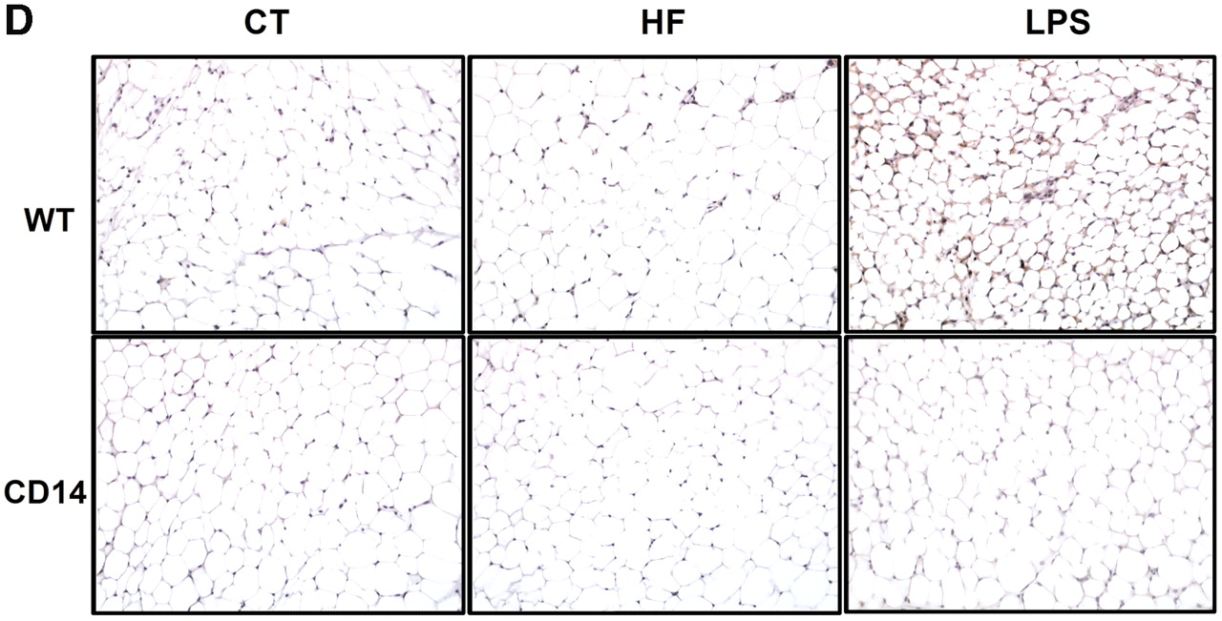
Metabolic endotoxemia impairs adipocyte morphology.
Patrice D. Cani et al. Diabetes 2007;56:1761-1772
©2007 by American Diabetes Association

Slide 19
Diabetes Care. 2012 Feb;35(2):375-82. doi: 10.2337/dc11-1593. Epub 2011 Dec 30.
High fat intake leads to acute postprandial exposure to circulating endotoxin in type 2 diabetic subjects.
Harte AL¹, Varma MC, Tripathi G, McGee KC, Al-Daghri NM, Al-Attas OS, Sabico S, O'Hare JP, Ceriello A, Saravanan P, Kumar S, McTernan PG.
“It is known that low-grade chronic systemic inflammation contributes to this risk, which appears altered by several factors such as increasing age, sex, ethnicity, genetics, and dietary influences. However, systemic inflammation appears to persist in type 2 diabetic subjects, despite medication, while the mechanisms and mediators of this continual inflammation appear less clear.”
“…clinical studies have also implicated gut-derived endotoxin as a “primary insult” to activate the inflammatory state, contributing to metabolic disease, with current cross-sectional data showing elevated systemic endotoxin levels in conditions of obesity, type 2 diabetes, coronary artery disease, and fatty liver disease (8,10,11,14–17). Within these studies, circulating endotoxin is observed to be positively associated with waist circumference, waist-to-hip ratio, insulin levels, inflammatory cytokines and lipids, including total cholesterol, triglycerides (TGs), and LDL cholesterol, and negatively associated with HDL cholesterol (8,10,11,14–17).”

Slide 20
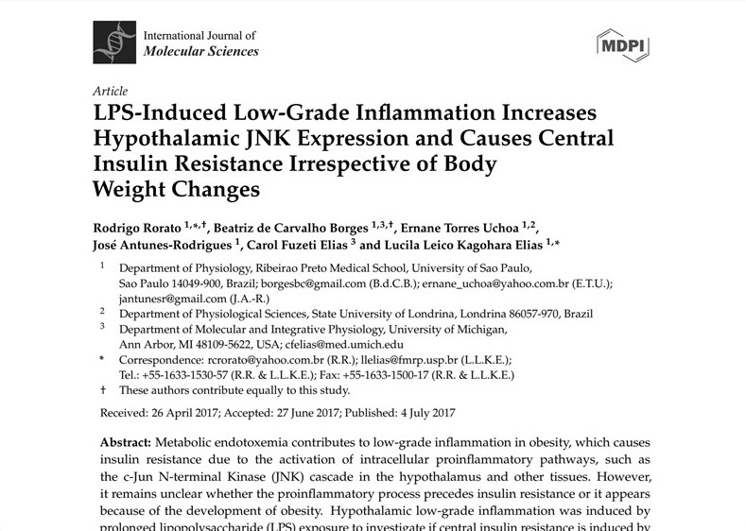
“The present data suggest that an increased JNK activity in the hypothalamus underlies the development of insulin resistance during prolonged exposure to endotoxins. Our study reveals that weight gain is not mandatory for the development of hypothalamic insulin resistance and the blockade of proinflammatory pathways could be useful for restoring the insulin signaling during prolonged low-grade inflammation as seen in obesity.”

Slide 21
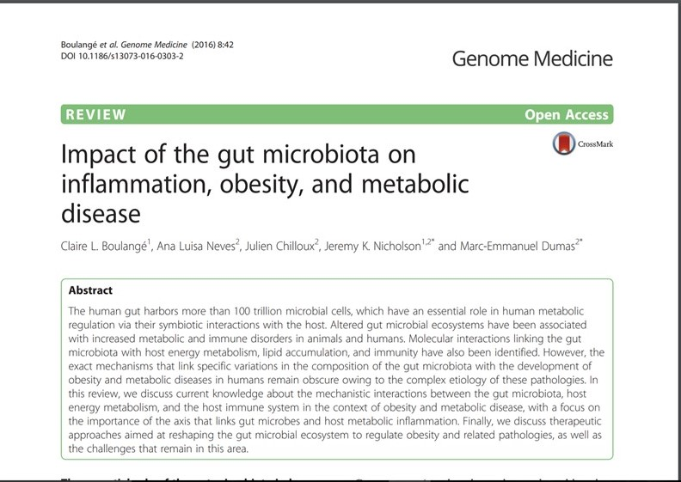
“The gut microbiota has recently been recognized as a key environmental factor driving metabolic diseases. In fact, the gut microbiota is even seen as a separate endocrine organ, which is involved, through a molecular crosstalk with the host, in the maintenance of host energy homeostasis and in the stimulation of host immunity.”
“…a healthy or dysbiotic gut microbiota affects the gut and metabolic health of the host through modulation of gut physiology and LPS infiltration, calorie intake, fat accumulation, and insulin action.”

Slide 22
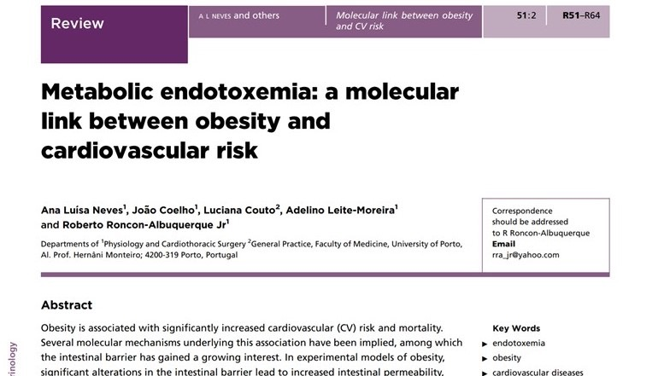

Slide 23
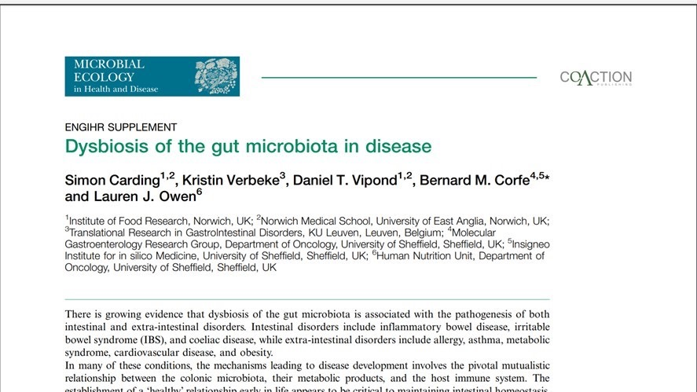

Slide 24
METABOLIC ENDOTOXEMIA AND ELEVATED LPS IN DISEASE
Metabolic Endotoxemia Initiates Obesity and Insulin Resistance
Patrice D. Cani, Jacques Amar, et al.
Diabetes 2007 Jul; 56(7): 1761-1772. https://doi.org/10.2337/db06-1491
Metabolic endotoxemia directly increases the proliferation of adipocyte precursors at the onset of metabolic diseases through a CD14-dependent mechanism
Elodie Luche, Béatrice Cousin, et al.
Mol Metab. 2013 Aug; 2(3): 281–291.
Lipopolysaccharide Causes an Increase in Intestinal Tight Junction Permeability in Vitro and in Vivo by Inducing Enterocyte Membrane Expression and Localization of TLR-4 and CD14
Shuhong Guo, Rana Al-Sadi, Hamid M. Said, and Thomas Y. Ma
The American Journal of Pathology, Vol. 182, No. 2, February 2013
Elevated endotoxin levels in non-alcoholic fatty liver disease
Alison L Harte et al.
Journal of Inflammation 2017:15
Received: 3 September 2009Accepted: 30 March 2010Published: 30 March 2010

Slide 25
CONDITION | MECHANISM
Leptin Resistance | LPS enters and causes inflammation in the enteric nervous system leading to a disruption in the gut-brain axis of communication.
Chronic Constipation | LPS enters the enteric nervous system and causes disruption in signals for gastric emptying and bowel motility.
Mood and Appetite Disorders | LPS disrupts ghrelin function which has a direct impact on appetite and mood.
Cognitive Decline | Inflammation in the blood brain barrier leads to cognitive decline
Loss of Memory and Recall | LPS can get into the amygdala and hippocampus which disrupts memory function
Depression | LPS can increase the turnover of serotonin in the synapse and CNS reducing the concentration in those regions
Anorexia | The reduction of serotonin in the synapse and CNS is proposed as a possible mechanism for anorexia.
Anxiety | LPS disrupts key communication between the hypothalamic-adrenal-pituitary axis thereby increasing the expression of corticosteroid releasing hormone
Chronic Pain | Elevated LPS in sensory neurons in the dorsal root stimulate nociceptors.
Parkinson’s | Intra-cranial LPS causes microglial activation and neuronal loss
Hypogonadism (low testosterone) | Increased circulating LPS and the subsequent chronic immune activation has feedback inhibition of testosterone production. GELDING theory.
Autoimmunity | Chronic activation of the innate immune system in various tissues leads to the by-stander effect where self-tissues inadvertently become targeted by the immune system.
ELEVATED LPS AND DISEASE
Notes:
Endocrine Abstracts (2012) 29 P1136. Leptin resistance and desensitization of hypophagia during prolonged inflammatory challenge are associated with high ptp1b expression in the hypothalamus. B. Borges, R. Rorato, P. Marangon, E. Uchoa, J. Antunes-Rodrigues & L. Elias
Qu et al. BMC Complementary and Alternative Medicine (2017) 17:185 DOI 10.1186/s12906-017-1700-9
Am J Physiol Gastrointest Liver Physiol. 2006 Oct;291(4):G611-20. LPS inhibits fasted plasma ghrelin levels in rats: role of IL-1 and PGs and functional implications.
Wang L
Ch Beck G, Brinkkoetter P, Hanusch C, et al. Clinical review: Immunomodulatory effects of dopamine in general inflammation. Critical Care. 2004;8(6):485-491. doi:10.1186/cc2879.
Brain Res Bull. 1999 Jan 15;48(2):223-31. Immune stimulation induces Fos expression in brainstem amygdala afferents.
Tkacs NC¹, Li J.
Dwarkasing JT, Witkamp RF, Boekschoten MV, Ter Laak MC, Heins MS, van Norren K. Increased hypothalamic serotonin turnover in inflammation-induced anorexia. BMC Neuroscience. 2016;17:26. doi:10.1186/s12868-016-0260-0.
Am J Physiol Gastrointest Liver Physiol. 2010 Sep;299(3):G723-32. doi: 10.1152/ajpgi.00494.2009. Epub 2010 Jun 24. Bacterial cell products signal to mouse colonic nociceptive dorsal root ganglia neurons.
Ochoa-Cortes F
Qi J, Buzas K, Fan H, et al. Painful Pathways Induced by Toll-like Receptor Stimulation of Dorsal Root Ganglion Neurons. Journal of immunology (Baltimore, Md : 1950). 2011;186(11):6417-6426. doi:10.4049/jimmunol.1001241.
Liu M, Bing G. Lipopolysaccharide Animal Models for Parkinson’s Disease. Parkinson’s Disease. 2011;2011:327089. doi:10.4061/2011/327089.
Tremellen K. Gut Endotoxin Leading to a Decline IN Gonadal function (GELDING) - a novel theory for the development of late onset hypogonadism in obese men. Basic and Clinical Andrology. 2016;26:7. doi:10.1186/s12610-016-0034-7.
Cavallo T, Granholm NA. Bacterial lipopolysaccharide induces long-lasting IgA deficiency concurrently with features of polyclonal B cell activation in normal and in lupus-prone mice. Clinical and Experimental Immunology. 1991;84(1):134-138.
J Immunol. 2005 Jul 15;175(2):959-66.Lipopolysaccharide injection induces relapses of experimental autoimmune encephalomyelitis in nontransgenic mice via bystander activation of autoreactive CD4+ cells. Nogai A, Siffrin V, Bonhagen K, Pfueller CF, Hohnstein T, Volkmer-Engert R, Brück W, Stadelmann C, Kamradt T.

Slide 26
Basic Clin Androl. 2016; 26: 7.
Published online 2016 Jun 22. doi: 10.1186/s12610-016-0034-7
PMCID: PMC4918028
Gut Endotoxin Leading to a Decline IN Gonadal function (GELDING) - a novel theory for the development of late onset hypogonadism in obese men.
Kelton Tremellen
Male obesity is associated with late onset hypogonadism, a condition characterized by decreased serum testosterone, sperm quality plus diminished fertility and quality of life.
The GELDING theory (Gut Endotoxin Leading to a Decline IN Gonadal function) – describes the development of obesity related hypogonadism.
“Several observational studies have previously reported an association between obesity related hypogonadism (low testosterone) and systemic inflammation. However, for the first time we postulate that the trans-mucosal passage of bacterial lipopolysaccharide (LPS) from the gut lumen into the circulation is a key inflammatory trigger underlying male hypogonadism.”
“Endotoxin is known to reduce testosterone production by the testis, thereby also leading to a decline in sperm production.”
“Testosterone is known to be a powerful immune-suppressive, decreasing a man’s ability to fight infection. Therefore we postulate that the male reproductive axis has evolved the capacity to lower testosterone production during times of infection and resulting endotoxin exposure, decreasing the immunosuppressive influence of testosterone, in turn enhancing the ability to fight infection. While this response is adaptive in times of sepsis, it becomes maladaptive in the setting of “non-infectious” obesity related metabolic endotoxemia.”

Slide 27
GUT PERMEABILITY – CHRONIC INFLAMMATION
Stress induces endotoxemia and increasing barrier permeability
Karin de Punder* and Leo Pruimboom
Frontiers in Immunology published: 15 May 2015
“Chronic non-communicable diseases (NCDs) are the leading causes of work absence, disability, and mortality worldwide. Most of these diseases are associated with low-grade inflammation.”
“In combination with modern life-style factors, the increase in bacteria/bacterial toxin translocation arising from a more permeable intestinal wall causes a low-grade inflammatory state. We support this hypothesis with numerous studies finding associations with NCDs and markers of endotoxemia, suggesting that this process plays a pivotal and perhaps even a causal role in the development of low-grade inflammation and its related diseases.”
GROUND ZERO OF MOST HEALTH DISORDERS

Slide 28
HOW DOES A HEALTHY MICROBIOME PROTECT AGINST METABOLIC ENDOTOXEMIA?
Neutralize LPS
-increase sIgA
-increase PAMP
-manages microbiome
Increase Mucin2 production
Increase tight junction protein expression
Increase regeneration of expelled IEC
Reduce inflammatory response with metabolites, indole-3-propionate, intectin
Tissue Barriers. 2015; 3(1-2): e982426. Published online 2015 Jan 15. doi: 10.4161/21688370.2014.982426
Notes:
The mucus layer under normal and perturbed conditions. The gut mucosa is covered by a thick layer of mucus that acts as a protective barrier against harmful substances. The barrier consists of 2 layers, an inner mucus layer and an outer mucus layer. Commensal and environmental microbes colonize and remain in the outer mucus layer by binding to mucus via lectin-like molecules, while the inner mucus layer is relatively sterile. Mucus is composed of high molecular weight glycoproteins called mucins. Mucins are produced and packaged into secretory granules within the goblet cell cytoplasm and secreted at the apical membrane. Under normal conditions, goblet cells continuously produce mucus to maintain a functional mucus layer; however, genetic and environmental factors can modulate goblet cell function and mucus production. Short chain fatty acids (SCFAs) produced by commensal microorganisms not only provide nutrients for colonocytes but also increase mucus production and secretion. Furthermore, SCFAs also modulate immune homeostasis and tolerance in the intestines. Under perturbed conditions during infection, pathogens can induce mucin hypersecretion, inhibit mucus production, degrade mucus or induce changes in mucin glycosylation that can lead to disruption of the mucus barrier. Altered barrier function can subsequently cause commensal and pathogenic microbes as well as microbial products to translocate to the epithelial surface. This in turn can trigger immune cell response and cytokine production leading to inflammation.
P Ancuta, A Kamat, KJ Kunstman, EY Kim, P Autissier, A Wurcel, T Zaman, D Stone, M Mefford, S Morgello, EJ Singer, SM Wolinsky, D Gabuzda. Microbial translocation is associated with increased monocyte activation and dementia in AIDS patients. PLoS One 3, e2516 (2008)
http://dx.doi.org/10.1371/journal.pone.0002516
De Punder K, Pruimboom L. Stress induces endotoxemia and low-grade inflammation by increasing barrier permeability. Front Immunol. 2015;15(6):223.
Sanz Y, Olivares M, Moya-Perez A, Agostoni C. Understanding the role of gut microbiome in metabolic disease risk. Pediatric Research. 2015;77:236-244.
Abdelgader AM, Abuajamieh M, Hammad HM, et al. Effects of dietary butyrate supplementation in intestinal integrity of heat-sressed cockerels. J Anim Physiol Anim Nutr (Berl). 2017. doi: 10.1111/jpn.12622. https://www.ncbi.nlm.nih.gov/pubmed/28063242
Karl JP, Margolis LM, Madslien EH, et al. Changes in intestinal microbiota composition and metabolism coincide with increased intestinal permeability in young adults under prolonged physiologic stress. Am J Physiol Gastrointest Liver Physiol. 2017: ajpgi.00066.2017
Nagpal R, Kumar M, Yadav AK, et al. Gut microbiota in health and disease: an overview focused on metabolic inflammation. Benef Microbes. 2016;7(2):181-94.
https://www.ncbi.nlm.nih.gov/pubmed/26645350

Slide 29
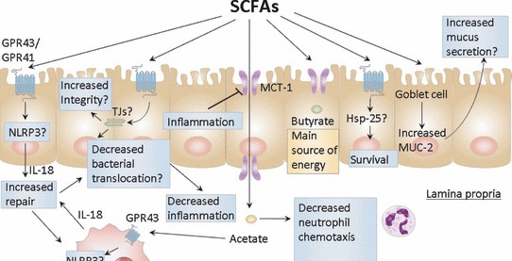
SHORT CHAIN FATTY ACIDS
Macia, Laurence et al. Microbial influences on epithelial integrity and immune function as a basis for inflammatory diseases. Immunological reviews. 245. 164-76. 10.1111/j.1600-065X.2011.01080.x.
Notes:
Figure 1: Potential effects of SCFAs on gut epithelial biology and immune cells. SCFAs may exert their effects through multiple mechanisms including those illustrated above. SCFA signaling via GPR43/GPR41 on epithelial or immune cells may activate the NLRP3 inflammasome, promote IL-18, and lead to epithelial integrity. SCFAs may promote epithelial integrity by preserving tight junctions (TJs). MCT-1 may regulate the transport of SCFAs across the epithelial barrier to access immune cells, such as macrophages and neutrophils and in turn, regulate chemotaxis and function. SCFAs may upregulate Hsp-25 to promote cell survival. SCFAs may promote maintenance of the mucus layer.

Slide 30
Benef Microbes. 2016;7(2):181-94. doi: 10.3920/bm2015.0062. Epub 2015 Dec 8.
Gut microbiota in health and disease: an overview focused on metabolic inflammation.
Nagpal R¹, Kumar M², Yadav AK², Hemalatha R², Yadav H³, Marotta F⁴, Yamashiro Y¹.
“Recent investigations have suggested a significant contribution of the gut microbiota in the regulation and impairment of energy homeostasis, thereby causing metabolic disorders, such as metabolic endotoxemia, insulin resistance and type 2 diabetes. Numerous inflammatory biomarkers have been found to be associated with obesity, diabetes and risk of other associated adverse outcomes, thereby suggesting that a persistent low-grade inflammatory response is a potential risk factor.”
Am J Physiol Gastrointest Liver Physiol. 2017 Jun 1;312(6):G559-G571. doi: 10.1152/ajpgi.00066.2017. Changes in intestinal microbiota composition and metabolism coincide with increased intestinal permeability in young adults under prolonged physiological stress.
Karl JP¹, Margolis LM², Madslien EH³, Murphy NE², Castellani JW⁴, Gundersen Y³, Hoke AV^{5,6}, Levangie MW^{5,6}, Kumar R⁷, Chakraborty N^{5,6}, Gautam A⁵, Hammamieh R⁵, Martini S³, Montain SJ², Pasiakos SM².
NEW & NOTEWORTHY Military training, a unique model for studying temporal dynamics of intestinal barrier and intestinal microbiota responses to stress, resulted in increased intestinal permeability concomitant with changes in intestinal microbiota composition and metabolism. Prestress intestinal microbiota composition and changes in fecal concentrations of metabolites linked to the microbiota were associated with increased intestinal permeability. Findings suggest that targeting the intestinal microbiota could provide novel strategies for mitigating increases in intestinal permeability during stress.

Slide 31
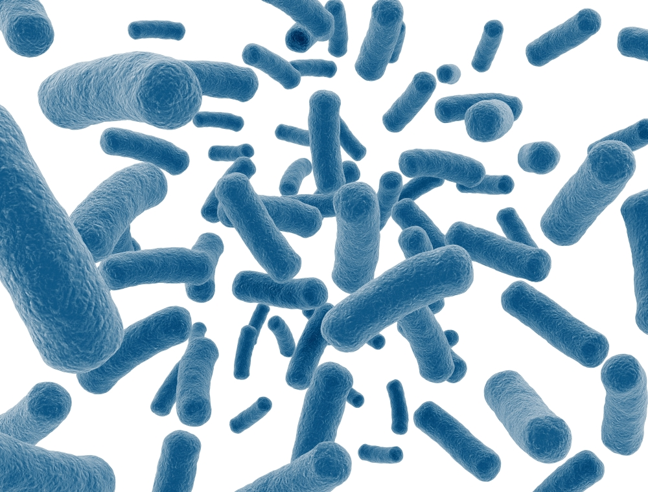

??!!

Slide 32
THE SPORE SOLUTION
J Interferon Cytokine Res. 2016 Feb;36(2):Effects of Bacillus subtilis on Epithelial Tight Junctions of Mice with Inflammatory Bowel Disease.
Gong Y¹, Li H¹, Li Y¹.
“B. subtilis intake upregulated expression of TJ proteins(claudin-1, occludin, JAM-A, and ZO-1), for improved barrier function, and downregulated cytokine expression (IL-6, IL-17, IL-23, and TNF-α) to reduce intestinal epithelial damage.”
Comp Biochem Physiol A Mol Integr Physiol. 2002 Sep;133(1):95-104.
Histological alterations of intestinal villi in chickens fed dried Bacillus subtilis var. natto.
Samanya M¹, Yamauchi KE.
“These birds had a tendency to display greater growth performance and intestinal histologies, such as villus height, cell area and cell mitosis, than the controls. ”
Bacillus subtilis Protects Porcine Intestinal Barrier from Deoxynivalenol via Improved Zonula Occludens-1 Expression
Min Jeong Gua, Sun Kwang Songa, Sung Moo Park
“B. subtilis may have potential to enhance epithelial barrier function and to prevent the cells from DON-induced barrier dysfunction.”

Slide 33
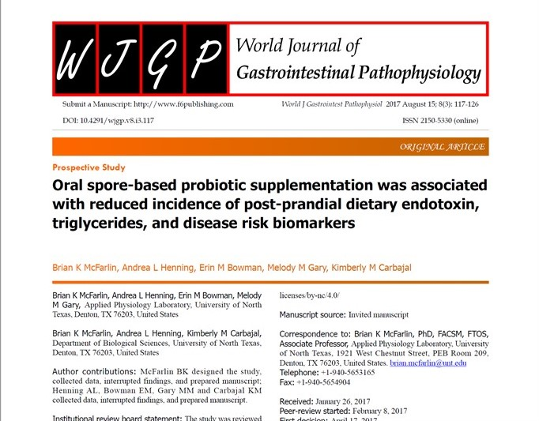

Slide 34
The effect of 30-days of probiotic supplementation
on post-prandial responses to a high-fat meal: Pilot Study
Principal Investigator: Brian K. McFarlin, PhD, FACSM, FTOS
University of North Texas

Slide 35
The effect of 30-days of probiotic supplementation
on post-prandial responses to a high-fat meal: Pilot Study
Principal Investigator: Brian K. McFarlin, PhD, FACSM, FTOS
University of North Texas

Slide 37
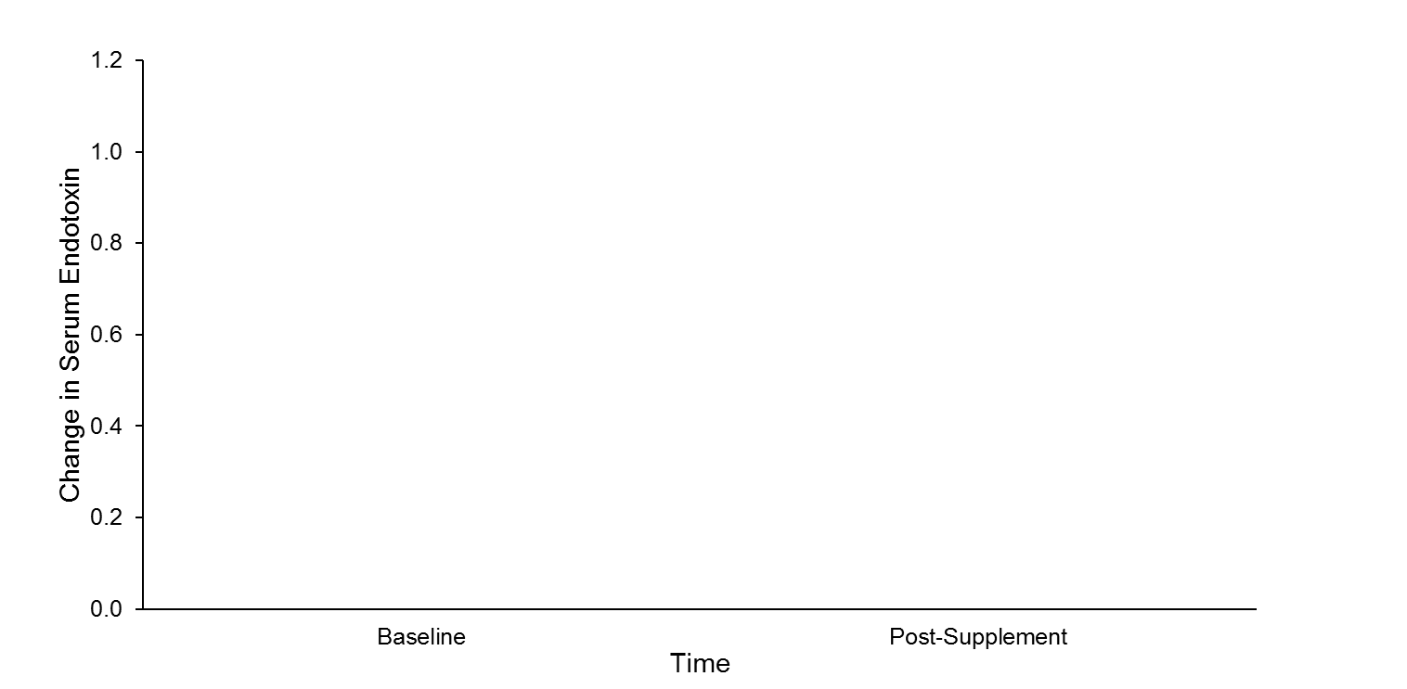
The effect of 30-days of probiotic supplementation
on post-prandial responses to a high-fat meal: An Expanded Pilot Study
Principal Investigator: Brian K. McFarlin, PhD, FACSM, FTOS
University of North Texas
32% Increase
Placebo Treatment Group
Over 60% Difference between the groups
Spore Treatment Group
45% Reduction

Slide 38
The effect of 30-days of probiotic supplementation
on post-prandial responses to a high-fat meal: An Expanded Pilot Study
Principal Investigator: Brian K. McFarlin, PhD, FACSM, FTOS
University of North Texas
SNEAK PREVIEW
Spores

Slide 39
The effect of 30-days of probiotic supplementation
on post-prandial responses to a high-fat meal: An Expanded Pilot Study
Principal Investigator: Brian K. McFarlin, PhD, FACSM, FTOS
University of North Texas
SNEAK PREVIEW

Slide 40
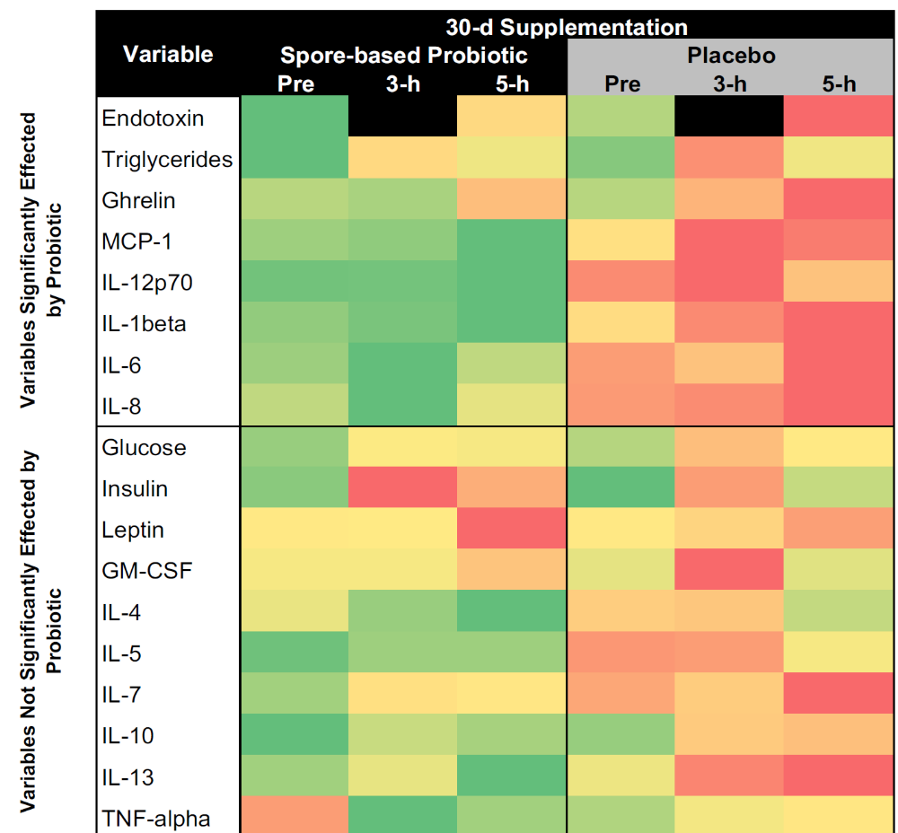
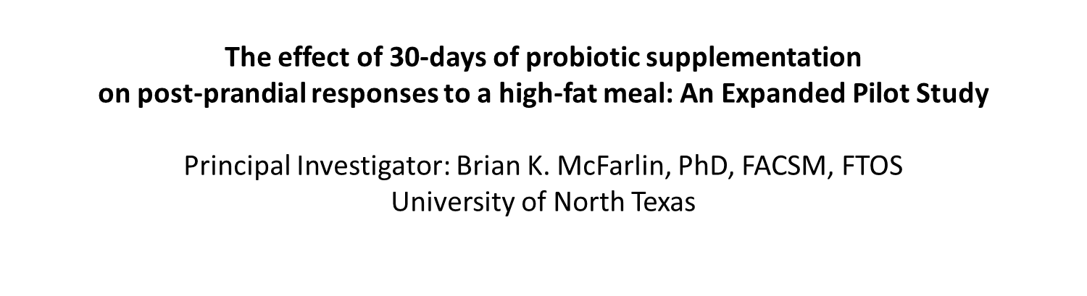

Slide 41
WHAT CAN WE DO??
INCREASE DIVERSITY
Time restricted feeding
Methodical fiber increase
Macronutrient Diversity
INCREASE sIgA
Supplements that help: essential fatty acids, glutathione, glycine, glutamine, phosphatidylcholine, Vitamin C and Zinc
Colostrum
Bacillus spores and saccharomyces – possibly pediococcus
Address the adrenals
Stress reduction
CHANGE EXPOSURE
Get Dirty!
Eliminate chlorine cleaners
Eliminate antimicrobial products
Get a dog
Protect from EMFs
BUTYRATE and SCFA!
IMPROVE MUCIN PRODUCTION
Key Supplements are: L-threonine, L-serine, L-proline, and L-cysteine. 95% increase in mucin2 production in male rats treated with DSS (dextran sulfate sodium)
Increase butyrate
Increase autophagosomes by autophagy
RESOLVE LEAKY GUT
Spore based probiotic
L-glutamine
Reduce saturated and oxidized fats
Lactoferrin
Notes:
J Nutr. 2006 Jun;136(6):1558-64.
Specific amino acids increase mucin synthesis and microbiota in dextran sulfate sodium-treated rats.
Faure M¹, Mettraux C, Moennoz D, Godin JP, Vuichoud J, Rochat F, Breuillé D, Obled C, Corthésy-Theulaz I.
Intestinal permeability and systemic infections in critically ill patients: Effect of glutamine, Daurea A. De-Souza, MD, PhD; Lewis J. Greene, PhD. Crit Care Med 2005 Vol. 33, No. 5
Zarrinpar A, Chaix A, Yooseph S, Panda S. Diet and Feeding Pattern Affect the Diurnal Dynamics of the Gut Microbiome. Cell metabolism. 2014;20(6):1006-1017. doi:10.1016/j.cmet.2014.11.008.
Lactoferrin-lipopolysaccharide (LPS) binding as key to antibacterial and antiendotoxic effects.
Drago-Serrano ME, Int Immunopharmacol. 2012 Jan;12(1):1-9. doi: 10.1016/j.intimp.2011.11.002. Epub 2011 Nov 18.

Slide 42
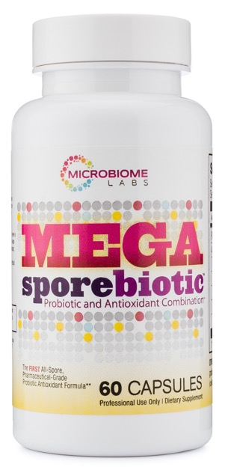
Conclusion
Among NCD, intestinal permeability/metabolic endotoxemia is the #1 cause of morbidity and mortality worldwide.
Metabolic Endotoxemia leads to conditions like obesity, heart disease, autoimmunity, diabetes, hypogonadism, Alzheimer's,etc.
Metabolic Endotoxemia is a feature of a dysbiotic gut.
It effects the immune system as well as the endocrine system, which is what leads to conditions like type 2 diabetes and obesity.
The hallmarks are high serum LPS and LBP (especially after a meal), elevated IL-6, IL-1beta, INF-G, elevated triglycerides and post-prandial insulin.
MegaSporeBiotic significantly reduced post-prandial endotoxemia, IL-6, IL-1beta, INF-g and Elevated triglycerides with NO dietary changes or other therapies.
Bacillus endospores also reduce ghrelin and trended towards a change in leptin.
In a separate study, MegaSporeBiotic reduced blood ammonia levels.
Significantly increases Akkermansia muciniphila, Bifidobacterium spp., and several groups of bacteria belonging to Bacteroidaceae.
MegaSporeBiotic increased the diversity of the microbiome as well
A probiotic that survives, colonizes and changes the microbiome!

