Slide 1

Self-Transcendence in Addiction Recovery
Daniel H. Angres, M.D.
Medical Director,
Positive Sobriety institute
Chief Medical Officer,
River Mend Health, Addiction Services
Adjunct Associate Professor of Psychiatry,
Northwestern Feinberg School of Medicine
Notes:
Communications Division
1

Slide 2
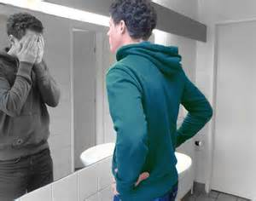
Self
Bundle Theory
David Hume: “Bundles of sensations, perceptions and thoughts, piled on top of each other.”
Bruce Hood “ The Self Illusion; Why There is No You Inside Your Head”, 2012
Notes:
Hume, 18th century Scottish Enlightenment Philosopher-contemplation during a ‘dreich’
Buddha, 6th century, thru meditation Hood:University of Bristol

Slide 3
The Self and Personality
Personality:
The dynamic organization within the individual of those psychophysical systems that determine his unique adjustments to his environment.
Allport G.W. 1937
“Self as the dynamic process of a shifting web of relations.”
Galin “The Concept Self and Person in Buddhism and Western Psychology, 2001

Slide 4
I think therefore I am
Cognitive Fusion:
Person and Mind (thought) become fused
Both inaccurate and nonadaptive
Hayes, Acceptance and Commitment Therapy, 2004

Slide 5


Slide 6
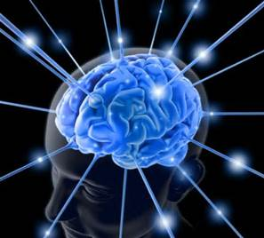
The Self and Consciousness
Where is consciousness?
Where am I?

Slide 7
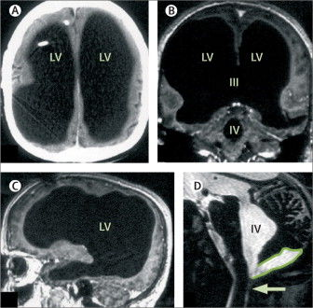
Brain anatomy may not actually be all that vital for consciousness
The Radical Plasticity Thesis: How the Brain Learns to be Conscious
Axel Cleeremans

Slide 8
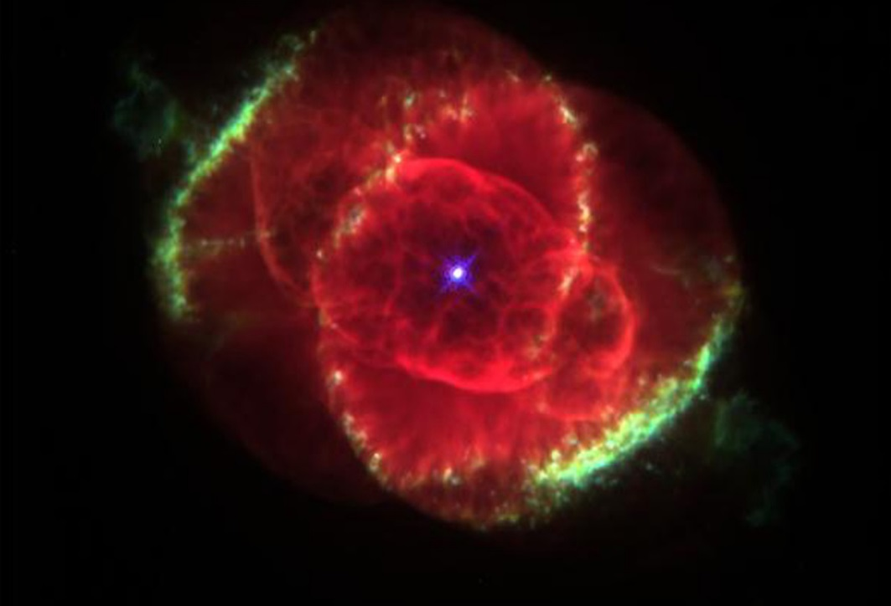
Top Down?
Morphic Resonance/Formative Causation
Rupert Sheldrake

Slide 9
Consciousness
Consciousness emerges out of large networks of cells; the bigger those assemblies, the larger the repertoire of conscious states available to the network. And yet “experience” can never be fully reduced to physical properties of the brain-consciousness is a fundamental property of living matter.
Christof Koch, “Consciousness, Confessions of a Romantic Reductionist” 2012

Slide 10
Consciousness
Huxley: The brain is a tool that extracts a finite drop of reality from the infinite sea of consciousness.
Sir James Jeans: “The Universe looks more like a great thought than a great machine.”
“ It is Consciousness that is the origin of matter, energy, and the laws of nature…”
Bernard Haisch, “The God Theory” 2006
Notes:
Haisch, an astrophysicist believes the purpose of life is experience and God wishes to experience life thru us.

Slide 11

Self-Aware Consciousness
(mind focused on itself)
A bridge to Self-Transcendence
Can evolve to accessing the “universal unity of being”
Can occur stepwise or spontaneously

Slide 12
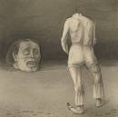
Observation alters “reality”/self-observation can alter behavior and brain (J.Schwartz)

Slide 13
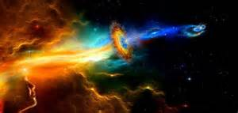
Becoming Self Actualized
“It is just this person, in whom ego strength is at it’s height, who most easily forgets or transcends the ego.”
Abraham Maslow, Toward a Psychology of Being, 1962

Slide 14
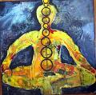
Transcending the self thru
Meditation:
A suspension of chatter and a way of shedding our story

Slide 15

Meditation: The act of sustained stillness
1)Concentrative: focusing on a stimulus
  (Breath, heartbeat, mantra ,body-part, object)
2)Mindfulness: awareness of present experience

Slide 16

Measuring Effects of Meditation
Right parietal lobe changes in S.P.E.C.T. studies
      (Newberg and D’Aquili, Univ. of Pennsylvania)
Right to left hemispheric shift in QEEG and FMRI
      (Richard Davidson, et.al., Univ. of Wisconsin)

Slide 17
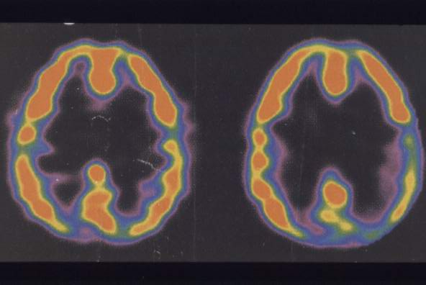
A Focused ‘Letting Go’

Slide 18

Default Mode Network
This persistent level of background activity, below the level of awareness, represents the brain’s “dark energy.”
Orchestrates systems (e.g. memory) for future conscious acts
Can be influenced by meditation

Slide 19

Some Benefits of Meditation
Decreased autonomic arousal (reduced cortisol production)
Decreased hypertension, enhanced immune function, increased positive emotions, brain plasticity, learning, cognition, attention and decision making
Enhanced perceptual receptivity, openness, ability to empathize
Decreased cellular aging
Improved Decision Making
Better Addiction Outcomes? (Marlatt, Kakutis)

Slide 20
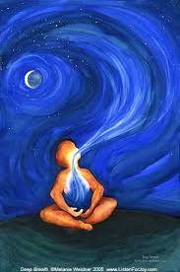
Meditation is Hard
External Aids to Meditation
Biofeedback
Neurofeedback
Breath pacers
Heart Rate Variability
Audio (& Visual) Entrainment

Slide 21
The Future: Optogenetics
Meditation on Demand
Animal studies:
light sensitive genes sent by virus
Gamma rhythms from fast spiking interneurons in specific areas in pre-frontal cortex “infected” by virus
Interneurons “turned on” by light
Scientific American Mind, P Reiner, Dec. 2009

Slide 22
The Program
“Meditation has no boundaries, either width or height. It is essentially an individual adventure, something each one of us works out in his own way”
12 and 12, pg. 101

Slide 23
"Drunkenness can be a kind of shortcut to the higher life, the attempt to achieve a higher state without an emotional and intellectual effort.”
Kurtz, Spirituality of Imperfection

Slide 24
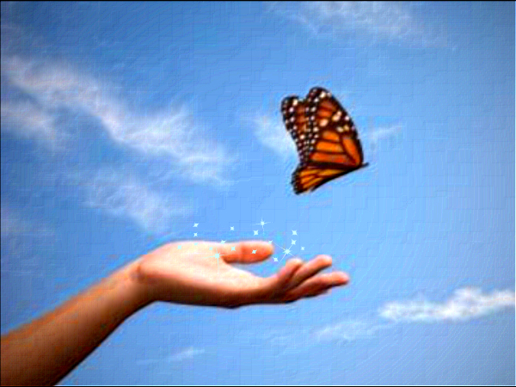
preamble
“Until we let go absolutely”

Slide 25
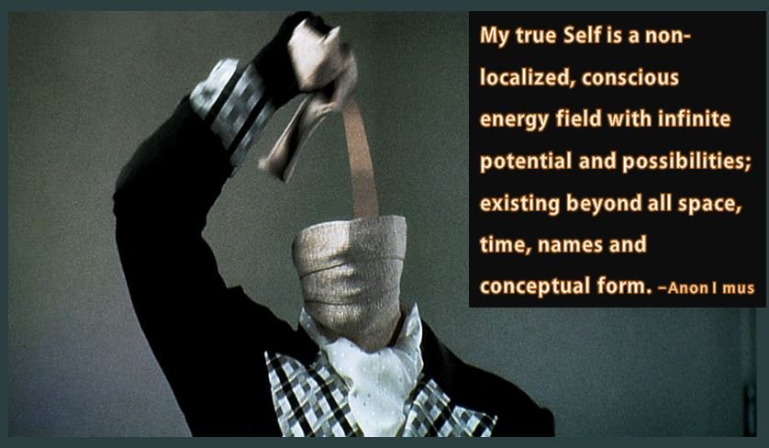
Letting go of our “story”
Form
A gentle back and forth
Formlessness

Slide 26
