Slide 1
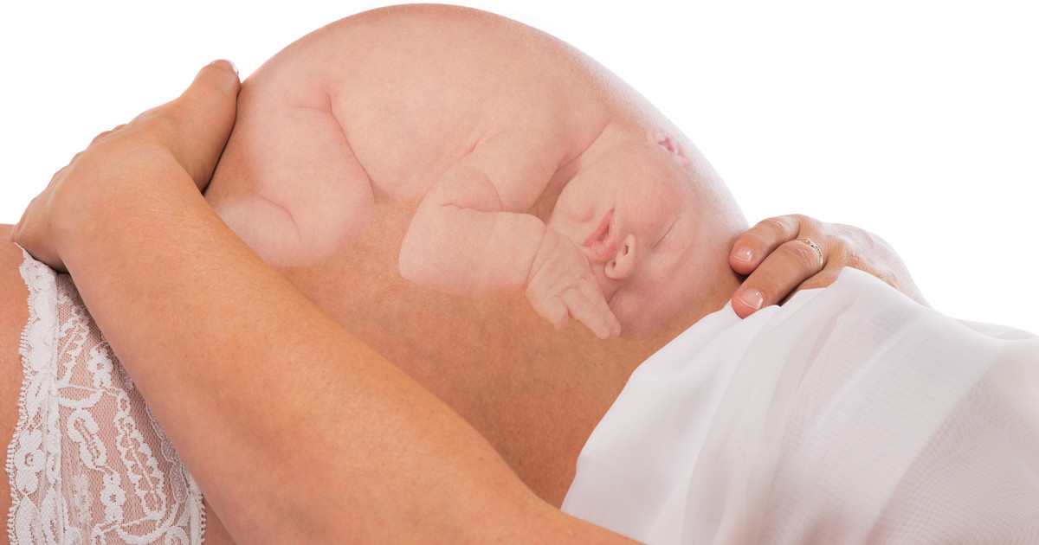
Dr. Shashi Joshi
M.B.B.S. (AIIMS), MD (Obst. & Gynae) PGI Chandigarh
Consultant Obst. & Gynae
PLACENTA ACCRETA

Slide 2
INTRODUCTION
Abnormally implanted, invasive, adherent placenta
Abnormally firm adherence to myometrium because of partial or total absence of decidua basalis and imperfect development of fibrinoid or Nitabuch layer
Accreta syndrome has evolved into one of the most serious problem of obstetrics resulting in significant morbidity & mortality. It is a leading cause of intractable PPH & emergency peripartum Hysterectomy
Until recently, there is no consensus for management.

Slide 3
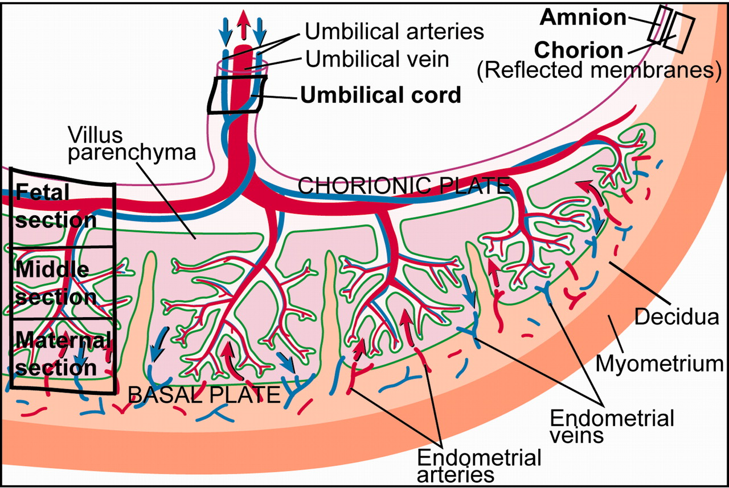

Slide 4
ETIOPATHOGENESIS
M/E – Placental villi are anchored to muscle fibers rather than decidual cells
Decidual deficiency prevents normal placental separation after delivery
For histological diagnosis besides placenta, uterus or curetting with myometrium are needed.

Slide 5
CLASSIFICATION
It is based on depth of trophoblastic tissue.
Placenta Accreta
  - Villi are attached to myometrium
  - 80% of cases
  Placenta Increta
    - Villi actually invades myometrium
    - 15% of cases
  Placenta Percreta
    - Villi penetrate through the myometrium into the serosa
    - 5% of cases

Slide 6
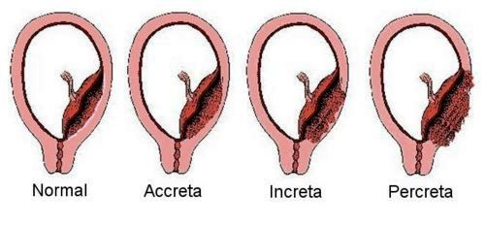

Slide 7
Of all the above three types it may be..
TOTAL ACCRETA
When abnormal adherence occurs in all the lobes of placenta
FOCAL ACCRETA
When a part or single lobe is abnormally adherent

Slide 8
RISK FACTORS
Placenta Previa – 10%
Prev Caesarean section
  * classical higher than low lying
  COHORT STUDY (2006)
Risk of placenta accreta with placenta previa –
Unscarred uterus = 3%
1 CS = 11%
2 CS = 40%
3 or more CS = 67%

Slide 9
Previous hystrotomy scar
Curettage
Myomectomy
Uterine anomalies
Maternal age > 35 years
multiparity

Slide 10
PRENATAL DIAGNOSIS
DIAGNOSIS CLINICAL
* Bleeding P/V because of associated placenta previa
* May be undetected till 3rd stage of labour when no associated placenta previa

Slide 11
RADIOLOGICAL
Sensitivity of 80% – 90%
GREY SCALE
Irregularly shaped placental lacunae (vascular spaces) within the placenta
Thinning of myometrium over the placenta
Increased lacunae giving moth eaten & swiss cheese appearance
Presence of local exophytic masses invading the serosa / urinary bladder

Slide 12
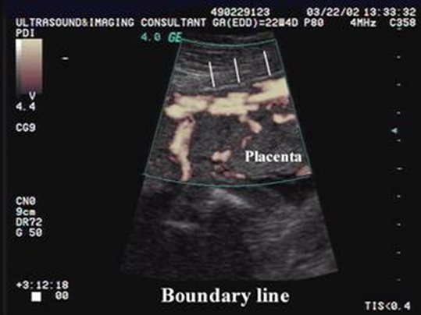

Slide 13
COLOUR DOPPLER
diffuse / focal lacunar flow
Vascular lakes with turbulent flow (peak systolic velocity 15 cm / sec)
Hypervascularity of serosa / bladder inter surface
Markedly dialated vessels over peripheral subplacental zone

Slide 14
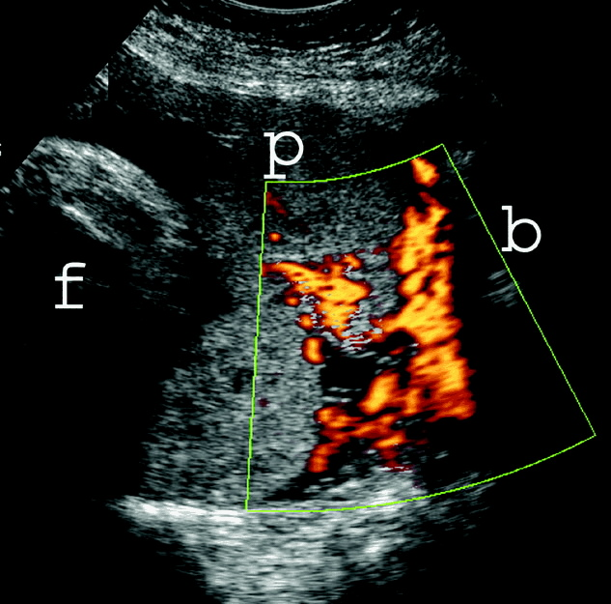

Slide 15
THREE DIMENSIONAL POWER DOPPLER
Numerous vessels involving whole uterine serosa bladder junction (Basal view)
Hypervascularcity (lateral view)
Inseperable cotyledonal & intervillous circulation, chaotic branching, detour vessels

Slide 16
SOME IMPORTANT CONCLUSIONS OF U.S.G.
U.S.G. popular due to low cost and easy accessibility
Presence of increased number of lacunae in the placenta at 15 – 20 weeks of gestation has been shown to be predictive U.S.G. sign of placenta accreta
When placenta is on lateral or posterior wall, it may be difficult to access by U.S.G.

Slide 17
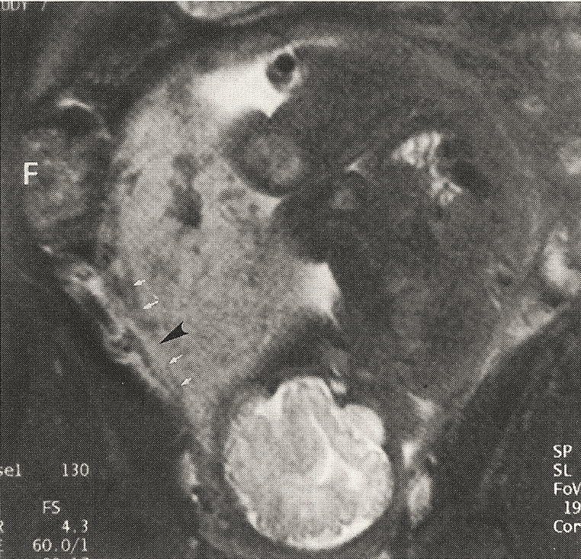
MRI
Expensive
Relatively in-accessible
No more sensitive than ultrasound
High false positivity
Specific benefits
  Parametrial invasion
  Ureteral involvement
  Posterior placenta
  Previous myomectomy

Slide 18
LABORATORY DIAGNOSIS
Biomarkers in maternal blood may aid in diagnosis of placenta accreta.
Increased α feto proteins
β human chorionic gonadotropins
Preg associated plasma protein A
Creatinine kinase
Cell free fetal / placental DNA
Placental m RNA

Slide 19
These analytes are generally markers of placental damage and / or abnormal placental development
Although these markers show promise in accreta diagnosis, they are not accurate enough to use clinically presently.

Slide 20
MANAGEMENT OF PLACENTA ACCRETA
ANTENATAL
Correction of anemia
β methasone administration
Blood & blood products ready for massive transfusion
Time of delivery 34 – 36 weeks
Once recognized major decisions concerns ideal institute
Appropriate
surgical, anesthetic, blood bank & ICU facilities, NICU
Availability of obstetrical surgeon, surgical urologist, interventional radiologist availability

Slide 21
American college of obst & gynae (2012 b) and society for maternal – fetal medicines (2010) recommended planned delivery at tertiary care facility
If possible, delivery should be planned for peak availability of all resources & team members

Slide 22
PRE-OPERATIVE PLANNING
Pneumatic compression stockings
Prophylactic antibiotics
Pre-operative cystoscopy
Placement of ureteral stents
Interventional radiology, such as internal iliac balloon catheterisation or postpartum arterial embolization have been described with mixed results

Slide 23
SURGICAL TECHNIQUE
Median / paramedian skin incision
improves visibility
Superior access to fundus & posterior uterine wall
Uterine incision
site distant from placenta
Deliver baby without disturbing the placenta
Upper uterine, transfundal or posterior uterine wall incision may be required

Slide 24
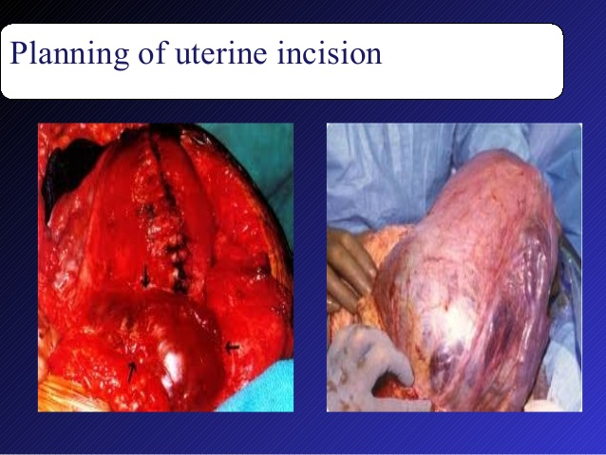

Slide 25
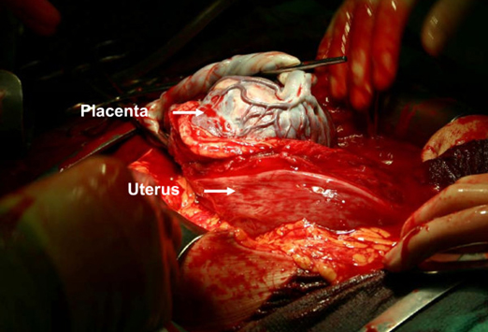
Proceed for hysterectomy to avoid life threatening hemorrhage
After delivery of baby, the cord is cut & legated close to placenta
Edge of the vertical incision is quickly sutured with the mass running suture for homeostasis
Ensure adequate uterine tone with pitocin or other uterotonics

Slide 26
Perform hysterectomy as usual
Delayed hysterectomy controversial (after 6 weeks)
Theory behind it-
allows for involution of gravid vascularity leading to decrease blood loss
Facilitates hysterectomy & avoids bladder recection

Slide 27
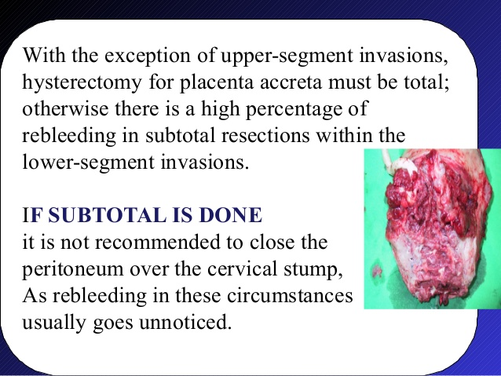

Slide 28


Slide 29


Slide 30
ALTERNATIVE SURGICAL & CONSERVATIVE THERAPY
Leaving placenta in situ
Uterine compression suture
  B-lynch stich
Vessel embolization
  Aorta
  Common iliac
  Internal iliac
  Uterine vessels
  Methotrexate therapy
  mixed results
  Can be occluded

Slide 31
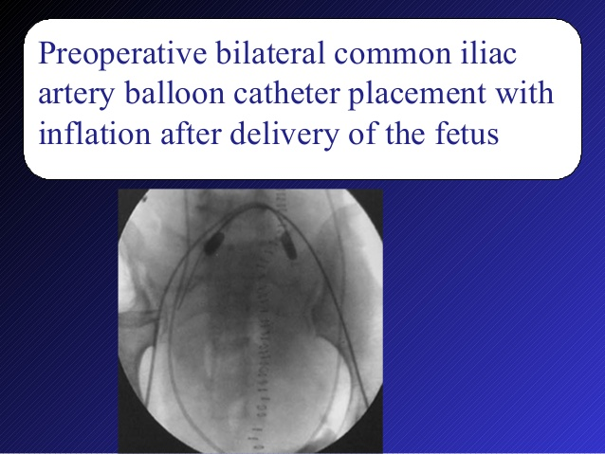

Slide 32
OUTCOME OF CONSERVATIVE THERAPY
Placenta is either absorbed or removed at a later date with curettage and / or hysteroscopy resection
RISKS
Infection
Hemorrhage
Need for hysterectomy
Successful pregnancy rare

Slide 33
COMPLICATIONS
Angiographic embolization
Uterine ischemia
Uterine necrosis
Uterine infection
Massive buttock necrosis
Paraplegia
Pelvic artery catheter inserted into internal iliac or uterine artery
Popliteal artery thrombosis / stenosis

Slide 34
Surgical therapy
massive / persistent hemorrhage
DIC
Shock
Multi organ failure
Bladder, ureter, bowel injury
Complications of massive transfusion like pulmonary edema, acute respiratory distress, renal failure, acuter tubular necrosis
Wound abdominal and vaginal cough infection and possible need for re operation
Late VVF
Maternal mortality 7%

Slide 35
MANAGEMENT OF PLACENTA ACCRETA DIAGNOSED DURING DELIVERY

Slide 36
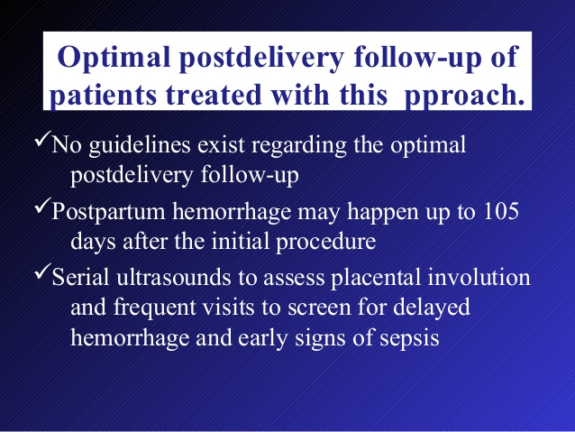

Slide 37
CONCLUSION
Placenta Accreta is a nasty little secret in the world of Obstetrics and Gynaecology. It is fast on the rise, due to the primarily dramatic increase in Caesarean Sections, the majority of which are unnecessary. Any type of uterine surgery increases your risk of developing placenta accreta with subsequent pregnancy, no more than caesarean section. The more caesareans you have, the greater your likelihood of developing placenta accreta.

Slide 38
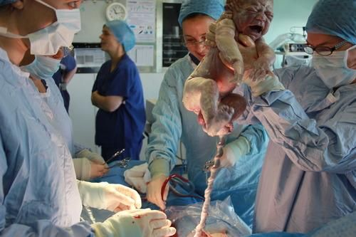

Slide 39


