Slide 1
Micro-organism and Health
Nwaobi Victor
Shupyk National Medical postgraduate academy kiev Ukraine.

Slide 2
Actuality of the theme
According to a recent National Institutes of Health (NIH) estimate, 90% of cells in the human body are bacterial, fungal, or otherwise non-human. Although many have concluded that bacteria surely enjoy a commensal relationship with their human hosts, only a fraction of the human microbiota has been characterized, much less identified. compared to the nearly 23,000 in the human genome – implies we have just begun to fathom the full extent to which bacteria work to facilitate their own survival. Microbes can be beneficial as well as harmful to human health

Slide 3
Aim and Task of Study
Aim: To evaluate the diversity, prevalence and persistence of micro-organism on human health
Task: To study and evaluate the epidemiological prevalence of micro-organism on health
To understand and explore modern diagnostic approach to different etiological factors of microbes on health

Slide 4
Materials and Methods
About 25 patients were examined on the infectious disease department at different time on different etiological microbes from 2014-2015 age 18-75 years with average age of 50, 10 men and 15 women
Patient was examine using different methods like growing in different nutrient agar on petri dishes, biotechnology, different disinfectant and antiseptic measures, FBC, Microscopic and gram staining technique and other instrumental methods.

Slide 5
Defining the Task
Microorganisms (Latin micro = small) are living beings so small (< 40 µm or 0.04 mm) that they are not visible by the naked eye. Microorganisms related to human health include certain bacteria, viruses, fungi and parasite
There are about 159,000 known species, although this is thought to be less than 5% of the total in existence

Slide 6
Defining the task
Micro-organisms and human are of immense importance to the environment, to human health and to our economy. Some have profound beneficial effects without which we could not exist. Others are seriously harmful, and our battle to overcome their effects tests our understanding and ingenuity to the limit. However, certain micro-organisms can be beneficial or harmful depending on what we want from them: saprophytic decomposers play an important role in breaking down dead organic matter in ecosystems, but these same micro- organisms can be responsible for food spoilage (rotting, going bad, going off) and subsequent illness.

Slide 7
Harmful Etiological Factors
Examples of familiar human diseases include:
Bacteria: salmonella, tetanus, typhoid, cholera, gangrene, bacterial dysentery, diphtheria, tuberculosis, bubonic plague, meningococcal meningitis, pneumococcal pneumonia
Viruses: rabies, influenza (flu), measles, mumps, polio, rubella (german measles), chicken pox, colds, warts, cold sores
Protoctists: malaria, amoebic dysentery
Fungi: athlete's foot, ringworm

Slide 8
Pathogens
These disease-causing organisms are called pathogens and we often refer to them in everyday, non-scientific terms as ‘germs’ or bugs. Each disease has a specific pathogen, i.e. different diseases are caused by different kinds of germ. If the disease organism can be transmitted from one person to another it is said to be infectious. Non-infectious diseases, such as allergies, cancer, vitamin deficiency, and mental illness may develop when the body is not functioning properly.

Slide 9
Beneficial Microbes
Microorganisms, like certain bacteria and yeasts, living on the human skin or in the nose, mouth, throat, small and large intestine and vagina, are part of the normal human flora; they prevent overgrowth of harmful microorganisms. Some of these microbes, when overgrow, may become pathogenic, though

Slide 10
Benefits
Yeast is a single-celled fungus that lives naturally on the surface of fruit. It is economically important in brewing and bread-making. Yeast respires anaerobically (i.e. without the use of oxygen) and breaks down glucose with the production of carbon dioxide, ethanol (alcohol) and energy. In wine-making the yeast feeds on fruit sugars in the grapes, and in beer-making it feeds on the maltose sugar in germinating barley.

Slide 11
Benefits
Decomposers Fungi and most bacteria are saprotrophic and have an important role in an ecosystem as decomposers, breaking down dead or waste organic matter and releasing inorganic molecules. These nutrients are taken up by green plants which are in turn consumed by animals.
Digestion Despite the vast quantities of cellulose eaten by herbivores, mammals themselves cannot digest cellulose and rely entirely on the action of carbohydrate-digesting bacteria in their guts. These secrete the enzyme cellulase which splits the cellulose into monosaccharides which can be absorbed by the gut

Slide 12
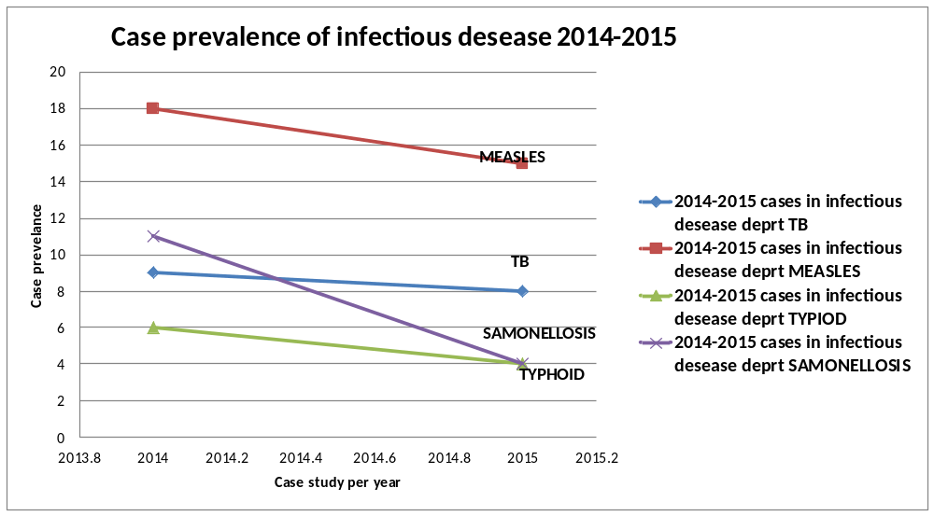
Case study

Slide 13
Evaluation

Slide 14
Case study
New infections continually appear. Having an available food source to grow on (humans) inevitably results in a microorganism that will take advantage. Some of these feeders will interfere with our own well being, causing disease.
Many diseases that were previously thought to have only behavioral or genetic components have been found to involve microorganisms. The clearest case is that of ulcers, which was long thought to be caused by stress and poor diet. However the causative agent is actually a bacterium, Helicobacter pylori, and many ulcers can be cured with appropriate antibiotics. Work on other non-infectious diseases such as heart disease, stroke and some autoimmune diseases also suggest a microbial component that triggers the illness.

Slide 15
Diagnosis
Bacterial infections can be diagnosed by growing a bacterial culture from a sample of infected body fluid (e.g. urine, blood), stool, discharge (e.g. sputum) or tissue (e.g. mucosal layer of the stomach
Viruses can be diagnosed by finding specific antibodies in the sample of blood (serologic tests). Vaccination against several virus infections is possible; only few viral infections can be treated by anti-viral medications

Slide 16
Diagnosis
PARASITE: Diagnosis can be often suspected from history of prolonged bloating or diarrhea and can be confirmed by the following tests:
Ova and parasites (O&P) test of the stool. The test is often false negative so three stools from three different days (at least two days apart) should be tested.
Hemoccult test may reveal blood in the stool
Blood tests often reveal elevated eosinophils and IgE antibodies and lowered ferritin, hemoglobin or red cells
CT or biopsy are needed to find cysts in the liver, lungs or brain.
FUNGI : Microscopy, Growing a colony of fungus in the laboratory from a rash sample. This is more accurate but may take weeks.
Some fungi exhibit a fluorescent glow when exposed to ultraviolet light. This can also help to identify the fungus causing an infection.

Slide 17
In Conclusion
Some pathogenic microbes that had been "controlled" through the use of antibiotics are beginning to develop drug resistance and therefore reemerge as serious threats in the industrialized world as well as developing nations. Tuberculosis is an illness that was on the decline until the middle 80's. It has recently become more of a problem, partly due to drug resistance and partly due to a higher population of immunosuppressed individuals from the AIDS epidemic. Staphylococcus aureus strains are emerging that are resistant to many of the antibiotics that were previously effective against them. These staph infections are of great concern in hospital settings around the world. Understanding both familiar killers and new pathogens will require an understanding of their biology, and thus an understanding of the field of microbiology.

Slide 18
THANKS
REMAIN BLESSED

