Slide 1


Study on Extractables and Leachables
By
Anupam Chanda , Alembic Pharma(10th Nov17)

Slide 2

INDEX
Definition of Extractables
Sources, Components and Significance of Extractable study.
Acceptance criteria for E/L study in different media
Safety Thresholds
Controlled Extraction Study (CES)
Extraction with Multiple Solvents and Techniques
Analysis of Extracts
Leachables Study
Stepwise Approach to Generating Chemical Characterisation Data for Risk Assessment
Analytical Methodology
Definition of Leachables
Difference between Extractables and Leachables
Testing and Analysis to Support Pharmaceutical and Medical Devices
Strategies for assessment of leachables in parenteral drugs
Packaging Materials Associated with Parenteral Products
Determination of Extractables and Leachables from Container Closure Systems
Regulatory Guidelines
DRUG REGULATORY GUIDELINES
FDA Industry Guidelines
Case Studies
Evaluation of Extractable and Leachables; Guidelines
Organizations involved with extractables and Leachables
Summary of Recommendations

Slide 3
DEFINITIONS
Extractables
chemical compounds that migrate from packaging/device materials under forced (strong solvents & high temperature) conditions.
Extractables are chemical entities , both organic and inorganic , that will extract from components of a container closure system or device into solvents under controlled conditions. They are used to identify and quantify potential leachables.
    Extraction conditions
Sr. No. | Temperature | Relative humidity [%RH] | Time points
 | 23 ± 2 °C | 73 ± 5 | Day-1
 | 23 ± 2 °C | 73 ± 5 | Day-7
 | 23 ± 2 °C | 73 ± 5 | Day-14
 | 23 ± 2 °C | 73 ± 5 | Day-28

Slide 4
Extractables
Source of Extractable | Extractable |  | Components of Extractable study | Significance of Extractable Study
Plastic Container | Additives, anti oxidants , stabilizers, plasticizers, emulsifiers, colourants , monomars, oligomers residual catalysts, impurities UV absorvers fillers, anti fogging, aniticrobials etc. Typical Plastic Additives - |  | Extraction - Suitable Solvents-optimized for the polymer/material - Vigorous extraction Technique(s) To asymptotic levels Multiply analytical techniques , GC, LC with different dectators Identify principally by MS Quantify extractables greater than or equal to the AET(based on the SCT) | To understand what substances are contained in a material that have the potential to leach into the drug product.
 | Lubricants Antistatic Agents Initiators Stabilizers Impact Modifiers Antioxidants Bactericides Catalysts | Blowing Agents Processing Aids Plasticizers Colorants Brighteners Release Agents Vulcanizing Agents

Slide 5
Extractables
Source of Extractable | Extractable | Components of Extractable study | Significance of Extractable Study
Printed Label | Ink, coating , UV varnish and adhesive | -------------- | --------------
Unit carton | Ink, coating , UV varnish and adhesive | -------------- | --------------
Containers mean
to Protect a Drug from
environmental contamination are actually themselves a Source of Contamination

Slide 6
Summary Flowchart for Leachables and Extractables Evaluation Process
Critical Component
Contacts formulaton or patient’s mouth or mucosa
Yes
No
Routine Extraction Studies and other testing, if necessary
Controlled Extraction Studies
Qualitative and quantitative assessment of all peaks > 1-20 µg / g
Other (not extractables) testing is sufficient (eg. Functional, identity, dimensional, etc. - as necessary).
Design and conduct a Leachables Study on aged registration batches through shelf life to quantify in drug product the extractables identified above
Quantify all peaks > 0.2 µg (total daily intake)
Provide identity and quantity of the leachables to toxicologists for assessment
Biological Safety Qualification of Lechables

Slide 7
Acceptance criteria for E/L study in different media
Polymer | Analytics/Extract | Component | Quantification limit
HDPE | ICPMS, ICP-OES microwave digestion | Mg | 50.0ppb
LDPE | ICPMS microwave digestion | Al | 10.0ppb
LDPE | ICPMS microwave digestion | Cr | 10.0ppb
LDPE | ICPMS microwave digestion | Mn | 10.0ppb
PVC | ICP- MS,IC/water 4 wees 80 deg.C | Fe | 10.0ppb
PVC | ICP- MS,IC/water 4 wees 80 deg.C | Ni | 10.0ppb
PVC | ICP- MS,IC/water 4 wees 80 deg.C | Cu | 10.0ppb
HDPE | ICP- MS,IC/water 4 wees 80 deg.C | Zn | 50.0ppb
HDPE | ICP- MS,IC/water 4 wees 80 deg.C | Cd | 2.0ppb
HDPE | ICP- MS,IC/water 4 wees 80 deg.C | Sb | 2.0ppb
PP | ICP- MS,IC/water 4 wees 80 deg.C | Pb | 2.0ppb

Slide 8
Acceptance criteria for E/L study in different media
Compounds | Analytes | Quantification limit
Antioxidants and UV absorbers | 2, 2-Methylene-bis (4-methyl-6-tert butyl-phenol). | 10.0ppb
 | 2, 2-Methylene-bis (4-ethyl-6-tert butyl-phenol). | 10.0ppb
 | 2, 6-di-tert-butyl-4-sec-butyl phenol. | 5.0ppm
 | 2, 6-di-tert-butyl-N, N-dimethylamino-p-cresol. | 10.0ppb
 | 2, 4-dihydroxy benzophenone. | 5.0ppm
 | 2-hydroxy-4-octyloxy benzophenone. | 5.0ppm
 | 2-hydroxy-4-methoxy benzophenone. | 5.0ppm
Ethylene oxide and Propylene oxide (bottle sterilization) | Ethylene oxide | 0.5 ppm
 | Propylene oxide | 0.5 ppm

Slide 9
Acceptance criteria for E/L study in different media
Compounds | Analytes | Quantification limit
Plasticizers | Butylated hydroxy toluene. | 0.2ppm
 | 2-Butanone Peroxide. | 0.2ppm
 | Di Butyl Phthalate. | 0.2ppm
 | 4,4-Isoprpyledene di phenol | 0.2ppm
 | Benzyl Butyl Phthalate. | 0.2ppm
 | Di (Ethylene Glycol) Dibenzoate. | 0.2ppm
 | Bis(ethyl hexyl )phthalate | 0.2ppm

Slide 10
Safety Thresholds
Toxicology and Risk Assessment
The PQRI(product Quality Research Institute) best practices have established some toxicological thresholds for Extractables and Leachables for “Orally inhaled and Nasal drug products(OINDP)
The qualification Threshold(QT) is the level(5 micg/day) below which a given leachable is not considered for safety qualifications unless it presents a structure activity(SAR) concern.
The safety concern Threshold(SCT)is the dose(0.15 micg/day) below which a leachable would present negligible concern for adverse carcinogenic and noncarcinogenic effects.
Known highly toxic substances such as PAHs, nitrosamines and 2-mercaptobenzothiazole) are considered to be “special case compounds” for “Orally Inhaled and Nasal Drug applications and should be considered on a case by case basis.
Analytical Evaluation Threshold(AET) can be calculated. The AET is the level at or above which an OINDP pharmaceutical development team should identify and quantify a particular extractable and/or leachable and report it for potential toxicological assessment.

Slide 11
For an extractables from a device component the AET (μg/g) can be determined using Equation 1:
Equation 1
AET = SCT .D_{t}
D_{d} m
D_{d} - Doses per day
D_{t} - Total Labelled doses
m - mass of component
The AET (μg/device) for a drug delivery device (e.g. an MDI) can be determined from Equation 2:
Equation 2
AET = SCT .D_{t}
D_{d}
D_{d} - Doses per day
D_{t} - Total Labelled doses

Slide 12
Decision flowchart for evaluating toxicity and risk evaluation (recommended or incorporation in CMC guidance for OINDP
Individual Leachable Above Reporing Threshold
≤ 0.2 µg TDI
> 0.2 µg TDI
No additional Evaluation
≤ 5 µg TDI (some Structural Information)
> 5 µg (Structure Confirmed)
SAR Concerns
No SAR Concerns
Collect Toxicological Data, SAR, Literature or In Vivo Data
Qualified
Risk Assessment Acceptable?
Yes
No
Qualified
Reduce, Remove or collect more Data

Slide 13
Controlled Extraction Study (CES)
Controlled Extraction Studies should:
Employ vigorous extraction with multiple solvents of varying polarity
Incorporate multiple extraction techniques
Employ multiple analytical techniques
Include a defined and systematic process for identification of individual extractables.
Optimise extraction methods
Should be guided by AET
Consider the potential for the presence of polycyclic aromatic hydrocarbons, N-nitrosamines and 2-mercaptobenzothiozole (MBT). If their presence cannot be ruled out, these should be considered as “special case” compounds requiring specific analytical techniques and technology defined thresholds.
The controlled extraction study has two parts:
1. Qualitative
2. Quantitative

Slide 14
Extraction with Multiple Solvents and Techniques
Typically three extraction techniques :
1. Reflux extraction
2. Soxhlet extraction
3. Ambient Temperature with ultrasonic agitation
Type of product | Type of solvents use for extraction
MDI(Metered-dose inhaler) | Dichloromethane (to mimic propellants), propan-2-ol and nheptane.
DPI (dry-powder inhaler) | water, propan-2-ol and n-heptane Spray Products and Nasal Sprays: water, propan-2-ol and n-heptane

Slide 15
Analysis of Extracts
There is no single analytical technique that could cover the identification of all potential extractables.
Although there are specific analytical methods for particular additives, incorporating all these methods into a study such as this is neither practical nor necessary. Therefore, a number of generic methods are used, which are able to detect and identify a very broad range of polymer additives.
A list of these techniques with target species is included in below Table :
Analytical Method | Target Species
Gas Chromatography -Mass Spectrometry (GC-MS) | Low molecular weight monomers, initiators, antioxidants, UV absorbers, lubricants, process aids, plasticisers, anti-static agents, modifiers and oligomers.
Headspace Gas Chromatography Mass Spectrometry (GC-MS) (DPI components only) | Very volatile species including monomers, initiators, solvents and other low molecular weight species.
Liquid Chromatography -Mass Spectrometry (LC-MS). | Medium to high molecular weight polar species including antioxidants, UV absorbers, plasticisers, lubricants process aids, heat stabilisers.
Gravimetric and Fourier Transform Infrared Spectroscopy (FTIR) | High molecular weight species fillers mineral oil lubricants, plasticisers, silicone oil mould release agents and oligomeric material.
Acid digestion Inductively Coupled Plasma Atomic Emission Spectroscopy (ICP-AES) | Metal compounds. Catalysts, stabilisers etc. (Screening analysis, of the component as received, for 36 elements, is carried out in the qualitative phase of the CES.)

Slide 16
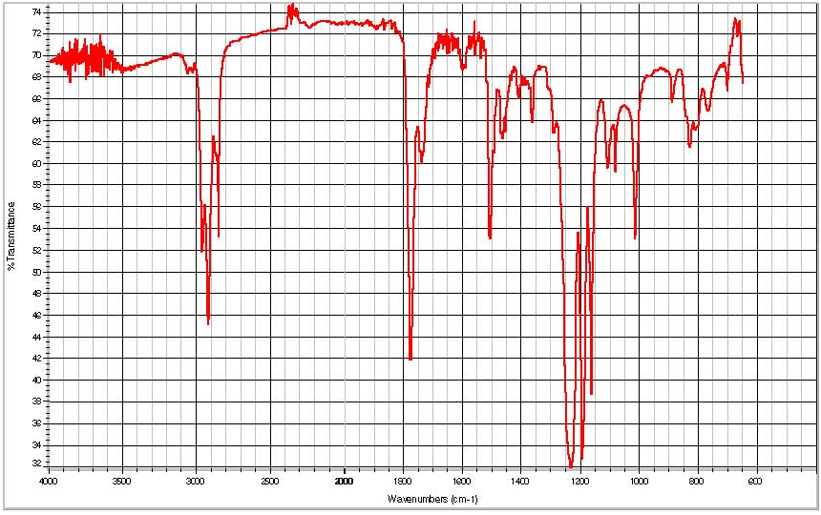
Infrared Spectrum of a Heptane Extract of a Polycarbonate Component

Slide 17
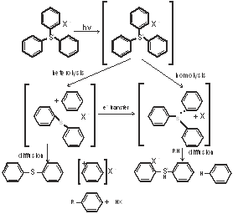
Case Study: UV curable printing ink

Slide 18
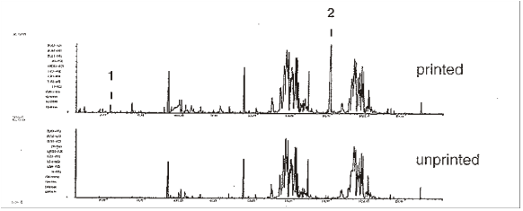
TDS-GC/MS of polymeric material Photolysis of triaryl sulfonium salts
Benzene
Diphenylsulphide

Slide 19
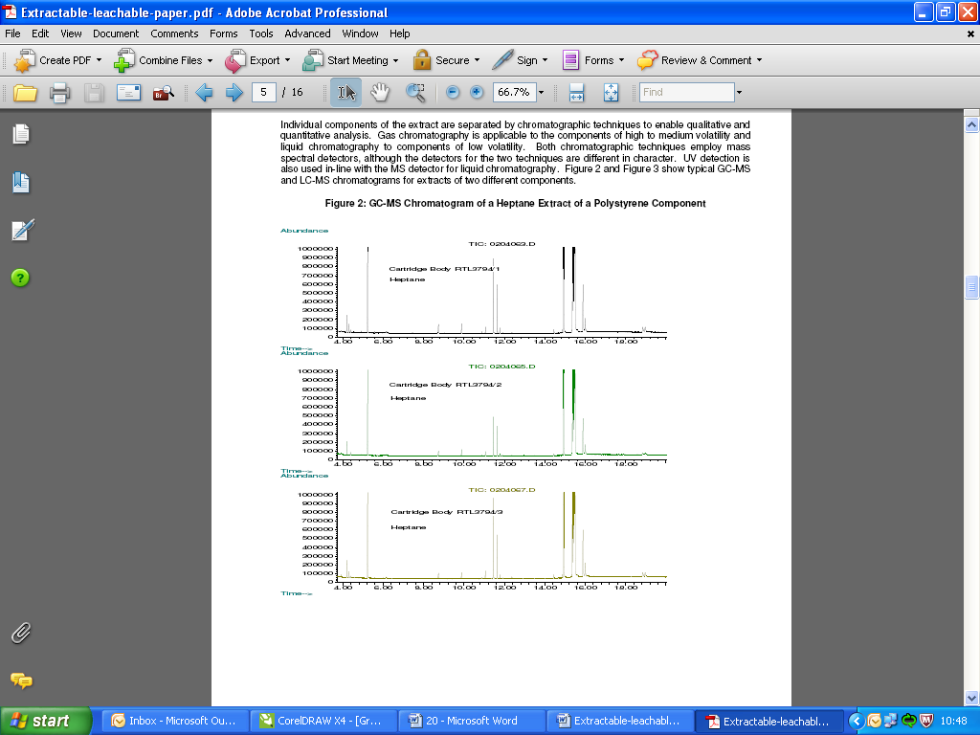
GC-MS Chromatogram of a Heptane Extract of a Polystyrene Component

Slide 20
Leachables
chemical compounds that migrate into the drug product during normal storage conditions. These are usually present in drug product matrices as complex mixtures at trace levels relative to the API.
Source of Leachables :
Rubber stopper, Glass vial, Prefilled syringe, polymer, Disposable Bioreactors, Fillers
Gaskets, Tanks, Tubing, Secondary Packing.
Leachables Study
Suitable storage conditions for storage (ICH Q1A(R2) and suggested time points for analysis are given in
Condition | Temperature (°C) | Relative Humidity (%RH) | Time Points (months)
Long Term | 25 ± 2 | 60 ± 5 | 0, 6, 12, 24, 36
 | 30 ± 2 | 65 ± 5
Intermediate | 30 ± 2 | 65 ± 5 | 0, 6, 12, 24, 36
Accelerated | 40 ± 2 | 75 ± 5 | 0, 3, 6, 9, 12

Slide 21
Analytical Methodology
The following analytical techniques can be applied to establishing the qualitative and quantitative composition of materials used in medical devices, which can be used to establish equivalence between materials or make toxicological risk assessments:
Physiochemical tests (pH, turbidity, NVR, Heavy Metals etc)
Fourier transform infrared spectroscopy (FTIR)
High performance liquid chromatography (HPLC)
Gas chromatography (GC)
Mass spectrometry (MS)
Inductively coupled plasma (ICP)
Gel permeation chromatography (GPC)
Differential scanning Calorimetry (DSC)
Infrared Spectroscopy
Infrared spectroscopy can be used to confirm the identity of polymers used in medical devices and can be useful to confirm the identify of some additives.

Slide 22
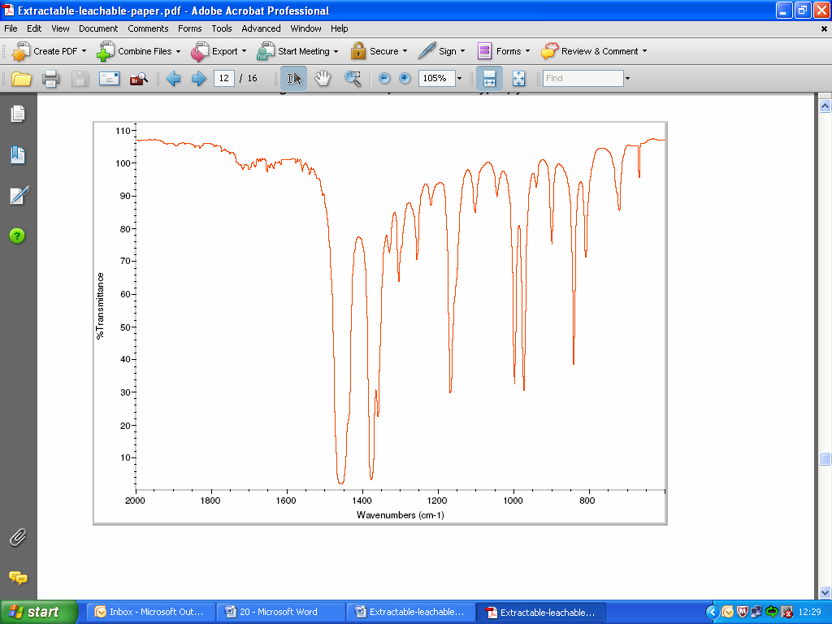
Infrared Spectrum of Polypropylene

Slide 23
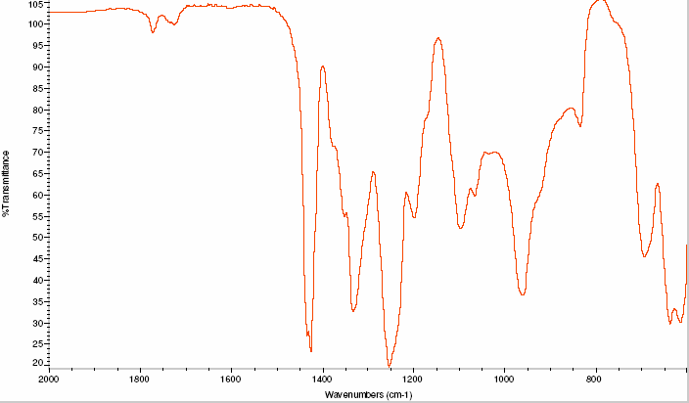
Infrared Spectrum of PVC

Slide 24
Chromatography – Mass Spectroscopy
Extracts of polymer materials can be extracted under various conditions. Very vigorous conditions, even dissolution followed by re-precipitation of the polymer, can be used when the composition, either qualitative or quantitative, of the material is required. Less vigorous conditions may be used when clinical exposure is being assessed by extraction in a suitable medium under appropriate conditions.
The extract can then be analysed by either GC-MS (gas chromatography – mass spectroscopy) or LC-MS (liquid chromatograph – MS) to identify and quantify the chemicals present in the extracts.
GC-MS
Gas chromatography-mass spectrometry (GC-MS) is used to separate and identify complex organic mixtures. It is applicable to volatile and semi-volatile organic compounds and is a highly sensitive detection technique providing a ‘fingerprint’ of the unknown analytes.
Below figure shows a typical chromatogram which may be generated during the GC-MS analysis of an extract. This shows chromatographic peaks for six separated major components of the extract. For each of these peaks a mass spectrum (see Figure 10 for an example) is available which can be used to identify the component.

Slide 25
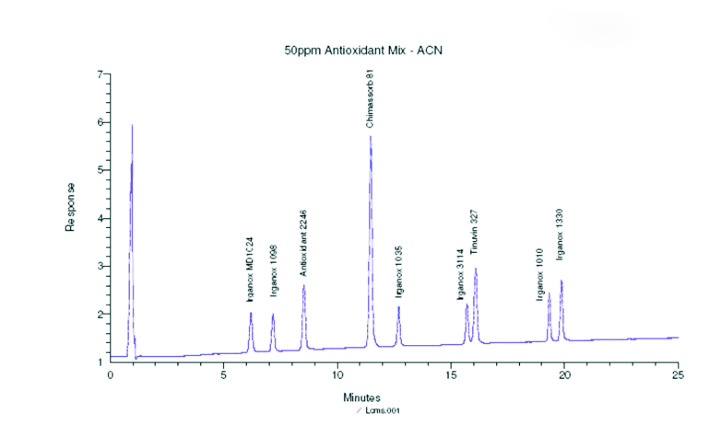
LC-MS Chromatogram of Antioxidant Solution

Slide 26
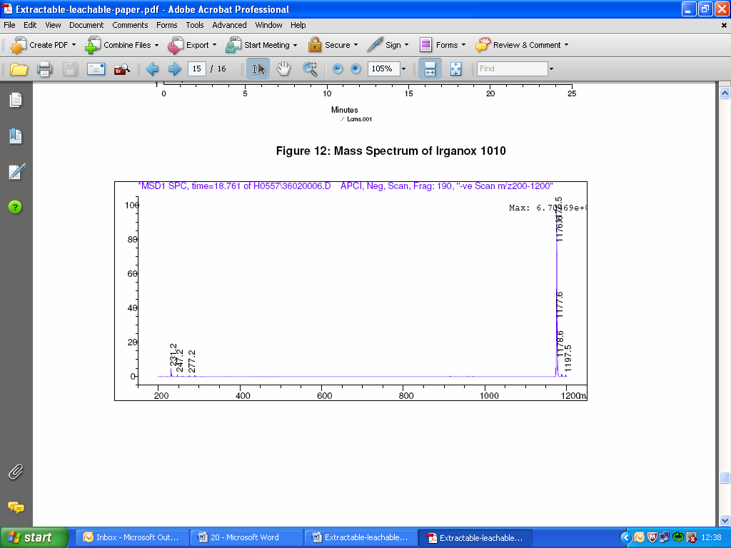
Mass Spectrum of Irganox 1010

Slide 27
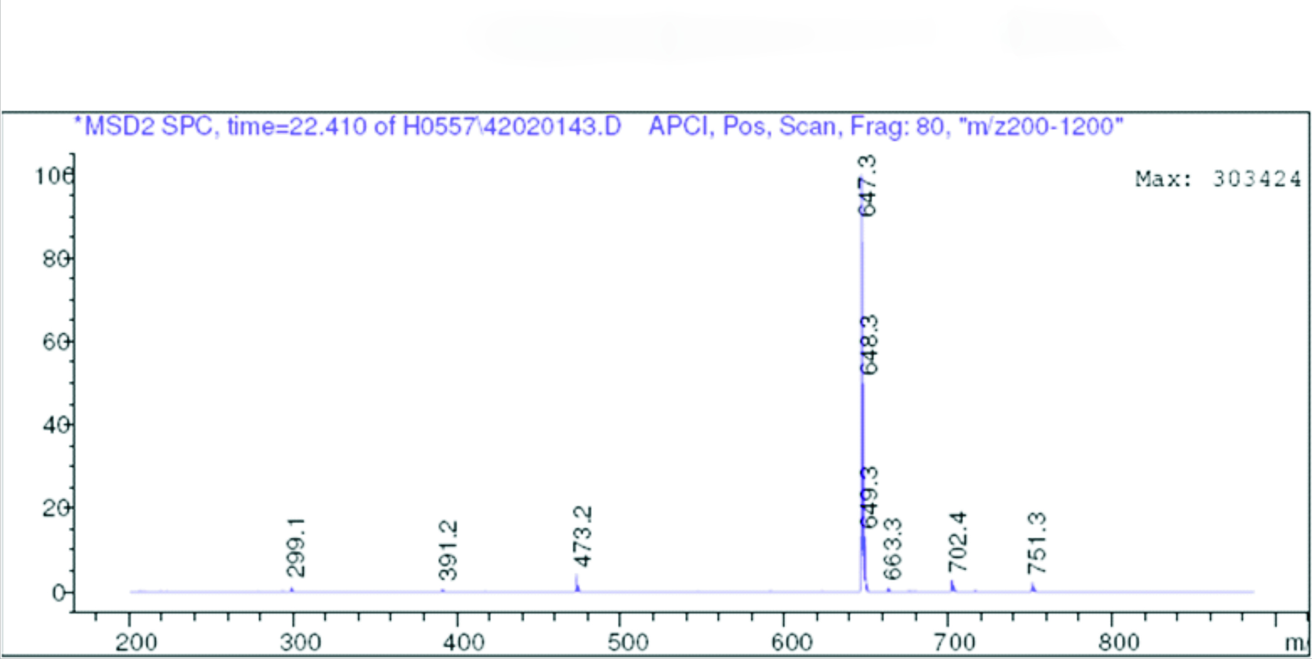
Mass Spectrum of Irganox 168

Slide 28
Leachables
Source of Leachables | Leachables | Components of Leachable study | Significance of leachable Study
Rubber Stopper | Thiurams, dithiocarbamates and mercaptobenzothiazoles are commonly used sulfur-containing Curing agents in Rubber manufacturing, hence , they are Potential leachables in the drug product where Sulfur-cured rubber is used | HPLC-MS/MS, HPLC Q-Tof, HPLC-UV, DAD HS-GC, HS-GC-MS GC (FID, ECD, FID-NP), GC-MS GC-TEA (nitrosamines) ICP-OES, ICP-MS, AAS, IR FTIR TGA, DCS X-ray fluorescence analysis Accelerated Solvent Extraction (ASE) Soxhlet | Is conducted in order to monitor any substances that leach out of a material into the final drug product in its commercial packaging (primary & secondary) and are thus exposed to patients.

Slide 29
Leachables
Source of Leachables | Leachables | Components of Leachable study | Significance of Leachable Study
Printed Label | Phtoinitiators 1-benzoylcyclohexanol and 2- hydroxyl-2-methylprophenone from ink used on labels of HDPE and glass bottles were found to migrate into a solid products.
Polymer | Polybutylene terephthalate(PBT) is a widely used polyester plastic in medical device and MDI valve components. PBT oligomers and other residuals or degradants can be similarly leached from the valve components fabricated from this material.
Disposable Bioreactors | Disposable bioreactors for the production of Biologics the various plastics- bags, tubing, filters are sources of potential contamination.

Slide 30
Leachables
Source of Leachable | Leachable | Components of Leachable study | Significance of Leachable Study
Prefilled Syringes/ Glass Vial | a) Potential contaminants are “inorganic oxides and ions from “ Borosilicate Glass” b) organics from the “ Rubber plunger”. c) Fe, Cr, Mn, Ni and Mo from Stainless steel needle. d)Adhesives(organic oligomers and polymers such as acrylates that are proceed via curing process) e)Silicon oil(polydimethyl siloxance ) to lubricate the barrel, syringe tools including tungsten pin and nylon pins. f) Metals and ions such as Fe and Mn may catalyze oxidation proteins. | ------------ | ------------

Slide 31
Difference between Extractables and Leachables
EXTRACTABLES
LEACHABLES
Compounds released from a container/closure system into a extraction solution in “Forced extraction experiments “ | Compounds that leach from a container/closure system into the “Drug formulation” under normal storage conditions(as part of the stability study)
Studies are “ worst case “ investigations , are only partially compound –specific , the polymers chemists know- how and creativity in the lab work is valuable, a high degree of experimental freedom exists. | Studies simulate realistic storage conditions with the drug product(e.g. as part of the stability test protocol)
In studies experimental modifications & repetitions are possible and the way to achieve an appropriate screening of extractable are variable. | Studies are compound specific, the methods have to be optimized and validated. Compounds which are monitored as potential drug impurities.
Studies should be adjusted to the drug formulation and the packaging system | Studies are specific regarding the drug formulation and the packaging system and size

Slide 32
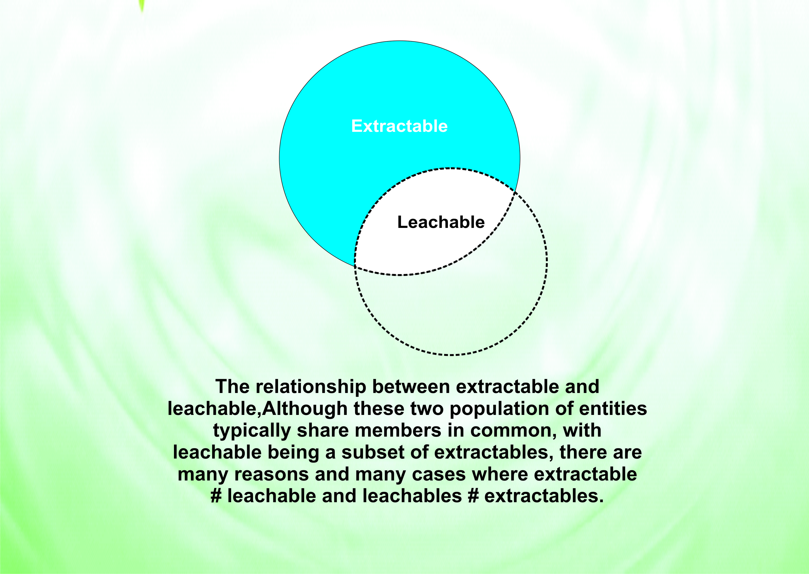

Slide 33
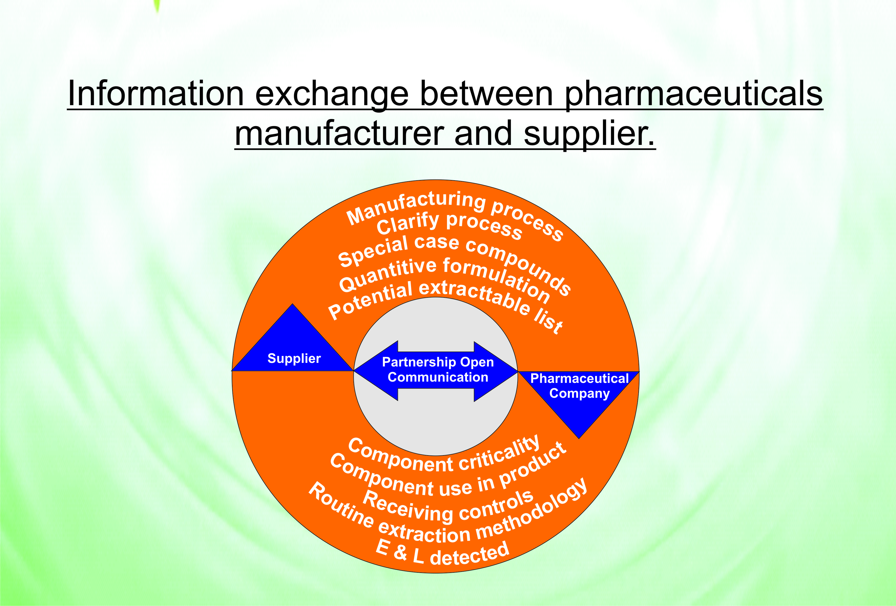

Slide 34
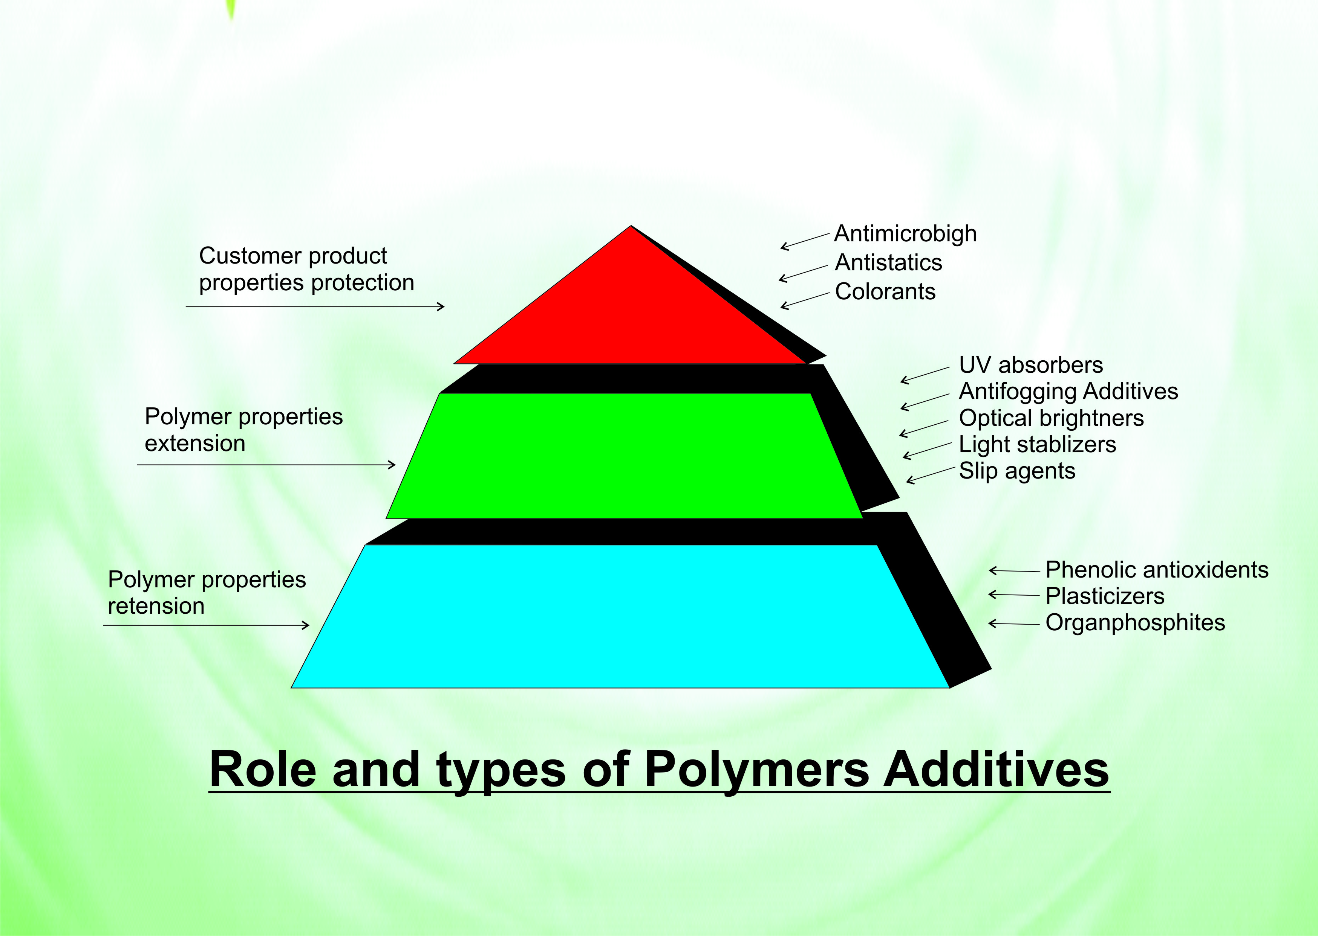

Slide 35
Glass Vial
Type I borosilicate glass is commonly used to make prefilled syringes and contains various inorganic oxides such as boron, silicon, calcium, sodium, potassium, iron, and aluminum .These inorganic oxides may not pose a direct toxicological risk but migration of glass components from ion-exchange, glass dissolution, pitting, stress, surface layer exfoliation, weathering, and/or erosion corrosion effects may lead to particle formation.
Extractables | Alkali oxides, Trace materials, Silicone
Interaction with drug Products- Biologics | Particulate Ph shifts Protein and Peptide Aggregation
Eto sterilization | Ethylene oxide

Slide 36
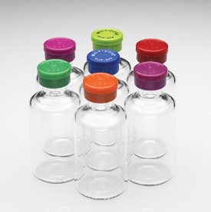
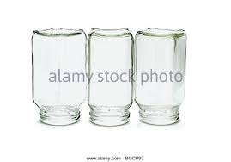
How to carryout Leachable studies
Fill the product , put the rubber stopper properly duly sealed with Flip-off cap
Place vials in “inverted form” that product will get in touch with Rubber stopper.

Slide 37
Glass syringe
Prefilled syringe is widely using for different types of drugs. Basically Type-I borosilicate glass is using for that purpose.
Silicone Oil( 0.6 – 1.0 mg/syringe)
Silicone oil is applied to coat the inner surface of the glass barrel. The most common form of silicone oil used in medical applications is polydimethylsiloxane and functions as a lubricant allowing the plunger to glide smoothly within the barrel to expel the drug. As the demand for prefilled syringe and automated injection devices increases, so does the importance of understanding silicone oil.
Extractables | Alkali oxides, Trace Metals, silicon oil.
Interaction with drug products-Biologics | Particulates Ph shifts Protein and Peptide Aggregation
Eto sterilization | Ethylene oxide

Slide 38
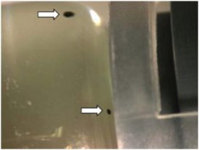
Black particles inside the glass syringe
Two black particles observed inside a pre-filled syringe. Larger particle is approximately 300 microns

Slide 39
Rubber stopper ,plunger and needle shield
The rubber stopper, plunger and needle shield are composed of rubber related materials. The product contact surface of the plunger is laminated with a fluoropolymer type film and the needle shield is unlaminated. Contact between the formulated drug with the plunger and shield may result in leached rubber additives or bromine related compounds. Leached rubber agents have been proposed to cause adverse patient effects.
Leachables | Thiurams, dithiocar –bamates and mercapto-benzothiazoles –curing agent.
Interaction with drug products-Biologics | Particulates Ph shifts Protein and Peptide Aggregation
Eto sterilization | Ethylene oxide

Slide 40
Influence of Gamma irradiation on Chemical Extractables
Test parameter | Amount tested | units | limit | Rubber stopper | uncoated | Fluro coated rubber stoppr
 |  |  |  | Before Gamma | Afrer gamma | Before gamma | After gamma
Appearance | 10 mm cuvet | % T at 430 | >=99.0 | 100 | 99.8 | 99.7 | 100
Foam test | 5ml | - | Foam disappears within 3 min | pass | pass | pass | pass
Ph | 20ml | Ph unit | Difference with blank(*) max 1.0 | -0.23 | -0.01 | -0.13 | -1.58
Reducing substances | 100ml | Ml 0.002M KMN04 | 2 | 0.39 | 0.51 | 1.1 | 1.39
Evaporation residue | 100ml | mg | 2 | 0.25 | 0.10 | 0.43 | 0.3
UV absorption(220-350nm) | 10mm cuvet | absorbance | 0.2 | 0.03 | 0.03 | 0.01 | 0.028
Zinc | 10ml | Ppm Zn2 | 1 | <0.01 | 0.015 | <0.01 | <0.01

Slide 41
Metal Needle
The attached hypodermic needle is made of stainless steel. Inorganic metals used in the stainless steel formulation such as Fe, Cr, Mn, Ni, and Mo may leach from the needle. Based on our experience, metals leach at low levels and are not a direct toxicological concern. However under specific conditions and concentrations, metals such as Mn may catalyze oxidization reactions on proteins .
Leachables | Fe, Cr, Mn, Ni and Mo.
Interaction with drug products-Biologics | Particulates Protein and Peptide Aggregation
Eto sterilization | Ethylene oxide

Slide 42
Adhesive
UV activated adhesives composed of organic and oligmeric/polymeric materials are commonly used to bind the stainless steel hypodermic needle to the glass barrel. The impact on drug quality was a concern since acrylates are reactive toward protein under certain conditions. Evaluation of a formulated protein stored in syringes containing endogenous levels of adhesives at 37°C for 45 days led to adduct formation. Irreversible addition of acrylates with the formulated protein was observed at multiple lysine, histidine, and N-terminus sites with 0.02% of amino acid sites being modified
Leachables | Adhesive
Interaction with drug products-Biologics | Particulates Protein and Peptide Aggregation

Slide 43
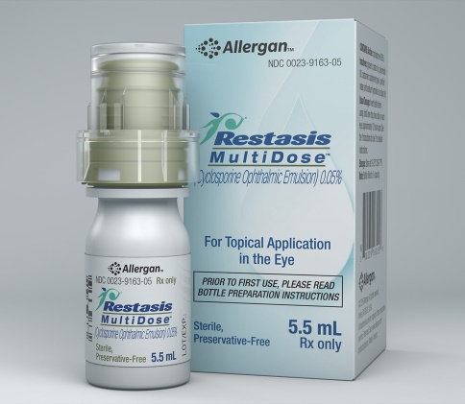
Potential leachable from bottle, label and carton(ophthalmic )
Plastic bottle | Plasticizer,lubricant,pigment,stabilizer,antioxidant,binding agent,sterilizing agent.
Label | Preservatives, sealant, ink,coating.
Mono carton | Preservatives, sealant, ink, coating.

Slide 44
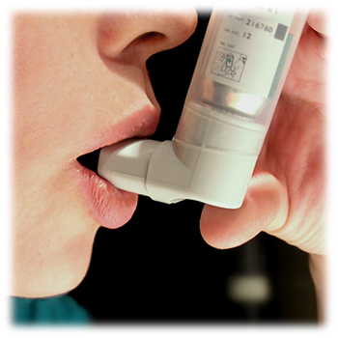
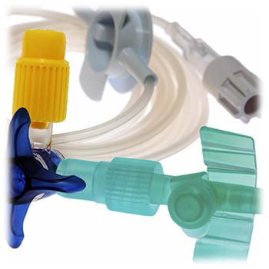
MDI, DPI and Catheter potential Leachables
Aluminun can | Aluminum and inside coating material
Actuator | Plasticizer,lubricant,pigment,stabilizer,antioxidant,binding agent,sterilizing agent.
Dispensing part | Plasticizer,lubricant,pigment,stabilizer,antioxidant,binding agent,sterilizing agent.

Slide 45
Recommended Leachables and Extractables Testing
Product Type |  | Controlled extraction study | Leachables study | Routine Extractables testing | Routine Leachable testing
MDI | Valve components(polymeric –contact with product) | Yes | Not applicable | Yes | Not applicable
 | Mouthpiece(including spacer) | Yes | No(one time in-use study) | Yes | Not applicable
 | Canister | Yes(if coated) | Not applicable | Yes(if coated) | Not applicable
 | Drug product | Not applicable | yes | Not applicable | No

Slide 46
Recommended Leachables and Extractables Testing
Product Type |  | Controlled extraction study | Leachables study | Routine Extractables testing | Routine Leachable testing
DPI | Protective secondary packaging(critical to the performance of the drug product) | Yes | Not applicable | Yes | Not applicable
 | Mouthpiece | Case by case | No(one time in-use study) | Yes | Not applicable
 | Canister | Yes(if coated) | Not applicable | Yes(if coated) | Not applicable
 | Drug product | Not applicable | yes | Not applicable | No

Slide 47
Recommended Leachables and Extractables Testing
Product Type |  | Controlled extraction study | Leachables study | Routine Extractables testing | Routine Leachable testing
Nasal spray | Pump components(polymeric contact with product) | Yes | No(one time in-use study) | Yes | Not applicable
 | container | yes | Not applicable | Yes | Not applicable
 | Actuator | Yes | No(one time in use study) | Yes | Not applicable
 | Drug product | Not applicable | yes | Not applicable | No

Slide 48
Recommended Leachables and Extractables Testing
Product Type |  | Controlled extraction study | Leachables study | Routine Extractables testing | Routine Leachable testing
Inhalation solution/suspension | Primary packaging material(polymeric) | Yes | Not applicable | Yes | Not applicable
 | Protective secondary packaging(critical to the performance of the drug product) | yes | Not applicable | Yes | Not applicable
 | Drug product | Not applicable | yes | Not applicable | No

Slide 49
Packaging Materials Associated with Parenteral Products
Dosage Form | Components | Example Material
Inhalation | MDI/DPI components, canisters, valves, gaskets, blister packs, bottles, actuators, mouthpiece, pumps, closures, liners, label/inks | polyolefins, styrene butadiene rubber, ethylene propylene diene monomer, rubber, thermoplastic elastomers, polyacetal, polyesters, polyamides, acrylics, epoxies, paper / paperboard, metals, glass
Injectable | SVP <100 ml/LVP >100ml cartridge, syringe, vial, amp-oules, flexible bag, closures / plungers, injection ports, needles, adhesives, inks, overwraps | polyolefins, butyl rubber, ethylene propylene diene monomer rubber, polyvinyl chloride, polyurethanes, polycarbonate, acrylics, poly-amides, polystyrene, thermoplastic elastomers, silicones, polyesters, epoxides, cellophane, fluoropolymers, styrenics, paper / paperboard, metals, glass

Slide 50
Dosage Form | Components | Example Material
Infusion | bottles, droppers, screw caps, liners, tips, tubes/liners, labels/ink | polyolefins, acrylics, vinyls, epoxies, polyamides, thermoplastic elastomers, polyesters, cellophane, glass, paper / paperboard, metals
Transdermal | adhesives, membranes, barrier films, reservoir, coatings, blister packs, preformed trays, overwraps, substrates, topical aerosol components | polyolefins, acrylics, vinyls, polyamides, polyesters, styrenics, rubber material thermoplastics, metal
Associated Components | nebulizers, dosing spoons, dropper, dosing cups | polyolefins, glass, rubber, thermoplastics, polyesters

Slide 51
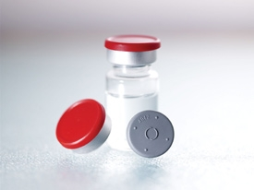
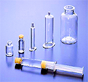

The selection and control of container closure systems are important parameters in pharmaceutical development and throughout the drug product life cycle.
Vials
Prefilled Syringes
Cyclic olefins

Slide 52
Container Closure System
.
Adequately preserve the integrity of the product(storage)
Contribute harmful components to the drug
Deliver the drug e.g .prefilled syringes, Inhalers, ophthalmic
What
Drug
Packaging
Should
Do
What Drug Packaging Should Never Do
Increase Toxicity of the product
Protect the Drug product during shelf life
Carciogenic/Genotoxic
Packaging materials have been in the focus of such investigations for long time as the contact time between drug product and packaging material is rather long.
Impact Drug efficiency/Stability(e.g. cause precipitation or Ph change

Slide 53
Determination of Extractables and Leachables from Container Closure Systems
1)Review composition of primary packaging components with vendors and obtain certificates of compendial compliance.
2) Identify potential Extractables and Leachables with assistance from vendors, literature search , primary screening etc.
3) Perform Extractable studies with solvents representative of the drug product.
4) Identify and quantify Extractables compare Extractables with list obtained from vendors.
5) Assess safety(concentration, rout of administration, dose regimen etc)
6) Develop test methods for selected potential Leachables for stability studies.
7) Identify ,quantify and assess safety of leachables ,develop limits for Leachables.

Slide 54
Regulatory Guidelines
Federal Food Drug and Cosmetics Act
Good Manufacturing Practices – 21 CFR
CFR 211.94- Drug Product Containers and Closures
CFR 211.160- General Requirements
D&C Act/ Rules :Schedule M
EU Directives
CDER Guidance Documents for Industry
International Guidelines
EMEA
Health Canada
Standard Compendia
USP/EP/IP/ICH Q4(Annexures), Q6 A, Q8

Slide 55
DRUG REGULATORY GUIDELINES
An area of increasing concern and scrutiny for US FDA’s Centre for Drug Evaluation and Research(CDER) is the potential adulteration of drug products by extractable and leachable compounds that enter a drug from a container closure system, disposable or device
Addressing this concern, 21 CFR 21.1.94 a states that:
Drug product containers and closures shall not be reactive ,additive, or absorptive so as to alter the safety, identity, strength, quality or purity of the drug beyond the official or established requirements.

Slide 56
Impact of Leachables in Drug
May increase Toxicity
May interfere Assay
May react with one or more of the drug product components (e.g may cause precipitation or “Ph ‘ change.

Slide 57
Biologics 21cfr600,11(h)
All final containers and closures shall be clean and free of surface solids, leachable contaminants and other materials that will hasten the deterioration of the product or otherwise render it less suitable for the intended use.
European Agency for the Evaluation of Medical Products(EMEA) issued (May 2005) the Guideline on Plastic Immediate Packaging materials , which indicates that
The aim of extraction studies is to determine those additives such as antioxidants, plasticizers, catalysts, initiators, etc)that might be extracted by the substance in contact with the plastic material. Extraction studies are considered necessary for plastic materials used container systems of nonsolid active substances and nonsolid dosage forms.
Interaction studies between plastic material and the active substance should be evaluated.

Slide 58
FDA Industry Guidelines
FDA Guidance for Industry –CCS for Packaging Human Drugs and Biologics (1999)
Address the review and evaluation of packaging requirements
According to this document each NDA or ANDA should contain enough information to demonstrate that a proposed container closure system and its components are suitable for its intended use.
The type and extent of information required will depend on the dosage form and route of administration.
CDER and CBER guidance documents details QC expected of a container closure system to be used in the packaging of drugs and biologics –understanding the level of extractables and leachables, the test methods related to these contaminants and other consideration relating to packaging components- outlines a risk based approach.
For injectable dosage forms, outlines the test required to show that interaction is not a problem. Associated components such as those used only at the time a dose is administrated ,self-adhesive labels and secondary packaging materials are also included in the review process.
Guidelines of Industry Nasal Spray and inhalation Solution ,suspension and spray Drug Products –Chemistry, Manufacturing and controls Documentation(2002) –details Toxicological evaluation of extractables from each of the components& appropriate in vivo/in vitro rests to be submitted.

Slide 59
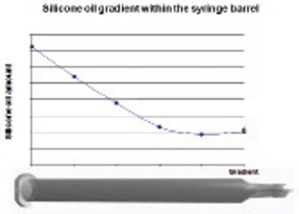
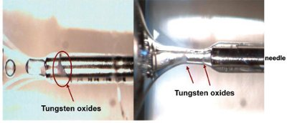
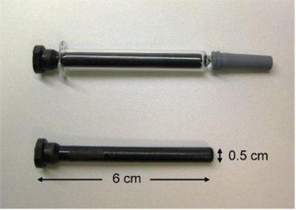
Silicone oil gradient
in an empty PFS
Tungsten oxides inside the syringe near the hypodermic needle-barrel zone
Polymeric pin and a polymeric pin inserted into a syringe.

Slide 60
Analytical techniques for different groups of leachable/extractable impurities
Quantification limit for E/L study in inorganic compounds
Analytical Method | Target Species | Examples
Inductively Coupled Plasma Mass Spectroscopy (ICP-MS) | Inorganic compounds. | Aluminum, Antimony, Cadmium, Chromium, Copper, Iron, Lead, Magnesium, Manganese, Nickel, Zinc,,Silica and Arsenic

Slide 61
Compounds | Analytes | Acceptance criteria
Elements | Mg | 50.0ppb
 | Al | 10.0ppb
 | Cr | 10.0ppb
 | Mn | 10.0ppb
 | Fe | 10.0ppb
 | Ni | 10.0ppb
 | Cu | 10.0ppb
 | Zn | 50.0ppb
 | Cd | 2.0ppb
 | Sb | 2.0ppb
 | Pb | 2.0ppb
 | As | 10.0ppb
 | Si | 10.0ppb

Slide 62
Case Studies:
Non container
Problem | Source | Resolution
Phenolic compounds found in a peptide product during release testing | Phenolic compounds were absorbed from a cleaning agent for rubber gaskets used in the filling lines. | Rubber gaskets were replaced by “Teflon rubber gasket” that did not absorb phenolic compounds.
Glass Vial
Problem | Source | Resolution
Particulates(upto 150 mic m) were observed in product containing a phosphate buffer after switching from a molded glass to a tubular glass vial. | Particles identified as aluminum phosphate from aluminum in the glass tubing vial | Inside of vials coated with baked-on-silicon

Slide 63
Tungsten Case Study
Problem | Source | Resolution
Visible protein particles(10 to 100 mic m) were observed in new lots of pre-filled glass syringes with a staked needle filled with an alpha helical protein at Ph 4.0 at Amgen. | Contaminated tungsten | Tungsten pins used to maintain the fluid channel during forming of the syringe cone at > 1,000 deg
Pre-filled Syringes case Study
Problem | Source | Resolution
Increased incidence of antibody mediated Pure Cell Aplasia(PRCA) severe and rare form of Anemia following introduction of reformulation in pre- filled syringes. | Polysorbate 80 caused the presence of a number leachables in formulation from the rubber plunger. Compunds were aromatic phenols and mercaptophenols related to vulcanizing agent for Butyl rubber | Uncoated plunger replaced by a coated plunger-adverse events return to pre-polysorbate 80 levels

Slide 64
Potential issues(Regulations) | Current Drug laws, Regulations , Guidances: How to address identified key Areas | FDA’S Quality control Approach
FDA provides guidance for protection against extractables and leachables in various documents. So the qualification and quality control of all components coming into contact with the drug formulation is an integral part of any FDA application process. | Analytical Characterization of Extractables(control Extraction studies) –the specific requirements for control extraction studies | Characterize/identify all possible extractables and establish a profile for each packaging components

Slide 65
Extractables and leachables issues often are not addressed up front and ultimately can cause regulatory delay for the drug manufacturer. | Analytical characterization of leachables –How is a correlation with extractables established ? | Establish a correlation between extractable and its leachables potential
The development, validation and testing of these components must be carried out under ICH and USP guidelines in a –CGMP compliant laboratory. | Safety Qualification of Leachables –what are current industry practices for establishing safety of leachables (e.g, what are the qualification criteria ?) | Set meaningful acceptance criteria for a given extractable in corresponding incoming packaging components, based on its qualification level actual observed data

Slide 66
This activities are time consuming, require expertise and a wide arry of analytical techniques. Drug manufacturers may not have the resources available & outsource these activities to contact laboratories. | Routine Extractable Testing- is quantative testing of extractables appropriate for control of composition of all components ?(a control strategy combining appropriate scientific practices, CGMP controls and supplier qualification systems for ensuring the relevant performance and safety characteristics of critical components) | Set meaningful acceptance criterion for a given leachable based on actual observed data in the drug product.
It is also imperative that the component vendors, laboratories, toxicologists and the regulatory agency have open, effective and timely communication –work collaborately.

Slide 67
Evaluation of Extractable and Leachables; Guidelines
Sr No. | Factors to be considered
1 | Material of construction of the system, surface treatments and /or processing aids, dosage form active ingredients and excipients, sterilization and/or other related processing and storage conditions.
2 | Review composition of primary packaging components with vendors, obtain certificates of compendial compliance.
3 | Identify potential Extractables and Leachables with assistance from vendors, literature search- MSDS, Technical data Sheets.
4 | Use of clean raw materials with minimal processing additives, extractables and leachables are minimized.

Slide 68
Organizations involved with extractables and Leachables
Organization | Abbreviation | Notes
American Association for Pharmaceutical Science | AAPS | International forum- exchange of knowledge among scientists –discovery, development and manufacture of pharmaceutical products. www.aaps.org
Bio-process systems Alliance,USA | BPSA | Inter-company group supporting the use of disposable reactor technology, www.bpsalliance.org
European Food safety Authority | EFSA | An EU official body, www.efsa.europa.eu

Slide 69
Extractable and Leachables safety information Exchange | ELSIE | Inter-company group producing databases of Extractables from selected plastics Toxicology for selected substances
International pharmaceutical Aerosol consortium on Regulation and science | IPAC-RS | International association of innovator and genetic companies that develop, manufacturer or market orally inhaled and nasal drug products , www.ipacrs.co
AAPS inhalation Technology Focus Group | ITFG | www.aaps/inside/focus_group/it/index.asp

Slide 70
National institute of standard and Technology | NIST | US agency responsible for advancing measurement science ,standards and technology. www.nist.gov
Product Quality Institute | PQRI | Collaboration between FDA’s centre for drug evaluation and research , industry and Academia. www.pqri.org

Slide 71
SUMMARY OF RECOMMENDATIONS –
Leachable/L evaluations should be based on methods/techniques used in controlled extraction studies.
Analytical method should be guided by the AET.
Comprehensive correlation should may obviate the need for routine implementation of drug product leachable specification and acceptance criteria.
Acceptance criteria for Leachables should apply over the proposed shelf life and include quantitative limits for known and unspecified leachables.
L/E methods should be validated according to ICH validation characteristics.
Safety consultation should be incorporated in the early stages of leachable studies.

Slide 72
Any Questions ?
Thanks
.

