Slide 1

Role of Ophthalmic Ultrasonography Pre-Cataract Surgery
Al-Neelain University
Faculty of Optometry and Visual Sciences
Raghda Faisal Abdelfatah Mutwaly. M.Sc. in optometry
Lecturer at Faculty of Optometry
Head of Medical Photography Department
Trainer in Arab Board for Consultation and Training

Slide 2
Introduction
  Ultrasound is an acoustic wave that consists of an oscillation of particles within a medium.
  The frequency used in the diagnostic ophthalmic ultrasound for posterior segment is 8–10MHz
  Ultrasound modes are A-mode, B-mode, M-mode and Doppler ultrasound.
  Brightness mode provides cross sectional image and gives a better demonstration of the shape and topography of the lesions.
  Over the last 30 years ultrasonography has greatly advanced and this has enabled us to study posterior segment of the eye even in the presence of opaque media.

Slide 3
Aim of the study
The study aimed to demonstrate the importance of B-scan ultrasonography as a diagnostic and prognostic method before cataract surgery.
Objectives
To assess the posterior segment of the eye preoperatively.
To determine the common posterior segment lesions in old patients.

Slide 4
Subject and Methods
Place of study
The study was conducted at the Department of Medical Photography, Al-Neelain University Eye Hospital, Khartoum, Sudan in 220 patients from January to May 2016.
Inclusion criteria
In this study elderly patients considered as 50 years and more.
Exclusion criteria
Patients with diagnosed posterior segment lesions were excluded.
Those who had previous history of ocular surgery or trauma were excluded.
All patient were diagnosed as senile cataract.

Slide 5
Methods
  This was prospective cross-sectional study based on collection of data through clinical examinations.
Demographic data
Age.
Preliminary examinations
Ocular history.
Main study
B-scan ultrasonography.
Slit lamp examination.
Visual acuity test.
Gender.

Slide 6
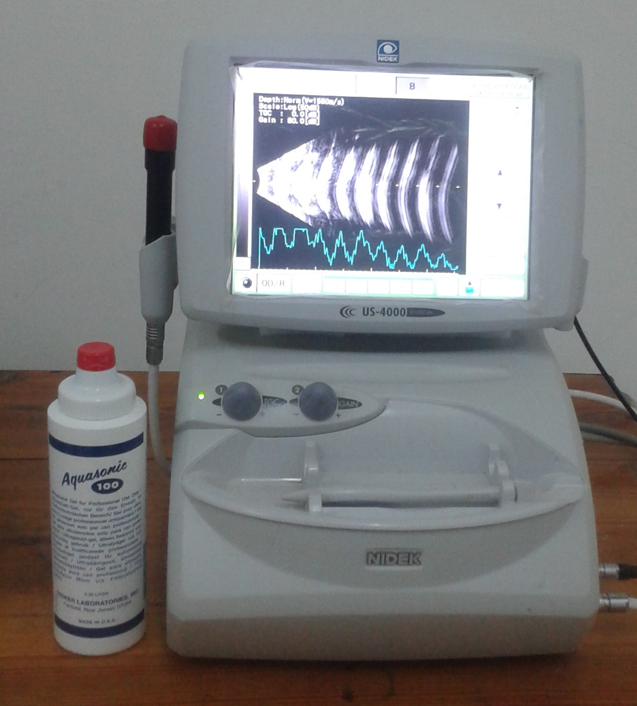
B-scan ultrasonography
Nidek Echo-scan (US-4000, Japan) with a probe of direct contact was used after application of the gel.
Then anterio-posterior, longitudinal and transverse views of B-scan along with A-scan were taken.
High gain (80 to 90dB) and medium gain (60 to 70dB) sensitivity were used.
Dynamic B-scan was used to enhance differential diagnosis in such cases.

Slide 7
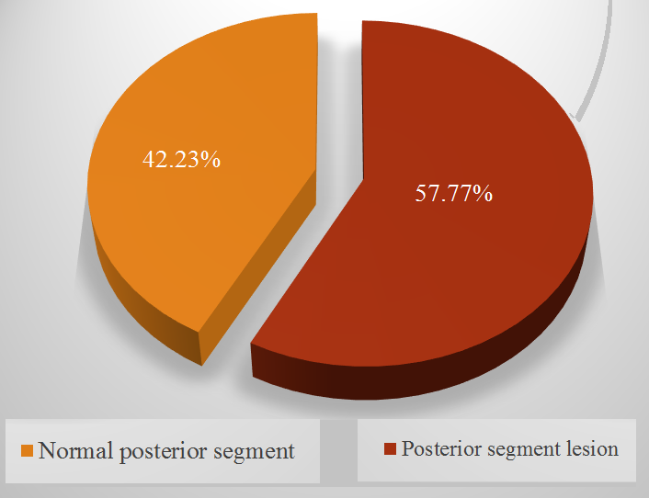
Results
Assessment of Posterior Segment

Slide 8
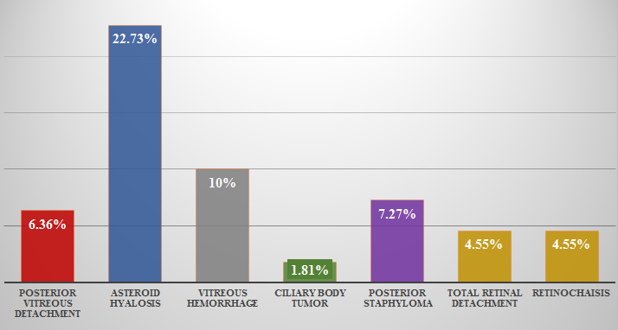
Posterior Segment Lesions

Slide 9
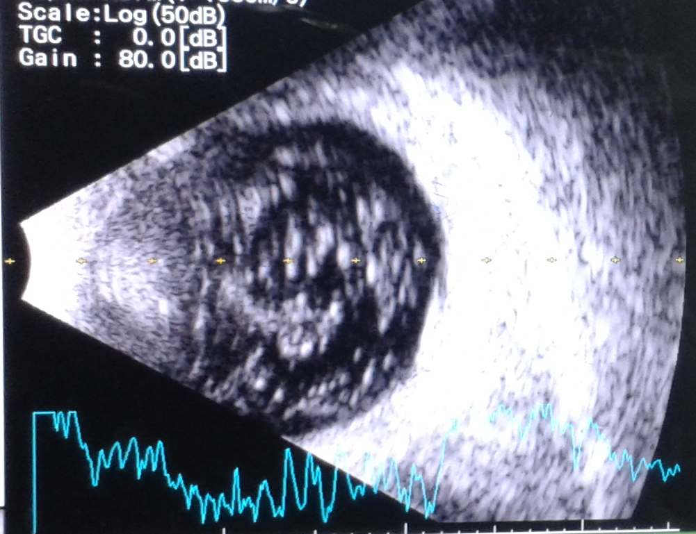
Asteroid hyalosis (longitudinal view)

Slide 10
Vitreous Hemorrhage
Transverse View
Posterior Vitreous Detachment
Longitudinal view
Posterior staphyloma
Axial view

Slide 11
Retinochaisis
Axial view
Total retinal detachment
Axial view
Ciliary body tumor
Transverse view

Slide 12
Discussion
  The study showed that more than 57% had posterior segment lesions.
  Approximately 25% had asteroid hyalosis, this because it’s a physiological age-related degeneration. This result agree with other studies in India (22%) and south Africa (23%)⁽¹⁾⁽²⁾.
  Vitreous hemorrhage (10%) is similar to that found in Pakistan (12% )⁽³⁾. However, posterior vitreous detachment was (7 %) closer to other study in Bahrain (9%)⁽⁴⁾.
  Vitreous hemorrhage and posterior vitreous detachment may result from systemic diseases like diabetes and hypertension.

Slide 13
Cont. Discussion
In addition, it has been noticed that posterior staphyloma was more than expected (7%) which is higher than other study in Niger (5%)⁽⁵⁾. This indicates that patients possibly of having myopia and unaware of it.
A lower incidence of retinochaisis (4%) and retinal detachment (4%) was noticed as compared to that found in other study in Pakistan (3%)⁽³⁾. These findings may due to other systemic diseases.
Ciliary body tumor is approximately 2%. It wasn’t reported by earlier studies. Hence it requires follow-up.

Slide 14
Conclusion
Ophthalmic ultrasonography is essential pre-cataract surgery.
The most common posterior segment lesion in old patients is asteroid hyalosis.
Posterior staphyloma needs further studies in old patients.
Ciliary body tumor is very rare and its the only neoplastic lesion found in old patients.

Slide 15
Recommendations
Pre-operative ocular and systemic assessment are essential in cataract patients.
Longitudinal studies: Ultrasonography after cataract extraction is important.
Use other modern clinical instruments such as ASOCT and UBM in pre-operative assessment.

Slide 16
References
Ali SI, Rehman H, 2010. Role of B-scan in preoperative detection of posterior segment pathologies in cataract patients. Pak J Ophthalmol.;13(4):108–112.
Bello TO, Adeoti CO, 2006. Ultrasonic assessment in pre-operative cataract patients. Niger Postgrad Med J. 13(4):326–8.
Byrne S, Green R, 2010. Ultrasound of the eye and orbit, 2nd ed. Jaypee Brother. Chapter 1:1-5.
Salman A, Parmar P, Vanila CG, Thomas PA, Jesudasan CA, 2006. Is ultrasonography essential before surgery in eyes with advanced cataracts. J Postgrad Med. 52(1):19–22.
Qureshi MA, Laghari K, 2013. Role of B-scan ultrasonography in pre-operative cataract patients. International Journal of Health Sciences (Qassim University) Jan;4(1):31-37.

Slide 17
Thank You

