Slide 1
STUDY OF OCULAR MANIFESTATIONS IN HIV POSITIVE PATIENTS AT A TERTIARY CARE CENTER IN KUMAON REGION, UTTARAKHAND, INDIA
DR. KALPANA KUMARI
POST GRADUATE STUDENT
GOVERNMENT MEDICAL COLLEGE
HALDWANI

Slide 2
INTRODUCTION
Human Immunodeficiency Virus (HIV) currently infects 35.3 million people across the world. Overwhelming size of the Indian population makes it a country with the largest number of people living with HIV /AIDS (PLWHA).
Ophthalmic manifestations of HIV infection are diverse. Both anterior and posterior segments of the eye can be involved which may range from simple Blepharitis to severe blinding conditions like CMV retinitis.
HIV can affect the eye primarily or more often secondarily due to various opportunistic infection.
Patients on HAART can develop severe inflammatory reaction due to immune recovery phenomenon which can cause severe ocular morbidity.

Slide 3
Ocular lesions seen in AIDS
OCULAR LESIONS IN AIDS
ADNEXAL LESIONS | HZO, Kaposi sarcoma of eyelid & conjuctiva, Molluscum contagiosum
ANTERIOR SEGMENT | Dry eye, Conjunctival microvasculopathy & Infectious keratitis & anterior uveitis
POSTERIOR SEGMENT | HIV retinopathy, CMV retinitis, Toxoplasmic retinochoroiditis, Pneumocystis carinii choroidopathy, Acute retinal necrosis, Herpes zoster retinopathy, Progressive outer retinal necrosis

Slide 4
In general, CD4 T-lymphocytes count has been used to predict the onset of certain ocular infections in patients who are HIV positive.
CD4 COUNT RANGE | OCULAR LESIONS SEEN IN THE AIDS
<500/cu mm | Kaposi sarcoma, Lymphoma & Tuberculosis
<250/cu mm | Pneumocytosis & Tuberculosis
<100/cu mm | Retinal & conjunctival microvasculopathy, VZV retinitis, HIV retinopathy & CMV retinits

Slide 5
AIMS & OBJECTIVES
To determine the prevalence of ocular conditions in HIV/AIDS patients presenting to a tertiary care centre of Kumaon region.
To study the relationship between ocular findings and CD4 count in HIV/AIDS patients.

Slide 6
METHODOLOGY
Hospital based cross-sectional study conducted in Department of ophthalmology, Government medical college, Haldwani a Tertiary care centre, Uttarakhand (Sushila Tiwari Memorial Hospital) in which 400 HIV positive patients were examined in terms of clinical examinations, relevant investigations, and treatment and documented.

Slide 7
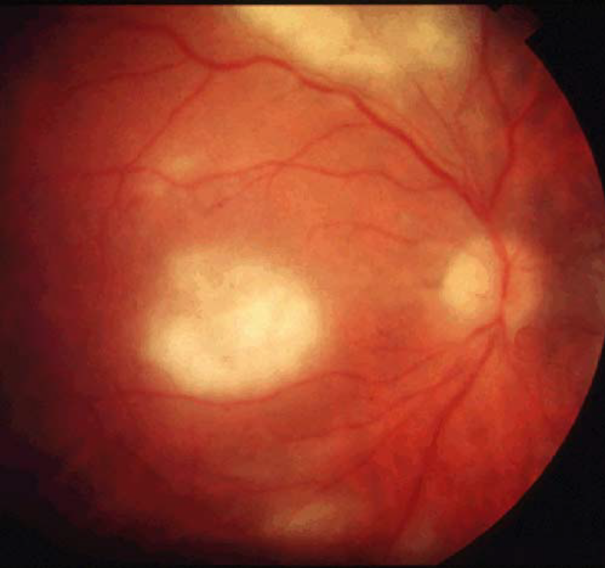
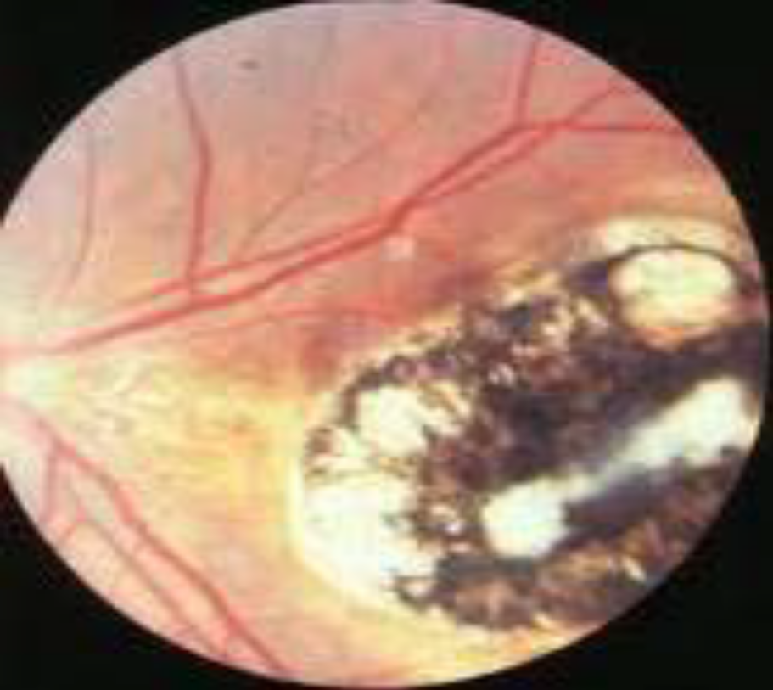
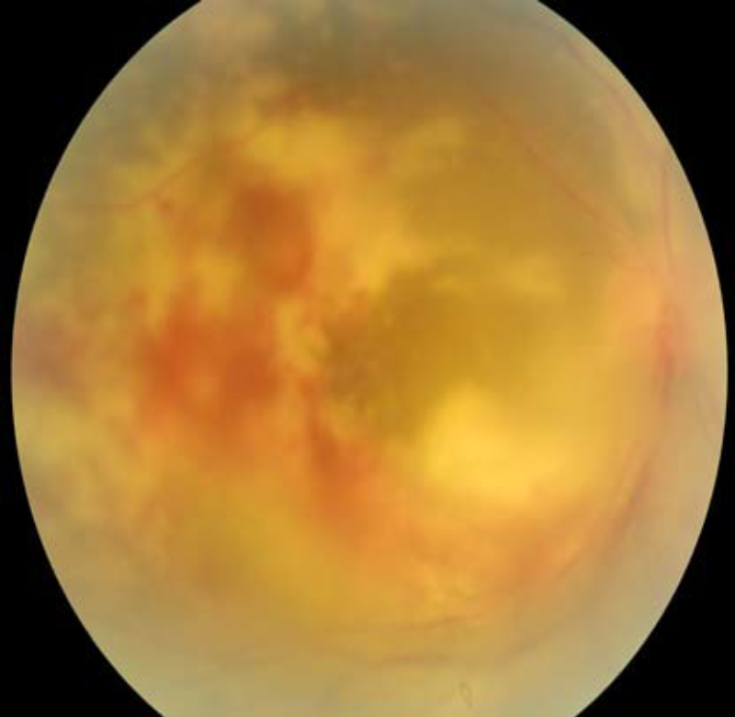
OCULAR LESIONS SEEN IN AIDS PATIENTS
ACTIVE CMV RETINITIS
ACTIVE CHORIORETINITIS
TOXOPLASMA RETINOCHOROIDITIS

Slide 8
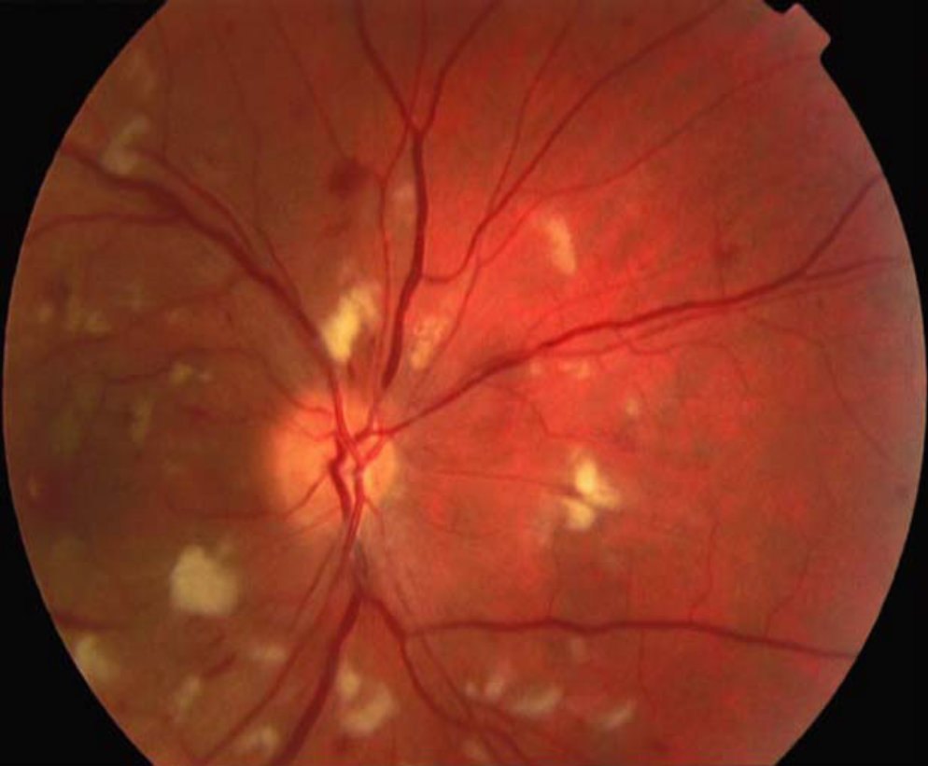
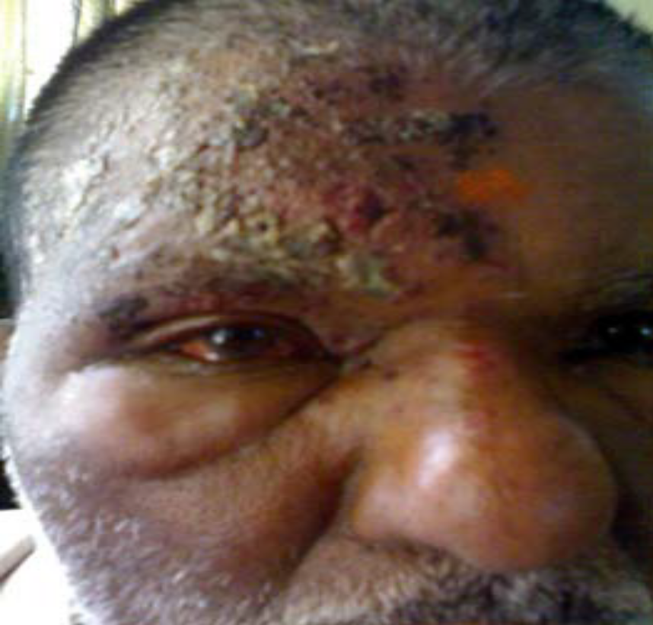
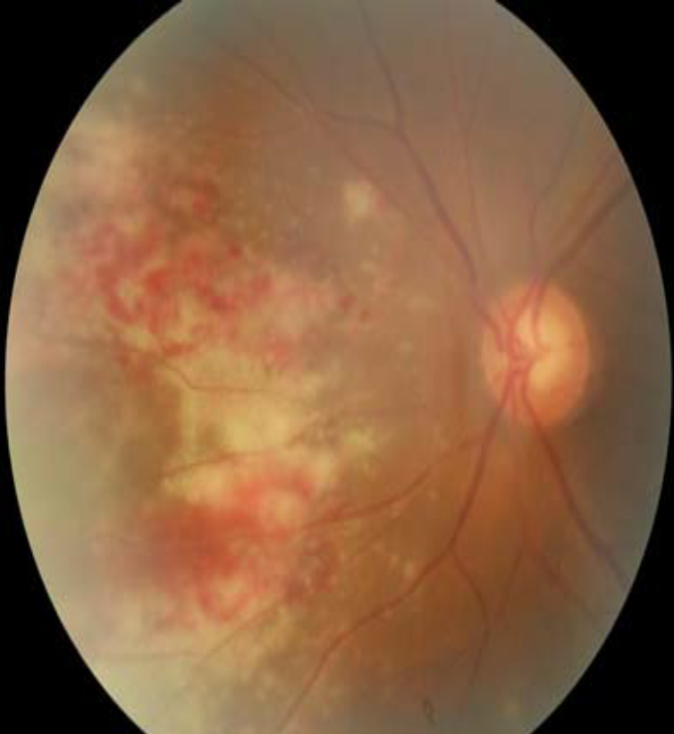
OCULAR LESIONS SEEN IN AIDS PATIENTS
HIV RETINOPATHY
HZO
CMV WITH MACULAR AREA INVOLVEMENT

Slide 9
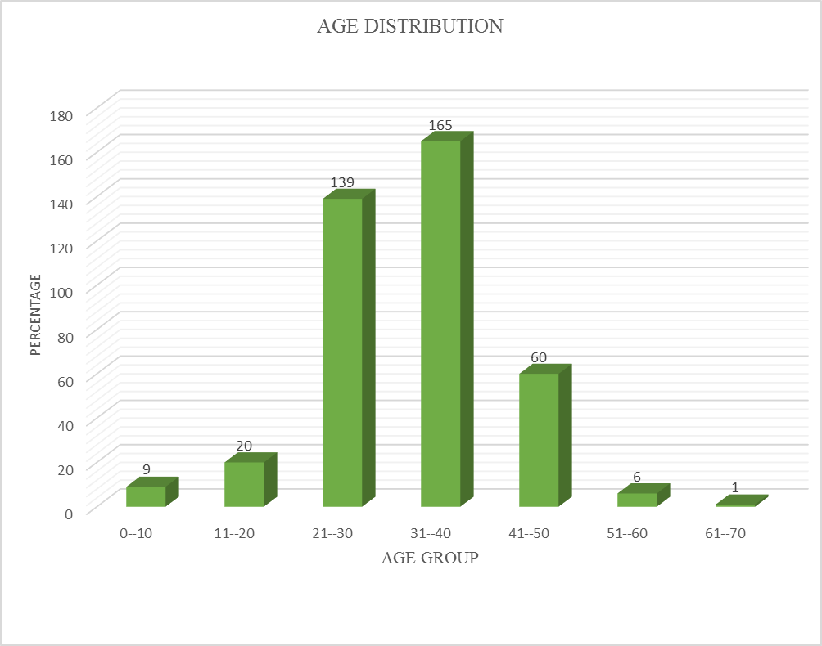
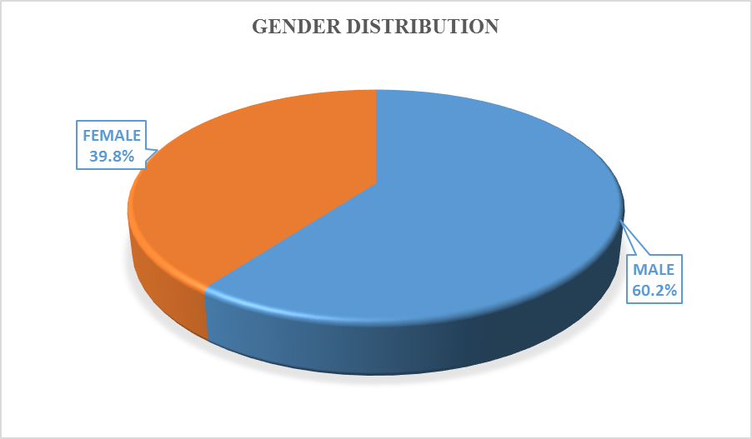
RESULTS

Slide 10
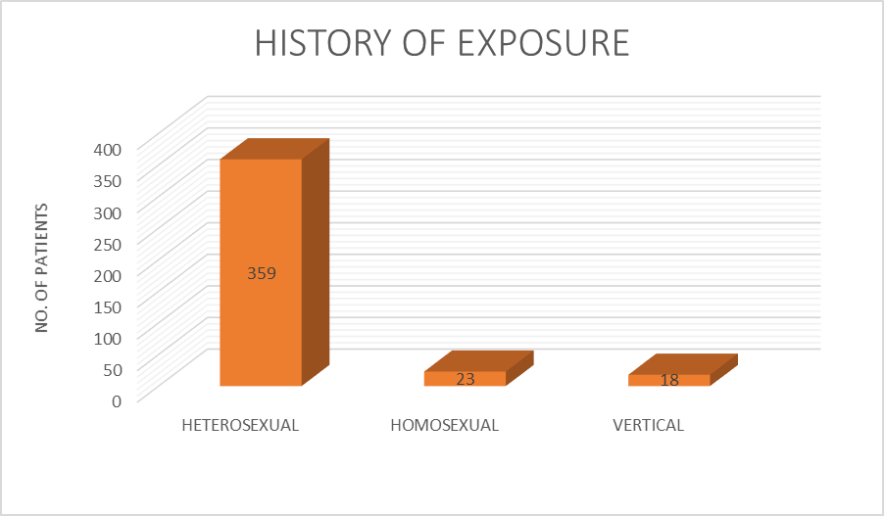
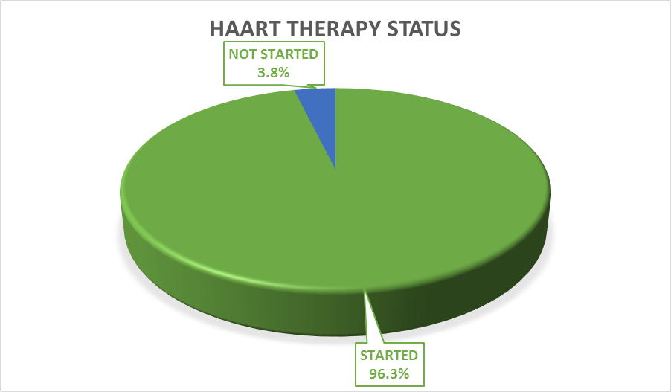
History of exposure & HAART status

Slide 11
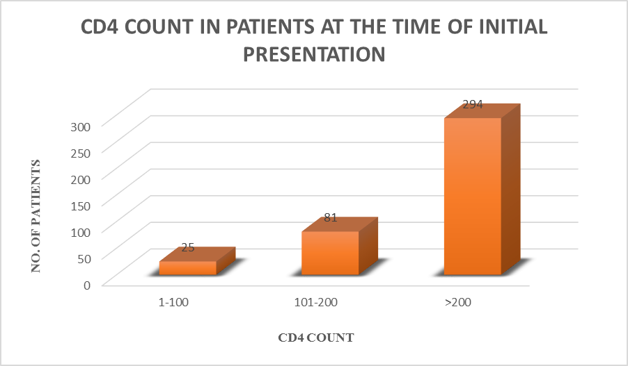
CD4 count in Patients at the time of initial presentation
CD₄ COUNT | NO. OF PATIENTS (%)
1-100 | 25 (6.3)
101-200 | 81 (20.3)
>200 | 294 (73.5)
Total | 400 (100)

Slide 12
PREVALENCE OF OCULAR MANIFESTATIONS
OCULAR MANIFESTATIONS | NO. OF PATIENTS | PERCENTAGE(%)
PRESENT | 114 | 28.5
ABSENT | 286 | 71.5
TOTAL | 400 | 100

Slide 13
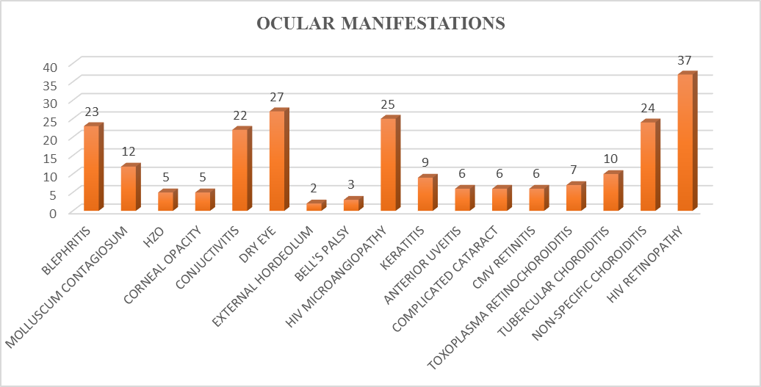
Classification of Ocular manifestations in HIV patients

Slide 14
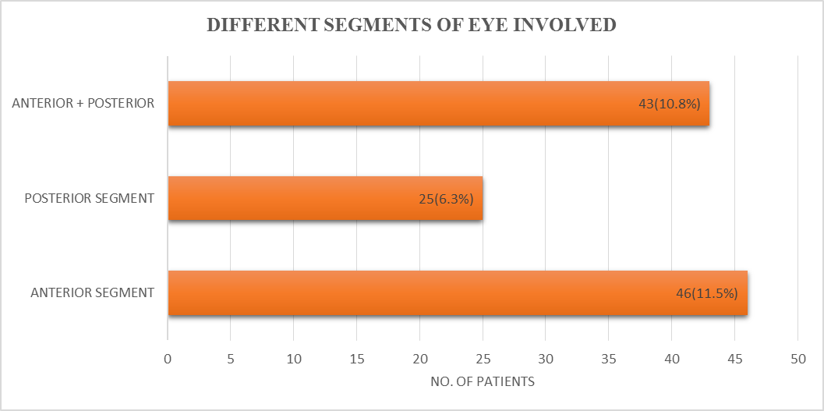
Classification of the patients based on the ocular manifestations in different segments of the eye
OCULAR MANIFESTATIONS | NO OF PATIENTS AFFECTED | % (PERCENTAGE)
ANTERIOR SEGMENT | 46 | 11.5
POSTERIOR SEGMENT | 25 | 6.3
BOTH (ANTERIOR + POSTERIOR) | 43 | 10.7
TOTAL | 114 | 28.5

Slide 15
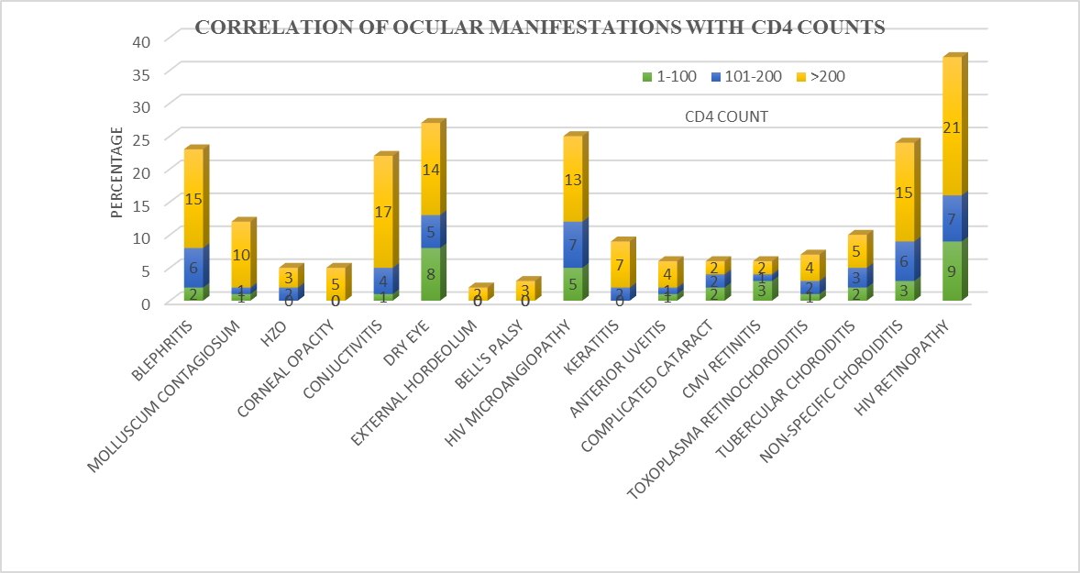
Correlation of ocular manifestations according to CD4 counts

Slide 16
OCULAR MANIFESTATIONS | CD4 COUNT |  |  | TOTAL NO. OF MANIFESTATIONS(%) | P-VALUE
 | 1-100 | 101-200 | >200
BLEPHRITIS | 2 | 6 | 15 | 23 (5.8) | 0.647
MOLLUSCUM CONTAGIOSUM | 1 | 1 | 10 | 12 (3) | 0.511
HZO | 0 | 2 | 3 | 5 (1.3) | 0.467
CORNEAL OPACITY | 0 | 0 | 5 | 5 (1.3) | 0.401
CONJUCTIVITIS | 1 | 4 | 17 | 22 (5.5) | 0.898
DRY EYE | 8 | 5 | 14 | 27 (6.8) | -
EXTERNAL HORDEOLUM | 0 | 0 | 2 | 2 (0.5) | 0.872
BELL’S PALSY | 0 | 0 | 3 | 3 (0.8) | 0.395
HIV MICROANGIOPATHY | 5 | 7 | 13 | 25 (6.3) | 0.020
KERATITIS | 0 | 2 | 7 | 9 (2.3) | 0.555
ANTERIOR UVEITIS | 1 | 1 | 4 | 6 (1.5) | 0.667
COMPLICATED CATARACT | 2 | 2 | 2 | 6 (1.5) | 0.59
CMV RETINITIS | 3 | 1 | 2 | 6 (1.5) | 0.01
TOXOPLASMA RETINOCHOROIDITIS | 1 | 2 | 4 | 7 (1.7) | 0.8
TUBERCULAR CHOROIDITIS | 2 | 3 | 5 | 10 (2.5) | 0.195
NON-SPECIFIC CHOROIDITIS | 3 | 6 | 15 | 24 (6) | 0.375
HIV RETINOPATHY | 9 | 7 | 21 | 37 (8.2) | 0.001
TOTAL | 38 | 49 | 142 | 229(57.3) | -

Slide 17
DISCUSSION

Slide 18
DISCUSSION
Comparison of Age & Sex distribution
STUDY | MALE:FEMALE RATIO
Present study(2016) | 1.5:1
Jyothirmay Biswas et al(2000) | 3.34:1
Gharai S et al (2008) | 2.9:1
Juliet Otiti-Singeri et al (2010) | 1.4:1
Yared Aseefa et al (2004) | 1.23:1
Lamichanne et al (2009) | 1.85:1
STUDY | AGE(21-50) years in %
Present study(2016) | 91%
Nateshan CR et al(2010) | 80.6%
Lamichhanne et al (2009) | 78.6%
Jyothirmay Biswas et al (2000) | 76
Aratee Palsule et al (2007) | 58.2%

Slide 19
Prevalence of ocular manifestations in HIV in various studies
STUDY | PREVALENCE(%)
PRESENT STUDY (2016) | 28.5%
Nateshan CR et al (2011) | 31.5%
Azonobi Richard Ifeanyi (2013) | 14.0%
Sophia pathai et al (2009) | 17.5%
Ganekal S et al (2012) | 46%
Shah et al (2009) | 8%
Astha singh et al (2012) | 21.5%
In our present study HIV retinopathy being the most commonest ocular
involvement (8.2%) followed by Dry eye disorders (6.8%) & HIV micro-angiopathy (6.3%)which is also found to be the most commonest involvement in
the studies conducted by the others .Our study shows a similar incidence of HIV
retinopathy as of BISWAS J et al.

Slide 20
Patients studied in terms of CD4 count
CD4 COUNT RANGE | PRESENT STUDY (N=400) | Douglas A Jabs et al (2007) N=389 | Sophia pathai et al (2009) N=26 | Udaya kumar et al(2010) N=100
1-100 | 25(6.3%) | 198(51%) | 13(50%) | 45(45%)
101-200 | 81(20.3%) | 86(22%) | 7 (26.9%) | 28 (28%)
>200 | 294 (73.5%) | 101(26%) | 6 (23.1%) | 27 (27%)

Slide 21
CONCLUSION
HIV/AIDS infection has become a common disease in our population and affects mainly the reproductive age group with males being more commonly affected.
The commonest route of transmission being the sexual route.
Due to the potentially devastating and rapid course of retinal opportunistic infections, all HIV infected person who experiences ocular symptoms should receive prompt and competent ophthalmic care as delay in therapy can lead to irreversible visual loss.

Slide 22


