Slide 1

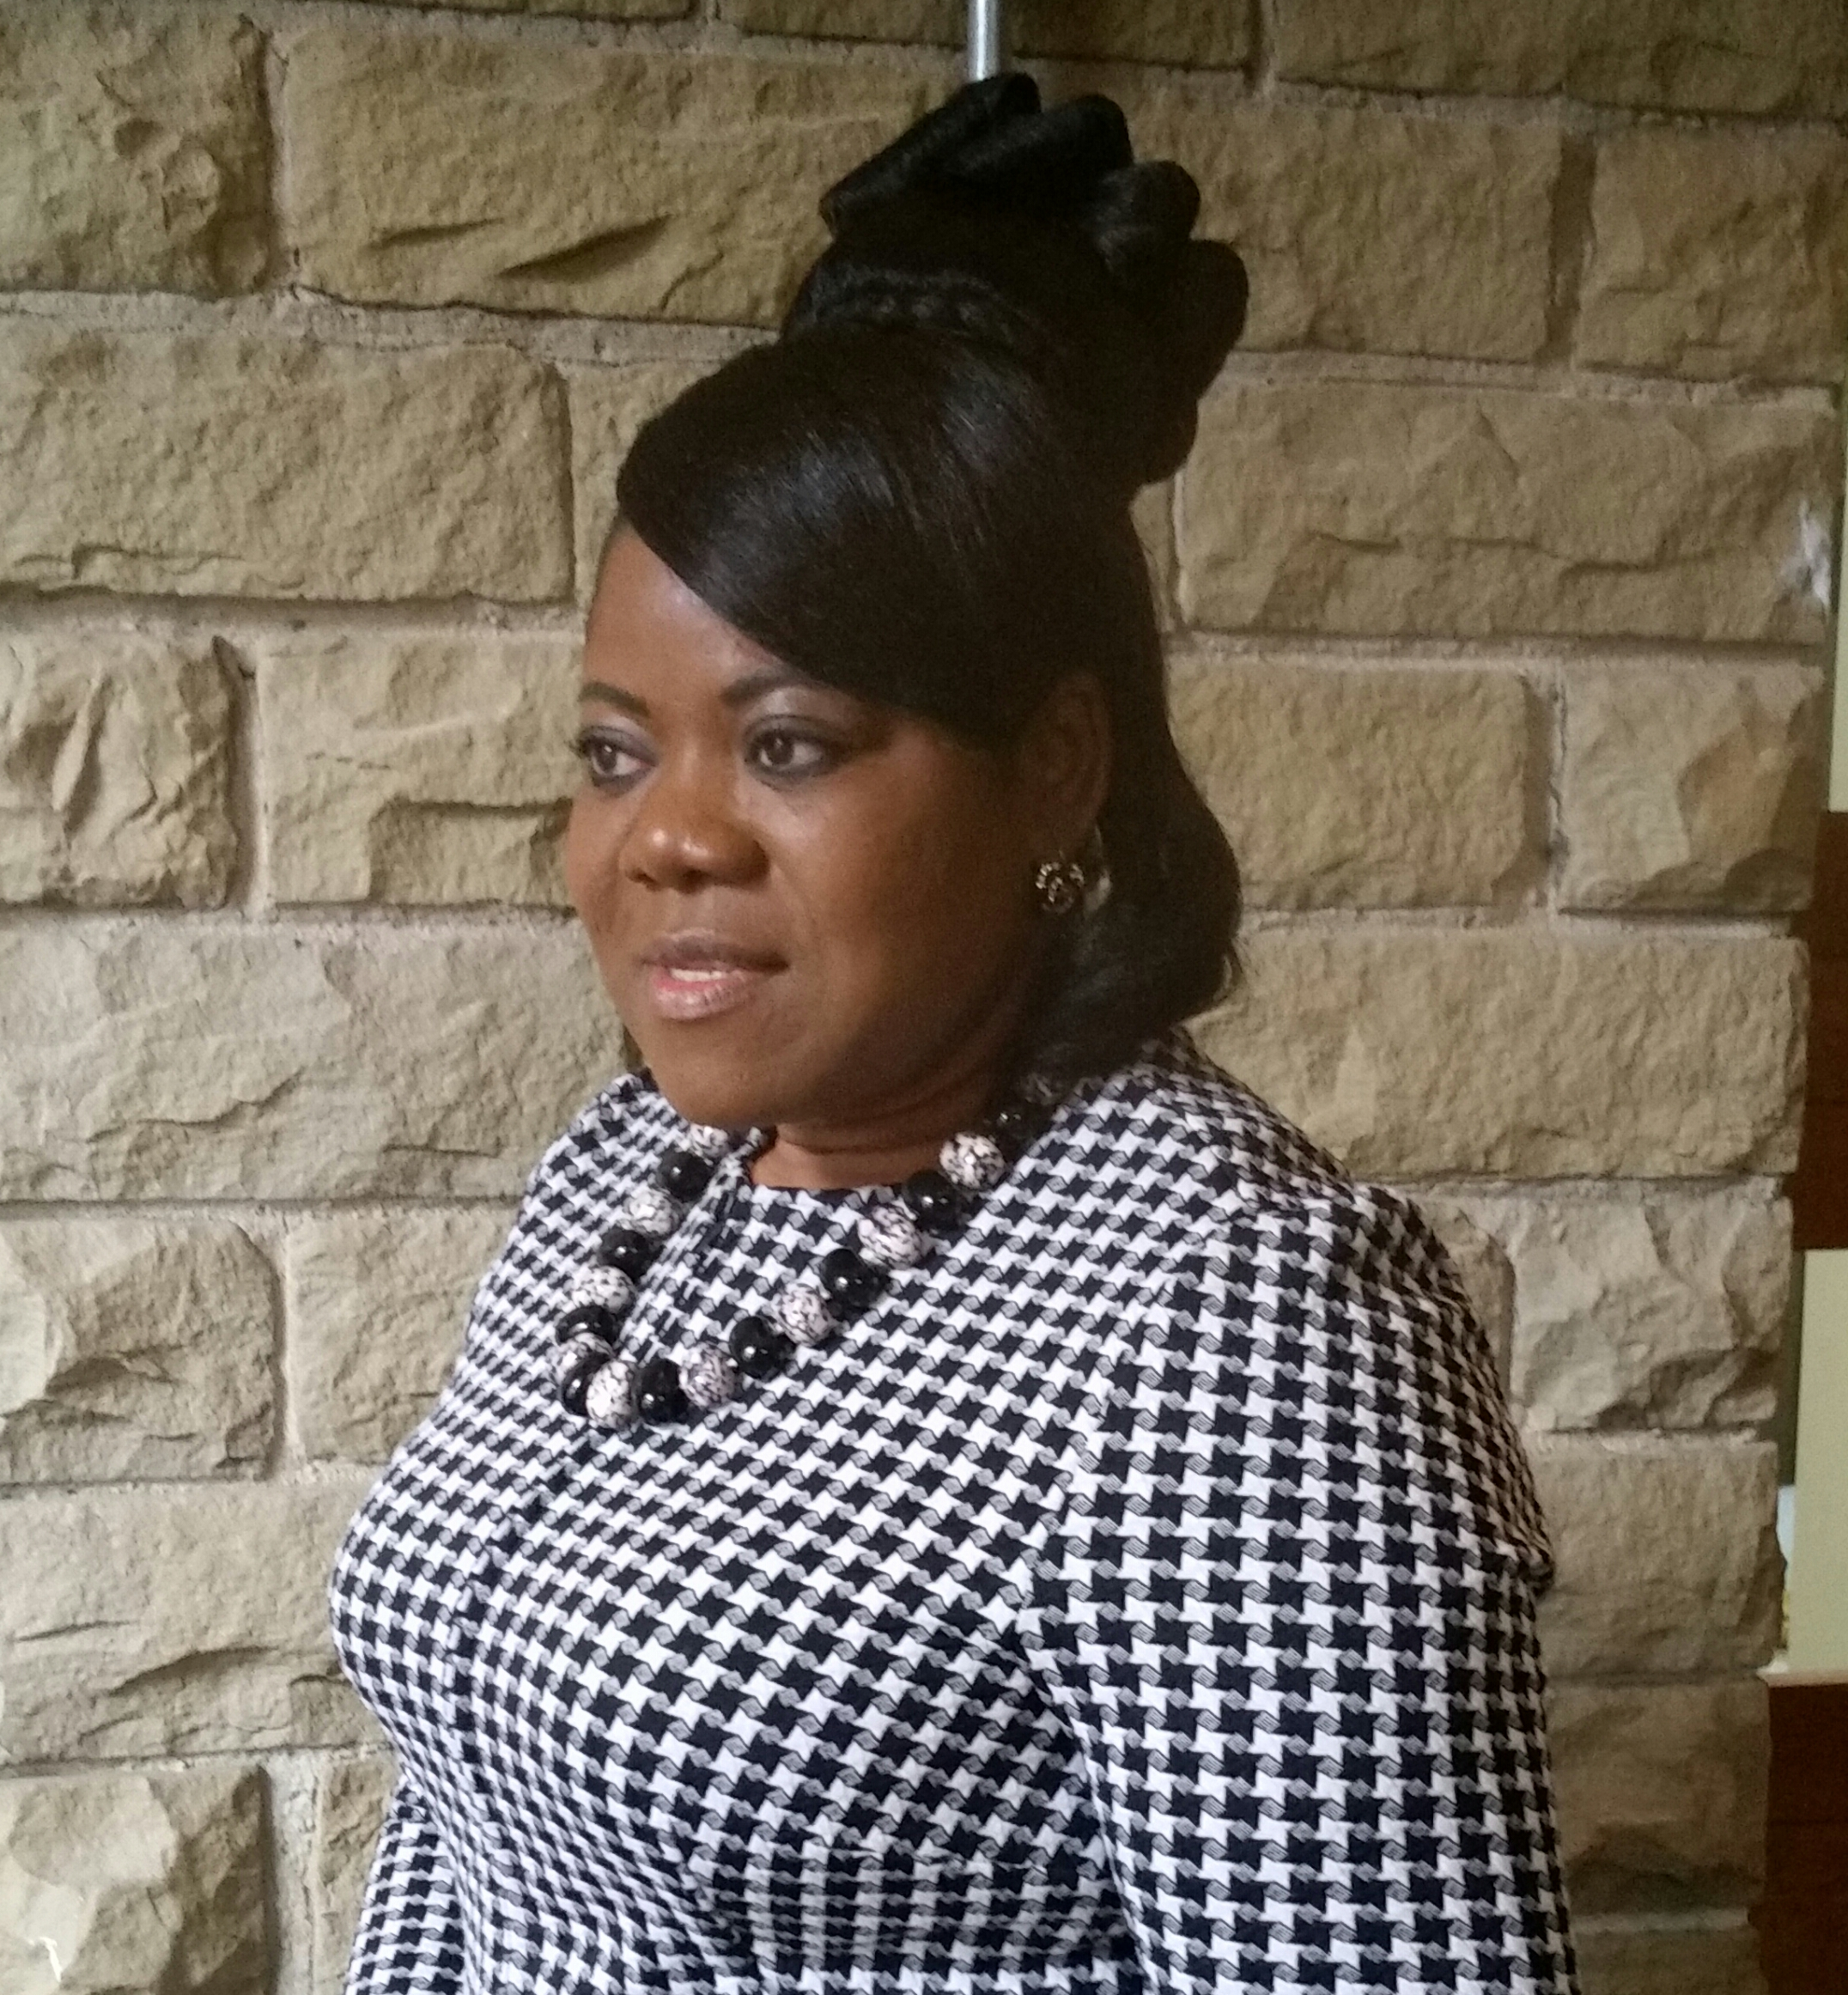
Chinyere Elewachi
Sam-Okerenta
An Exploration of Support Services for Black African and black Caribbean (BAC)
Female Breast Cancer Survivors in the UK: A Qualitative Study
sensitive service is not fully known (DoH, 2010). Research Questions
What are the lived experiences of BAC female breast cancer survivors in the UK in terms of accessing available support services? Are the information and support services for this group culturally sensitive to them?
Aims and objectives
To explore the lived experiences of the BAC female breast cancer survivors in the UK and examine if and to what extent existing information and support services are culturally relevant and sensitive to them.
To contribute to a broader understanding of how this group of women accesses available support services in the UK.
Research methods
This is a qualitative descriptive phenomenological study. Approximately, 10-15 participants will be identified nationally, purposively sampled and recruited from the targeted population through charity organisations using snowballing and self-referrals, flyers, website advertisement. Inclusion criteria include BAC female breast cancer survivors of 18years and above treated for breast cancer and have spent five months or more after active hospital management. Data will be collected through digitally recorded semi-structured interviews, transcribed and simultaneously analysed using Colaizzi (1978) descriptive phenomenology.
Expected contribution to knowledge
Currently, there is little UK cancer survivorship studies focused on BME breast cancer survivors; indeed, no studies currently exist that have explored the lived experiences of BAC female breast cancer survivors in the UK with regards to their access to information and support services. This study addresses this identified gap. It will also provide recommendations regarding possible strategies to improve access to support services among this underrepresented group of women; thus, could identify possible measures to reduce pressure on NHS.
Key references:
Cancer Research UK (2014 and 2016)
Breast Cancer Care(2014)
National Cancer Intelligence Network (2010).
Department of Health (2010)
Breast cancer statistics in the UK
-Most commonly diagnosed.
-Over 51,000 new cases annually.
-Causes over 11,000 deaths annually.
-Currently, 2.5 million people are living with cancer.
-Up to four million people will live with cancer in 2030 (Prediction) (Cancer Research UK 2014 and 2016).
UK Policies on Cancer
Cancer survival rates have improved over the past 40 years within the UK; thereby, putting pressure on the National Health Service. There is now a move towards encouraging self-management where possible and Breast Cancer Care (BCC), UK, endorses this. In 2010, the National Cancer Survivorship Initiative (NCSI) vision was: 'those living with and beyond cancer are supported to live as healthy and active a life as possible for as long as possible’ (NCIN, 2010). However, Cancer Support Centre (CSC) in Sheffield and the BCC have noted a significantly low uptake of their services by the Black Minority Ethnic (BME) women (BCC, 2014).
More so, the UK Independent Cancer Taskforce recommendations focus on reducing inequalities, improving cancer outcomes and access to health and social care. However, the BME especially, the Black African and Caribbean women's access to a culturally
Quality self-management Information
Good culturally sensitive Support
Improved quality of life; excellent breast cancer survivorship experience and good breast cancer outcome

