Slide 1

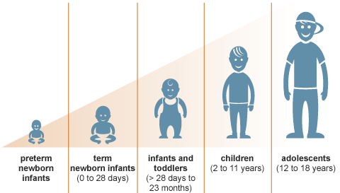
PEDIATRIC NUTRITION
BY
DR.ESSEL MENSAH RICHARD

Slide 2
OBJECTIVES
To recognize the changing nutritional needs of developing children, from infancy to adolescence.
To understand the need for nutrition for pediatrics.
Relate nutrition to growth and development in infants, children and adolescents.
Appreciate the essence of breastfeeding.
Understand nutritional guidelines for infants, children and adolescents.
disease, and osteoporosis.

Slide 3

INTRODUCTION
When choosing a colour for the child: IT’S ALWAYS A BLUE FOR BOYS & PINK FOR GIRLS
But when it comes to Nutrition for a Child, these differences fade away.
Right nutrition in early days of life is very important.

Slide 4

INTRODUCTION…
Adequate Nutrition is essential for lifelong health and well being.
Thus it is necessary to identify and correct any nutritional problems to avoid it to carry in next year of life.

Slide 5

WHY IS NUTRITION IMPORTANT?

Slide 6
Nutrition is important for …
Providing energy for our daily activities
Maintaining body functions
Growth and development
Therapeutic benefits
Healing
Prevention

Slide 7
Growth in Infants and Children
Growth refers to an increase in physical size of the whole body or any of its parts.
It is simply a quantitative change in the child’s body.
It can be measured in Kg, pounds, etc

Slide 8
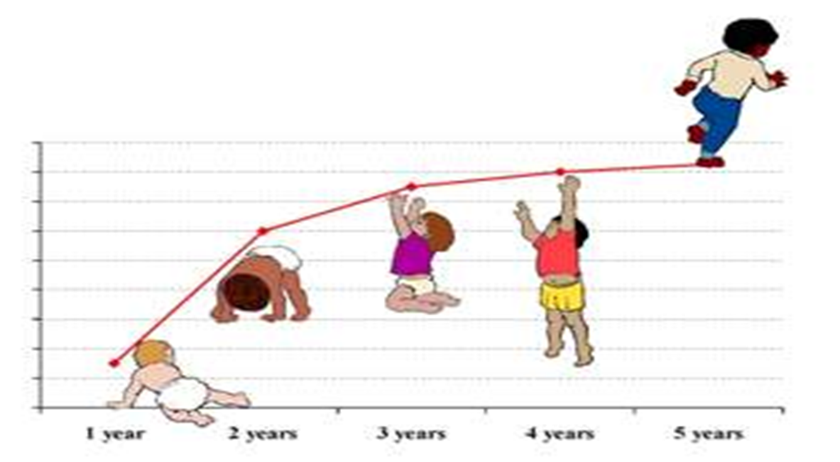
Child Growth (Image: WHO)

Slide 9
Development in Infants and Children
Development refers to a progressive increase in skill and capacity of function.
It is a qualitative change in the child’s functioning.
It can be measured through observation.
NB: Growth and Development are greatly influenced by nutrition

Slide 10
Feeding the Newborn
What are the options?
  Breast feeding
    Ghana Health Service (GHS) recommends exclusive breast feeding for 6 months.
  Formula feeding

Slide 11

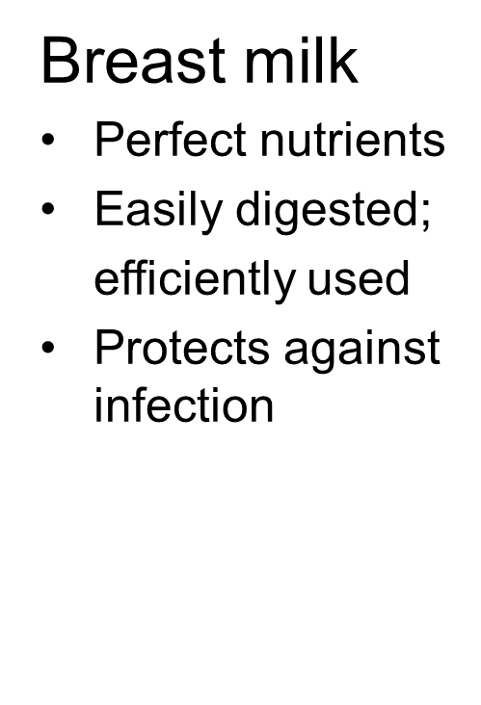


Advantages of breastfeeding to the child

Slide 12
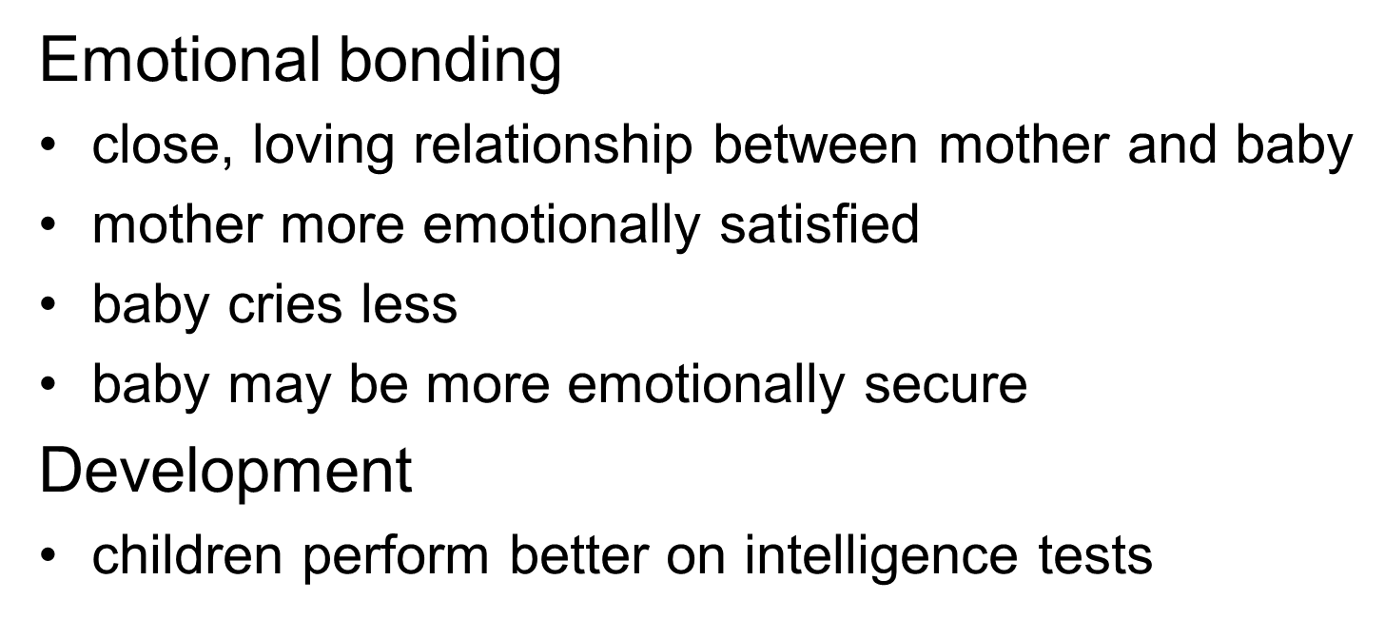
Psychological benefits of breastfeeding

Slide 13
Breast Feeding Advantages to Mothers
May delay return of ovulation.
Loss of pregnancy-associated adipose tissue and weight gain.
Suppresses post-partum bleeding.
Decreased breast cancer rate.

Slide 14
Disadvantages of artificial feeding
Interferes with bonding
More diarrhoea and persistent diarrhoea
More frequent respiratory infections
Malnutrition; Vitamin A deficiency
More allergy and milk intolerance
Increased risk of some chronic diseases
Obesity
Lower scores on intelligence tests
Mother may become pregnant sooner
Increased risk of anaemia, ovarian cancer, and breast cancer in mother

Slide 15
Infant Formula
3 Forms:
  Ready to feed - most expensive, does not require water.
  Concentrate - requires mixing with water in equal parts.
  Powder - requires mixing with water.

Slide 16
Composition of Standard Infant Formula
Caloric density: standard formulas contain 20 calories/oz (0.67 calories/cc).
Protein content: ratio of whey to casein varies-most are 60:40 similar to human milk.
Fat: most provide ~50% of calories from fat from saturated and polyunsaturated fatty acids.
Carbohydrate: lactose, beneficial effect on mineral absorption (Ca, Zn, Mg), and on colonic flora.
Micronutrients: Higher vitamin and mineral content than human milk to cover 97% of the population.

Slide 17
Special Formulas
Soy: used for vegetarians, lactase deficiency, galactosemia.
Lactose free: cow’s milk-based formula.
Protein hydrolysate: infants who can not digest or are allergic to intact protein.
Free amino acids.
Pre-term infant: unique for premise, predominant whey protein, cow’s milk based, higher protein and calcium,
Pre-term follow up

Slide 18
QUESTIONS

Slide 19
Nutritional Guidelines for Infants, Toddlers and Pre-schoolers
Infants should be exclusively breast fed for the first six months (wherever possible).
Also provides right amount of other nutrients which are easily digestible.
Solid food (Commentary foods ) has to be gradually introduced after 6 months along with breast feeding.
Never overfeed or force the child to eat.

Slide 20
Nutritional Guidelines for Infants, Toddlers and Pre-schoolers …
Provide adequate green leafy vegetable, other
vegetables and fruits for goods sources of vitamins, minerals (specially Iron) and fibre.
Provide enough dairy sources for calcium intake.
Provide food in a colourful and appealing way.

Slide 21
Nutritional Guidelines for School going children (6-12 years)
Provide variety in meals. Avoid monotony.
Encourage healthier options for snacks rather than fried and unhealthy snacks like crisps, fries etc.
School meals and packed lunches are very important part of daily nutritional intake.
Balance food with physical activity.
Set good examples for healthy eating habit.

Slide 22
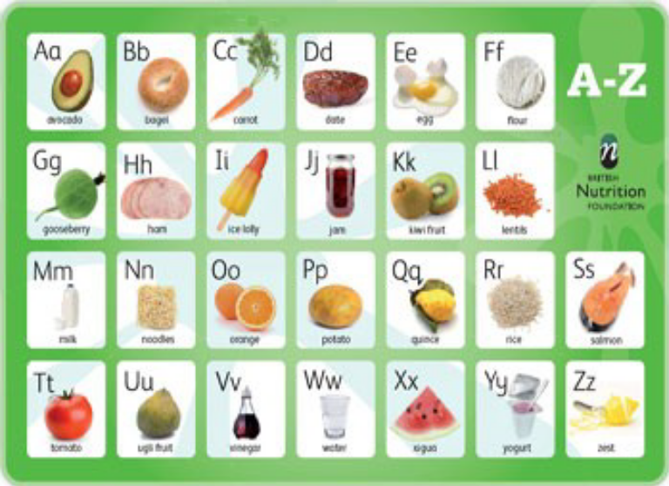
Nutritional Guidelines for School going children (6-12 years ) …
Provide plenty of grains, fruits and vegetable, low fat dairy products.
Moderate sugars and salt.
Involve the child in making food choices.

Slide 23
Nutritional Guidelines for Adolescents (12 to 18 years)
Choose diet low in salt, sugar, fat (saturated fats).
Choosing the diet with plenty of grains, vegetables, pulses, dairy products.
Consume balanced and small frequent meals with lot of variety in them.
Involve the adolescent in making good choices as well as preparations of healthy food.
Drink less of sugar-sweetened beverages (e.g., soft drinks, sport drinks, fruit drinks, etc.)

Slide 24
QUESTIONS

Slide 25
BIOGRAPHY
I am 33years of age, a Ghanaian born citizen, married, father of three lovely children and a graduate from the University of Ghana Medical School in Legon, Ghana with MB ChB. I am a Junior Health Paediatric Doctor with the Komfo Anokye Teaching Hospital under the Ghana Health Service.

