Slide 1
Carbohydrate Counting in diabetic patient
Prepared by:dietitian: Kawther Bageas
Master degree in clinical nutrition & health

Slide 2
definition
It is a meal planning approach used with patients who have diabetes that focuses on carbohydrate as the primary nutrient affecting postprandial glycemic response.

Slide 3
By CHO COUNTING:
The pt. will be able to better manage the glucose level.
Will be estimate how much insulin will be needed.
It will help keep the blood levels of glucose within the target range.
Can be used by patients with type 1, type 2, and GDM.

Slide 4
Who should learn cho counting??
Patient who:
Ability to perform basic math.
Looking at education level.
Conception & knowledge of portion control.
Willingness to do blood glucose monitoring before and after meals while learning the system.
People who plan to use an insulin pump.
Age.

Slide 5
Nutrient categories
Can slow down carbs digestion.
FAT
PROTEIN
Nutrient categories
CARB
100% of carbs break down into blood glucose within 2hrs. After eating
Generally contain little carbs.

Slide 6
Note:
Protein eaten in small portion DOES NOT affect blood glucose.
Protein can have an effect on the blood glucose if eaten in large amounts.
If the protein is more than 3 OZ, may the pt. need to do more frequent blood glucose testing after the meal.
Notes:
If protein serving is larger than the palm of the hand and wider than the deck of cards, it should consedares effect on the body sugar.

Slide 7
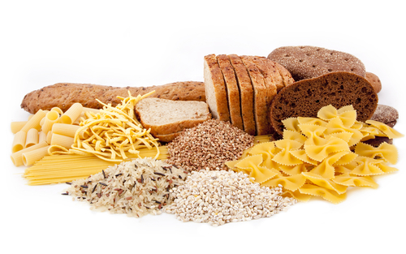
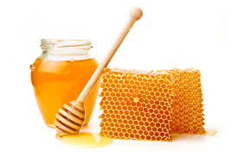
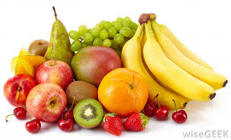
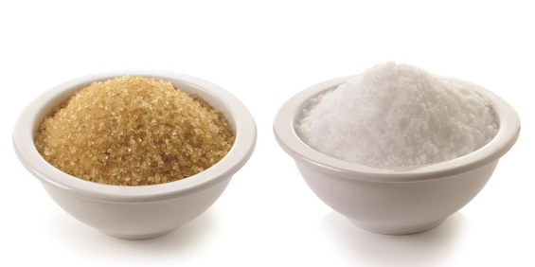
Sources of cho
Complex carbs:
like rice, pasta, cereal, bread…
Natural sugar:
like milk, yoghurt, honey and fruits…
Added sugars:
like sugar in sweets, deserts,
canned juiced…

Slide 8
Carbohydrate counting is based on two ideas:
1- Eating equal amounts of sugar (such as fruit or, on occasion, candy) or starch (such as bread or pasta) will raise blood sugar about the same amount.
2- Carbohydrate is the main nutrient that effects blood sugar. Within one to two hours after eating carbohydrate, most of it is changed to blood sugar. Protein and fat have much less effect on blood sugar.
The key to remember is that the amount of carbohydrate eaten
(whether sugar or starch) will determine how high the
blood sugar level will be after a meal or snack.

Slide 9

1 Starch serving
=
=
15 gm CHO
1 Fruit serving
=
=
15 gm CHO
1 Milk serving
=
=
12 gm CHO
1 Veg. serving
=
=
5 gm CHO
1 Sugar serving
=
=
5 gm CHO

Slide 10
Cho gram counting
Exchange list | Carbohydrate (gm) | Protein (gm) | Fat(gm) | Calories
Starch/bread Meat Lean Medium fat High fat Vegetables Fruit Milk Skim Low fat Whole fat Fat | 15 - - - 5 15 12 12 12 - | 3 7 7 7 2 - 8 8 8 - | 0-1 3 5 8 - - Trace 5 8 5 | 80 55 75 100 25 60 90 120 150 45

Slide 11
Remember that carbohydrates are not bad – they are the body’s main energy source.
Selecting healthy carbs and monitoring the protein size will provide the body with valuable nutrients.
This will help the avoid wt. gain

Slide 12
Carbs counting methods
Each 15g serving is equal to 1 exchange or carbs choice.
Carbohydrate Exchange system:
this system is based on counting serving of food that contain 15g of carbs.
Carbohydrate gram counting:
it is consists of adding up the exact number of grams of carbs in each meal.
Carbohydrate counting tools:
1. the carbs counting guide. ( ADA EXCHANGE LISTS FOR MEAL PLANNING )
2. web sites or applications.
3. Measuring cups.
Food labels, food lists and meals planning books
Notes:
Are great tools for carbs gram counting.

Slide 13
Patients Essential Tools:
Measuring cups for liquids & solids:
1cup = 240ml
Measuring spoons:
1 tablespoon = 15gm
1 teaspoon = 5gm

Slide 14
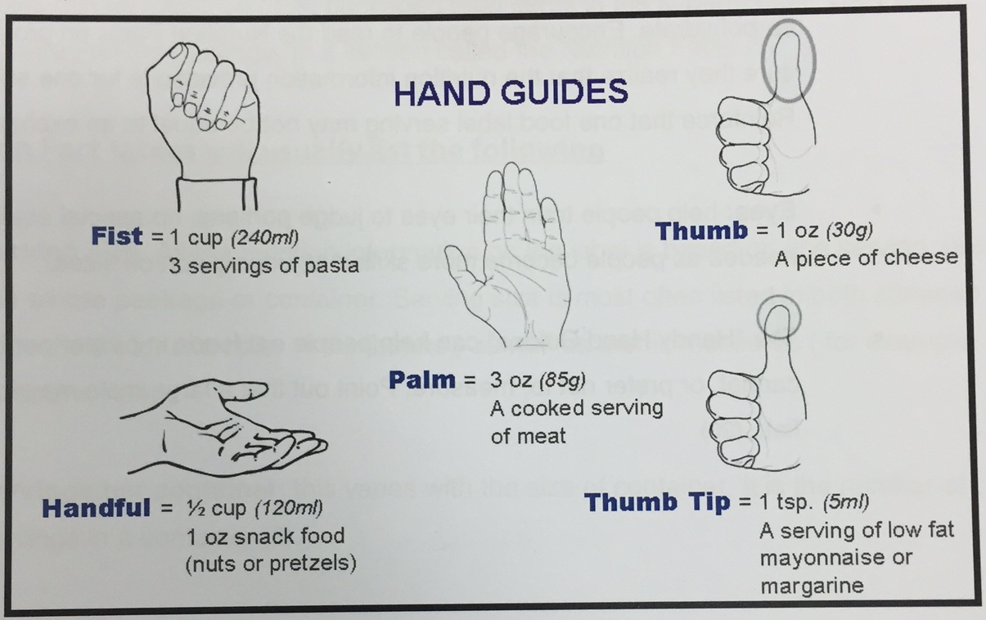
Food models:

Slide 15
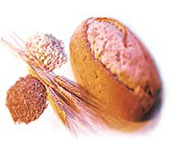
carbohydrate Exchange system:
Starch & bread list = 15gm cho
Cooked rice 6 spoons
Cooked macaroni 8 spoons
Brown/white bread 1 slice toast
¼ loaf
½ samoli
Potato baked 1 medium
Corn flakes 1/2cup

Slide 16


Vegetables list = 5gm cho
½ cup cooked vegetables or vegetable juice
1 cup of raw vegetables
1 large tomato
Fruit list = 15gm cho
one medium orange 12 pc. Grapes
one small apple one kiwi
½ banana ½ cup juice
3 dates ¾ cup mandarin
4 apricot 1/3 cantaloupe

Slide 17
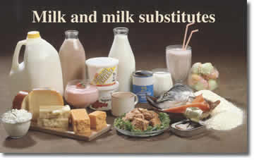
Milk list = 12gm cho
The milk is divided into 3 parts based on the amount of fat and calories:
Skim milk (1cup)
Low fat milk (1cup)
Whole milk (1cup)

Slide 18
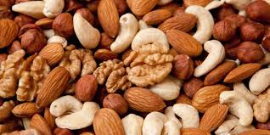
Nuts:
40 pieces kajo 12g carbs
4 tablespoon Sesame 15g carbs
¼ cup Humos 17g carbs
1 cup Pistachio 13g carbs

Slide 19
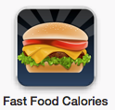
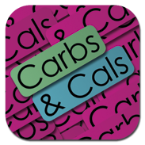



Smart Phone Applications
Carb master
Website
Nutritiondata.self.com

Slide 20
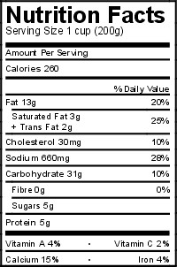
Reading food labels
1st check for quantity of
the serving
2nd check total CHO in
a serving
Finally, identify the amount you will eat

Slide 21
Calculation of cho
50-55% carbohydrate
15-20% protein
30% fat
For example:
1800 × 0.55 = 990 ÷ 4 = 247.5 gm carbohydrate
1800 × 0.15 = 270 ÷ 4 = 67.5 gm protein
1800 × 0.30 = 540 ÷ 9 = 60 gm fat
Then distribute these nutrients in meals per day (5-6 meals)

Slide 22
For example:
1800 × 0.55 = 990 ÷ 4 = 247.5 gm carbohydrate
Total kcal/d = 1800
Total carbs/d = 247.5 gm
Breakfast = 77.5 gm
Lunch = 77.5 gm
Dinner = 77.5 gm
Snack = 15 gm
15gm or less carbs in Snacks
No need insulin

Slide 23
Calculate cho ratio
450
TDD
Insulin: Carbs Ratio =
SO, every………. Gm of cho need 1 unit of rapid-action insulin
e.g:
TDD IS 42 UNITS.
450/42 = 10
SO, carbs ratio is 1:10

Slide 24
Ahmed has as insulin to carbs ratio of 1:12.
He eats a breakfast that has 60g carbs in it. How much insulin is he going to take to cover the carb in the meal?
60g / 12 = 5 units of insulin.
So, Ahmed will take 5 units of insulin to cover the 60g carb meal.

Slide 25

There will be times when the pts. Blood glucose is higher than his pre-meal target when he needs to have a meal.
What should he/she do ?

Slide 26
Insulin sensitivity factor or correction factor
It tells how much additional rapid-acting insulin the pt. needs to get his blood glucose back to the pre-meal target level.
The ISF depend on how sensitive a person is to insulin.

Slide 27
Remember:
A person may have more than one insulin to carb ratio (e.g. a ratio of 1:10 for breakfast; 1:12 for lunch; 1:15 for dinner) based on PA, or insulin needs…
The ratio may change with body weight, variation in PA, and hormonal changes.

Slide 28
1700
TDD
ISF =
EXAMPLE:
Mona’s TDD IS 35
SO, ISF =
1700/ 35 = ~ 50
This means that 1 unit of rapid-acting insulin lowers her blood glucose by 50 mg/dl, and her ISF = 1:50

Slide 29
correction factor
Correction dose =
( actual blood glucose ) – ( target blood glucose )
ISF
Fasting BS | BS before meal | BS after 2hrs of meal
90 - 110 | 110 - 130 | 140 -160

Slide 30
Example:
Mona checks her blood glucose before dinner, and it is 225 mg/dl. To find out how much she needs to lower her blood glucose to get her target ??
Her ISF = 1:50
( 225 – 110 ) / 50 = 115 / 50 = 2.3 units of insulin

Slide 31
Hypoglycemia
( low blood sugar )
low blood sugar reactions maybe caused by the followings:
Exercising without reducing the amount of insulin OR not eating enough food.
Overestimating the amount of insulin or not eating enough food to compensate for the exercise.
Overestimating the amount of insulin needed to cover the food eaten.
Skipping or delaying meals.
Alcohol consumption.

Slide 32
What about a pre-meal low blood glucose ??
It has 2 options:
Taking less insulin. ( -1 to 2 units )
Eating more carbs at the meal. ( add 15g more )

Slide 33
Fiber effect
Pt. with type 1, 2 or insulin pump therapy should be taught how increase the intake of fiber and must be include meals with greater than 5g of fiber.
This because the grams of fiber from the total carbs count are for the most part not digested and are not absorbed as glucose.

Slide 34
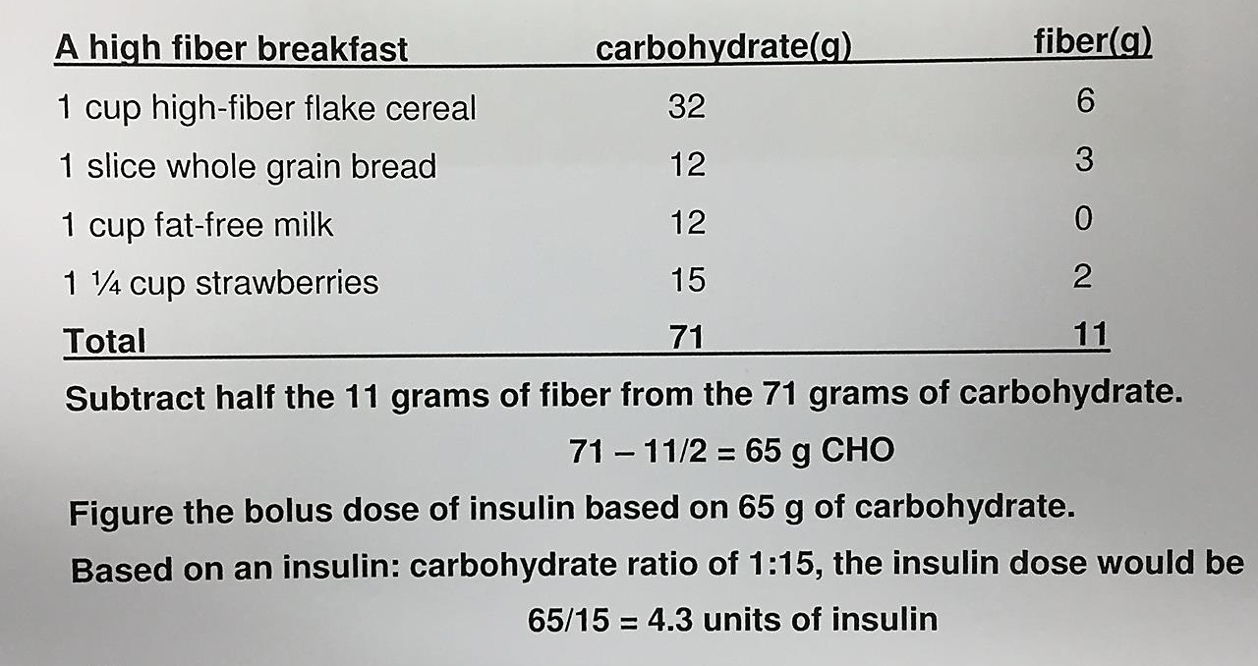
An example of how to teach fiber intake :

Slide 35
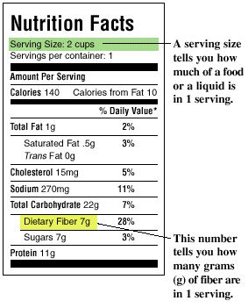
Dietary fiber on nutrition labels
if there are more than 5 grams of fiber in a serving of a food, subtract the extra grams of fiber from the total cars grams per serving.
The recommended daily value for fiber intake is approximately 25 grams per day.

Slide 36
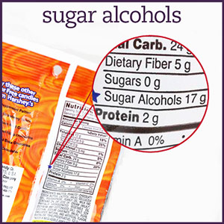
More on nutrition labels
sugar- free ( sugar alcohols ) label:
- Are a group of sweeteners found in sugar- free food.
- Sugar-free doesn’t mean carbohydrate free.
Examples:
Sorbitol, mannitol, and xylitol.
Sugar alcohols may have an effect on glucose levels and do contain fewer calories than sugar.
They don’t have any advantages in improving overall diabetes control.

Slide 37
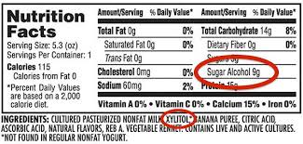
Note:
Sugar alcohols WILL contain carbohydrate.
Sugar alcohols WILL affect blood sugar.

Slide 38
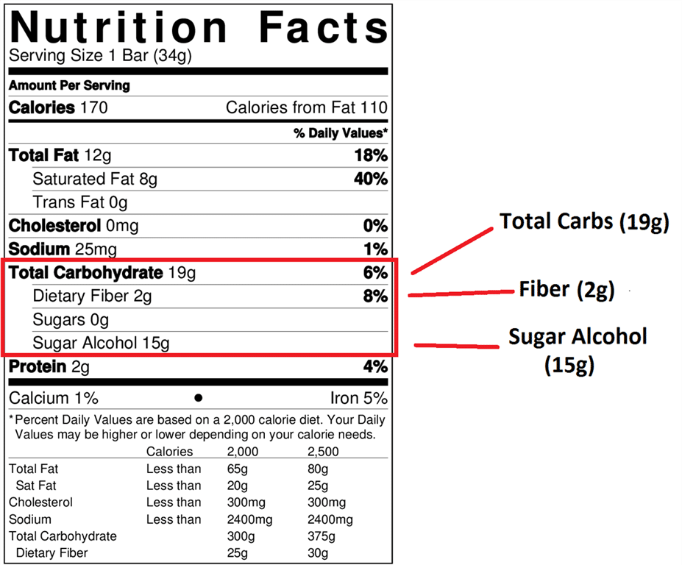
If sugar alcohols are greater than 10 grams per serving, it may able to deduct half the number of grams from the total carbohydrate found on label.

Slide 39
Non- calories sweeteners:
- are added to foods to reduce sugar and calories.
- These sweeteners have NO EFFECT on glucose (sugar) level.
There are currently 5 FDA- approved sweeteners:
saccharin.
Aspartame.
Acesulfame K.
Sucralose.
Neotame.
There found in diet drinks, light yogurt, and sugar-free gelatin desserts, and pudding

Slide 40
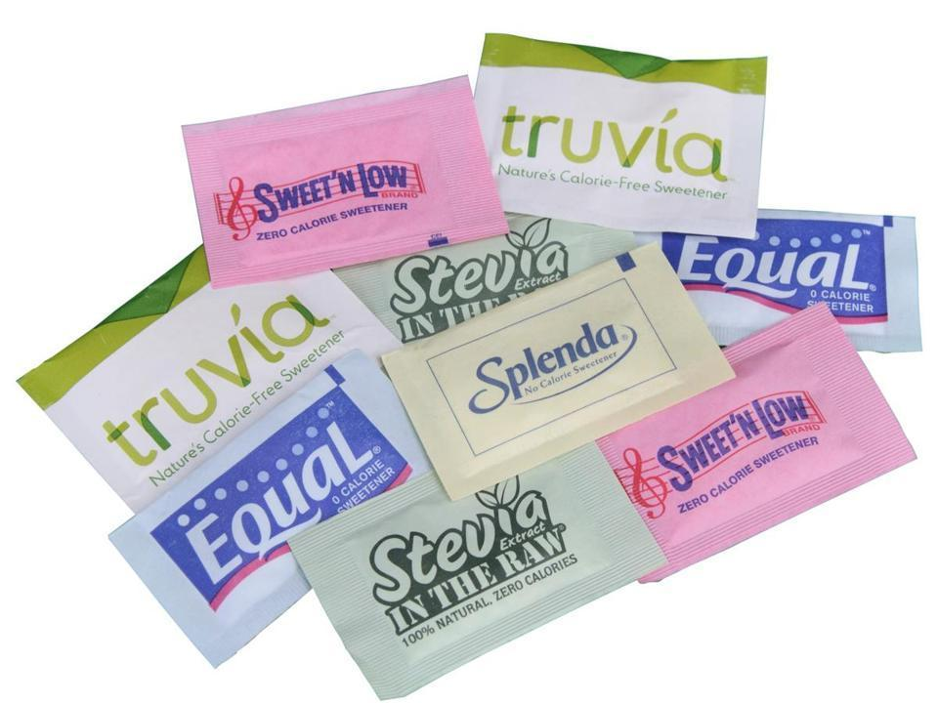
Note:
Non- calorie sweeteners DO NOT contain carbohydrate.
Non- calorie sweeteners DO NOT affect blood sugars.

Slide 41
Carbohydrate counting tips
eating out.
Weight gain.
Healthy eating. ( high fiber consumed )

Slide 42
Alcohol beverages:
Pure alcohol alone DOES NOT raise blood glucose
NO BOLUS INSULIN IS NEEDED
In fact, alcohol can increase the risk of hypoglycemia, because:
The liver cannot make glucose while it is processing alcohol.
Alcohol can prevent the body’s normal protective mechanisms from working if the blood glucose falls while drinking alcohol.
Notes:
For 1 litter of alcohol ( 110 g )

Slide 43
Typically, less insulin is required per gram of carbs when drinking alcohol.
Giving a bolus for carbs when drinking should be done very carefully because of the increase risk of low blood glucose.
Tips:
Never drink alcohol on an empty stomach.
Low carbs alcoholic drinks can usually be added to normal meal plan.
Additional blood glucose testing is recommended when consuming alcohol.

Slide 44
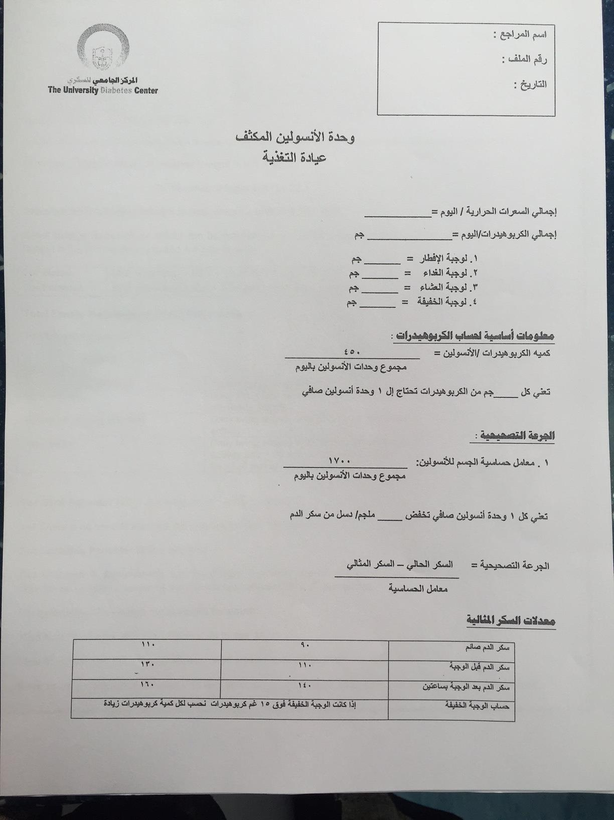
Attachments

Slide 45
