Slide 1

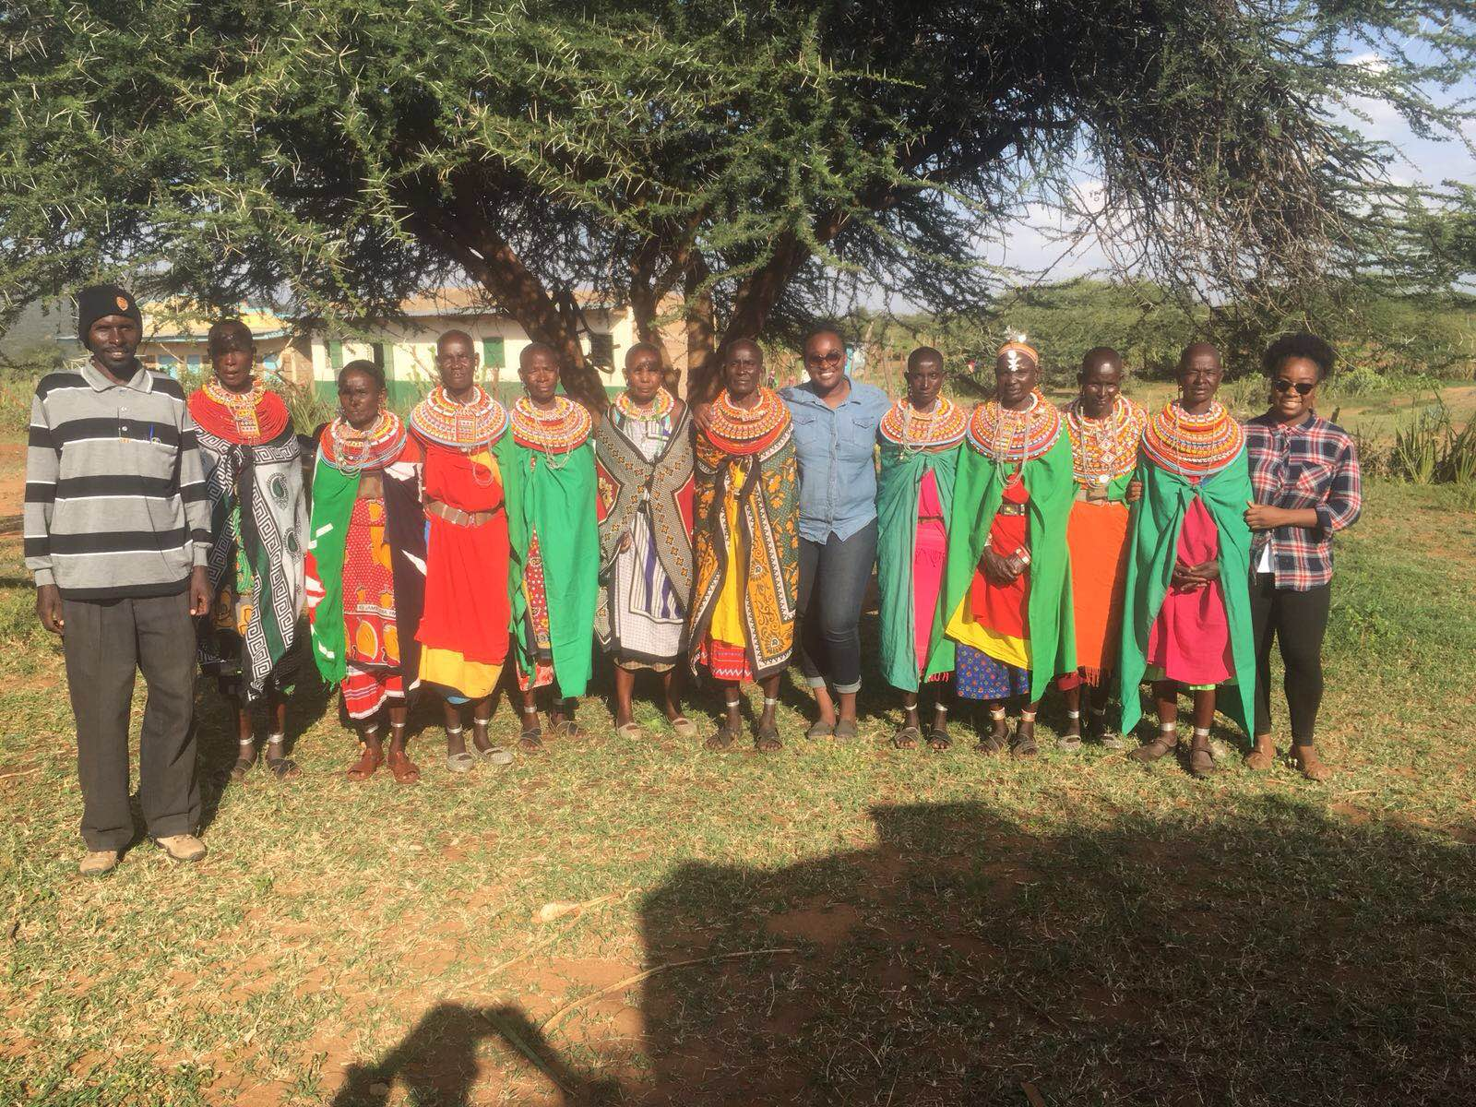
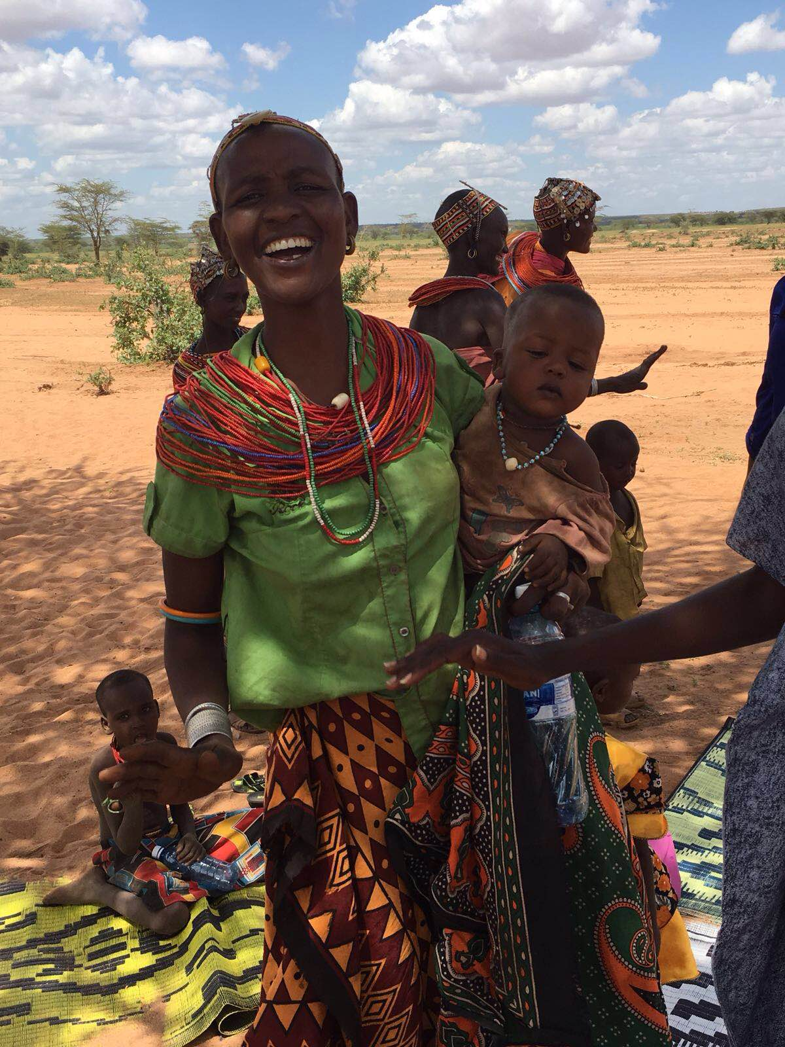
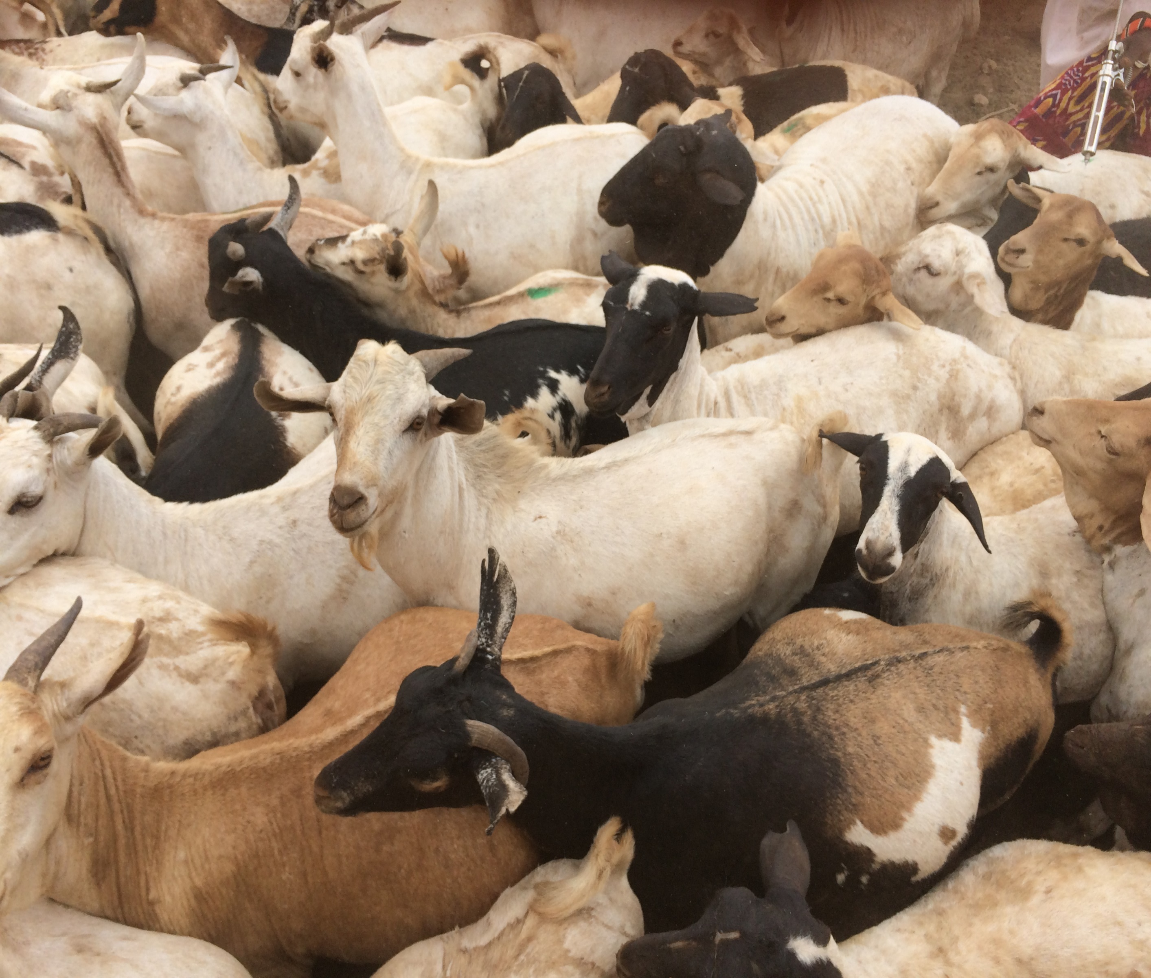
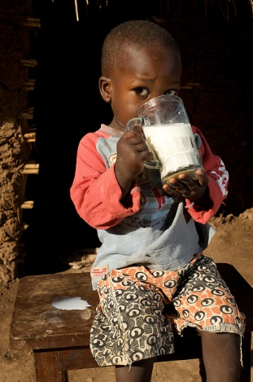


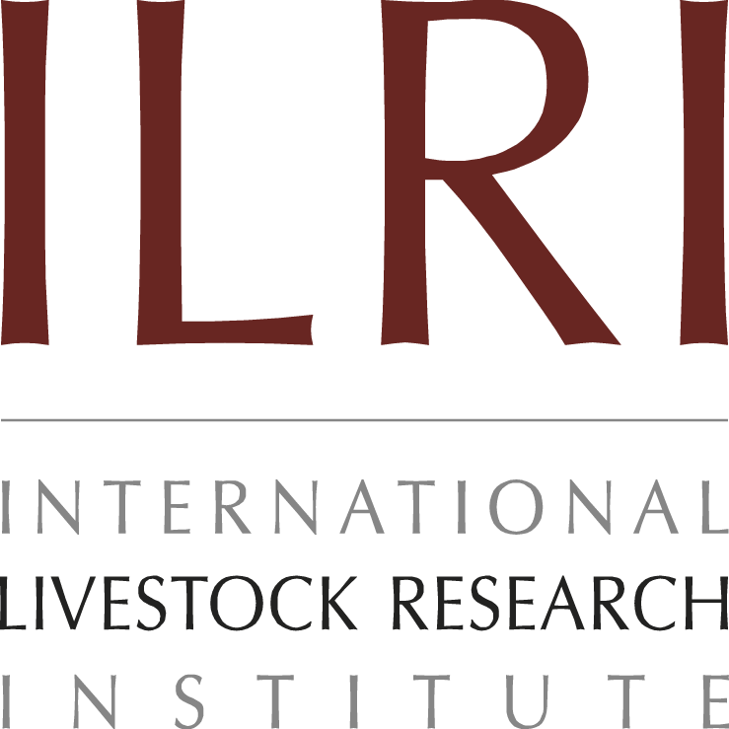

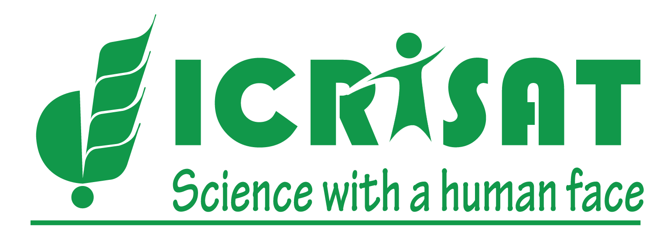

This project is part of the U.S. Government’s global hunger and food security initiative
November 2017
Background Study on Empowering Women through Investment in Livestock Value Chains: A Pathway for Improving Maternal and Child Nutrition in Northern Kenya
Adere, W., Roach, T., Kotutt, J., Beda, A., Lains, G., Patel, K., Webb Girard, A.
Background
There is growing interest in approaches that improve women’s engagement in livestock value chains, their impact on women’s empowerment and maternal and child nutrition (MCN). Strategies to enhance women’s participation in livestock production, marketing, income control, time management, group participation and nutrition education on consumption of Animal Source Foods (ASF) can be powerful in improving the diets of women and children. This study in Marsabit and Isiolo, was aimed at understanding how empowerment of women through livestock interventions can enhance MCN. The objective of the study was to understand the pathways through which livestock influence women’s empowerment and MCN.
Methods
Data was collected through observation and 66 focus group discussions with 660 purposively selected participants and subjected to content analysis
Pictures
Findings
Women are responsible for time-consuming activities (search for fodder, firewood and water) that affect MCN and market participation. Barriers to women’s market participation include distance, household responsibilities, theft, harassment and discriminatory pricing. Men predominantly control the sale and income earned from live animals, whereas women control the sale and income earned from livestock products (milk, meat, eggs). There is variability across communities on expenses for household and health needs. Mostly men make final decisions on large costs (e.g. school fees) whereas women make them for small costs (e.g. food). Factors that influence households’ ability to purchase or consume ASFs included income, climate, distance, availability, culture, and women’s income control.
Conclusion
Women’s empowerment domains identified include livestock products and market participation. Increased women’s engagement in production and sale of livestock products can improve feeding practices, and the nutritional status of communities.
This document is licensed for use under the Creative Commons Attribution 4.0 International Licence. AUGUST 2016

