Slide 1



Journal Club Presentation
Noora Abdulmajid
Charge Nurse of Nursing Education Unit
Dubai Hospital-Dubai Health Authority

Slide 2

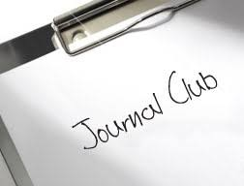
Objective
Introduction
Historical Background
Important to attend the Journal Club
Successful features of Journal Club
Benefits of Journal Club
Evaluation Criteria for Journal
Unit Distribution Plan
Conclusion
References
2

Slide 3

Introduction
A journal club it is involvement of a group of specialists, experts or professional typically in health-related fields, who meet to discuss, debate and analysis or critique investigation or research articles (Diaz and Walsh, 2018).
Thus, journal club have a very potentially operated in a very in health fields in order to help the professional to be updated with current evidence based practice in their healthcare work environments (Diaz and Walsh, 2018).
3

Slide 4
Introduction
According to Diaz and Walsh (2018), journal club will enhance the health care professional to be more capable in analyzing and solving the problem related to their workflow and more prompt in resolution making by implementing new research or investigation to find out solutions for the clinical practice and situation.
The connection between investigation and scientific training befalls at the bedside with straight enduring or client care, and making these connections is an expectation of clinical nursing practice. Critical appraisal of current research is a vital competence for nurses and is regarded by medical professionals as the standard for healthcare (Diaz and Walsh, 2018).
Despite this, journal clubs are commonly underutilized in recognized nursing learning and education (Diaz and Walsh, 2018).
4

Slide 5

Historical Background
British Surgeon Sir James Pagetdid the background of conducting the journal club in 1835 when he had a small corner into some of the baker shop near by the hospital where he used to sit and read about journals (Bowles et al., 2013).
In 1875, William Osler credited the first establishment of journal club is organized in McGill University (Bowles et al., 2013).
5

Slide 6
Historical Background
Professor Mattingly of Exeter University wrote one of the first articles about journal clubs as an: ‘introduction to the systematic use of medical literature’ for junior staff, and ‘a convenient method of surveying the medical literature’ for senior staff (Mattingly, 1966). Since then journal clubs have been widely used to keep abreast or up to date of the current literature(Bowles et al., 2013).
In the 1990s the concept of evidence based medicine was introduced, defined as the careful, clear, and sensible use of current best evidence in making decisions about the care of individual clients.
The skill of critical evaluation and the ability to use the current evidence base in medical practice
has evolved, with journal clubs being integral or essential to this process (Bowles et al., 2013).
6

Slide 7


Important to attend the Journal Club
The journal club it has the potential connection in investigation or research into clinical practice by reinforcements of critical review of the current medical literature and it will act as great inputs for application of evidence-based practice in medical education as well it can increase the networking and debating between the individuals and their colleagues (Gemayel and Martin, 2019)
Conducting the journal club in clinical fields help the coworker to develop and improve their critical appraisal skills and thinking as well as it will progress the skill competence in work environments in the healthcare organization (Gemayel and Martin, 2019).
7

Slide 8
Successful features of Journal Club
The successful and good journal should take into consideration of setting the time convenient for the members, attendance compulsory of the group members, healthcare professional must share the clinical information, designing the team leader who can possesses or owns research experience and guiding the club members in their choice of journal articles (Gardner et al., 2016)
The club should has clear purposes that can be agreed by all members and periodically reviewed, the articles selected for discussion are aligned with the agreed ‘overall aim’ of the club and of clinical relevance to the members, Original articles are the most frequent papers discussed and The papers are read in good time before the meeting. Circulating the subject matter by email or the internet are effective ways to do this (Gardner et al., 2016)
8

Slide 9

Benefits of Journal Club
The reimbursements or benefits of journal clubs in both professional and educational settings are extensively documented as a way to raise or increase awareness of research, investigation and evidence-based practice, develop professional reading habits and appraising skills, improve critical thinking, and promote a shared knowledge base via interdisciplinary collaboration (Diaz and Walsh, 2018).
1- Critical appraisal skills are developed
2- Participants keep abreast of current medical literature
3-Research literacy and evidence-based practice are developed
4-The needs of continuing medical education are met
5-Interview skills are developed
6-Academic debate is stimulated
7-Intradepartmental social and professional networking take place
8- Publications are generated (e.g. letters to editor, further research)
9

Slide 10

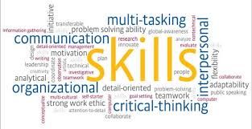
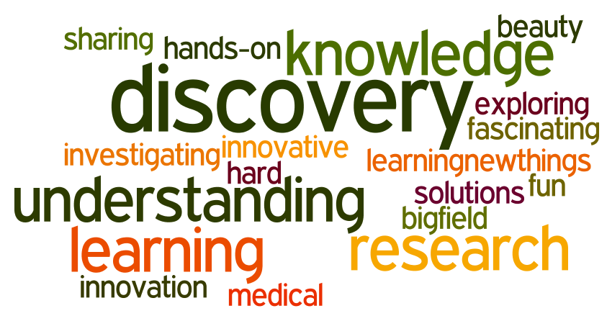



Journal Club
Nursing Education Unit
Dubai Hospital

Slide 11
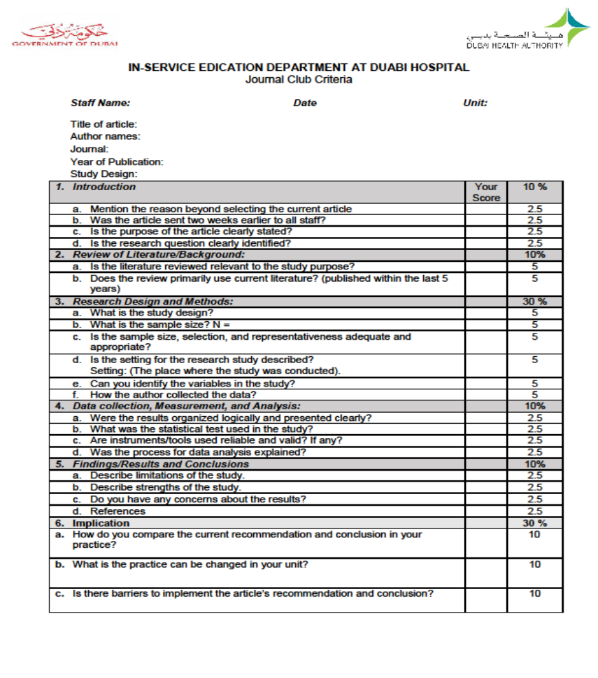
Evaluation Criteria for Journal
11

Slide 12

Unit Distribution Plan
12

Slide 13
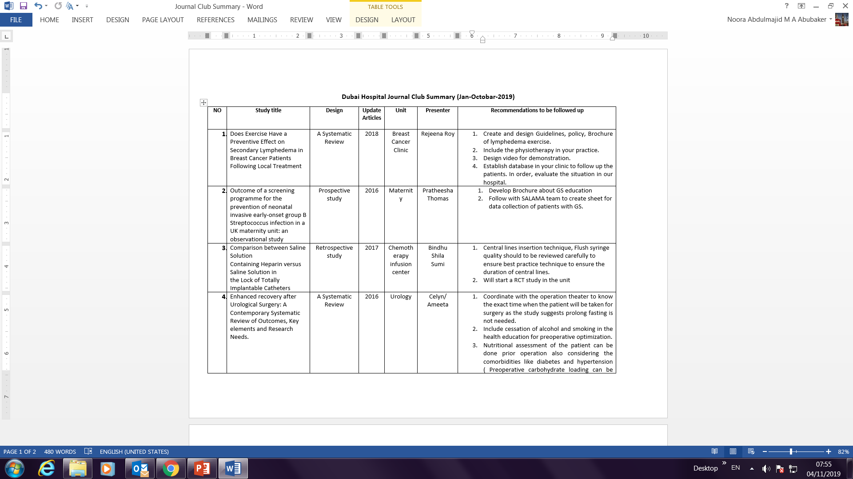

Slide 14
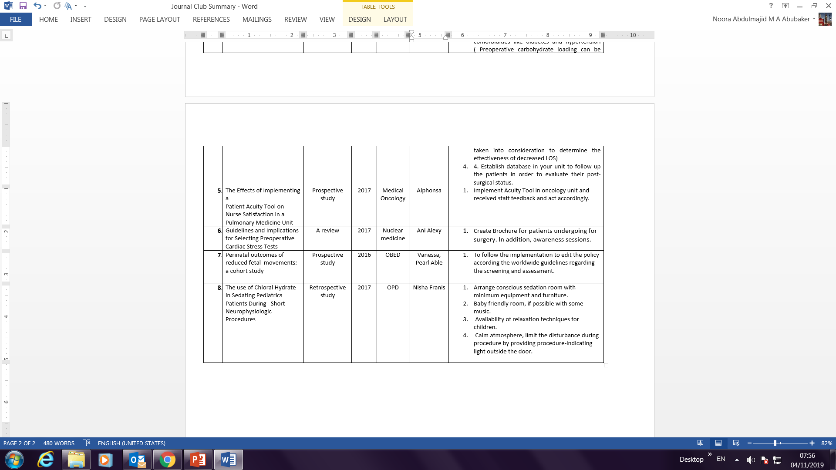

Slide 15
Conclusion
A journal club can be well defined as a group of individuals or members who meet frequently to discuss or debate about critically the clinical applicability of research or investigation findings from the current healthcare literature in the health care organization (Foronda, Hudson and Budhathoki, 2017).
The journal can be also define as a convene nursing staff gathering to share or discuss the knowledge that used from the research or investigation in the clinical nursing practice based on the study they presented or the clinical gab in their work environments (Foronda, Hudson and Budhathoki, 2017).
As it was mention in the background of organizing the first journal club in McGill University in Canada, by William Osler since 1875, thus the method was having a long tradition way of presenting the healthcare education and research (Foronda, Hudson and Budhathoki, 2017).
15

Slide 16
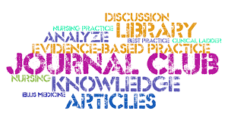
Conclusion
Besides, so many studies have been taken into consideration the potential benefits of conducting the journal club from 1995 to 2013 and all these studies indicate that journal clubs enhance the individual’s familiarization with scientific or systematic papers and skills associated to reading and evaluating related information (Foronda, Hudson and Budhathoki, 2017).
Furthermore, Journal club can promote encourage the dissemination or broadcasting of research finding as well it was found as an effective operative teaching method for healthcare professionals in several ways, specifically by:
• updating the professional knowledge
• promoting critical thinking
• improving critical appraisal skills through assessing the validity and applicability of the scientific literature
• increasing the use of literature in clinical practice and
• influencing changes in daily practice
16

Slide 17
References
1-Bowles, P., Marenah, K., Ricketts, D. and Rogers, B. (2013). How to prepare for and present at a journal club. British Journal of Hospital Medicine, 74(Sup10), pp.C150-C152.
2-Diaz, S. and Walsh, A. (2018). Promoting Evidence-Based Practice and Information Literacy through an Undergraduate Nursing Journal Club. Pennsylvania Libraries: Research & Practice, 6(1), pp.23-38.
3- Foronda, C., Hudson, K. and Budhathoki, C. (2017). Use of Virtual Simulation to Impact Nursing Students’ Cognitive and Affective Knowledge of Evidence-Based Practice. Worldviews on Evidence-Based Nursing, 14(2), pp.168-170.
4- Gardner, K., Kanaskie, M., Knehans, A., Salisbury, S., Doheny, K. and Schirm, V. (2016). Implementing and Sustaining Evidence Based Practice Through a Nursing Journal Club. Applied Nursing Research, 31, pp.139-145.
5- Gemayel, R. and Martin, S. (2019). How to prepare and deliver a great talk. The FEBS Journal, 286(1), pp.39-45.
6- Kost, T. (2017). POP Talk: Prepare, Organize, Present. BioProcessing Journal, 15(4), pp.4-5.
17

Slide 18

The End

