Slide 1

2017 and Beyond:
Trends, Data Analytics and Population Health: Engaging Nurse Practitioners at Stakeholders
Faisal Aboul-Enein, DrPH, RN, FNP, FACHE
Faculty Member
School of Nursing
Walden University

Slide 2
Predicting healthcare and population health management trends is somewhat difficult due to the unknown variables.
How the Supreme Court rules on the Affordable Care Act (ACA), could have major impact.
Can the Republican-controlled Congress find sufficient override-veto support from their Democratic counterparts?
Here’s what I predict we’ll see happen in healthcare in 2016 in terms of the building blocks of population health and other factors. Also, what are missing links…

Slide 3
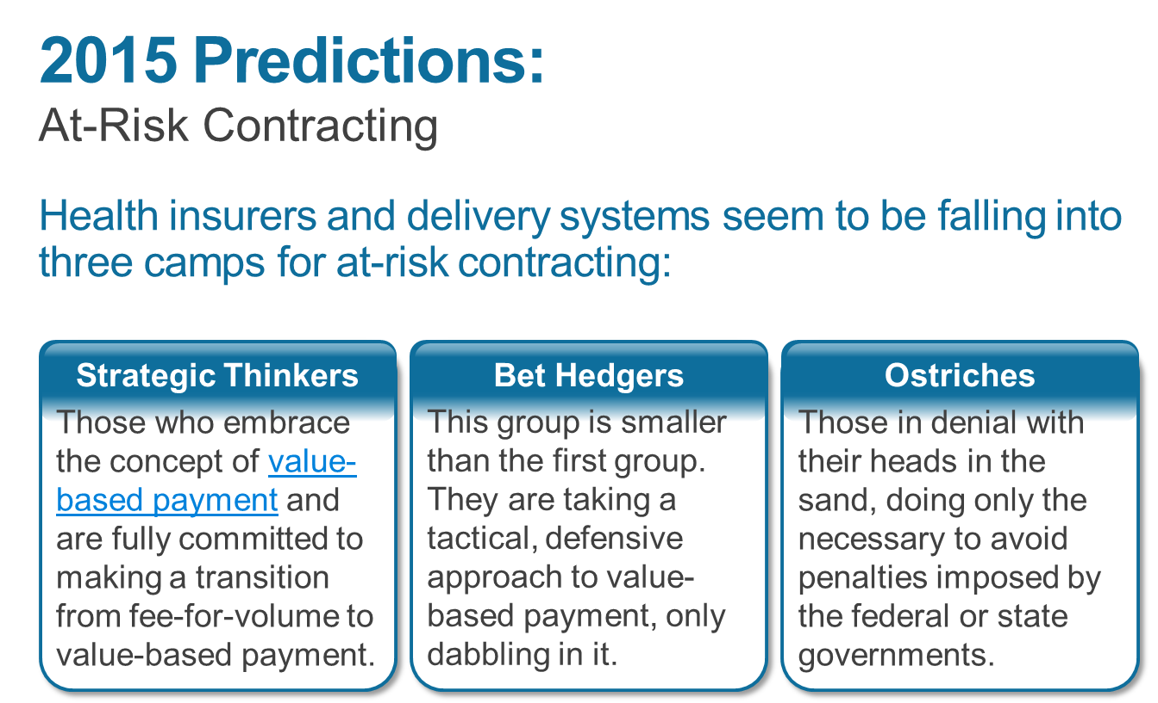
Predictions versus trends

Slide 4
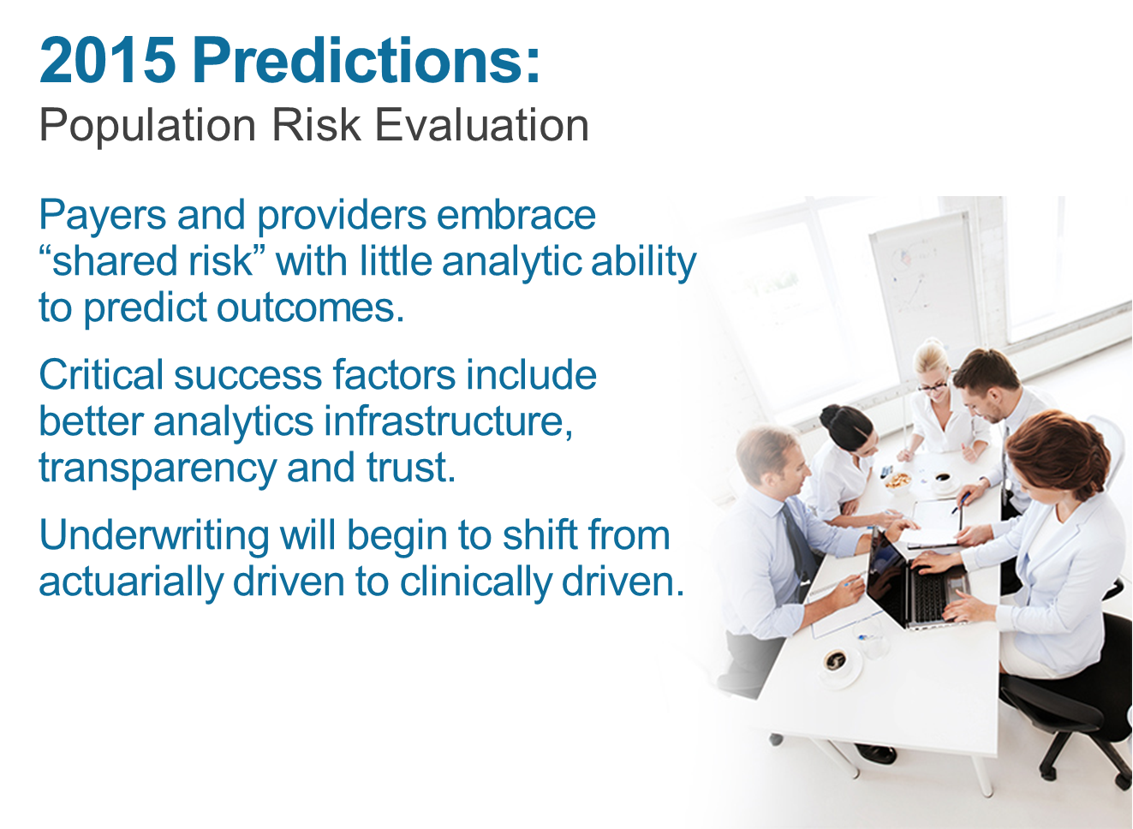
Payers and providers embrace “shared risk” with little analytic ability to predict outcomes.
Critical success factors include better analytics infrastructure, transparency and trust.
Underwriting will begin to shift from actuarially driven to clinically driven

Slide 5
Predictions versus trends
Clinically driven services seek to reflect the cost of clinically relevant underwriting buckets so the delivery system is taking risk for buckets of cost around which it can organize clinical improvement projects.
Insurers are much better equipped and have more experience managing financial risk.
Providers are much better equipped to manage utilization of services.

Slide 6
Population Risk Evaluation
Payer, providers and analytics vendors can team up to construct better risk models to which both payer and provider can relate.
Forward-thinking providers will look at changing risk parameters before inpatient care becomes necessary and treat first in clinic.
Some “super high risk” patients can shift to hospice care rather than taking a tour-de-force approach.

Slide 7


Slide 8
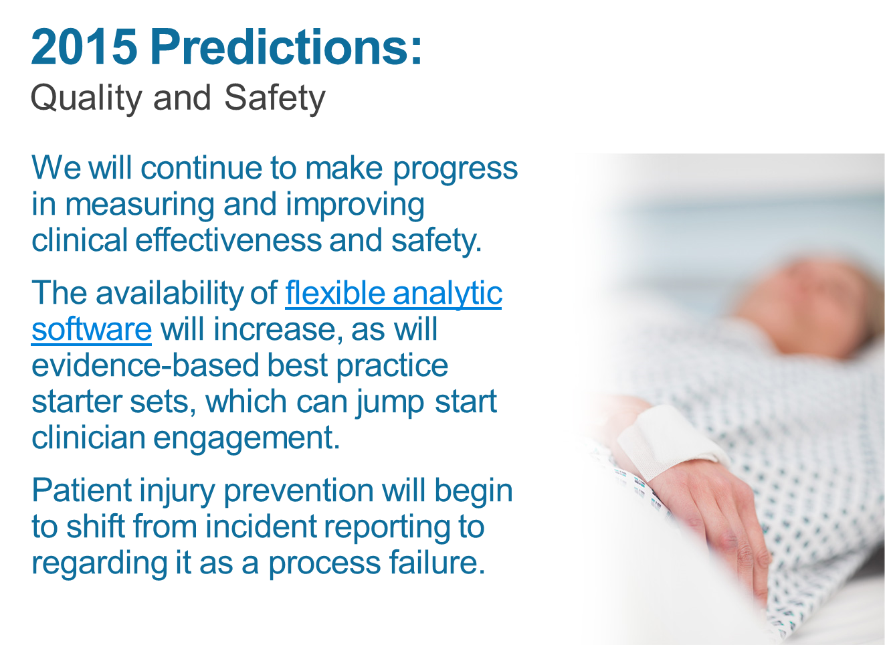

Slide 9
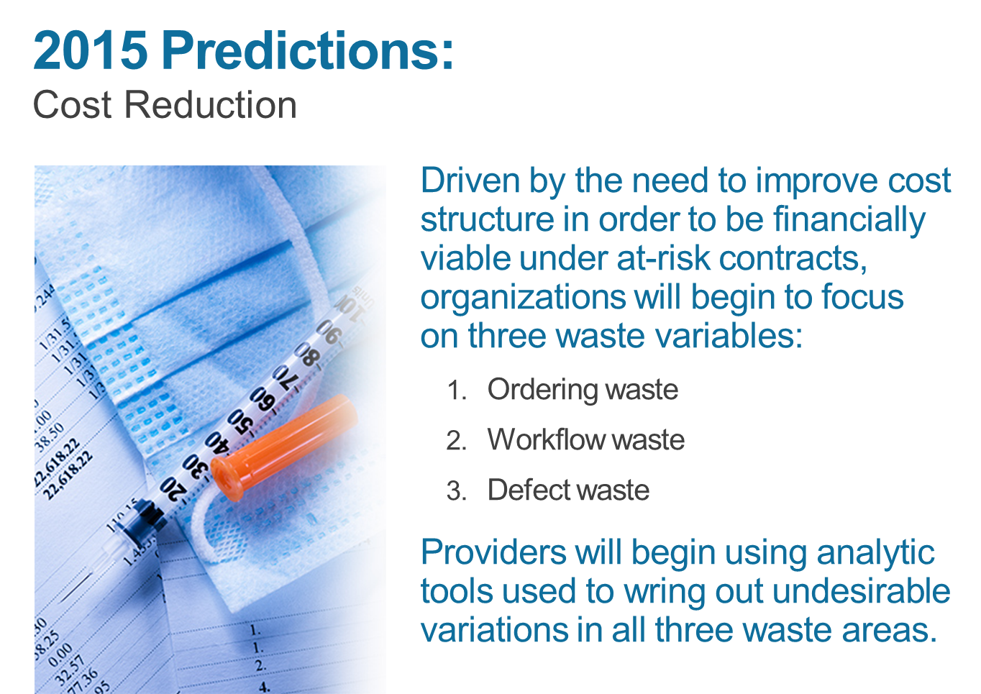
Cost Reduction

Slide 10

Infrastructure- Remote monitoring

Slide 11
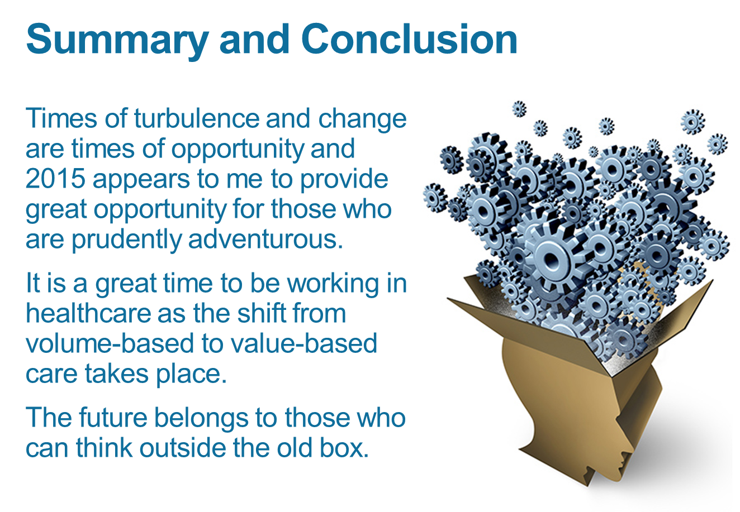

Slide 12


Slide 13
References
Population Health Management: Implementing a Strategy for Success
Dr. David A. Burton, Sr. Vice President
What Is Population Health and How Does It Compare to Public Health?
Leslie Falk, RN, MBA, PMP, Vice President
The Key to Transitioning from Fee-for-Service to Value-Based Reimbursement
Bobbi Brown, Vice President Finance, and Jared Crapo, Vice President
What Is an ACO? A Definitive Guide to Accountable Care Organizations
Dr. John Haughom, Special Advisor, and Dr. David A. Burton, Sr. Vice President
A Best Way to Manage a CMS Hospital Readmission Reduction Program
Bobbi Brown, Vice President Finance
ACO Success Requires Precise Patient Population Definitions
Luke Skelley, Vice President
Additional references available upon request.

Slide 14
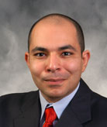
Dr. Aboul-Enein began his nursing career in Saudi Arabia working in primary care 25 years ago. He has held many positions, including staff nurse on a renal transplant unit, ICU nurse, administrative supervisor, director, nurse practitioner in triage services, and hospital staff development. In addition, he has taught at several universities at undergraduate, graduate, and doctoral levels, both online and in the classroom. Dr. Aboul-Enein has been published in numerous publications including the Journal of Public Health and International Journal of Nursing Practice. He has conducted many presentations, internationally and nationally. Dr. Aboul-Enein is an officer in the U.S. Public Health Service Commissioned Corps reserve with the rank of lieutenant commander. He has won numerous awards such as the Spirit of Nursing award from the U.S. Army Nurse Corps and the Best Nurses award in 2006 from the Texas Nurses Association. In 2013, he won the Walden's Faculty Excellence Award. He is an active member of the Southern Nursing Research Society. Dr. Aboul-Enein is a Fellow of the Royal Society of Public Health and an active member of the American College of Health Care Executives. He has been a Walden faculty member since 2010 and teaches core and leadership/management courses in the MSN and DNP program. He values thought leadership to impact health care reform.

Slide 15

Questions

