Slide 1
Antibiotic Stewardship Program
Jahangir James
Registered Nurse
Hep C department in charge.
Infection Control nurse

Slide 2
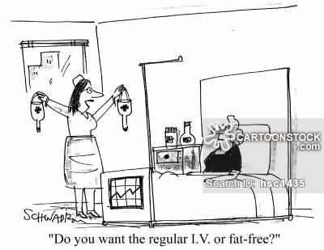

Acute Patient Care
Don’t worry, we have got the worlds best antibiotics and we’ll use them all to kill you (your infection)
Please treat my infection ASAP

Slide 3
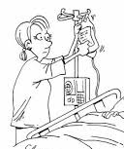

Please help me I am getting worse, I have been pooping the whole day
Don’t worry we’ll take care of it , lets kill everything in your body

Slide 4
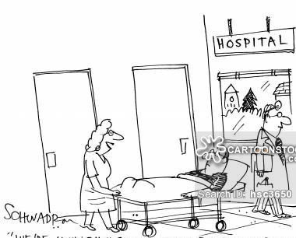
We are moving you to intensive care and intensive billing
Oh please Help me Lord!!

Slide 5

Died of antibiotic and billing overload

Slide 6
Facts
Antibiotics are magical drugs.
These are life saving drugs used to treat life threatening infections.
Unfortunately, their over and misuse has rendered most antibiotics ineffective.
WHO estimates antimicrobial resistance AMR will cause 10 million deaths and 100 trillion dollars in cost by 2050.

Slide 7
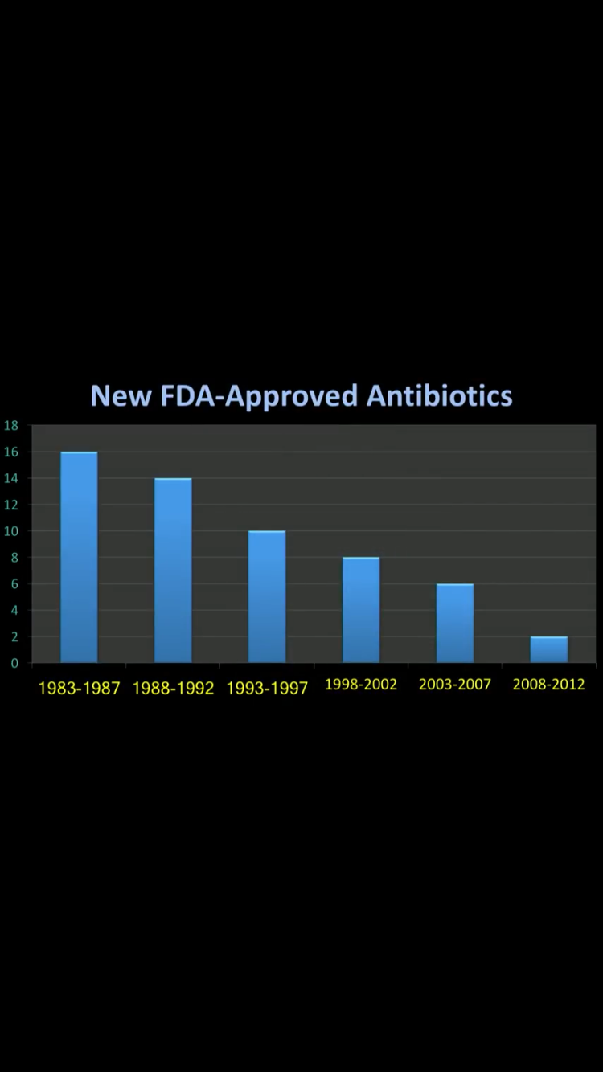
Antibiotics are running out!!

Slide 8

To Use or Not To Use Antibiotics
Rationale use of antibiotics
Irrational use of antibiotics

Slide 9
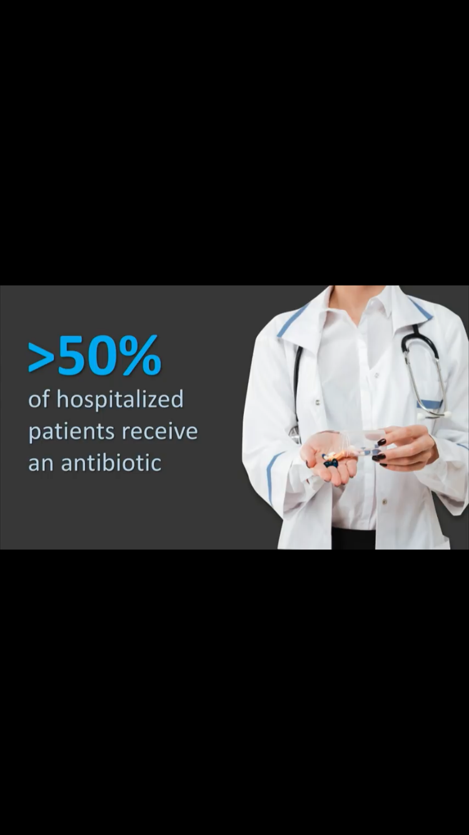
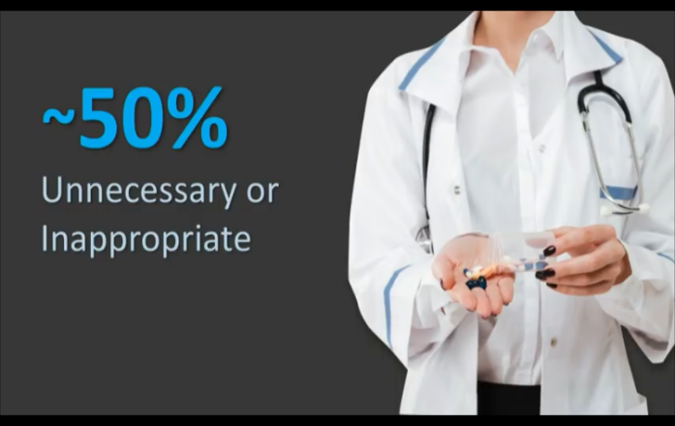
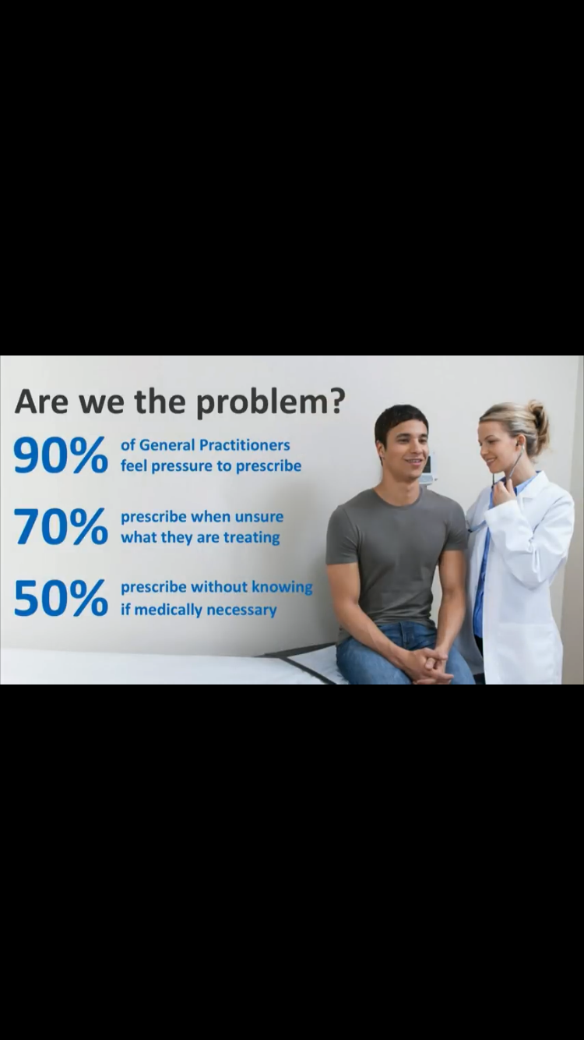
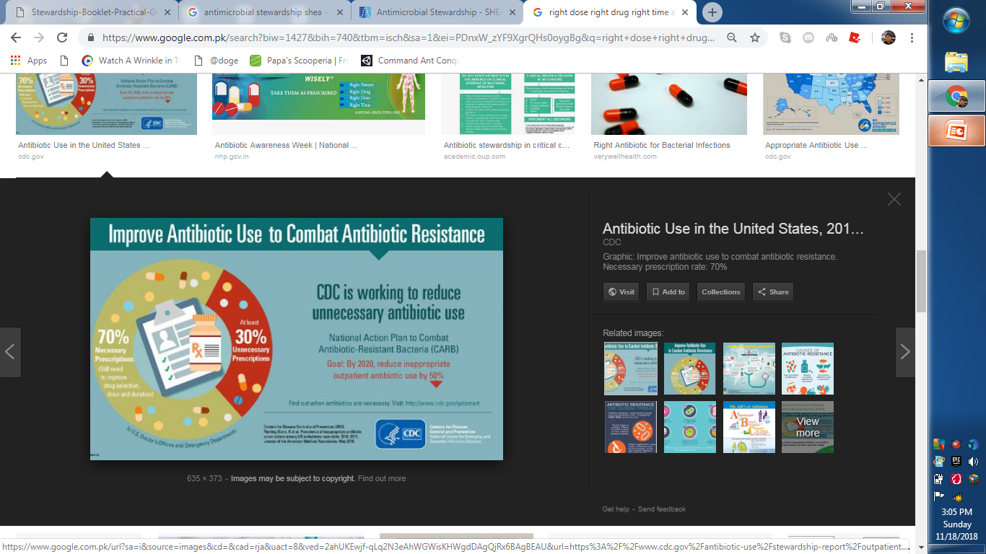
Irrational use of Antibiotics

Slide 10
Antibiotic Stewardship
Antibiotic stewardship refers to a set of coordinated strategies to improve the use of antimicrobial medications with the goal of enhancing patient health outcomes, reducing resistance to antibiotics, and decreasing unnecessary costs.

Slide 11
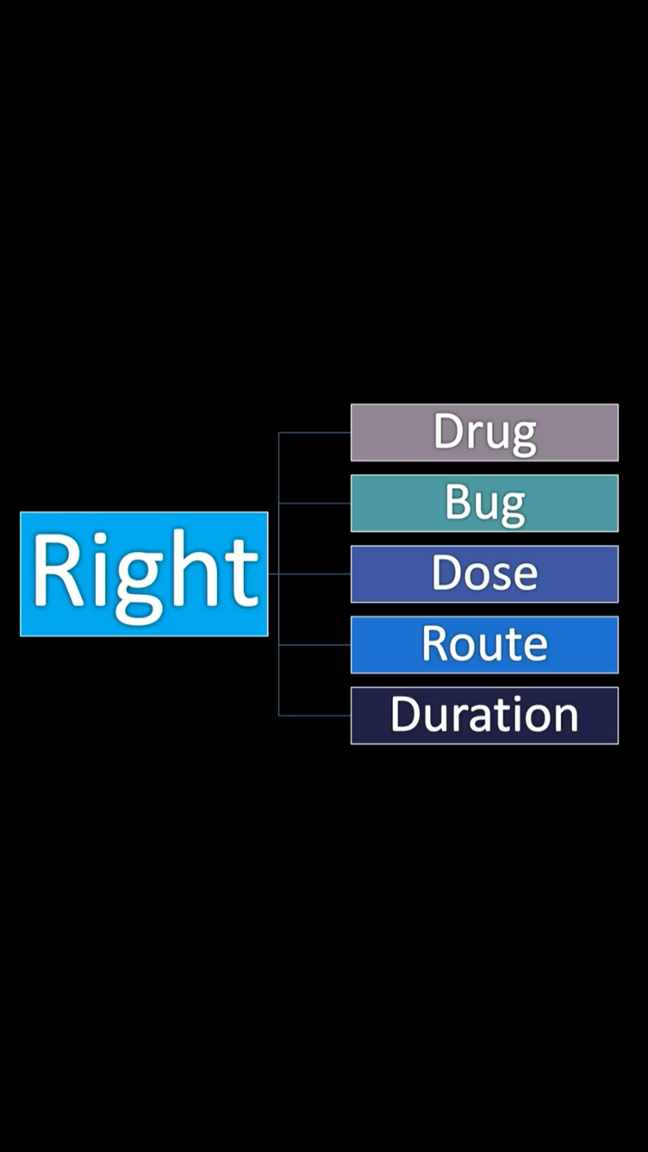
Why Implement Antimicrobial Stewardship in the Hospitals
To regulate the use of antibiotics

Slide 12
Goals of Antimicrobial Stewardship
To improve infection cure rate
Improve patient safety
  Adverse effects
  Prevention of MDR hospital acquired infections
To reduce morbidity and mortality
To decrease the health care costs

Slide 13
How to Implement Antibiotic Stewardship
Set up structure and organization
Ensure accountability and leadership
Assess the motivations
Define priorities and how to measure progress and success
Identify effective interventions for your setting
Identify key measurements for improvement
Educate and Train
Communication

Slide 14
How to Implement Antibiotic Stewardship
Set up structure and organization
  Multidisciplinary AS team [AST] with core membership of: -
    an infectious diseases physician (or lead doctor or physician champion) –
    a clinical microbiologist –
    a clinical pharmacist with expertise in infection.
    Specialist nurses, for example infection prevention or stewardship nurses

Slide 15
How to Implement Antibiotic Stewardship
Set up structure and organization
Ensure accountability and leadership
  The program should be supported by the senior hospital management, who are accountable for the outcomes.
  A team of people and resources should be allocated by the head of the organization to implement and evaluate the program. The ASP team members must possess power, expertise, credibility and leadership.

Slide 16
How to Implement Antibiotic Stewardship
Set up structure and organization
Ensure accountability and leadership
Assess the motivations
  Define where you are and where you want to go, with quantitative figures.
  One of the ways of obtaining these data is to measure the quantity and quality of antibiotic use
  Devise strategy according to local data and expertise available

Slide 17
How to Implement Antibiotic Stewardship
4. Define priorities and how to measure progress and success
    The objectives of the ASP and how they are going to be achieved and measured need to be agreed by all the key stakeholders and communicated clearly.
    For example the goal is timely and appropriate use of antibiotics
    Another goal eg timely de-escalation of antibiotics

Slide 18
How to Implement Antibiotic Stewardship
5. Identify effective interventions for your setting
  Timely administration of antibiotics
    Clinical pathways
    Surgical prophylaxis guidelines
    Publish Antibiotic guidelines
  Timely de-escalation of antibiotics
    Formulary restriction, front end or back end strategy
    Regular audits and feedback to the prescriber

Slide 19
How to Implement Antibiotic Stewardship
6. Identify key measurements for improvement
  “If you cannot measure it, you cannot improve it” Lord Kelvin 1824-1907
  Measurement of prescribing performance is essential to evaluate the impact of stewardship interventions on clinical practice and demonstrate benefits for patients.
  Establishing what to measure, the frequency of measurement and how the data will be communicated and acted upon are also key.

Slide 20
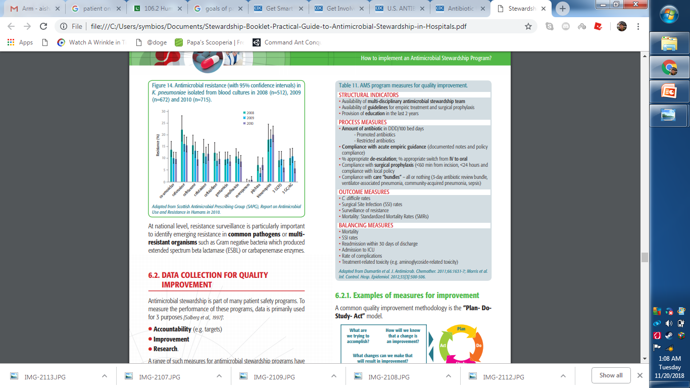
Identify key measurements for improvement

Slide 21
How to Implement Antibiotic Stewardship
7. Educate and Train
  Education is a key component of any Antimicrobial Stewardship Program.
  It should include healthcare professionals from all care settings, as well as patients and the public.
  By increasing people’s knowledge and understanding of how antimicrobials should be used to treat common infections and why inappropriate use may lead to resistance and loss of effective treatments, this valuable resource can be protected for future generations.

Slide 22
How to Implement Antibiotic Stewardship
8. Communication
  Communication is a key component of the success of an ASP.
  Clear, simple communication should show the vision and the benefits of the program, with core clinical messages
  Direct communication with the prescriber is very important

Slide 23
