Slide 1
Introducing New Implementation of Bar-Code System
MSc in Healthcare Management, Institute of Leadership, Royal College of Surgeons in Ireland

Slide 2
Introduction
Implementation of barcode system in such hospital had substantial effects on change by improving the process of medication administration and reducing the occurrence of medication administration mistakes (Seibert et al., 2014).
In public hospital, the trial had taken place and found the significant result before and after implementation of the new system and how this technology improved the hospital management performance (Seibert et al., 2014).
Enhancing patient safety by applying new technology system in healthcare settings in dropping the medication error and accumulative the timeframe and accurateness of drug documentation (Pereira et al., 2014).
Different public health in Canada was leading a project to assess the effectiveness of barcode scanning the termination date and the code number of vials before administration to a patient (Pereira et al., 2014).
Therefore the result was beneficial in cost cutting, better performance, minimizing the medication administration error and increasing the quality of patient care (Pereira et al., 2014).
The implementation of barcode medication administration in Hospital A was one of the most significant decision making in improving the excellence of patient care.

Slide 3
Aim and Objective
The main aim will be conducting a post-survey to address the improvement of the patient safety by implementation of barcode medication administration system as well as to address the employees perception by implementation of new technology changes in the hospital A in 2017-2018.
The Objective will be:
1- By February 2018, 80% of patient safety improvement with new system implementation of barcode medication administration system in the hospital A.

Slide 4
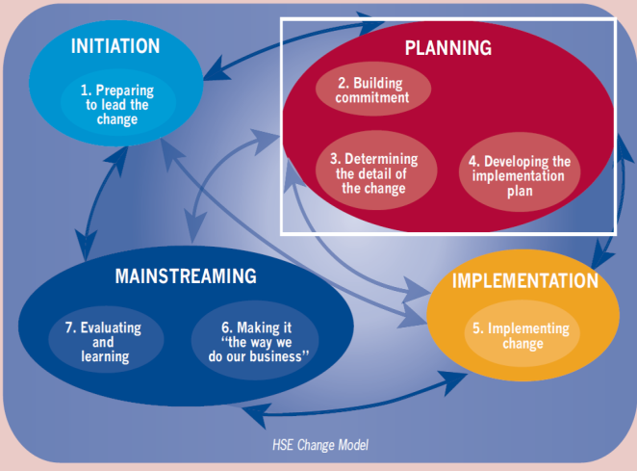
Methodology
HSE model of change defines the drivers of change that qualifies the individuals to shift from present condition to anticipated state. HSE (2008) had split the process of the organizational development of change into four stages see figure1 (Hse.ie, 2008).Thus, the HSE change model were selected for organizational developmental project change.
1- Initiation: Identifying the requirements of change, produce the common sense of importance, recognize the key influence of shareholder, swot, assess the willingness of the change and the impact.
2- Planning: to assemble a vision and communication for the change, review the present condition, comment the investigation for the key shareholder, explain the requirement of the change, undertake the complete plan of transform, summarize the arrangement for accomplishment.
3- Implementation: the main aim is to concentrate on the implementation process of the project change plan in the organization and ensuring and assessing all the aspects are meeting the commitments and participants with presence sympathetic influences that maintain the sustainability of transformation.
4- Mainstreaming: verify the effectiveness of the change and make sure the choice production with support the modification. Collecting the feedback from the survey of the new project change to evaluate the efficiency and the effectiveness of barcode system.
Figure 1: HSE Change Model

Slide 5
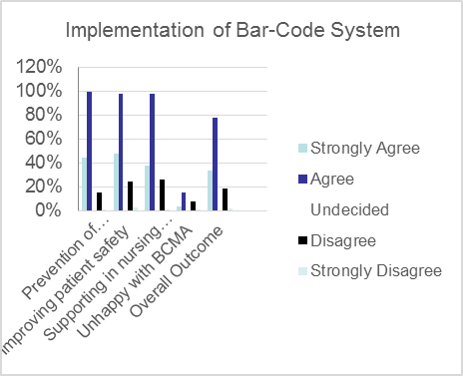
Evaluation
The Kirkpatrick model of evaluation was used to appraise the barcode system in enhancement of patient safety by conducting the survey to obtain the end-use feedback about new changes figure 2
250 senior nurses had received the survey about barcode and 78% of end-user impress their perception and satisfaction about new changes by implementing the barcode system in improving the quality of patient care and safety.

Slide 6
Conclusion
Implementation of new technology such as barcode system had shown significant impact on improving the quality of patient safety and increased the end-user workflow performances and their satisfaction in the organization.
Organizational Impact
The impact of barcode medication administration on improving patient safety, reduction of medication error, accurate medication dosage, improve documentation and enhancement of quality of patient care.

