Slide 1

UNIVERSITETI I PRISHTINËS “HASAN PRISHTINA”
FAKULTETI I MJEKËSISË
DEPARTAMENTI I FIZIOTERAPISË
TEMA: TRAJTIMI FIZIKAL DHE ORTOTIK I TORTIKOLISIT MIOGJEN
Kandidatet:
Visar Tifeku
Prishtinë, 2017

Slide 2
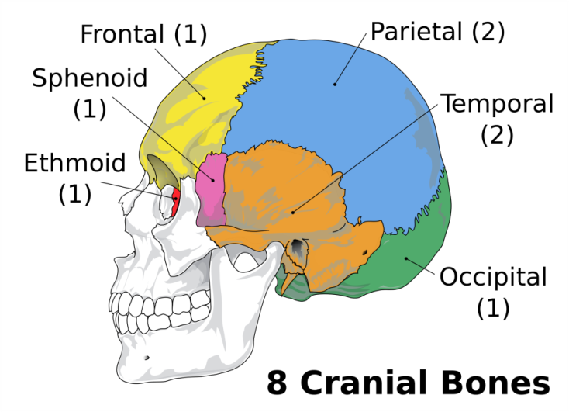
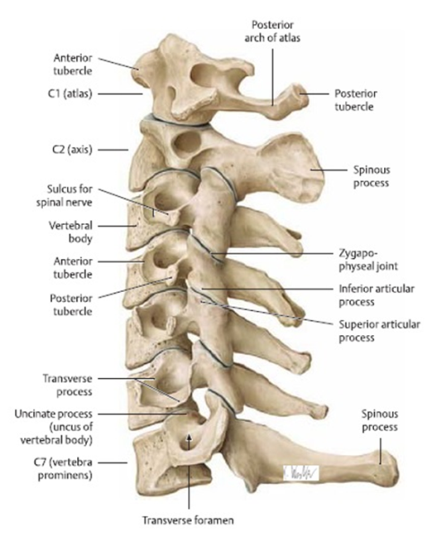
Anatomy of the skull and cervical region
Skull skull is formed by 8 bones:
Ashti ballor (os frontale),
Ashti pykor (os sphenoidale),
Ashti shoshor (os ethmoidale),
Ashti zverkor (os occipitale),
2 bone bones (temporal os) and
2 bones (the parietal parietal).
The cervical region is composed of 7 beads (C1-C7) of which the first, second and seventh are distinct from the others.

Slide 3
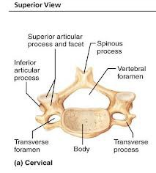
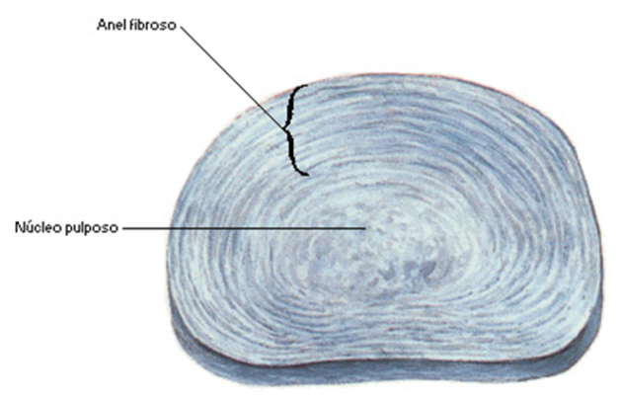
Characteristics of cervical vertebrae and intervertebral disc
- Each vertebrae consists of:
The body of the vertebrae
The bead of the vertebrae
The arch of the vertebrae
Spinal, broad, knot and
Holes of the beads
The spinal bones are separated by the intervertebral discs.
Composed by nucleus pulposus and anulus fibrosus.
It has a significant role in moving and depreciating them.

Slide 4
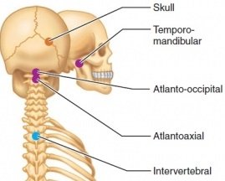
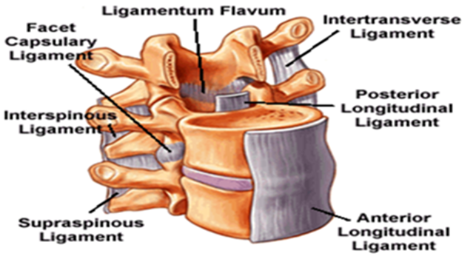
Articulations and ligaments
The articulations of the cervical region are:
Articulation of the atlanto-ocipitalis
Atlanto-axialis articulation
Intervertebral articulation
Ligaments are:
Lig.longitudinal anterior,
Lig.longitudinal posterior,
lig.flava,
lig.interspinalis,
Lig.supraspinalis and
lig.tranzversalis.

Slide 5
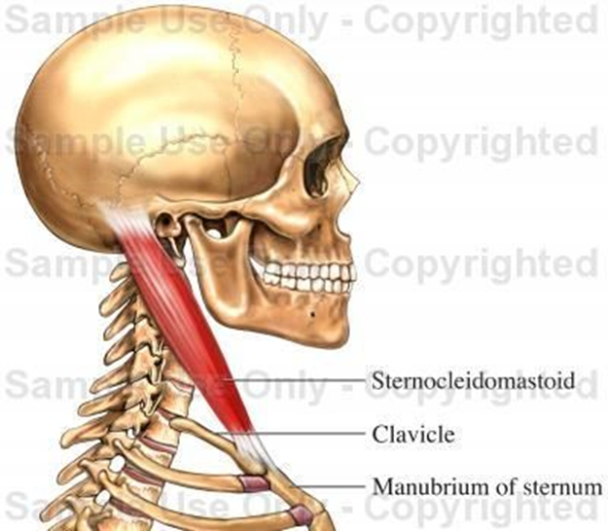
Muscle
Many muscles are involved in the movement of the neck but the muscle most affected by torticolysis is m.sternocleidomastoideus.
Sternokleidomasteoid muscle is a powerful muscle located on both sides of the neck.
Origin ~ the sternum manubrium and the medial part of the clavicle.
Ascension ~ mastoid process.
Action - when both sternocleidomasteoid muscles shrink, then they cause the scrotum. When it shrinks, one cranial muscles bend over the shrunken muscle and face turns to the opposite side.

Slide 6
Torticolism of myogenesis
Torticolysis is a deformity characterized by the lateral flexion (flexion) of the head to the arm on the side of the localization of deformity and its rotation on the opposite side.
It is caused by unilateral contractility of the sternocleidomastoid muscle and secondary secondary muscle relaxation and neck fascias.
The word Tortikolis derives from the Latin words "tortus", twisted, twisted, and "collum" neck.

Slide 7
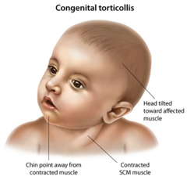
Torticolysis can be:
Primary (congenital) and
Secondary (gained).
Congenital torsion is manifested at birth.
Acquired or secondary torsion is manifested in the most infants, in children and adults.

Slide 8
Etiology
The myogenic tortillin etiology is unknown.
Contributing factors are:
Abnormal intrauterine position,
Twin births,
Cesarean births,
Harder births assisted with forceps
trauma
Infection and so on.
Most authors think that in the presentation of muscular congestion torticosis we are dealing with polyetiologic factors.

Slide 9
symptoms
The initial signs are:
The distortion of the head on the side of the shortened muscle,
Looking toward the healthy side,
The restraining of the neck movement,
hipertonusi,
Shortening of the sternokleidomastoideus and
Released head (plagiocephaly).
Late signs are:
Facial asymmetry,
Asymmetry of the head,
Cervico-thoracic scoliosis and
Visual disorder.

Slide 10
Diagnosing
Early diagnosis is a prophylactic measure.
To complete a patient assessment, it is important to make a thorough and complete systematic examination.
Examination includes:
- anamnesis, - functional tests,
- observation, - special tests and
- amplitude of movement, - palpim.
For a more realistic diagnosis we also do radiography, ultrasound, electromyogram, blood mirror and magnetic resonance.

Slide 11
Treatment of torticulitis
Conservative treatment of torticulosis consists of:
Use of modalities (thermotherapy and electrotherapy),
Physical therapy and
Orthopedic instruments.
Paraphytotherapy is applied in the morning, before kinesiotherapy about 20-30 min. It is most commonly started in the third week of life, in a series of 3-4 weeks, paused for 3 weeks, then the series is repeated.
Hot Paraphony Affects:
Improving blood circulation and metabolism,
Reduces pain and
Increases elasticity of shortened tissue.

Slide 12
Electrotherapy can be started when the baby is three weeks old.
The application time is 20 minutes in a series of 10-15 days. After the 2-3 week break, the series can be repeated.
Electrophoresis is applied monopolically by applying fibrolytic and antisklerotic herbs (potassium, iodine, thyomucase, hydrocortisone).
These are given to accelerate hematoma resorption and inhibit the development of fibrosis.

Slide 13
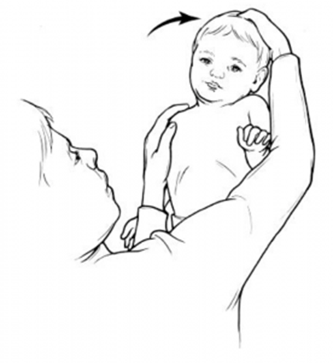
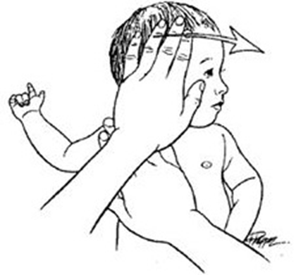
Kinesiotherapy uses passive and active movement techniques.
These exercises are applied to maintain or increase the length of the neck muscles, in particular the m.SCM.
Extension is carried out carefully, slowly and if encountered in resistance it becomes a short pause.
The muscle in the prolonged position is held 5-10 seconds.
This maneuver is repeated 5-6 times a day with a duration of 10-15 min.

Slide 14
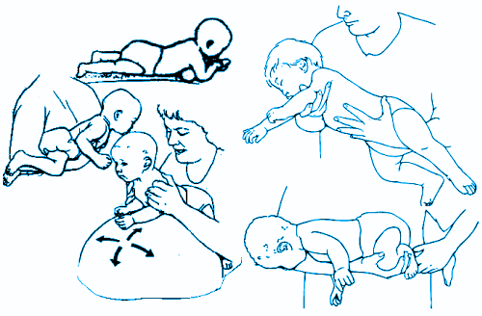
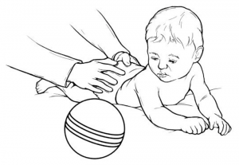
The same exercises should be repeated from the mother at home.
It is important for the baby to lie in bed when sleeping.
Sounds, lights and toys must always be in the sick side

Slide 15
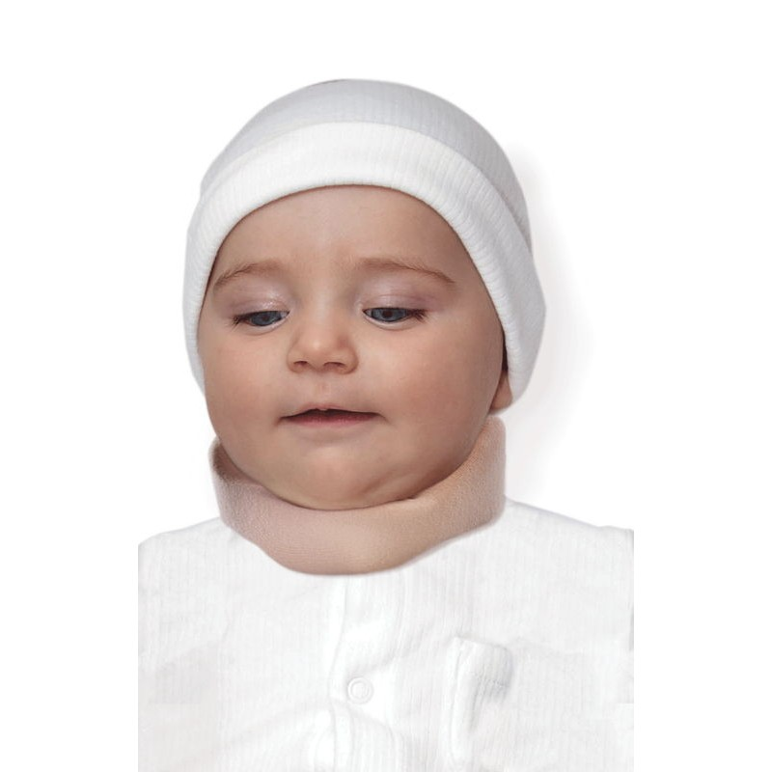
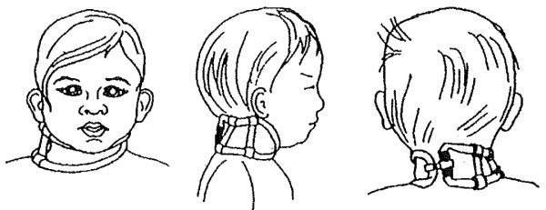
Orthotic treatment
The following are used:
Schanz's cherub
Thomas's cherub
Improvised chafing-paper for babies less than 1 year old
Average recovery time:
In the presence of hematoma 3-6 months,
Without hematoma is 1-3 months.
If surgery is not available until 6 months of treatment, surgical treatment is proposed.

Slide 16
Purpose
The purpose of this research was to analyze patients treated with myoglycemic tortikolis at the Physiatrics Clinic for the period November 2016 to April 2017.
Research is a retrospective cohort with the descriptive component. Study subjects were 116 cases and were analyzed during 10 treatment days.
We have analyzed the subjects on the basis of sex, age, place, physical therapy and the attacked side.
Statistical calculations, tables and graphs are worked on the SPSS program.

Slide 17
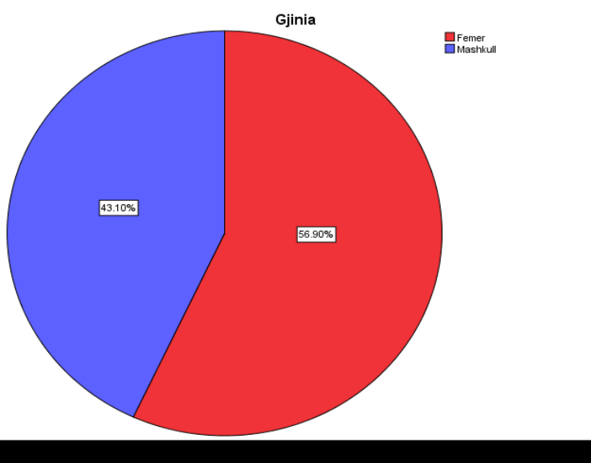
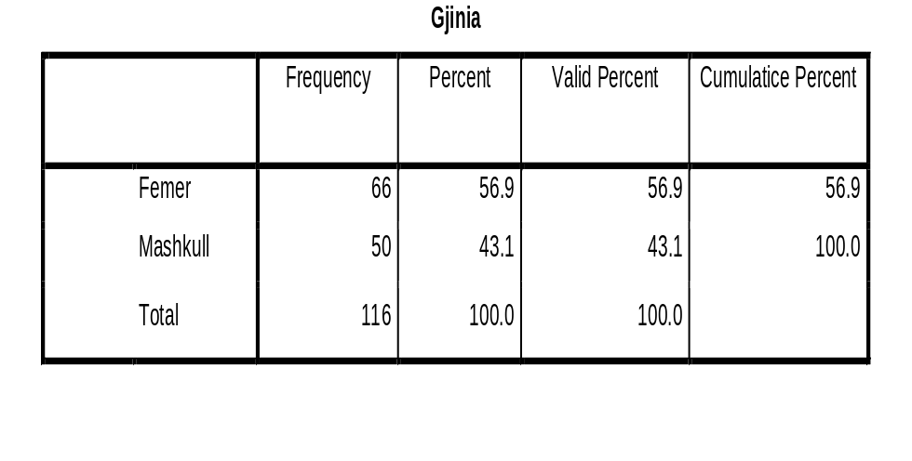
Results
From the data presented in the chart and graph, we note that in the study were included in total 116 cases treated with myogene torticolis.
Women with 66 or 56.9% were the most affected gender, compared to males who were 50 or 43.1%

Slide 18
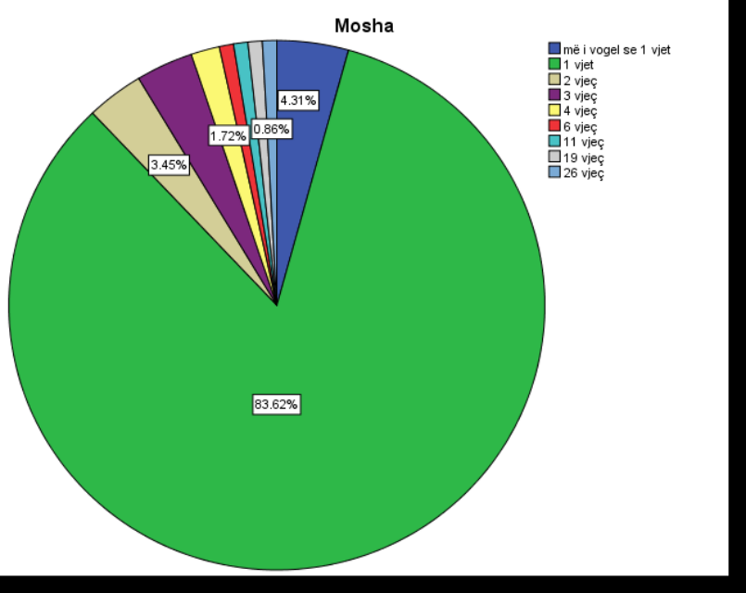
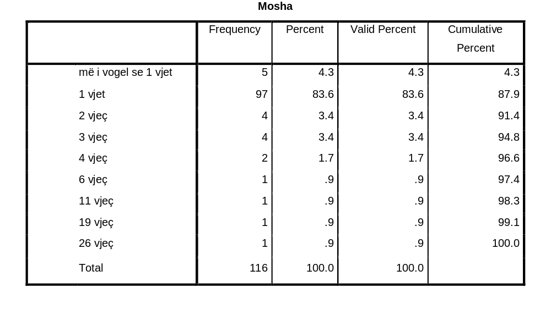
Of the total of 116 cases treated with torticulus, the age most affected were 1 year olds with 83.6%, children aged 2 and 3 with the same percentage 3.4%, while children over 4 years were with a higher percentage small.

Slide 19
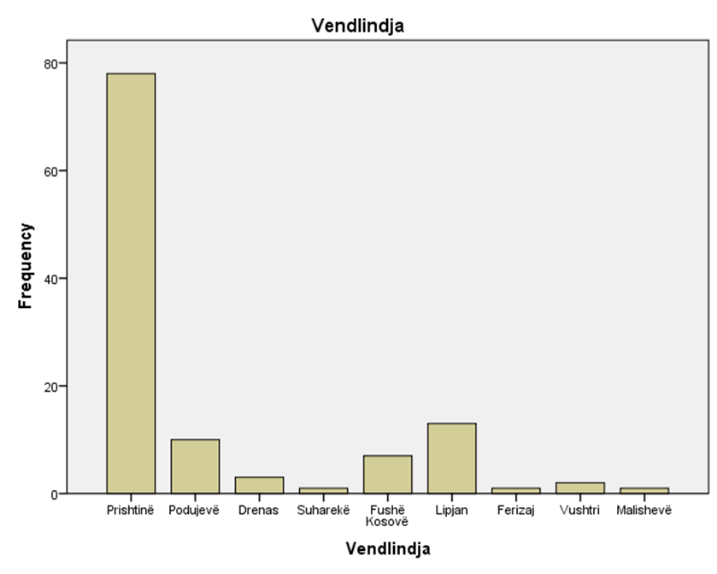
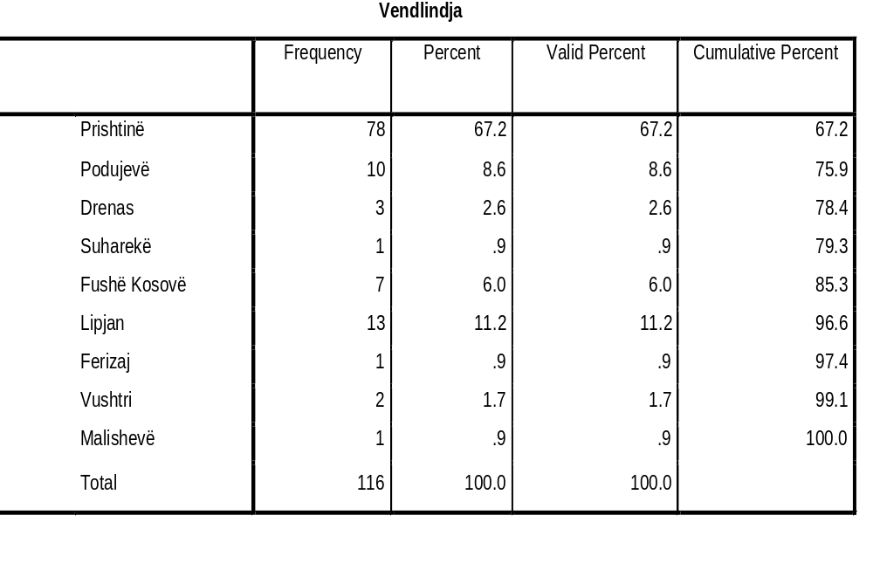
In the table are presented the treatment with tortogenic miogens based on their birthplace. It is noted that the largest number of patients was from Prishtina with 78 cases or 67.2%. Lipjan 13 cases with 11.2%, Podujevo 10 cases with 8.6% and Fushe Kosova 7 cases 6%.

Slide 20
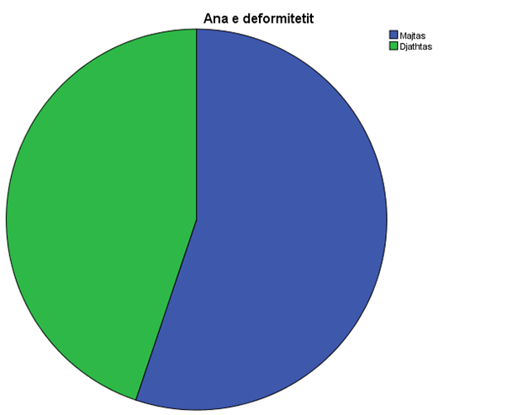
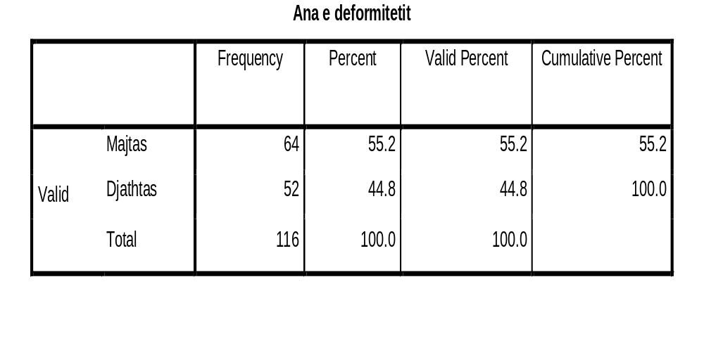
Out of a total of 116 cases that were diagnosed as torticulus and treated the most meticulous side was the left side with 64 cases or 55.2% and 52 cases or 44.8% of the right side.

Slide 21
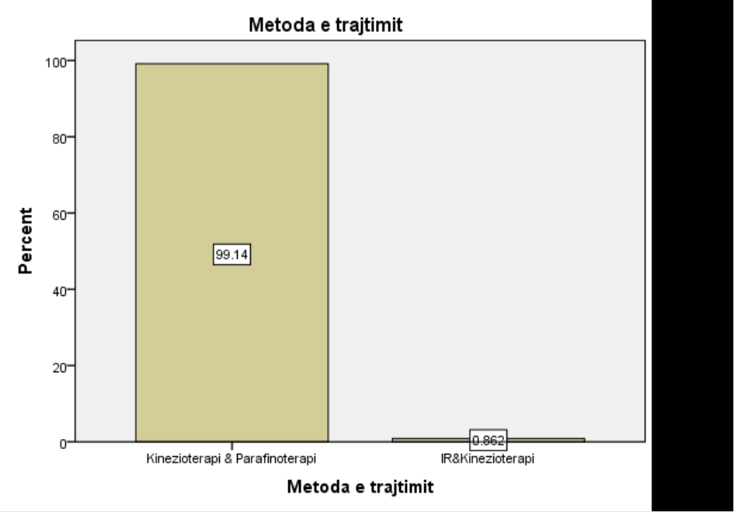
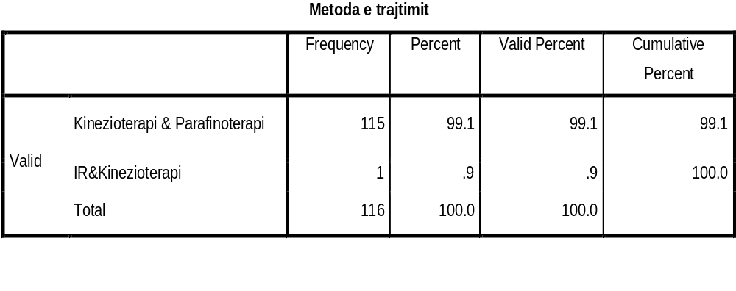
Out of a total of 116 cases treated with torticulosis, around 99.1% were treated with kinesiotherapy and parafinotherapy, while 0.9% or only one case was treated with interfering current (IR) and kinesiotherapy and this patient belonged to the age of 26.

Slide 22
conclusion
The most affected gender by myogene tortikolysis was the female gender.
The average age of attack is 1 year.
The capital has been the most attacked country with tortogenic miogens in the territory of Kosovo.
Kinesiotherapy and paraffinotherapy affect almost completely the treatment of myogeneic torticosis.
The most frequent localization was the left hand side.

Slide 23
suggestions
Reduce your time in baby carriers!
More time on the boat!
Engaging in game activities that enable the use of both hands and feet!
Encourage the baby to look at both sides!
Change the arm with which you keep the baby while feeding!

Slide 24
THANK YOU FOR YOUR ATTENTION!

