Slide 1
Japanese encephalitis
2018/10/04
AMC NR R2 안형석

Slide 2
Patient information
55644594 신O훈
56/M
충북 보은군 거주
C.C : Altered mental status (2018/09/05)

Slide 3
Brief history
농사일, 과수원 하면서 혼자 지내시 분,
평소 매일 소주 1병 가량 복용
2018/08 허리 디스크 시술 받음
이 당시 부터 거의 술 안 마셨다고 함
이후 농사일도 거의 안했으나 밭, 과수원이 바로
집 앞이라 지나가며 접촉은 많았을 것이라고 함
2018/09/04 마지막으로 자녀들이 보았을 때 fever, skin rash, headache
등의 증상은 없었다고함
2018/09/05 동네 주민에 의해 발견
당시 Lt. side weakness, dysarthria 보이는 채로 길에
쓰러져 있었음. 이에 충북대병원 ER 내원

Slide 4
Past medical history
HTN/DM/Tb/Hepatitis (+/-/-/-)
Chronic alcoholics
Family history
신경학적 질환 특이 가족력 없음
Social history
농사일

Slide 5
Initial vital sign
BP : 160/110 mmHg
HR : 65/min
RR : 22/min
BT : 37.9`C

Slide 6
Neurologic examination
Alert but confused
Orientation : T/P/P -/-/-
Obey : none
Cranial nerve exam
  Isocoric pupil (3/3) with LR prompt / prompt
  VOR +/+
  Corneal reflex +/+
  No facial palsy

Slide 7
Neurologic examination
Motor power : VI 이상 / III
-> Rt. Side에 비해 Lt. 잘 움직이지 못하는 모습 보임
Reflex
  DTR : hypoactive in all limbs
  Babinski sign -/-
  Hoffmann sign -/-
Meningeal irritation sign
  Neck stiffness +

Slide 8
Initial assessement
#1. Lt. side weakness, dysarthria, confusion
-acute stroke (Rt. hemisphere)
#2. Delirium tremens
#3. seizure
#4. metabolic encephalopathy
#5. encephalitis

Slide 9
Initial assessement
#1. acute stroke (Rt. hemisphere) -> MR Diffusion/CT
#2. Delirium tremens -> Ativan 1mg q4hr
#3. seizure -> EEG
#4. metabolic encephalopathy -> Lab
#5. infective encephalitis (viral, 가을설출혈열…) -> CSF tapping
non-infective encephalitis (autoimmune, paraneoplastic, ADEM)

Slide 10
Brain imaging

Slide 11
EEG

Slide 12
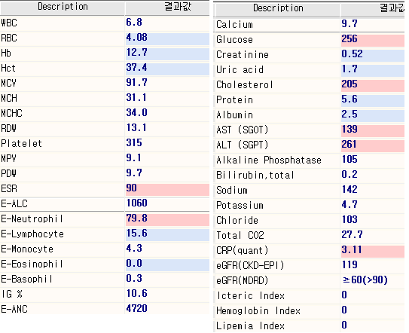
Lab

Slide 13
CSF analysis
2018/9/06
WBC Lymphocyte Monocyte | 51 45 48 | /uL % %
Protein | 81.2 | mg/dL
Glucose (BST) | 85 (108) | mg/dL
2018/9/12
Opining pressure WBC Lymphocyte Monocyte Neutrophil | 26 21 89 10 1 | mmH20 /uL % % %
Protein | 73.3 | mg/dL
Glucose (BST) | 81 (135) | mg/dL

Slide 14
CNS infection lab
CSF tests
CSF culture/Gram stain | negative
CSF AFB stain/culture | negative
CSF Indian ink | negative
CSF CFW-KOH | negative
CSF fungus culture | negative
CSF cryptococcal Ag | negative
CSF TB PCR | negative
CSF M.pneumoniae PCR | negative
CSF MTB/RIF Xpert PCR | negative
CSF Syphilis VDRL titer | negative
CSF, ADA | 10.2 | IU/L
CSF tests
CSF, HSV-1 PCR | negative
CSF, HSV-2 PCR | negative
CSF, CMV PCR | negative
CSF, EBV PCR | negative
CSF, herpes zoster PCR | negative
CSF, enterovirus PCR | negative
Vasculitis lab: negative
Euroimmun lab: negative

Slide 15
질병관리본부 수탁 JEV lab
1차(9.07) serum IgM+IgG IFA 1:16 미만
2차(9.11) serum IgM+IgG IFA 1:64
3차(9.16) serum IgM+IgG IFA 1:128

Slide 16
Hypoactive DTR, motor weakness
-> r/o peripheral weakness
Spine MR
NCV

Slide 17
Spine MR

Slide 18
NCV

Slide 19
Final diagnosis
Japanese encephalitis with ant. Horn involvement

Slide 20

Review

Slide 21
목차
JEV introduction, epidemiology
Diagnosis
Clinical manifestation
Pathology
viral cycle, brain/cord, biopsy…
Flaccid paralysis

Slide 22
목차
JEV introduction, epidemiology
Diagnosis
Clinical manifestation
Pathology
viral cycle, brain/cord, biopsy…
Flaccid paralysis

Slide 23
Japanese encephalitis virus
Single strand RNA virus which belongs to Japanese encephalitis virus serogroup of genu flavivirus, family flaviviridae
West Nile virus, dengue virus, tick-borne encephalitis virus, yellow fever virus, Zika virus and several other viruses
Arthropod borne (ARBOvirus)
Avian vertebrate hosts, transmitted by Culex mosquitos
Humans are “dead-end” hosts

Slide 24
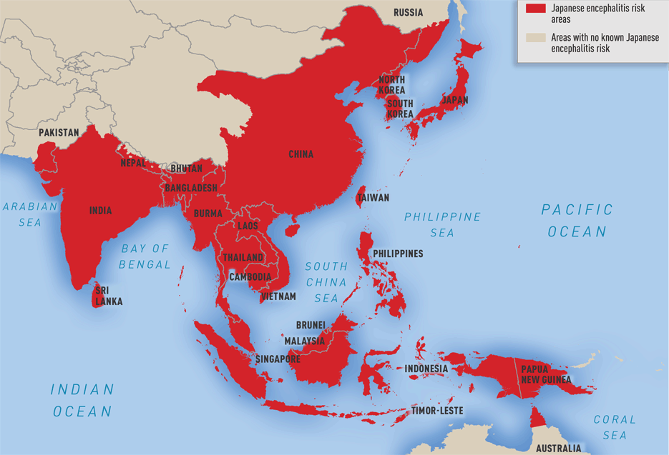
www.cdc.gov
Notes:
JEV는 동아시아, 동남아시아에서 endemic함.

Slide 25
History
1871 First recognized
1924 Severe epidemic in Japan
1935 JEV isolated in human brain in Japan
1936 Mosquito transmission from Culex tritaenorrhynchus identified
1949 Large epidemic in South Korea
1959 Role of pigs and birds as reservoir identified
1971 Mouse brain-derived inactive vaccine first introduced
1982 Major outbreak in south Korea
1985 National Immunization Program
Notes:
1982 1194명, 1983 193명

Slide 26
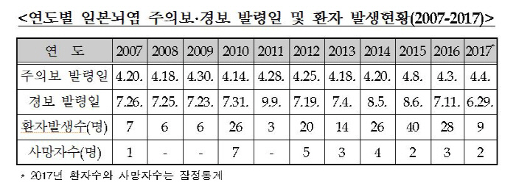
Epidemiology

Slide 27
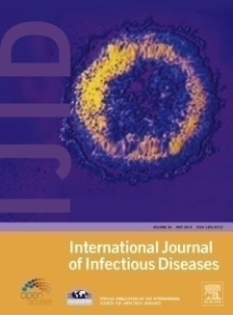
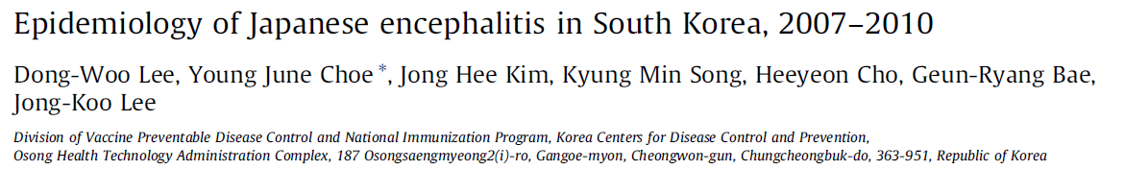
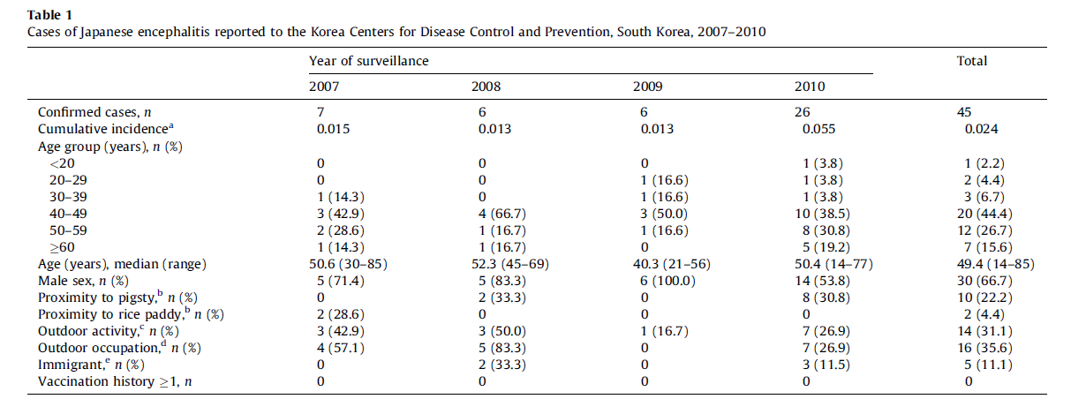
Epidemiology
Notes:
a Cumulative incidence is the number of cases per 100 000 population at risk.
b Proximity to pigsty or rice paddy was defined as location of residence within 5 kilometers of a pigsty or rice paddy.
c Outdoor activity was defined as outdoor activity after 9:00 p.m. more than three times a week.
d Outdoor occupation was defined as spending more than 50% of work time outside of the building.
e Immigrant was defined as a foreign-born person who had resided in Korea for more than 3 months before the onset of symptoms.
Outdoor activity : 늦은 밤에 순찰돌기 / 이른 새벽에 출근 (4명은 논이나 밭일하러, 3명은 공장에 출근하고 있었고, 2명은 경비직으로 출근하였고, 나머지는 교통경찰, 목수, 건설현장일 등등을 순이었음.)
외국 국적의 사람은 5명이 포함되어 있었는데, 국적은 다르지만 한국에서 3개월 이상 거주하고 있었음.

Slide 28
목차
JEV introduction, epidemiology
Diagnosis
Clinical manifestation
Pathology
viral cycle, brain/cord, biopsy…
Flaccid paralysis

Slide 29
Diagnosis
질병관리본부 진단 기준
Febrile illness associated with neurological symptoms suggestive of JE, confirmed by laboratory evidence of one or more following :
direct detection of JE virus, JE virus antigen, or JE virus gene from brain tissue or cerebrospinal fluid (CSF),
JE-specific IgM-capture by ELISA on CSF or serum in the absence of IgM to other flaviviruses,
a four-fold or greater rise in JE virus-specific neutralizing antibodies between the acute and convalescent phase serum specimens.

Slide 30
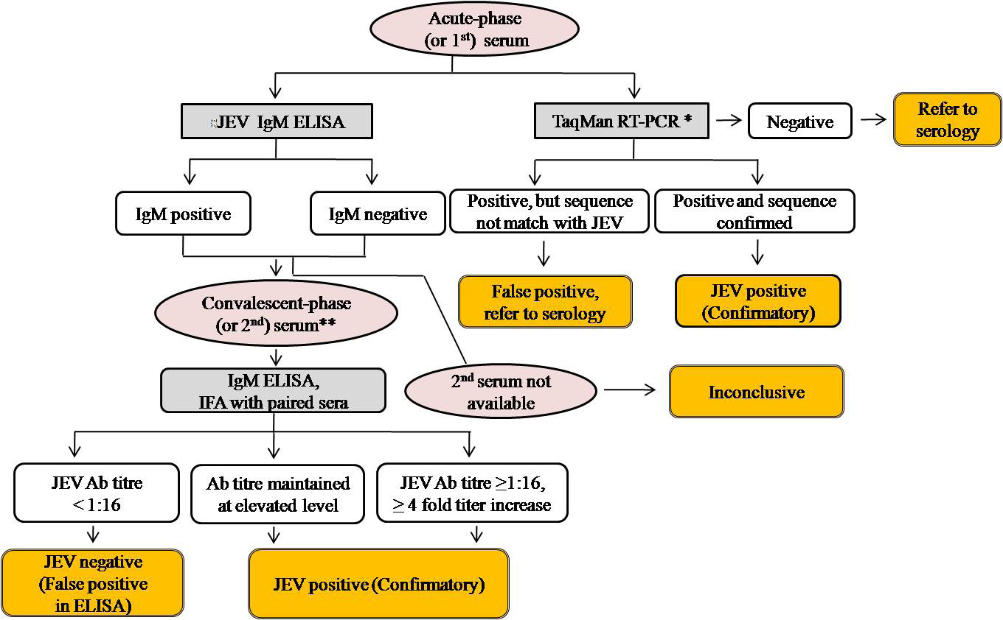
Diagnosis
질병관리본부

Slide 31
목차
JEV introduction, epidemiology
Diagnosis
Clinical manifestation
Pathology
viral cycle, brain/cord, biopsy…
Flaccid paralysis

Slide 32
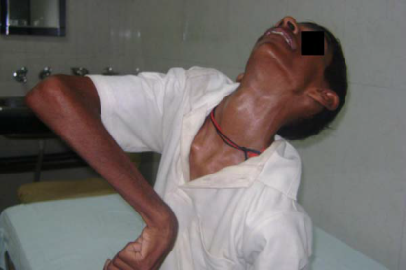
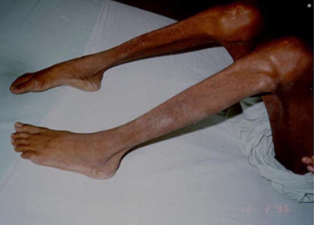
Clinical feature
Survival
Asymptomatic infection 95%
Symptomatic infection 5%
Incubation period
5-15 days
Prodromal syndrome
2-4 days
Encephalitis symptoms
Headache, fever, GI symptoms
behavioral abnormality, seizure, movement symptom or cerebellar signs
Death
IgM
IgG
Notes:
전구기 2-3일, 급성기 3-4일, 아급성기 7-10일, 회복기 4-7주
10-35% 발병 10일 이내 사망
10-35% 발병 10일 이내 사망 (1950년대 국내 사망률 43.8%-> 1960년대 31.5% -> 2010년 20%
headache, fever, rigor, GI symptoms

Slide 33
Survival
50% of survivors have severe neurological sequelae
Prognostic predictors : Extremes of age, high fever, deep coma, hypotonia, features of seizure, raised ICP and low level of IgG and IgM antibodies against JE
10-35% dies within 10 days
Mortality rate within 3 months :
43.8%(1950s) → 31.5%(1960s) → 20%(2007-2010)
Death

Slide 34
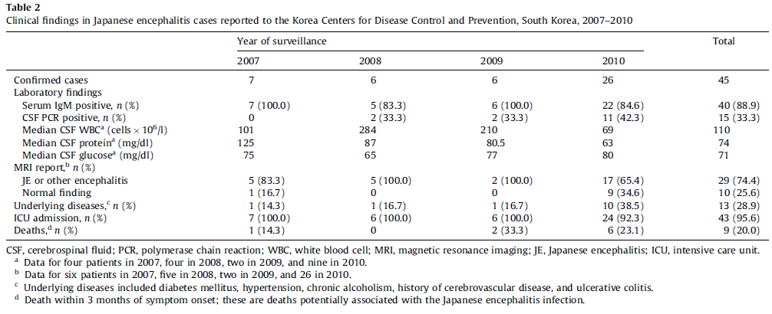
Clinical feature
Notes:
대부분 IgM positive
Viral PCR 검출율 낮다. Viremia 적다
100~200 wbc
MR상 대부분 이상소견 동반
사망

Slide 35
목차
JEV introduction, epidemiology
Diagnosis
Clinical manifestation
Pathology
viral cycle, brain/cord, biopsy…
Flaccid paralysis

Slide 36

1) Blood supply
-directly infect vascular endothelial cell
-trans choroid plexus, circumventricular organs
-infected hematopoietic cells,
‘Trojan horses’
-inflammation induced breakdown of BBB
2) Peripheral nerve
motor nerve-> polio, rabies
sensory nerve -> HSV-1
olfactory nerve -> HSV-1, Nipah, rabies

Slide 37
1) Blood supply
-directly infect vascular endothelial cell
-trans choroid plexus, circumventricular organs
-infected hematopoietic cells,
‘Trojan horses’
-inflammation induced breakdown of BBB
2) Peripheral nerve
motor nerve-> polio, rabies
sensory nerve -> HSV-1
olfactory nerve -> Influenza, HSV-1, Nipah, rabies

Slide 38
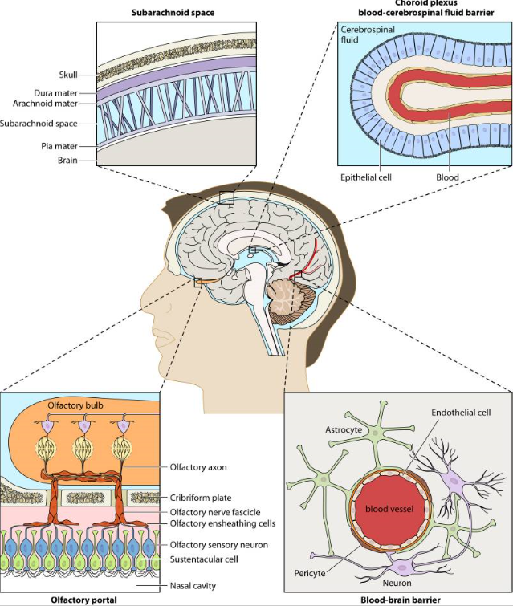
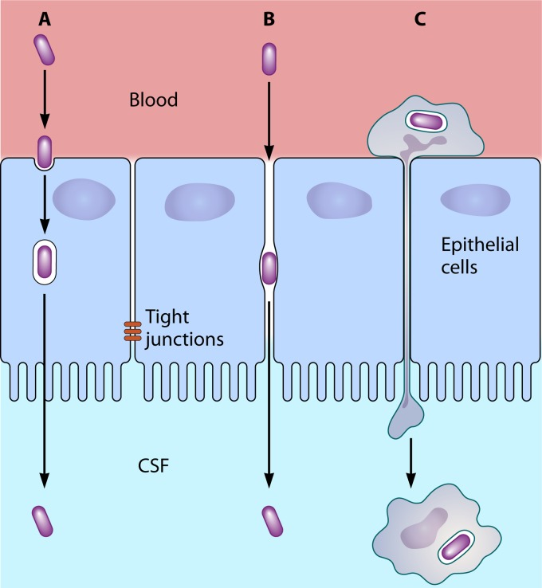
Notes:
https://www.ncbi.nlm.nih.gov/pmc/articles/PMC4187632/

Slide 39
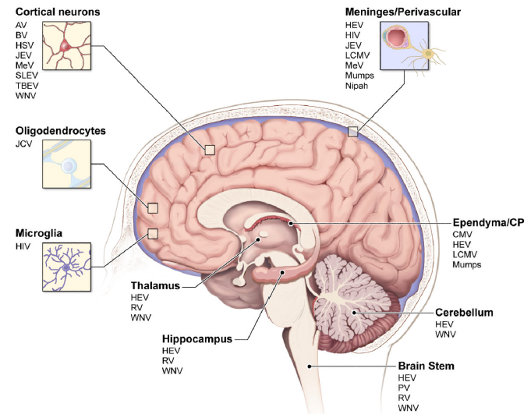

Slide 40
1) Blood supply
-directly infect vascular endothelial cell
-trans choroid plexus, circumventricular organs
-infected hematopoietic cells,
‘Trojan horses’
-inflammation induced breakdown of BBB
2) Peripheral nerve
olfactory nerve -> Influenza, HSV-1, Nipah, rabies
motor nerve-> polio, rabies
sensory nerve -> HSV-1

Slide 41
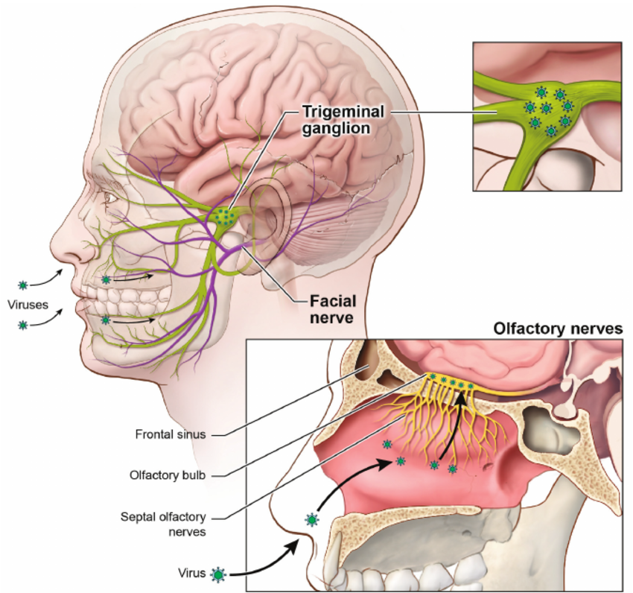

Slide 42
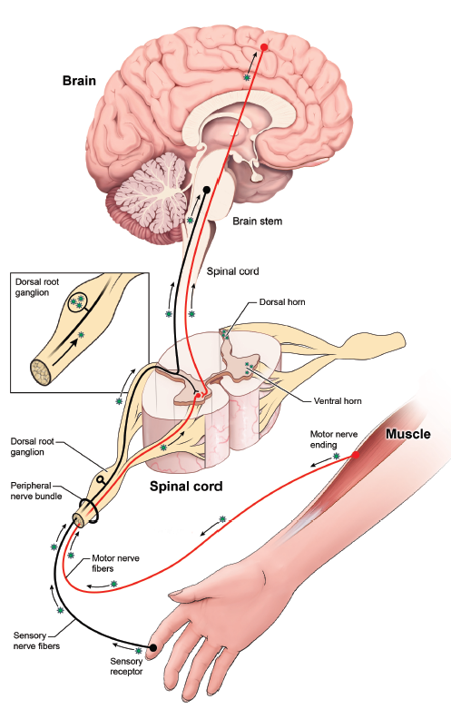
Rabies virus
Polio virus
Adenovirus
Herpes virus
Notes:
https://link.springer.com/article/10.1080%2F13550280802339643
Rabies virus (RV), poliovirus (PV), and adenoviruses (AdV) all infect peripheral
nerves at neuromuscular junctions to access the CNS and induce fatal encephalitic
disease (rabies), paralytic disease (poliomyelitis), and meningoencephalitis (AdV)

Slide 43
Rabies virus-> encephalitis
Polio virus-> myelitis
Adenovirus-> meningoencephalitis
Herpes virus-> encephalitis
Notes:
https://link.springer.com/article/10.1080%2F13550280802339643
Rabies virus (RV), poliovirus (PV), and adenoviruses (AdV) all infect peripheral
nerves at neuromuscular junctions to access the CNS and induce fatal encephalitic
disease (rabies), paralytic disease (poliomyelitis), and meningoencephalitis (AdV)

Slide 44
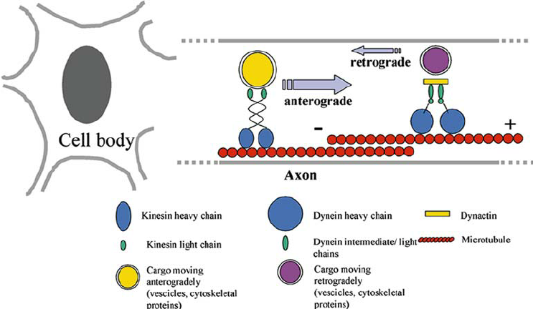
Notes:
Motor proteins called dyneins are responsible for retrograde transport, which moves
molecules along microtubules from neuronal synapses to the cell body. Kinesins,
on the other hand, control anterograde movement by transporting molecules in the
opposite direction (Salinas et al. 2010). Utilization of these motor proteins is essential
for effi cient transneural migration of viruses, which would otherwise have to rely
on passive diffusion to navigate the long distances between nerve terminals and cell
bodies. In fact, it is estimated that the capsid proteins of poliovirus and HSV would
take up to 61 and 231 years, respectively, to move through 1 cm of cytoplasm by
passive diffusion (Sodeik 2000). Therefore, many neurotropic viruses have evolved
strategies to exploit the transportation network within neurons.

Slide 45
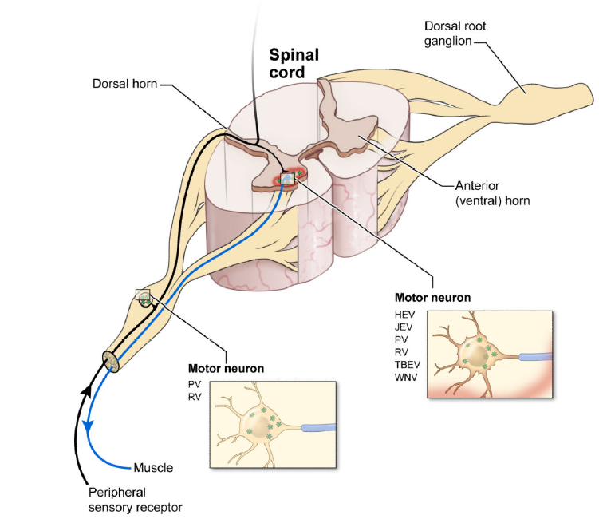

Slide 46
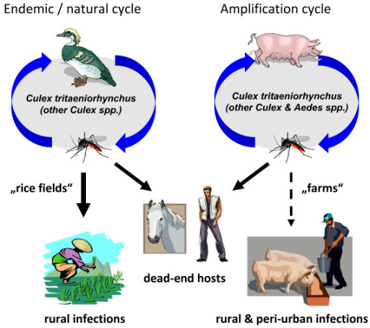
Epidemic cycle
  Culex tritaeniorrhynchus (작은빨간집모기)
  Culex pipiens (빨간집모기)
  Aedes Albopictus (흰줄숲모기)
  Aedes vexans (금빛숲모기)
Notes:
우선 초기에 모기에 물려서 감염이 발생하게 됩니다.

Slide 47
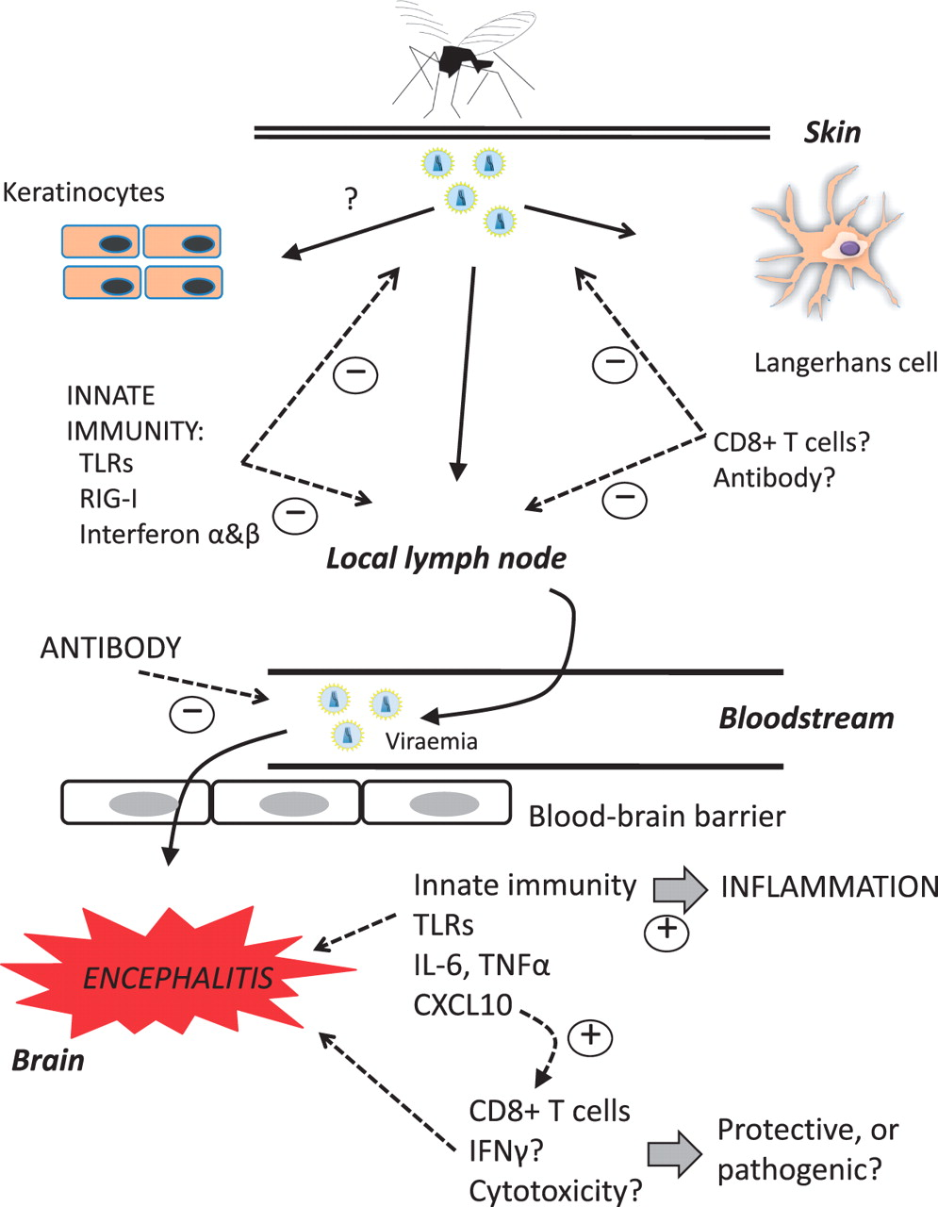
Virus amplifies peripherally in dermal tissue, and then lymph node
Viremia occurs
BBB entry
Mechanism unknown
Notes:
Mechanism unknown.
St Louis encephalitis virus의 경우에는 olfactory route를 통해 CNS를 통과한다고 알려져있고.
Postmortem study를 해보면 brain의 diffuse한 infection이 관찰되며, flavivirus가 endothelium 내부에서 replication하는것이 관찰되기도 하여, endothelial cell을 통과하여 BBB를 통과할것으로 추정한다.
또한 autopsy case들을 전자현미경으로 분석해보면 바이러스가 rough ER과 Golgi apparatus에서 replication하는것을 볼수 있다ㅣ. Neuron들의 endoplasmic reticulum에 hypertrophy와 extensive한 destruction이 관찰된다. Inflammatory cell과 phagocytosis가 perivascular space에서 관찰된다고 함.
The ER is a vital cell organelle that is important for folding, assembly and transport of the newly synthesised proteins from the nucleus. JEV infection lowers the protein folding capacity of ER and increases viral protein synthesis. This causes it to expand, leading to a stress response and eventually to apoptosis and cell death.

Slide 48
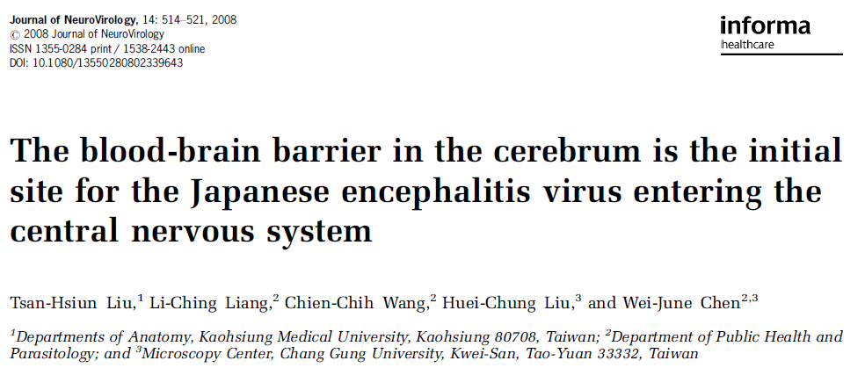
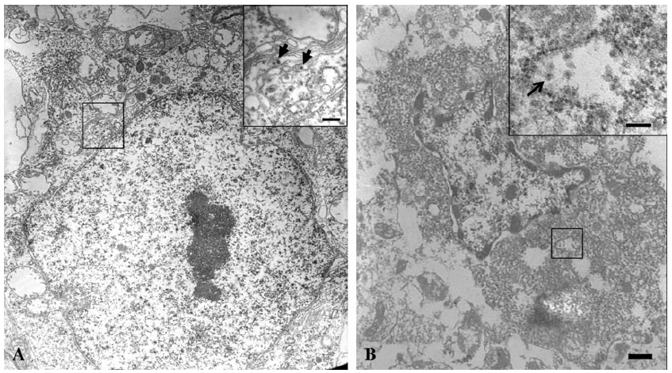

Slide 49
Nevertheless, features including the diffuse infection throughout the brain and no viral antigens in the choroid plexus or ependymal indicate that viruses probably enter the CNS via a hematogenous route (Kimura-Kuroda et al, 1992), especially when severe viremia is induced (Yamada et al, 2004).
Notes:
Portals of Viral Entry into the Central Nervous System
https://www.researchgate.net/publication/282851330_Portals_of_Viral_Entry_into_the_Central_Nervous_System
The blood-brain barrier in the cerebrum is the initial site for the Japanese encephalitis virus entering the central nervous system.
https://www.ncbi.nlm.nih.gov/pubmed/19023687

Slide 50
Notes:
https://www.ncbi.nlm.nih.gov/pmc/articles/PMC4187632/

Slide 51

11 case
They are almost always perivascular in distribution
widespread destruction of ganglion cells accompanied by lymphocytic and polymorphonuclear leukocytic infiltration and by microglial proliferation.
In the cerebral cortex the injured ganglion cells were surrounded by increased numbers of glial satellites; in the cornua of the spinal cord there was neuronophagia.
The injured anterior horn cells were invaded by both leukocytes and microglia in the process, of neuronophagia
In the present cases, the white matter was spared except in those rare instances where the lesions spread from affected collections of ganglion cells to encroach on the myelinated fibers.
Notes:
The injured anterior horn cells were
invaded by both leukocytes and microglia in the process, of neuronophagia
(Fig. 7). The latter was rarely seen in regions other than
the cord; elsewhere the damaged ganglion cells were indicated by
increased glial satellitosis.

Slide 52
Gray matter > white matter
Infectious encephalitis >Post-infectious encephalitis
Brain tissue <-> spinal cord
surrounded by increased numbers of glial satellites<-> leukocyte, microglia invasion (neuronophagia)

Slide 53
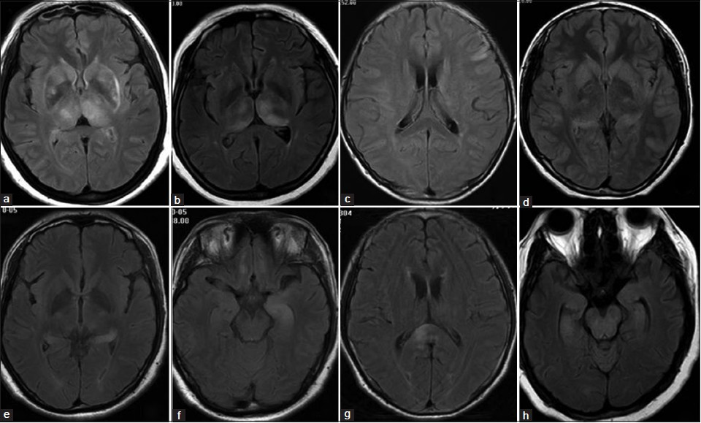
MRI findings
Qi Meng et al, 2014

Slide 54
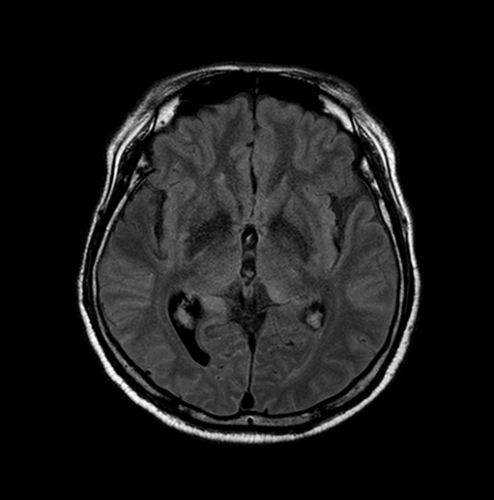
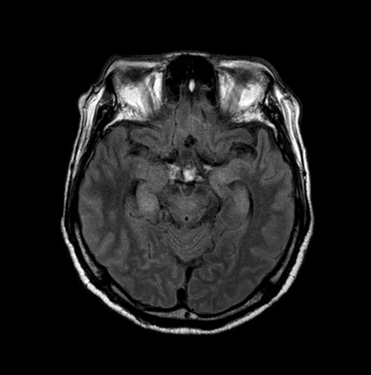
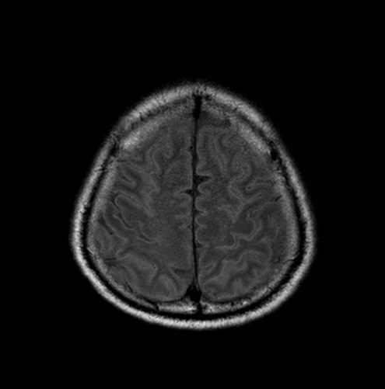
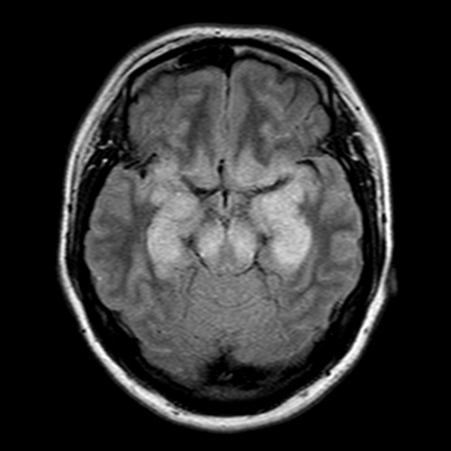
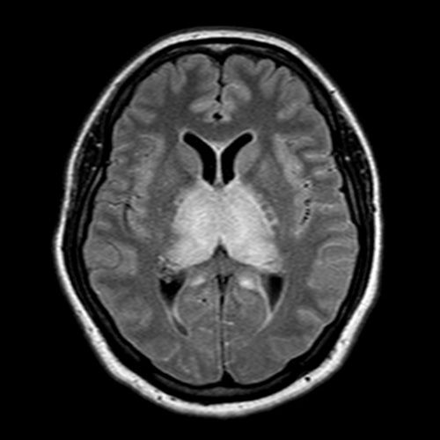
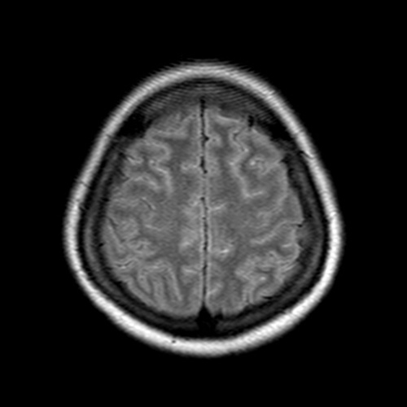
Thalamus 94%
Basal ganglia 35%
Midbrain 58%
Pons 26%
Cerebellum 19%
Cerebral cortex 19%
Temporal lobe 17.7%
Notes:
Kalita, J., Misra, U.K., 2000a. Comparison of CT scan and MRI findings in the
diagnosis of Japanese encephalitis. J. Neurol. Sci. 174, 3–8.
Handique, S.K., Das, R.R., Barman, K., Medhi, N., Saharia, B., et al., 2006. Temporal
lobe involvement in Japanese encephalitis: problems in differential diagnosis.
Am. J. Neuroradiol. 27, 1027–1031.

Slide 55
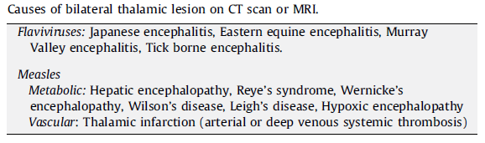

Slide 56
목차
JEV introduction, epidemiology
Diagnosis
Clinical manifestation
Pathology
viral cycle, brain/cord, biopsy…
Flaccid paralysis

Slide 57
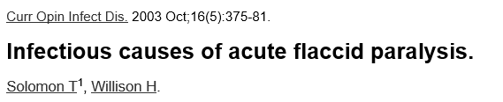
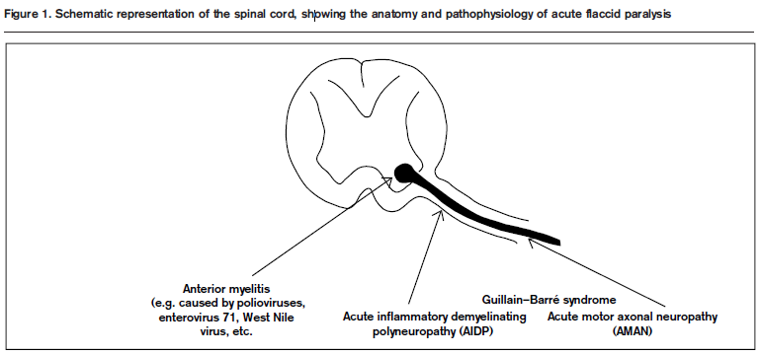

Slide 58
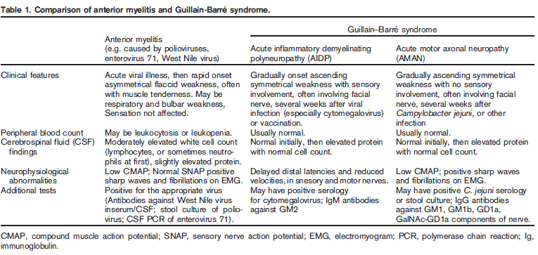

Slide 59
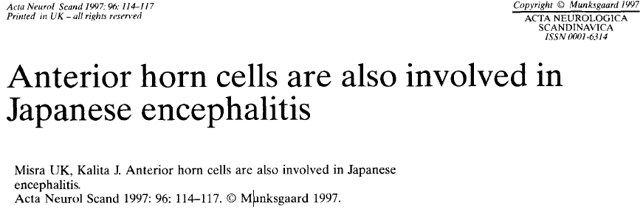
12 patients with JE (fever, unconsciousness…)
7 with muscle wasting

Slide 60
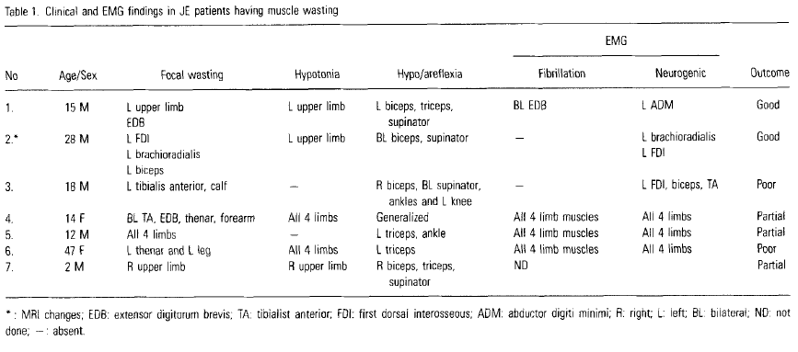
Notes:
All these patients had
characteristic encephalitic syndrome comprised of
fever with varying degree of unconsciousness. In
the initial stage, focal hypotonia in 3 and focal
reflex loss in 6 patients were present. All 4 limbs
were flaccid in 2 patients and the reflexes were
absent in 1 patient. By the 2nd to 4th week, muscle
wasting was noted, which involved all 4 limbs in 2
patients and was focal in 5 patients. The focal
wasting was patchy involving a few muscles of a
limb in 2 patients and a number of noncontiguous
muscles in different limbs in 3 patients.
After 3 months, muscle wasting although persisted
but hypotonia was replaced by spasticity in 5
patients and tone became normal in 2 patients.
In the group with extensive
anterior horn cell involvement, the recovery was
poor in 2 patients or partial in 3 patients. These
results suggest the important role of anterior horn
cell involvement in the outcome of JE patients.

Slide 61

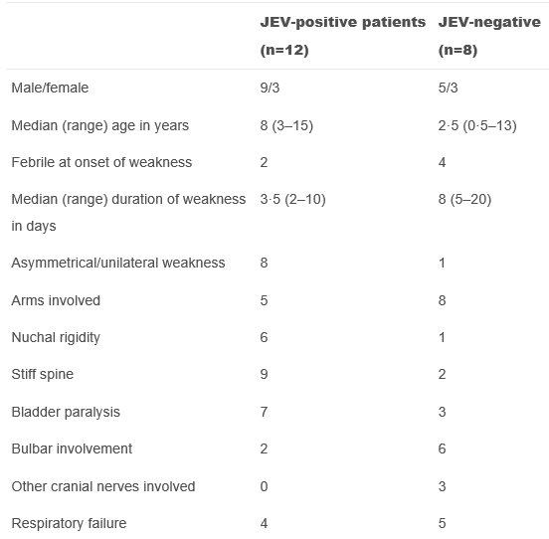
22 patients with acute flaccid paralysis
8- JEV negative
2- CSF negative
12- JEV positive
JEV negative…
Wild poliovirus type 1
Non-polio enterovirus (coxakie, echovirus 20, echovirus 14)

Slide 62
Polio <-> JEV
The presentation mimicked poliomyelitis in many respects: a short prodrome with fever, vomiting, and headache; rapidly progressing asymmetrical flaccid paralysis, usually beginning in the lower limbs,
However, urinary retention, pyramidal tract signs, and encephalitis are rare complications of poliomyelitis and should point to JEV infection in
endemic areas

Slide 63
Summary
Hematogenous spread
Gray matter > white matter
Anterior horn involvement (prognosis)

Slide 64
https://jvi.asm.org/content/89/10/5602

