Slide 1


Slide 2
HYPRTENSION
Dr. AHMAD SHAJARI

Slide 3
Definition of HTN:
Borderline:90 -95 percentile
Mild: 5-9 mmHg above 95 percentile
Moderate:10-15 mmHg above 95 percentile
Severe: More than 15 mmHg above 95 percentile or vital organ damage.

Slide 4
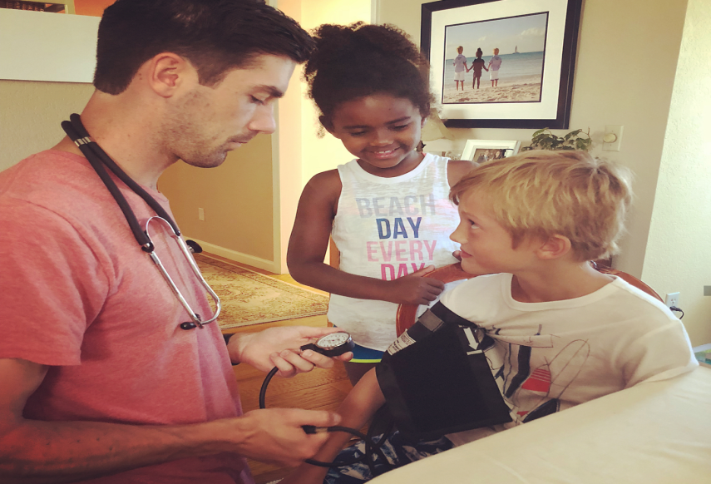
Differences in children and adults:
Incidence
BP is not measured routinely
Difficulties in BP measurement
Vital organ damage
Etiology
Symptoms

Slide 5
Upper limit of BP:
BP | Age(yr)
110/70 | 1-5
120/80 | 6-9
125/85 | 10-13
135/90 | 14-18

Slide 6
Blood pressure Measurements in children and Adolescents:
Environment
Quiet and comfortable.
Cuff size
Cuffs differ in width and in length. The rubber bladder should encircle 80% to 100% of girth of upper arm and cover 40% of length of upper arm . If the cuff is too small use of the next larger size will avoid falsely elevated readings.

Slide 7
Blood pressure measurements in children and Adolescent:
Procedure
Sources of error
The technique is similar to the adults . The IV Korotokoff sound is used as the best indirect reflection of diastolic pressure . Blood pressure should be measured in both arm , standing, sitting and supine, and the leg.
These include arm not at heart level , malfunctioning manometers, and observer bias and/or hearing deficit.

Slide 8
Renal diseases:
The most common cause of HTN(75-80%)
The most common renal disease:
Reflux-nephropathy(25-50%)
The most common type of RVH:
Fibromascular dysplasia(70%)

Slide 9
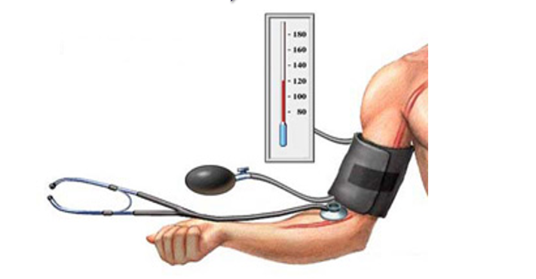
_age>3 yrs
_ ICU CHF
_Risk factor: Convulsion
Catheterization
_ Reno vascular hypertension
_Abdominal mass
_ Coarctation of the Aorta
_neruo fibro matosis
_Turner syndrome
_CAH
_Drug ( steroid _ACTH)
_Burn _Hus _FTT
_Eye mass
_proteinuria - Hematuria

Slide 10
Etiology:
1)Renal or Azotemia hypertension
(75-80 %)(Reflux nephropathy 25-50%)
U/A pr- blood – cast WBC _cast RBC
S.G _ Urea _ cr _ Edema
Oliguria
Transient HTN: Acute nephritis due to Infection
HSP HUS ATN Obstruction uropathy

Slide 11
2)Renin Mediated Hypertension(10-15%)
- Cardio vascular ( Coarctation of aorta)
-Reno vascular
-Alkalosis metabolic
-Hypokalemia
-Target organ damage
-HTN(diastolic)
DMSA – DTPA –IVP
Renin - Aldosterone
Angiography

Slide 12
3) Mineralo corticoid induced Hypertension
(3-5%)
BP systolic
diastolic (NL)
U/A NL
Edema Negative
Target organ damage= Negative
_ Alkalosis metabolic
Hypokalemia
Aldosterone Renin
CT scan Tumor
Liddle syndrome- psudohyperaldestronism

Slide 13
4)cathecolomin induced Hypertension
(2 -5%)
BP
Alkalosis metabolic
Hypokalemia
_surgery on neck
-feocromocitoma: Epinephrine
nephrine sonograghy,CTscan
Neurofibromatosis (MIBG=metaio debenzyl)
-Guilluin – Barre syndrome

Slide 14

Poliomyelitis
Burn
Steven johnson syndrome
-Dysautonomia familial

Slide 15
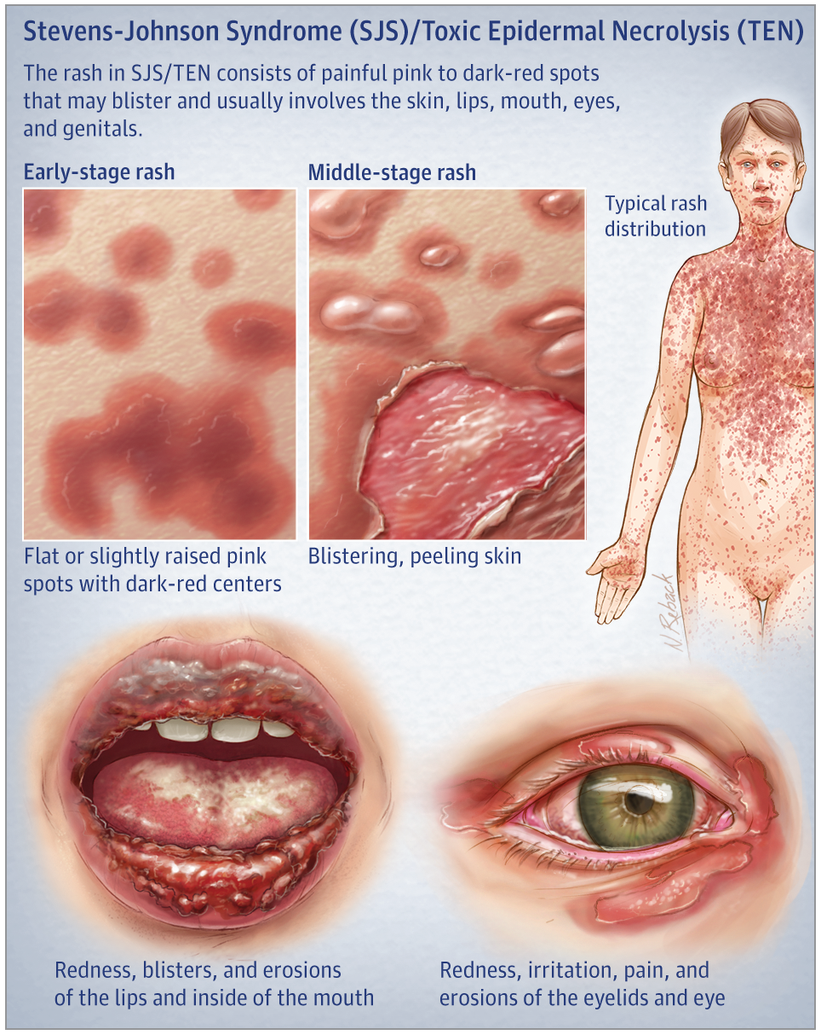

Slide 16
Hemotologic Anemia- polycythemia
Endocrine
metabolic
Cushing syndrome
Hyperthyroidism
Hypothyroidism
Diabetes
Hypernatremia
Hypercalcemia

Slide 17
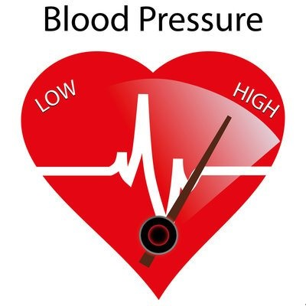
Symptoms in infants
CHF (56%)
Respiratory distress (36%)
FTT , vomiting (29%)
Irritability (20%)
Convulsion (11%)

Slide 18
Symptoms in older children:
Headache (30%)
Nausea , Vomiting (13%)
Hypertensive encephalopathy (10%)
Polyuria , enuresis , visual defect ,facial palsy, epistaxis , etc.

Slide 19
treatment
-Renal HTN
Lasix _ vasodilator: Nifedipine
Hydralazine
_ Renin mediated HTN Inderal
Captopril –Enalapril- labetalol
-mineralocoticoid induced HTN
Spironolactone
Catecolamine induced HTN
Perazosin – phenoxybenzamine
Phentolamine – labetalol - inderal

