Slide 1

Emergence of Multi drug resistant pathogens In Neonatal Sepsis
By
Professor Zareen Fasih
Chairperson Peadiatric Department
Zia-ud-din Hospital Karachi
Secretory General Pakistan Pediatric Association

Slide 2
Increased resistance of
Multi-Resistant Enterobacter sepsis
in a Tertiary care NICU setting – a two year study
Ziauddin University Karachi Pakistan

Slide 3
Introduction & Background
Neonatal sepsis is one of the most frequent causes of admission in a tertiary care neonatal intensive care setting .
It is also the most important cause of neonatal morbidity and mortality worldwide.
Incidence of neonatal sepsis varies from 1-2.5/1000 live births.

Slide 4
Introduction & Background
Neonatal sepsis can be “ early onset ” if it presents within first 7 days of life and “ late onset ” if it presents between 7- 28 days of life.
The spectrum of organisms that cause neonatal sepsis is wide and includes both gram positive and gram negative organisms. Among the gram positive the most common -----.
In any unit the protocol of selection of antibiotics depend upon the frequency and occurrence of the type of organisms and their sensitivity patterns to the antibiotics.

Slide 5
Introduction & Background
During past years there has been a change in the common pathogens causing neonatal sepsis.
Especially in the units where extremely premature VLBW and high risk neonates are admitted and where highly specialized intervention like
mechanical ventilation
CVP line insertion
umbilical line placement
catheterization are routinely practiced.

Slide 6
Introduction & Background
Various studies worldwide have shown that with high risk babies who are on prolonged use of antibiotics the emergence of pathogens other than the common pathogens is quite common.
Secondly, experience has shown that very soon these organisms develop resistance to commonly used antibiotics like third generation Cephalosporins and Aminoglycosides

Slide 7
Introduction & Background
Hence, it is very important for neonatologists and microbiologists to periodically evaluate the spectrum of organisms causing neonatal sepsis in their units and to determine the antibiotic policies in context and the resistance patterns of the organisms.

Slide 8
Introduction & Background
It is also of paramount importance to look into the risk factors for the development of resistance to the antibiotics.
Only after that one would be able to decrease the emergence of resistant organisms of neonatal sepsis and to decrease the morbidity and mortality due to neonatal sepsis.

Slide 9
Introduction & Background
We carried out this study to look into occurrence of Enterobacter sepsis in our unit and the emergence of resistance patterns of the above organisms to commonly used antibiotics
So that
protocol guidelines can be prepared regarding selection of antibiotics and secondly measures taken to prevent the development of resistant strains of Enterobacter .

Slide 10
Material and methods
The study was conducted in the neonatal intensive care unit of Ziauddin Hospital North Campus , Karachi during Jan. 2008- Dec ,2010.
Blood specimen for culture was drawn from 2166 newborn babies admitted in NICU with clinical signs of sepsis
Repeat blood cultures were sent when the neonate did not show signs of improvement OR deteriorated on 1st line antibiotics .

Slide 11
A single sample of 2-3 ml of blood was collected and incubated in 30ml of Brain Heart infusion broth (Difco).
The colony isolates were identified by their colony morphology and also by using API-20E galleries (System Montalieu Vercieu ,France ) for Enterobacteriaceae (antibiotic resistance pattern of isolates were studied by using Modified Kirby Bauer disc diffusion technique. 5-6
As required, other samples e.g.
Urine
CSF
skin swab
E/T tip
UAC tip UVC tip and E/T secretions
were also sent for culture and sensitivity when indicated .

Slide 12
When one looked into the spectrum of organisms causing sepsis among gram positive organisms staphylococcus lugdenensis was grown in 150 (27.7 %) cases followed by staphylococcus aureus in 54 (10.00% ) cases.
While among gram negative organism Enterobacter was seen in 84 (15.5 % ) cases followed by Pseudomonas 43 (7.96 %) cases.(Table 3.)

Slide 13
The type of organisms for neonatal sepsis (n = 540):
Gram positive organism | n | %
Staph.lugdenensis | 150 | 27.77
Staph. aureus | 54 | 10.0
Gram negative organism | n | %
Enterobacter cloacae | 84 | 15.55
Pseudomonas | 43 | 7.96

Slide 14
All the neonates were initially given broad spectrum intravenous antibiotics (Cefotaxime and Amikacin )
The antibiotics regimen was modified when the blood culture results were known.
The Enterobacter positive cases occurred in clusters , at intervals lasting from 4-6 months.
In our unit ,all neonates were housed in 2-18 cot, intensive care cubicles.
It was difficult to isolate the infected babies or outside referrals.

Slide 15
Enterobacter was the most common isolate in the period from Jan. 2009 till Dec.2010.
Decrease in the incidence of early onset sepsis and a rise in the incidence of late onset sepsis with Enterobacter was also observed during this period (4.6/1000 live births).
Tightening of the infection control measures particularly frequent hand washing and cohort isolation of the infected neonates resulted in subsidence of the clusters.

Slide 16
The source of Enterobacter was blood in 75 ( 89.28% ) cases.
The time of onset of Enterobacter sepsis was late onset in 69 (82.14% ) cases , while it was early onset in 15 (17.85 % ) cases. (Table 2.)
Enterobacter Sepsis n = 84.
Table 2
Time of onset of Sepsis | n | %
Early onset (0-7 days) | 15 | 17.85
Late onset (7-28 days ) | 69 | 82.14

Slide 17
Univariate analysis of risk factors revealed a significant association between
  LBW n=54 ( p value 0.001)
  and prolonged stay in the nursery n=66 ( p value 0.001)
  and enterobacter sepsis ( Table 7.)
Looking into the resistance pattern of the organism to the first line antibiotics used in the unit (Cefotaxime and Amikacin ) 72% of the organisms showed resistance to the first line antibiotics

Slide 18
Antimicrobial Resistance pattern (%) 0f organisms
Department of microbiology
dr. ziauddin hospital Karachi
Organisms | Isolates | AK | AMP | AMC | ATM | PB | CTX | CAZ | CFM | SXT
Acinetobacter | 459 | 59 | NT | NT | NT | 0 | 79 | NT | NT | 68
E. Coli | 1580 | 5 | 87 | 43 | 79 | 0 | 79 | NT | 79 | 88
Enterobracter spp | 1100 | 13 | NT | NT | 45 | 0 | 45 | NT | 45 | 38
H. Influenzae | 70 | NT | 10 | NT | NT | NT | 0 | NT | 0 | 73
Proteus Mirabilis | 287 | 10 | 57 | 24 | 45 | NT | 45 | NT | 45 | 63
Ps. Areruginosa | 619 | 20 | NT | NT | 34 | 0 | NT | 37 | NT | NT
Solmonella typhi | 273 | NT | 34 | NT | 0 | NT | 0 | NT | 0 | 34
Vibrio cholerae | 74 | NT | 12 | NT | NT | NT | NT | NT | NT | 84
Moraxella catarralis | 217 | NT | NT | 0 | NT | NT | NT | NT | NT | 91
Klebsilla spp | 336 | 31 | NT | 25 | 59 | 0 | 59 | NT | 59 | 56
Year 1

Slide 19
Antimicrobial Resistance pattern (%) 0f organisms
Department of microbiology
dr. ziauddin hospital Karachi
Organisms | Isolates | CN | IPM | MEM | OFX | TZP | SCF | C | E | LEV | TET | CT
Acinetobacter | 459 | 64 | 65 | 65 | 83 | 67 | 62 | NT | NT | NT | NT | 0
E. Coli | 1580 | 48 | 0 | 0 | 66 | 9 | 3 | NT | NT | NT | NT | 0
Enterobracter spp | 1100 | 28 | 0 | 0 | 40 | 11 | 3 | NT | NT | NT | NT | 0
H. Influenzae | 70 | NT | NT | 0 | NT | NT | NT | 10 | NT | 9 | NT | NT
Proteus Mirabilis | 287 | 31 | 0 | 0 | 30 | 0 | 0 | NT | NT | NT | NT | NT
Ps. Areruginosa | 619 | 35 | 20 | 20 | 35 | 17 | 11 | NT | NT | NT | NT | 0
Solmonella typhi | 273 | NT | NT | NT | 90 | NT | NT | 34 | NT | NT | NT | NT
Vibrio cholerae | 74 | NT | NT | NT | 0 | NT | NT | 0 | NT | NT | 0 | NT
Moraxella catarralis | 217 | NT | NT | NT | 60 | NT | NT | NT | NT | NT | NT | NT
Klebsilla spp | 336 | 54 | 0 | 0 | 45 | 23 | 23 | NT | NT | NT | NT | 0
Year 1

Slide 20
Antimicrobial Resistance pattern (%) 0f organisms
Department of microbiology
dr. ziauddin hospital Karachi
Organisms | Isolates | AK | AMP | AMC | ATM | PB | CTX | CAZ | CFM | SXT
Acinetobacter | 187 | 74 | NT | NT | NT | 0 | 92 | NT | NT | 72
E. Coli | 648 | 12 | 87 | 36 | 69 | 0 | 69 | NT | 69 | 69
Enterobracter spp | 329 | 21 | NT | NT | 69 | 0 | 69 | NT | 69 | 52
H. Influenzae | 77 | NT | 4 | NT | NT | NT | 0 | NT | 0 | 71
Proteus Mirabilis | 116 | 10 | 38 | 13 | 46 | NT | 46 | NT | 46 | 69
Ps. Areruginosa | 388 | 28 | NT | NT | 37 | 0 | NT | 33 | NT | NT
Solmonella typhi | 75 | NT | 41 | NT | 0 | NT | 0 | NT | 0 | 41
Vibrio cholerae | 25 | NT | 9 | NT | NT | NT | NT | NT | NT | 90
Moraxella catarralis | 151 | NT | NT | 0 | NT | NT | NT | NT | NT | 94
Klebsilla spp | 255 | 30 | NT | 47 | 72 | 0 | 72 | NT | 72 | 58
Year 2

Slide 21
Antimicrobial Resistance pattern (%) 0f organisms
Department of microbiology
dr. ziauddin hospital Karachi
Organisms | Isolates | CN | IPM | MEM | CIP | TZP | SCF | C | E | LEV | TET | CT
Acinetobacter | 187 | 73 | 72 | 72 | 85 | 75 | 80 | NT | NT | NT | NT | 0
E. Coli | 648 | 40 | 1 | 1 | 65 | 7 | 3 | NT | NT | NT | NT | 0
Enterobracter spp | 329 | 48 | 1 | 1 | 41 | 16 | 3 | NT | NT | NT | NT | 0
H. Influenzae | 77 | NT | NT | NT | NT | NT | NT | 3 | NT | 7 | NT | NT
Proteus Mirabilis | 116 | 37 | 0 | 0 | 27 | 0 | 0 | NT | NT | NT | NT | NT
Ps. Areruginosa | 388 | 38 | 16 | 16 | 31 | 23 | 5 | NT | NT | NT | NT | 0
Solmonella typhi | 75 | NT | NT | NT | 90 | NT | NT | 41 | NT | NT | NT | NT
Vibrio cholerae | 25 | NT | NT | NT | 0 | NT | NT | 0 | NT | NT | 6 | NT
Moraxella catarralis | 151 | NT | NT | NT | 55 | NT | NT | NT | 28 | NT | NT | NT
Klebsilla spp | 255 | 50 | 8 | 8 | 40 | 25 | 23 | NT | NT | NT | NT | 0
Year 2

Slide 22
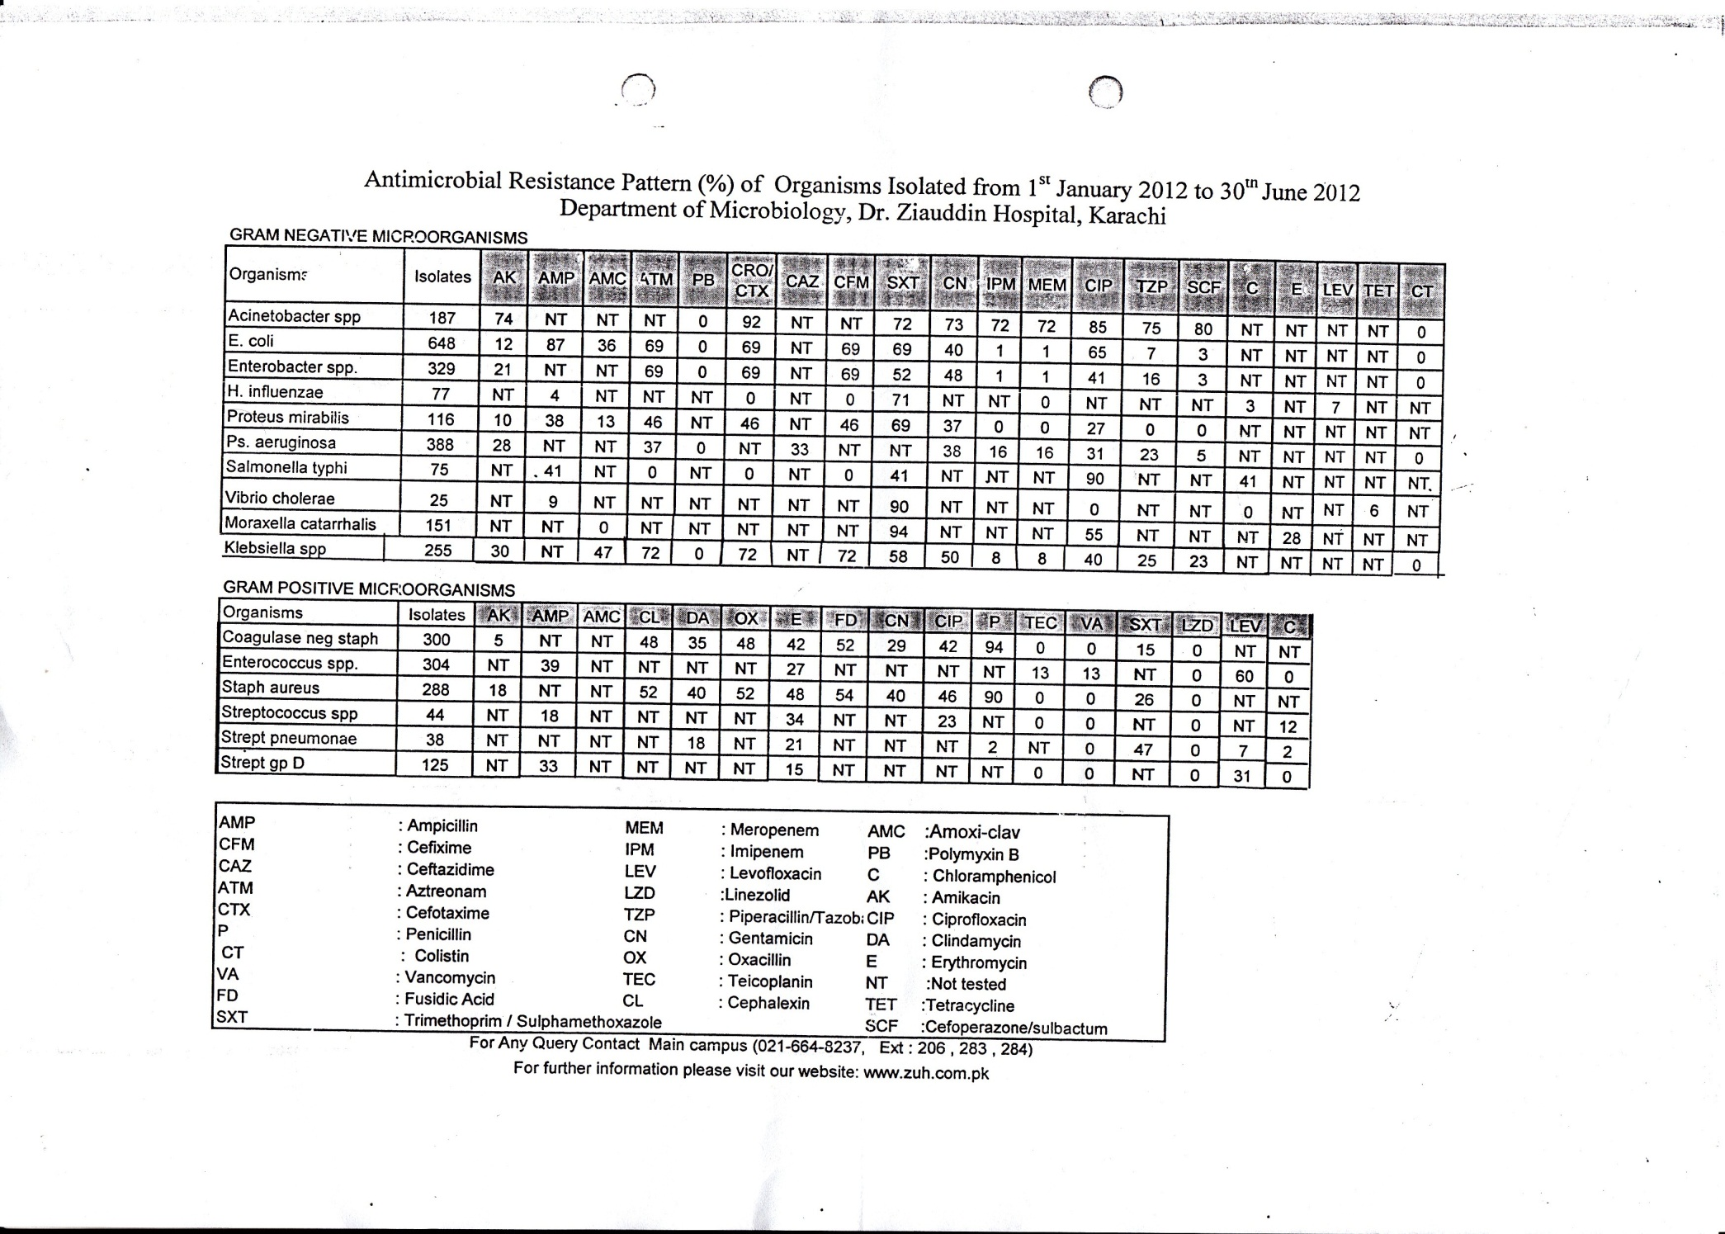

Slide 23
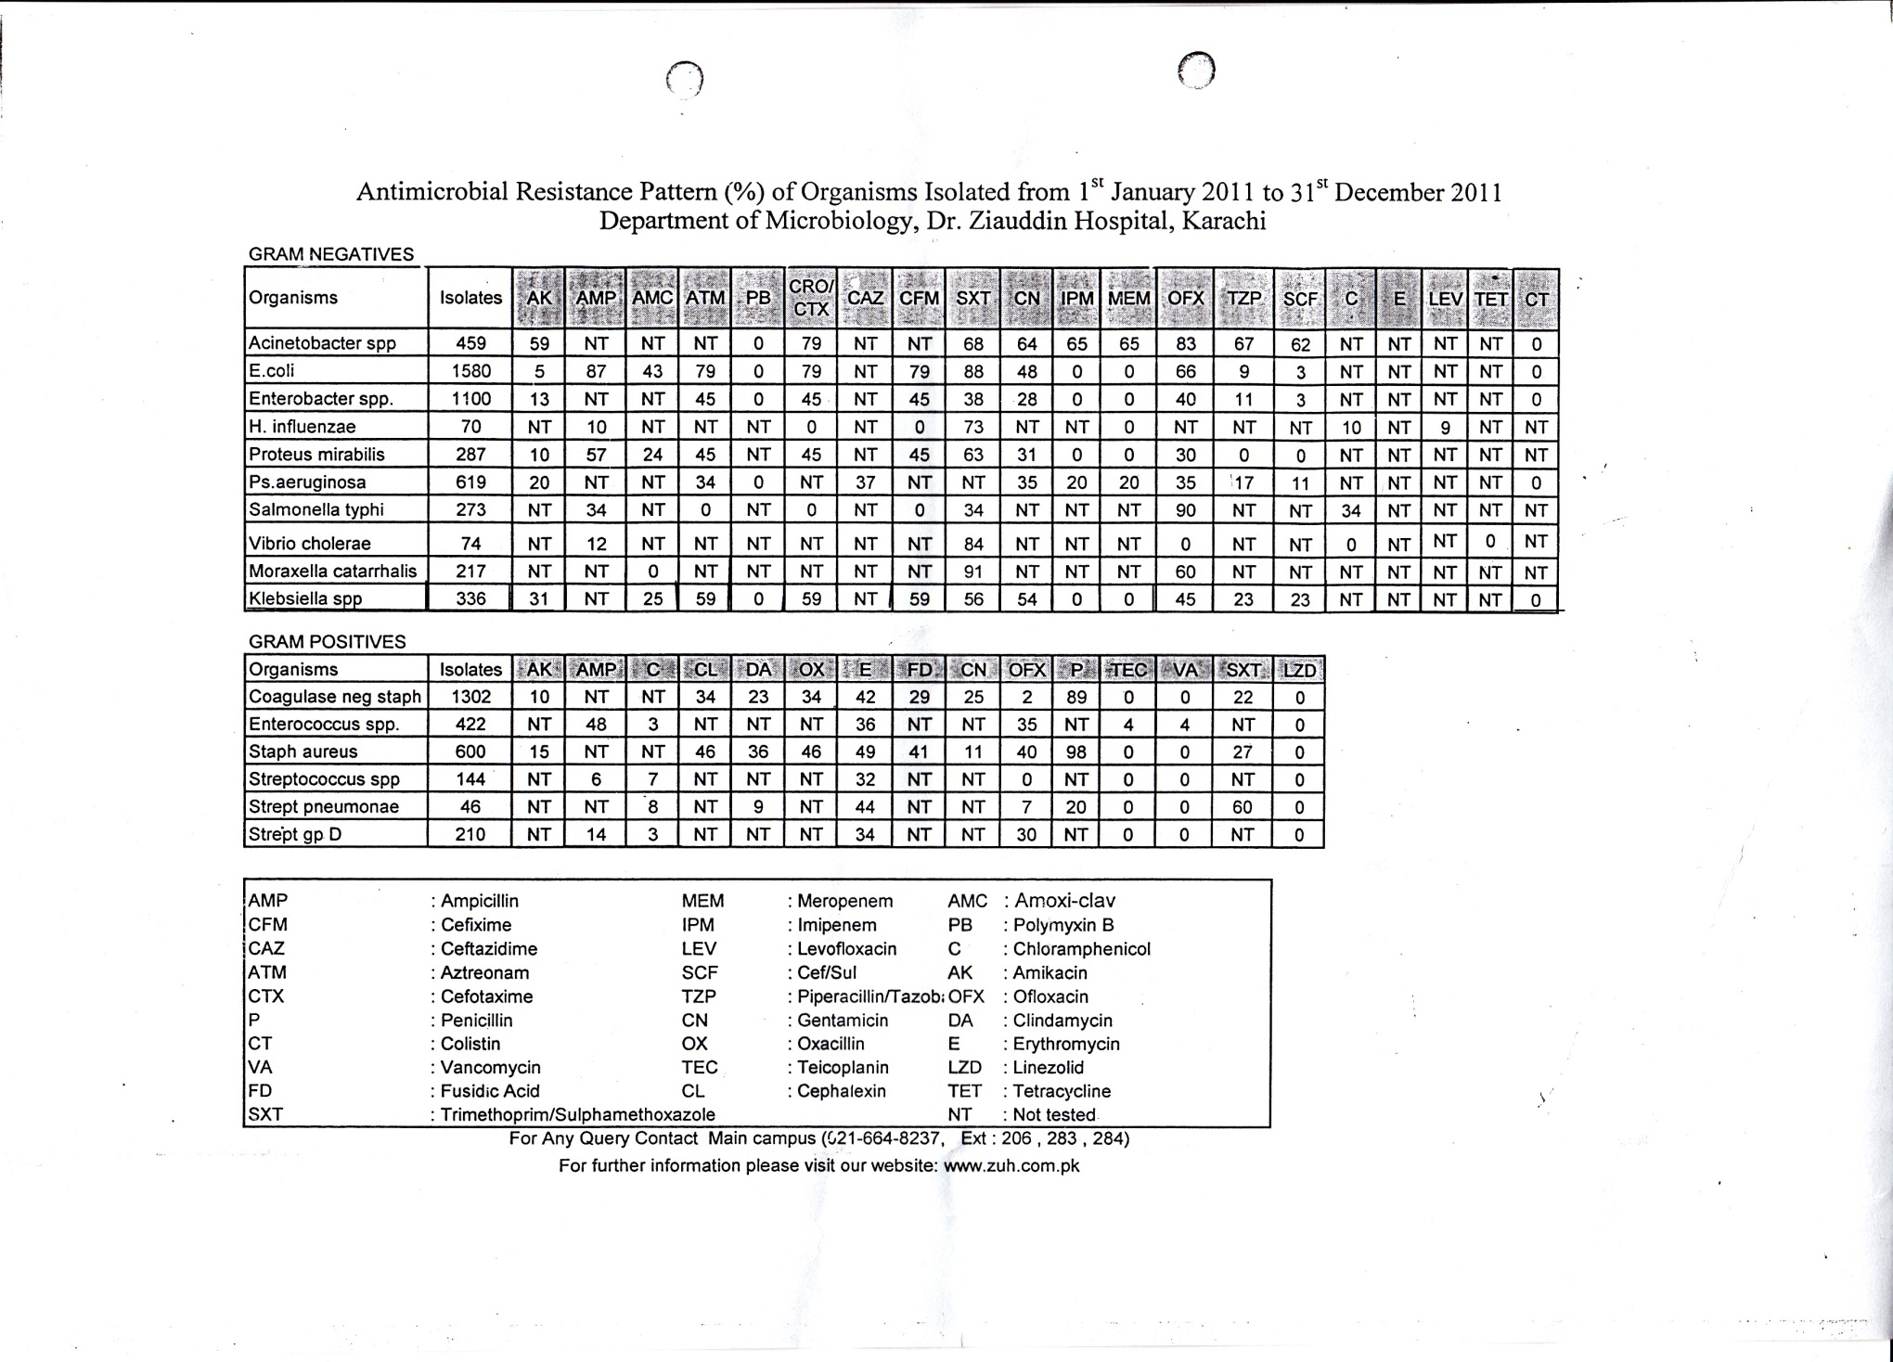

Slide 24
Result
Out of 2,166 samples of blood cultures sent , there were 540 (24.93%) cases of culture proven sepsis .
Enterobacter was grown in 84 (15.5 %)
The source of Enterobacter is shown in (Table 1.)

Slide 25
Sources of Positive Cultures of Enterobacter
Table 1
Source | n | %
Blood | 75 | 89.28
E/T Tip | 2 | 2.3
Urine | 6 | 7.14
CSF | 0 | 0.00
Umbilical Tip | 1 | 1.19

Slide 26
Enterobacter sepsis was more common in male neonates with an average ratio of 2:1 of male to the female neonates.
From a total of 84 neonates ONLY 28% were sensitive to first line antibiotics while 72% showed resistance pattern.
The distribution of incidence of sepsis by the time of sepsis is shown in Table 2.
Enterobacter sepsis was more frequent in late onset sepsis.

Slide 27
The potential risk for factors for developing Enterobacter sepsis e.g. sex ,PROM ,prematurity ,LBW , ventilatory support , invasive procedures in NICU
Prolonged use of antibiotics were analysis were analyzed .
Risk factors like
  Low birth weight
  Prematurity
  Prolonged stay in the NICU,
  were significantly associated with a higher chance of developing Enterobacter sepsis in the neonates .

Slide 28
Factors | n | % | P value
Sex: Male | 48 | 57% | 0.281
Female | 36 | 43% | 0.281
LBW | 54 | 64% | 0.001
Prematurity 20-32 WEEKS | 54 | 64% | 0.001
Prematurity 33-37 weeks | 24 | 28% | 0.001
Prolonged stay in NICU | 66 | 78% | 0.001

Slide 29
Discussion:
In this observational study , we describe epidemiological characteristics of Enterobacter sepsis outbreak in a neonatal ICU and analyze major risk factors for development of enterobacter sepsis.
The nosocomial outbreak is indicated by the occurrence of 84 neonatal enterobacter sepsis during 2 years with a crude 53 per 1000 admissions.

Slide 30
Enterobacter species isolates were all Enterobacter cloacae and Enterobacter aerogenes which tallies with the most frequent species isolated.
Over the last decade previously less common organism like Enterobacter aerogenes has been identified as a more frequent isolate as a cause of nosocomial outbreaks in NICU settings.

Slide 31
Infections caused by these organisms are difficult to treat due to the emergence of multi-drug resistance to most commonly used antibiotics in a NICU setting.
One study confirms the association of various established risk factors for the developing Enterobacter sepsis in a NICU settings.

Slide 32
Among these we especially recognize the relevance of prolonged use of antibiotics in neonates secondary to prematurity or low birth weight .
Our results also verify the length of stay in the neonatal intensisve unit as a major statistically important risk factor.

Slide 33
Although each of the mentioned risk factors can independently justified , their separate analysis might not be appropriate because of the apparent inter-relationship between them.

Slide 34
Conclusion
This is a very important report showing that some previously described risk factors for developing Enterobacter sepsis were equally applicable in the present study.
Increasing survival of low birth weight and premature babies that require implementation of invasive methods
  like ventilators,
  placement of umbilical arterial and venous lines ,
  intubation ,
  nasogastric tube insertion
  and prolonged use of antibiotics
  provide a favorable environment for the continuous presence of Enterobacter spp. as a cause of sepsis in the neonatal intense care units.

Slide 35
Our data suggest the possibilities that prolonged stay in the nursery due to prematurity and low birth weight are important risk factors in the pathogenesis of Enterobacter sepsis in neonates.
Prolonged use of antibiotics may result in emergence of multi-drug resistant organisms.
Further studies are needed to establish the role of antibiotics in the emergence of multi-drug resistant micro-organisms in neonatal intensive care units.

Slide 36
References:
2.Dawodu A, Urnran K, Twum DK. A case control study of neonatal sepsis: experience from Saudi Arabia. J.Trop. Pediatr,, 1997;43:84-88.
3..Escobar GJ. The neonatal “sepsis work-up”: personal reflections on the development of evidence based approach toward newborn infections in a managed care organization. Paediatrics, 1999; 103:360-73.
4.Sanghvi KP, Tudehope DI. Neonatal sepsis in a neonatal intensive care unit: a 5-year analysis. J. Paediatr. Child Health, 1996;32:333-38.
5.Baur Aw,Kirby WM,Shirs JC,et al .Antibiotic susceptibility testing by a standard single disc method.Am.J. Clin. Pathol.,1966; 45:493-96.
6.Morre DL – Nosocomial infections in newborn nurseries and neonatal intensivecare units in Mayhall C.G ed. Hospital epidemiology and infection control.Baltimore William & Wilkins ;1996 535-64.
7.Sanders WE Sanders CC.Enterobacter spp. Pathogens poised to flourish at the turn of the century .Clin.Microbiol. Rev. 1997 ,10-220-41.
8.Falkiner FR .Enterobacter in Hospital J. Hosp. Infect. 1992; 20 137-40.
9.Acolet D , Amict .Z ,Hou ange ,Hurley R, Kaulmann ME.Enterobacter Clearance in a antibiotic resistant nosocomial pathogen in Belgian Hospital –Clin.Microbiol. Infect. 1999 ; 5 ; 622-7.
10.Chang EP ,Chiang D H ,Lin ML,Clen TL, Wang F D,Lui CY,Clinical Characteristics and predictors of mortality in patients with Enterobacter aerogenes bacteria.J.MicrobiolImmunol. Infectious 2009 ; 42 (4) 329 -35.

Slide 37
References:
11.Gaynes RP Edwards JR ,William R, Culver DH ,Tolsun JS, Martune WJ.Nosocomial Infections among neonates in high risk nurseries in the United States.Pediatrics 1996 ; 98 : 357-61.
12.Fok TF , Lic CH, Wong EM ,Lyon DJ ,Wong W , Ng PC, et al.Risk factors for Enterobacter septicemia in a neonatal unit care unit case control study .Clin.Infect. Dis. 1998 ; 27(5) : 1204-9.
13.Delben M ,Yarkulja G ,Basso M, Krebs VL ,Gibelli MA, Van der Heji den I , et al. Investigation of an outbreak of Enterobacter cloacae in a neonatal care unit.Scand. J. Infect. Dis. 2000 ; 32 (3) 293-8.
14.Dren MP, Ludwig ,AC, Leilities JU, Daschner FD , Low Birth Weight ? nosocomial infection of Neonates in a neonatal intensive care unit J.Hosp.Infect.1995; 30: 65-72.
15.Rojo D.,Pinedo A, Clavijio E, Gracia V ,Analysis of Risk factors associated with nosocomial bacteremias ,J.Hosp.Infect. 1999 ; 42 :135-41.

