Slide 1


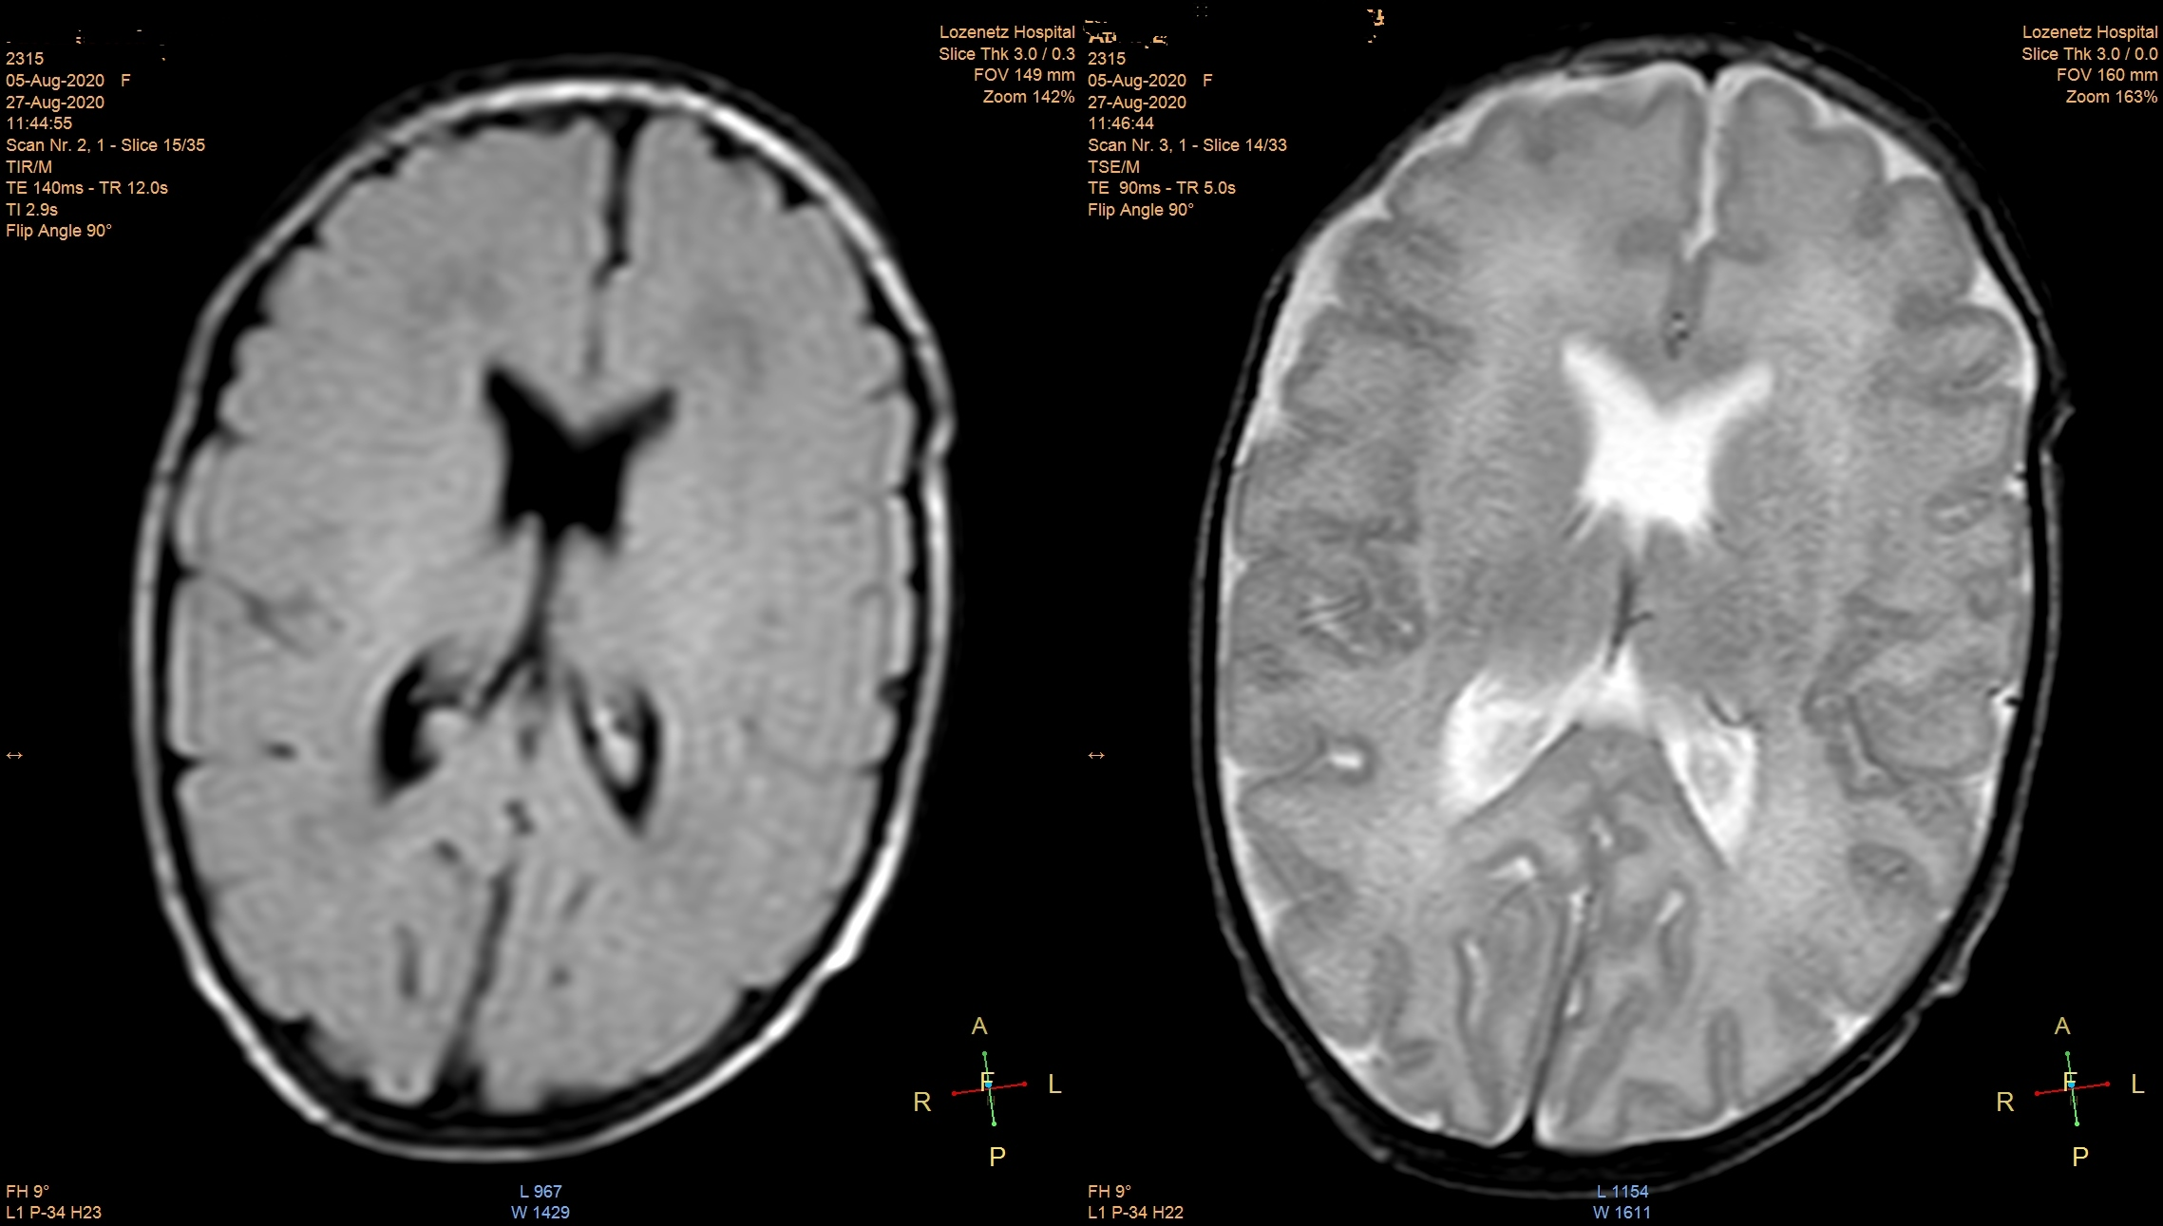
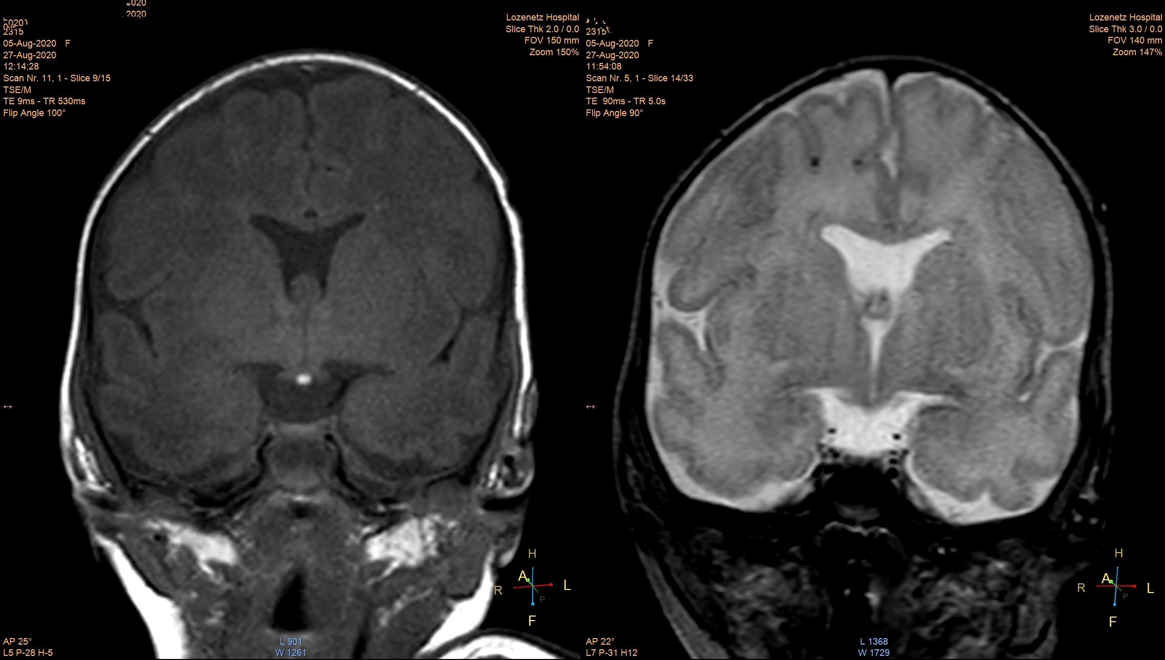
20th Annual World Congress on Neonatology
September 20-21, 2021 Vancouver, Canada
Agenesis of septum pellucidum with hypophyseal abnormalities – case report
Boyadzhiev S., Goncharov A., Vuchkova E., Uzunova Y.
Medical faculty, Sofia University “St. Kliment Ohridski”, University Hospital Lozenetz
Introduction
Agenesis of septum pellucidum is a rare congenital anomaly of the newborn with an incidence of 2-3 per 100 000 children. There is tremendous phenotypic heterogenicity and an unknown genetic reason (<10% of the cases have associated gene). The condition is sometimes part of a syndrome called septo-optic dysplasia (SOD) that is characterized by hypoplasia of the optic nerve, hypophyseal insufficiency and structural defects in the midline of the brain (different anomalies in septum pellucidum and/or corpus callosum).
Prenatally the anomaly can be assumed when there is hypo- or dysgenesis of the septal leaflet, which leads to complete lack of visibility of the cavum septum pellucidi. This finding has vast differential diagnosis – holoprosencephaly, agenesis/dysgenesis of corpus callosum, hydrocephalus etc. In these cases the recommendation is to obtain prenatal magnetic resonance imaging (MRI) or continue supervision after birth with ultrasound and if needed MRI. Vision and endocrine function of the hypophysis can be assessed only postnatally.
Clinical presentation can be diverse, the main symptom is impaired vision (because this condition is mainly part of SOD syndrome), followed by anomalies of the pallatum durum, hypopituitarism with predominant involvement of somatotropin and different neurological injuries (paralysis, paresis, seizures, nystagmus etc.)
Prognosis is unclear - should be discussed on an individual basis depending on the severity of organ involvement. Treatment includes multidisciplinary management which can include hormone substitution, anticonvulsants, physio- and kinesitherapy, visual impairment is generally untreatable.
Due to the remaining suspicion for SOD we made a consultation with ophthalmologist – no pathology from ocular examination.
Hormonal status was assessed and revealed hypocorticism and hypothyroidism which required treatment with hydrocortisone and L-thyroxin.
Additionally we performed cytogenetic analysis – normal chromosomes.
The newborn’s condition improved after the hormonal substitution and it was discharged at 40 days of age with weight – 2500 gr, no pathology on physical examination and was referred to a multidisciplinary pediatric center for additional follow up.
Discussion
Agenesis of septum pellucidum is a rare condition with multiform presentation, in a lot of the cases concomitantly with hypoplasia of the optic nerve as a part of SOD. Our patient has isolated septum anomaly with hypopituitarism without any pathology from the optic nerves.
In some cases the anomaly is recognized prenatally during routine fetal morphology examinations, but in this case the condition was not recognized.
Abnormal development of brain structures can produce different neurological symptoms with varying severity – seizures, paresis, paralysis etc. Our patient had multiple apnoic pauses and reduced muscle tone with normal motor function as well as normal, symmetrical reflexes of the newborn.
Hypopituitarism can range from panhypopituitarism to isolated injury of a single endocrine function and required hormone substitutes. The presented case has hypocorticism and hypothyroidism without episodes of hypoglycemia. Additionally this patient will require strict growth measurements and in the future thorough assessment of pubertal development.
Long term prognosis is unclear and depends of the symptoms that have developed. Cases with severe neurological involvement (i.e. seizures) and those with ocular involvement have the tendency to be with retardation in the neuropsychological development. Our patient has mild neurological involvement that became better after hormone substitution and has better prognosis than other cases.
Fig. 1 - agenesis of septum pellucidum
Case report
Newborn from first pathological pregnancy (multiple infections of the mother, positive vaginal microbiology for streptococcal bacteria).
Emergency caesarean section in 35 gestational week due to pathological tocogram and changes in fetal heart rhythm.
After birth – depressed condition, requiring application of positive end expiratory pressure (6 mm) and oxygen supplementation.
Apgar 1 min – 7, 5 min – 9, 10 min – 10.
Birth weight – 1950 gr, height – 44 cm, head circumference – 29 cm
After admittance in the neonatal unit for additional care the child was left on noninvasive ventilation due to the persistently increased oxygen needs.
Physical examination was mostly normal, except for reduced muscle tone.
In the next few days we observed a couple of apnoic spells, quickly resolved by mechanical stimulation and oxygen administration, muscle tone remained reduced.
Transfontanelle ultrasound was performed – lack of cavum septum pellucidum.
MRI was performed – confirmation of the ultrasound finding plus ectopy of the neurohypophysis, reduced size of the adenohypophysis, corpus callosum, optic nerves and hiasma opticum are normal.
Conclusion
Agenesis of septum pellucidum is a rare condition with polymorphic symptoms, hard to assess and diagnose in the neonatal period. Careful physical examination with the use of modern imaging studies help in quickly distinguishing the disease, evaluating it and starting the appropriate treatment.
Fig. 2 - hypophyseal ectopia

