Slide 1
THE USE OF NANONIZED EXTRACTS FROM LOCALLY AVAILABLE PLANT(MORINGA OLEIFERA) FOR THE TREATMENT OF BREAST CANCER.
D.O.N.OBIKWELU*, C.O.NEBO**,ADA NWOKOCHA*** AND S.I. UMEH****
PRESENTED AT THE COUNCIL MEETING OF THE NIGERIAN SOCIETY OF ENGINEERS ON 14TH JULY 2016 AT ABUJA.
*Professor and former Chair, Metallurgical & Materials Engineering Dept. University of Nigeria, Nsukka,
** Professor and Vice Chancellor, Materials Engineer, Ado-Ekiti Federal University, Ekiti. Nigeria.
*** Senior Lecturer and Director of Research, Department of Pediatric Medicine, University of Nigeria Teaching Hospital, Enugu Campus.
**** Laboratory Analyst, Department of Crop Science, University of Nigeria. Nsukka.

Slide 2
THE RATIONALE OF THE STUDY
The intractable deadly cancer of the breast is spreading fast amongst both young and old women.
Research efforts (1-8) to reduce the scourge of this disease, abound in the literatures.
But it appears that little success is achieved partially because of lack of co-ordination of these useful efforts from various disciplines, lack of cooperation of seemingly antipodal disciplines and lack of will and effort to exploit the curative potentials of the locally available plants in the immediate environment.
Inability of workers in the field to realize that cancer cure requires multi-disciplinary approach and it is only when seemingly antipodal fields merge and artificial boundaries melt that meaningful solution will appear.

Slide 3
PREAMBLE: THE FIELD OF NANOSCIENCE AND NANOTECHNOLOGY
The Field of Nanoscience and Nanotechnology is the study and applications of materials at nano size ranges.
The term, “nano” is 10⁻⁹ unit and a nanometer
is 10⁻⁹ M.
Nanoscale structures, as defined by the American Nanotechnology Initiative, have dimensions ranging from 1-nanometer to 100 nanometers.
It has been found that materials in these nano size ranges play the most significant role in the properties and applications of materials used in the Science, Engineering and Medicine.

Slide 4
NANOPARTICLES: THE DRIVING FORCE OF NANOSCIENCE AND NANOTECHNOLOGY
Nanoparticles are the driving force of Nanoscience and Nanotechnology.
The dimensions of nanoparticles are in the nano size ranges.
Nano-particles play key roles
Cure of cancer, other non-communicable diseases and some communicable diseases.
In the production of efficient and effective drugs.
In the production of anti-corrosion paints and coatings
And many other engineering products.
Great many innovations and technological advances have resulted from the applications of Nanoscience and Nanotechnology.

Slide 5
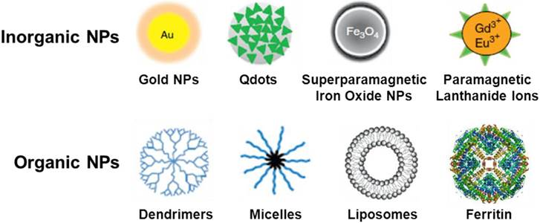
EXAMPLES OF NANOPARTICLES

Slide 6
BACKGROUD INFORMATION
Nanostructures are of the order of 1 to 100 nanometers.
According to Singer and Nicholson biological and body structures fall into the nano-size ranges (9).
A force of 1500 nanonewtons according to a report in the Science Daily was just enough to separate a cell from a substrate, therefore a force of that magnitude can adhere an appropriately configured nanoparticle to a cancer cell (10).
The mechanism of cancer cure is not clear but the comparable sizes of cancer cells with nanostructures will play a significant role.
Substitutional and interstitial poisoning is a possibility in cancer cure.
The T-cells a naturally occurring human immune system combine with nanostructures to cure cancer.

Slide 7
BACKGROUND INFORMATION CONTD.
Use of inorganic nanostructures to treat breast cancer was reported in the Science Daily (11).
Use of nano-particle probes like semiconductor quantum dots, organic dies and other chemical-base equipment in cancer detection and cure has been reported (12-13).
The use of locally available plants in the environment for the cure of cancer was never mentioned in reasonable detail in the literature.
Our belief is that organisms both human and animal can survive in their lifetime exploiting all that is locally available in its natural environment and this was the premise of the present study.

Slide 8
SCANNING ELECTRON MICROGRAPH OF CANCER CELLS DESTROYED BY T-CELLS.
The first slide shows active cancer cells in the body.
The second slide shows the cancer cells destroyed by the T-Cells. This slide resembles the SEM micrograph of nanostructured iron(II) pthallocynate supported on multi-walled carbon nanotube.

Slide 9
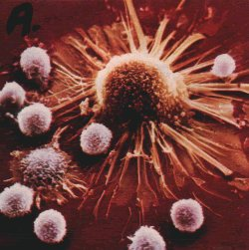
THE SCANNING MICROGRAPH OF ACTIVE CANCEROUS CELLS

Slide 10
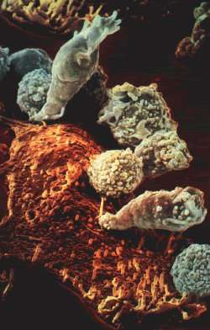
SCANNING MICROGRAPH (SEM) OF TUMOR DESTROYED BY T-CELLS(CANCER FIGHTING IMMUNE SYSTEM IN THE BODY) RESEMBLING SEM OF NANOSTRUCTURED IRON(11) PTHALOCYNANIE SUPPORTED ON A MULTI-WALLED CARBON NANOTUBE) Mamuru and Ozoemena(14)

Slide 11
THE ANATOMY OF THE BREAST FOR THE CANCER CURE
The tree-like network from the nipple to the body of the breast makes the nanoparticles to transport readily through the breast to effect cure.

Slide 12
THE BREAST ANATOMY
The breast anatomy makes it amenable to our suggested treatment of its cancer disease.
The tree-like network from the root (nipple) into the fine tubular structures in the interior provides pathways for effective therapy.
It is supposed that considering surface energy effects cancer would probably initiate at the root of the tributary branch and eventually spread by the mechanism of grain (cell) or domain growth to effect the fatal event of the individual host.

Slide 13
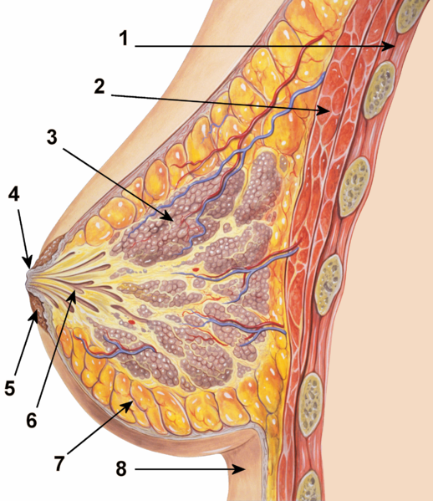
BREAST ANATOMY, (1:CHEST WALL, 2:PECTORALIS MUSCLES,3:LOBULES,4:NIPPLE, 5:AREOLA,6:LACTIFEROUS DUCTS,7:FATTY TISSUE, 8:SKIN RESPECTFULLY).

Slide 14
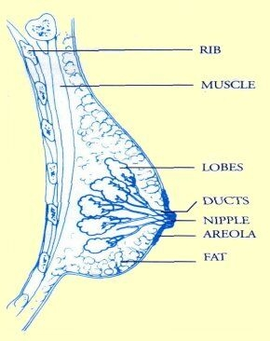
BREAST ANATOMY FOR CANCER TREATMENT

Slide 15
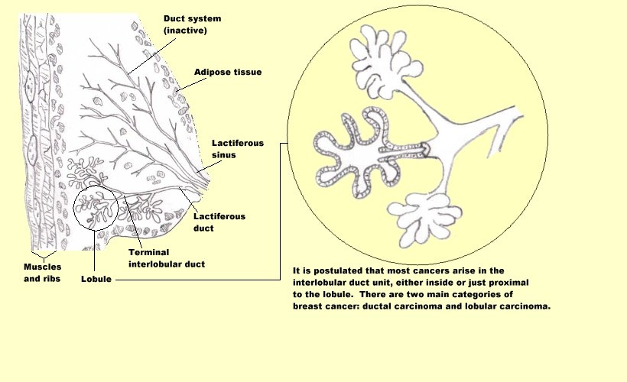
BREAST DETAILED STRUCTURE.

Slide 16
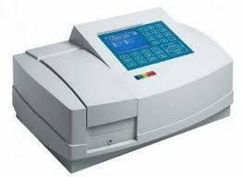
MATERIALS AND EQUIPMENT FOR THE STUDY
Conical flasks, oven, methanol, gold salt, thermometer, moringa oleifera leaves
Spectrophotometer

Slide 17
BRIEF LITERATURE ON NANONIZATION
There are recorded exotic methods of producing nanoparticles in the literature but our simple and unique organo-inorganic technique is less mentioned in the literature.
Earlier studies produced stable gold nanoparticles solution from aqueous extracts of almond leaf (terminalia catappa) and chloro-auric acid solution(15).
Some studies used lactic acid bacteria in buttermilk to produce nanoparticles of gold, silver and their alloys(16)
Using bacteria and algae on ionic gold, gold nanoparticles were produced.
Previous work on moringa oleifera concentrated on its nutritional value but not in its use in breast cancer cure.
Mehanaz Kamal and Talha Jawaid of Pharmacy Department of the Integrated University, Lucknow (19) documented a detailed phytochemical constituents of the roots, bark, gum exudates, whole pods, mature seeds and seed oil of this plant which is found in most parts of the world.

Slide 18
METHODS
In the present study moringa oleifera leaves were soaked in 80% methanol and the extract mixed with 0.1 molar solution of sodium tetra-chloroaurate at room temperature to produce gold nanoparticle-moringa extract fluid.
The gold nanoparticles were stabilized to avoid clustering due to the small sizes.
The stabilization was confirmed by the change in color of the solution in 5 minutes from pale yellow to purple red.
The stabilized moringa-gold nanoparticle (M-AuNP) was prepared and confirmed.
The Ultraviolet(UV) Visible Spectrophotometer was used to analyze the gold nanoparticle-moringa extract fluid.
The stability and identity of the gold nanoparticle were analyzed in the U-V Absorbance recorded in 30 minutes and shown in Fig.2 with the peak absorbance at approximately 295nm wavelength .

Slide 19
RESULTS AND DISCUSSION.
UV Spectrophotometric scan showed high levels of phytochemicals viz;
(flavonoids,
catechines,
isoflavones,
epigallocatechines etc)
at the absorbance values of 2393 and 235 nanometers wavelengths.

Slide 20
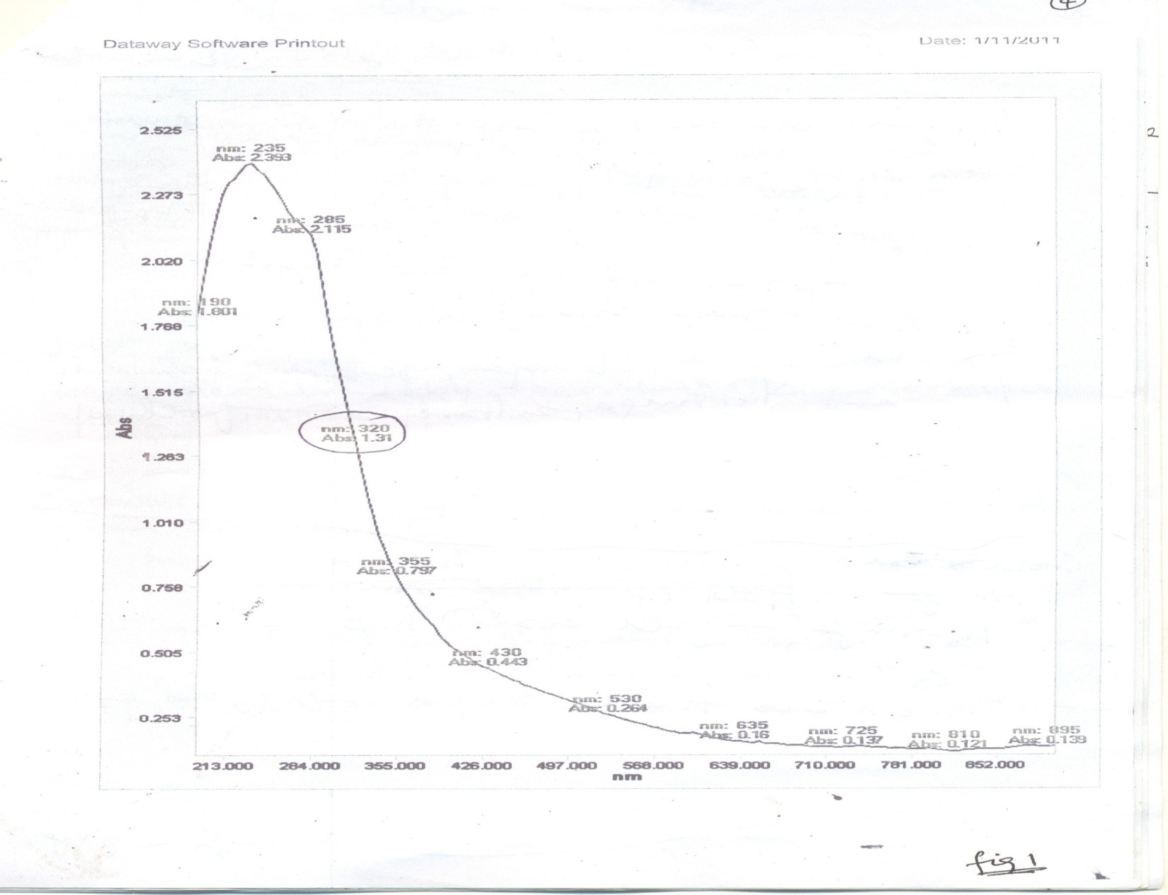
SPECTROPHOTOMETRIC GRAPH OF EXTRACTS FROM MORINGA OLEIFERA LEAVES SHOWING PHYTOCHEMICALS .

Slide 21
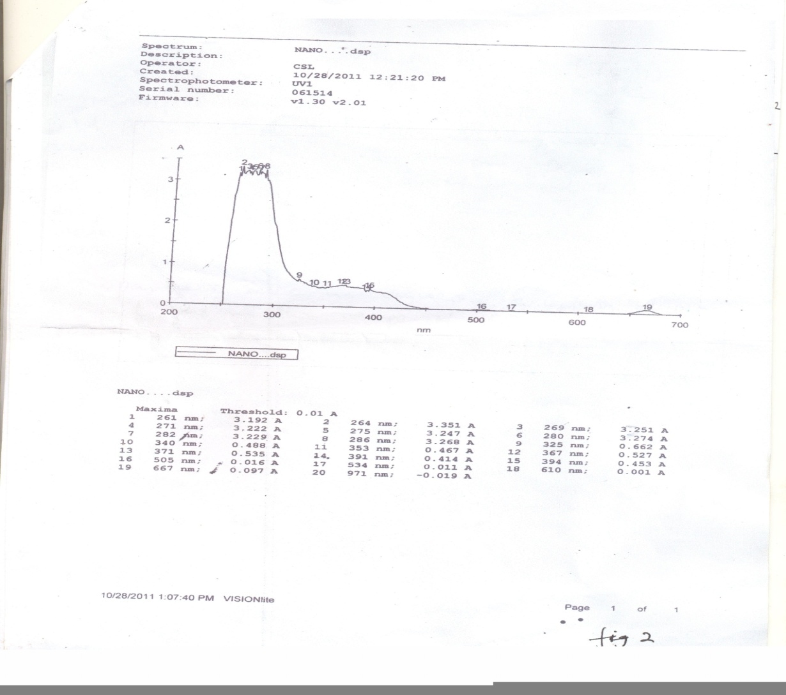
STABILITY OF GOLD-MORINGA NANOPARTICLE RECORDED WITH UV-ABSORBANCE SCAN,

Slide 22
USE OF GOLD NANOPARTICLE TO GUIDE THERAPUETICAL MISSILE TO CANCER LOCATION.
Use of Gold Nanoparticle is safe because
Gold is inert.
It has no adverse effect on the body system.
Any presence of gold even in very negligible concentration anywhere is very easily
-detected by silver using the auto-metallographic (AMG) technique.
- released into the urine and removed through simple filtration in the renal glomeruli.
Evaldes Sadauskas et al of Denmark (17) in their study of Kupffer cells being central in the removal of nanoparticles from the body, using gold nanoparticles intravenously and intra-peritoneally administered into adult mice proved the above assertions beyond reasonable doubt.

Slide 23
LOCALLY AVAILABLE PLANTS.
Locally available plants like Bitter leaf, Uziza and Utazi were analyzed for the presence of the potent phytochemicals for cancer cure.
The proximate compositions of bitter leaf in grams/100g of the dried leaf were 36% protein, 5.6% fibre,3.6%fat, some calcium and carotenoid and little phytochemical( not significant for cancer cure)
When bitter leaf is mixed with honey its bitterness is decreased and believed to be anti-parasitic, anti inflammatory and antibacterial (18).
Uziza and Utazi were not relevant in the study so they were discarded.

Slide 24
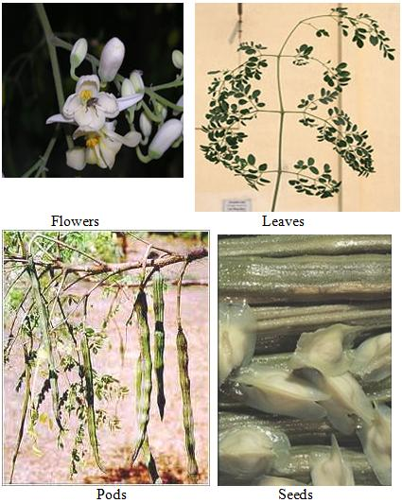
MORINGA OLEIFERA PLANT AND PRODUCTS.

Slide 25
FINDINGS OF THE STUDY
Obikwelu et al (20) using a special wet technique on the moringa oleifera dry leaf found that the extract contained high levels of phytochemicals which are the ingredients that destroy cancer cells.
Isoflavone and catechines phytochemicals found in the moringa extract act as anti-oxidants and scavenging agents that remove dangerous free radicals in the body.
The Ultra violet (UV) Visible Spectrophotometer used in this study confirmed the speculative documentation by earlier workers on moringa oleifera shown in Figure 01.

Slide 26
THE PHYTOCHEMICALS IDENTIFIED IN GOLD NANOPARTICLE MORINGA EXTRACT.
The phytochemicals flavonoids and catechines in the extract were known by earlier workers to
Act as scavengers for free radicals in the body
Act as antioxidants and
Reduce gold ions to gold nanoparticles
Coat the gold nanoparticles and
Act as anti-cancer agents.

Slide 27
EFFECT OF THE GOLD NANOPARTICLE- MORINGA EXTRACT ON THE BREAST CANCER.
The nanonization process of gold salt by the moringa oleifera extract achieved the dual purpose of reduction of gold salt to gold nanoparticles and adhering of the phytochemicals to the gold nanoparticles.
The pay load of the gold nanoparticles and the phytochemicals is the anti-carcinogenic curative missile for the breast cancer treatment.
The high surface to volume ratio of this gold nanoparticle-moringa extract provides the indescribable affinity and drive towards a disturbed(cancerous) surface which acts as kinetically ready receptor.
As soon as this gold nanoparticle-moringa extract fluid enters the breast it is kinetically drawn to the disturbed cancerous surface to stick to destroy the cancer.

Slide 28
BREAST ANATOMY FOR CANCER CURE

Slide 29
BREAST DETAILED STRUCTURE.

Slide 30
PROPOSED MECHANISMS OF CANCER(TUMOUR) ANNIHILIATION BY APPROPRIATE NANOPARTICLES.
Y. Matsumura and H. Maeda(21) observed the enhanced permeability and retention(EPR) of nanoparticles around body tissues leading to the accumulation of nanoparticles around the tissue.
EPR effect is promoted by increase in surface energy and tensile stress around the tumour site generating surface energy and tensile effect (SETE) proposed by Obikwelu(22).
SETE effect makes the structures around the tumour permeable and the nanoparticles with comparable sizes with the structures which kinetically leak into the tumour interstitium to effect the gradual annihilation of the tumour.
Interstitial tumour interstitium poisoning( ITP) recently proposed by Obikwelu et al (22) where nanoparticles of sizes 0.225 of the size of the adjoining infected cell units (tumour cells) locate in the interstitial sites to effect a cure.
Substitutional Poisoning (SP) (22) results from using varying sizes of nanoparticles in a domain of tumour cell units to retard or put a stop to the growth of the tumour interface.

Slide 31
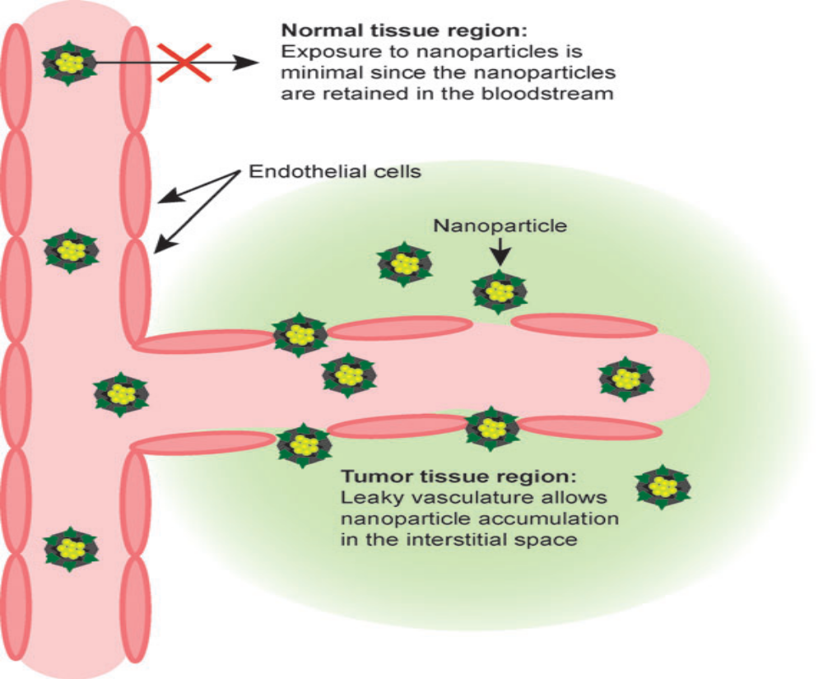
PROPOSED PICTORIAL MECHANISM OF M-AuNP INTERACTION WITH CANCER CELL IN THE BREAST

Slide 32
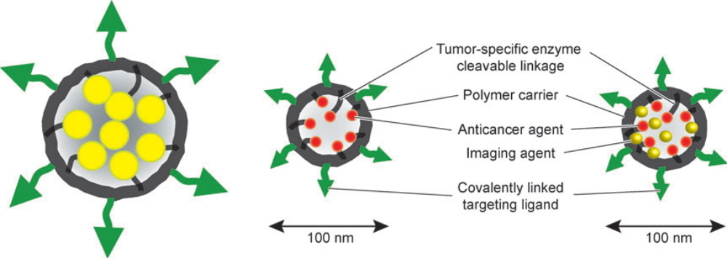
TARGETING THE BREAST CANCER MECHANISM USING POLYMERIZED MORINGA EXTRACT, CHALLENGE OF MEMS BIOENGINEERS

Slide 33
ADMINISTRATION OF THE GOLD NANOPARTICLE MORINGA EXTRACT INTO THE BODY
From our preliminary analyses moringa leaf contained the highest concentration (about 1270mg/g) of phytochemicals, the seed (about 1080mg/g) and the stem about (107mg/g) especially of isoflavone.
The moringa leaves or seeds, after appropriate hygienic treatment could be finely ground and dozed into edible slurry like colloidal corn flour(akamu), yam porridge, jollof rice or any other solid delicacy and eaten as food.
The active payload of anti-cancer ingredient in an appropriately designed nano-receptacle (MEMS device) would dissolve in the blood stream and locate to the breast environment to effect the expected cure.
The correct and effective administration mode of the curative payload will be decided by the medical professional.
Monitored dosage will determine the kinetics of the treatment.
The severity of the cancer disease will determine the dosage as decided by the medical specialists.

Slide 34
NEXT STEP– clinical trials.
The curative payloads of this gold nanoparticle moringa extract in the proper aqueuos medium will be injected into the cells of any guinea pig preferably rabbits and the changes will be observed with an appropriate equipment.
In-vitro stability of all the above will be studied using UV-Spectrophotometer and better analytical tools.
Then in-vivo studies in the guinea pigs will be done for further findings before human trials will be embarked on.
Controlled injection of pharmacologically and medically certified aqueous payloads of the gold nanoparticle moringa extract into the infected breast will be carefully followed. .
Nanoencapsulation of these tested nano-moringa composite is an pharmaceutical research work.

Slide 35
CONCLUSION
The Scourge of intractable diseases like cancer calls for the melting of the discipline boundaries, national boundaries and integrated multidisciplinary approach.
The human body system is a material system and it obeys the laws that control the structure and properties of materials.
Tumor (cancer) and its constituents are materials.
The message here is “Let us work together, exploiting both renewable and non-renewable resources in our immediate environment and the veritable potentials of nanotechnology to face the scourge of cancer and other deadly diseases”.
The National Health Delivery System should be unbundled so that all relevant professionals will pool resources together to solve this cancer scourge.

Slide 36
REFERENCES
1. W.C. Hanahan, R.A.Weinberg, The Hallmarks of Cancer Cell 100, 57-70, 2000.
2.M.Ferari, Cancer Nanotechnology: Opportunities and Challenges. Nat.Review Cancer, 5,pp161-171,2005.
3.P.Allivisatos, The Use of nanocrystals in biological detection. Nat.Biotechnology,22,pp.47-52,2004
4. D.O.N.Obikwelu, Review on nanoparticles in cancer therapy. Paper presented at the University of Nigeria Teaching Hospital, Enugu Campus. April 2008.
5.D.O.N.Obikwelu Nanostudies at the University of Nigeria, Nsukka,

Slide 37
REFERENCES
6. D.O.N.Obikwelu, Nanomaterials, Paper presented at the International Conference of Advanced Materials at the Raw Materials Development and Research Centre, Abuja. 2010.
7.Y.Matsumura, H.Maeda, A new concept for macromolecular therapeutics in cancer chemotherapy: mechanism of tumoritropic accumulation of proteins and anti tumour agents smancs. Cancer Res. 46: 6387-92, 1986.
8. Science Magazine, 2008.
9. Ditto

Slide 38
REFERENCES
10. Science Daily 2008
11. Science Daily, 2008.
12.W.Yu et al Experimental detection of the extinction coefficient of CdTe, CdSe and CdS nanocrystals, chem,Materials.15:2854-60,2003.
13.M.G. Harrising, J.Barentsz et al Non-evasive detection of clinically occult lymph-node metastases in prostrate cancer, N.Engl.J.MED: 2491-99,2003.
14. S.A.Mamuru and`K.Ozoemena, The electro-catalytic reduction of molecular oxygen at nanostructured iron(II)phthalocynanine and its multi-walled carbon nanotube. 5th Inter. Conference of African-MRS Conf. held at Abuja, Dec. 2009.

Slide 39
REFERENCES
15. D.O.N.Obikwelu, C.O.Nebo, S. Ume. Investigative Study of the use of nanonized moringa-extract for the treatment of breast cancer. Finding being patented. 2010.
16.Nair and Predeep Using XRD Fourier Transform Infra- red Spectroscopy Measuurements in remediation of metallic ions.
17. Evaldas Sadaaukas, http://www.e.journals.net, 2010.
18. Uwechue, http://www.africaresource.com

Slide 40
REFERENCES CONTD
19. Mehnaz Kamal and Talha Jawaid http:/www.pharmainfo.net 2008.
20. D.O.N.Obikwelu, C.O.Nebo and S.Ume, ibid.
21.Y.Matsumura and Maeda ibid
22.D.O.N.Obikwelu Unpublished.

