Slide 1

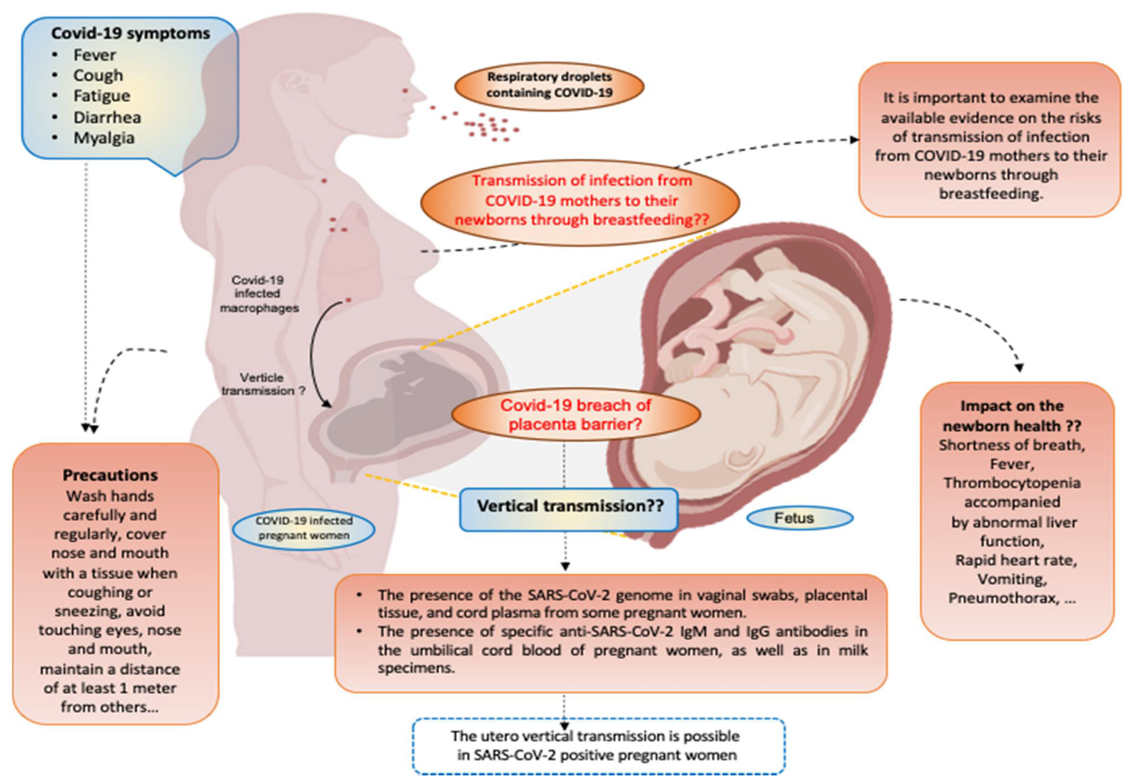
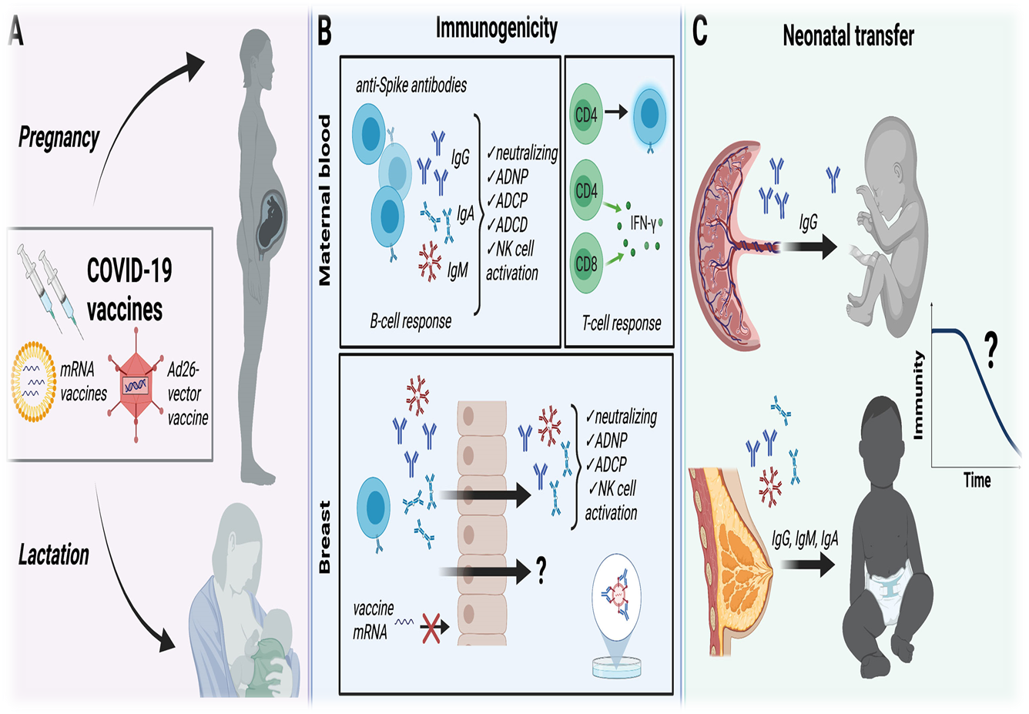
VERTICAL TRANSMISION OF INFECTION OR IMMUNITY?
IMPORTANT DECISION TO MAKE for pregnant mothers!
ZOHRA IMRAN (Principal, Zainab Punjwani School of Midwifery)
SHIREEN ARIF (Principal, Associate Professor, Pakistan Rangers College of Nursing)
Pregnant women are considered one of the most susceptible groups in a population, due to physiological changes during pregnancy. In the time of spread of covid-19 as pandemic communicable disease changes in cellular immunity, can increase the risk of serious illness in response to viral infections and the risk of vertical transmission.
Vertical transmission is defined as the possibility of transmission from a mother to her fetus during the antepartum and intrapartum periods or to the neonate during the postpartum period, and it can occur via the placenta, body fluid contact during childbirth, or through direct contact owing to breastfeeding after birth. In fully vaccinated pregnant and lactating mothers with two dose mRNA vaccine results in development of IgG, IgA, IgM titers which develop neutralizing anti-spike IgG transplacental transferable from mother to fetus. Similarly IgG, IgM and IgA transferred through breastmilk.
In conclusion, When a pregnant woman get vaccinated, the antibodies made by her body may be passed to her fetus. These antibodies may help protect baby from the virus after birth. How much protection antibodies may provide is not yet known.
VERTICAL TRANSMISSION OF DISEASE
VERTICAL TRANSMISSION OF IMMUNITY
Shook, Fallah1, Silberman & Edlow. (2021). Understanding. Frontiers in cellular and infection microbiology. doi: 10.3389/fcimb.2021.73539
Saadaoui, kumar, Al Khodo. COVID-19 Infection during Pregnancy: Risk of Vertical Transmission, Fetal, and Neonatal Outcomes. . J. Pers. Med. 2021, 11, 483. https://doi.org/10.3390/ jpm11060483

