Slide 1
Role of Veterinarians in One Health
Overcoming the Challenges of livestock trade for improved livelihood and food Security
Dr Faouzi Kechrid
World Veterinary Association IP President
Euro-Arab and African Veterinary Associations President
Tunisian Medical Veterinary General Union President
LivestockAsia
Bangkok-Thailand November 2-3,2017

Slide 2


Content
    Introduction of the WVA
    One Health concept
    WVA Activities in One Health
    WVA Collaborations on One Health
    Conclusions
.

Slide 3
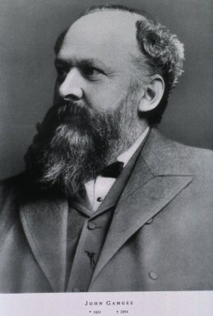
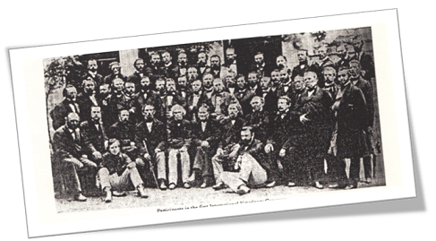
  History
In 1863, Dr John Gamgee convened a first International Veterinary Congress in Hamburg, Germany. An initiative that has grown to what the World Veterinary Association (WVA) is today.

Slide 4
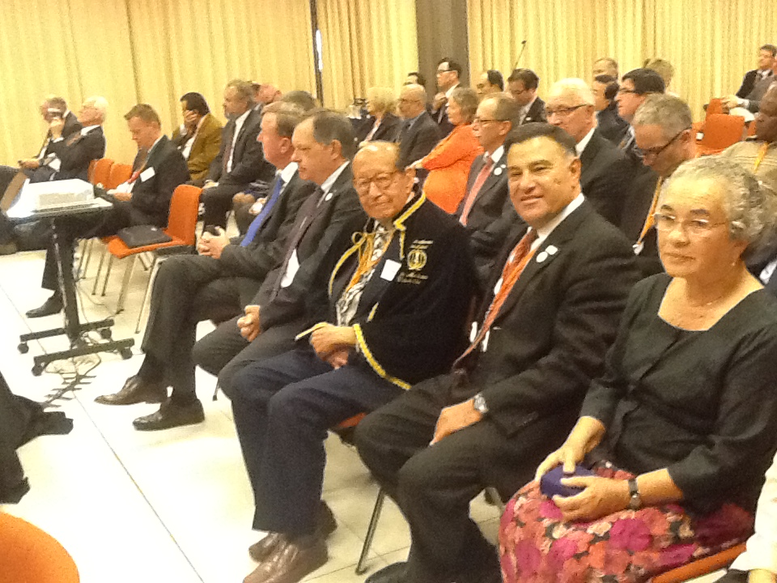

Slide 5


WVA Members
The WVA unites and represents the global veterinary profession on all its wide aspects and is an umbrella organisation for:
National Veterinary Associations.
International Associations of Veterinarians working in different areas of veterinary medicine.

Slide 6
Veterinary Medicine
WVA Mission
To assure and promote animal health and welfare and public health globally, through developing and advancing veterinary medicine, the veterinary profession as well as public and private veterinary services.
P
U
B
L
I
C
H
E
A
L
T
H
A
N
I
M
A
L
H
E
A
L
T
H
A
N
I
M
A
L
W
E
L
F
A
R
E
Veterinary Education

Slide 7
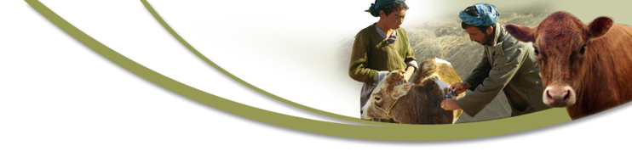
Policy areas
﻿One Health
- Animal Health and Welfare
- Public Health
- Environment
Strengthening the veterinary profession
  Education and Life Long Learning
  Statutory Bodies and Associations
  Professional Ethics and Attitude
  Strengthening collaboration private and public parties
Animals
v
Society
Owner

Slide 8
One Health Concept
﻿The idea that people, animals and the environment are strongly linked by a multifactorial situations that
affecting the health and welfare of people and animals as well as the environment.
Animal
Health & Welfare
Public Health
Environment
Some examples:
Diseases (infectious, zoonosis, etc.)
Food (foodborne diseases, production systems, food security etc.)
Medicine (Antibiotic resistance, biocides etc.)
Environment (Urbanization, globalization, climate shift, bioterrorism etc.)

Slide 9



One Health Concept – Veterinary aspect
This concept is defined as the collaborative efforts of multiple disciplines, working locally, nationally and globally, to reach optimal health for people, animals and the environment.
Veterinarians in all areas of the profession have opportunities and responsibilities to protect the health and well-being of people.

Slide 10
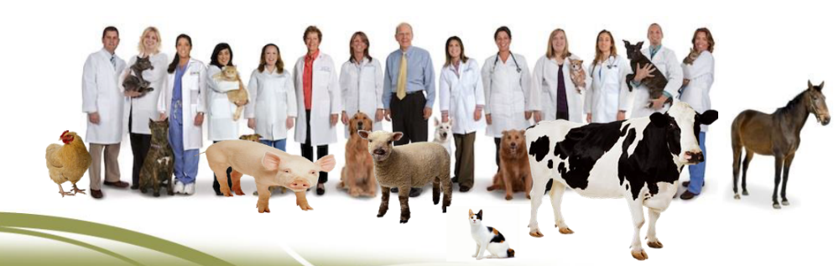
Role of Veterinarians in One Health
Veterinarians are:
looking after the health of animals (treatment and prevention of diseases)
looking after the health of people (zoonosis diseases)
ensuring safer animal products for human consumption (foodborne diseases, food frauds)

Slide 11
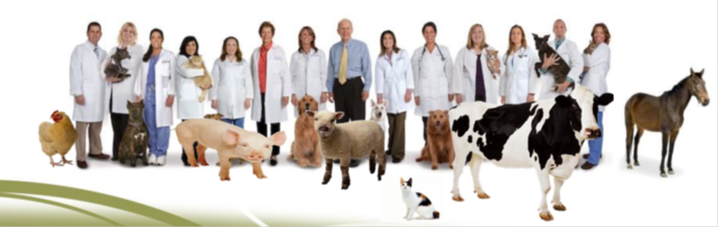
Role of Veterinarians in One Health (cont.)
Veterinarians are:
ensuring sufficient food (advance breading and production techniques)
protecting the environment (prudent use of medicine, chemicals and treat waste)
taking care for animal welfare (one welfare concept)

Slide 12
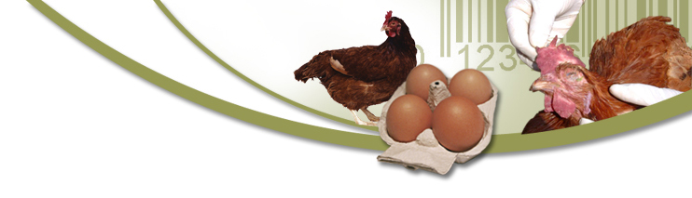







WVA collaborations in the field of One Health
WVA believes in working in partnership.
WVA signed recently a Memorandum of Understanding and effectively collaborates with relevant global partners on various veterinary issues related to One Health.
World Medical Association (WMA)
World Animal Health Organization (OIE)
Food and Agriculture Organisation of the UN (FAO)
World Society for the Protection of Animals (WSPA)
International Dairy Federation (IDF)
World Farmers Organization (WFO)
Global Alliance on Rabies Control (GARC)

Slide 13

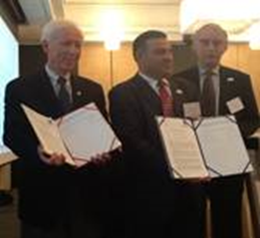
WVA collaborations in the field of One Health
On 10th October 2012, the World Medical Association (WMA) and WVA signed the WVA-WMA Memorandum of Understanding. WVA and WMA agreed to collaborate in the One-Health concept, which is a unified approach to veterinary and human medicine in order to improve Global Health.
This initiative encouraged some WVA members to sign similar agreement with the National Medical Associations in their countries.

Slide 14
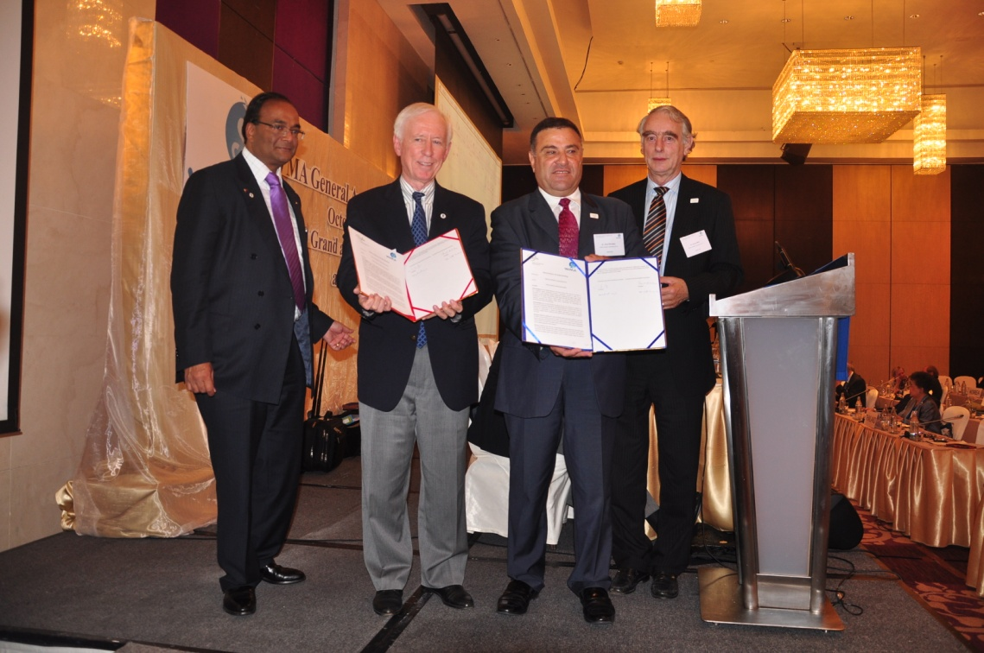

Slide 15
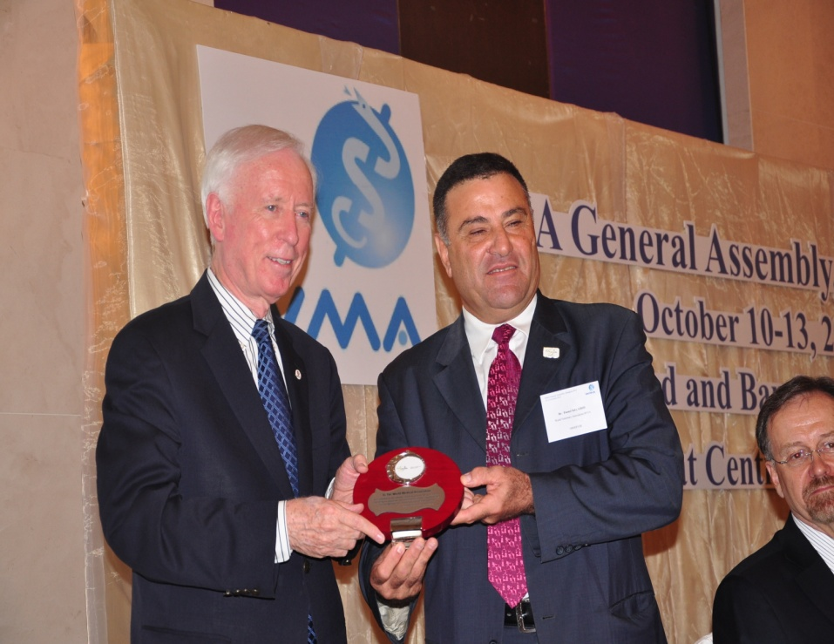

Slide 16
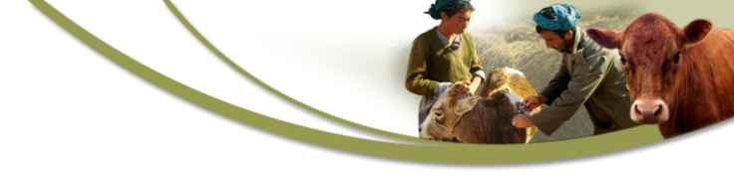
WVA Activities on One Health
WVA-FAO-OIE-WHO Global Summit:
1st Global Summit in 2011 on Antimicrobial resistance
2nd Global Summit in 2013 on inter-institutional collaboration in the field of one health
3rd Global Summit in 2015 in Istanbul
Main Conclusions from the Global Summit on Antimicrobials:
The occurrence of antimicrobial resistance (AMR) is a truly global “One Health issue”, affecting the health and welfare of people and animals as well as the environment.
Responsible use of antimicrobials is pivotal both for humans and animals.
Prevention of AMR is a “public good”. Everybody is affected and responsible in working to keep antimicrobials effective. This needs strong commitment, global education and enough resources.
The full document can be found in the WVA website: www.worldvet.org

Slide 17

WVA Activities on One Health
World Veterinary Day Award (OIE/WVA)
2009: Veterinarians and Livestock Farmers: A Winning Partnership”.
2010: One World, One Health: more cooperation between veterinarians and physicians
2011: Rabies
2012: Antimicrobial Resistance
2013: Vaccinations
2014: Animal Welfare
2015: Zoonotic Diseases
2016:Continuing Education in One Health
2017:Antimicrobial Resistance:from Voice to Action

Slide 18
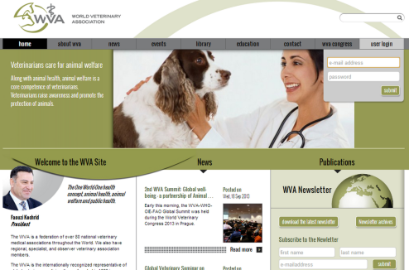
WVA Policy Positions on One Health Issues:
  Rabies control
  Responsible Use of Antimicrobials
  Control of Inappropriately Aggressive Dogs
  One Health Concept (in drafting process)
These documents can be found in the WVA website: www.worldvet.org

Slide 19
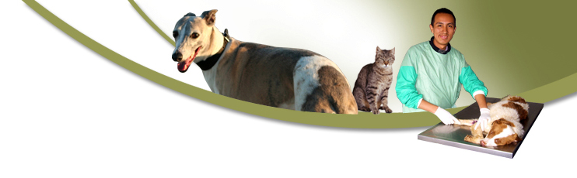

In conclusions
Veterinarians have the scientific, medical training and the statutory accountability as well as the opportunity and responsibility to engage in a wide range of employment fields that deliver services to the benefit of society and all animals.
Animal Health + Human Health + Environment Health
=
One Health

Slide 20

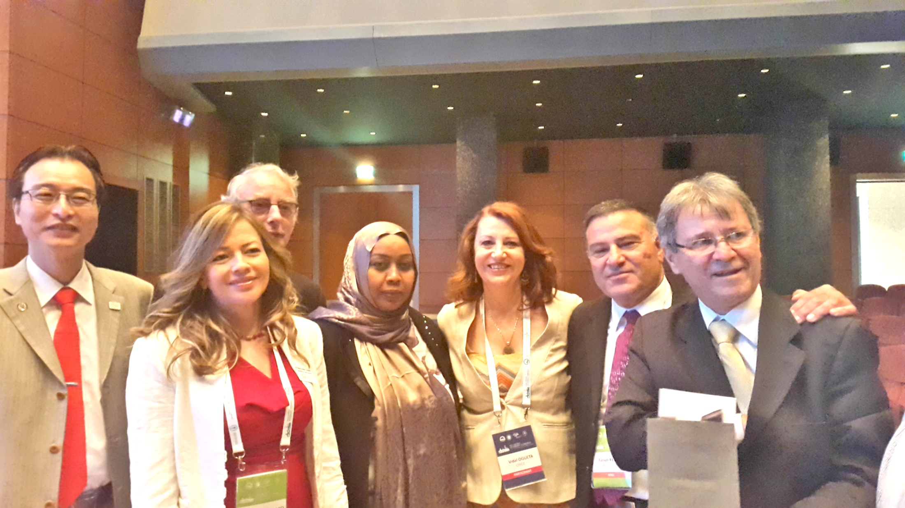
The WVA organized the
1st WVA-WMA: “One Health” Conference
20-22 May 2015 in Madrid
32nd WVC 13 -17 September 2015 in Istanbul
more details on www.worldvet.org

Slide 21
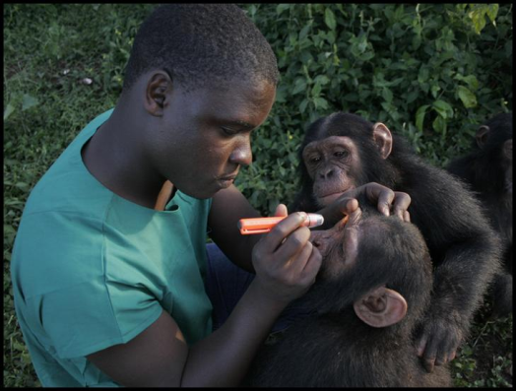



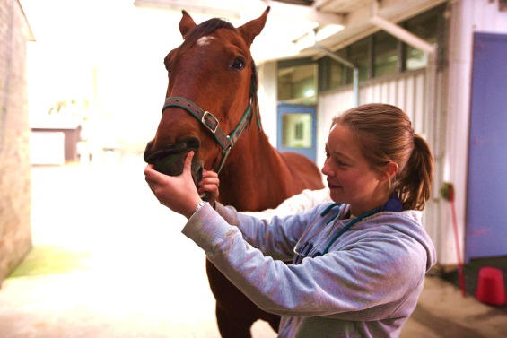
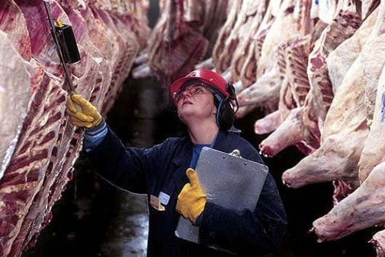
Thank you for your attention
www.worldvet.org

