Slide 1
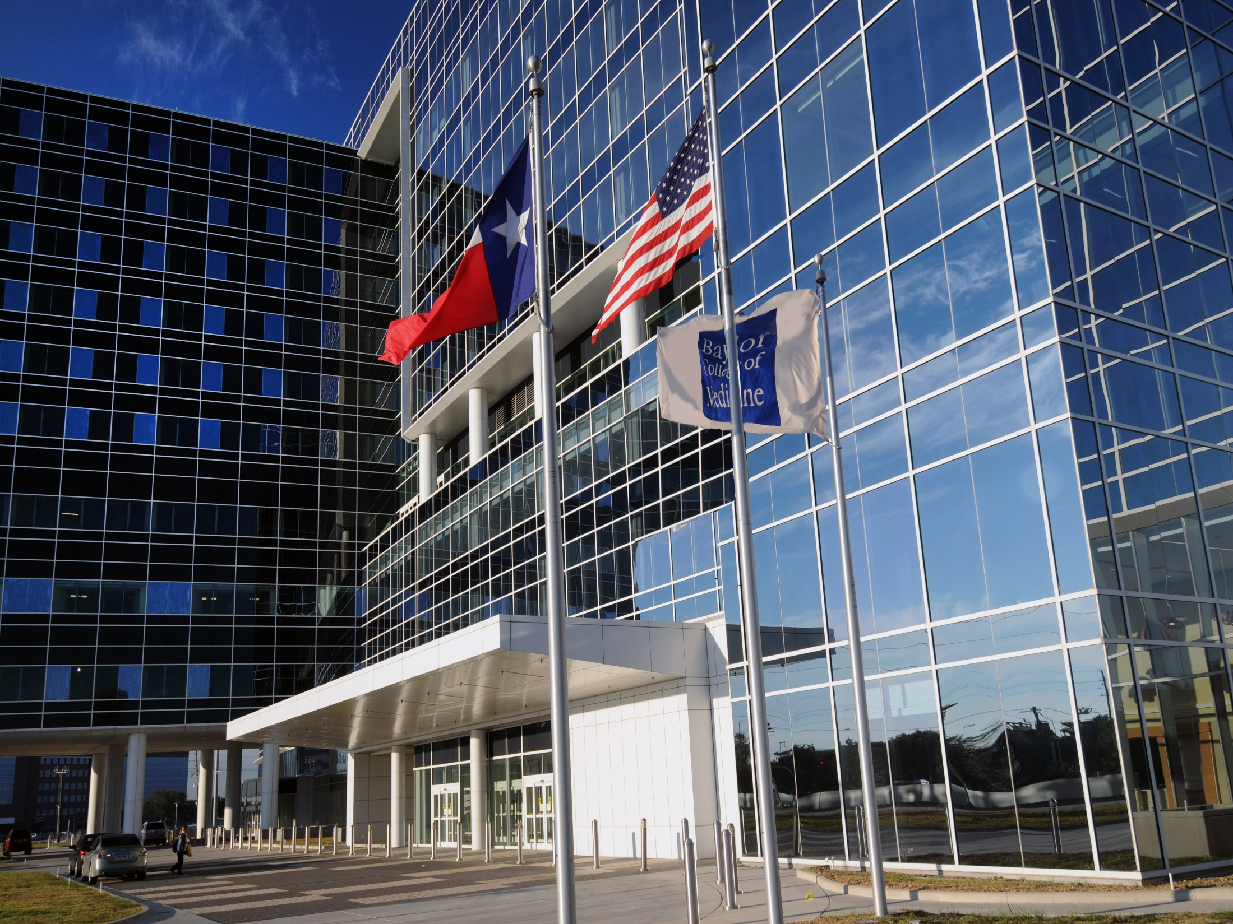


Improving The Patient Experience With Technology
May 17th, 2018
Craig DeGarmo, MBA, MHA
Chief Administrative Officer and Vice Chair of Administration
Baylor College of Medicine- Department of Medicine

Slide 2
Craig DeGarmo MBA, MHA Background
Training- Practice Management, Organizational Change, Business, Accounting, Marketing, Philanthropy, Epic, Health Services Administration
8 years stationed as trauma medic in USN
2 ½ years as Project Coordinator and Epic Trainer at The University of Florida
3 ½ years as Director for Epic (DoM) and the Administrator for Nephrology, Hypertension and Renal Transplantation at The University of Florida
2 years as the Chief Administrative Officer for the Department of Medicine at MedStar Georgetown University Hospital
1 year as the Chief Administrative Officer and Vice Chair for Administration in the Department of Medicine at Baylor College of Medicine in Houston, TX

Slide 3
What We Are Going To Review Today
What is JabFab
How does JabFab work
Life in the Department of Medicine before JabFab
Life in the Department of Medicine after JabFab implementation
Future implementations of JabFab
How this affects us at BCM
Questions

Slide 4

WHAT IS jabfab?
ENHANCING THE PATIENT EXPERIENCE

Slide 5

Why JabFab?
We are living in a real-time economy
#GenerationNow

Slide 6

Digital customer engagement & service models are eating the world…
Impulse of the Customer & Experience Management
Old School
Surveys
Voice of the
Customer
After-the-fact >>>> Real-time in the Moment

Slide 7

jabfab

Slide 8
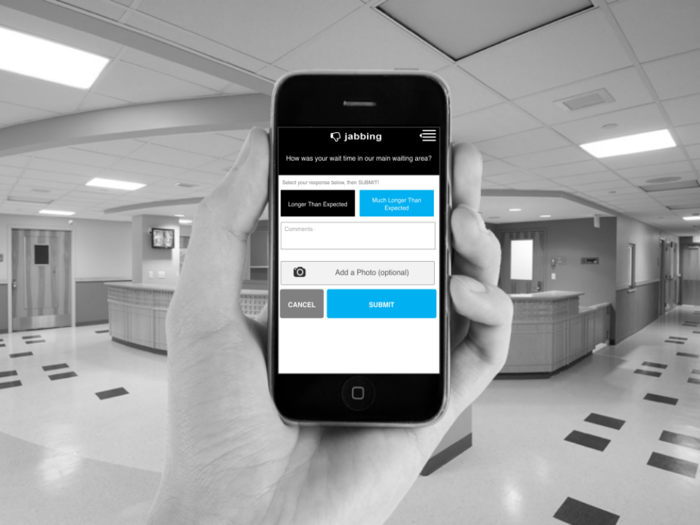

Introducing
A real-time mobile feedback system
  Collecting patient or staff feedback in a brief way
  Knowing about it
  right away
  Dealing with it straight away
Nothing to install
No app to download
Engage and act on the IMPULSE of the customer

Slide 9



WHY JABFAB MOBILE CUSTOMER ENGAGEMENT & SERVICE MAKES SENSE
Private, mobile, in the moment
Convenient, short form, easy to do
Double-down
on good experiences
Address dissatisfaction in
real-time
Get smarter to be preemptive

Slide 10


Example Awareness
Poster and Check Out Cards for inspiration

Slide 11


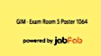
Examples of Hyper-local collateral for real-time action oriented use cases

Slide 12
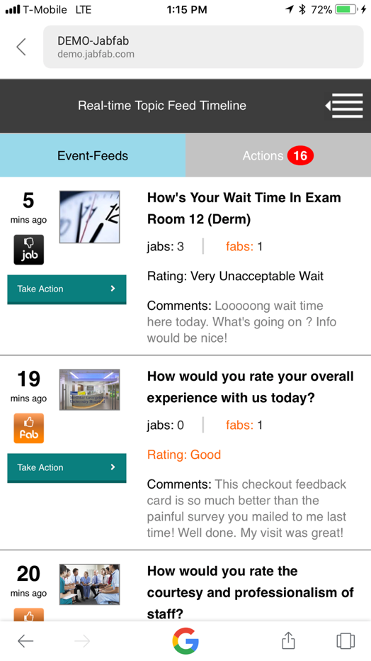
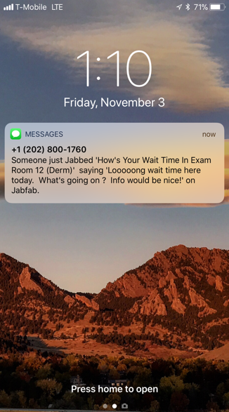
Example of mobile notifications & patient experience monitoring

Slide 13
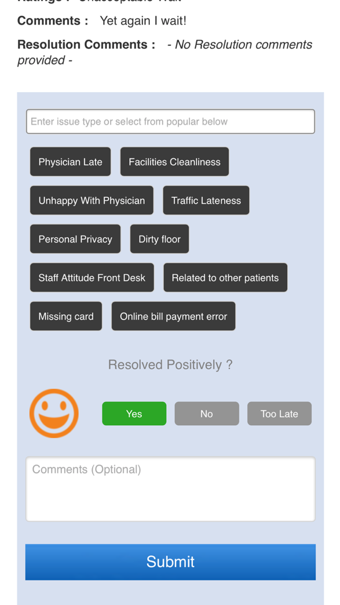
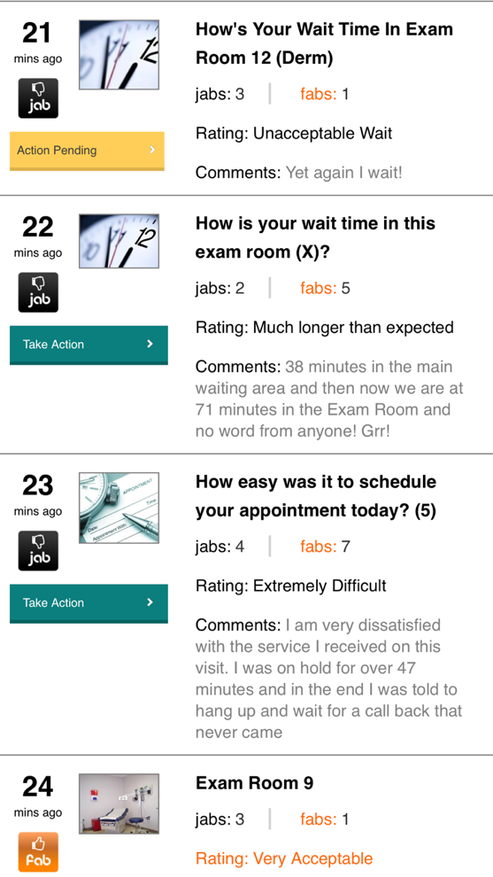
Example of mobile monitoring and acting on real-time feedback

Slide 14
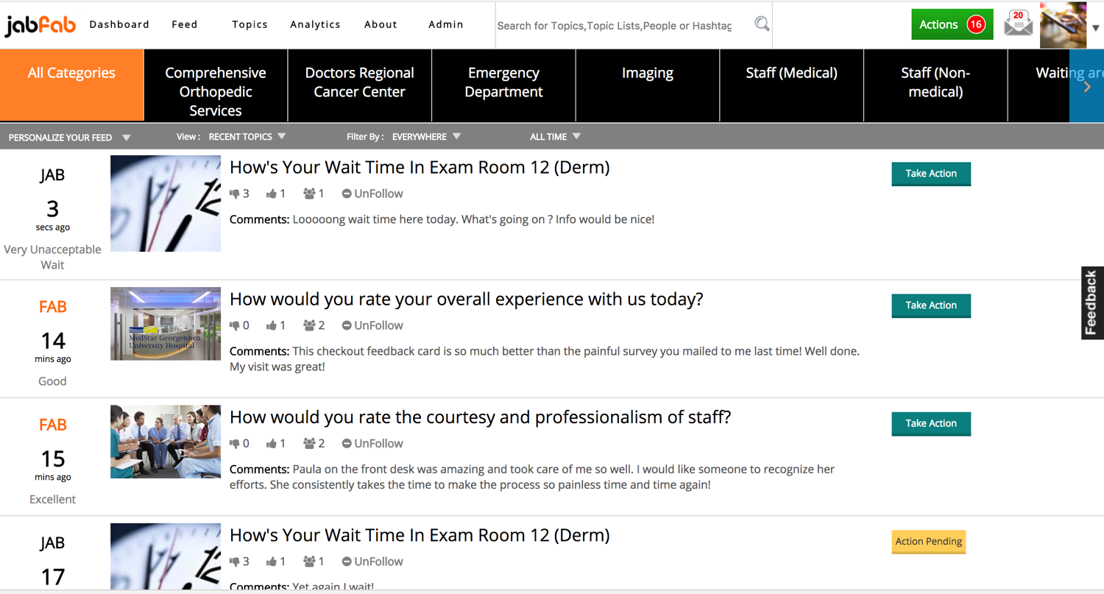
Example of desktop monitoring and acting on real-time feedback

Slide 15
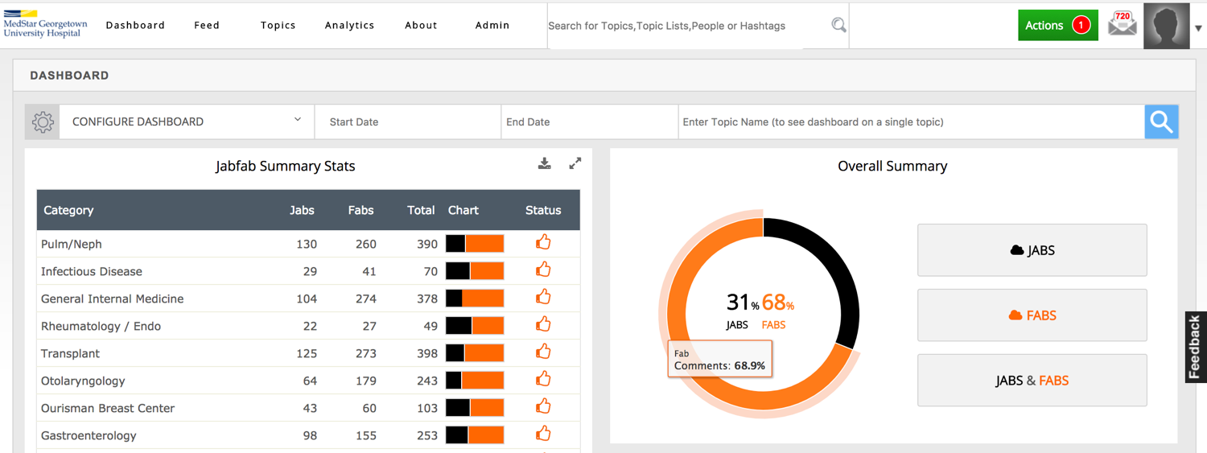
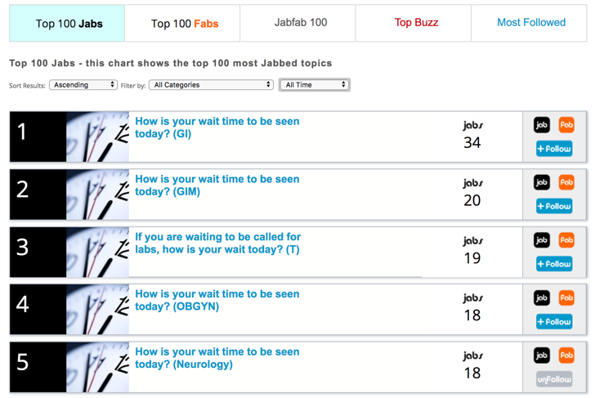
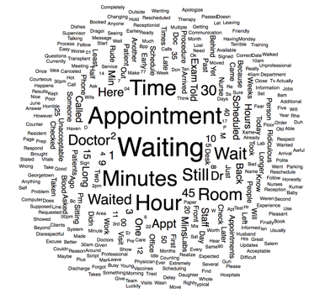

Examples of Dash for
Management & Admin Insights
JAB CLOUD
FAB CLOUD

Slide 16
Life before jabfab (Georgetown)
Constant patient complaints
Horrible clinical culture
Horrible morale
Inefficient clinical flow
Physicians and staff working in silos

Slide 17
Goal at Gtown was 85% for Press Ganey

Slide 18
Goal at Gtown was 88% for Press Ganey

Slide 19
Life after jabfab (Georgetown)
Patient complaints resolved in real time
Clinical culture created to be patient centered
Huge morale swing due to Kudos Chips
Completely changed clinical flow based on patient feedback
Physicians and staff working together to achieve common mission

Slide 20
Goal at Gtown was 85% for Press Ganey. Hit 100% every single month since

Slide 21
Goal at Gtown was 85% for Press Ganey. Hit 100% almost every single month since

Slide 22
Future implementation plans for jabfab (Georgetown)
April 2017 jabfab implemented across the remaining divisions in Medicine
  Endocrinology
  General Internal Medicine
  Medical Pediatric Specialties
  Infectious Disease
  Nephrology
  Pulmonary
  Rheumatology
  Gastroenterology
  Cancer

Slide 23
Future implementation plans for jabfab (Georgetown)
July of 2017 jabfab implemented across the remaining departments in the college
  Fam med
  OB/GYN
  Ophthalmology
  Otolaryngology
  Audio
  Breast center
  Plastics
  PM&R
  Sleep
  Transplant
  Urology
  Surgery
  Wound center

Slide 24
Future implementation plans for jabfab (Georgetown)
January of 2018 jabfab implemented across the MedStar system
  MedStar Franklin Square Medical Center
  MedStar Good Samaritan Hospital
  MedStar Harbor Hospital
  MedStar Montgomery Medical Center
  MedStar National Rehabilitation Hospital
  MedStar Southern Maryland Hospital Center
  MedStar St. Mary's Hospital

Slide 25
How this affects us at BCM
Joined in April 2017
Full departmental reorganization June 2017
Tripartisan mission acceleration project July 2017
Signed contract with jabfab April 2018

Slide 26
Simple 6-Step Process For Implementing JabFab
Step 1 | Determine Scope Of Pilot | Complete
Step 2 | Agree on measures of success & commercial terms | 1 day
Step 3 | Configure the JabFab system with all practices and locations in scope | 3 days to 1 week
Step 4 | Create JabFab awareness materials and collateral for patient/visitor engagement | 2 weeks Depending upon approach taken
Step 5 | Conduct management & user Go-Live and Pre-Go Live awareness & Training | 1 Day
Step 6 | Review, Monitor, Adjust, Measure & Discuss Advancement To Broader Use | 3-4 weeks initial use Then.. 4-6 months continued use Total: 6 months

Slide 27
Piloting @ Baylor - Scope:
5 practice areas were defined as the highest potential for the scope of the trial, based on the recent Patient Experience survey results:
Cardiology- (Baylor Clinic & Hall – Garcia) (35%)
  BC Cardiovascular Disease
  BC Cardiology Interventional
  BC Cardiac Electrophysiology
  HG Cardiovascular Disease
  HG Cardiology Interventional
  HG Cardiac Electrophysiology

Slide 28


Slide 29
Piloting @ Baylor - Scope:
5 practice areas were defined as the highest potential for the scope of the trial, based on the recent Patient Experience survey results:
Oncology (65%)
Infectious Diseases (70%)
Gastroenterology (60%)
BCM has the option of testing JabFab in any other areas desired, during the pilot project, in order to help with building out a business case for broader use as a differentiator and impact to Patient and Visitor experience management.

Slide 30
Why is this important?
Key drivers:
  Wait time measurement
  Ease of appointment scheduling
  Courtesy and Professionalism of staff
  Overall Experience
  Understanding of care plans provided to Patients
  Parking and arrival
  Facilities cleanliness and hygiene

Slide 31


Slide 32

Thank you!

