Slide 1

Health Screening for New Entry Medical Students to NUMed -
A Retrospective 4-Year Study from 2015-2018
Goh WP, Evans G, Hurn E, Leong A, Lim YK, Saw YT, Subramaniam B, Tan ZJ, Ong ELC
Newcastle University Medicine Malaysia

Slide 2

Background
World Health Organization (WHO): Healthcare workers are exposed to biological hazards, such as TB, Hepatitis, HIV
WHO: 37% of hepatitis B among healthcare workers was due to occupational exposure.
Occupational health hazards:
    Needle stick injury
    Exposure Prone Procedure (EPP) E.g. caesarean
Notes:
WHO
-Healthcare workers are exposed to a complex variety of health and safety hazards everyday including biological hazards, such as TB, Hepatitis, HIV/AIDS, SARS;
-WHO global burden of disease from sharps injuries to health-care workers showed that 37% of the hepatitis B among health workers was the result of occupational exposure.
Occupational health hazards include but not limited to:
Needle stick injury
Exposure Prone Procedure (EPP) - risk of exposure of patients' open tissues to your blood. E.g. caesarean

Slide 3
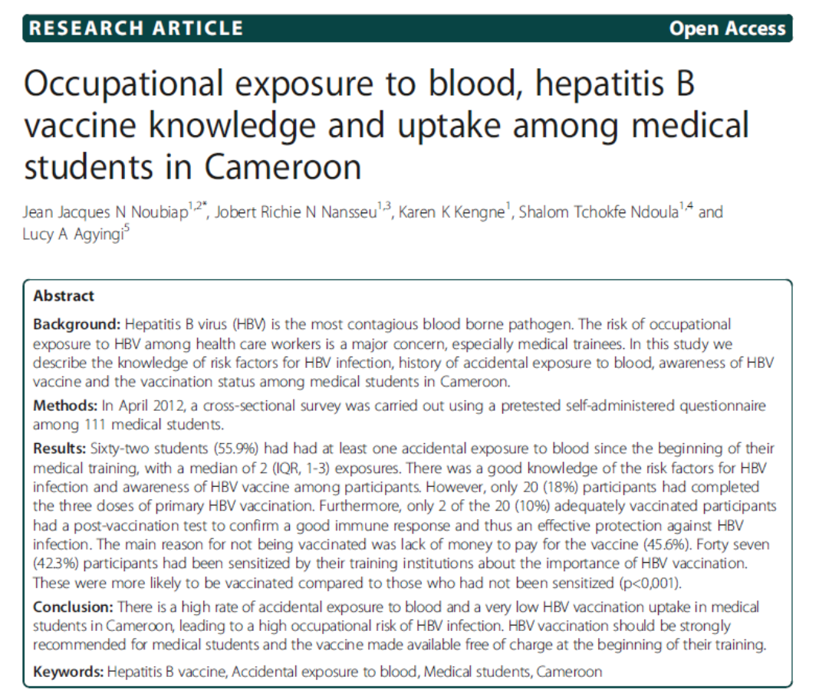
High rate of accidental exposure to blood!
Notes:
More than half (55.9%) had at least one accident leading to blood exposure

Slide 4

Needle stick injury is the major cause (74.9%) of injuries among healthcare workers.
Estimated risk of viral transmission to non-immune healthcare workers
  22% for Hepatitis B
  1.8% for Hepatitis C
  0.3% for HIV
Notes:
Released by Occupational Health Unit, MOH, Malaysia
Hepatitis B is the one with highest risk of transmission

Slide 5
UK Department of Health (DH)
"Health clearance for tuberculosis, hepatitis B, hepatitis C and HIV: New healthcare workers", March 2007
All new healthcare workers must
undergo health clearance:
Tuberculosis
HBV vaccination, post-vaccination response test
Blood-borne virus (BBV): Hepatitis B, Hepatitis C, HIV
Notes:
Department of Health guidance states that all new health care workers must undergo health clearance
TB disease/immunity
An offer of HBV vaccine with post-vaccination test
Screening for BBVs for those performing EPPs
This is not to prevent those infected with BBVs from working in the NHS, but rather to restrict them from working in those clinical areas where their infection may pose a risk to patients in their care’

Slide 6
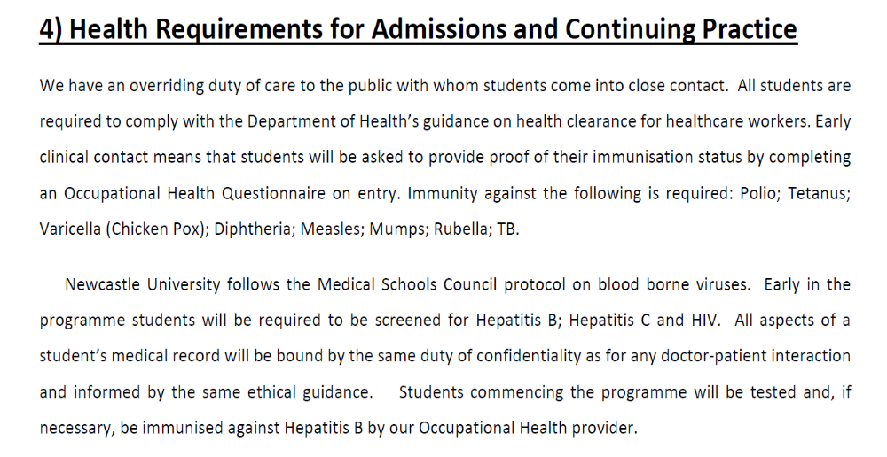
Newcastle University Admission Policy
Notes:
Newcastle University Admission Policy: Health Requirement
Students must comply with the UK Department of Health’s guidance as what was mentioned just now
They are required to complete Occupational Health Questionnaire on entry
The University follows Medical Schools Council protocol in doing early screening BBV at the beginning of the programme
This is not to prevent students from joining MBBS, but protect them from clinical encounter with higher risk of exposure

Slide 7
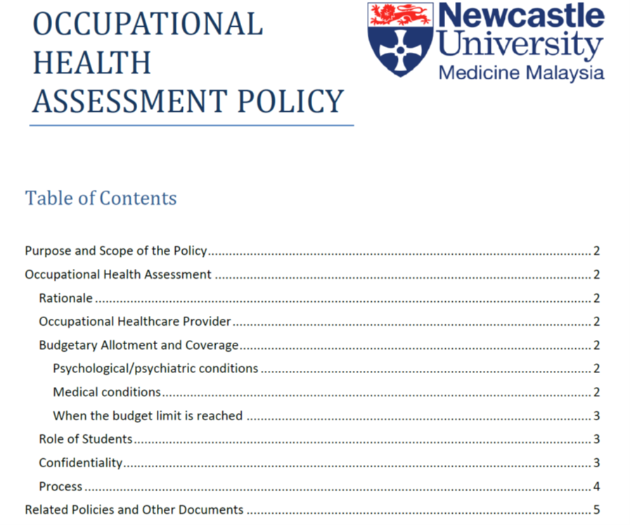
Notes:
This is OHA policy in NUMed, which includes

Slide 8
Occupational Health Assessment Policy
  Blood Screening
    HIV
    HBsAg (Hepatitis B Surface Antigen)
    HDs Ab
    HCV Ab (Hepatitis C Virus Antibody)
    HB Core Ab (Hepatitis B Core Antibody)
    Varicella IgG (Chicken Pox)
    Rubella
    Measles
    Mumps
    VDRL and
    Malarial Parasite (MOE requirement)
  Urine Test
    Urine FEME (include Glucose & Albumin)
    Urine Cannabis
    Urine Morphine
Urine Amphetamine

Slide 9
Aims
To evaluate vaccination and immunisation status of new entry medical students to NUMed as per Occupational Health and Immunization Policy
To assess Hepatitis B vaccination and subsequent seroconversion of new entry medical students to NUMed

Slide 10
Method and materials
Study design
Retrospective
Cross-sectional study
Study period
4-year period
Study population
(n=345)
345 new entry Malaysian MBBS students to NUMed
Median age : 19 years
From 2015-2018
International and 80 students excluded due to lack of data
Notes:
345, new entry, Malaysians, MBBS student, Regardless of age, gender and ethnicity
Median age of 19 years
We excluded international students and 80 students due to lack of data

Slide 11
Method and materials (cont)
Health Screening Report
OH Questionnaire
Demographic data
Data template
Data obtained were recorded in pre-designed data template
Vaccination status
Seroconversion status (Antibody titer)
Notes:
Demographic (age, DOB, gender, ethnicity and nationality)
Vaccination as per occupational health policy and local recommendation
Another piece of important information is the Serum antibody titer, measured using enzyme linked immunoassay, to identify the seroconversion status

Slide 12
Method and materials (cont)
Data analysis
Statistical analysis
Comparative statistics using Prism
Statistical significance defined as a p-value <0.05
Seroconversion rate were calculated
Data matching and comparison
Notes:
We calculated Hep B seroconversion rate among vaccinated students
In order to observe for any trend/pattern in relation to demographic factor, we matched and compared the data
We analysed with comparative statistics using Prism.
Fisher’s exact
Chi-square test

Slide 13
Results
Hepatitis B vaccination (Engerix 20mcg per dose – 3 doses)
Hepatitis B seroconversion (as measured by ELISA)
Measles
Rubella
MenQ (Quadrivalent meningococcal vaccine A, C, Y, W-135)
Yellow fever
Notes:
Hep B vaccination, seroconversion, which is our primary focus
Vaccination coverage for each individual vaccination

Slide 14
Demographics of the study population (n=345)
Cohort | Male | Female | Age range | Median age
2015 (n=52) | 19 (36.54%) | 33 (63.46%) | 18-23 | 19 years
2016 (n=80) | 30 (37.5%) | 50 (62.5%) | 18-33
2017 (n=116) | 39 (33.62%) | 77 (66.38%) | 18-21
2018 (n=97) | 33 (34%) | 64 (66%) | 17-23
Overall (n=345) | 121 (35.1%) | 224 (64.9%) | 17-33
Gender
Ethnicity
Cohort | Chinese | Malay | Indian
2015 (n=52) | 37 (71.15%) | 9 (17.3%) | 6 (11.54%)
2016 (n=80) | 55 (68.75%) | 6 (7.5%) | 19 (23.75%)
2017 (n=116) | 73 (62.93%) | 19 (16.38%) | 24 (20.69%)
2018 (n=97) | 49 (50.5%) | 34 (35.1%) | 14 (14.4%)
Overall (n=345) | 214 (62.03%) | 68 (19.71%) | 63 (18.26%)
Notes:
In term of gender, out of 345, a majority of 64.9% new entry medical students are females.
62.3% are of Chinese ethnicity, followed by Malay and Inidan

Slide 15
Hepatitis B Vaccination
Hepatitis B Vaccination
Cohort | Vaccinated | Not vaccinated
2015 (n=52) | 52 (100.00%) | 0
2016 (n=80) | 78 (97.5%) | 2 (2.5%)
2017 (n=116) | 113 (97.41%) | 3 (2.59%)
2018 (n=97) | 97 (100%) | 0
Overall (n=345) | 340 (98.55%) | 5 (1.45%)
Seroconverted = Anti-HBs titer > 10 IU/L
How many of NUMed students did seroconvert after vaccination?
Notes:
If a person is said to be seroconverted: Protective level of anti-HBs >10 IU/l

Slide 16
Seroconversion rate of Hep B vaccination
Hep B Seroconversion
Cohort | Seroconverted (>10 IU/L) | Non-responder (<10 IU/L) | Not vaccinated
2015 (n=52) | 52 (100.00%) | 0 | 0
2016 (n=80) | 52 (65.00%) | 26 (32.50%) | 2 (2.50%)
2017 (n=116) | 59 (50.86%) | 54 (46.55%) | 3 (2.59%)
2018 (n=97) | 60 (61.9%) | 37 (38.1%) | 0
Overall (n=345) | 223 (64.64%) | 117 (33.91%) | 5 (1.45%)
Notes:
Among 345, only 223 or 64.64% seroconverted, despite the 100% seroconversion in 2015 cohort.
33.91% are non-responder to Hep B vaccine

Slide 17
Hep B Seroconversion in relation to gender
Cohort | Gender | Seroconverted (>10 IU/L) | Non-responder (<10) | Non-vaccinated
2015 (n=52) | Male (n=19) | 19 (100.00%) | 0 | 0
 | Female (n=33) | 33 (100.00%) | 0 | 0
2016 (n=80) | Male (n=30) | 17 (56.67%) | 13 (43.33%) | 0
 | Female (n=50) | 30 (60.00%) | 18 (36.00%) | 2 (4.00%)
2017 (n=116) | Male (n=39) | 19 (48.72%) | 19 (48.72%) | 1 (2.56%)
 | Female (n=77) | 41 (53.24%) | 34 (44.16%) | 2 (2.6%)
2018 (n=97) | Male (n=33) | 20 (60.6%) | 13(39.4%) | 0
 | Female (n=64) | 40 (62.5%) | 24(37.5%) | 0
Overall (n=345) | Male (n=121) | 75 (61.98%) | 45 (37.19%) | 1 (0.83%)
 | Female (n=224) | 144 (64.28%) | 76 (33.93%) | 4 (1.79%)
Notes:
Slightly lower hep B seroconversion than female

Slide 18
Hep B Seroconversion in relation to ethnicity
Cohort | Ethnicity | Seroconverted (>10 IU/L) | Non-seroconverted (<10 IU/L) | Non-vaccinated | P value
2015 (n=52) | Chinese (n=37) | 37 (100.00%) | 0 | 0 | N/A
 | Malay (n=9) | 9 (100.00%) | 0 | 0
 | Indian (n=6) | 6 (100.00%) | 0 | 0
2016 (n=80) | Chinese (n=55) | 38 (69.09%) | 16 (29.09%) | 1 (1.82%) | 0.7648
 | Malay (n=6) | 4 (66.67%) | 2 (33.33%) | 0
 | Indian (n=19) | 11 (57.89%) | 7 (36.84%) | 1 (5.27%)
2017 (n=116) | Chinese (n=73) | 39 (53.42%) | 33 (45.21%) | 1 (1.37%) | 0.0011
 | Malay (n=19) | 3 (15.79%) | 15 (78.95%) | 1 (5.26%)
 | Indian (n=24) | 17 (70.83%) | 6 (25.00%) | 1 (4.17%)
2018 (n=97) | Chinese (n=49) | 35 (71.4%) | 14 (28.6%) | 0 | 0.0783
 | Malay (n=34) | 16(47.1%) | 18 (52.9%) | 0
 | Indian (n=14) | 9 (64.29%) | 5 (35.71%) | 0
Overall (n=345) | Chinese (n=214) | 149 (69.63%) | 63 (29.44%) | 2 (0.93%) | 0.0023
 | Malay (n=68) | 32 (47.06%) | 35 (51.47%) | 1 (1.47%)
 | Indian (n=63) | 43 (68.25%) | 18 (28.57%) | 2 (3.17%)

Slide 19
Any statistically significant difference?
Demographic | All | Seroconverted (>10 IU/L) | Non-responder (<10 IU/L) | Non-vaccinated | P-value
Total cohort | 345 | 223 (64.64%) | 117 (33.91%) | 5 (1.45%) | N/A
Median age | 19 | 19 | 19 | 19
Gender
Male | 121 (35.1%) | 75 (61.98%) | 45 (37.19%) | 1 (0.83%) | P=0.2976
Female | 224 (64.9%) | 144 (64.28%) | 76 (33.93%) | 4 (1.79%)
Ethnicity
Chinese | 214 (62.3%) | 149 (69.63%) | 63 (29.44%) | 2 (0.93%) | P = 0.0023
Malay | 68 (19.71%) | 32 (47.06%) | 35 (51.47%) | 1 (1.47%)
Indian | 63 (18.26%) | 43 (68.25%) | 18 (28.57%) | 2 (3.17%)
No significant difference between genders
Statistically significant difference between ethnicity groups.
Why? Further studies required to investigate the reason

Slide 20
Varicella (Chickenpox) Vaccine
Cohort | Varicella Vaccine
 | Vaccinated | Not Vaccinated | No Data
2015 (n=52) | 45 (86.5%) | 7 (13.5%) | 0
2016 (n=80) | 63 (78.75) | 17 (21.25%) | 0
2017 (n=116) | 95 (81.9%) | 21 (18.1%) | 0
2018 (n=97) | 84 ( 86.6%) | 13 (13.4%) | 0
Overall (n=345) | 287 (83.2%) | 58 (16.8%) | 0
Notes:
Out of 345 in our study population, 287 were vaccinated, that is 83.2% vaccination rate

Slide 21
Varicella Zoster immunity
Cohort | Positive | Borderline | Negative
2015 (n=52) | 45 (86.54%) | 0 | 7 (13.46%)
2016 (n=80) | 58 (72.5%) | 5 (6.25%) | 17 (21.25%)
2017 (n=116) | 90 (77.59%) | 5 (4.31%) | 21 (18.10%)
2018 (n=97) | 80 (82.5%) | 4 (4.1%) | 13 (13.4%)
Overall (n=345) | 273 (79.13%) | 14 (4.06%) | 58 (16.81%)
Notes:
Varicella Zoster immunity is developed by prior exposure to VZV, either through vaccination or infection.

Slide 22
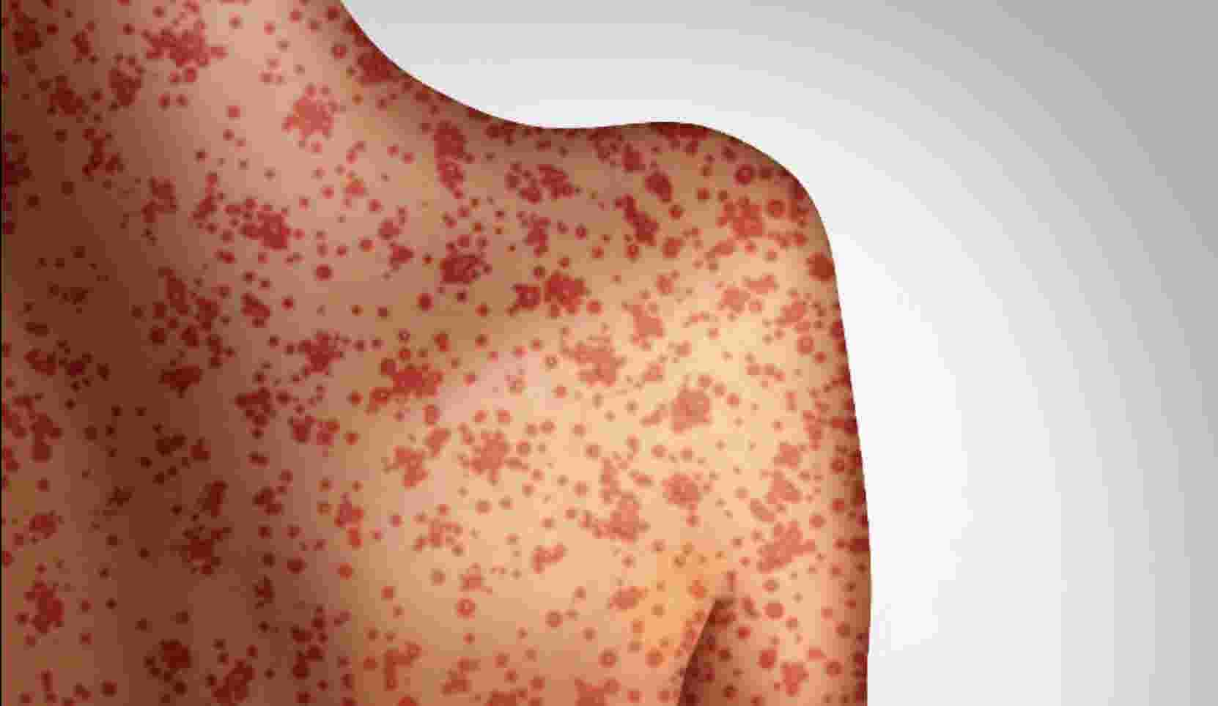
Measles
Cohort | Measles
 | Vaccinated | Not Vaccinated | No data
2015 (n=52) | 1 (1.9%) | 0 | 51 (98.1%)
2016 (n=80) | 59 (73.75%) | 4 (5.00%) | 18 (22.5%)
2017 (n=116) | 103 (88.8%) | 10 (8.6%) | 3(2.6%)
2018 (n=97) | 94 (96.9%) | 1 (1.1%) | 2 (2.1%)
Overall (n=345) | 257 (74.5%) | 15 (4.3%) | 74 (21.4%)
Notes:
Highly contagious viral disease

Slide 23
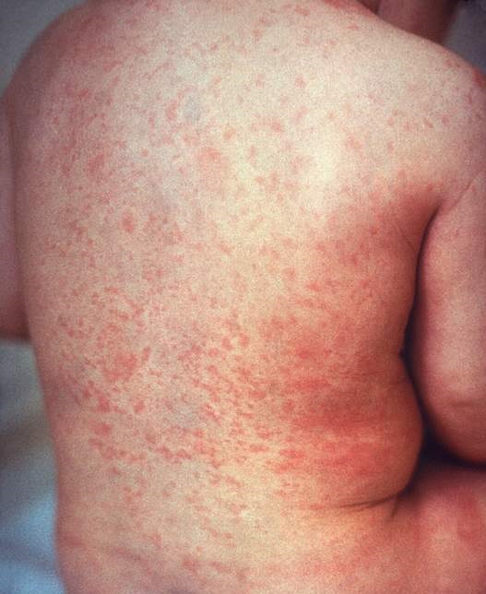
Rubella (German measles)
Cohort | Rubella
 | Vaccinated | Not Vaccinated | No Data
2015 (n=52) | 1 (1.9%) | 0 | 51 (98.1%)
2016 (n=80) | 54 (67.50%) | 7 (8.75%) | 19 (23.75%)
2017 (n=116) | 92 (79.3%) | 21 (18.1%) | 3 (2.6%)
2018 (n=97) | 90 (92.8%) | 5 (5.2%) | 2 (2.1%)
Overall (n=345) | 237 (68.7%) | 33 (9.6%) | 75 (21.7%)
Notes:
also called German measles, is a contagious viral infection best known by its distinctive red rash.
Common cause of fetal abnormalities
237 out of 345

Slide 24
MenQ (Quadrivalent Meningococcal vaccine)
Cohort | MenQ (Quadrivalent Meningococal vaccine)
 | Vaccinated | Not Vaccinated | No Data
2015 (n=52) | 0 | 1 (1.9%) | 51 (98.1%)
2016 (n=80) | 22 (27.50%) | 33 (41.25%) | 25 (31.25%)
2017 (n=116) | 52 (44.8%) | 63 (54.3%) | 1 (0.9%)
2018 (n=97) | 80 (82.5%) | 15 (15.5%) | 2 (2.1%)
Overall (n=345) | 154 (44.6%) | 111 (32.2%) | 79 (22.9%)
Notes:
Quadrivalent meningococcal vaccine (protecting against 4 main serogroups of meningococcal disease A, C, Y and W-135)
This is not in NUMed occupational health policy, but we included this because this is recommended by Department of Health for new entry students in UK

Slide 25
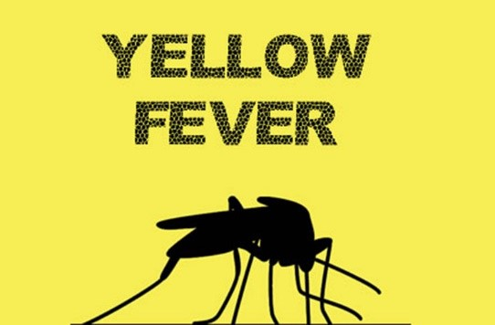
Yellow fever
Cohort | Yellow Fever
 | Vaccinated | Not Vaccinated | No Data
2015 (n=52) | 0 | 52 (100%) | 0
2016 (n=80) | 7 (8.75%) | 43 (53.75%) | 30 (37.5%)
2017 (n=116) | 12 (10.3%) | 95 (81.9%) | 9 (7.8%)
2018 (n=97) | 1 (1%) | 94 (96.9%) | 2 (2.1%)
Overall (n=345) | 20 (5.8%) | 284 (82.3%) | 41 (11.9%)
Notes:
Yellow fever is a disease transmitted by infected mosquitoes. The "yellow" in the name refers to the jaundice that affects some patients
We included this because this is recommended by MOH, Malayia
82.3% non-vaccination rate

Slide 26
Discussion
This is the first study to demonstrate low seroconversion rate (64.64%) among new entry young medical students, with median age of 19.
In other words, 3 out of 10 medical students in NUMed are:
  Non-responders, i.e. do not have protective immunity against Hep B infection
  At higher risk of Hepatitis B acquisition if accidental exposure occurs (HBV incidence rate in Malaysia increased 6x from 2010 to 12.65 per 100,000 in 2015)
Notes:
What does this signify?
The incidence rate of hepatitis B in Malaysia has increased 6-folds from 2.26 per 100,000 in 2010 to 12.65 per 100,000 population in 2015 over 5 years
That is according to National Strategic Plan for Hepatitis B and C 2019-2023, Ministry of Health, Malaysia

Slide 27
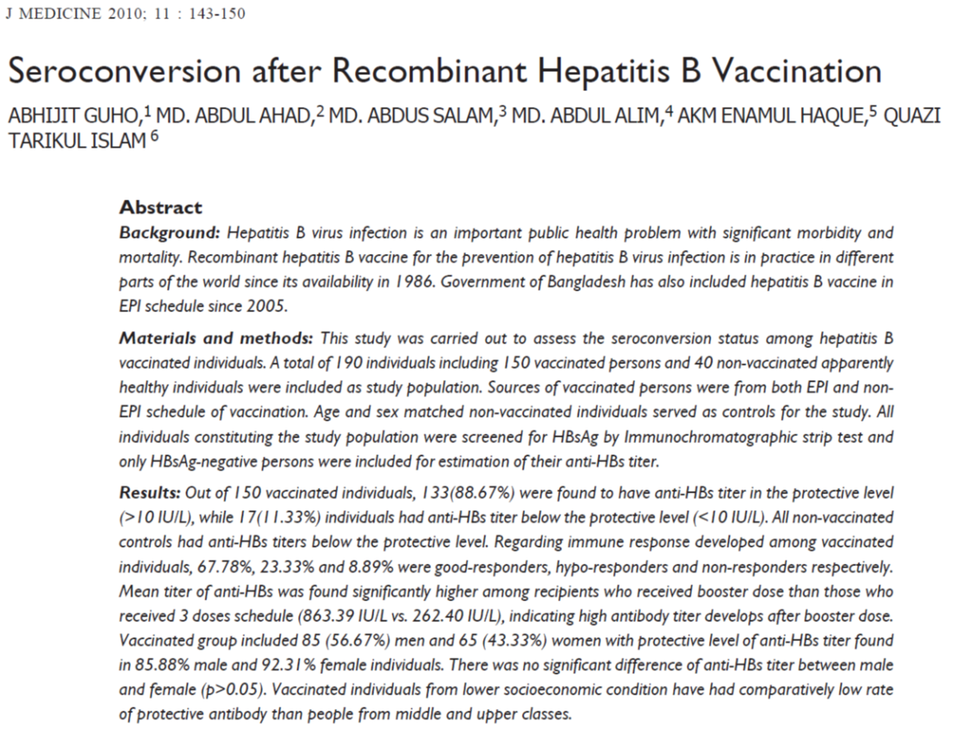
Comparison on HBV vaccine seroconversion with previous studies

Slide 28
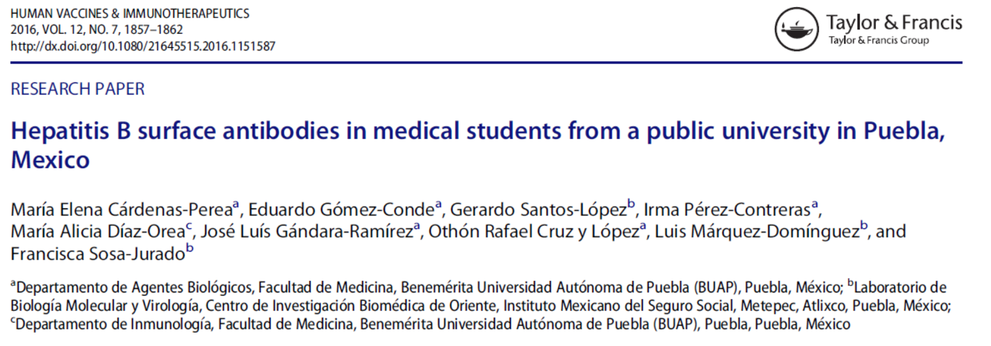
Notes:
Aim: analyse response to Hep B vaccination

Slide 29
88.67% seroconverted after Hep B vaccination
Hepatitis B Vaccine seroconversion rate in previous studies…
Year | Author | Country | Study population | Seroconversion rate
2019 | Guho et al | Bangladesh | Random individuals (n=190) | 88.67%
2019 | Obiri-Yeboah et al | Ghana | Healthcare workers (n=711) Median age = 29 years | 91.8%
2016 | Cardenas-Perea et al | Mexico | Medical students (n=201) Mean age = 20.6 years | 93.2%
2015 | Dassah et al | Ghana | Children 1-10 years (n=200) | 100%
2002 | Perera et al | Sri Lanka | Medical students (n=258) | 90.5%
Notes:
Range from 88.67-100%
All these are much higher than NUMed students’

Slide 30
Discussion (cont)
Students of Malay ethnicity showed a significantly higher non-conversion rate of 53.62% (p=0.0023) as compared to the Chinese and Indian origin
More than half of Malay students will not respond to hepatitis B vaccine, thus not protected!
Notes:
Let’s come back to our current study

Slide 31
Factors for good immune response
Dose (10, 20, 40 micrograms induce higher titer than 2, 5 microgram)
Route (Intramuscular > intradermal)
Site (deltoid/thigh > buttock)
Storage (Cold chain 2-8 degree Celsius)
Brands
Genetic (beyond the scope of study)
Duration (Does anti-HBs titer decrease over time?)
Notes:
Studies suggest these contributing factors for satisfactory immune response

Slide 32
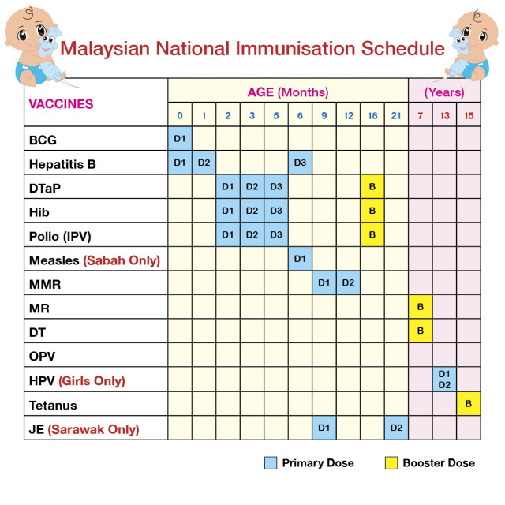
National Immunisation Programme (NIP)
Introduced in early 1950s
Notes:
The full course of hepatitis B vaccination was provided as early as 0, 1 month and 6 months old.

Slide 33
Vaccination coverage (From low to high)
Vaccine | Vaccination rate | Non-vaccinated | No Data
Yellow fever | 20 (5.8%) | 284 (82.3%) | 41 (11.9%)
MenQ | 154 (44.6%) | 111 (32.2%) | 79 (22.9%)
Rubella | 237 (68.7%) | 33 (9.6%) | 75 (21.7%)
Measles | 257 (74.5%) | 15 (4.3%) | 74 (21.4%)
Varicella | 287 (83.2%) | 58 (16.8%) | 0
Hepatitis B | 340 (98.55%) | 5 (1.45%) | 0
Notes:
As a summary, there is the highest vaccination rate for Hep B
The highest non-vaccination rate for yellow fever
Consider limitation due to missing data

Slide 34
Limitation
Documentation error on self-reporting Occupational Health Questionnaire
Missing data of 80 students on vaccination status
Lack of data among international students

Slide 35
Recommendation
Further course or booster dose of vaccination is recommended for non-responder or non-vaccinated students as per advised by Occupational Health policy.
Post-booster testing of antibody titer should be conducted to ensure seroconversion
Clearer guidance on completion of Occupational Health Questionnaire to reduce documentation error

Slide 36
Recommendation (cont)
Future studies is recommended to:
Investigate the reason of non-seroconversion among new entry young Malaysian medical students
Establish evidence-based explanation for lower seroconversion rate among the Malay ethnicity group
In larger sample size to establish the strength of this observation

Slide 37
Conclusion
This is the first study demonstrating a low HBV seroconversion rate (64.64%) among young new entry medical students to NUMed (median age: 19) following standard recommended 3-dose vaccination
3 out of 10 NUMed students at risk of acquiring HBV infection
Students of Malay ethnicity showed a significant non-conversion rate of 53.62% (p=0.0006) as compared to the Chinese and Indian origin.
Previous studies showed seroconversion rates of over 90% and further studies should be considered to investigate why this young population of Malaysian students did not mount protective antibody titer.
Notes:
The highlights of the study:

Slide 38
ACKNOWLEDGEMENTS:
Thanks to the Student Office, NUMed for tracking down the students’ health screening questionnaire
Thanks to Columbia Asia Hospital, the NUMed’s Occupational Health Provider for information on Hep B vaccine.

Slide 39
Reference
Health worker occupational health, World Health Organization (WHO)
Sharps Injury Surveillance (2007), Occupational Health Unit, Ministry of Health, Malaysia
Newcastle University Admission Policy (2020), School of Medical Education, Newcastle University, United Kingdom
Occupational Health Assessment Policy, Newcastle University Medicine Malaysia
Noubiap JJ, Nansseu JR, Kengne KK, Tchokfe Ndoula S, Agyingi LA. Occupational exposure to blood, hepatitis B vaccine knowledge and uptake among medical students in Cameroon. BMC Med Educ. 2013;13:148. Published 2013 Nov 8. doi:10.1186/1472-6920-13-148
Guho, A., Ahad, M., Salam, M., Alim, M., Haque, A., & Islam, Q. (1). Seroconversion after Recombinant Hepatitis B Vaccination. Journal of Medicine, 11(2), 143-150. https://doi.org/10.3329/jom.v11i2.5461
Obiri-Yeboah D, Awuku YA, Adjei G, et al. Post Hepatitis B vaccination sero-conversion among health care workers in the Cape Coast Metropolis of Ghana. PLoS One. 2019;14(6):e0219148. Published 2019 Jun 28. doi:10.1371/journal.pone.0219148
Cárdenas-Perea ME, Gómez-Conde E, Santos-López G, et al. Hepatitis B surface antibodies in medical students from a public university in Puebla, Mexico. Hum Vaccin Immunother. 2016;12(7):1857–1862. doi:10.1080/21645515.2016.1151587
Dassah S, Sakyi SA, Frempong MT, et al. Seroconversion of Hepatitis B Vaccine in Young Children in the Kassena Nankana District of Ghana: A Cross-Sectional Study. PLoS One. 2015;10(12):e0145209. Published 2015 Dec 30. doi:10.1371/journal.pone.0145209
Perera, Jennifer & Perera, Bernadene & Gamage, Siritilak. (2002). Seroconversion after hepatitis B vaccination in healthy young adults, and the effect of a booster dose. The Ceylon medical journal. 47. 6-8. 10.4038/cmj.v47i1.6396.
National Strategic Plan for Hepatitis B and C 2019-2023, Ministry of Health, Malaysia

Slide 40
Thank you.
Health Screening for New Entry Medical Students to NUMed -
A Retrospective 4-Year Study from 2015-2018
Goh WP, Evans G, Hurn E, Leong A, Lim YK, Saw YT, Subramaniam B, Tan ZJ, Ong ELC
Newcastle University Medicine Malaysia

