Slide 1
Introduction to cytogenetics
By: Madina Mohammed Bashir

Slide 2
Cytogenetics = The study of chromosome number,, function, and behavior in relation to gene inheritance, organization and expression
Cytogenetics is the study of chromosomes and their role in heredity.
The goal of cytogenetics:
1. diagnosis of chromosomal abnormalities.
2. localisation of any (often abnormal) chromosomal region/DNA sequence.
structure

Slide 3
Important definitions
Chromatin: non condensed DNA with proteins attached (interphase of the cell cycle)
Chromosome: condensed DNA with proteins attached (M phase of the cell)
Human cells contain 46 chromosome, 44 autosome and 2 sex chromosome.
A karyotype is the number and appearance of chromosomes in the nucleus of a eukaryotic cell. The term is also used for the complete set of chromosomes in a species, or an individual organism.
The chromosomes are depicted (by rearranging a microphotograph) in a standard format known as a karyogram or idiogram: in pairs, ordered by size and position of centromere for chromosomes of the same size.
Molecular cytogenetics: Fluorescence in situ hybridization (FISH). Identification of genetic disorder(s) in cells or tissues using a specific probe

Slide 4
Classification of chromosomes
Chromosomes may be classified by the position of the centromere.
(a) Metacentric - centromere is in the middle.
(b) Submetacentric - centromere is somewhat distant from the middle.
(c) Acrocentric - centromere is almost at the end. Chromosomes 13, 14, 15, 21 and 22 are acrocentric.
3) The short arm is referred to as the p arm (p for petite); the long arm is referred to as the q arm.
When arranging chromosomes in a karyotype, the p arm is placed at the top.

Slide 5
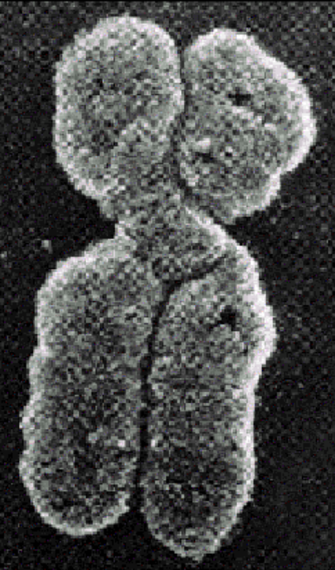
Chromosome
Chromo = colored in response to dye
Some = body
Chromosome of Eukaryotes have been the traditional subject for cytogenetic analysis because they are large
enough to be examined with light microscope
Notes:
Chromosomes of different species differ in number and information content
Humans and several other species of organisms have 46 chromosomes
Chromosomes of different species differ in number and information content
Humans and several other species of organisms have 46 chromosomes
Chromosomes of different species differ in number and information content
Humans and several other species of organisms have 46 chromosomes

Slide 6
Why Analyse Chromosomes and Genes?
Genetic errors arise from deletions or insertions of genetic material, abnormal numbers of whole chromosomes or genes, and even from misplacement of a single base in the DNA sequence
Genetic abnormalities can range from relatively harmless to severe: from vitamin deficiencies and food allergies to cancer, birth defects and infant mortality.
Chromosome analysis is an important laboratory test for birth defects, mental retardation, miscarriage, infertility and cancer.

Slide 7
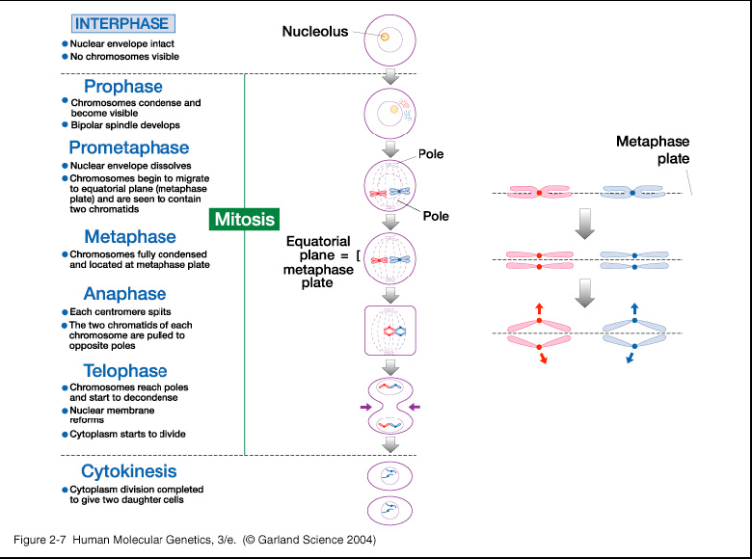
Cytogenetic methods to detect chromosomal
abnormalities underlying human birth defects usually
involve analysis of mitotic chromosome

Slide 8
What tissues are appropriate for chromosome study?
Any tissue that can be stimulated to undergo cell division in-vitro
Cytogenetics studies are performed on:
blood,
bone marrow,
amniotic fluid,
and solid tissue specimens.
Cells from the specimen are cultured, harvested and banded then viewed under a microscope for numerical and structural abnormalities in chromosomes.
• It is only during mitosis of the cell cycle that distinct chromosomes can be visualized with a light microscope
After culturing, in-vitro, a proportion of cells are arrested in mitosis, and are then “harvested” for chromosome analysis After harvesting, the cell preparations are dropped onto glass slides and stained. For most chromosome analyses, a G-banding technique is utilized for staining.

Slide 9
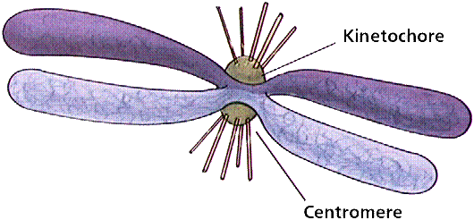
Chromosome
Sister Chromatides
Notes:
What is a Chromosome?
The DNA in an individual chromosome is one, long molecule which is highly coiled and condensed. The total number of bases in all the chromosomes of a human cell is approximately six billion and individual chromosomes range from 50 to 250 million bases.

Slide 10
Types of genetic diseases
Chromosome Abnormalities
Numerical (+/-)
Structural (deletion, insertion, inversion, translocation, …)
2. Single gene disorder
3. Multifactorial disorder

Slide 11
Karyotyping
Karyotype:
Karyotyping is the analysis of chromosomes
Or it is A pictorial display of metaphase chromosomes from a mitotic cell
Homologous chromosomes- pairs
Notes:
Karyotyping is the process of pairing and ordering all the chromosomes of an organism, thus providing a genome-wide snapshot of an individual's chromosomes. Karyotypes are prepared using standardized staining procedures that reveal characteristic structural features for each chromosome. Clinical cytogeneticists analyze human karyotypes to detect gross genetic changes—anomalies

Slide 12
Preparing a karyotype
Harvested cells are first cltured
The cells are then treated with colchicine which arrests the cells in metaphase, and then treated and stained to observe the chromosomes
Chromosomes can be photographed or visualized using a computer, and then analyzed
Chromosomes are identified by size, position of the centromere, and banding and staining regions

Slide 13
Banding Techniques:
There are three banding technique(QG&R) (Q-AT Specific),(G-banding )(R- Reveres banding),where are C banding is used particularly for the identification of Y chromosome.

Slide 15
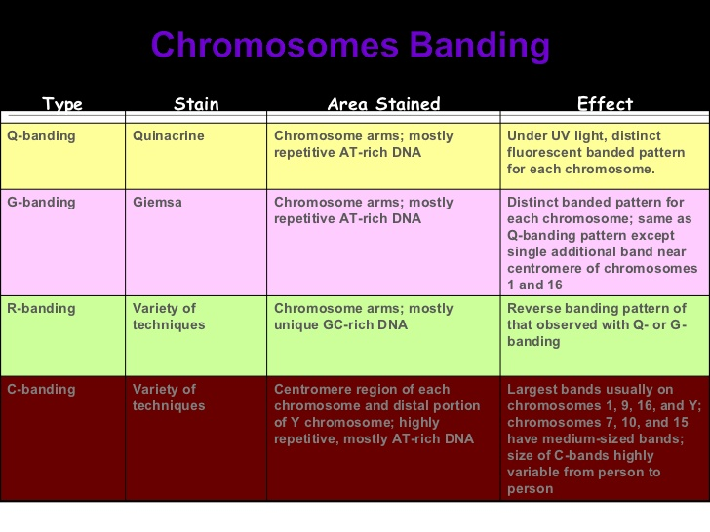

Slide 16
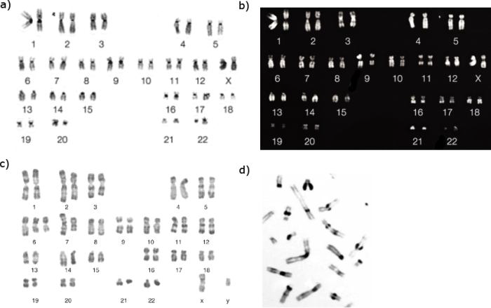
G-banding
Q-banding
C-banding
R-banding

Slide 17
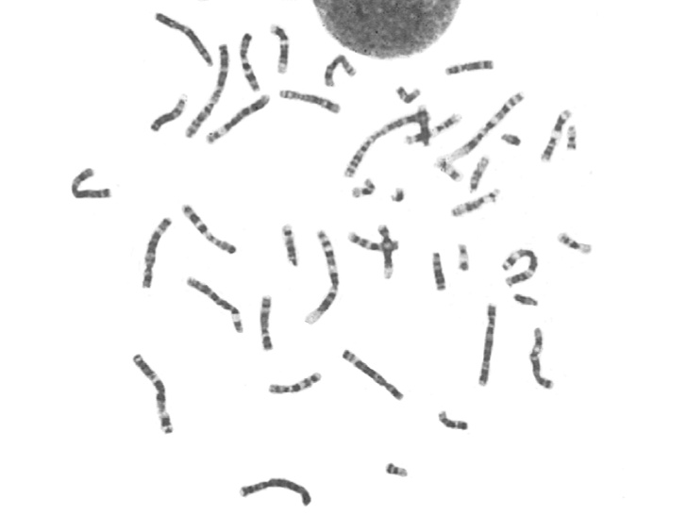

Slide 18
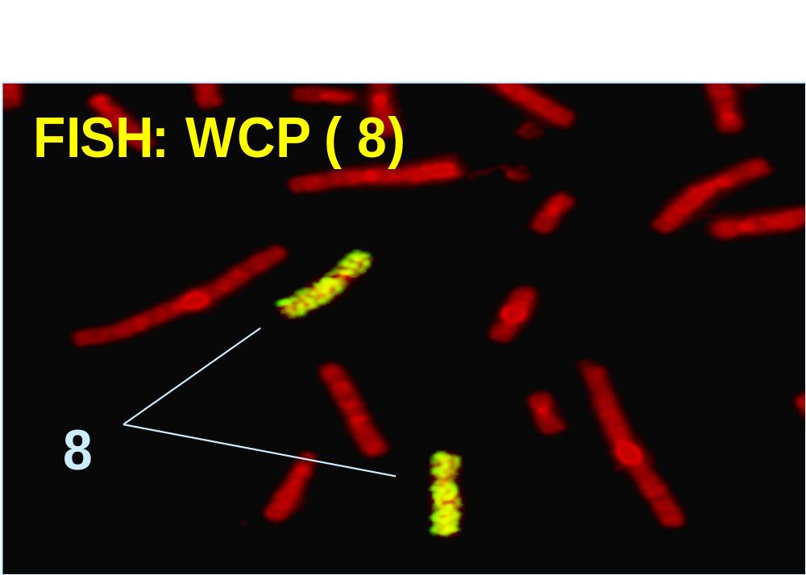
Molecular cytogenetic

Slide 19
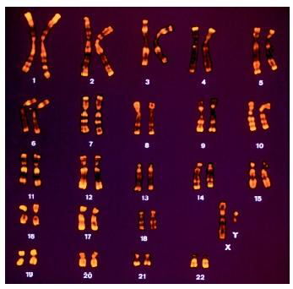

Slide 20
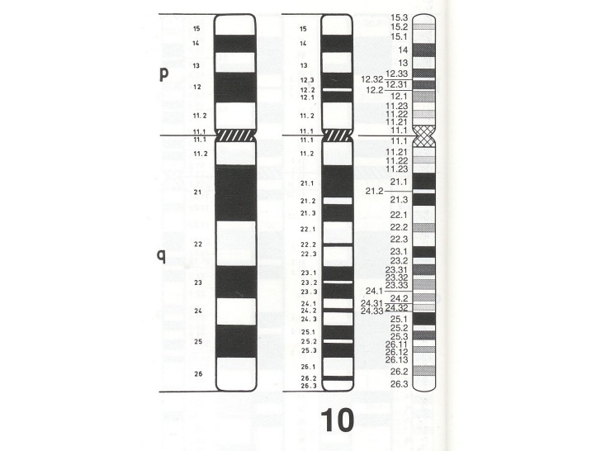

Slide 21
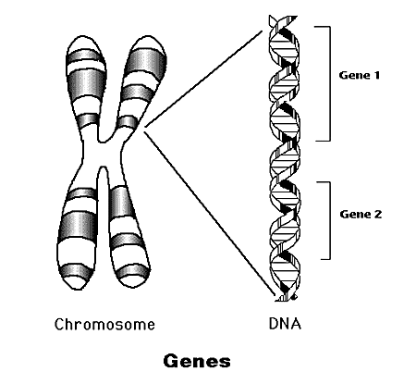

Slide 22
Human diseases resulting from altered kariotype are mostly caused by ANEUPLOIDIES, TRANSLOCATIONS, and DELETIONS.

Slide 23
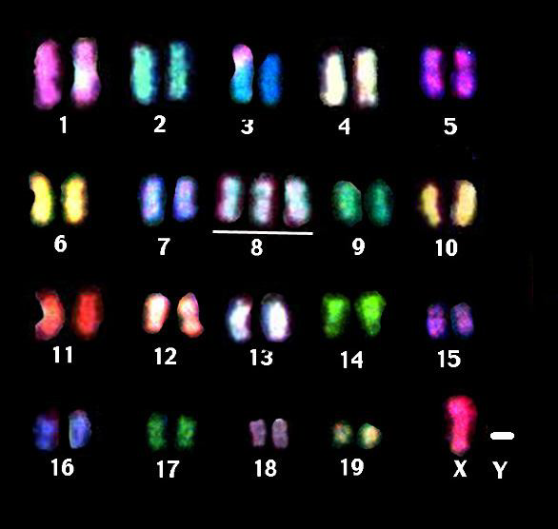
ANEUPLOIDY is the abnormal number of chromosomes. The most frequent aneuploidia is trisomy, having three instead of two chromosomes

Slide 24
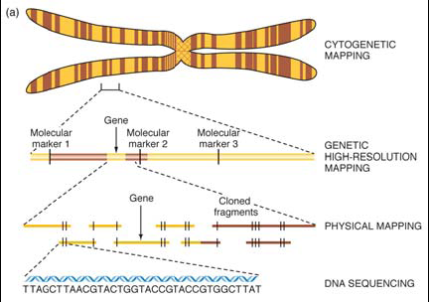

Slide 25
Nomenclature
A) A karyotype is described by listing, in this order:
  1) Number of chromosomes followed by a comma
  2) Sex chromosome constitution followed by a comma
  3) Anomalies in number or morphology of chromosomes.
B) Examples:
  1) Normal male: 46,XY; normal female: 46,XX
  2) Klinefelter Syndrome: 47,XXY
  3) Turner Syndrome: 45,X
  4) Female with Down Syndrome: 47,XX,+21
  5) Male with Angelman Syndrome (deletion between q11 and q13 on chromosome 15): 46,XY,del(15)(q11q13). q11 is read as "q one one"; q13 is read as "q one three".

Slide 26
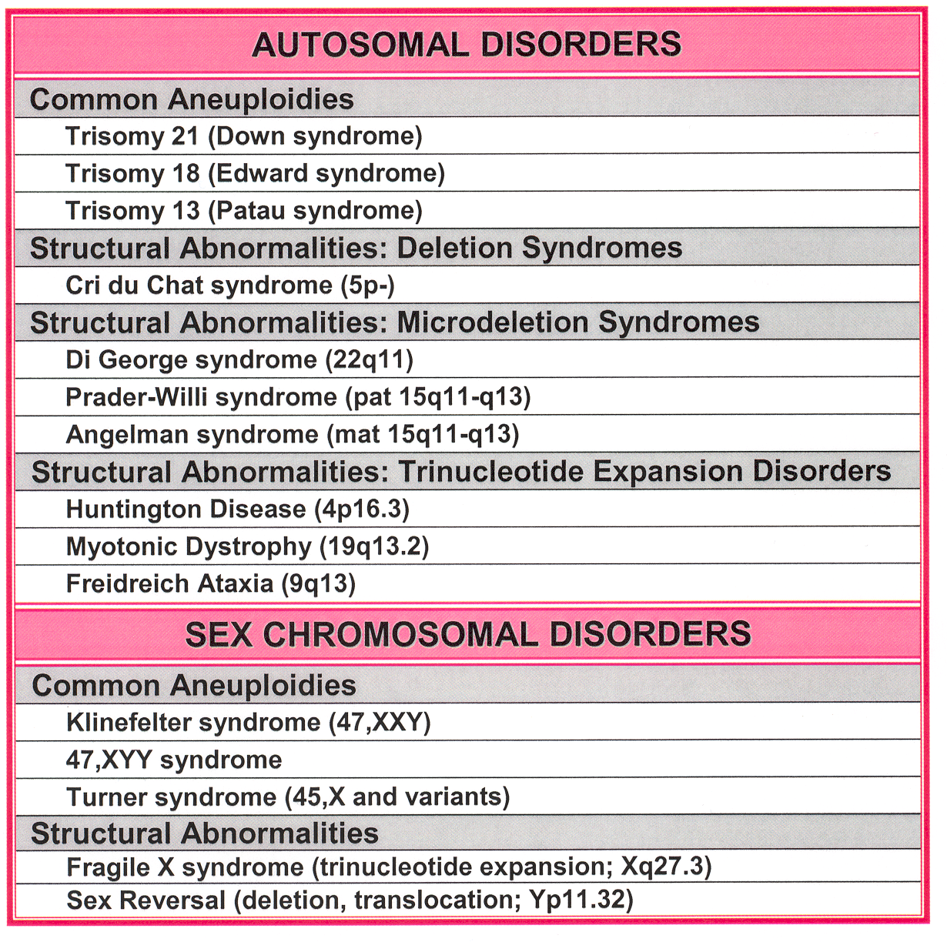

Slide 27
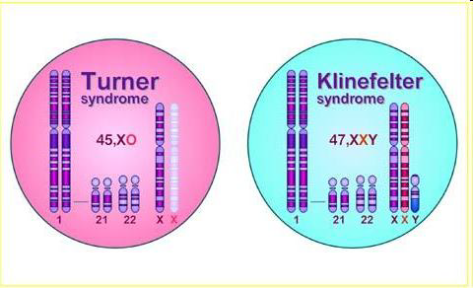
SEX CHROMOSOMAL ANEUPLOIDIES

Slide 28
identify the following genotypes

Slide 29
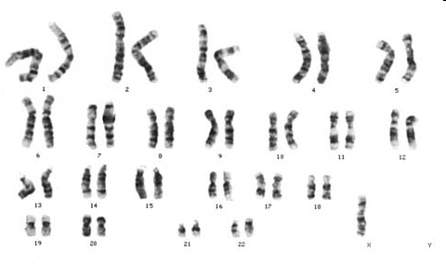

Slide 30
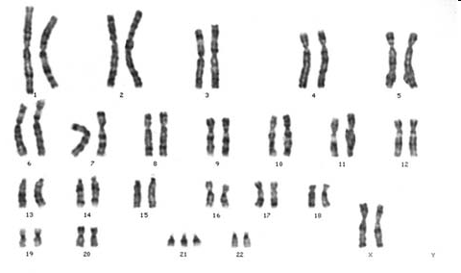

Slide 31
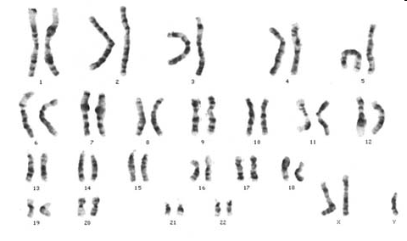

Slide 32
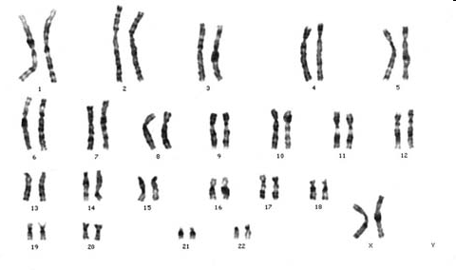

Slide 33
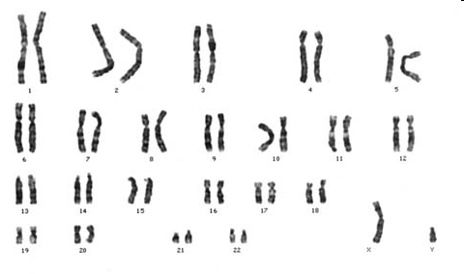

Slide 34
The end
Thank you

